Slide 1
Exploring New Ideas for ICMA Governance
ICMA Regional Vice-Presidents

Slide 2
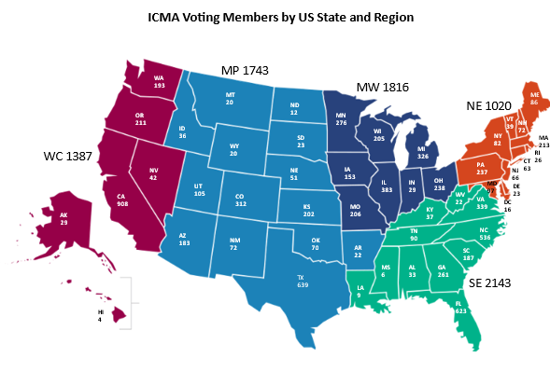
Why now?
Notes:
ICMA Constitution tasks the ICMA Board with creating U.S. regions that are proportionally drawn in terms of voting members.
Member growth strategies have led to imbalanced regions
Have not made changes to the regions in decades

Slide 3
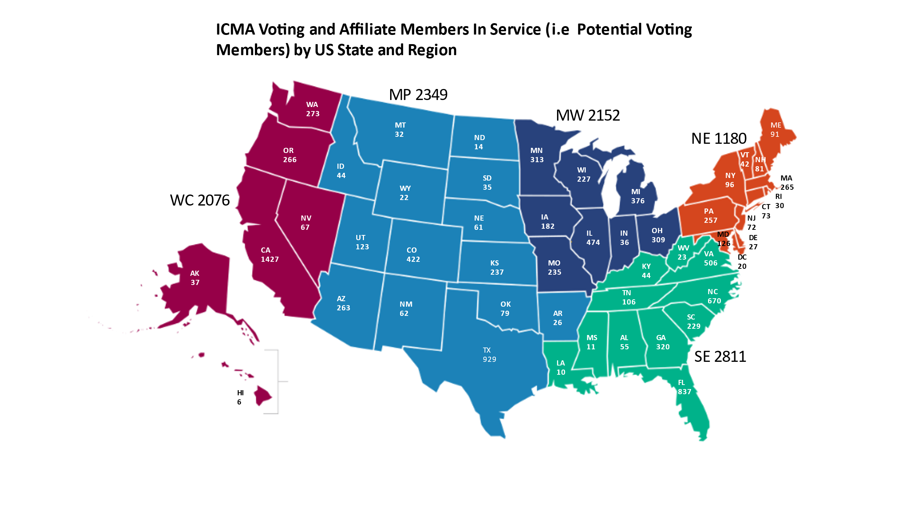
Why now?
Notes:
Waiting until our newly enfranchised affiliate members (early career thru Department Director) reach the voting qualifications of 5 years of local government experience and 5 years of ICMA membership, doesn’t solve the problem.

Slide 4
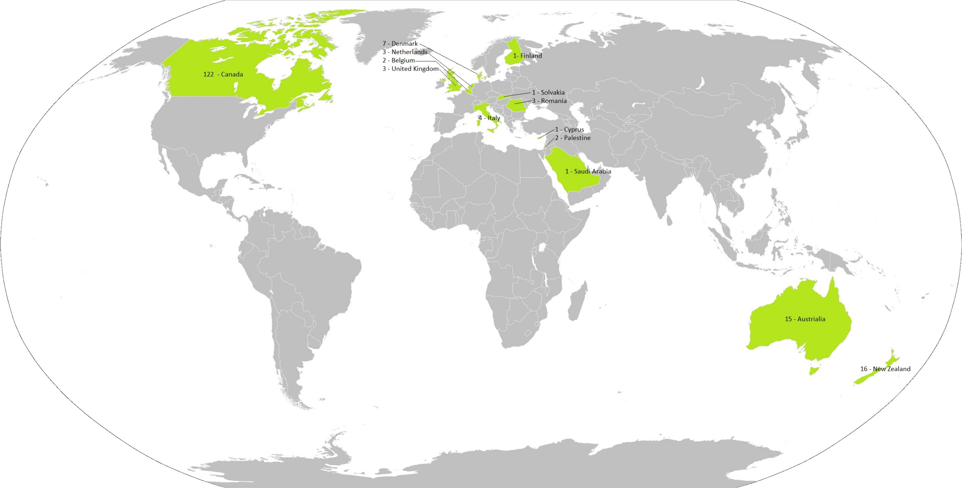
International Membership (Voting)
Notes:
International membership vs global programming

Slide 5
ICMA’S Current Governance Structure
Vice-Presidents
6 regions: Northeast, Southeast, Midwest, Mountain Plains, West Coast and International
3 vice-presidents per region (selected by the members)
Serve 3-year terms
President, President-elect, Past President
Selected by the ICMA Executive Board from a pool of prior vice-presidents
Serve 1 year term

Slide 6
Looking for your feedback on….
Is regional representation the right model for ICMA board representation? If not, what are your thoughts?
Given the emphasis ICMA has placed on global engagement and growing international membership, what are your thoughts on international representation on the board?
Do the regions matter to you as a member?
Does the region matter to your state association?
Does the region your state is currently in still make sense?
If you could join an adjoining region, why should or shouldn’t you?

Slide 7
ICMA Governance Task Force
Does the current structure meet ICMA’s goal of being a diverse, inclusive, and global organization?
Offer recommendations on reconfiguring ICMA’s regional structure to address the issues of global and U.S. regional representation, makeup, diversity, procedures, and future realignment of the board
Address issues raised in the framework and scope approved by the board plus any other relevant issues raised during this process
18 Members (3 from each region) will begin work at Austin Conference. Work virtually to deliver recommendations to the ICMA Board by December 2024
Interested? Apply by March 1st! Visit ICMA’s website for instructions

Slide 8
QUESTIONS & FEEDBACK

