Slide 1
Residents as Consumers
Why local governments must measure resident satisfaction and how to do so
Lee R. Feldman, ICMA-CM RETIRED | Senior Advisor, Zencity
Dr. Mark Watson | City Manager, Oak Ridge, TN
Jamie Stewart | Communications and Project Manager, Garden City, KS

Slide 2
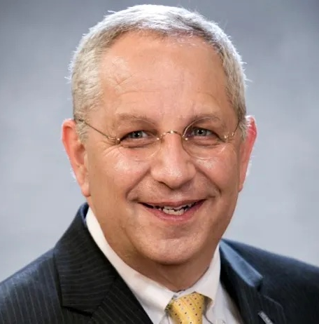
Residents
From neighbors to consumers: A mindset shift
Lee R. Feldman, ICMA-CM RETIRED
Senior Advisor, Zencity

Slide 3
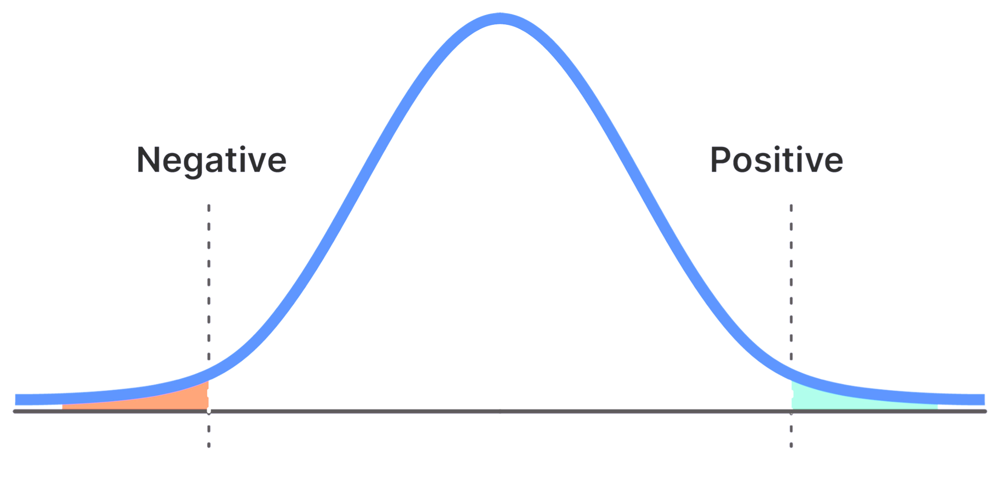
How do we measure the satisfaction of the 80% in the middle?
And why is it important?

Slide 4
“While you are looking, you might as well also listen, linger and think about what you see.”
Jane Jacobs

Slide 5
Look
Listen
Linger

Slide 6
The Bottom Line
Resident satisfaction should not be taken for granted, and improvement and self-reflection are crucial.
We should begin to think of neighbors as consumers of our local government services and their satisfaction is key for the success and longevity of the city/county - promoting trust.

Slide 7
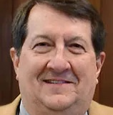
Oak Ridge, TN
Dr. Mark Watson
City Manager, Oak Ridge, TN

Slide 8
Oak Ridge
Located in East Tennessee at the edge of the Great Smoky Mountains
Population 31,500
Diverse population representing over 50 nationalities
Full-service city including education, library, electrical and other utilities
Founded in 1959 after being a “Secret City” as part of the Manhattan Project during WWII
Home to Oak Ridge National Laboratory, Department of Energy facilities and National Nuclear Security Administration

Slide 9
Working with Zencity since 2020
Our Goals for Using the Platform
To regain contact with citizens and their concerns
Developing modern ways to communicate and survey
Provide facts to our citizens
Increase awareness of City projects and their impacts

Slide 10
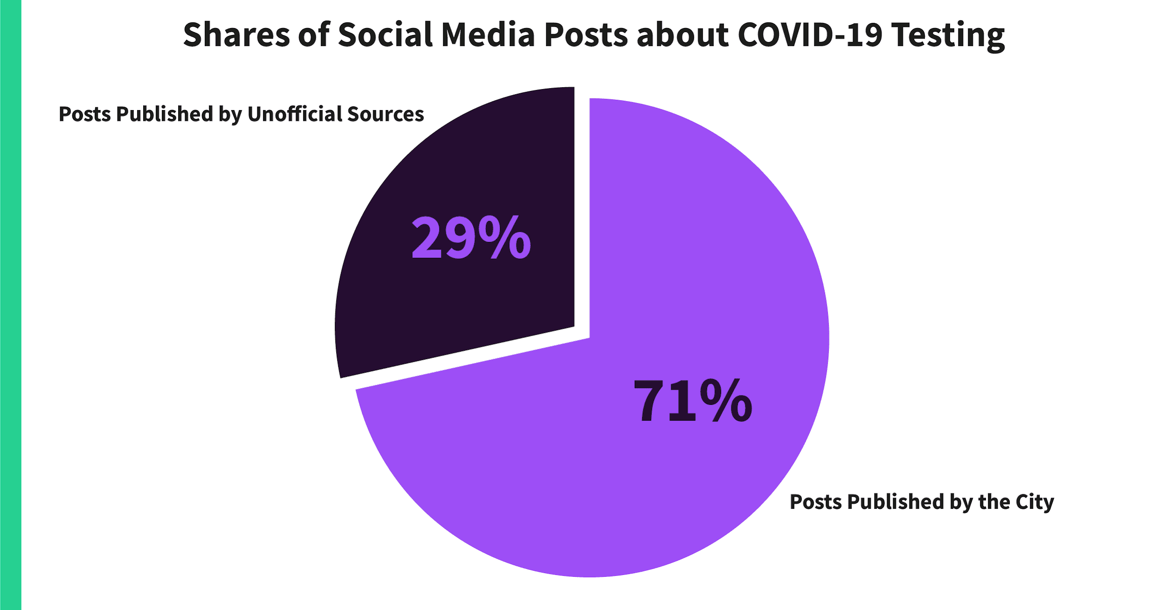
Zencity – Case Studies
Clarification of COVID-19 testing policies
Testing information sent to 12,000 social media friends explaining state testing policies
Found citizens genuinely valued City as a source

Slide 11
Zencity – Case Studies
Threat of Violence in Schools (Dec. 2021)
Schools were on lockdown and not releasing much information
Parents were panicking and rumors flying!
The City identified information gaps and filtered factual data to the community
5,700 interactions through platform

Slide 12
Survey Platforms
Goal:
City Council and Boards deserved accurate statistically valid demographic opinions on road safety/maintenance
Result:
Prioritization of roads was identified through responses
1) Road repair
2) Road signs
3) Pavement markings (Dec. 2021)
Goal:
Citizens to help prioritize building a new pool in a different configuration or keep the same
Result:
The history of the pool as a 2.2 million gallon spring fed facility was prioritized first before considering varying amenities such as slides or “lazy rivers”

Slide 13
Oak Ridge is a City Without a Newspaper
Goal:
Using the platforms, our goal is to establish the City’s social media sources as “best in class” information
Newsletters for various City topics will be able to be selected by specific citizen interest
Services offered by the City can be easily identified and connected

Slide 14
Other Topics of Interest on our Dashboards
Power outages
New airport project
Spring cleanup coordination
Motorsports park project
Changeout in waste collection contractor
Winter weather

Slide 15
For More Information
The Spread of COVID-19 and Confusion: The City of Oak Ridge’s Method for Strengthening Messaging Around Testing
How Oak Ridge, TN, Mitigated a Crisis Situation and Kept the Public Informed Using Zencity
Contact: Lauren Gray, Senior Communications Specialist
lgray@oakridgetn.gov
(865) 425-3576

Slide 16
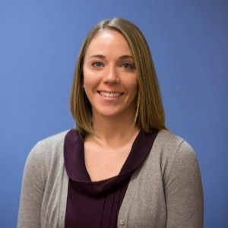
Garden City, KS
Jamie Stewart
Communications & Project Manager, Garden City, KS

Slide 17
About Garden City, KS
The County seat of Finney County, Kansas
Incorporated in 1883
Approximately 11 sq mi
Local economy is driven largely by agriculture.
Population estimates (2020 Census):
Total population is 27,856
Race/Ethnicity
Hispanic or Latino-53.1%
White (Non-Hispanic or Latino)-35.2%
Two or More Races-10.6%
Asian-5.2%

Slide 18
Garden City, KS & Zencity
Background
In 2020, Garden City outlined strategic priorities for staff. One of these included improving the reach of information to residents.
FOCUS: Internal + External + Product The first step: evaluate and measure external communications.
Tools:
The first step the City wanted to take was to assess the residents’ preferences on how they would consume information and gauge their feedback on the City’s current communications strategy.
Garden City, KS, partnered with Zencity to launch a City Communications Survey to get this initial assessment/feedback.

Slide 19
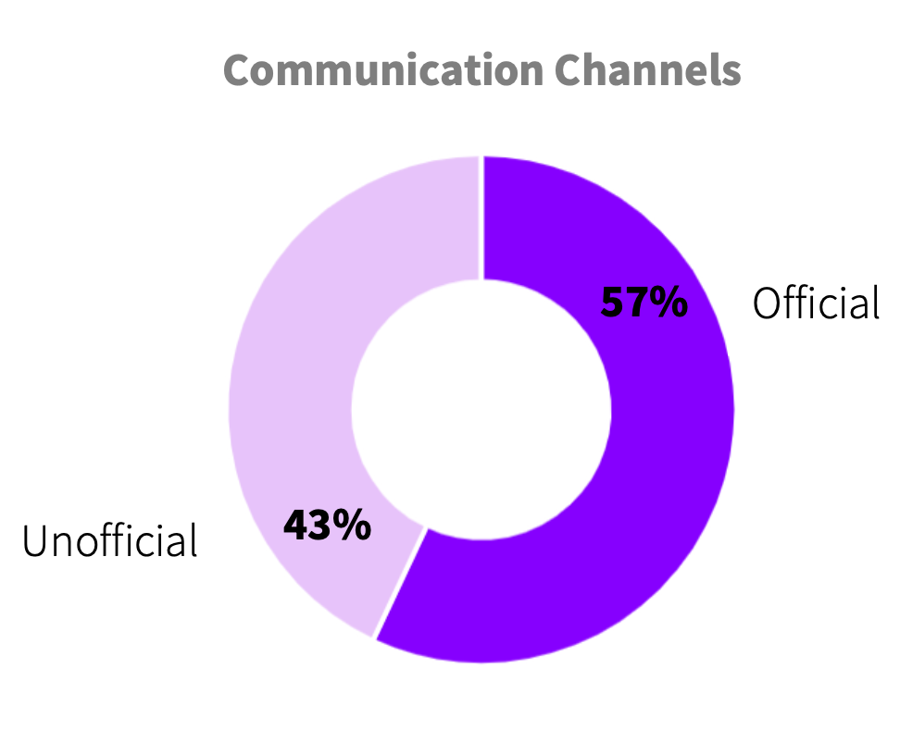
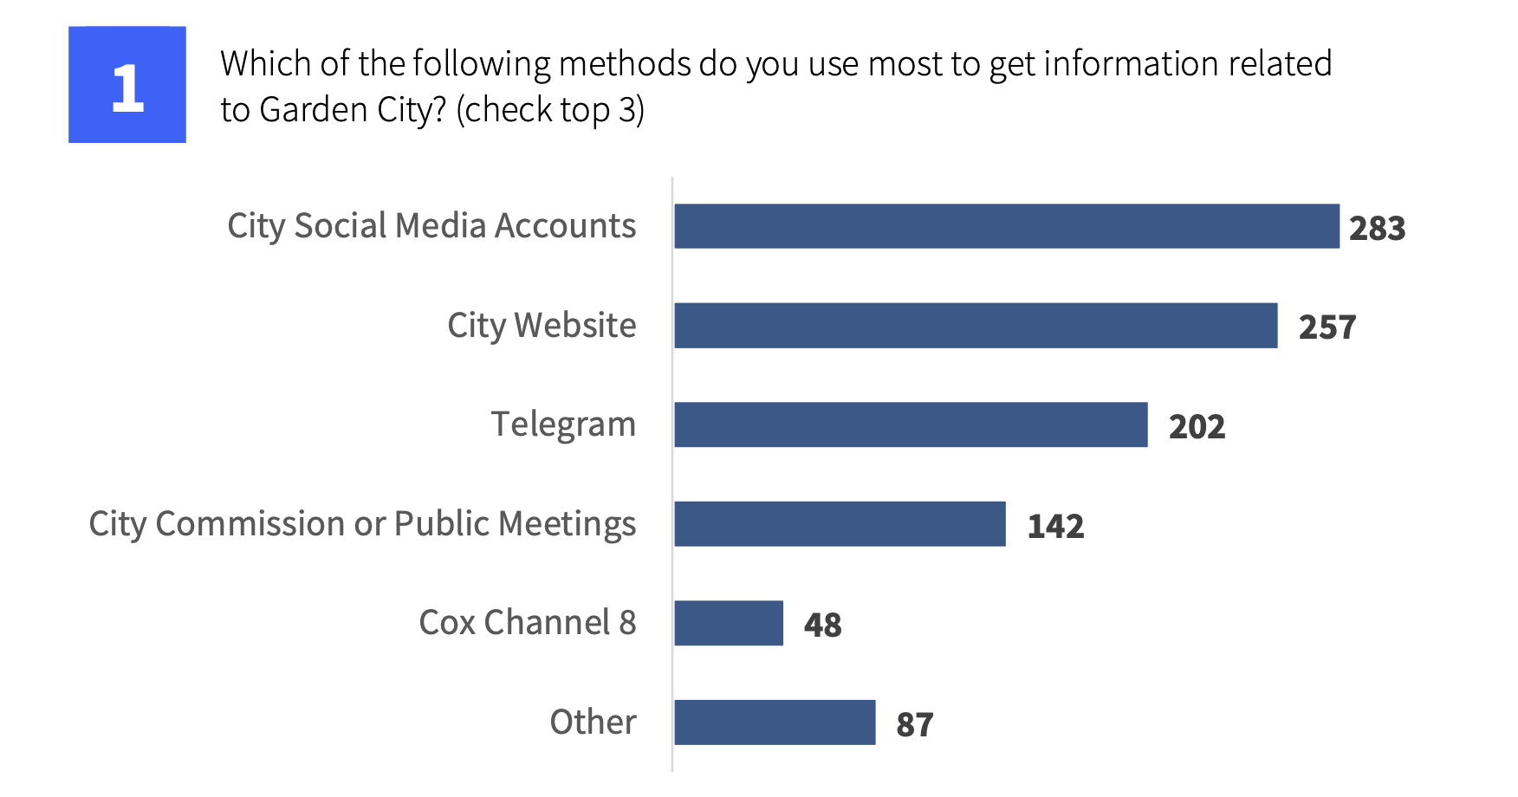
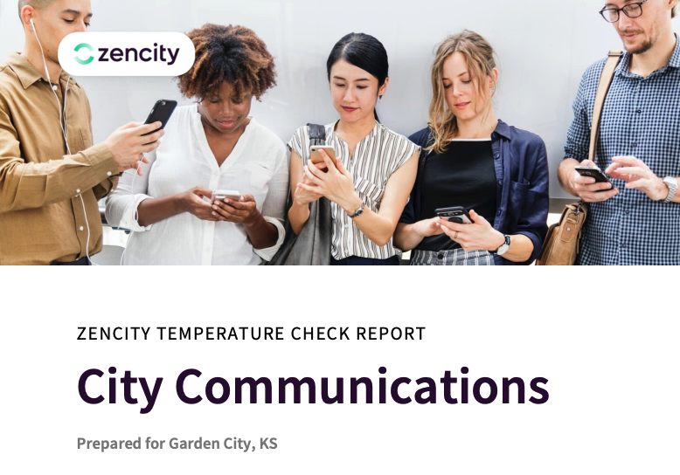
Key takeaways
2021 Garden City, KS, Communications Survey
Response sentiment showed that residents are overall slightly more satisfied than dissatisfied with the City’s online communication efforts.
Social Media was identified as the primary source of information, with the Website being second.
The survey highlighted the desire for residents to get information via SMS/Text.
Identified a need to offer information in multiple languages.

Slide 20
Operationalizing the Data
Hired bi-lingual staff to offer communications in English & Espanol
Explored ways to provide communications via text message
Begin the process of upgrading the City website.
Next Steps:
Assess changes with Zencity Benchmarking Report
2022/23 focus is improving internal communications to staff

Slide 21
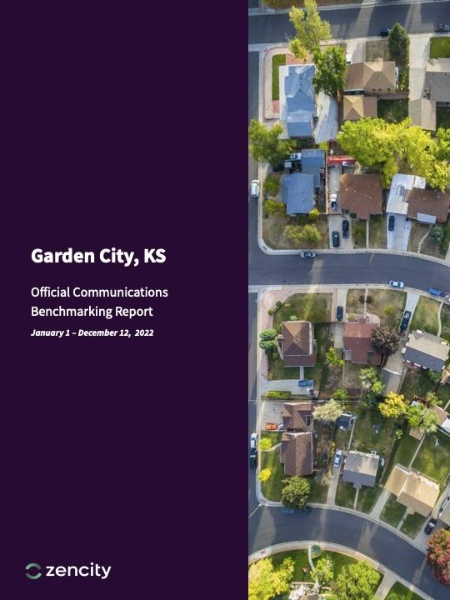
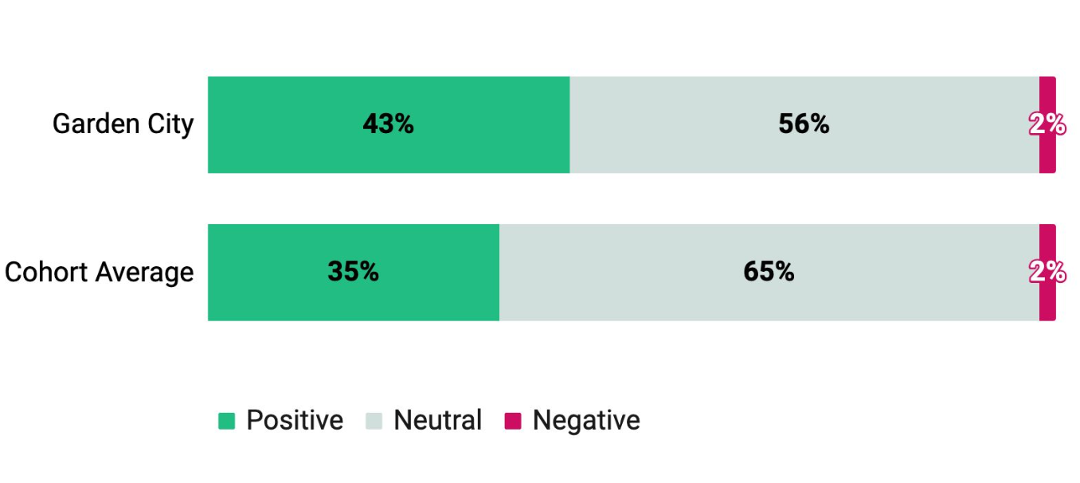
KEY TAKEAWAYS FROM INITIAL ASSESSMENTS
Zencity Benchmarking Report offered an analysis of data collected from public sources and compared it with ten similar partner cities.
Positive sentiment on official pages was more than 15x higher than negative sentiment.
Interaction + Followers have grown since offering posts in multiple languages
Successful launch of My GCKS (SMS/TEXT Messaging customer service tool)

Slide 22
Residents as Consumers
Why local governments must measure resident satisfaction and how to do so
Lee R. Feldman, ICMA-CM RETIRED | Senior Advisor, Zencity
Dr. Mark Watson | City Manager, Oak Ridge, TN
Jamie Stewart | Communications and Project Manager, Garden City, KS

