Slide 1
LEADING CHANGE: Moving from What IS to What CAN BE
By Heather Hansen O’Neill

Slide 2
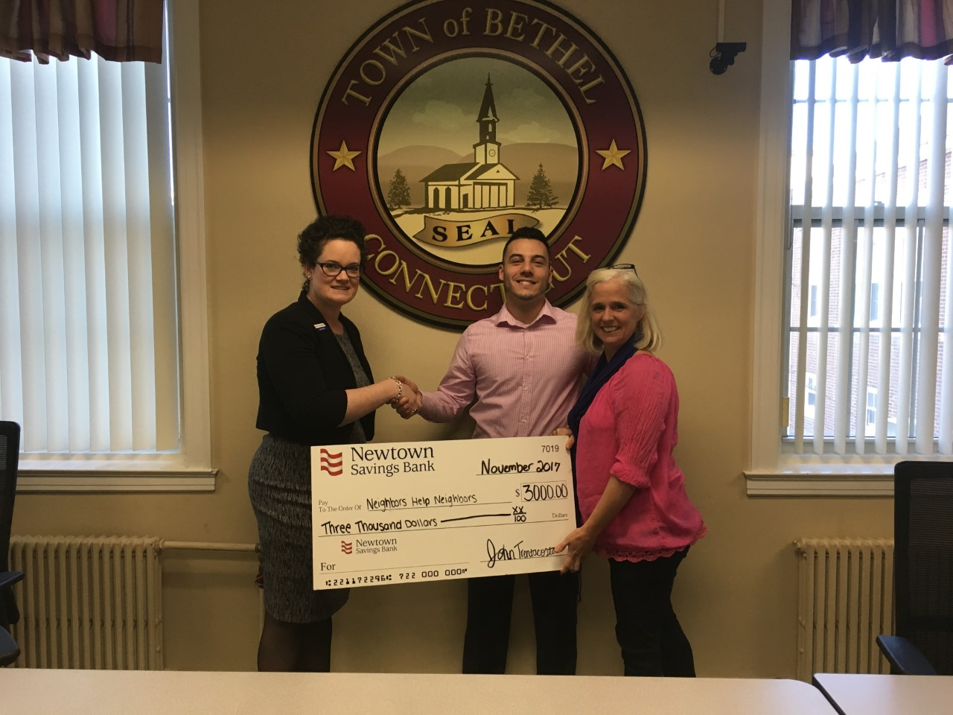
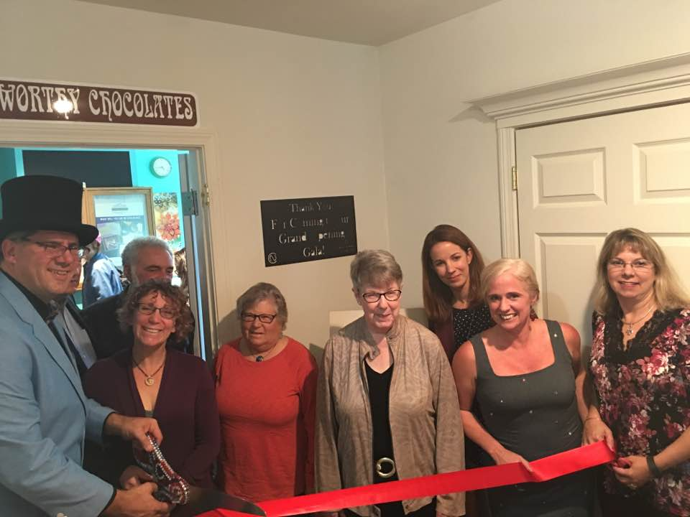
ALL SMILES? OR….

Slide 3
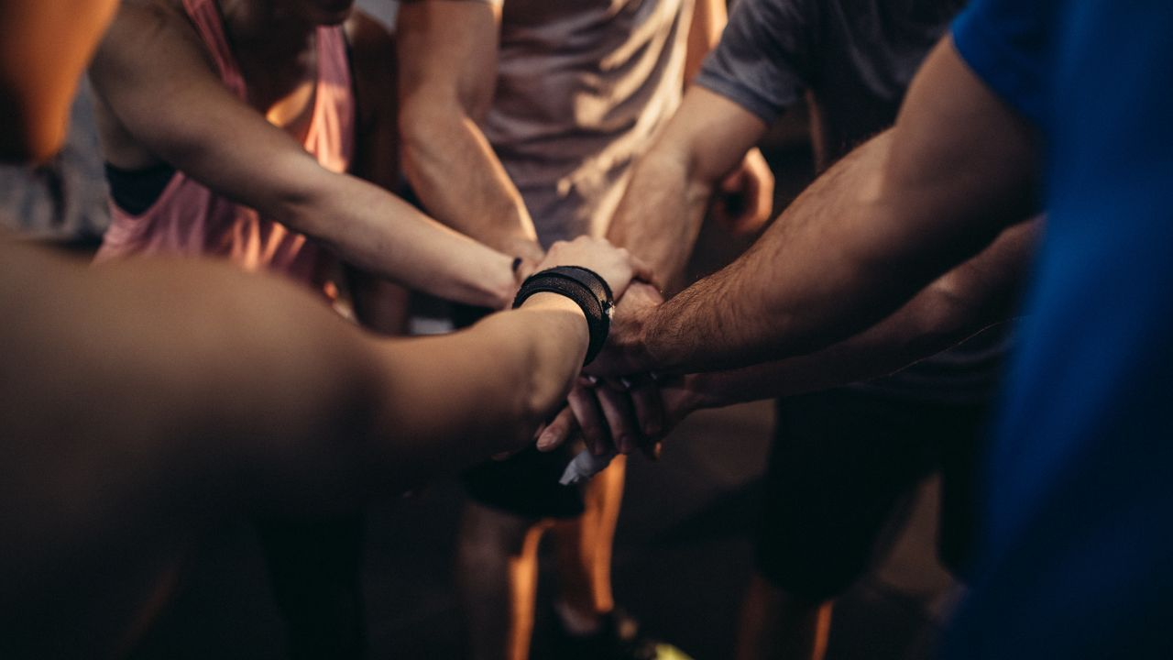
What You Do Matters.
Commitment
Perseverance
Passion to Serve a Greater Good

Slide 4
WHO AM I?

Slide 5
Disclaimer
Some of the stories and examples you will hear today involve high risk adventures. The adventures that precipitated the stories were dangerous. Heather Hansen O’Neill, From Fear to Fire LLC, and any associated companies are not in any way recommending you partake in said adventures. You are responsible for your actions and decisions. Should you choose to take the lessons and strategies provided in today’s keynote, the extreme benefit of increased productivity, reduced stress, and joy are potential risks. In agreeing to listen to this program you consent to these risks should they occur. Attendees take full responsibility for their choices and their happiness today and in perpetuity

Slide 6
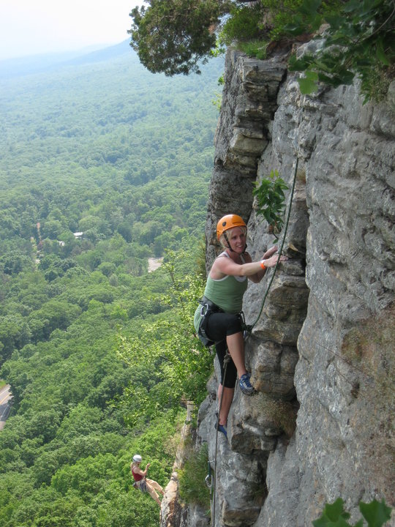
What happens along the climb?

Slide 7
Seek those who lift you higher, who help your light shine brighter!
Regional Vice Presidents:
Board President:
Dave Slezickey
Jeff Towery
Diane Stoddard
Regional Directors:
Kenneth Williams
Karen Daly
Trish Vinchesi

Slide 8
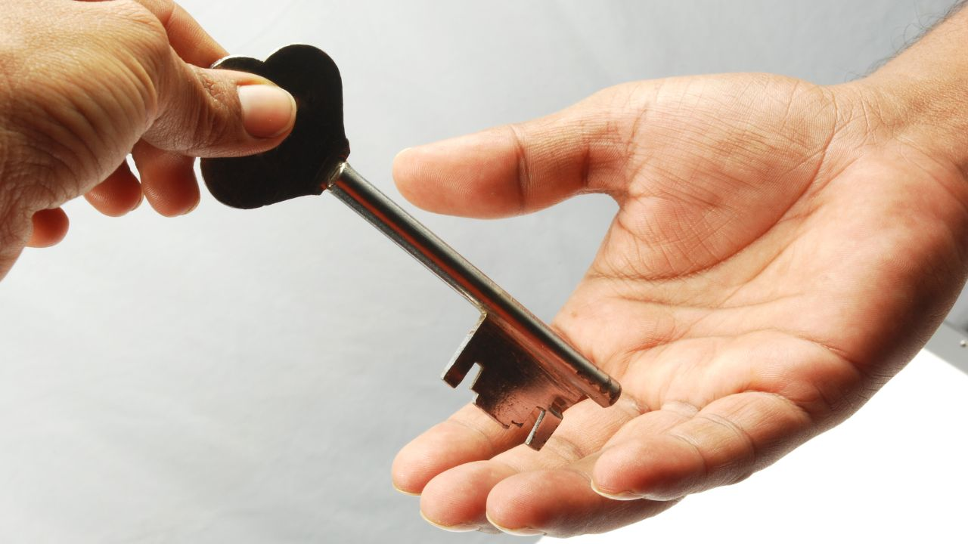
OWN CHANGE

Slide 9
PARTNER EXERCISE

Slide 10
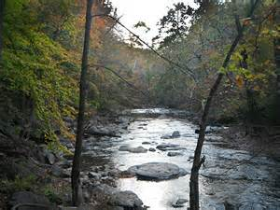

Slide 11
PARTNER EXERCISE

Slide 12
You can create any what…if you have a strong enough why.

Slide 13
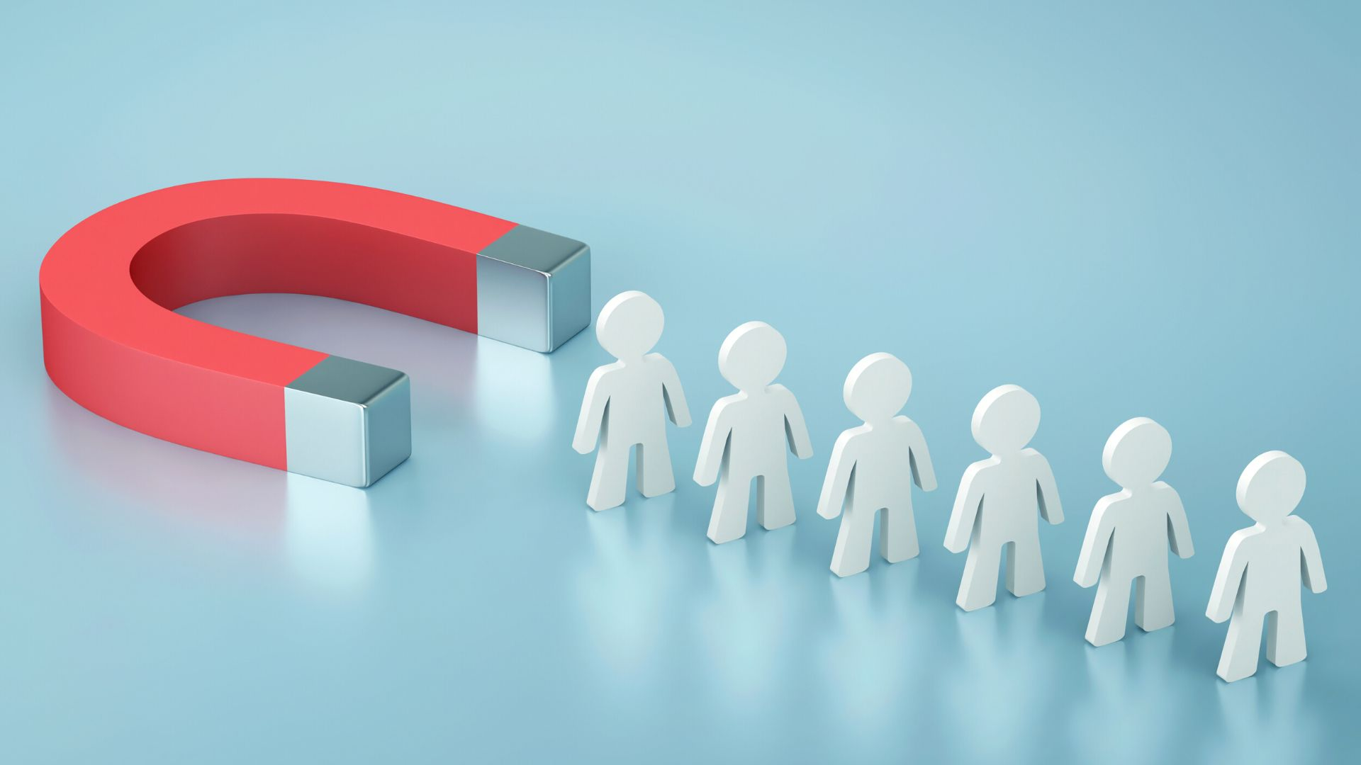

Slide 15
Create
What CAN BE
Accept
What IS
Awareness of Beliefs
About It

Slide 16
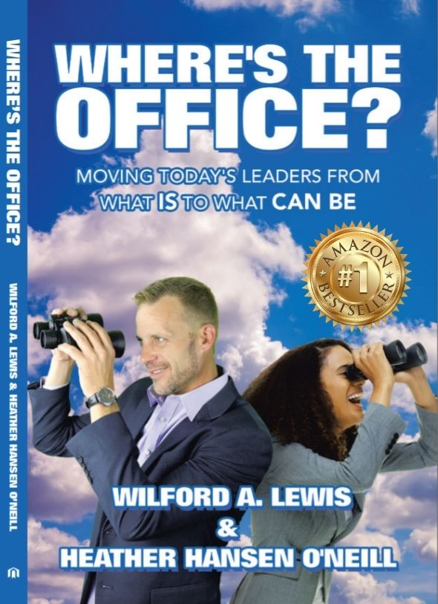
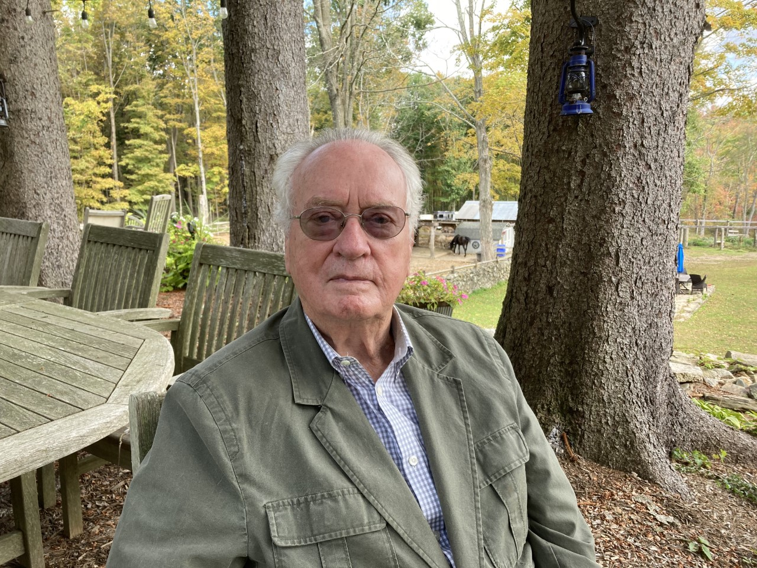

Slide 17
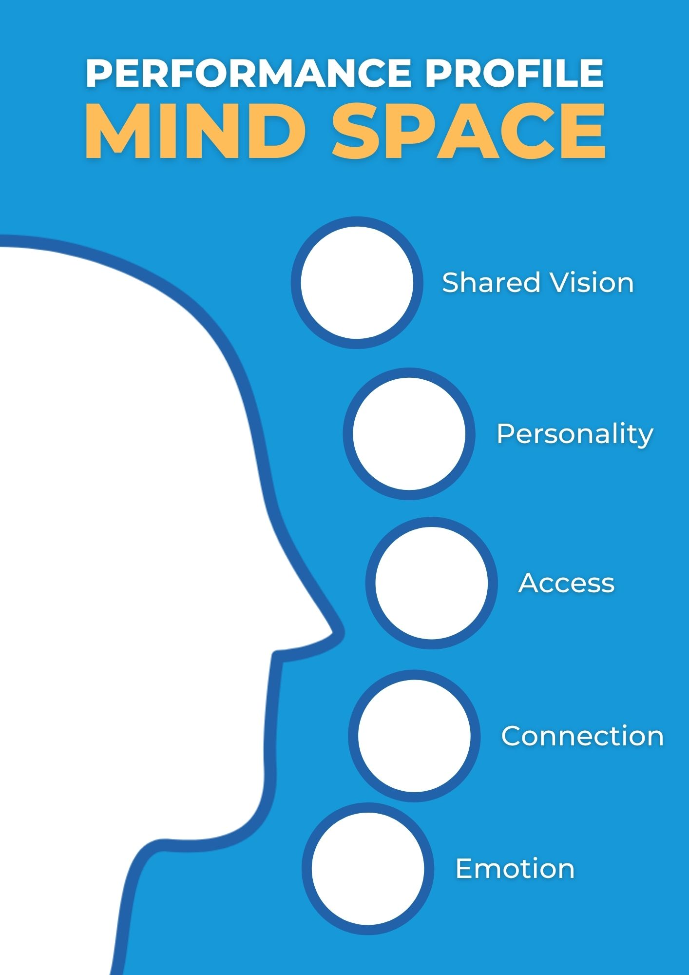
MindSPACE to Promote Positive Culture in Your Work Environment!

Slide 18
MindSPACE
SHARED VISION
PERSONALITY
ACCESS
CONNECTION
EMOTION

Slide 19
Do I have a big vision that contributes to our local mission?
SHARED VISION
Have I asked any other key players about their vision- is it aligned?
How can we create a space for inclusivity, wellbeing, and productivity?

Slide 20
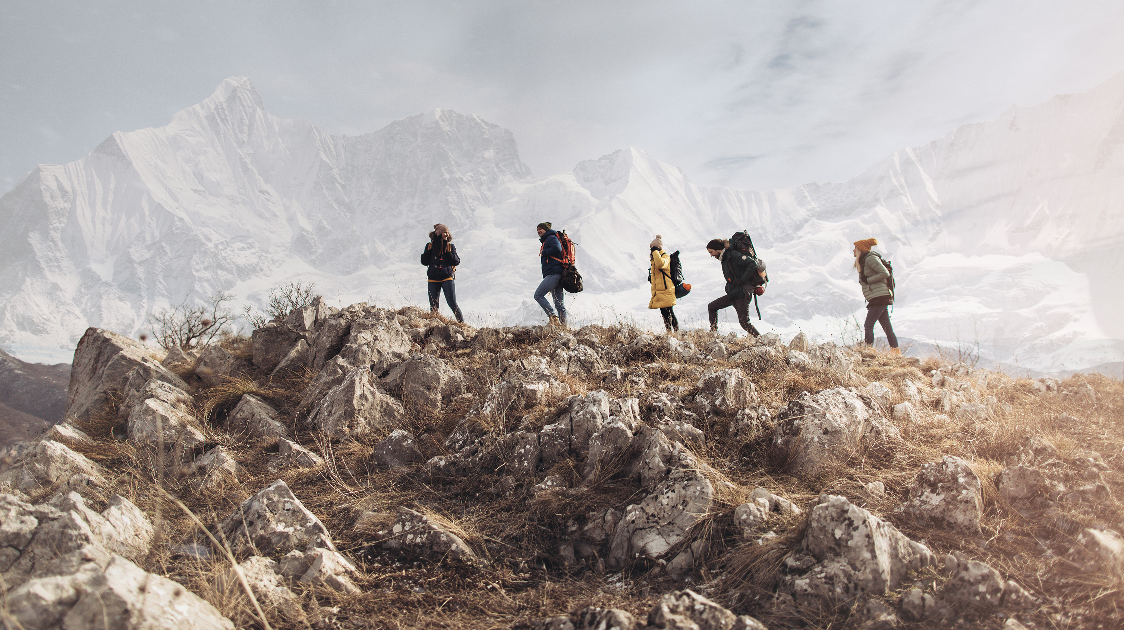
SHARED VISION

Slide 21
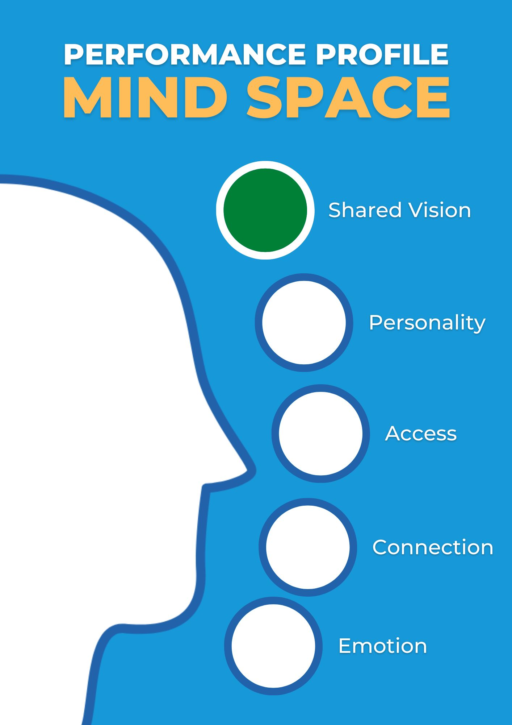
We’re GOOD!

Slide 22
Who is on our team (including managers, employees, voters, commissions, vendors, business, etc.)
PERSONALITY
Am I cultivating and managing an award-winning team by using my strengths and the strengths of these team members best?
Do we create opportunities for others to demonstrate their abilities and potential?

Slide 23
Who is on our team (including managers, employees, voters, commissions, vendors, business, etc.)
PERSONALITY
Am I cultivating and managing an award-winning team by using my strengths and the strengths of these team members best?
Do we create opportunities for others to demonstrate their abilities and potential?

Slide 24
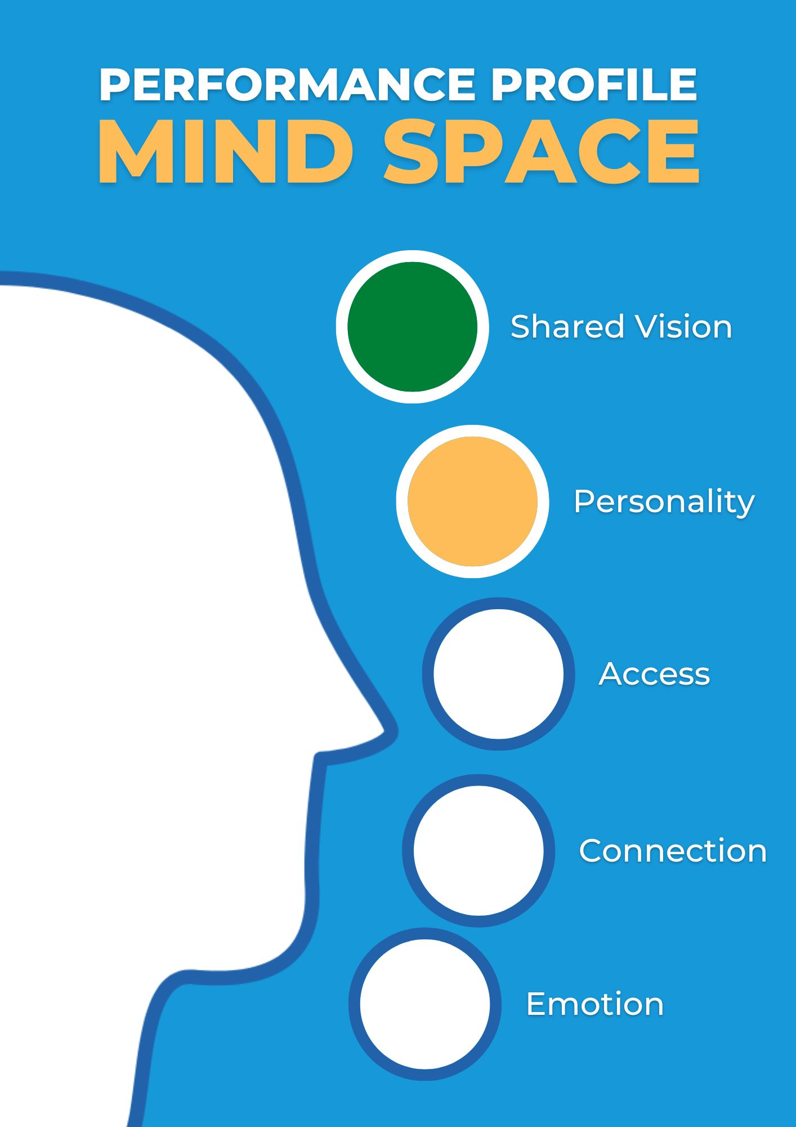
Let’s keep an eye on this…

Slide 25
Does everyone have access and instruction in the tools they need to succeed?
ACCESS
Do we have an internal process that supports the standards we wish to uphold?
Have we created a process that enables us to optimize our people from any environment (remote, in-person, hybrid)?

Slide 26
ACCESS

Slide 27
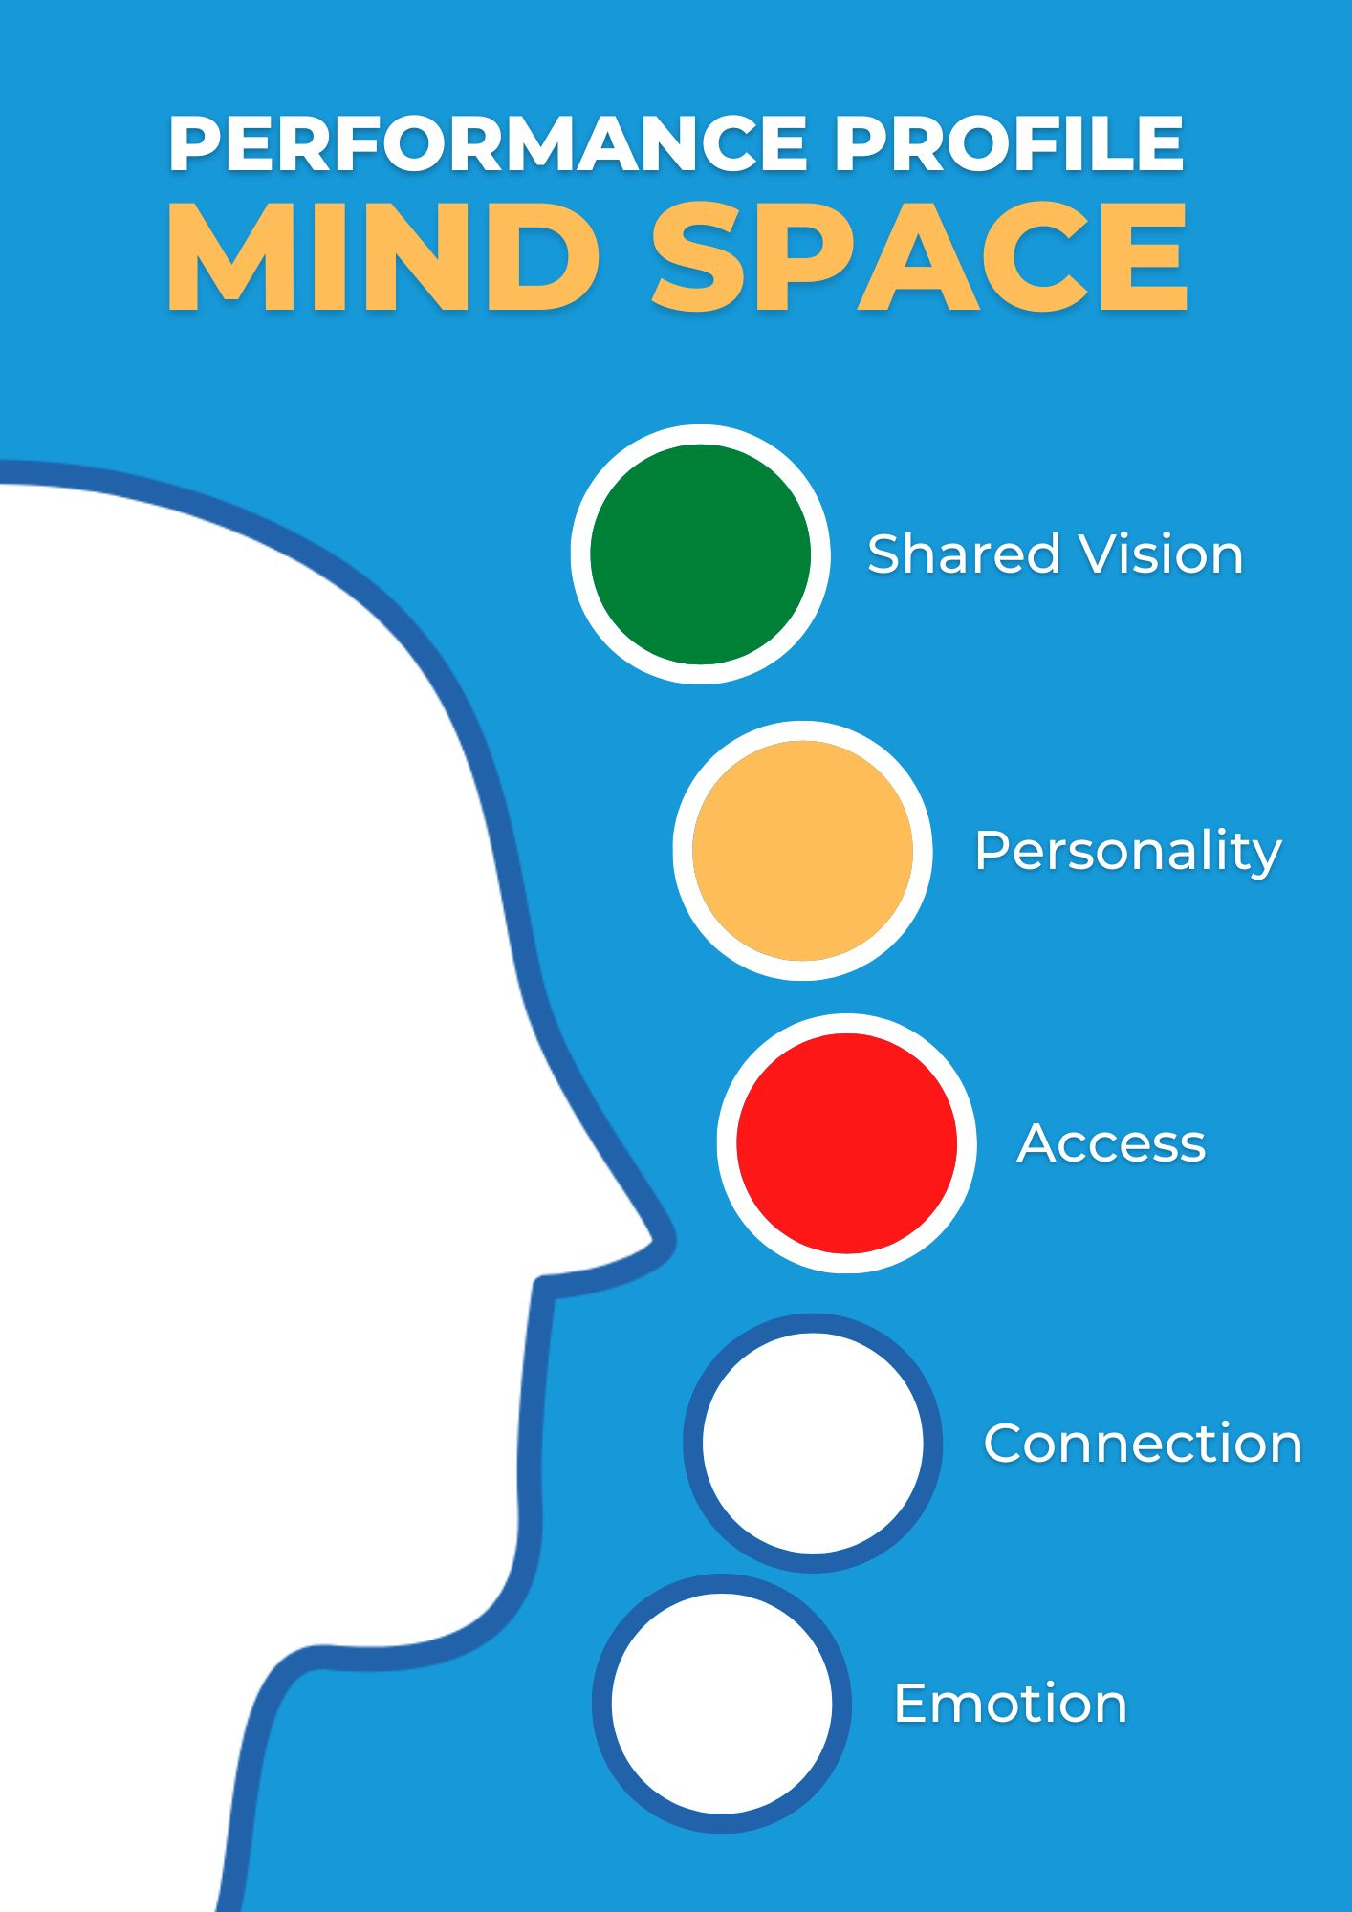
We need to fix this!

Slide 28
Have we cultivated an atmosphere of trust and appreciation?
CONNECTION
Does everyone have open lines of communication to the people they need to be efficient, and service focused?
Are we encouraging the sharing of best practices?

Slide 29
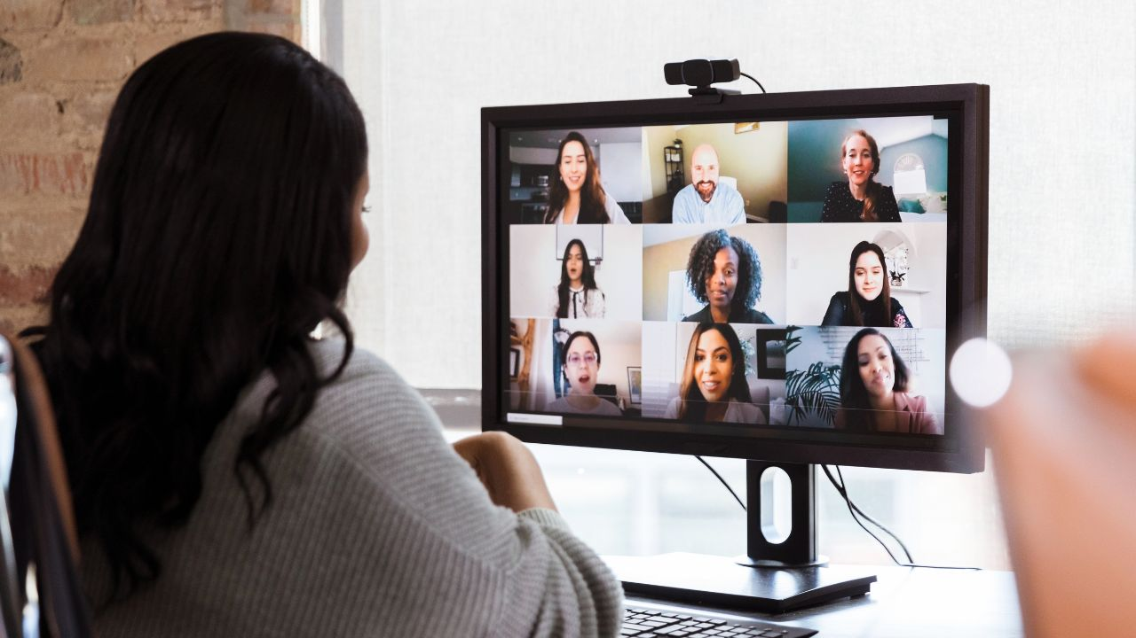
CONNECTION

Slide 30
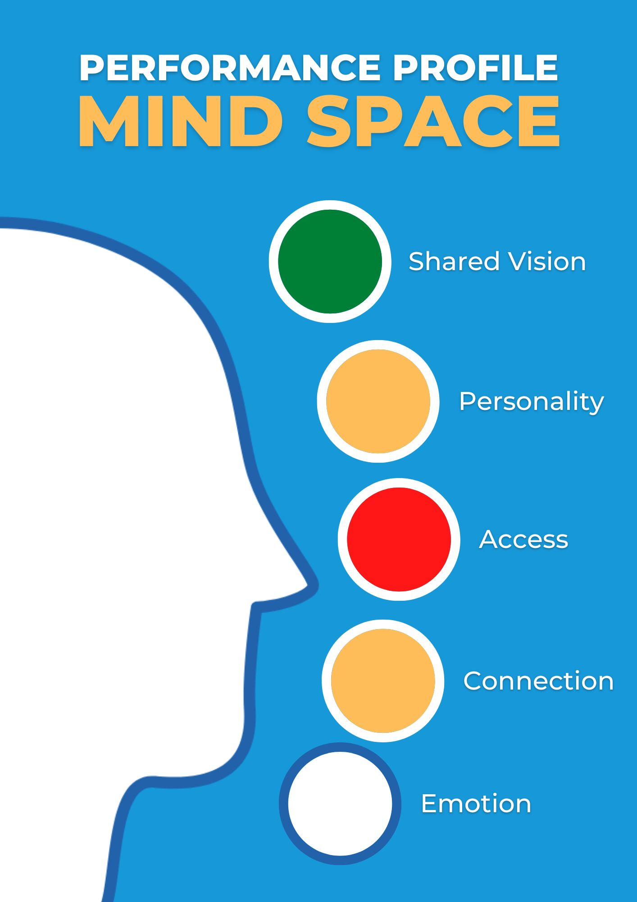
Let’s keep an eye on this…

Slide 31
Are we aware of the energy and emotional quality we have generated with our team?
EMOTION
Am I aware of patterns and beliefs that may include unconscious bias?
Do we have opportunities for people to express themselves and offer feedback?

Slide 32
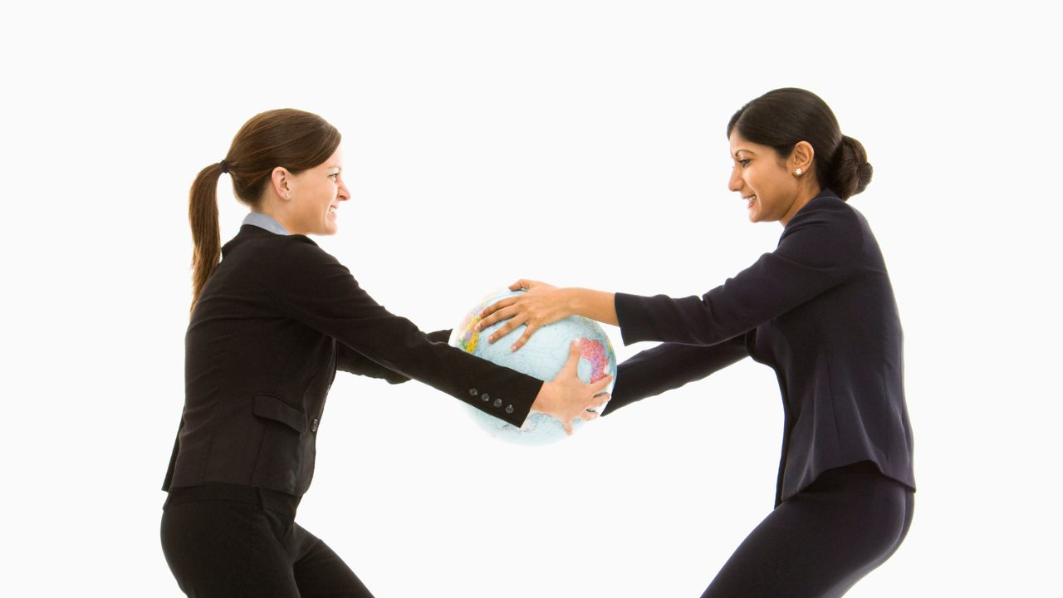
EMOTION

Slide 33
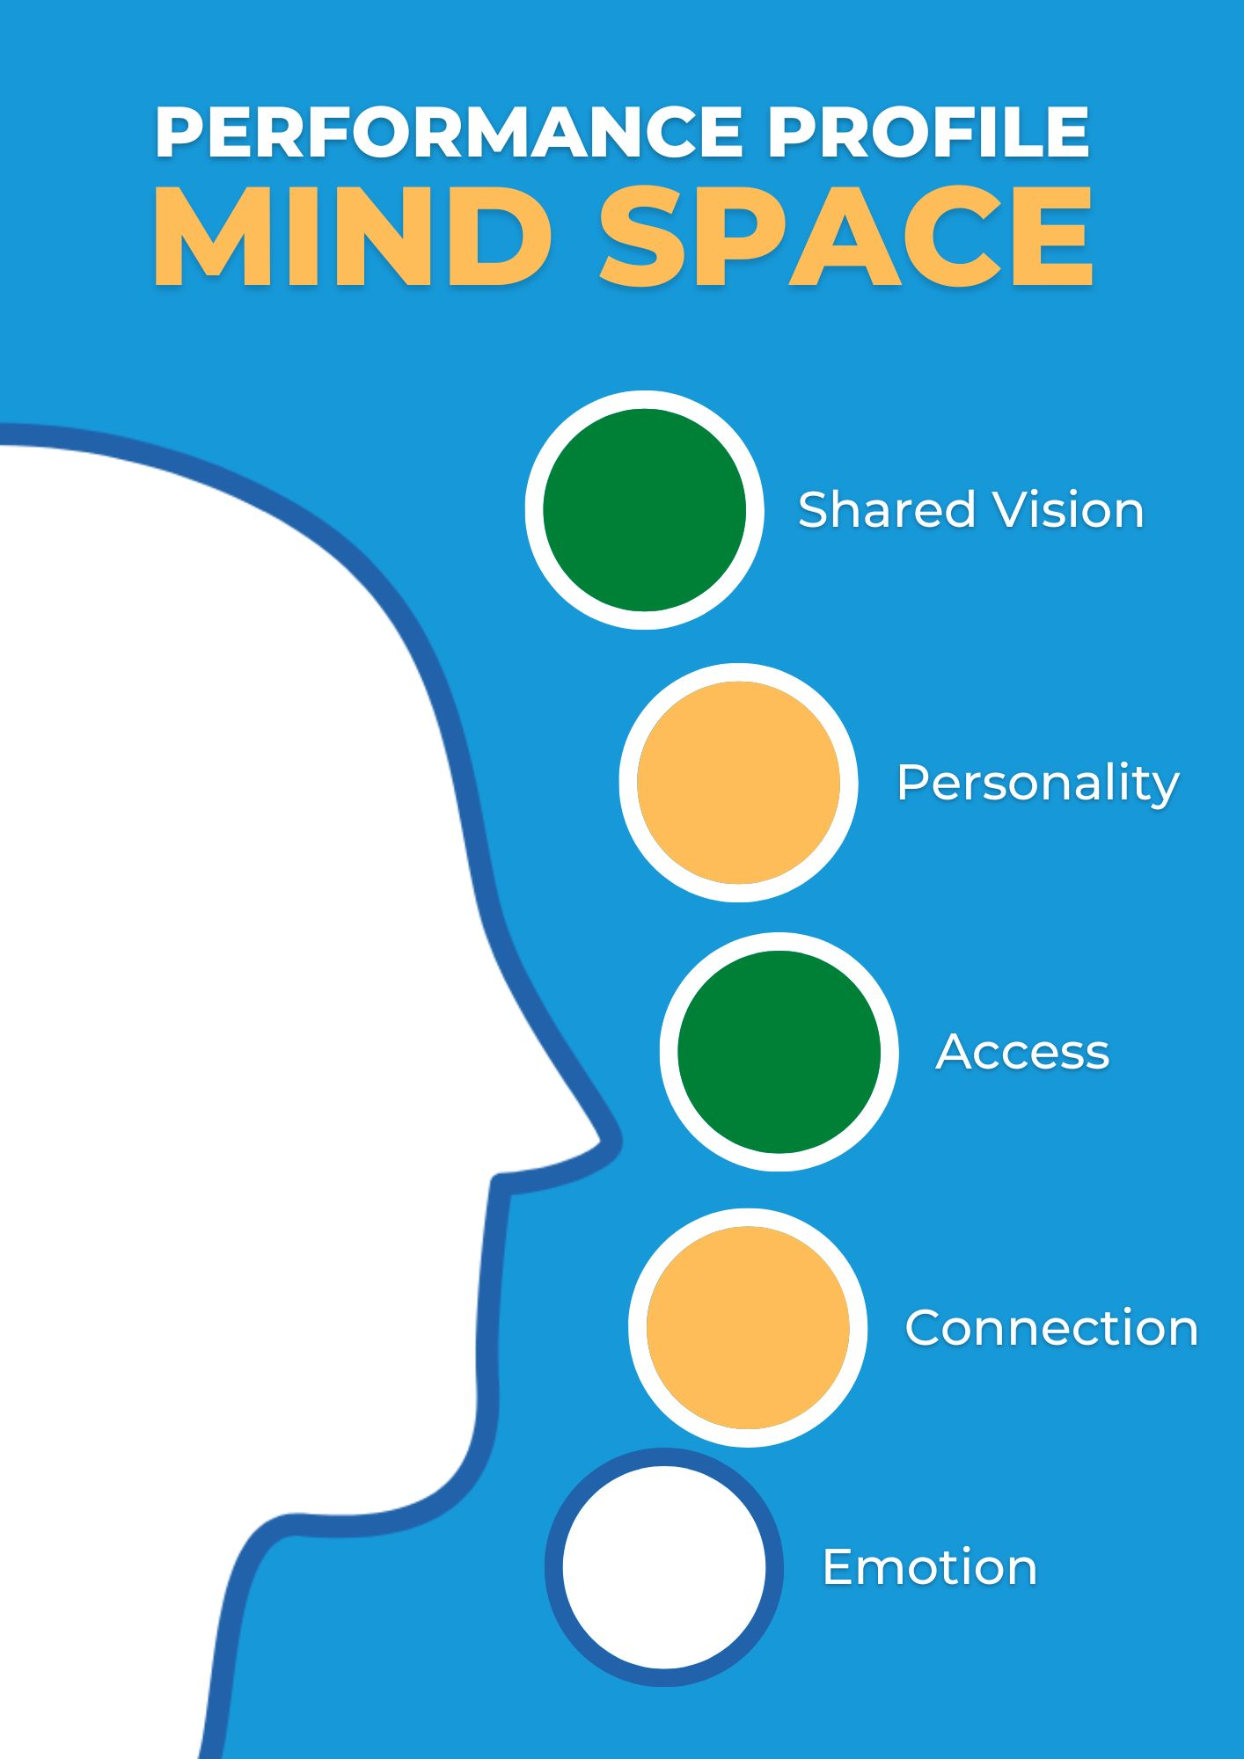
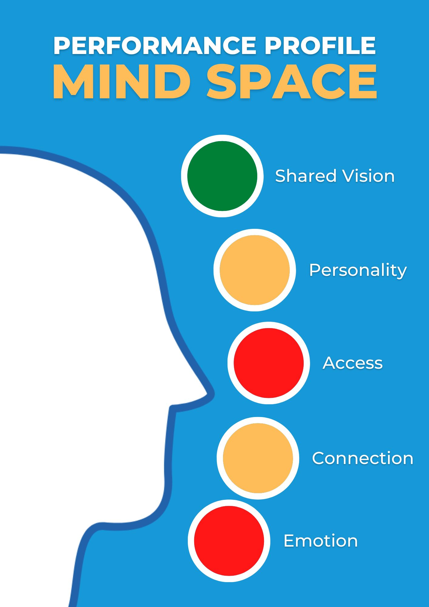
We have our priorities…let’s get working on these now!

Slide 34
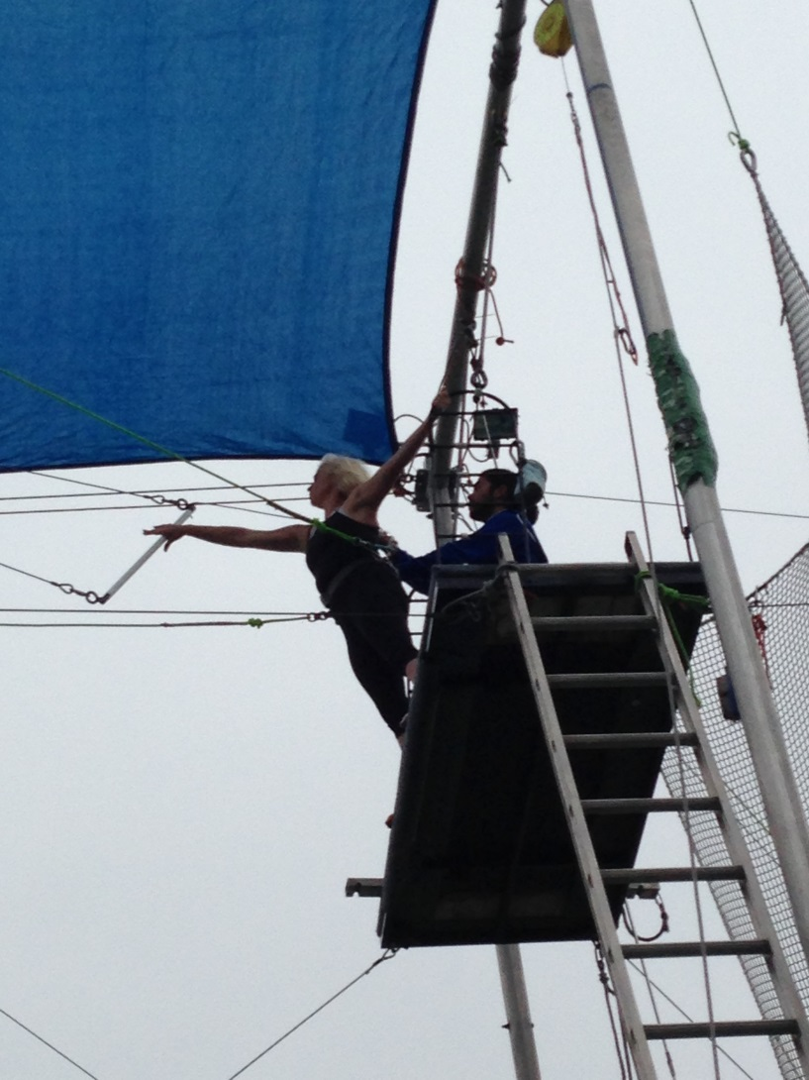
LET GO…

Slide 35
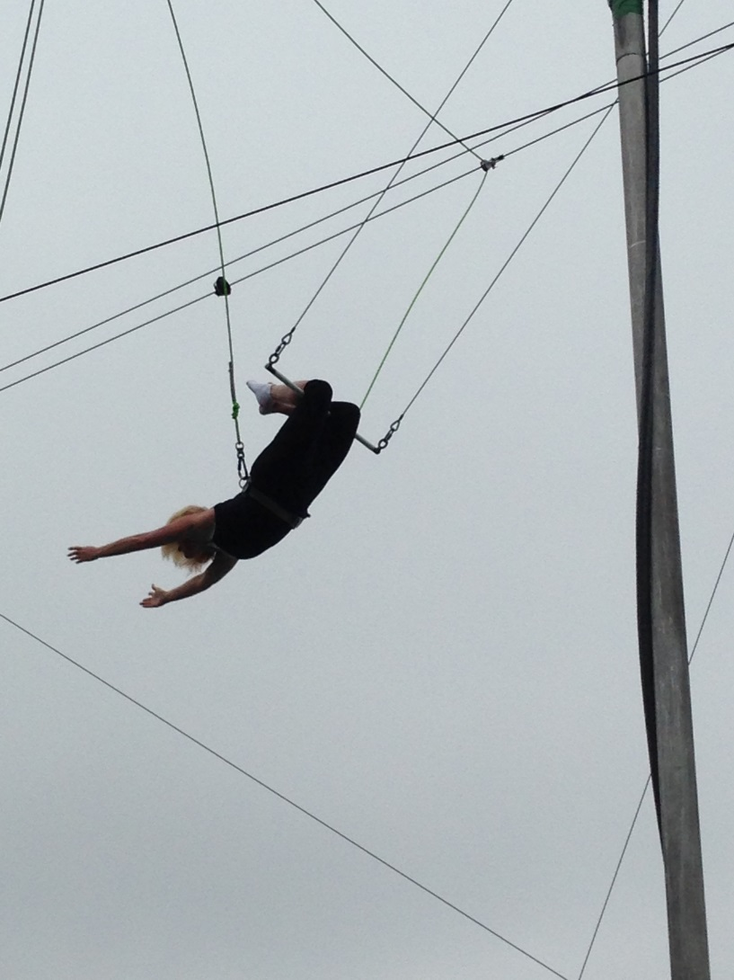
…AND FLY!

Slide 36
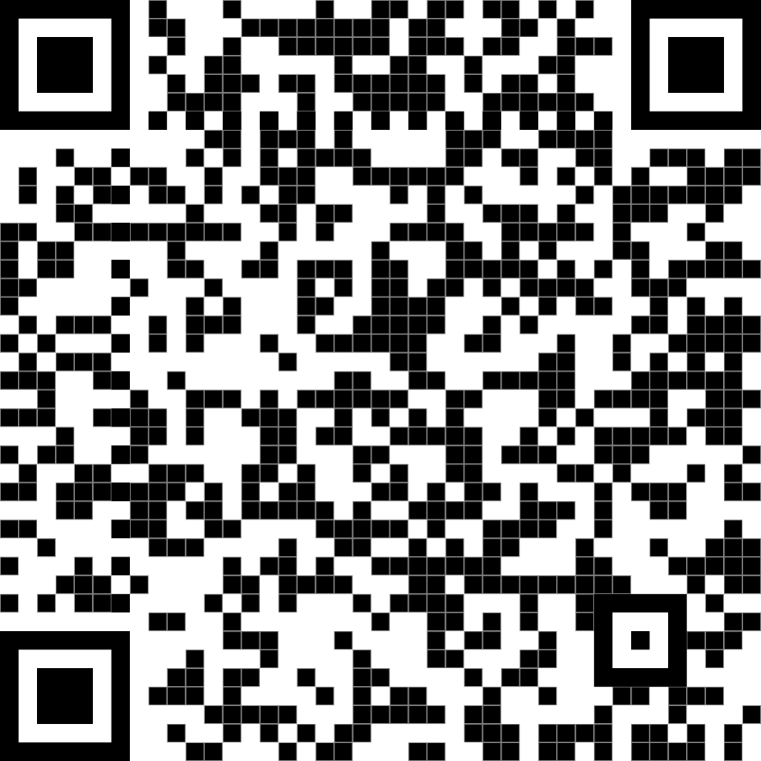
THANK YOU!
Q&A TIME
…Or Connect on LinkedIn
LINKEDIN PROFILE

Slide 37
LEADING CHANGE: Moving from What IS to What CAN BE
By Heather Hansen O’Neill

