Slide 1
Leading With Values
Martha Perego, Managing Director Member Services & Ethics

Slide 2
our Ethical foundation

Slide 3
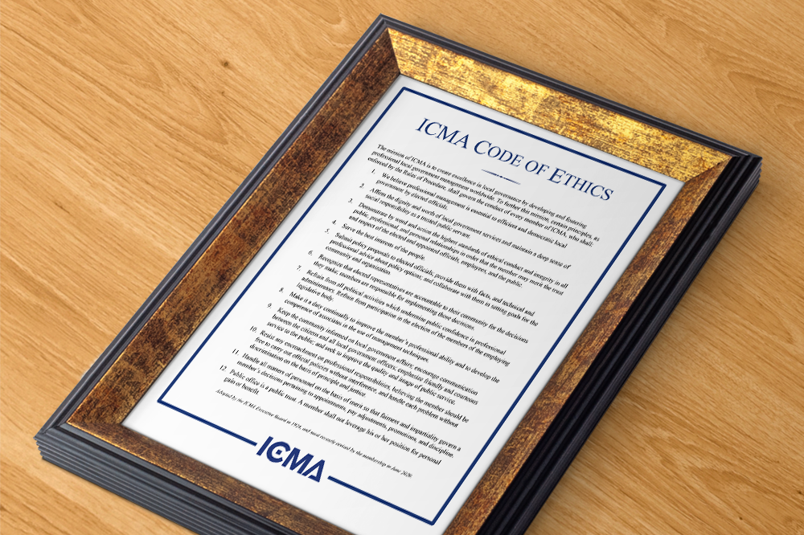
Ethical foundation of public service
Public office is a public trust
You are independent, impartial and responsible to the public
Decisions and policy are made by government via the right channels
Public must have confidence in the integrity of the government

Slide 4
Core principles icma code of ethics
Integrity
Fairness
Honesty
Transparency
Commitment
Competency
Political Neutrality

Slide 5
why is this so hard?

Slide 6
human nature
We can easily “fool ourselves” when facing an ethical challenge…
Rationalize our behavior
Act out of self interest
Notes:
Because we don’t think about values, we don’t recognize when we have an ethics issue.

Slide 7
We all have blind spots
“When it comes time to make a decision, our thoughts are dominated by thoughts of how we want to behave; thoughts of how we should behave disappear.”
Notes:
How could they have let this happen?”
The proper question is: How can we ourselves overcome our natural tendency to evade and self-deceive

Slide 8
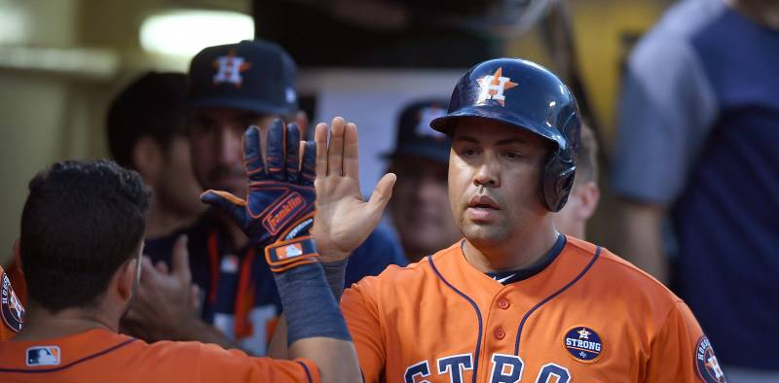
“I don't call that cheating. I call that using small details to take advantage.”
Notes:
manager AJ Hinch.

Slide 9
Right versus rights challenges
“The really tough decisions don’t center upon right versus wrong. They involve right versus right. They are genuine dilemmas precisely because each side is firmly rooted in one of our basic, core values.”
The common core values that stand as dilemmas paradigms are:
Truth versus loyalty
Individual versus community
Short-term versus long-term
Justice versus mercy
Rushworth Kidder

Slide 10
Is this conduct ethical?
Out for a weekend ride
Presidential motorcade
Not wearing any work branded items
Friends posted the picture and others on social media

Slide 11
What action would you take if this was a city employee?
Picture gets posted to the city cycling group’s page (informal team)
Mayor hears about the post and wants to know “why do staff get involved in politics?”
Mayor wants action taken now!

Slide 12
Political neutrality

Slide 13
Educating our children
Latest issue in your town is the school board’s decision to remove books from classrooms
Topic hasn’t crossed over to Town Library shelves (yet)
Although your children are just learning to read, you are pretty concerned about the school board’s decision making.

Slide 14
Educating our children
You’ve stayed on the sidelines thus far
But the decision to “ban” this book has moved you onto the field!
If you engage is this “political activity”?

Slide 15
Political neutrality
Refrain from all political activities which undermine public confidence in professional administrators.
Personal Advocacy of Issues. Members share with their fellow citizens the right and responsibility to voice their opinion on public issues. Members may advocate for issues of personal interest only when doing so does not conflict with the performance of their official duties.

Slide 16
the approach matters
WHAT IMPACT DOES VOICING YOUR OPINION HAVE ON YOUR ROLE?
Convenor or facilitator on community issues
Neutral mediator to resolve disputes
Source of facts, objective and credible recommendations
Guardians of the process
Service provider
Leader

Slide 17
Principles in Real life
Think about a time when your stood firm on a principle and it wasn’t easy!
What was the principle?
What did you risk in doing so?
What did you risk in not doing so?

Slide 18
why is this so hard?

Slide 19
The organizational challenge
Culture matters!
Actions speak louder than words
What is and is not informally talked about is important
What conduct/behavior do we reward or tolerate?

Slide 20
Less trash = more cash?
The city council adopted a 2-bag limit on residential garbage collection.
As the city sanitation crew works its route, it arrives at a house with 3 bags of trash out front at the curb.
One bag has a $20 bill pinned to it.

Slide 21
What would your employees do?
Take the bag and the $20 ( to buy lunch?)
Leave the bag and the $20 at the curb
Call a supervisor for direction
Other

Slide 22
building an ethical organization
Define the Organization’s Core Values
Commit to Ethics Training
Recruit Ethical Talent
Provide Advice and Enforcement
Develop Comprehensive Reporting Mechanisms
Develop Strong Organizational Policies
Assess How You are Doing
Reinforce Your Values

Slide 23
Between a rock and a hard place
The learning/adjustment curve with the new manager is steep and just a bit challenging. The management team is committed to “getting onboard”. The leadership style differs from the former manager.
Of concern:
Interactions with staff that are “off”
Questionable travel reimbursements
One policy decision that didn’t go to council
Hiring underqualified people for high level positions
Including some “friends”
Describe your approach. Do you ignore? Talk with the manager? Go to others? Leave?

Slide 24
Building Ethical Habits
Be clear about the values that should drive your conduct
Consider those values before you act
Seek advice if you are unsure
Don’t follow an order that is unethical
Talk about values in your organization
Share how you resolve competing values in decisions
Talk about “ethics in the trenches” with your co-workers
Report wrongdoing
Lead from the front

Slide 25
Principle is inconvenient
“It’s this gap between the short-term and the long-term that makes a principle valuable. If your guiding principle is do whatever benefits you right now, you don’t have principles of much value.
Quote by Seth Godin

Slide 26
Principle is inconvenient
“But it’s the valuable principles that pay off, because they enable forward motion, particularly when it feels like there are few alternatives.
We embrace a culture based on principles because it’s that structure and momentum that enables connection and progress to happen in the first place.”
Quote by Seth Godin

Slide 27
Resources for you
Confidential advice on ethics issues
ICMA Code of Ethics icma.org/ethics
ETHICS MATTER!
Being Politically Neutral in a Partisan World, April 2021
Want to Elevate Your Career? Nurture Your Reputation, January 2022

Slide 28
ethics support and advice
Martha Perego
Director Member Services & Ethics
mperego@ICMA.org
202-962-3668

