Slide 1
Local Government Leadership for Economic Mobility
Laura Goddeeris, AICP, ICMA Director of Research Anna Mitchell, MPA, ICMA Senior Program Manager

Slide 2
ICMA’s EMO Initiative
Supported by the Bill & Melinda Gates Foundation to:
Increase local decision-makers’ understanding of drivers of and barriers to mobility and opportunity
Support local leaders in identifying and implementing actions to advance upward mobility for residents of their communities.
Through:
Research & resources
In-person and virtual learning opportunities
Peer learning cohort + grants to local governments

Slide 3
What is Economic Mobility and Opportunity?
Economic success. When a person has adequate income and assets to support their and their family’s material well-being.
Being valued in community. When a person feels the respect, dignity, and sense of belonging that comes from contributing to and being appreciated by people in their community.
Power and autonomy. When a person has the ability to have control over their life, to make choices, and to influence larger policies and actions that affect their future.
Urban Institute, Mobility Metrics Framework https://upward-mobility.urban.org/

Slide 4
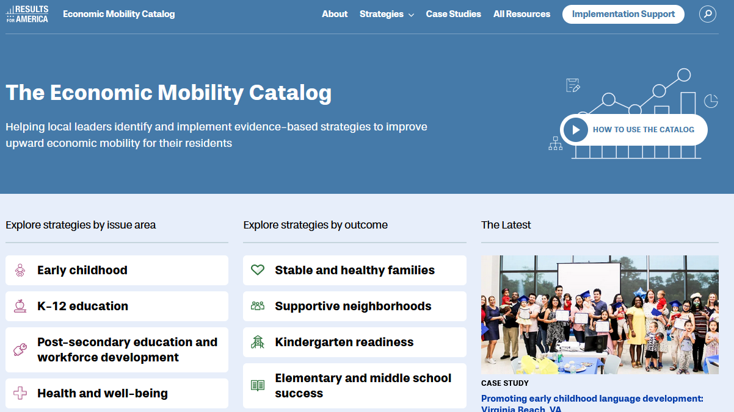
Key Focus Areas
Education
Workforce
Health and well-being
Justice and public safety
Housing and community development
Financial security
Results for America, Economic Mobility Catalog https://catalog.results4america.org/

Slide 5
Examples of Local Government Influence
Housing and Community Development | Economic and Workforce Development | Representative and Responsive Governance | Public Health and Safety
Vacant/abandoned property issues Housing security/stability/ affordability Public transportation access Broadband access and digital skills | Inclusive procurement Sector-specific job training Financial education and counseling Transitional employment and re-entry support | Fees and fine reform Reducing obstacles to public benefits Prioritizing equity in local decision making Increasing political participation and representation | Traffic and safety improvements Parks and public space improvements Mental health services Diversion program and incarceration alternatives

Slide 6
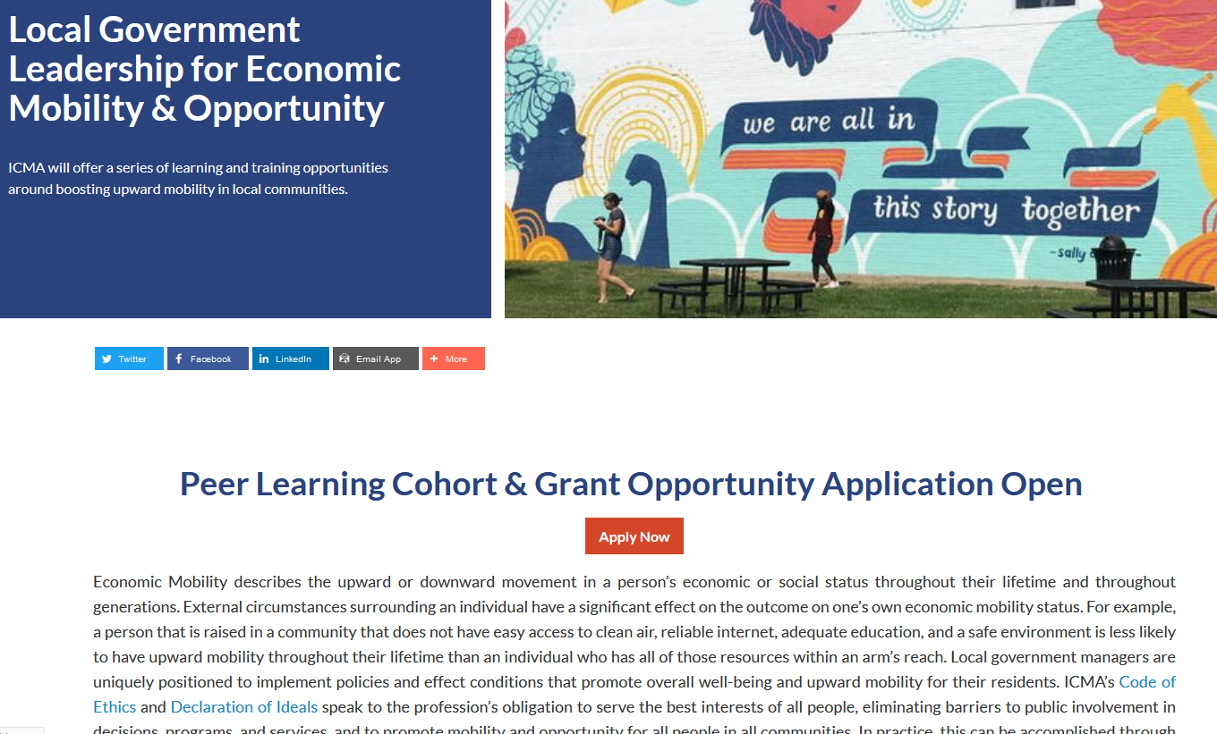
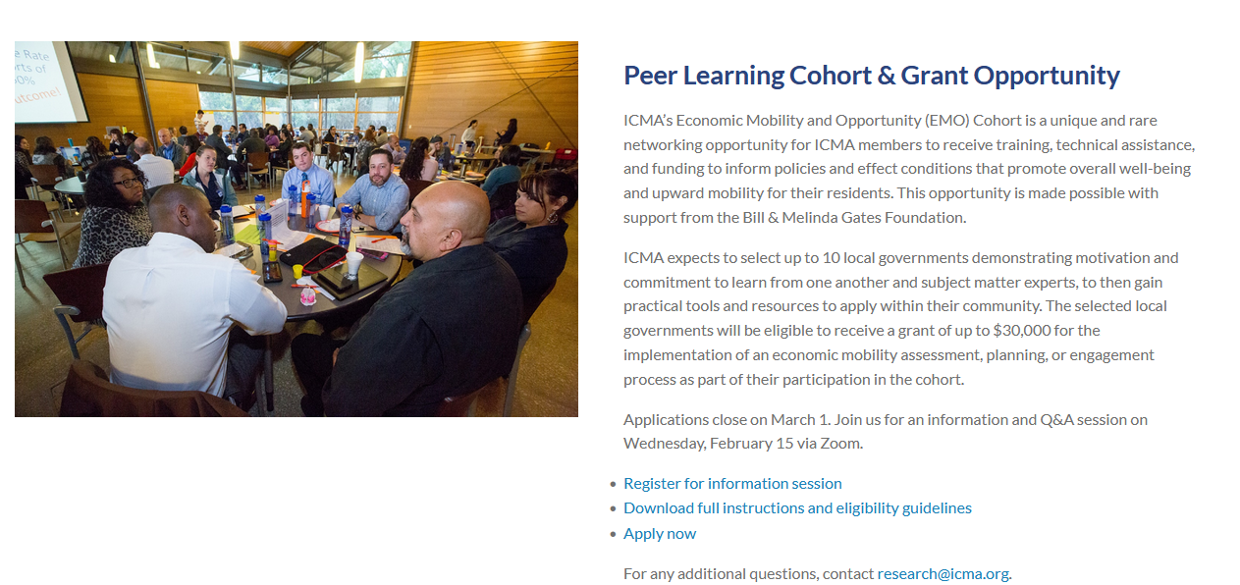
Peer Learning Cohort
Apply online at icma.org/emo
Application deadline: Wednesday, March 1, 2023 (5:00 pm EST)
10 local governments; 3 participants per local government
Two in-person convenings, travel expenses paid, monthly virtual meetings
$30,000 grant for an EMO centered project
Email research@icma.org with any problems or questions

Slide 7
Discussion Questions

Slide 8
Thank you!
Laura Goddeeris, AICP Director of Research, ICMA
Anna Mitchell, MPA Senior Program Manager, ICMA
research@icma.org

