Slide 1
The Call of Public Service: Value-Centered Leadership
T.C. Broadnax, City Manager, ICMA-CM

Slide 3
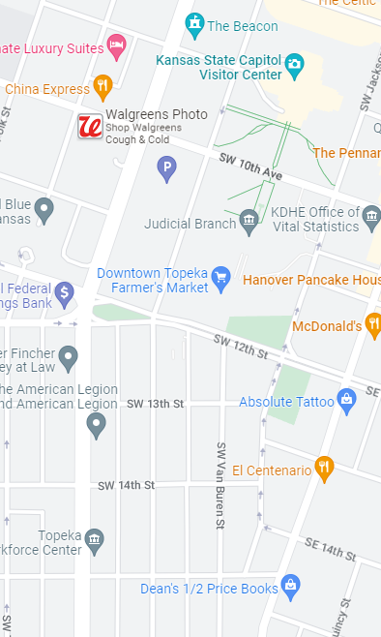
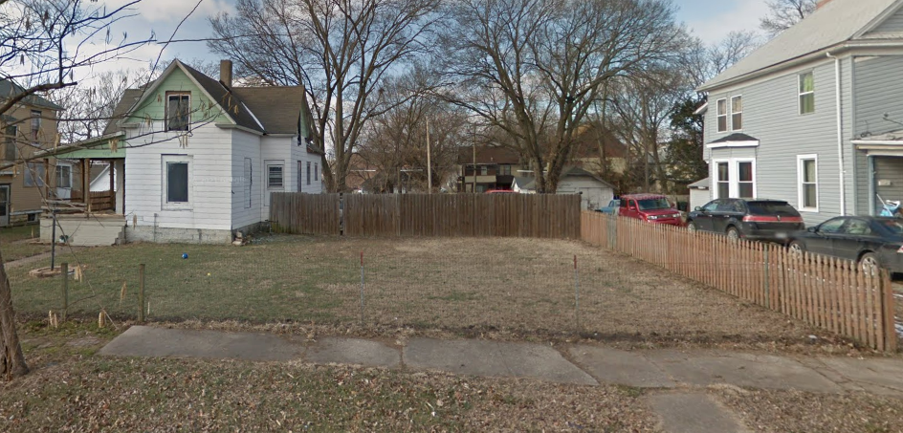
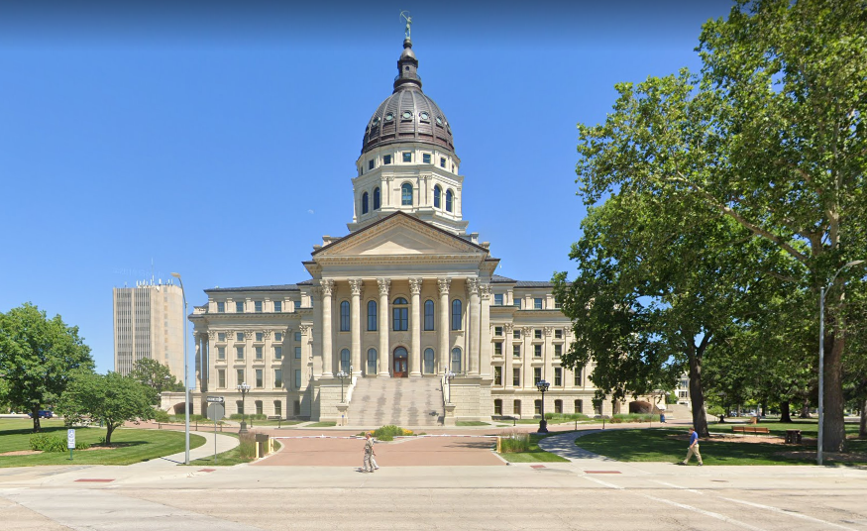
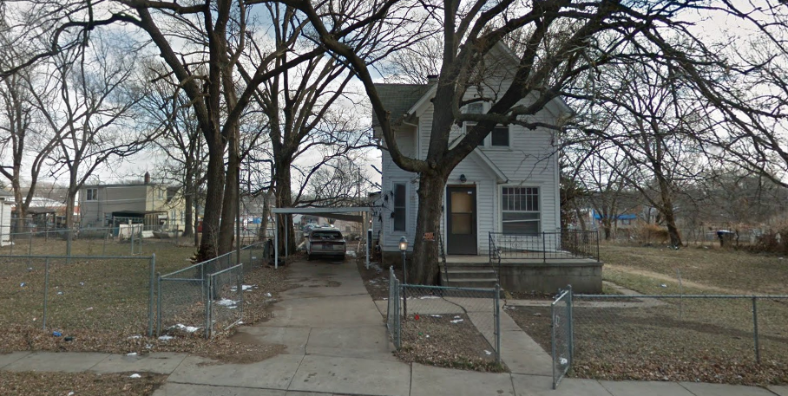

Slide 4
Empathy
Ethics
Equity

Slide 5
What lies ahead?

Slide 6
Place

Slide 7
Place
Time

Slide 8
Place
Time
Perspective

Slide 9
Place
Time
Approach
Perspective

Slide 10
What the people want is simple. They want an America as good as its promise.
- Barbara Jordan, Frmr. US Congresswoman

Slide 11
The Call of Public Service: Value-Centered Leadership
T.C. Broadnax, City Manager, ICMA-CM

