Slide 1
Being Successful As A First-Time Administrator
Tricia Vinchesi, ICMA Northeast Regional Director Karen Daly, ICMA Mountain Plains Regional Director Ashley Wayman, Rollingwood City Administrator
Notes:
Learning to manage is hard. You are one part of a three-legged stool – you, the council/board, and staff, all serving the community
It can be overwhelming even in the best of circumstances, especially if its your first time and never more so during the probationary period
How do you use the skill set you have gained thus far to maximize your success and keep the stool legs stable, so they don’t break?
What do you need to know most the first 30, 60, 90 days?
Two parts – theory and practical/real world examples and when the shine comes off

Slide 2
Focus on Building relationships knowledge for the present and the future trust and credibility yourself network of training and support
This Photo by Unknown Author is licensed under CC BY-SA

Slide 3
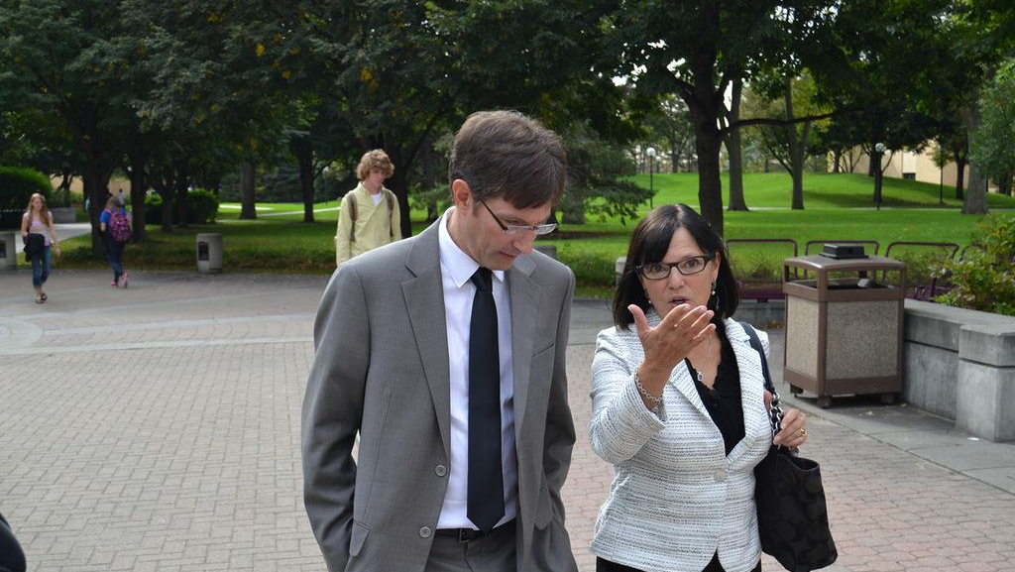
Build Relationships
Mayor/Council/Board
Staff/Unions
Boards/Commissions
Community
Media
Notes:
LISTENING TOUR Council hired you\; they can fire you. Meet one on one, find out what makes them tick listen to their passion. How do they want to communicate? Email/phone? HOW DO THEY VIEW YOUR ROLE? . STAFF: Your staff is your greatest resource and you are their biggest ally Show appreciation, find out about them on a personal level COMMISSIONS: elected and non-elected Community includes Rotary, Chamber of Commerce, Business Association, Non-Profits
Mayor/Council/Board: most important; clarify roles, responsibilities, find out their concerns, goals, expectations.
Staff/Unions: greatest resource. You are their ally. Learn details of issues, projects, challenges, training and personnel needs, career goals, organizational history.
Boards/Commissions: recognize value of volunteerism
Community: know the locality you serve; listen to what citizens are saying to help improve services
Media: hold accountable but do your part as well to help provide factual reporting
Ashley:
The way your elected officials view your role is, in my experience, one of the most important things to understand right away. Particularly in a small community, you need to know what they expect from you because it is their city- you are just running it!
How much to stay status quo
How much new to bring
Changes over time
There is also a difference in building those relationships if you are new to the organization or have promoted up. They may have had a previous role expectation for you that now needs to shift.

Slide 4
A local reporter is planning to run a story about one of your police officers who may have been involved in a large, rowdy super bowl party in a nearby city. Eventually, law enforcement was called in to disperse the party-goers. No arrests were made but it was common knowledge that one of your police officers was present. What do you tell the reporter?

Slide 5
Build Knowledge
Job description, charter/bylaw or special act powers, duties and authority
Become a budget expert
Tour municipal facilities
Know your staff’s competencies and where there are shortages
Read strategic and master plans, zoning and consultant reports, annual audits
Go to community events and learn town traditions
Notes:
Ashley:
Listening was one of the hardest things for me when I was new to my role. I was inundated with new work and responsibilities and could find myself neglecting my relationships with staff members. Setting up time to sit with them and have them tell me about their jobs was key. That time needs to be given to others if you want to be seen as a good leader.
Ashley:
Learning about what makes your organization unique is important early on and continuing throughout your time in the organization.
Budget, Budget, Budget. My “sentence” in the finance department early in my career is something that I am grateful for every day in my role as City Administrator.

Slide 6
You just got hired to be the new manager of north county and are excited to hit the ground running. One of the county commissioners, who was an enthusiastic supporter of your appointment, invites you to an event to meet important people in the county and be introduced as the new manager. The event, just by chance, happens to be associated with their reelection campaign. What do you do?

Slide 7
Make a Plan
30 days
Six months
One year
Two-three years
Five-ten years
Notes:
Ashley:
30-60 day planning might seem crazy- feels like you are trading water. But prioritize anyway. And keep track of what you are accomplishing so you don’t get caught only seeing what you need to do, but also get to see what you have done. Small wins!

Slide 8
Build for Today and Tomorrow
Establish the process of strategic planning; short-term and long-term planning is the most important focus of a community
Is there an existing strategic plan?
Can’t do a strategic plan? What are five things you would like to accomplish?

Slide 9
Build Trust and Credibility
Treat elected officials the same, share information equally Support their decisions once made regardless of your personal opinion Be who you are, not who you think they want
Lead by example. Allow for all opinions but insist upon respect, civility, and fairness Follow the ICMA Code of Ethics .
Notes:
Ashley:
Let people get to know you.
Let your employees in on what is going on in your work world.
Communicate your goals.
Ashley:
First thing you need to do!
Accomplished by:
Authenticity and Honesty
Fairness and Respect
Communication

Slide 10
One of your board members has asked you to address an issue involving two neighbors. They are arguing over whether a tree that straddles their shared property line should be removed or trimmed or left alone. The board member wants you to get involved because one of the neighbors called them demanding a resolution. The board member thinks the only way to de-escalate the situation is for the community to trim the tree. The tree does not appear to be on public property. What do you do?

Slide 11
Build Yourself
Have an employment agreement
Have documented goals; avoids surprises
Keep copies of your major accomplishments
Have an approved performance evaluation
Take care of yourself; establish good work habits and set boundaries now
This Photo by Unknown Author is licensed under CC BY-SA
Notes:
Ashley:
Document goals for yourself and key staff – hold yourself accountable!
Know your accomplishments – you will forget them so document!
Surround yourself with experts
Don’t neglect your professional and personal development

Slide 12
Build Your Network
Develop a professional development plan Take advantage of training opportunities outside your comfort level Join professional membership organizations, attend meetings and cultivate relationships Don’t go it alone when things get tough
Notes:
Ashley:
I have found that the “tell me about it” approach works well.
We like to call the “bus test” the “If I win the lottery” test. Either way you’re not coming in tomorrow- but the organization shouldn’t come to a stop because you aren’t!
Question the “because we have always done it that way” approach. But remember that there are people that have been doing it that way for a long time and find security in that mindset that you might threaten/disrupt. So do so cautiously and open-mindedly.

