Slide 1
Employee Experience: Next Gen HR
Mike Land, City Manager, ICMA-CM, CPM
Matia Messemer, Employee Experience Director, SHRM-SCP

Slide 2
Learning Opportunities
There is an emerging iteration of the HR profession tied to experience, and it could be a tool for promoting organizational health.
Where to start with an employee experience model.
Use the employee life cycle model to understand current employee experience and future employee experiences. Link to communities’ desires as represented by elected officials.
Approach Coppell’s story as a case study.

Slide 3
Organizational Need
The Why
The Lens of Employee Experience

Slide 4
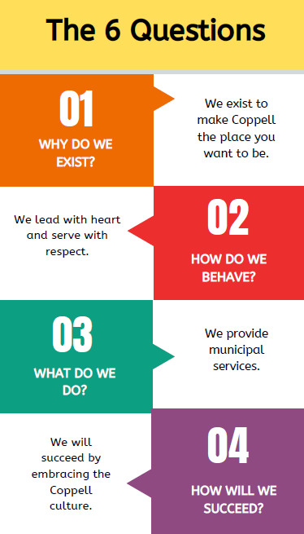

Slide 5
Idea of Employee Experience
Key Focus Areas:
Development
Training
Allyship
Benefits
Relationships
Systems
Talent Acquisition
Culture Connector
Leadership Partner

Slide 6
Organizational Structure
The how
Creating the Employee Experience Department

Slide 7
Employee Experience AND Human Resources Professional Standards
Human Resources (HR) Knowledge Domains (SHRM)
People
Organization
Workplace
Human Resources Competencies (SHRM)
Leadership
Interpersonal
Business

Slide 8
Employee Experience AND Human Resources People-Focused
Cultural alignment and lead
Design Thinking
Belonging
Organizational Effectiveness
Innovation
Emotional connection
Purpose
Notes:
Lens is the difference…
Lens of compliance?
Lens of protection?
Lens of fear?
Lens of skepticism or cynicism?
OR
Lens of experience?
Lens of service above self?
Lens of trust?

Slide 9
Employee Experience Department
Focus Areas:
Learning
People Systems
Benefits
Relationships
Organizational Effectiveness
Innovation
Talent Acquisition & Making
Specialist Model
Team Development
Employee Life Cycle
Foundation of Pay & Benefits
Permission for More

Slide 10
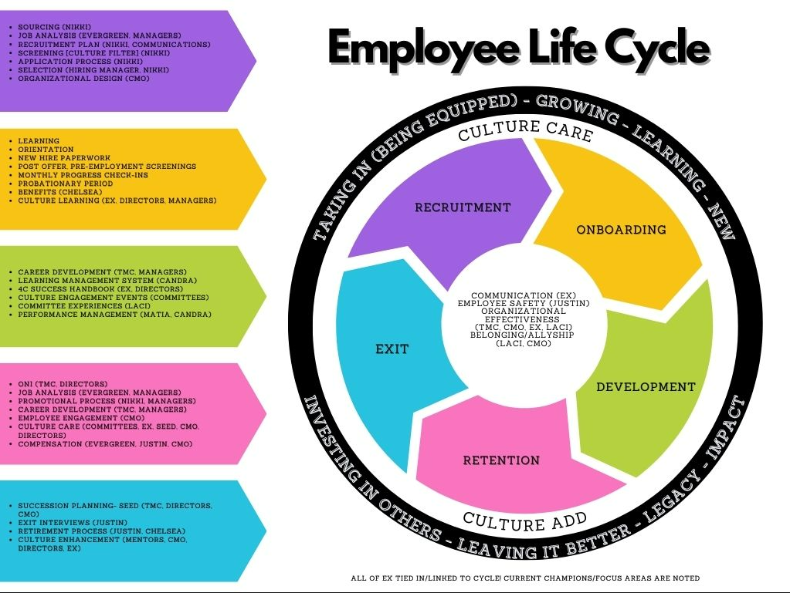

Slide 11
Organizational Effectiveness
The Future
Meaningful Employee Experiences

Slide 12
Pillar 4: Future Oriented Approach to Residential Housing
Pillar 1: Perpetuate a Learning Environment
Pillar 5: Create Business and Innovation Nodes
Pillar 2: Foster an Inclusive Community Fabric
Pillar 6: Implement Innovative Transportation Networks
Pillar 3: Enhance the Unique "Community Oasis" Experience
Pillar 7: Apply Smart City Approach to Resource Management

Slide 13
Takeaways…
Explore employee experience in more detail
Understand and discuss the next iteration of HR, and recognize the type of HR they have in their organization
Link organizational culture to organizational effectiveness through assessing org needs, developing structure for solutions, and achieving the desired outcome.
Engage critical thinking around employees’ experiences within their organization

Slide 14
Q & A
Matia Messemer – matia.messemer@coppelltx.gov
Mike Land – MLand@coppelltx.gov

