Slide 1
Elevating Trust in Local Government
Richard Davis, Former Baytown City Manager, ICMA-CM
Brian Moran, Assistant to the City Manager

Slide 2
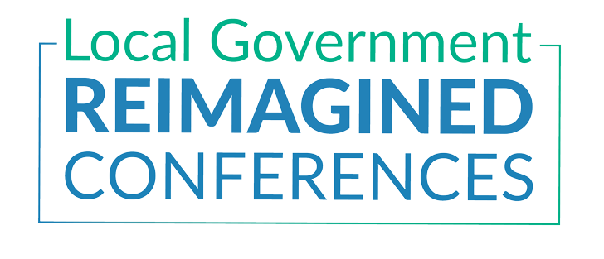
Does your city have a strategic plan?

Slide 3
Have you involved your citizens in the creation of a strategic plan?

Slide 4
Are your resident priorities and council priorities aligned?

Slide 5
In your community, what do you believe is the greatest cause of resident disengagement?

Slide 6
What is community-based strategic planning?
Community-based strategic planning is a process by which citizens and local government engage in an exercise of deep listening and the subsequent identification of citizen priorities, those things citizens believe are mostly likely to elevate their quality of life.

Slide 7
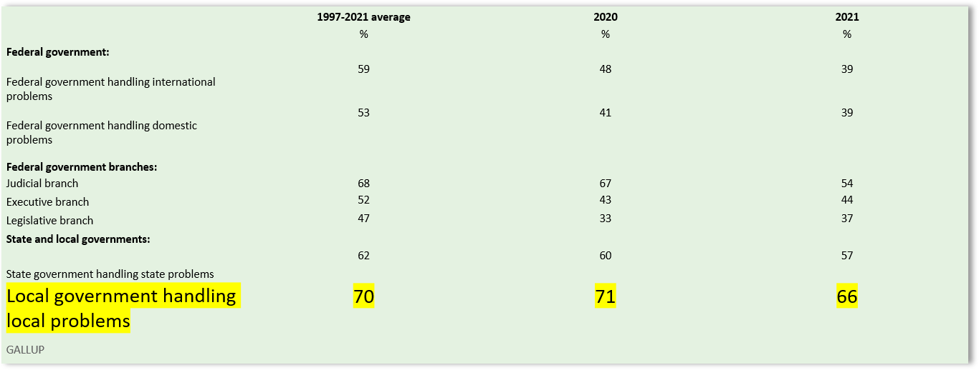
Americans’ Trust in Levels of Government vs. 2020 and Historical Average
https://news.gallup.com/poll/355124/americans-trust-government-remains-low.aspx
A full third of our citizens likely do not trust our willingness or ability to address their needs

Slide 8
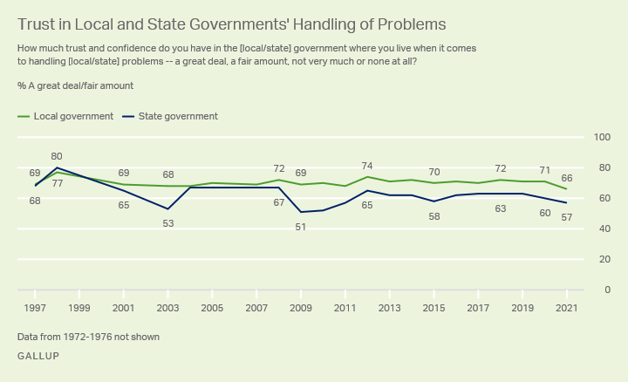
This is not a new problem
“The more that local governments become the new battleground for polarizing battles, the more we’ll lose ground in the fight to regain civic trust. That would be an epic loss that American government can ill afford.”
-Donald F. Kettl
https://news.gallup.com/poll/355124/americans-trust-government-remains-low.aspx

Slide 9
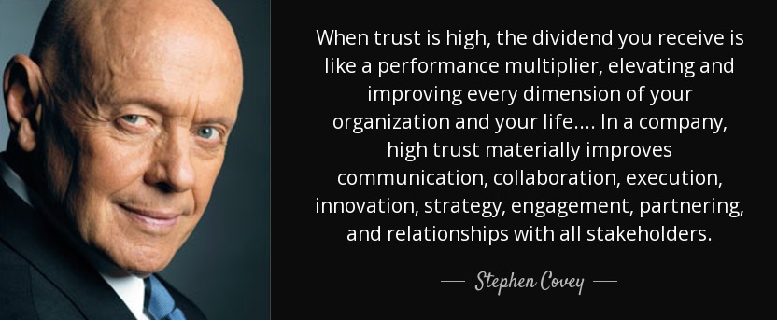
Trust drives our resource engine. Even the wealthiest community is bankrupt without it. With it, even the poorest city can make miracles happen.

Slide 10
Trust results when “trustworthiness” and demonstrated “competency” collide.
Trustworthiness
Competency
TRUST

Slide 11
A community-based approach to strategic planning allows for the opportunity to address both elements of trust
https://digitalcommons.unf.edu/ed_gamble/541/

Slide 12
The Challenge is…
An ICMA Survey indicated that only two-thirds have or use a strategic plan to guide decision making. Of those, only a third allowed their residents to play a role in creating it.

Slide 13
The Reality is…
The reality is that both citizen apathy and outrage are many times the product of a lack of civic engagement. Many citizens desire involvement in local governance beyond simply Election Day.

Slide 14
The Community-based Strategic Planning Process

Slide 15
The Community-based Strategic Planning Process
Setting the Stage
Data Gathering
(Listening)
Identification of Citizen Priorities
Report Composition
Implementation & Return and Report

Slide 16
The Community-based Strategic Planning Process
Setting the Stage
Data Gathering
(Listening)
Identification of Citizen Priorities
Report Composition
Implementation & Return and Report
Setting the Stage:
Appoint the SPAC
Develop the Mission
Gather the Stakeholders
Brand and Promote the Initiative
Define and Schedule Events

Slide 17
The Community-based Strategic Planning Process
Setting the Stage
Data Gathering
(Listening)
Identification of Citizen Priorities
Report Composition
Implementation & Return and Report
Listening:
Focus groups
Workshops
Open Houses
Survey(s)
Create creative contests and events

Slide 18
The Community-based Strategic Planning Process
The Five most powerful questions:
What do you like most?
What do you like least?
Why did you move here?
What, if changed would make you consider leaving?
If you were king or queen for a day, what would you change or what would you do?
Setting the Stage
Data Gathering
(Listening)
Identification of Citizen Priorities
Report Composition
Implementation & Return and Report

Slide 19
The Community-based Strategic Planning Process
Setting the Stage
Data Gathering
(Listening)
Identification of Citizen Priorities
Report Composition
Implementation & Return and Report
Identification of Priorities
Data Analysis
Strategic Directives
Key Initiatives
Consider the Unsaid

Slide 21
The Community-based Strategic Planning Process
Setting the Stage
Data Gathering
(Listening)
Identification of Citizen Priorities
Report Composition
Implementation & Return and Report
Putting it all together:
Strategic Directives & Initiatives
Tool Box
The Presentation

Slide 22
The Community-based Strategic Planning Process
Report
Council Goals
Strategic Plan
Budget
Implementation
Implementation Plan
Implementation and Reporting

Slide 23
The Community-based Strategic Planning Process
Implementation and Reporting:
Who’s responsible
Strategy Reporting Software
Community Scorecard
Reporting Frequency

Slide 24
Sharing Success

Slide 25
FY 23-27 Strategic Plan

Slide 26
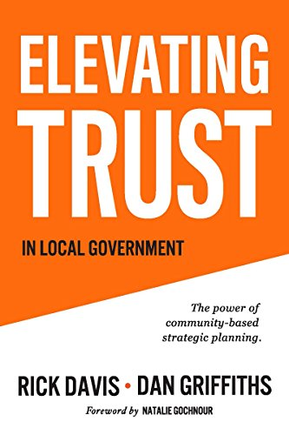
The Community-based Strategic Planning Process
Available on Amazon:
Rick Davis
Daviscountyrick@gmail.com
(801) 834-8981
Brian Moran
Brian.moran@baytown.org
(832) 784-27221

