Slide 1
21st Century Fire and Emergency Services

Slide 2
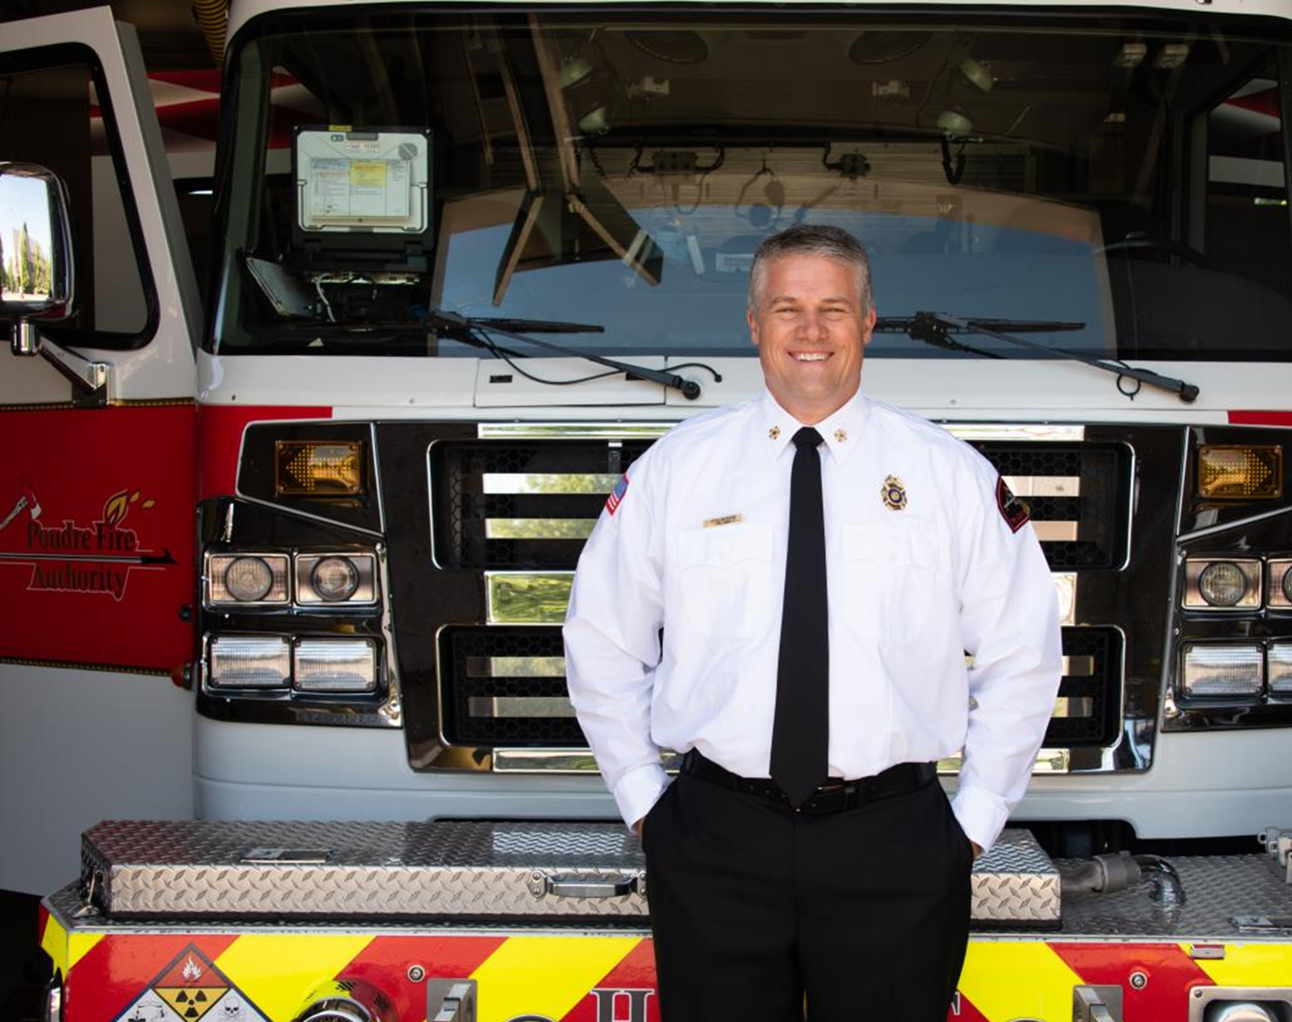
Introduction
Derek Bergsten, MPA, CFO, PIO
Fire Chief – Poudre Fire Authority, Fort Collins, Colorado
Previous Fire Chief – Rockford Fire Department, Rockford, Illinois
Masters of Public Administration

Slide 3


While there will be challenges, the next 30 years hold great potential to refine and improve how services are provided at the local level. It is our hope that this white paper will help achieve that result.
Representing the Center for Public Safety Excellence - Chief Randy R. Bruegman (Retired), CFO, FIFIReE
Representing the International City/County Management Association - City Manager Pat Martel (Retired), ICMA-CM

Slide 4
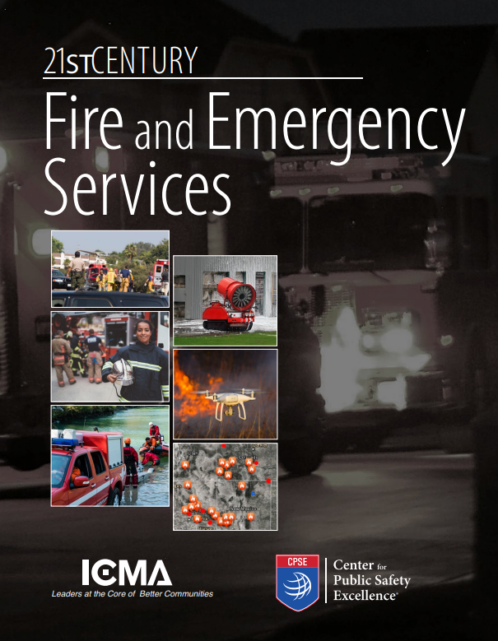

Collaboration and Perspective
International City/County Management Association (ICMA)
Center for Public Safety Excellence (CPSE)
International Association of Fire Fighters (IAFF)

Slide 5
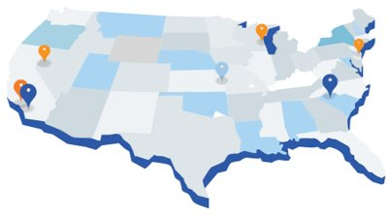
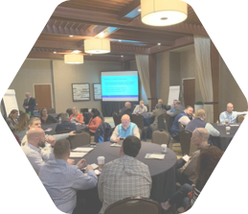
Development Process
Stakeholder Feedback was Key

Slide 6
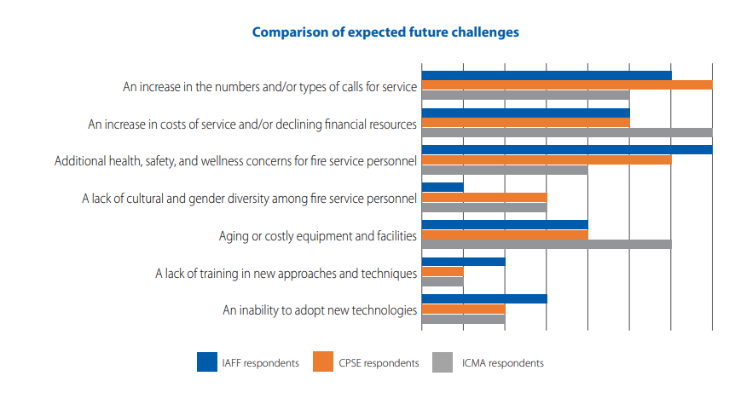

Slide 7
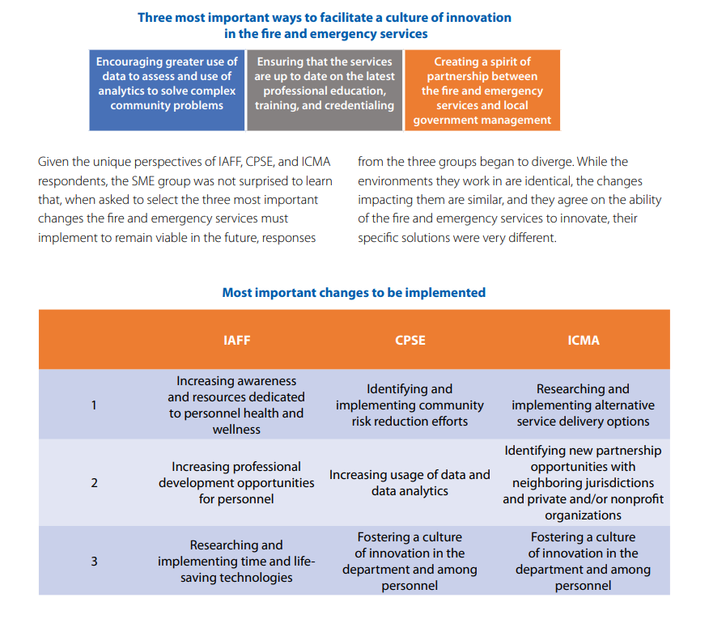

Slide 8
Forces impacting the 21st Century Fire and Emergency Services

Slide 9

Critical Issues
E: Partnerships

Slide 10
Initiative 1: Acknowledge the need to work with a wide range of partners to serve the community and develop local strategies to create new approaches to providing services more effectively.
Inventory and leverage the allied services (law enforcement, health, social services, non-governmental agencies) in the community to provide more effective and efficient services.
Partner with insurers and health providers to provide innovative response strategies, improve patient outcomes, and reduce system costs.

Slide 11
Initiative 2: Promote a symbiotic relationship with other internal departments and outside agencies that are routinely allied responders to an incident.
Routinely meet, train, develop standardized operational response plans, and share real-time intelligence.
Develop goals and outcomes.
Promote regular communications.
Develop opportunities for stakeholders to appreciate the roles and responsibilities of all other stakeholders.

Slide 12
Initiative 3: Continue to expand community emergency response capabilities.
Promote individual and neighborhood self-sufficiency.
Focus on creating personal accountability.
Identify and support community functions.

Slide 13
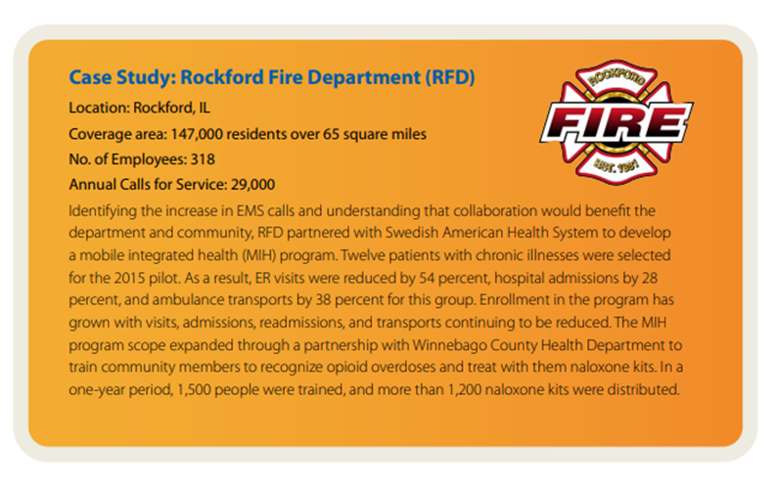

Slide 14
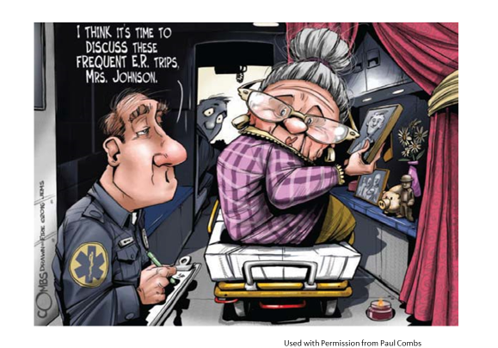

Slide 15
What is Mobile Integrated Health?
According to the Illinois Department of Public Health
Mobile Integrated Healthcare (MIH) is the provision of healthcare using patient-centered, mobile resources in the out-of-hospital environment. It may include, but is not limited to, services such as providing telephone advice to 9-1-1 callers instead of resource dispatch; providing community paramedicine care, chronic disease management, preventive care or post-discharge follow-up visits; or transport or referral to a broad spectrum of appropriate care, not limited to hospital emergency departments.

Slide 16
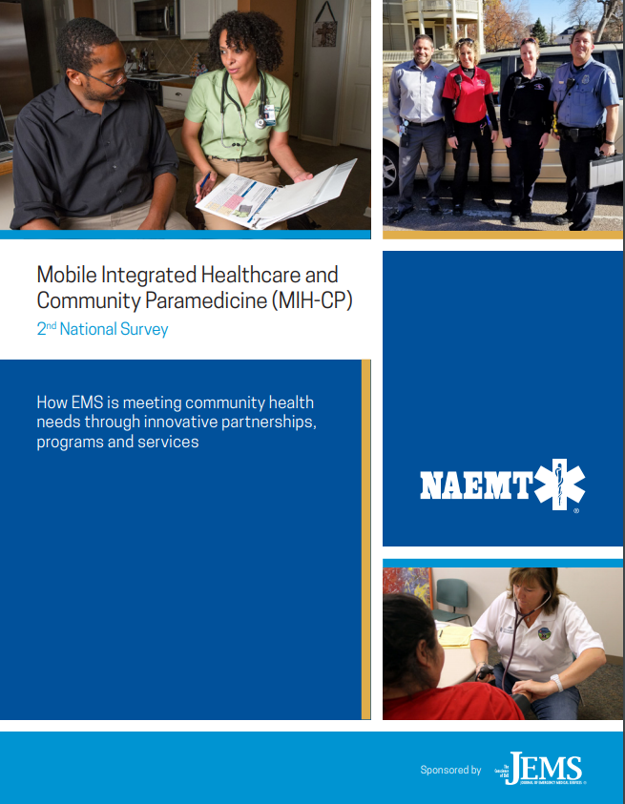
2009 – 4 programs
2014 – 160 programs
2017 – 280 programs
Now – 1,000’s of programs
Source - http://www.naemt.org/docs/default-source/2017-publication-docs/mih-cp-survey-2018-04-12-2018-web-links-1.pdf?Status=Temp&sfvrsn=a741cb92_2

Slide 17
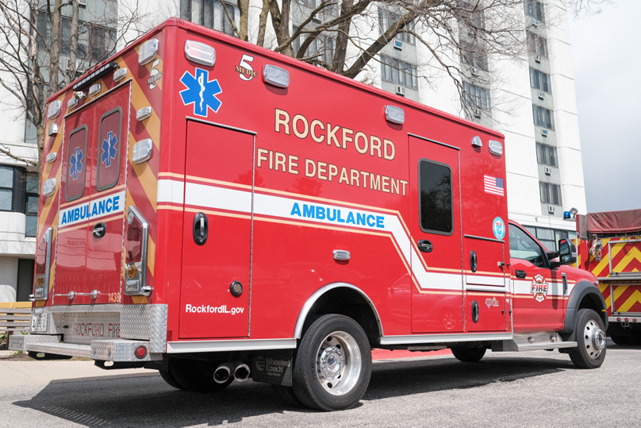
MIH Program Objectives
Preventing hospital re-admissions
Frequent emergency medical services (EMS) and emergency department (ED) users
Chronic disease management
Alternative destinations
Other programs
Home health support
Primary care/physician extender model
Hospice support
Nurse triage

Slide 18
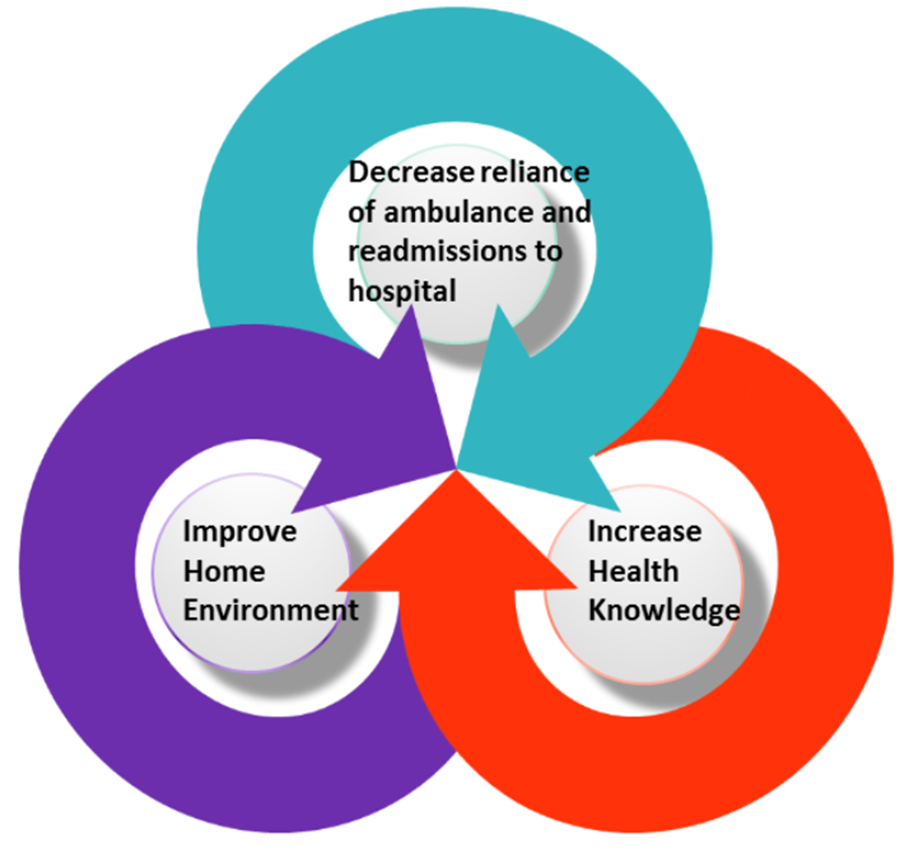

Slide 19
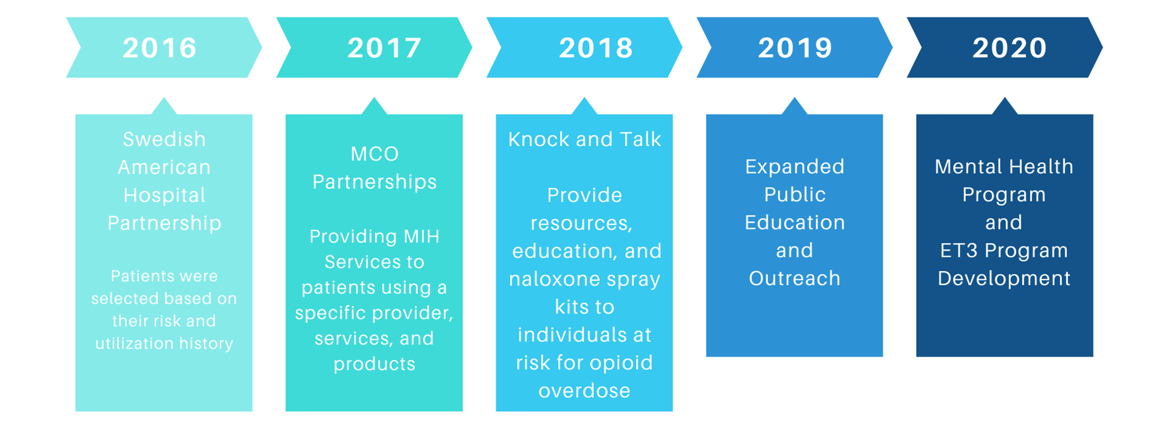

Slide 20
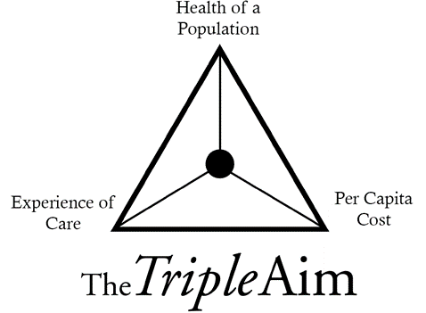
Key Components of MIH
Recognized as the multidisciplinary practice of medicine
Team based
Educationally appropriate
Consistent with the Institute for Healthcare Improvement’s IHI Triple Aim philosophy
Financially sustainable

Slide 21
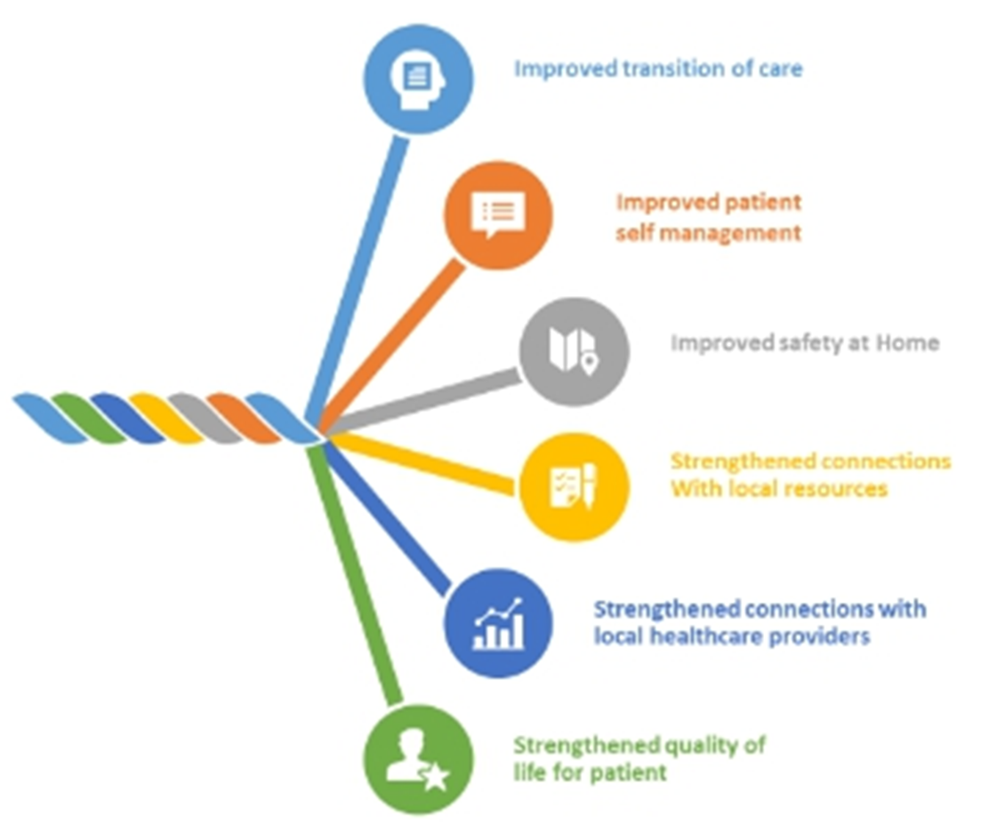

Slide 22
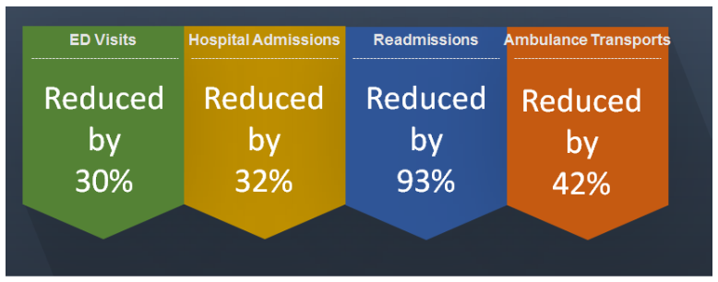
Measuring Success

Slide 23

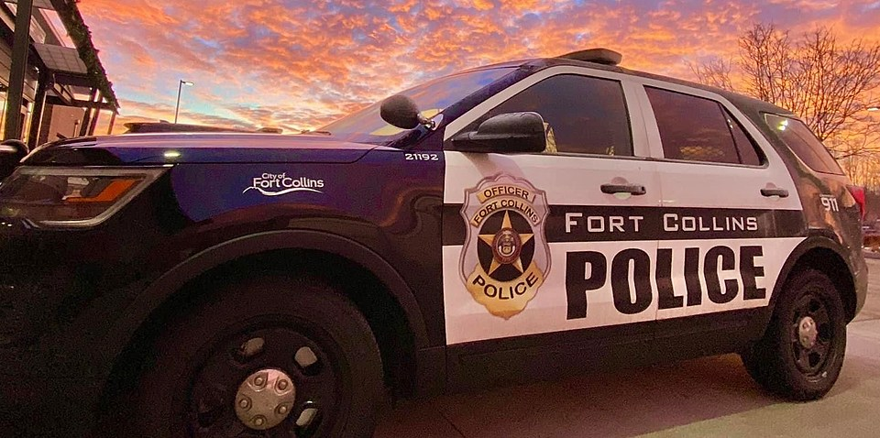

Poudre Fire Authority Programs
Partnerships with Police Department Co-Responders
Licensed Clinical Social worker for Fire Authority
Sharing of patient outcomes to address high utilizers

Slide 24
Thank you!

