Slide 1
The Evolving Community Survey - Common Problems with Traditional Surveys and How They Can Be Avoided?
Jonathan R. Lewis, ICMA-CM, County Administrator, Sarasota County, FL
Lee R. Feldman, ICMA-CM retired, Senior Advisor, Zencity

Slide 2
The Importance of Surveys
Jonathan R. Lewis, ICMA-CM, County Administrator, Sarasota County, FL

Slide 9
Not Your Bubbie’s Survey
The Future of Surveys
Lee R. Feldman, ICMA-CM retired, Senior Advisor, Zencity

Slide 10
We know that
But
Surveys are an essential tool
Surveys have been carried out for centuries
Surveys continue to have an important role to play in local governance
Surveys have been done one way for too long
Surveys can and need to be updated to fit the here and now
Notes:
Surveys are essential to local governance and have been done for centuries
But because they have been done for so long, doesn’t mean we can’t envision them anew
Surveys have been done one way; how do we re-envision surveys for our current reality?

Slide 11
So, how do we re-envision surveys?
What are the common mistakes we still make when surveying our communities?
How do we create more efficient, effective, and adaptable surveys?
Notes:
Surveys are essential to local governance and have been done for centuries
But because they have been done for so long, doesn’t mean we can’t envision them anew
Surveys have been done one way; how do we re-envision surveys for our current reality?

Slide 12
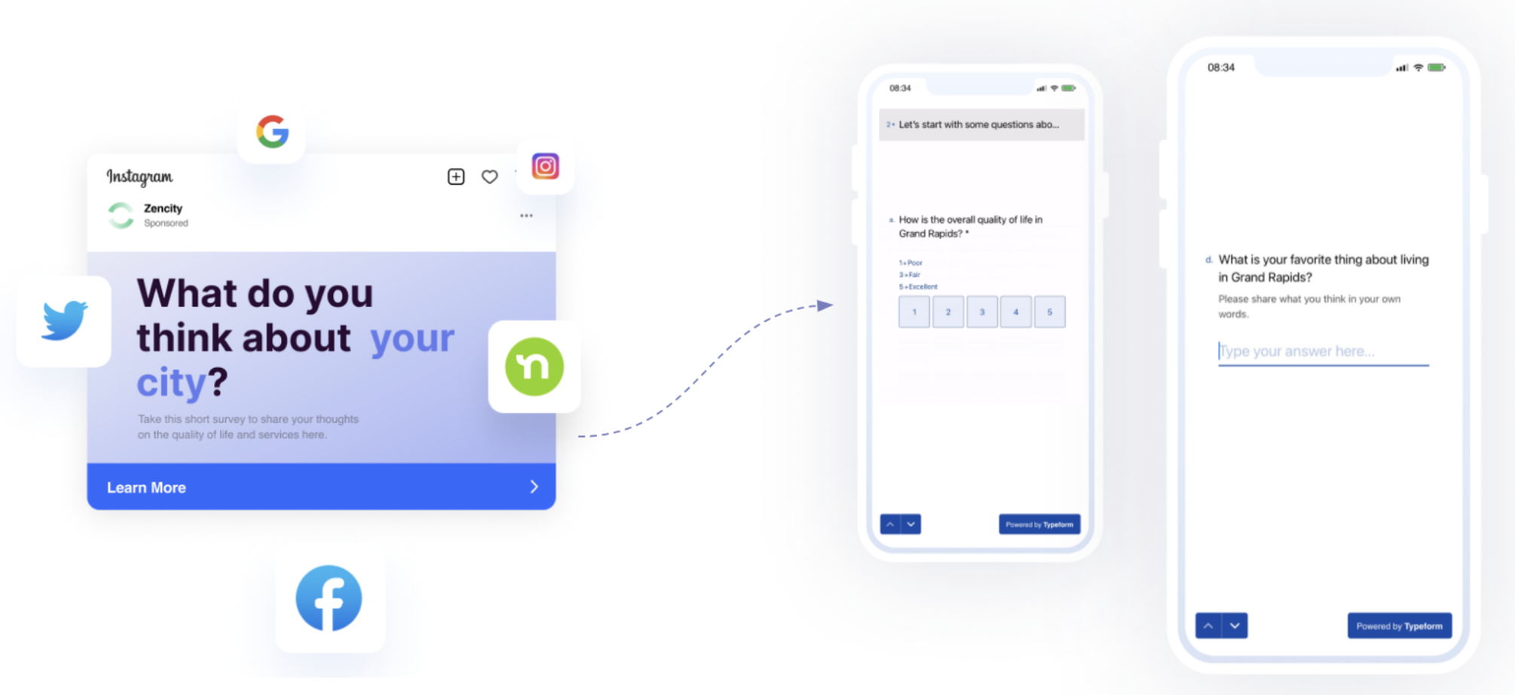
1 Sampling
Your Bubbie’s survey
Surveys of the future
Traditional surveys use probability samples, which may miss people who aren't on some list (people who move often or tend to be younger) and could miss people who choose to not respond.
Non-probability surveys can help fill this gap by reaching more people, especially those hardest to reach.
Notes:
Surveys have been used to measure public sentiment for nearly a century. These more traditional surveys would identify a list of people or houses, draw a random sample from that list, and contact those individuals or households. This worked well for much of the 20th century, whether by mail, telephone, or in person.
But times have changed. For decades now, response rates have declined. So even if you're contacting 1000 people from your list, maybe 100-200 will respond.
And even further, the people who appear on the list that's used might be different from people who aren't on those lists. If you have a list of households, you could be more likely to miss people in multi-unit apartment buildings or other renters--people who tend to be younger and are more likely to be people of color.
Nonprobability samples can address these limitations and provide a sample that is representative of the population of a city. We reach people where they are--on their devices.

Slide 13
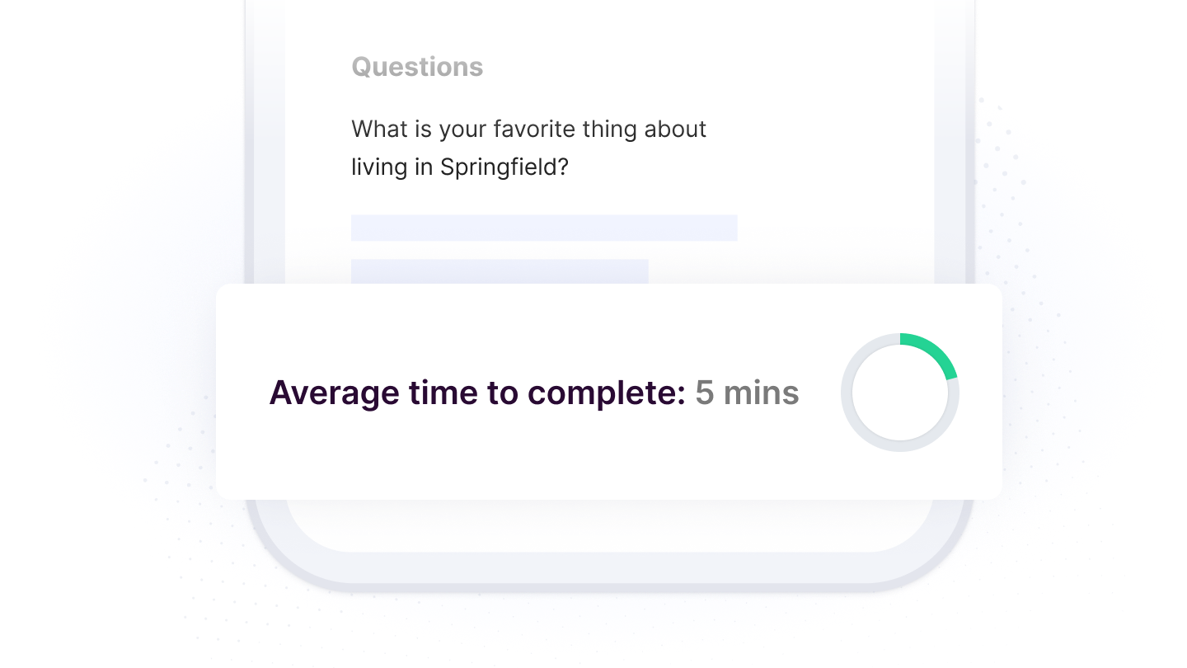
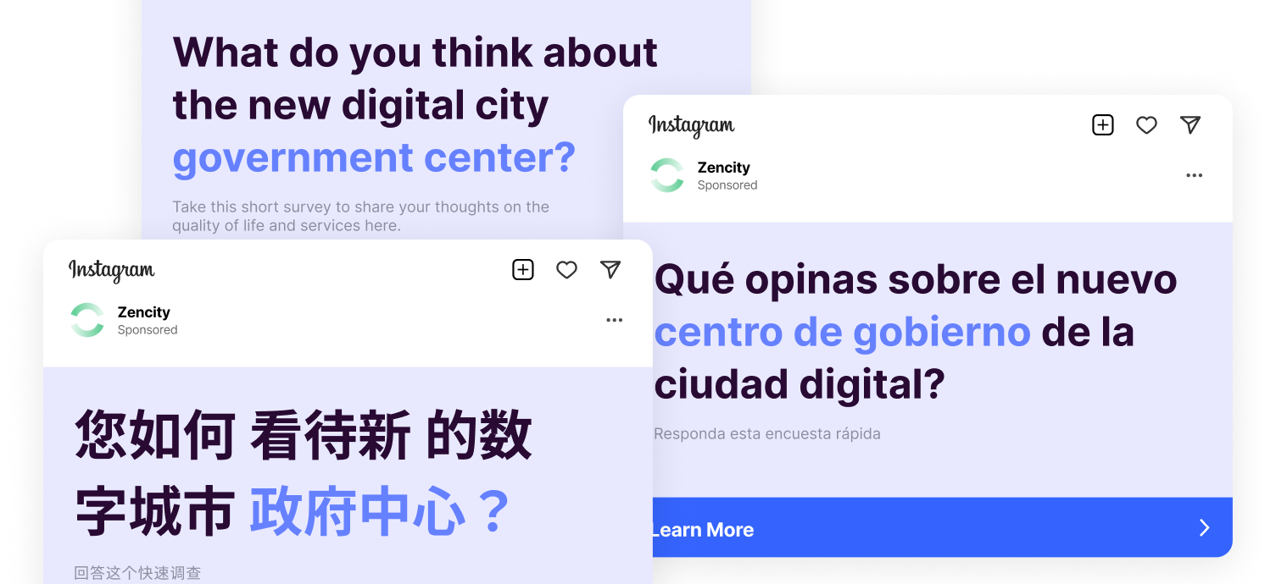
2 Inclusivity
Your Bubbie’s survey
Surveys of the future
Traditional surveys rely on distribution methods that leave out many people who don’t have a permanent address or a landline and are not likely to post their response back.
Surveys that find people where they are (most often, on their phones and tablets) and on the apps and websites they frequent, will enjoy a more diverse set of responses.
Notes:
Use the same distribution strategy and reach the same people - Diversify our survey distribution and collect more inclusive and diverse feedback by finding people where they already are and through the websites/devices they use most often

Slide 14
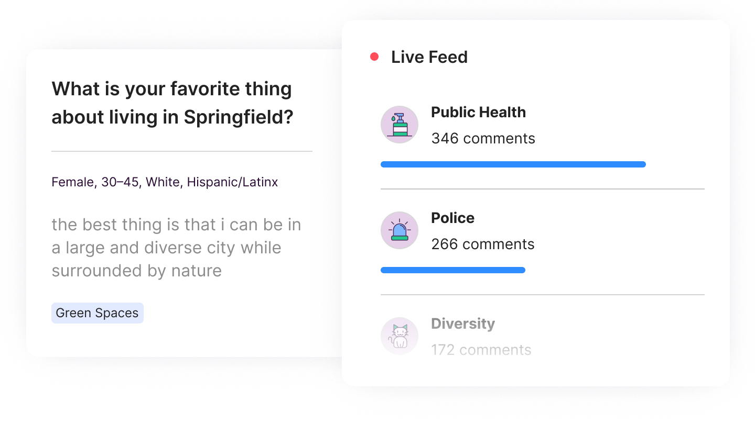
3 Effort and Resources
Your Bubbie’s survey
Surveys of the future
Traditional surveys are a heavy lift and resource-intensive; between survey design, distribution, collection, and analysis, by the time we get to making decisions, the data has gone stale.
Technology (digital distribution, automatic response collection, and AI-based data analysis) saves time that can be used to focus on the survey’s takeaways rather than the survey itself.
Notes:
We spend so much time and effort on designing the survey, distribution and collection, and analysis, that by the time we get around to make decisions and implement them, the data is already stale. Solution: Technology and AI can help us better utilize our resources so we can spend our time focusing on the survey’s takeaways rather than the survey itself (making the survey the means, not the ends).

Slide 15
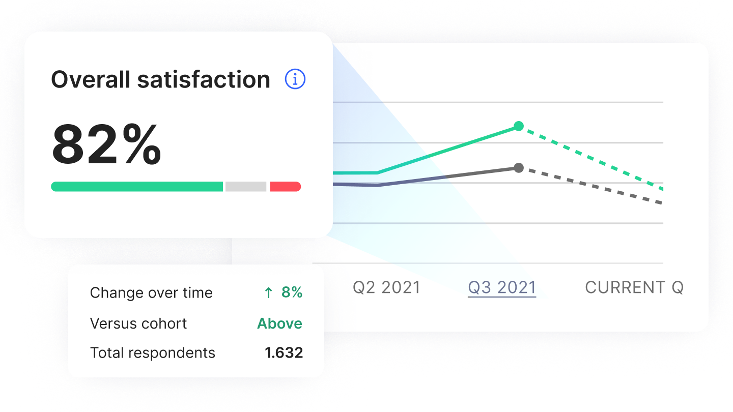
4 Cadence
Your Bubbie’s survey
Surveys of the future
Traditional surveys are usually run bi-annually, annually, or less - making it harder to be limber and responsive to the survey’s findings, which take “forever.”
A higher cadence, always-on surveys, and real time dashboard showing results as they come in, provide insight into public sentiment throughout the survey’s progress - not just when it concludes.
Notes:
Because of the resource-intensive aspect, we run surveys on a cadence that prevents us from being responsive and limber. Solution: With a higher cadence, an always running survey and a IRL dashboard, we can identify trends before they become problems, and have fresh data all the time.

Slide 16
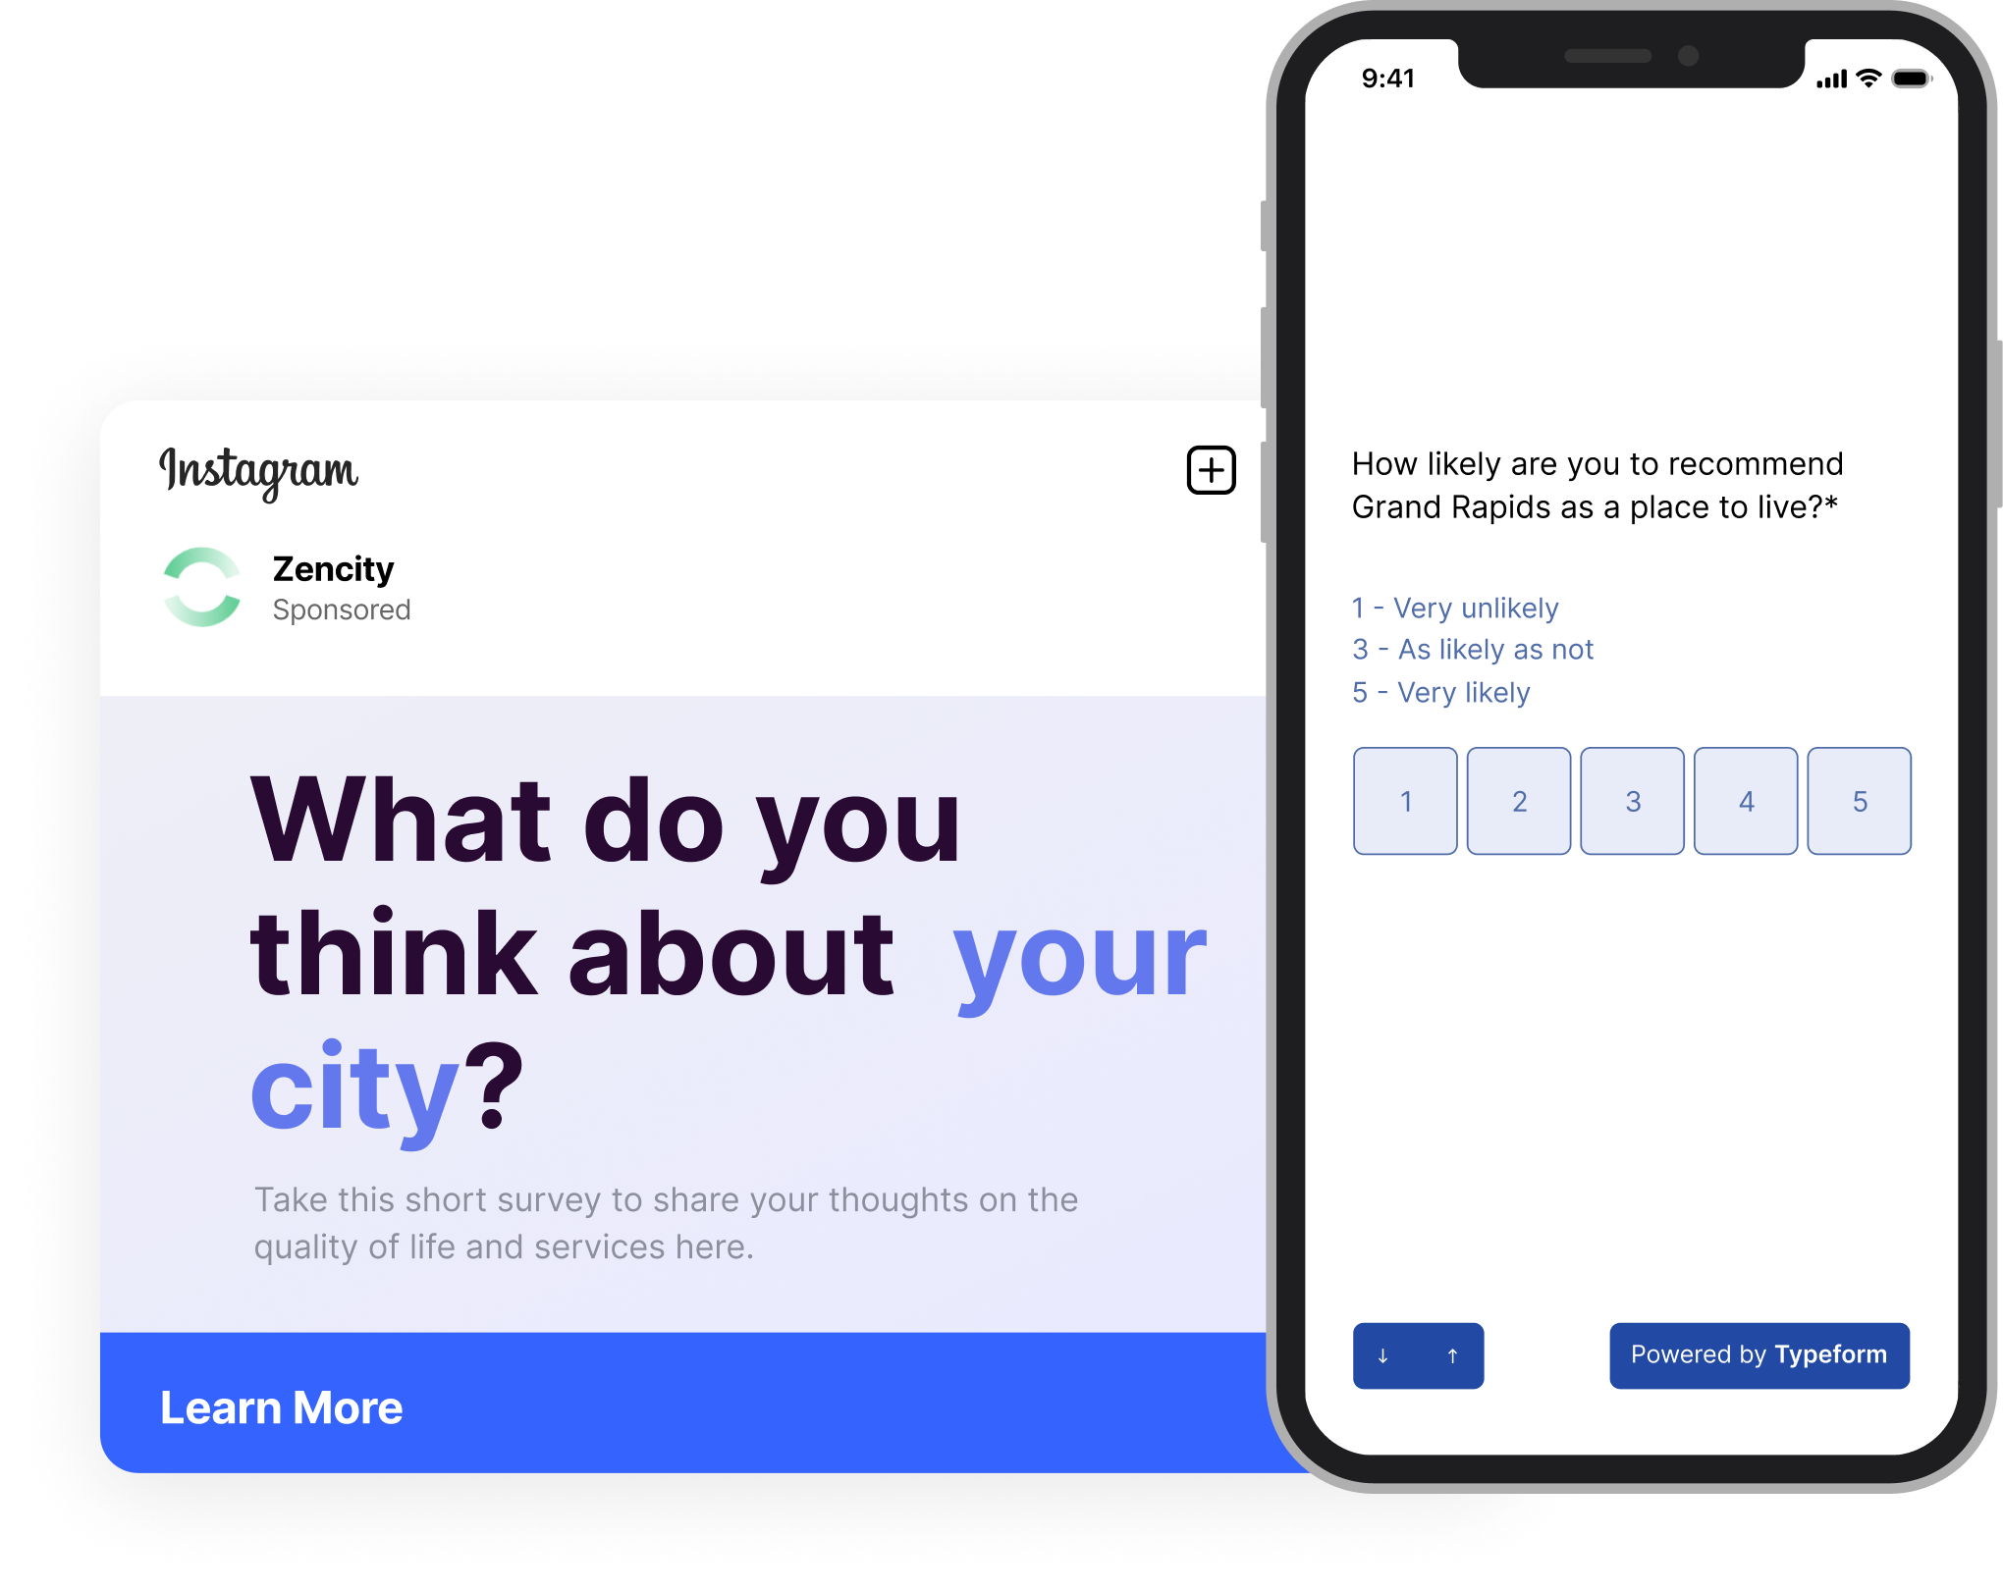
5 The future of surveys
The future of surveys is not less surveys, but better surveys.
More technology-based
More efficient and light on their feet
More inclusive and accessible
More representative
More frequent
More actionable

Slide 17
Discussion and Questions

