Slide 1
Assistant Chief Administrative Officers Roundtable: Public Discourse, Media Shaping and Reputation Risk Management May 11, 2023

Slide 2
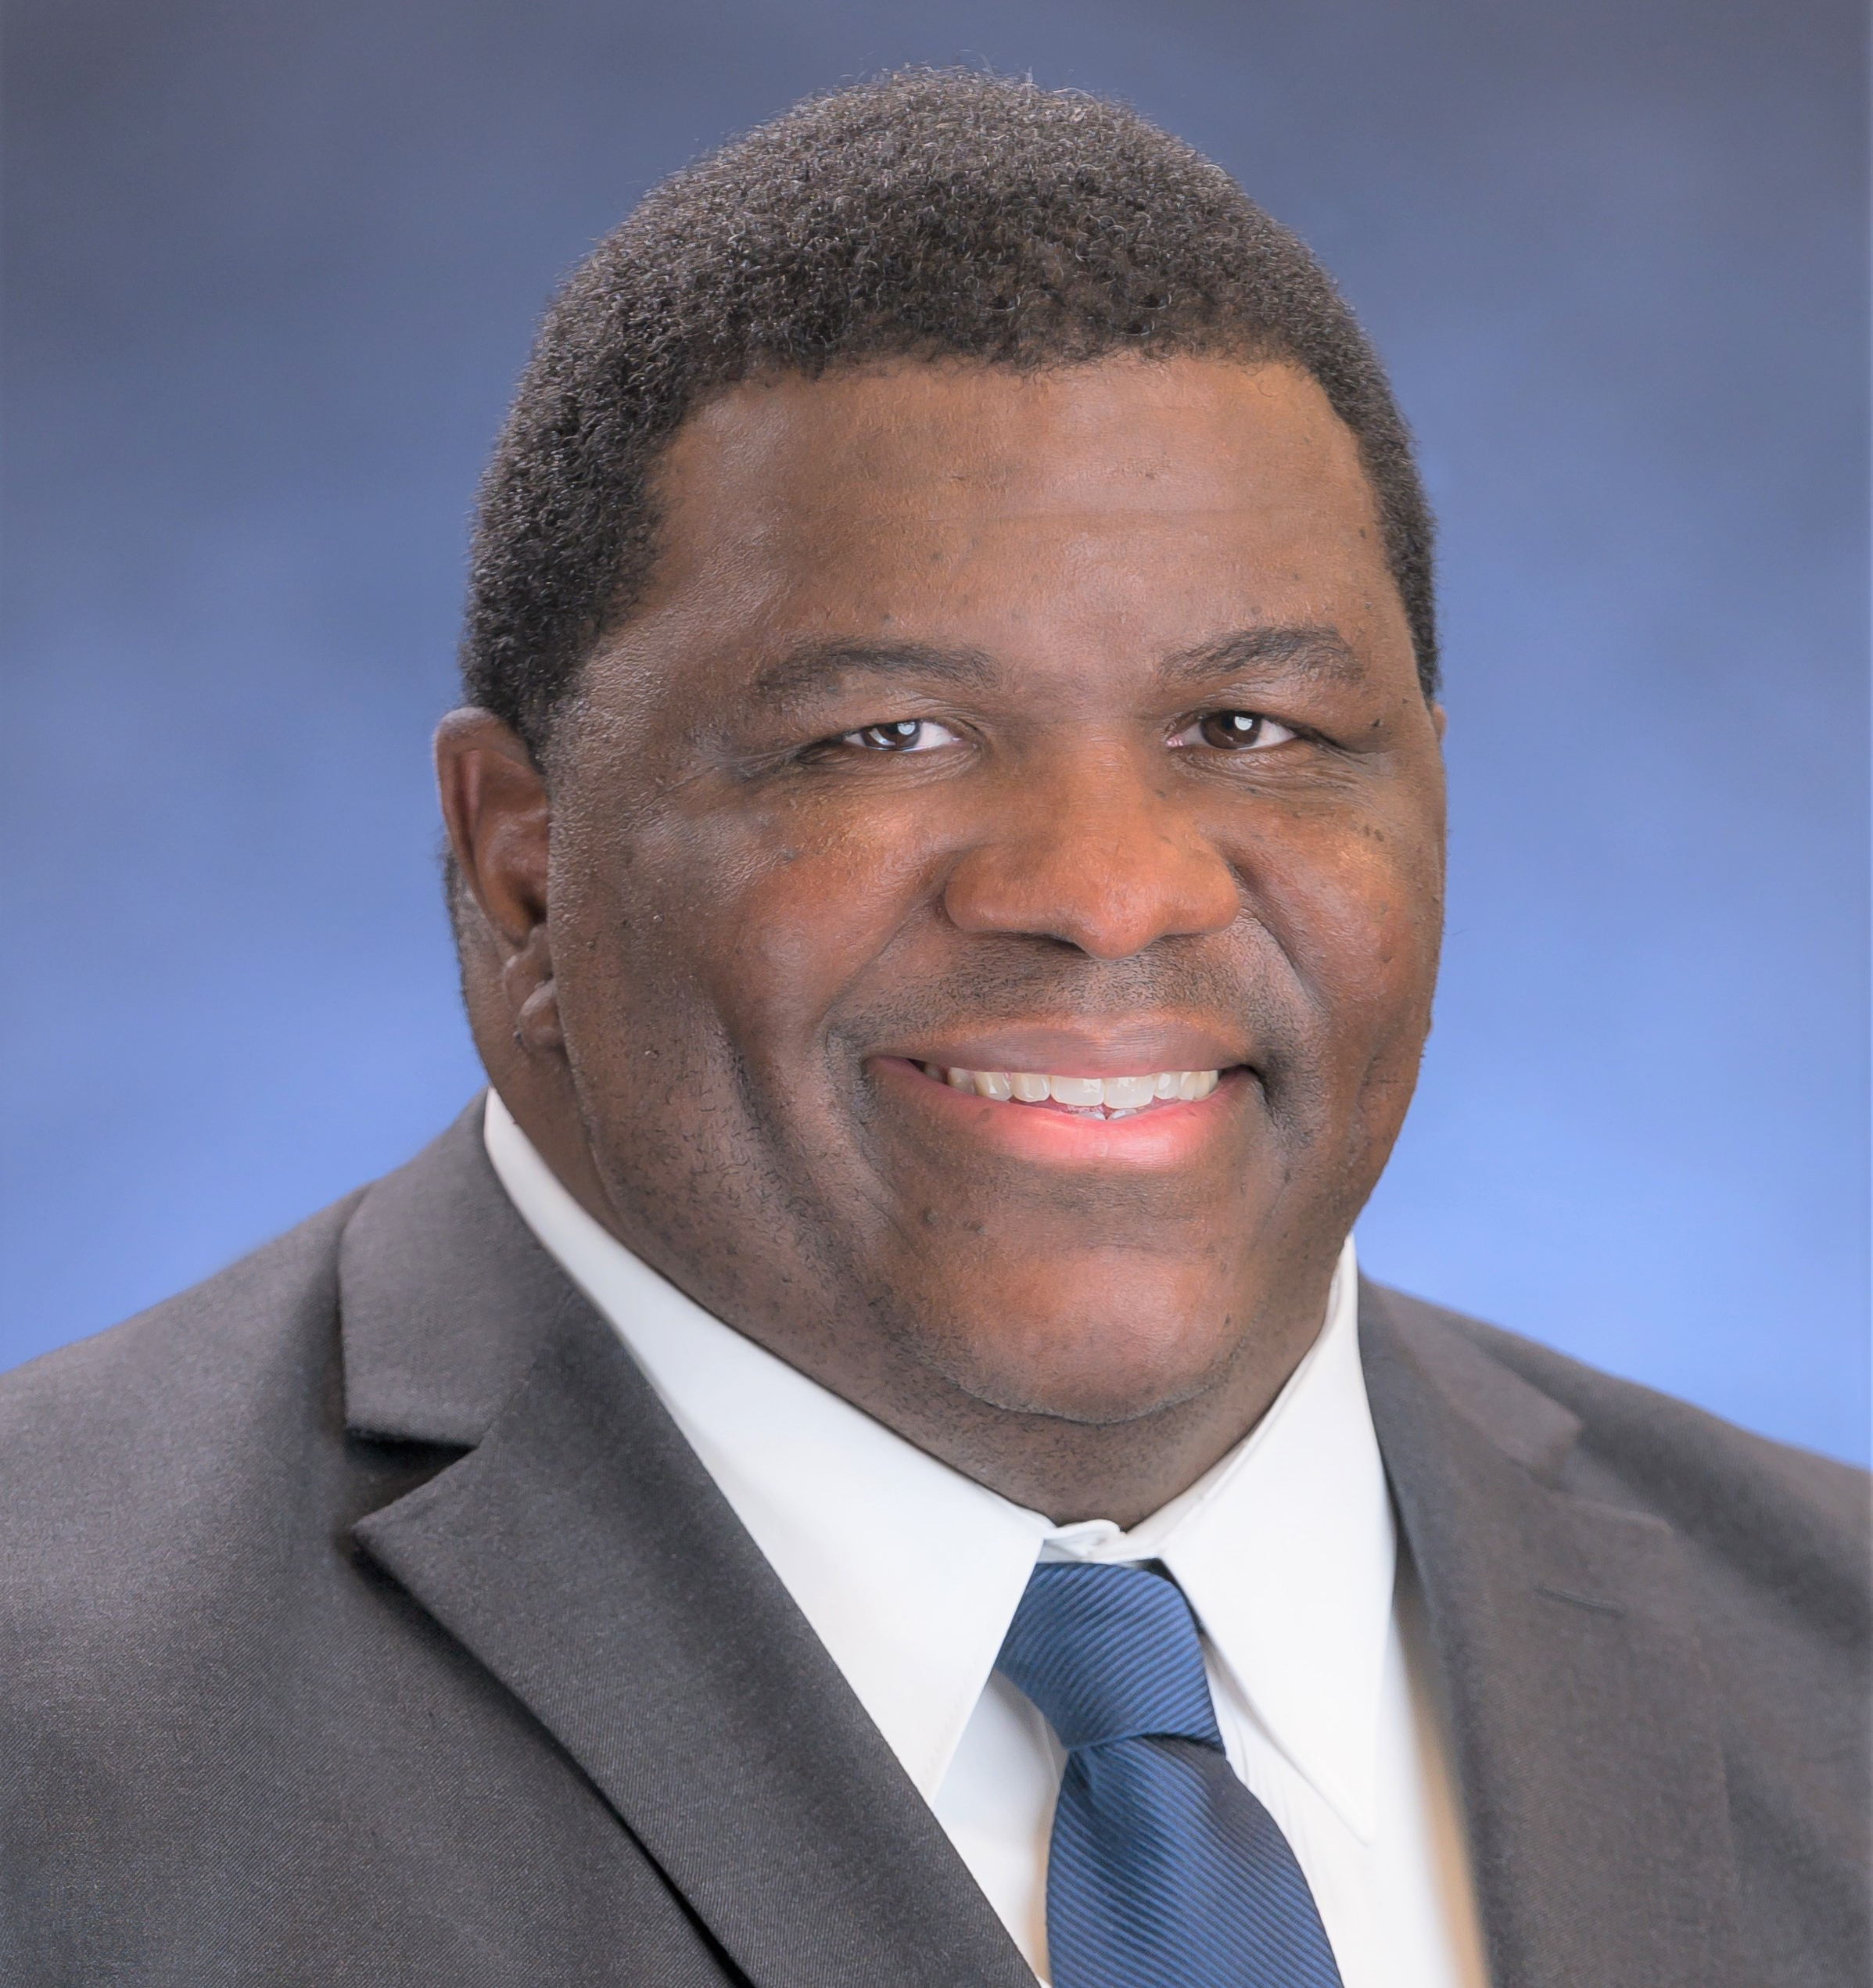
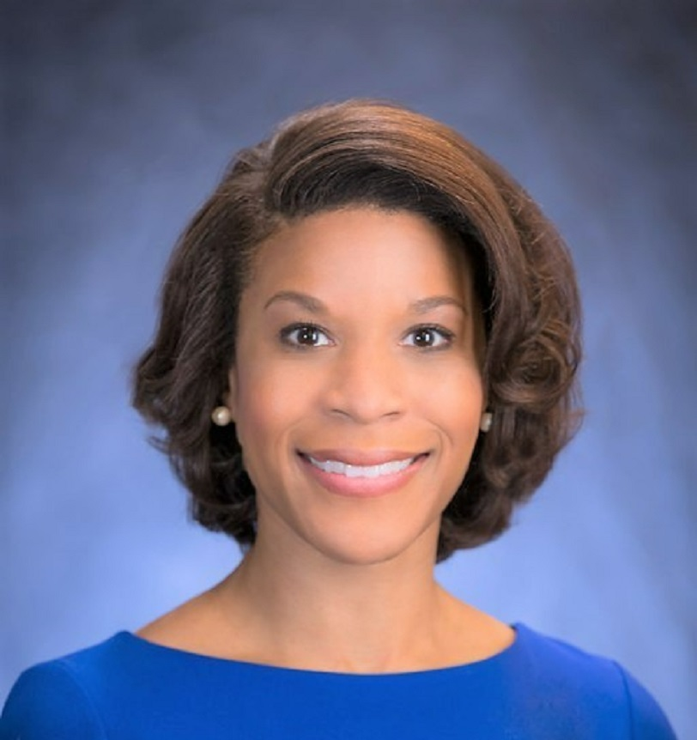
Panelists and Moderator
Mary Frances Forcier, Ph.D.
Deputy Public Affairs & Communications Officer
Carl Rush,
MBA, M.Ed
Chief Equity Officer
Monica Spells,
MPA, ICMA-CM
Assistant County Administrator

Slide 3
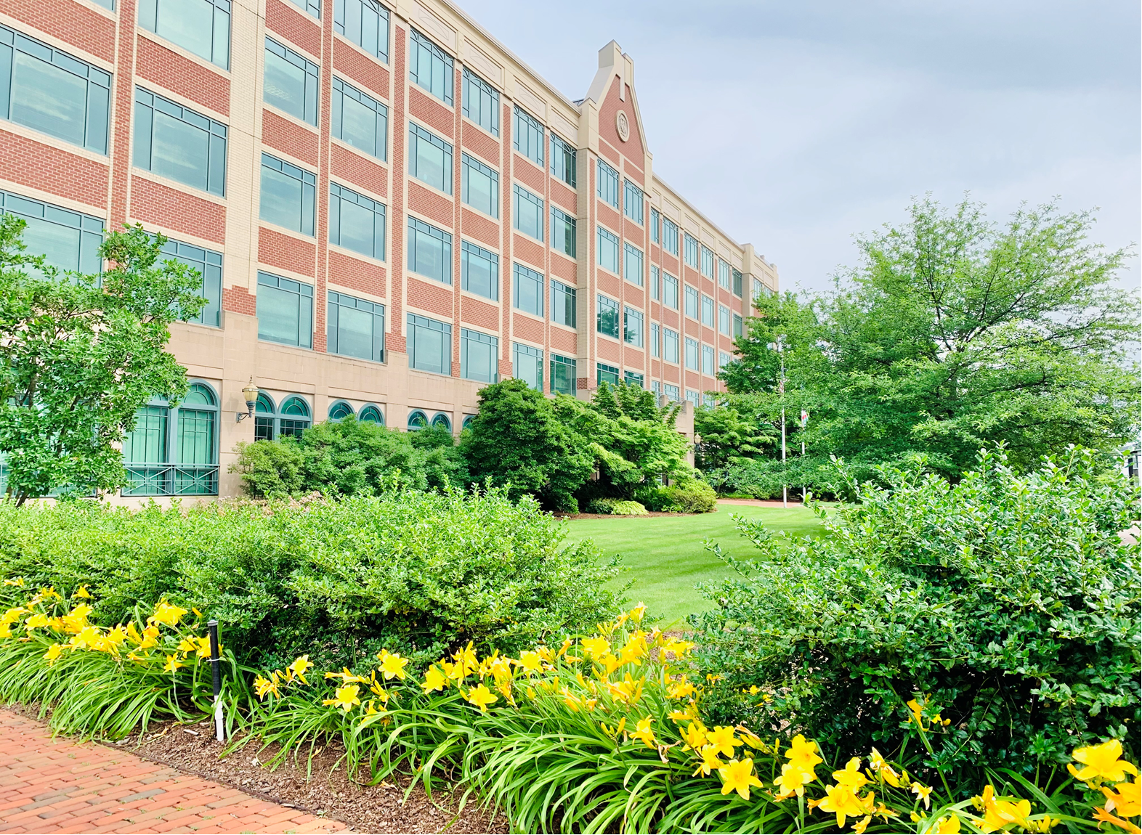
Loudoun County: What does the data tell us?
Dramatic growth and economic prosperity
In the 2020 Census, Loudoun saw the most growth of any jurisdiction in the Northern Virginia region.
34% increase – 108,000 people – since 2010. Now 420,900 residents.
Added 196 positions in FY23.
$4.2 billion adopted budget and 4,000+ employees for FY24.

Slide 4
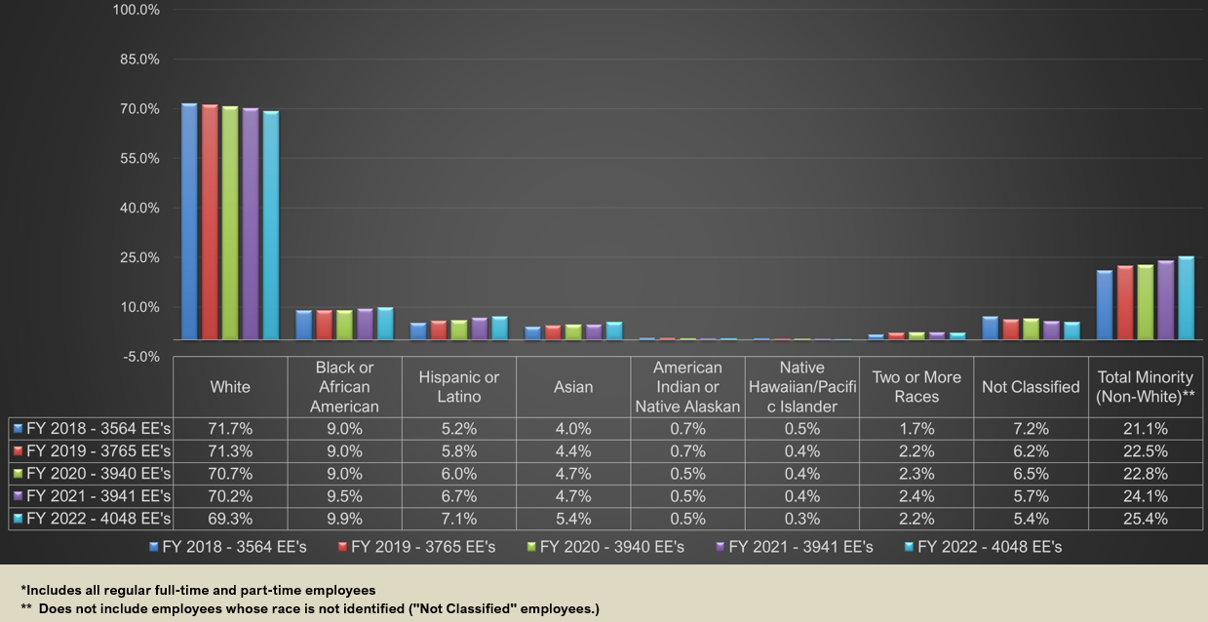
Loudoun County’s Employees by Race/Ethnicity 5-Year Trend

Slide 5
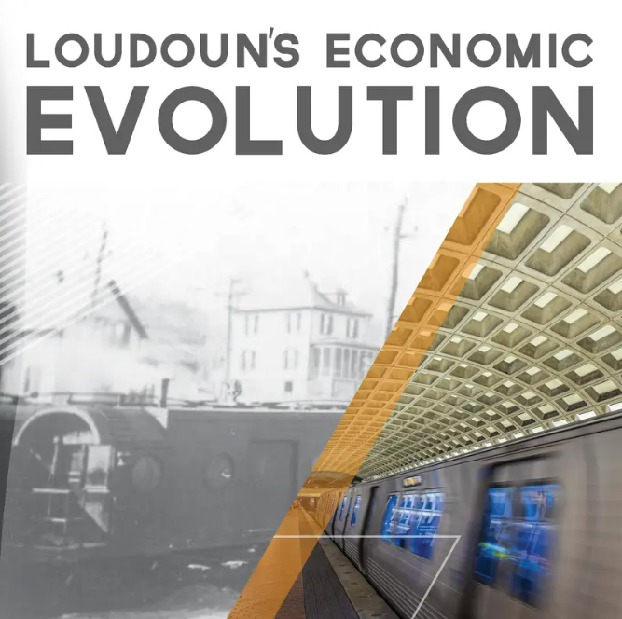
Loudoun County: What does the data tell us?
Dramatic growth and economic prosperity
Home to the largest and fastest growing data center hub in the world.
Over the past decade, has attracted industry leaders like Amazon, Verizon Business, Google, Facebook and Salesforce to invest in major facilities.
Home to Dulles Airport & Metrorail Silver Line.
Ranked as the top county in Virginia for business growth for several consecutive years.

Slide 6
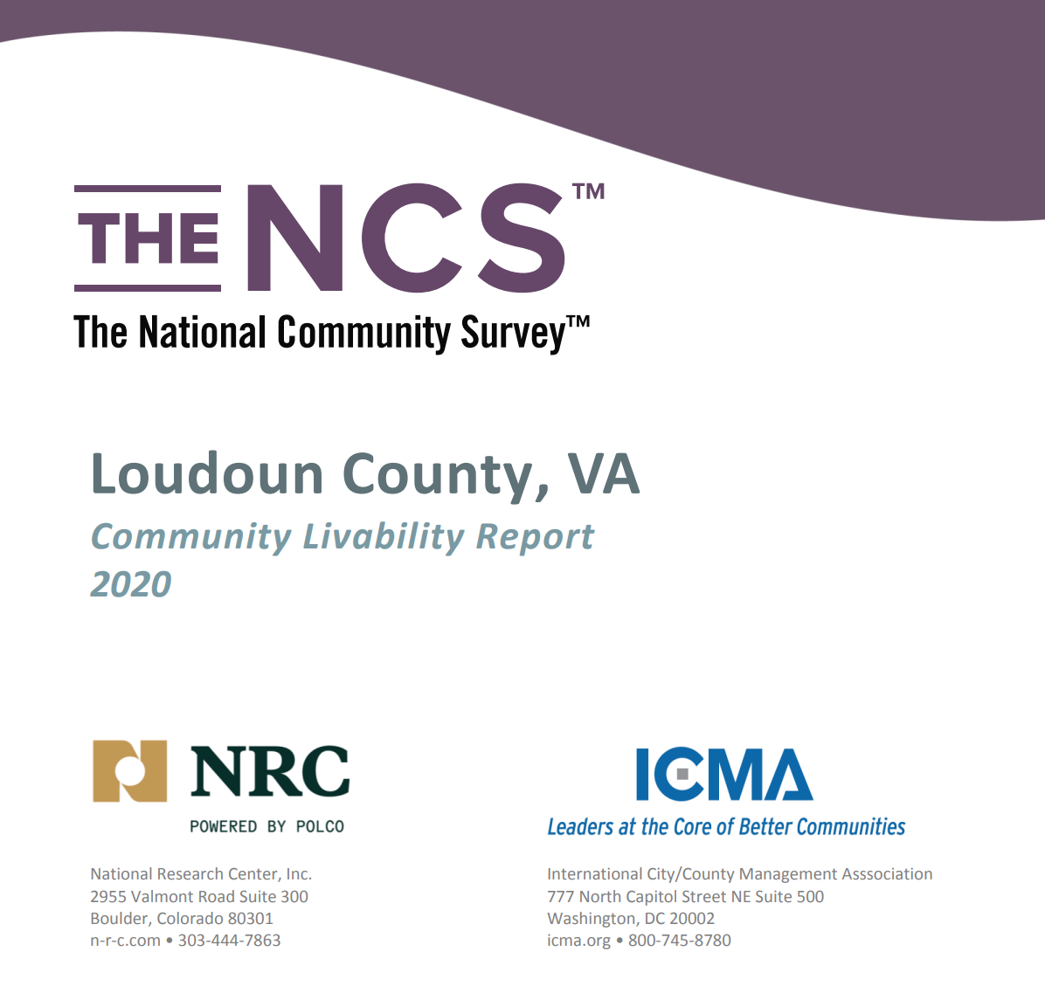
Loudoun County: What does the data tell us?
2020 Survey of Residents: about 9 in 10 residents gave excellent or good ratings to the overall quality of life in the county
High ratings for safety, economic health, and as a place to raise children.
About 85% gave favorable marks to the overall image or reputation of the county, which was higher than the national average.
At least 8 in 10 respondents would recommend living in Loudoun County to someone who asked and planned to remain in the county for the next five years.

Slide 7
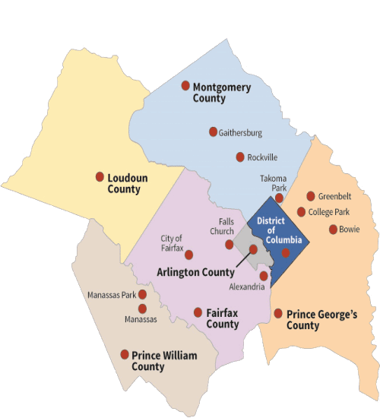
Loudoun County: What does the data tell us?
Characterized as the “happiest large county in the United States.”
Loudoun residents “get more for their money than people in any other county in Virginia.”
Ranked the "healthiest county in the Commonwealth of Virginia."
Ranked the "richest county in the U.S." based on median household income.
Sources: SmartAsset, Robert Wood Johnson Foundation and the University of Wisconsin Population Health Institute, and U.S. News.

Slide 8
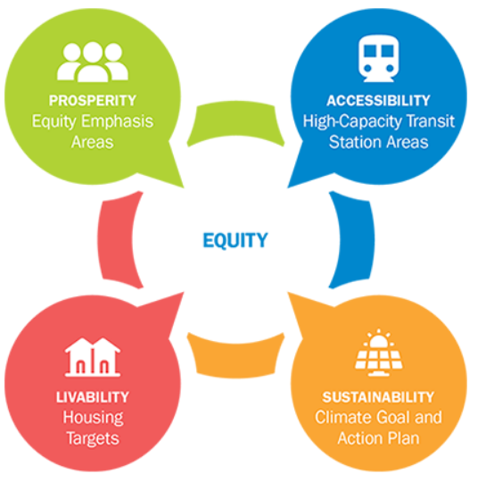
Region United: Loudoun’s Role in the Region
To address key, interconnected challenges and advance the region’s vision for a more prosperous, accessible, livable, and sustainable future, the Metropolitan Washington Council of Governments has set planning priorities for the next decade related to equity, transit and land use, housing, and climate change.
Taken together, these priorities form Region United: Metropolitan Washington Planning Framework for 2030.

Slide 9
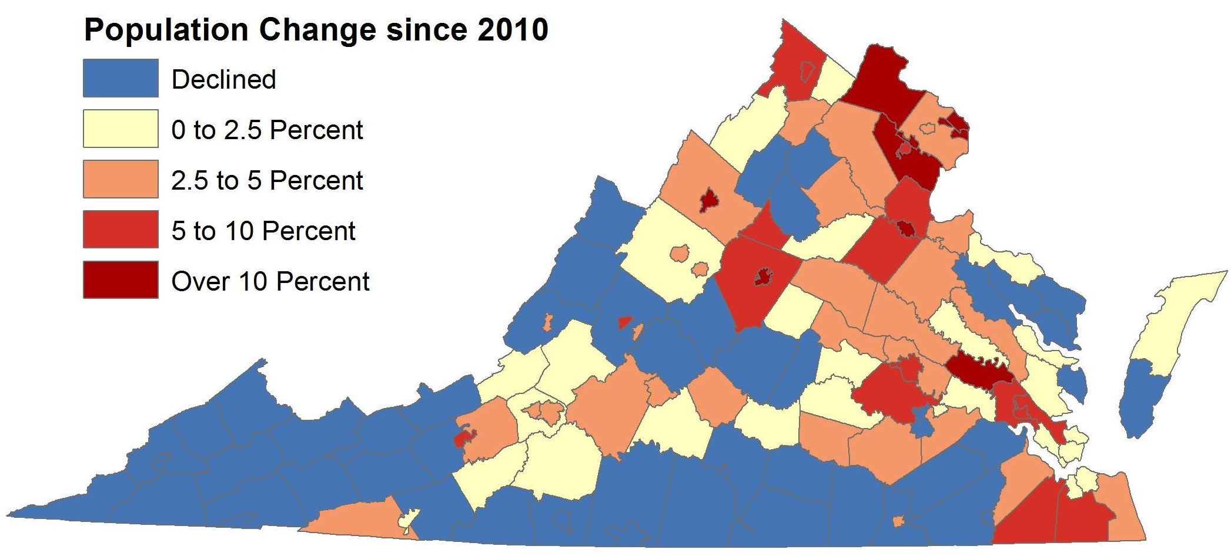
The Growing Pains of Rapid Growth
Rising housing prices
Providing affordable housing
Creating viable transportation options
Keeping up infrastructure
Different strategies to effectively serve more diverse residents

Slide 10
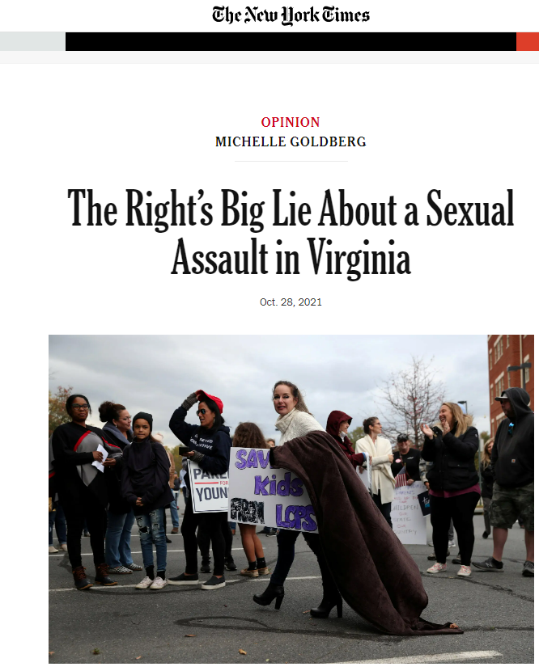
Loudoun County: What does the media tell us?
A quick scan would cast doubt on the county’s reputation for satisfied residents,
excellent schools, safe communities, and outstanding quality of life.

Slide 11
Loudoun County's approach
Establish a baseline of current perceptions & trust
Analyze media coverage: Where is it originating? What is it saying?
Assess social media: ongoing issues, or “one-off” flashes?
Assess reputational risk
Community surveys
Interviews with decisionmakers: elected officials, economic development professionals, business leaders
Is the “threat” real? How long does it last? What sector of government is it focused on?
What is the potential impact on government operations?
Commit to civility and demonstrate it daily
Elected officials, front-line customer service staff, meeting management: all are important
Focus on civility, transparency and opportunities to participate
Inform and guide communications
Correct misperceptions; don’t overreact
Work with elected officials and leadership to understand the landscape and respond effectively

Slide 12
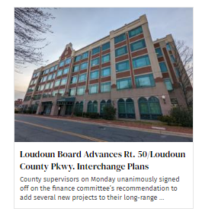
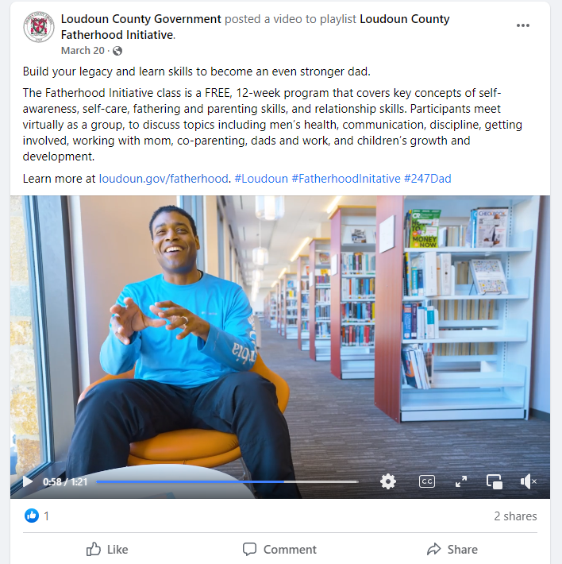
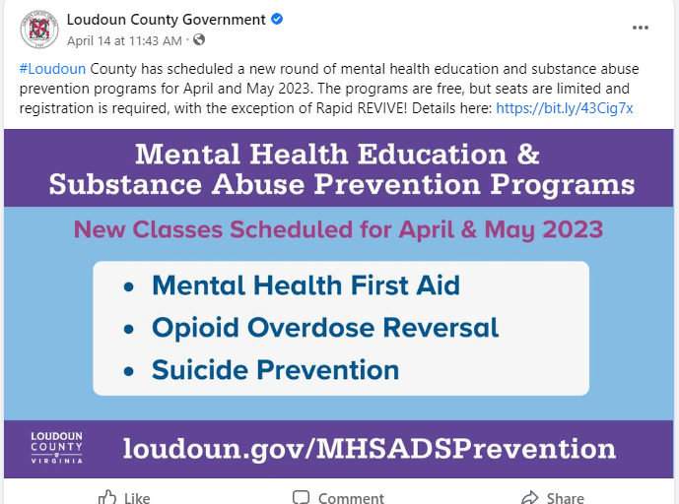
Keep telling the day-to-day story

Slide 13
Audience Discussion
What impact does the current climate have on your city or county, civic life in your community, and the region’s economy?
What trends are occurring that could affect the organization, either positively or negatively?
Why is reputational risk important for cities and counties?
What do most of your residents really believe about their local government?
How can we build and maintain trust?

Slide 14
MaryFrances.Forcier@loudoun.gov Carl.Rush@loudoun.gov Monica.Spells@loudoun.gov

