Slide 1
Help for Local Democracy May Be As Close As Your Nearest University

Slide 2
Part 1: General Introductions & Today’s Roadmap

Slide 3
Today’s Presenters
David Collinsworth
Adjunct Instructor/Executive-in-Residence, Ohio University Voinovich School of Leadership and Public Service
Charles Hartgrove
Director – Virginia Institute of Government (VIG)
Megan Hasting
Continuing Education Specialist, Glenn College of Public Affairs, The Ohio State University

Slide 4
Today’s Roadmap
Panelist Presentations
Dialogue: Challenges & Solutions
Wrap-Up & Takeaways

Slide 5




5 ways that CUPSO organizations provide value
Provide students with opportunities to learn about and participate in the public policy process
Improve policy making by providing credible research and evaluation information
Improve government management practices through training and technical assistance
Develop leadership skills among city, county, state, and regional government and nonprofit leaders
Notes:
Upskill – employers see MAPS as an investment in developing their leadership pipeline
Employee wellness – renewed emphasis on employee wellbeing, personal development courses
Fill gaps in employer-training
Support performance objectives (Peer to Supervisor)
Reinforce lifecycle of leadership (leaders keep learning)

Slide 6
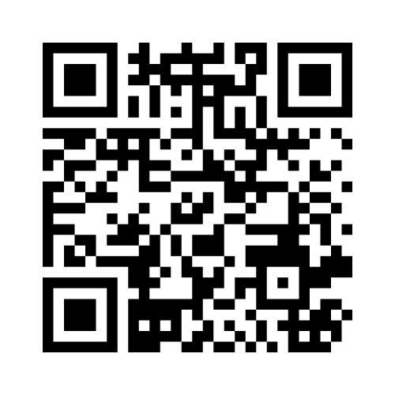
What is one thing you want to learn from today’s session?
Go to: www.menti.com
Enter Code:
View results

Slide 7
Part 2: Panelist Presentations

Slide 8

Dave Collinsworth
Adjunct Instructor/Executive-in-Residence
Ohio University Voinovich School of Leadership and Public Service

Slide 9
Background
32-year career in city management in Ohio
Retired 2021 after 13 years as city manager of Westerville, Ohio (home to Otterbein University)
Post-public service career options
Ohio University’s Voinovich School of Leadership & Public Service/Voinovich Academy
  Elected Official Training
  Community Mental Health Initiative
  Juvenile Crime Collaboration

Slide 10
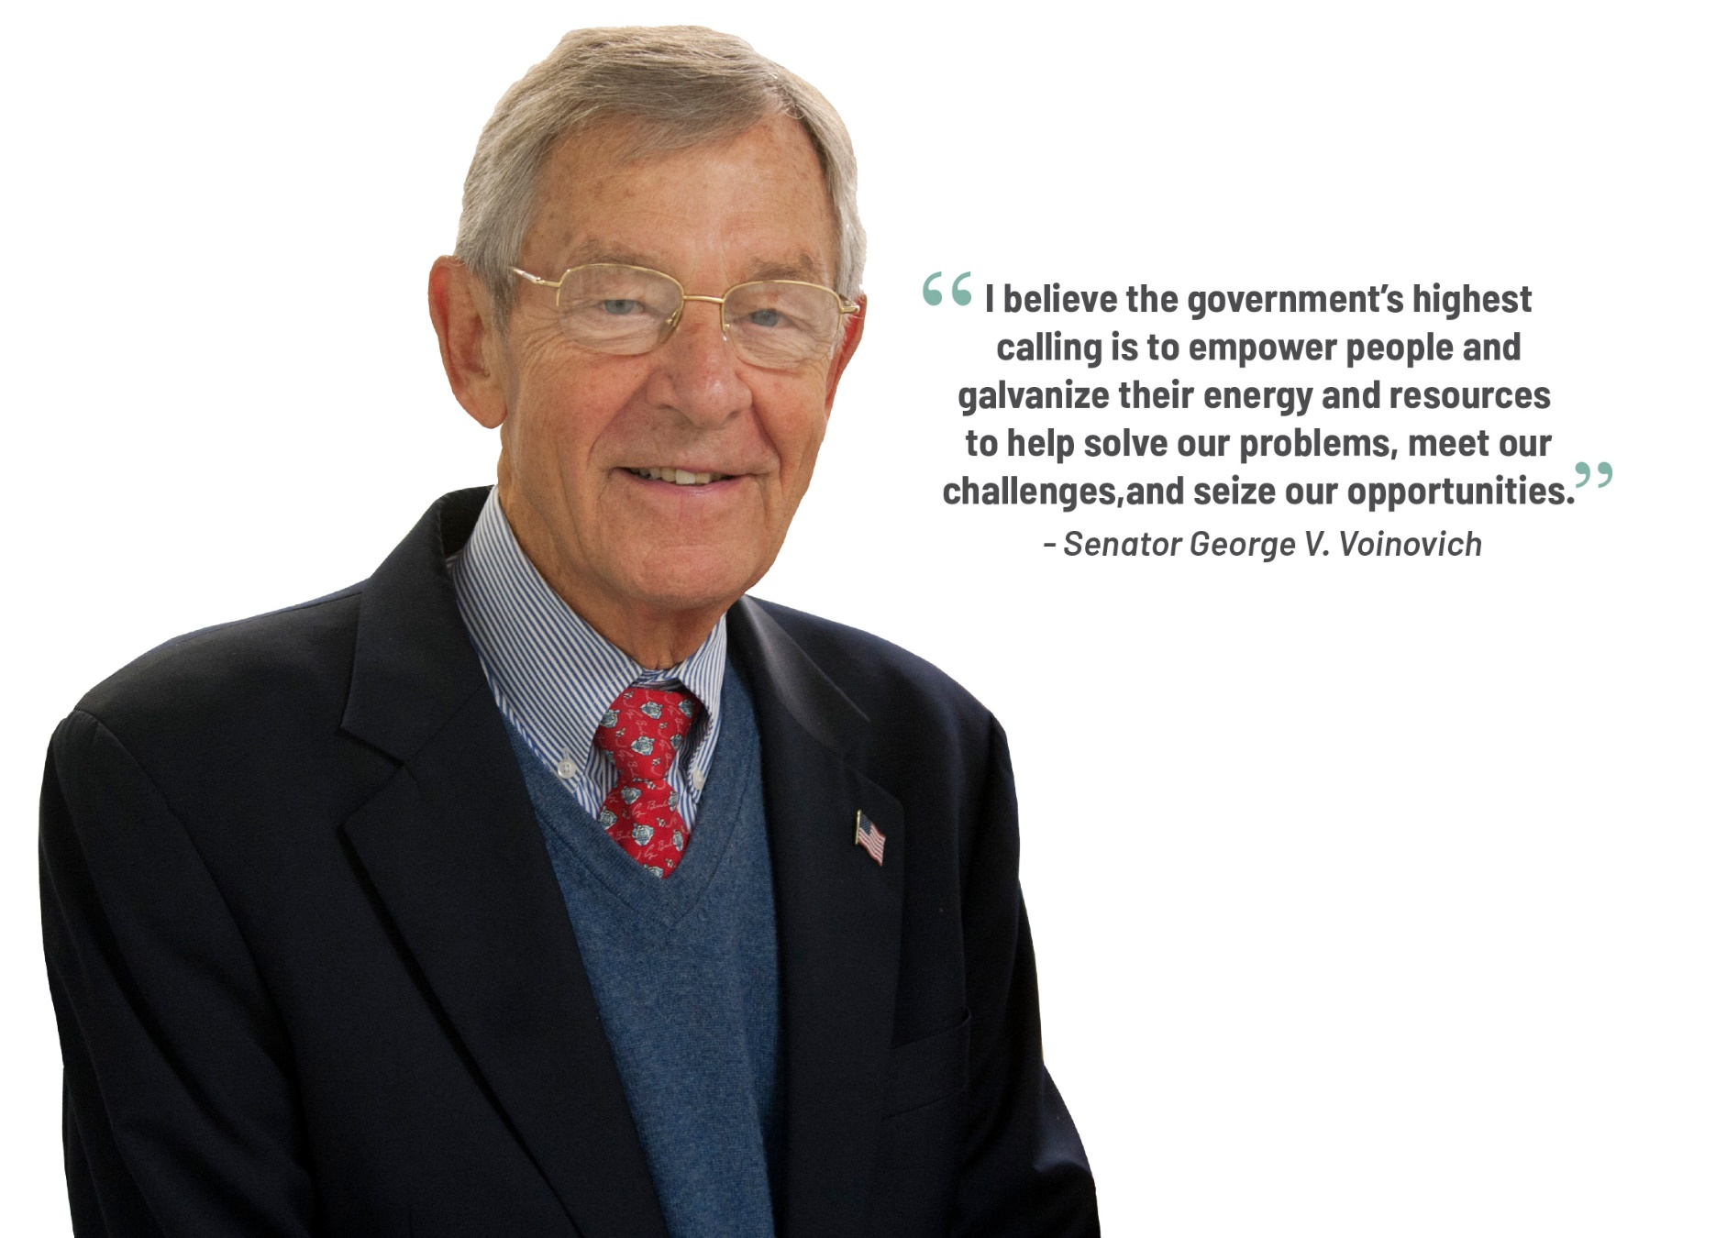
Voinovich
Academy
Vision

Slide 11
Voinovich Academy Mission & Strategy
The Voinovich Academy builds public service leadership capacity in our region and state so that those in public service have the tools to make a difference.
Build and develop partnerships
Develop tailored leadership programs
Respond to emerging needs

Slide 12
Build & Develop Partnerships: Rise & Thrive
Voinovich Academy (VA) engaged with other University partners on state funded grant concerning community mental health and wellness
Focus on Town-Gown Initiatives
Identified successful models for collaboration to improve mental health outcomes
  Steering Committee
  Survey of Colleges/Universities & hosting jurisdiction (cities/towns)
  Analysis and identification of successful cooperative models
  Town-Gown Workshop to highlight models & promote collaboration

Slide 13
Develop Tailored Leadership Programs: Governing Essentials for Local Elected Officials
Inquiry to VA to create program for newly elected officials
Created advisory group to design curriculum
Launched Governing Essentials in Feb. 2021
Program Design
  Six “Modules” – 2 full day & 4 half-day; 3 in person & 3 “virtual”
  Key Concepts: Governance, E.D., Finance, Communications, Safety, Public Works, Ethics
  Instructor base – experienced practitioners in fields
  Target – new or relatively new elected officials (cities, townships, counties)
  56 participants to date over three cohorts
  Over 90% of participants “highly recommend” program to colleagues

Slide 14
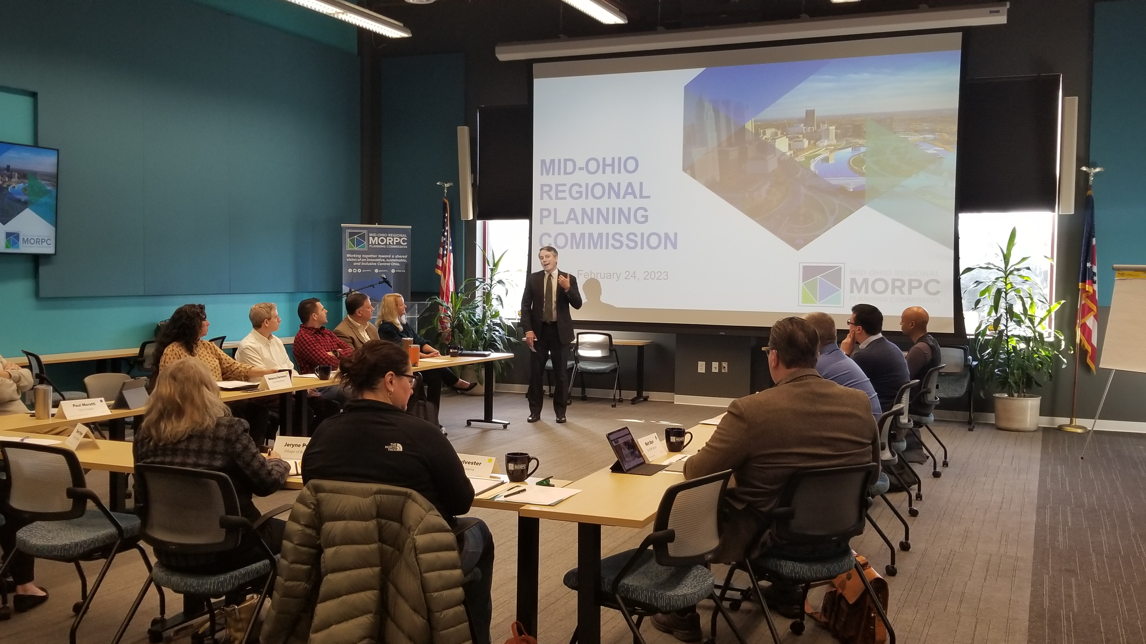
2023 Cohort

Slide 15
Respond to Emerging Needs: Juvenile Crime
KIA Boys
Frustrated Law Enforcement
Engagement by Regional Chiefs and Central Oho Mayors & Managers
Invitation to County leadership and Juvenile Court to Discussion
VA serving as convener and facilitator
First Session held end of April

Slide 16
University Partnerships Key Takeaways
Many large state universities have “centers for local government” to assist communities
These resources can often be less expensive than traditional consultants
At community level, collaboration begins with intention; requires care & feeding
The time to get to know your college/university leadership is not during a crisis

Slide 17
Charles Hartgrove, ICMA-CM
Director – Virginia Institute of Government (VIG)
www.vig.coopercenter.org
Previously served as Chief Deputy Commissioner – Virginia Department of Taxation
Former town manager and deputy city manager leading Virginia communities for over 20 years: Lynchburg, Ashland, Middleburg, and Gate City

Slide 18
Weldon Cooper Center for Public Service (WCCPS)
Reimagining Public Service
Vision: Resilient Virginia communities shaped by the people who live there.
Mission: To empower Virginians to promote the well-being of their communities through practical, policy relevant research, and training for effective and inclusive leadership.

Slide 19
Business Units - WCCPS
Center for Economic and Policy Studies
Center for Survey Research
Demographics Research Group
Sorensen Institute for Political Leadership
Virginia Institute of Government

Slide 20
What is the Virginia Institute of Government (VIG)?
VIG was created in 1994 by the General Assembly
Director manages the daily operations of VIG
Approximately 235 Virginia cities, towns, and counties are active members
Membership dues to VIG are based on population of locality

Slide 21
VIG’s Mission
VIG strives to serve as the central navigator for Virginia communities to assist in building governance capacity and developing dynamic leaders at all levels of local government across the country. This will be achieved by curating a portfolio of services, partnerships, and best practices that provide value to our members.

Slide 22
VIG’s Services
Virginia local government professional/technical support
Houses the Senior Executive Institute (SEI) and Leading, Educating, and Developing (LEAD) professional development programs for local governments throughout the United States and beyond; specifically designed for chief administrative officers, deputies/assistants, and department heads/senior managers
Provides the Constitutional Officer Education Program for treasurers, commissioners of the revenue, and their staffs
Consulting Services - board/council retreats, leadership team development, strategic planning, diversity, equity, and inclusion, etc.

Slide 23
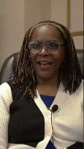
Video:

Slide 24
VIG’s Partners
Partner with the Virginia Municipal League (VML), Virginia Association of Counties (VACO), Virginia Local Government Management Association (VLGMA), Virginia First Cities, and the International City/County Management Association (ICMA) to serve the needs of both elected and appointed local government leaders

Slide 25
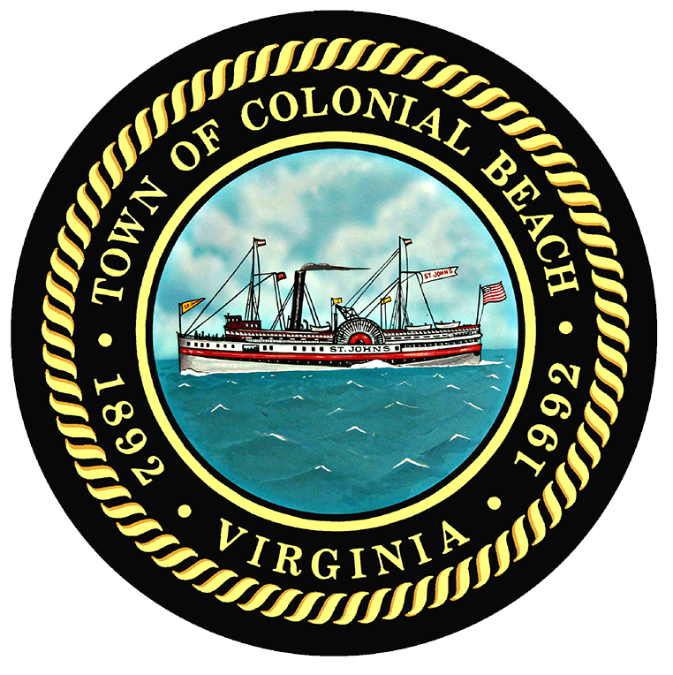






VIG’s Clients
Virginia local govs consulting

Slide 26
Megan Hasting
Continuing Education Specialist, OSU Glenn College of Public Affairs

Slide 27

Committed to delivering continuing education for public and nonprofit professionals across a lifetime of leadership in public service

Slide 28
Supporting a Lifetime of Leadership in Public Service
1. Awareness
2. Growth
3. Maturity
4. Legacy
5. Transition
Emerging Leaders (Internships)
Retiring Leaders (succession planning, change management)
Direct Contributors (upskill high potential employees)
Senior Leaders (executive academies)
Mid-Career Leaders (management & teambuilding training)

Slide 29
Supporting a Lifetime of Leadership in Public Service
1. Awareness
2. Growth
3. Maturity
4. Legacy
5. Transition
Emerging Leaders (Internships)
Retiring Leaders (succession planning, change management)
Direct Contributors (upskill high potential employees)
Senior Leaders (executive academies)
Mid-Career Leaders (management & teambuilding training)

Slide 30

Our Programs
TRAINING WORKSHOPS
Management Advancement for the Public Service (MAPS)
Ohio Registered Election Official Certification
Professional Fundraising Certificate
Custom Training
STATE OF OHIO LEADERSHIP INSTITUTE
Democracy Camp
Ohio Government Internship Program
PROGRAMS FOR OHIO WOMEN EMPOWERED TO REPRESENT
NEW Leadership
Ready to Run Campaign Training
Women of POWER
POWER Commission
CERTIFICATE PROGRAMS
Public and Nonprofit Leadership
Public and Nonprofit Leadership - Veterans
EXECUTIVE EDUCATION
Public Leadership Academy for Elected Officials
Public Safety Leadership Academy for Law Enforcement
Notes:
Not to go through the programs one-by-one, but to share a few characteristics of CUPSO programs more widely:
Breadth and depth to program offerings
Designed with specific stakeholders and audiences in mind
Skill-specific

Slide 31
Aligning Local Government Challenges with Program-Specific Solutions
Audience | Core Objectives | Partners | Program(s)
County elections officials | Provide workforce training to ensure fair and accurate elections for all Ohioans | County Boards of Elections Ohio Association of Election Officials | Ohio Registered Elections Officials Program
Local and state level elected leaders | Build deeper understanding of policy issues and lasting relationships across political boundaries. | OSU Government Affairs Party Chairs in Ohio | Public Leadership Academy
Law enforcement officers | Offer leadership training to senior law enforcement officers from across Ohio | Ohio Department of Public Safety Ohio State Highway Patrol | Public Safety Leadership Academy
Public service professionals | Provide practical management and leadership skills to build a leadership pipeline | Local and State Government Nonprofits Public Agencies | Certificate in Public and Nonprofit Leadership; MAPS Skills-Based Training

Slide 32

Benefits of partnering with your local university:
Maximizes expertise & retains talent
Drives economic development
Creates pathways for consistent collaboration
Deepens learning opportunities for all stakeholders
Notes:
Leverage the power of college towns – The connection between universities that create knowledge and communities that develop leaders create incubators for a creative synergy; not pursuing this places you at a competitive disadvantage
Having a university located in the community is a draw for diversity and talent, with young professionals drawn towards the opportunities and offerings unique to college towns

Slide 33
Part 3: Discussion & Takeaways

Slide 34
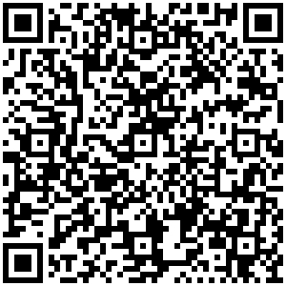
CUPSO Resource List & Member Directory
Notes:
Leverage the power of college towns – The connection between universities that create knowledge and communities that develop leaders create incubators for a creative synergy; not pursuing this places you at a competitive disadvantage
Having a university located in the community is a draw for diversity and talent, with young professionals drawn towards the opportunities and offerings unique to college towns

Slide 35
Audience Questions
Notes:
Leverage the power of college towns – The connection between universities that create knowledge and communities that develop leaders create incubators for a creative synergy; not pursuing this places you at a competitive disadvantage
Having a university located in the community is a draw for diversity and talent, with young professionals drawn towards the opportunities and offerings unique to college towns

Slide 36
Thank you!

