Slide 1
Navigating Polarization: How To Win Friends & Influence People
Tim Rahschulte, CEO
timr@pdaleadership.com

Slide 2
Our work is increasingly challenged due to polarization. Join your peers in this interactive session focused on the best practices emerging to address this challenge. Facilitated by Dr. Tim Rahschulte, CEO of the Professional Development Academy and chief architect of the ICMA High Performance Leadership Academy, this session will detail the cause and effect of polarization and share insights on solutions and ways forward.

Slide 3
Our work is increasingly challenged due to polarization. Join your peers in this interactive session focused on the best practices emerging to address this challenge. Facilitated by Dr. Tim Rahschulte, CEO of the Professional Development Academy and chief architect of the ICMA High Performance Leadership Academy, this session will detail the cause and effect of polarization and share insights on solutions and ways forward.

Slide 4
Best speeches in history include . . .

Slide 5
Martin Luther King, Jr.: I Have A Dream, 1963
Benjamin Franklin: Address to Federal Convention, 1787
George Washington: Inaugural Address, 1789
Thomas Jefferson: Inaugural Address, 1801
Sojourner Truth: Ain’t I a Woman, 1851
Frederick Douglass: The Meaning Of The Fourth Of July To A Negro, 1852
Abraham Lincoln: The Gettysburg Address, 1863
Rudyard Kipling: If, 1895
Franklin D. Roosevelt: The Only Thing We Have To Fear Is Fear Itself, 1933
Lou Gehrig: Farewell To Baseball, 1939
Winston Churchill: We Shall Fight On The Beaches, 1940

Slide 6
Mahatma Gandhi: Quit India, 1942
Eleanor Roosevelt: United Nations Focus On Human Rights, 1948
John F. Kennedy: Ask Not What Your County Can Do For You, 1961
Douglas MacArthur: Duty, Honor, County, 1962
John F. Kennedy: We Choose To Go To The Moon, 1962
Nelson Mandela: An Idea For Which I Am Prepared To Die, 1964
Lyndon B. Johnson: The Great Society, 1964
Robert F. Kennedy: On The Death Of Martin Luther King, 1968
Mother Teresa: Love Begins At Home, 1979
Herb Brooks: Miracle On Ice, 1980
Ronald Reagan: Challenger Disaster, 1986

Slide 7
Barbara Bush: Choices And Change, 1990
Maya Angelou: On The Pulse Of Morning, 1993
Nelson Mandela: Free At Last, 1994
Elie Wiesel: The Perils Of Indifference, 1999
Steve Jobs: You Got To Find What You Love, 2005
General Mark Welch: Are You Ready To Lead, 2011
Stanley McChrystal Leadership Is A Choice, 2012
Clayton Christensen: How Will You Measure Your Life, 2012
Malala Yousafzai: UN Speech, 2013
Matthew McConaughey: 5 Rules For The Rest Of Your Life, 2018
Amanda Gorman: The Hill We Climb, 2021

Slide 8
Best speeches in history are the BEST because . . .

Slide 9
“It is simply impossible to become a great leader without being a great communicator.”
- Matt Myatt, Forbes
Speak not with a forked tongue
Get personal
Get specific
Focus on the leave-behinds not the take-aways
Have an open mind
Shut up and listen
Replace ego with empathy
Read between the lines
When you speak, know what you're talking about
Speak to groups as individuals
Bonus - Be prepared to change the message if needed
Source: 10 Communication Secrets Of Great Leaders, Forbes

Slide 10
Best speeches (period) include . . .
Clarity Confidence Community

Slide 11
Communication . . .
It’s not just what we say.
It’s also what we do and how we do it.

Slide 12
COMMUNICATION FOR LEADERS
why
how
Reporting
Negotiating
Writing
Face-to-Face
One-on-One
Recommending
Collaborating
Telling
Telephone
Team
Influencing
Coaching
Showing
Video
Organization
Deciding
Directing
Engaging
Asynchronous
Community

Slide 13
Communication . . .
It’s not just what we say.
It’s also what we do and how we do it.

Slide 14
The most reputable, supporting, best-place-to-work organization in the world today is: ____________

Slide 15
The most reputable, supporting, best-place-to-work organization in the world today is:

Slide 16
The most reputable, supporting, best-place-to-work organization in the world today is:

Slide 17
“We live in a highly specialized world where it’s easy to overlook the FUNDAMENTALS.”
Thornton May, Futurist

Slide 18
ENGINEER

Slide 19
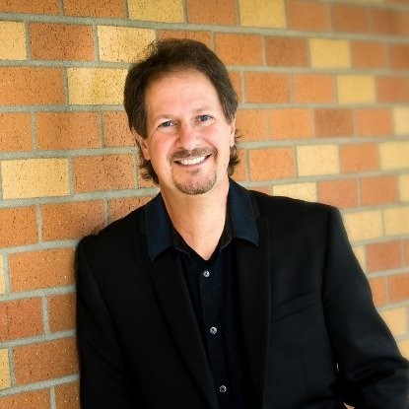
ENGINEER
Russ Martinelli

Slide 20
ENGINEER
Russ Martinelli

Slide 21
ENGINEER
Russ Martinelli

Slide 22
ENGINEER
Who’s going to take care of the PEOPLE?
Russ Martinelli

Slide 23
We live in a highly specialized world where it’s easy to overlook the FUNDAMENTALS.

Slide 24
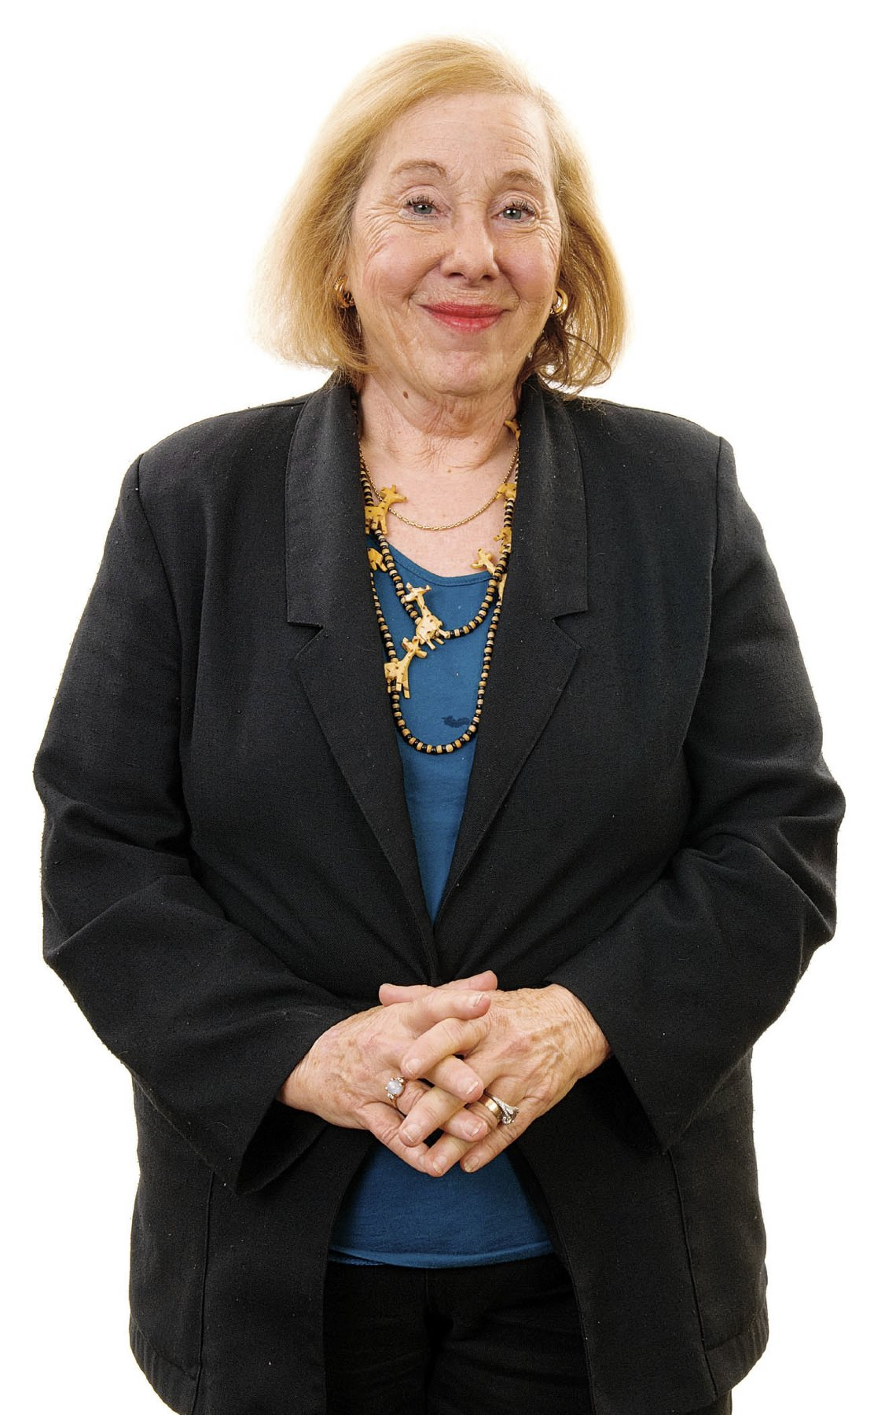
The Fundamentals
The theory of work is simple: PEOPLE SERVING PEOPLE.
Tom Peters Rosabeth Moss Kanter

Slide 25
It takes __________ to form an impression about someone.
<how long?>
Effective communication is the lifeblood of every organization, team, and personal relationship you have, and is the foundation that will determine the success you have in each of them.
1/10 of a second
Notes:
Nothing happens without communication. More specifically, no results will occur without proper messaging aligned to strategy, objectives, and capacity of resources. Regardless of the brilliance of any idea, it must be shared with others to generate value and this requires messaging. The best messaging generates clarity, confidence, and community. The best leaders consider messaging a process of ongoing dialogue.
Lee Iacocca once said, “You can have brilliant ideas, but if you can't get them across, your ideas won't get you anywhere.”

Slide 26
The Fundamentals
What is the most pressing issue you face today?

Slide 27
Leading in Times of Great Change
SUCCESS
SUCCESS
Expect the world push back against your plans.
Plan
TIME
Reality
TIME

Slide 28
What will you do with the world as you find it?
What shows up when you do?

Slide 30
Key Take Away
Focus on getting it right, not on being right

Slide 33
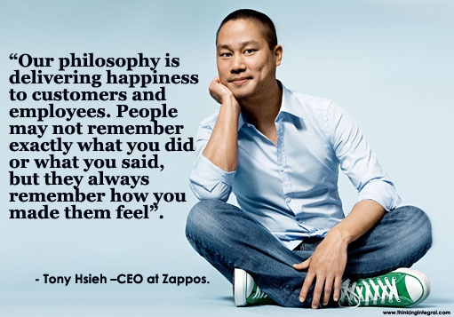

Slide 34
The Fundamentals
What is the most pressing issue you face today?

Slide 35
Elizabeth Kubler-Ross

Slide 38
What do great leaders do?

Slide 40
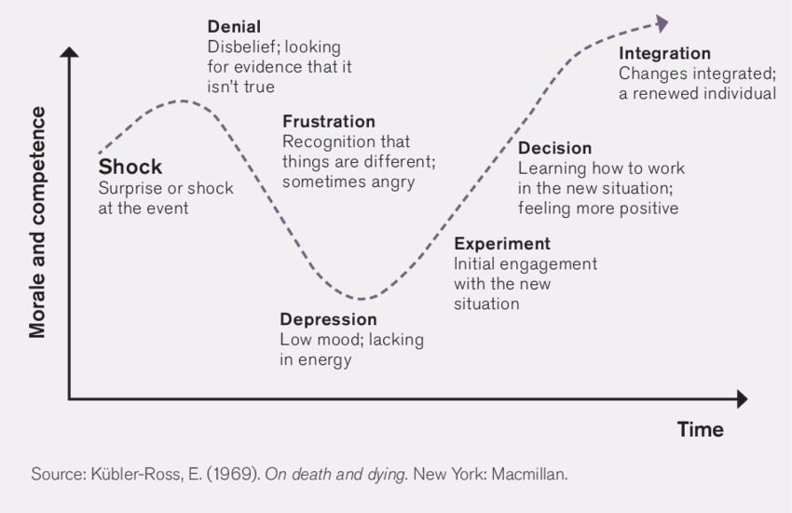
Applied over the years to organizational change

Slide 41
Meet people where they are, not where you think they should be or may want them to be.
Amber Case

Slide 42
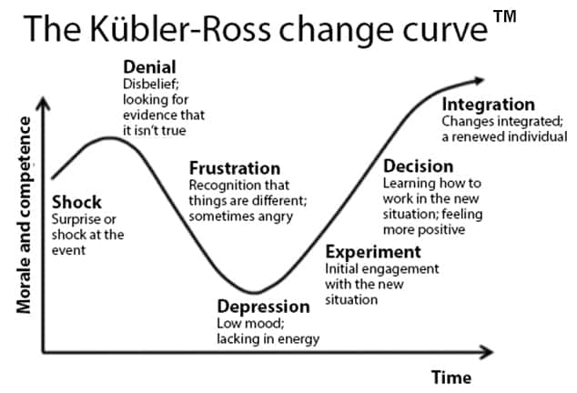
Lead by example.
Encourage praise.
Celebrate wins.
Respond to objections.
Plan for the dip.
Watch and address behavior.
Encourage exploration.
Provide time to test.
Lots of training.
Reinforcement.
Give time to adjust.
Listen to concerns.
Provide empathy.
Create rationale.
Provide care/support.

Slide 43
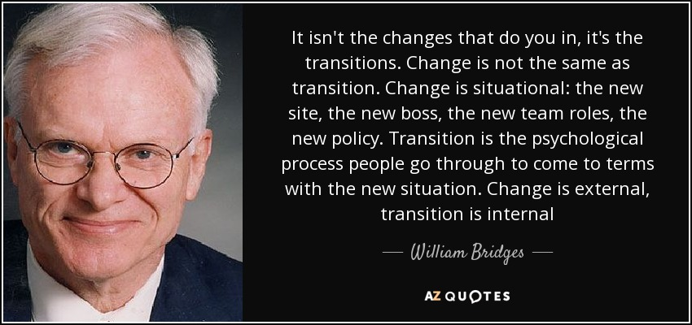

Slide 44
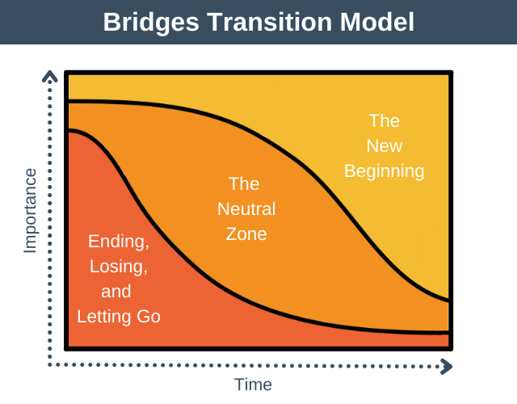

Slide 45
Leading Change By Meeting People Where They Are
List all people who will be impacted by the change
List all the people
Place each person on the list in the corresponding area of the Bridges Transition model on the right.
[Insert name of the change initiative here]
Change Plan
Detail all the possible ways to meet each person where they are and help navigate each person to the future state change – the new beginning as Bridges defines it.
Training
Mentoring
Listening
Clarity of situation
Celebrating wins
. . .

Slide 46
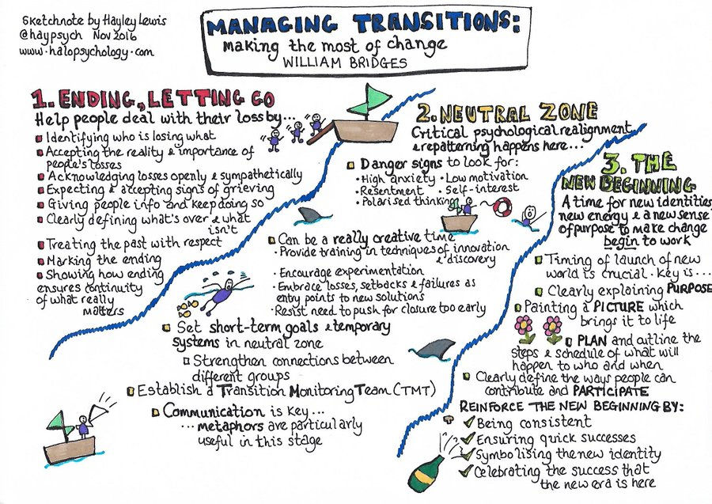

Slide 47
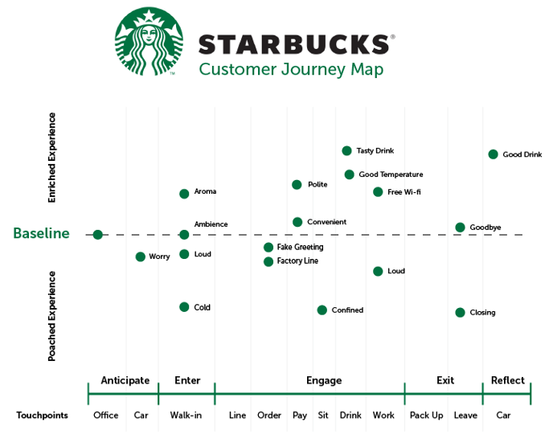

Slide 52
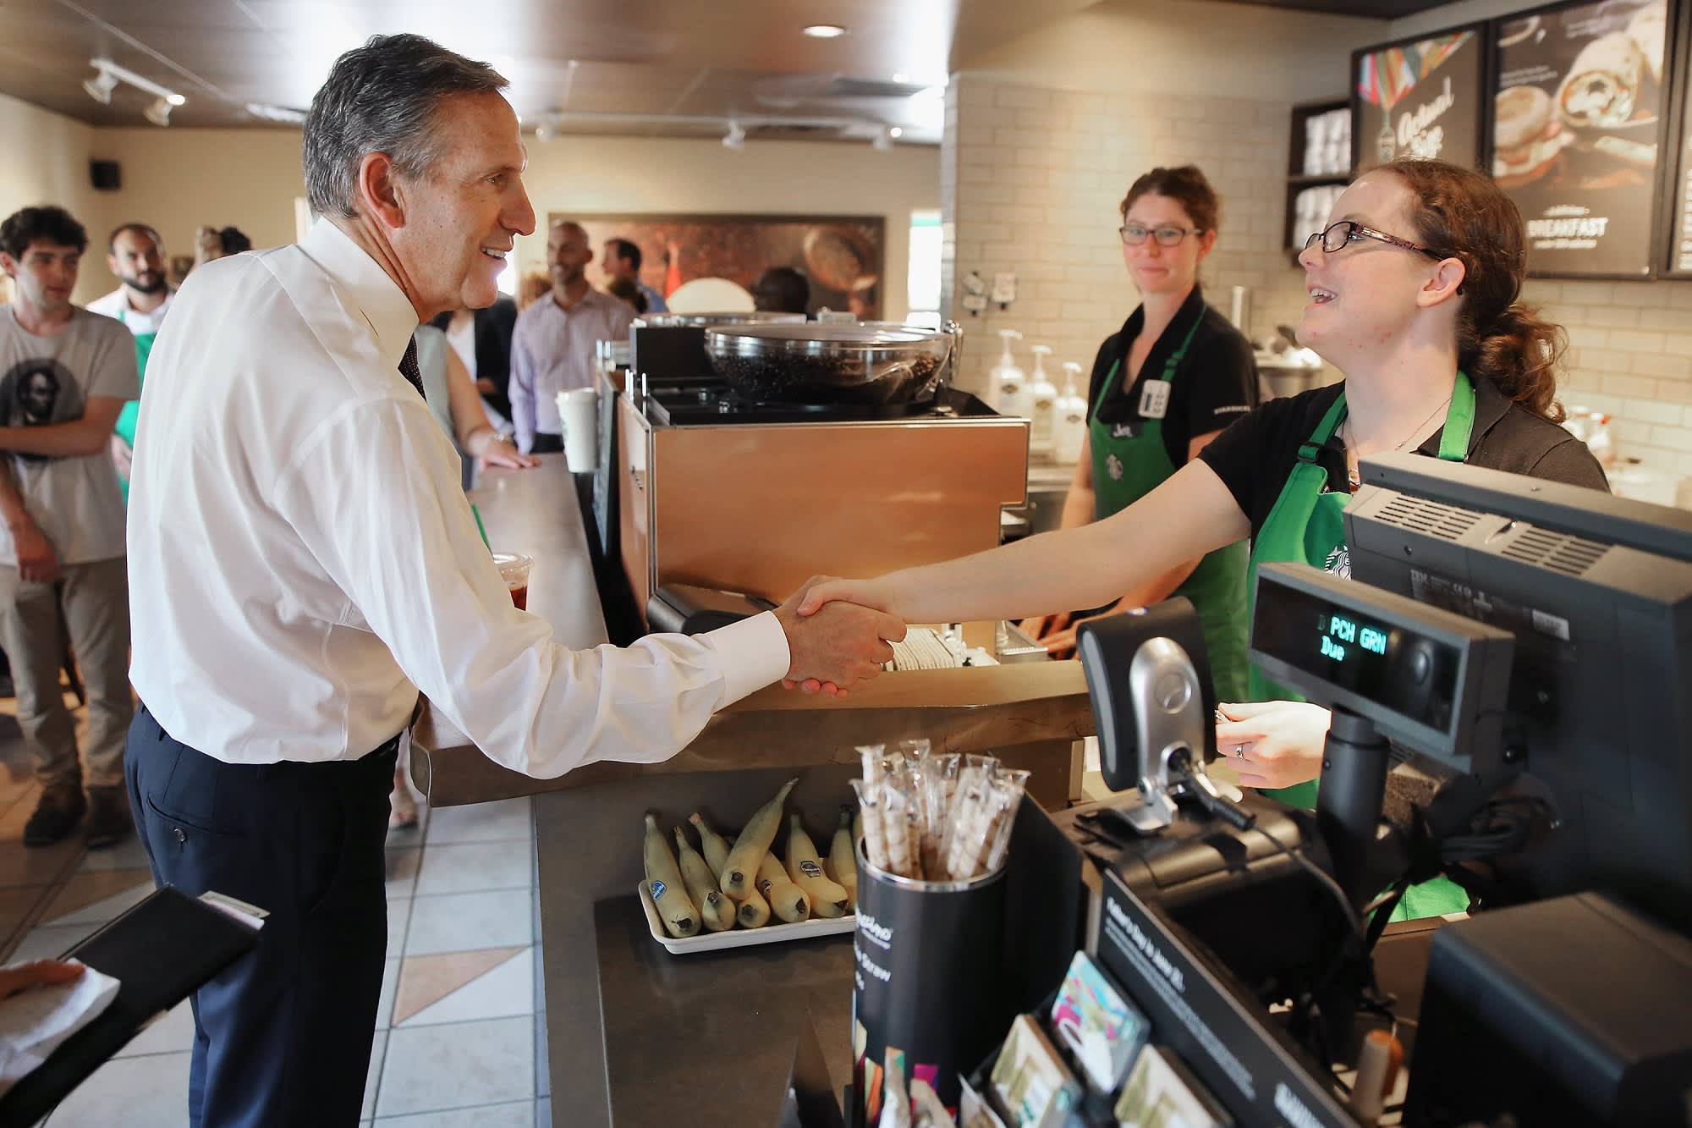
Starbucks boss Howard Schultz visits 25 shops a week.

Slide 53
EXERCISE
You detail a customer journey and express how the experience can be “pouched” or “enriched.”

Slide 54
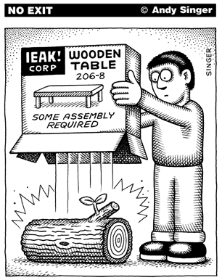

Slide 55
Design Thinking For All Things

Slide 56
Design Thinking For All Things

Slide 57
Design Thinking For All Things
EXERCISE
What is an everyday thing (in your organization) that is a point of frustration for customers, users, employees, or other stakeholders? [NOTE: this thing, if fixed, would increase the user or employee experience with your company and the overall value of your company.]

Slide 58
Design Methodology Models
IDEO
BCG
Stanford DSchool

Slide 59
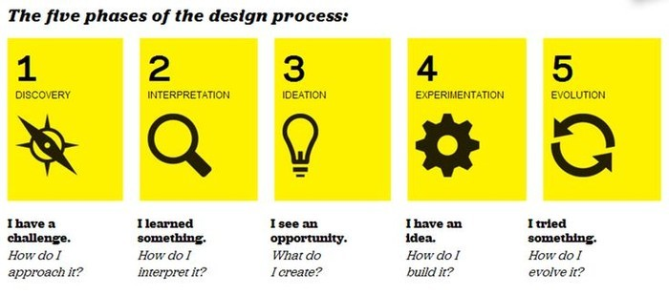
Design Thinking For All Things

Slide 60
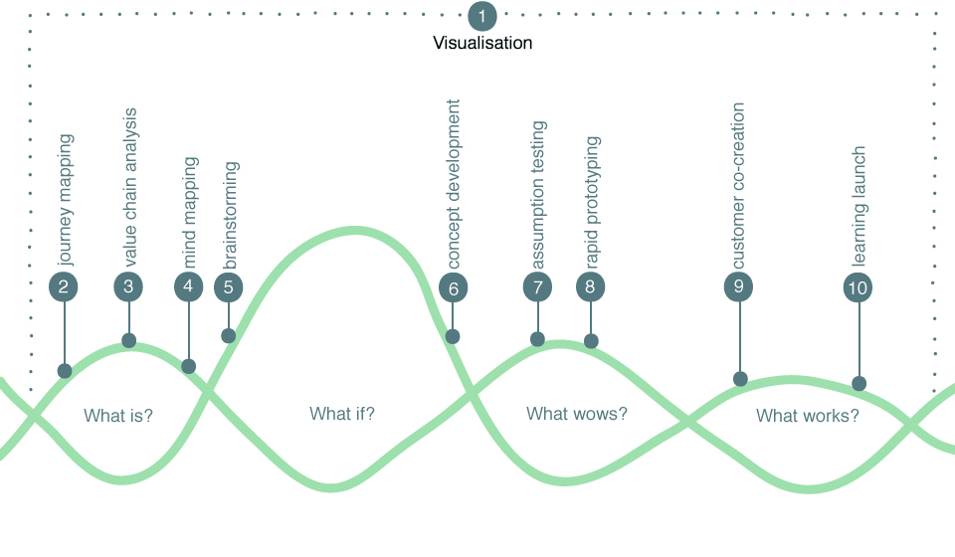
Design Thinking For All Things
Jeanne Liedtka

Slide 61
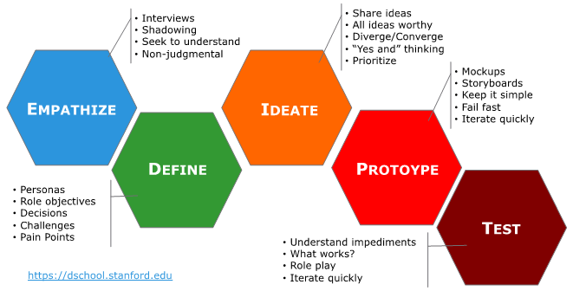
Design Thinking For All Things

Slide 66
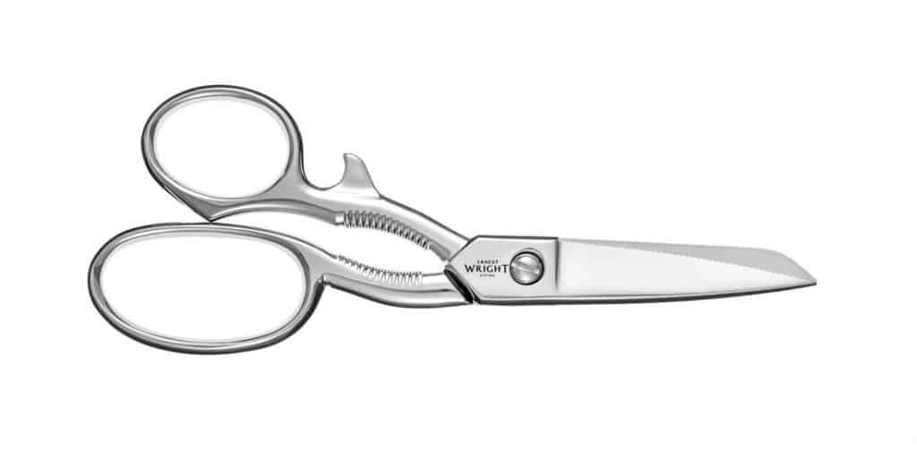

Slide 72
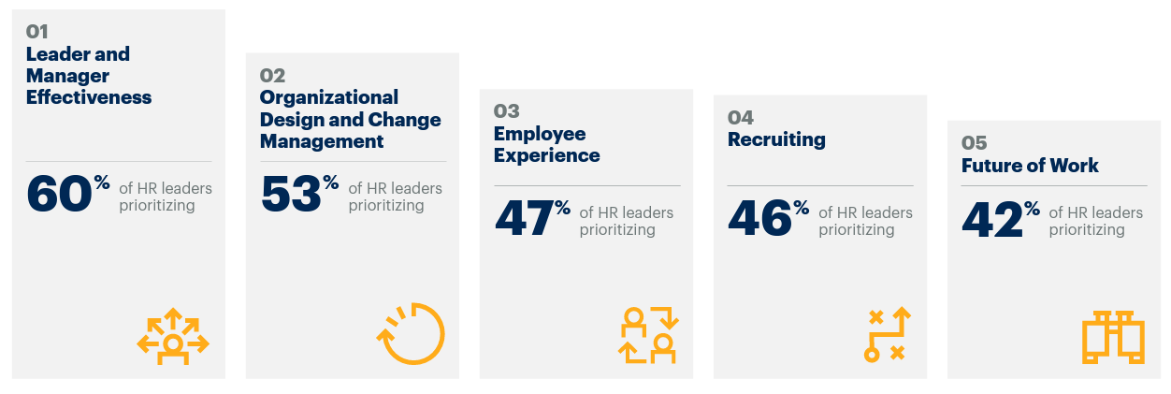
Designing The Employee Experience
TOP FIVE PRIORITIES FOR 2023 AND BEYOND
SOURCE: Gartner

Slide 73
Designing The Employee Experience
TOP FIVE PRIORITIES FOR 2023 AND BEYOND
SOURCE: Gartner

Slide 76
Designing The Employee Experience
Pre-Employment
Employment
Post-Employment

Slide 77
Designing The Employee Experience
Pre-Employment
Employment
Post-Employment
Job Search
Application Process
Interviewing
Offer (negotiation)
Background Checks
Acceptance
Start Date Set
Onboarding Activities
Career Planning
Professional Development
Performance Management
Growth Opportunities
Departure Announcement
Transition Planning
Exit Interviews
Separation
Possible Connections
Re-Employment (Boomerang)

Slide 78
Designing The Employee Experience
Pre-Employment
Employment
Post-Employment
ATTRACT – RECRUIT – ONBOARD – ENGAGE – DEVELOP – PERFORM - EXIT
Job Search
Application Process
Interviewing
Offer (negotiation)
Background Checks
Acceptance
Start Date Set
Onboarding Activities
Career Planning
Professional Development
Performance Management
Growth Opportunities
Departure Announcement
Transition Planning
Exit Interviews
Separation
Possible Connections
Re-Employment (Boomerang)

Slide 79
Designing The Employee Experience
Enriched Experience
Baseline
Poor Experience
Pre-Employment
Employment
Post-Employment
Touchpoints ATTRACT – RECRUIT – ONBOARD – ENGAGE – DEVELOP – PERFORM - EXIT

Slide 80
Designing The Employee Experience
Immediate Sense of Belonging
Alignment Of Work To Mission
Good Experience
Team Integration Activities
Shows Concern For People
Positive Social Media Presence
Enriched Experience
Welcome Letter (and SWAG)
MBOs
A 90d Detailed Schedule
30d Review
60d Review
90d Review
High Performance Growth Plan
Quarterly Conversations
Great Employee Value Proposition
Diversity Index
Clear Expectations (Handbook)
Flexible Work Space
Career Path
Goodbye
Baseline
Self-Directed Training
Poor Total Comp Package
Difficult Job Portal
No Mentor/Buddy
Lack Of Well Being
Little / No Communication With Manager
Too Much Autonomy
Unclear Job Description
Lack Of Trust And Transparency
Poor Experience
Resources Not Ready
Poor Interview Feedback
Not Knowing Who’s Who
Manual Forms
Lag Time For/No Training
Lack Of Input To Make Improvements
Sense of Dead End
Pre-Employment
Employment
Post-Employment
Touchpoints ATTRACT – RECRUIT – ONBOARD – ENGAGE – DEVELOP – PERFORM - EXIT

Slide 81
Designing The Employee Experience
How do they view their work? (e.g., “work to live" versus “live to work")
What's the nature of their specific work environment? (e.g., front-line workers versus those that work from home)
What type of work do they do? (e.g., routine versus varied, collaborative versus working solo)
What's their attitude toward technology and their level of digital dexterity?
What's their attitude toward organizational change?
What are their motivations for action, outreach, and personal growth?
ONE SIZE DOES NOT FIT ALL
SOME ASSEMBLE REQUIRED
Leadership Is A Contact Sport

Slide 82
Designing The Employee Experience
Immediate Sense of Belonging
Alignment Of Work To Mission
Good Experience
Team Integration Activities
Shows Concern For People
Positive Social Media Presence
Enriched Experience
Welcome Letter (and SWAG)
MBOs
A 90d Detailed Schedule
30d Review
60d Review
90d Review
High Performance Growth Plan
Quarterly Conversations
Great Employee Value Proposition
Diversity Index
Clear Expectations (Handbook)
Flexible Work Space
Career Path
Goodbye
Baseline
Self-Directed Training
Poor Total Comp Package
Difficult Job Portal
No Mentor/Buddy
Lack Of Well Being
Little / No Communication With Manager
Too Much Autonomy
Unclear Job Description
Lack Of Trust And Transparency
Poor Experience
Resources Not Ready
Poor Interview Feedback
Not Knowing Who’s Who
Manual Forms
Lag Time For/No Training
Lack Of Input To Make Improvements
Sense of Dead End
Pre-Employment
Employment
Post-Employment
Touchpoints ATTRACT – RECRUIT – ONBOARD – ENGAGE – DEVELOP – PERFORM - EXIT

Slide 83
Designing The Employee Experience
Immediate Sense of Belonging
Alignment Of Work To Mission
Good Experience
Team Integration Activities
Shows Concern For People
Positive Social Media Presence
Conduct Stay Interviews
Enriched Experience
Welcome Letter (and SWAG)
MBOs
A 90d Detailed Schedule
30d Review
60d Review
90d Review
High Performance Growth Plan
Quarterly Conversations
Great Employee Value Proposition
Diversity Index
Clear Expectations (Handbook)
Flexible Work Space
Career Path
Goodbye
Baseline
Self-Directed Training
Poor Total Comp Package
Difficult Job Portal
No Mentor/Buddy
Lack Of Well Being
Little / No Communication With Manager
Too Much Autonomy
Unclear Job Description
Lack Of Trust And Transparency
Poor Experience
Resources Not Ready
Poor Interview Feedback
Not Knowing Who’s Who
Manual Forms
Lag Time For/No Training
Lack Of Input To Make Improvements
Sense of Dead End
Pre-Employment
Employment
Post-Employment
Touchpoints ATTRACT – RECRUIT – ONBOARD – ENGAGE – DEVELOP – PERFORM - EXIT

Slide 84
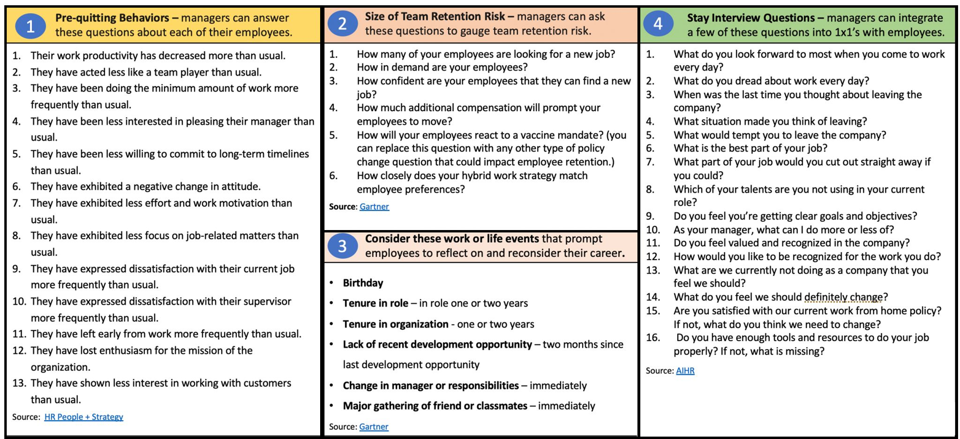
Tools to identify and address employee risk

Slide 85
Designing The Employee Experience
What do you look forward to each day when you commute to work?
What are you learning here, and what do you want to learn?
Why do you stay here?
When is the last time you thought about leaving us, and what prompted it?
What can I do to make your job better for you?
How to conduct a stay interview:
The 5 Questions

Slide 86
Designing The Employee Experience
Marc Esteve’s research into why some public employees are more motivated at work than others discovered six factors that are crucial for motivating public employees.
INCENTIVES
Employees work hard when they believe doing so results in a desired outcome. The tangible rewards include pay, promotion opportunities, maintaining employment, fringe benefits, gifts and physical conditions at work. The intangible incentives include status and prestige, skills development, power and self-esteem from praise and recognition.
ENJOYMENT
People are problem solvers. They work hard to perform well because the joy of the task is rewarding. Employees in the public sector find their jobs more enjoyable if they can use a greater variety of skills, see the end result of their work, see that their work is important, (3) have autonomy, control, and independence needed to complete tasks, and (4) get feedback.
RELATEDNESS
Intrinsic motivation depends on a sense of relatedness to others at work. This is a desire to feel emotionally connected with others and care for them. High-quality relationships and the interactions with others at work can create this sense of relatedness and thus intrinsically motivate staff in the public sector. Hence why Gallup asks “do you have a best friend at work” to measure one’s engagement.
WARM GLOW
Employees may also feel good about and therefore be motivated by helping their organization and society with their work. In other words, their intrinsic motivation grows from a sense of helping others over and above the social outcomes they attain with their work. This pleasure of making a difference for others is often termed warm glow.
COMMUNITY
Employees driven by pro-social motivation are driven to work hard because of the positive outcomes their work produces for society. Public employees may be pro-socially motivated due to affection, compassion, and care and concern for others. They may also be motivated by their association with public values, such as fairness, social equity, social justice and social responsibility. As a result of this, work that is socially driven becomes a calling and gives them purpose in life and career.
THE TEAM
Employees are motivated to work hard for organizations, groups, and teams they identify with and feel a commitment towards.

Slide 87
Designing The Employee Experience
Immediate Sense of Belonging
Alignment Of Work To Mission
Good Experience
Team Integration Activities
Shows Concern For People
Positive Social Media Presence
Enriched Experience
Welcome Letter (and SWAG)
MBOs
A 90d Detailed Schedule
30d Review
60d Review
90d Review
High Performance Growth Plan
Quarterly Conversations
Great Employee Value Proposition
Diversity Index
Clear Expectations (Handbook)
Flexible Work Space
Career Path
Goodbye
Baseline
Self-Directed Training
Poor Total Comp Package
Difficult Job Portal
No Mentor/Buddy
Lack Of Well Being
Little / No Communication With Manager
Too Much Autonomy
Unclear Job Description
Lack Of Trust And Transparency
Poor Experience
Resources Not Ready
Poor Interview Feedback
Not Knowing Who’s Who
Manual Forms
Lag Time For/No Training
Lack Of Input To Make Improvements
Sense of Dead End
Pre-Employment
Employment
Post-Employment
Touchpoints ATTRACT – RECRUIT – ONBOARD – ENGAGE – DEVELOP – PERFORM - EXIT

Slide 88
Designing The Employee Experience
PURPOSE
FLEXIBILITY
DEVELOPMENT
INFRASTRUCTURE
LEADERSHIP
Your Employee Value Proposition
There are five things to consider when building your EVP

Slide 89
Some things will never, ever change
It’s all about people. Period.
People are the lifeblood of any team, organization, community.
Effectiveness is grounded in our connections with one another – the touchpoints we have with one another – in our work throughout our workplace, and for the customers we serve.

Slide 90
HOW TO WIN FRIENDS AND INFLUENCE PEOPLE
BECOME A FRIENDLIER PERSON
Don't criticize, condemn or complain.
Give honest, sincere appreciation.
Arouse in the other person an eager want.
Become genuinely interested in other people.
Smile.
Remember that a person's name is to that person the most important sound in any language.
Be a good listener. Encourage others to talk about themselves.
Talk in terms of the other person's interest.
Make the other person feel important - and do so sincerely.
The only way to get the best of an argument is to avoid it.
WIN PEOPLE TO YOUR WAY OF THINKING
Show respect for the other person's opinions. Never say, "You're wrong."
If you are wrong, admit it quickly and emphatically.
Begin in a friendly way.
Get the other person saying, "Yes, yes" immediately.
Let the other person do a great deal of the talking.
Let the other person feel that the idea is his or hers.
Try honestly to see things from the other person's point of view.
Be sympathetic with the other person's ideas and desires.
Appeal to the nobler motives.
Dramatize your ideas.
CHANGE PEOPLE WITHOUT RESENTMENT
Throw down a challenge.
Begin with praise and honest appreciation.
Call attention to people's mistakes indirectly.
Talk about your own mistakes before criticizing the other person.
Ask questions instead of giving direct orders.
Let the other person save face.
Praise the slightest and every improvement. Be "lavish in your praise."
Give the other person a fine reputation to live up to.
Use encouragement. Make the fault seem easy to correct.
Make the other person happy about doing the thing you suggest.

Slide 91
What numbers do you see?
25
45
8

Slide 92
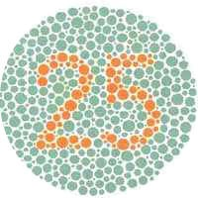
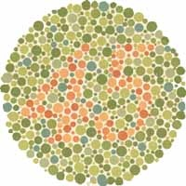
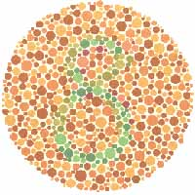
What numbers do you see?
Shinobu Ishihara

Slide 93
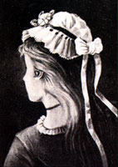

Slide 94
Test your perception
Here are the basics of perception theory:
We are constantly being bombarded with countless stimuli of which we are only able to pay attention to a few pieces of data at any one moment.
Perception is what we pay attention to.
Three basic elements of perception process:
Selectivity—we make choices about what to pay attention to
Subjectivity—we relate what we perceive to similar experiences and prior knowledge, which implies a process of recognition/interpretation based upon previous experiences and understandings (fields of experience)
Structure—we impose patterns, meanings, and causality on the data (the principle of wholeness)

Slide 95
The Minto Pyramid Principle
Imagine you receive this letter from Lucy. What does she want to tell you?
Dear Shirley,
Remember last Saturday afternoon when I was playing in the park with my boyfriend and you came over, and he told me that when my back was turned, you kissed him?
And also, on Sunday when you came to my house and my Mom made you a tuna fish salad for lunch and you said: “Yech! That’s the worst salad I ever ate!”?
And yesterday, when my cat brushed against your leg, you kicked her and threatened to sic your dog “Monster” on her?
Well, for all of these reasons, I hate you, and I no longer want to be your friend.
Lucy
Could this be written more clearly?
Dear Shirley,
I HATE you.
Here are my reasons:
You stole my boyfriend.
You insulted my mother.
You scared my cat.
Main statement or “governing thought”
Reasons supporting the governing thought
Source: [Zel99], http://education.dbai.tuwien.ac.at/wie/WS05/

Slide 96
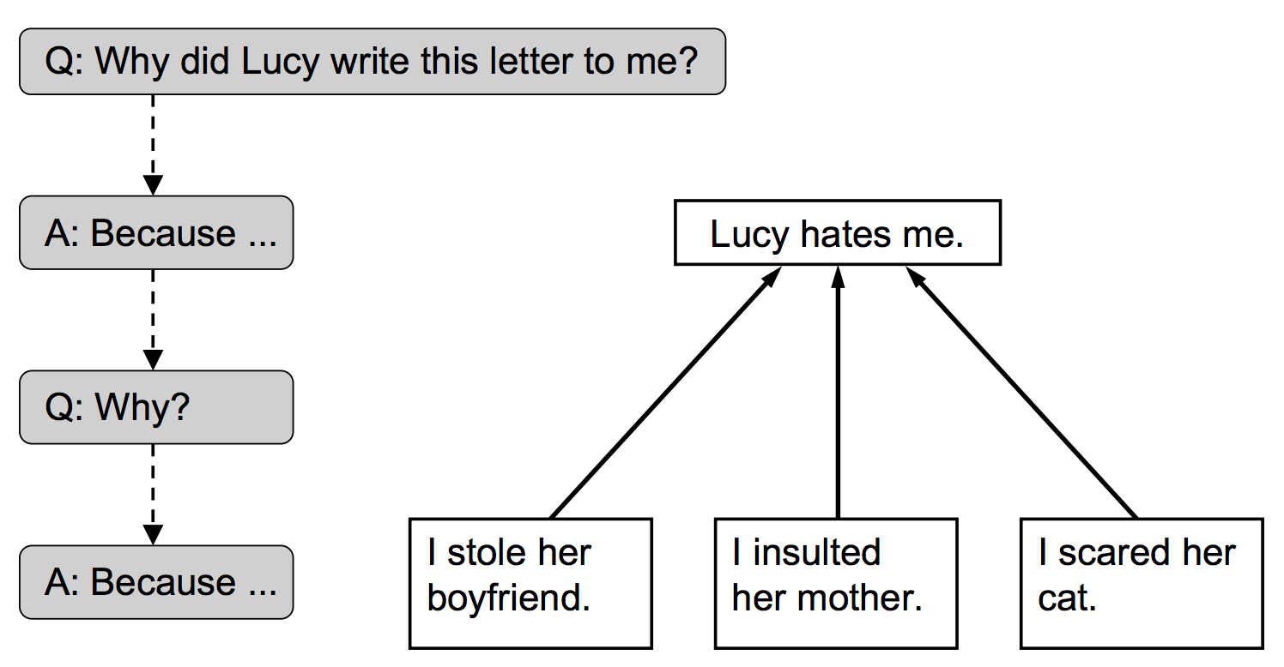
The Minto Pyramid Principle
Imagine you receive this letter from Lucy. What does she want to tell you?
Could this be written more clearly?
Dear Shirley,
I HATE you.
Here are my reasons:
You stole my boyfriend.
You insulted my mother.
You scared my cat.
Main statement or “governing thought”
Reasons supporting the governing thought
Source: [Zel99], http://education.dbai.tuwien.ac.at/wie/WS05/

Slide 97
The Minto Pyramid Principle
Imagine you receive this letter from Lucy. What does she want to tell you?
Whenever you read or a write, first “distill” the key message, and then analyze or support it along a logical question-answer pyramid.
Key Message: First find or state the key message before you plunge into details.
Questions: Ask questions before you give answers (even if it’s only in your mind).
Pyramid: Envision the question-answering process to follow top-down a fictitious logical pyramid structure.
Could this be written more clearly?
Dear Shirley,
I HATE you.
Here are my reasons:
You stole my boyfriend.
You insulted my mother.
You scared my cat.
Main statement or “governing thought”
Reasons supporting the governing thought
Source: [Zel99], http://education.dbai.tuwien.ac.at/wie/WS05/

Slide 98
The Minto Pyramid Principle
Imagine you receive this letter from Lucy. What does she want to tell you?
Could this be written more clearly?
Dear Shirley,
I HATE you.
Here are my reasons:
You stole my boyfriend.
You insulted my mother.
You scared my cat.
Main statement or “governing thought”
Reasons supporting the governing thought
Source: [Zel99], http://education.dbai.tuwien.ac.at/wie/WS05/

Slide 99
The Abilene Paradox
The false consensus effect occurs when we overestimate the number of other people (or extent to which other people) who share our opinions, beliefs, and behaviors.

Slide 100
Negotiation . . .
A process by which two or more parties with both conflicting and compatible goals or preferences voluntarily seek to reach agreement on a decision or transaction.
The Parable Of The Orange
What if one of us had simply asked:
Why do you want the orange?

Slide 101
Negotiation . . .
A process by which two or more parties with both conflicting and compatible goals or preferences voluntarily seek to reach agreement on a decision or transaction.
The Parable Of The Orange
Position: I want the orange
The thing I say I want
My demand
What would make me happy
Interest: Something to eat
The reason why I want it
My underlying concern
My deeper need or drive

Slide 102
What will you do with the world as you find it?
What shows up when you do?

Slide 103
Leadership is a Contact Sport

Slide 104
Leadership is a Contact Sport
Did I do my best to increase my happiness?
Did I do my best to find meaning?
Did I do my best to be engaged?
Did I do my best to build positive relationships?
Did I do my best to set clear goals?
Did I do my best to make progress toward goal achievement?

Slide 105
5 x 4 x 12 =
You have 240 days (opportunities) every year to have lunch with someone. Use those opportunities to build a relationship. You’re going to need it!
240

Slide 106
Enjoy the journey!
“I’ve come to the frightening conclusion that
I am the decisive element.
It is my personal approach that creates the climate. It is my daily mood that makes the weather. I possess tremendous power to make life miserable or joyous. I can be a tool of torture or an instrument of inspiration, I can humiliate or humor, hurt or heal. In all situations, it is my response that decides whether a crisis is escalated or de-escalated, and a person is humanized or de-humanized. If we treat people as they are, we make them worse. If we treat people as they ought to be, we help them become what they are capable of becoming.”
Johann Wolfgang von Goethe
Notes:
You’ll find leadership to be a process, and you’ll realize it’s a learning journey as much as anything else. You’ll never really “arrive” when it comes to leadership, but when in Chicago, if you’ve embraced the rules in this workbook and committed to continuous improvement toward being a truly exceptional leader, we suspect that you’ll leave the train, walk out of the station, pause, reflect, and say, “Wow! What a ride.”

