Slide 1
Reimagining Recruitment
Gerald Young
MissionSquare Research Institute

Slide 2
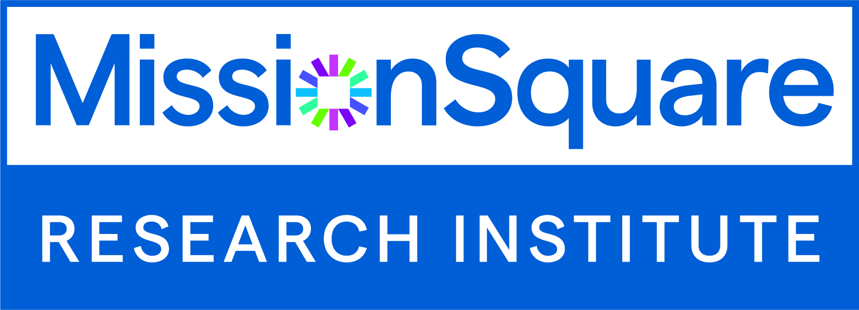
MissionSquare Research Institute
MissionSquare Research Institute (formerly SLGE) promotes excellence in state and local government and other public service organizations so they can attract and retain talented public servants
missionsq.org/researchinstitute

Slide 3
A Sector in Flux
…the past 10 years

Slide 4
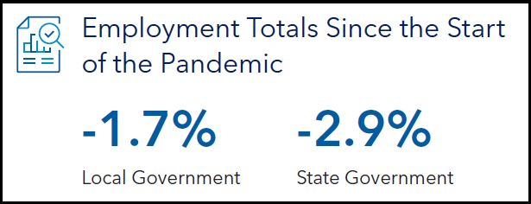
Local Government - Employment Levels
Source: BLS Current Employment Statistics
Notes:
The private sector has largely recovered from the pandemic, but local government employment is still 1.7% below it’s peak in February 2020.

Slide 5
Labor Turnover
In the first four months following the declaration of the public health emergency (February 2020), layoffs spiked by approximately 160% from 20-year averages.
For 2022, quit rates were 57% higher than 20-year averages and separations such as retirements have spiked almost twice their typical rate in the Summer of 2020 and again in late 2021.
At the same time, job openings have continued to consistently increase and were over double their 20-year averages in 2022.
Source: BLS Job Openings and Labor Turnover Survey
Notes:
That’s been a multi-pronged problem, fueled by:
Initial layoffs when the pandemic struck, particularly in fields with high public contact like libraries, recreation, convention centers, and education
Increased resignations, both as a result of health concerns and as a reaction to a job market that increased options for those looking for work
Increased retirements, tied to an aging public sector workforce, which combined with the high level of resignations has placed job openings at a 20-year high

Slide 6
Question
Is this turnover reflective of your government’s experience?
Notes:
Before I get into what the research shows, I’d like to start by asking you whether this is what your government is experiencing or whether your turnover experience is more limited, or perhaps just focused on a few key occupations.

Slide 7
Key Employment Notes
11years
Mid-2024
1.4%
For government employment to recover from the Great Recession
Projected return to pre-pandemic levels, assuming current growth rates
Projected Employment Change, Local Government, 2021-2031
Sources: BLS Employment Projections Program (local government, excluding education and hospitals) and MissionSquare Research Institute analysis of BLS Current Employment Statistics
Notes:
So knowing that turnover is an issue, let’s start with the bad news. With the Great Recession, it took 11 years until local government employment returned to its former level. Based on current trends, it looks like we’ll get back to the February 2020 levels either late this year or early next year. Just a four-year slump. And, on the horizon, there’s a projected ten-year increase of 1.4% in local government staffing from 2021-2031.
Of course, that’s assuming there are no further disruptions like a collapse of debt ceiling negotiations, or perhaps something closer to home… a change in the nature of work.

Slide 8
Examples of local government occupations with notable changes projected over next 10 years…
+10% or more | -15% or more
Data Scientists Landscape Maintenance Construction Managers Computer System Managers | Parking Enforcement Data Entry Executive Secretaries/Assistants Payroll Clerks
Source: BLS Employment Projections Program (local government, excluding education and hospitals)
Notes:
With the pandemic, we saw that immediately in a rise in remote work, but we can also expect the need for staffing in certain occupations to continue to evolve, with more computer system managers, for example. But as CRM, parking apps, or office productivity tools continue to proliferate, we’ll see staffing declines in customer service, parking enforcement, and clerical work, as well as in some finance and supervisory positions. And that’s before the impacts of new developments in artificial intelligence have been factored in.

Slide 9
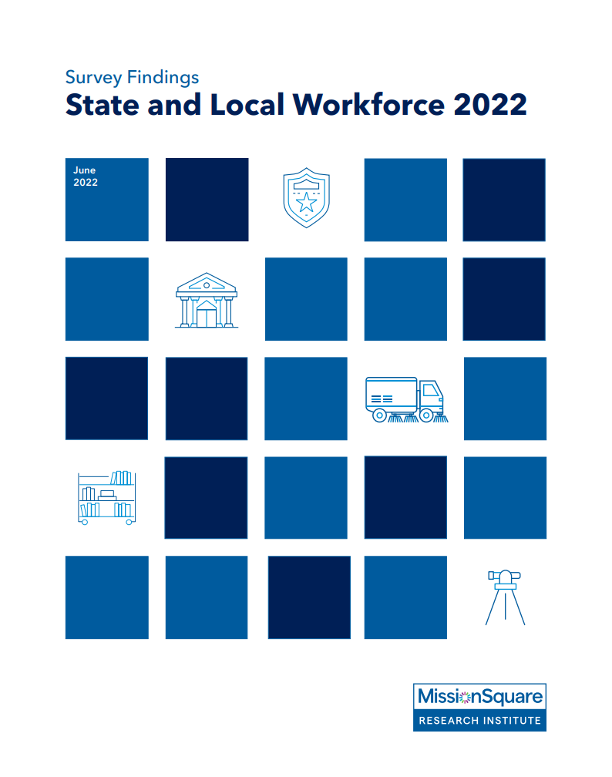
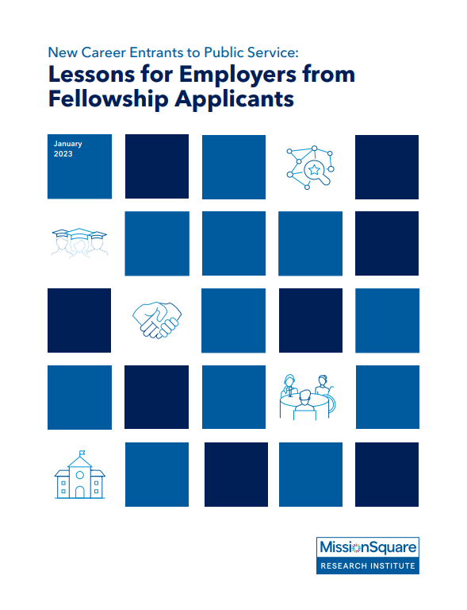
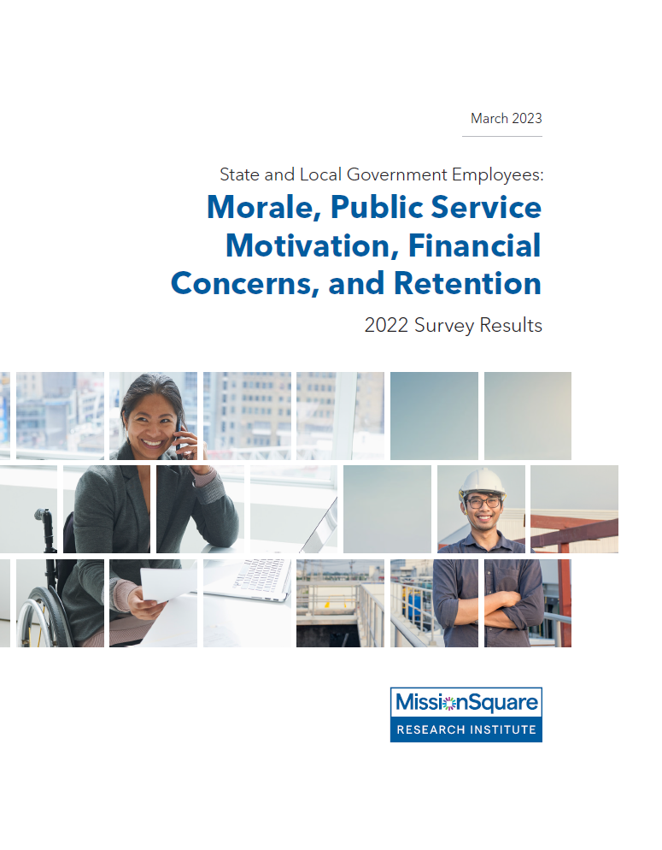
Notes:
MissionSquare Research Institute has been studying the impacts on the public workforce from a variety of angles – including in surveys of human resource managers, state and local government employees, and prospective new entrants to the public sector.

Slide 10
Most Successful Recruitment Practices, According to Public Sector HR Professionals
Social Media (59%)
Employee Referrals (55%)
College Outreach/Partnerships (37%)
Job Fairs (30%)
Internships/Apprenticeships (23%)
Notes:
The first of those efforts has been in place since 2009, looking at how local and state governments are working to improve their recruitment and retention. We’d already seen strategies like social media outreach and employee referrals growing in importance, but there have also been a range of other strategies joining them, including:
College partnerships
Outreach to veterans and their family members
Outreach to specific neighborhoods or demographics
And outreach in languages other than English
The point being that there’s no single best way to engage with the community and that goes for how you engage with them around employment as well.

Slide 11
Top Factors Attracting Current State and Local Employees to Current Public Sector Job
Notes:
One of those other methods of outreach governments are using is building a campaign around the value of a career in public service. That’s not simply a feel-good concept – it respond to what employees themselves are saying. Since the pandemic started, we’ve been surveying employees roughly every 6 months to assess their attitudes toward their employment, morale, and retention outlook. While they’ve expressed growing likelihood to quit – with 59% considering retiring, resigning, or otherwise leaving the workforce - they also place a high value on the personal satisfaction they draw from their jobs and the ability to serve their community.

Slide 12
How Early Career Entrants Rank Various Workplace Aspects
#1 - Meaningful Work / Mission
#2 - Workplace Culture
#3 - Compensation and Benefits
#4 - Professional Development
#5 - Location
#6 - Organizational Reputation
#7 - Hiring Process and Timeline
Notes:
That same sentiment is evident among new job prospects, with a survey of government fellowship applicants ranking meaningful work as their top priority.

Slide 13
Practitioner Workforce Priorities: Identified in Institute Surveys and Focus Groups
Reassess compensation and benefits packages
Enhance employee recognition; emphasize employee impact on the community
Provide and expand financial wellness programs
Prioritize employee safety and mental health
Reevaluate how and where work is conducted
Align to current job requirements, strategically plan for staff transitions, and focus on diversity, equity, and inclusion
Notes:
None of that is to exclude compensation as a concern. That’s the top concern raised in exit interview and public sector wages are consistently rated as less competitive with the overall labor market, although that tends to be balanced by more competitive public sector benefits.
For employers dealing with high retirements among long-time employees, however, they may find that the younger employees taking their place are less motivated by retirement benefits and may likewise be less likely to stay for a full career. We’re just concluding a new survey that will shed more light on that, focusing on employees 35 and under. But beyond that, there are a number of non-traditional benefits that are highly valued:
Asked what employers can do beyond compensation to improve the employee experience, the top response was improved recognition for the employees’ contributions to the organization
Among both the fellowship applicants and the 35 and under employees, there was strong interest in a diverse and inclusive workplace culture
While there’s been growing interest among employers in offering financial wellness programs, 2/3 of employees not currently participating in one express interest in doing so.
And from hybrid work, flexible work schedules, and paid family leave, to career ladders, EAPs, and voluntary benefits, there are a lot of programs employers can put I place to support employees and help them realize their growth potential within the organization.
Our latest research on the overall financial wellbeing of public sector workers also includes the impact of health coverage, sick leave, life insurance, and the greater stability to be found in the public sector.

Slide 14
Additional 2023 Findings on:
29% Dropped degree requirements
19% Offer hiring bonuses
9% Use mobile apps
Full-time > part-time
Salary compression
Time to hire
On-the-spot job offers
Post-hiring upskilling
(New reports pending later this spring)
Notes:
Aside from the 35 and under survey, we also have new data that will be released in the next few weeks that will show how governments are changing job descriptions and degree requirements, and finding new ways to connect with candidates, such as through mobile apps to submit and track applications.
Hiring bonuses have become a go-to strategy lately, either broadly (5%) or in a targeted manner (29%), but only 16% are analyzing data on their total cost and effectiveness as a recruiting tool. Regardless, as those bonuses are being offered, or as salary increases have been granted to certain positions, more employers are also prioritizing the analysis of how that’s impacting pay equity and salary compression.
Finally, as key positions in public safety, health, and skilled positions from engineering to finance to technical trades remain hard to fill, often with fewer qualified applicant than there are vacant positions, time to hire is growing, jurisdictions are adjusting services to meet their limited staffing, and they’re also looking at gig hiring, shared services, apprenticeships, post-hiring upskilling, overhiring, and even on-the-spot conditional job offers.

Slide 15
Discussion
What workforce recruitment barriers is your local government dealing with in 2023?
What recruitment strategies are working best?
Is restructuring necessary?
What is being overlooked? What approaches are working outside of local government?
Notes:
So rather than focus on the data behind each of these issues, I’d like to have a discussion with you:
To start with, what recruitment barriers are you dealing with? Are some of those internal or process related, or are they more a factor of the job market as a whole?
What recruitment strategies are working? Have you applied ideas from the private sector?
Restructuring can take many forms – cutting services, shifting them to virtual only, changing positions based on available staffing (including both part-time and gig options), or even sharing staff among departments or agencies. How have you restructured staffing so far?
And who has started having discussions with staff about how technology may change the work, and whether that has implications either for staffing or for re-training?
On our DEI survey, respondents indicate that they weren’t as successful as they wanted to be at diverse recruiting because any recruiting was so difficult. In some ways, that difficulty recruiting can also be freeing in that it makes it that much easier to experiment and try new strategies.

Slide 16
Twitter: @MSQInstitute
Web: missionsq.org/researchinstitute
Email: research@missionsq.org

