Slide 1
Cutting Through the Noise: Community Engagement in a Hybrid World
Brian Chasnoff, Assistant Director of Communications, City of San Antonio
Krystal Jones, Executive Director of Arts & Culture, City of San Antonio

Slide 2
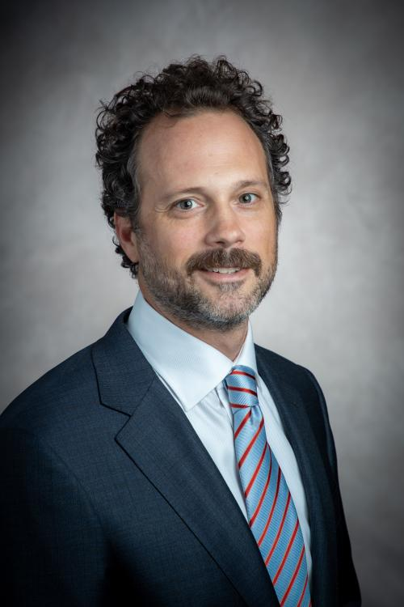
Today's Facilitators
Brian Chasnoff
Former Life: 17+ years in journalism
Currently: Leads strategic communications & engagement for San Antonio’s $1.2B Bond Program & infrastructure investments
Preferred stress relief: Cycling
Favorite Quote These Days: "Once the search is in progress, something will be found." - Brian Eno
Krystal Jones
Former Life: 17+ years in public relations / marketing
Currently: Leads $16M+ public art program, $9M+ grant programs, two City owned art galleries & Film Commission
Preferred stress relief: Biking
Favorite Quote These Days: “I am here today to cross the swamp, not to fight all the alligators.” – Rosamund Stone Zander

Slide 3
The Before Times (Pre-Pandemic)
Meetings at a City facility, often during City hours
Paper surveys
Public comment
Disjointed surveys (Survey Monkey, Google Forms, emails, etc.)
Recommitment to transparency / community engagement
SASpeakUp engagement campaign started in 2018

Slide 4
Digitization Via Disruption
Pandemic caused all to enter crisis communications business
Launched www.saspeakup.com – November 2020
Unified surveys – digital or paper
One-stop shop for project information and all City events / meetings
All virtual meetings, all the time
Placed a large spotlight on digital divide
Stepped back in time to radio and TV placements while repurposing content for social
Timeless innovations: Music, murals and breakfast tacos

Slide 5
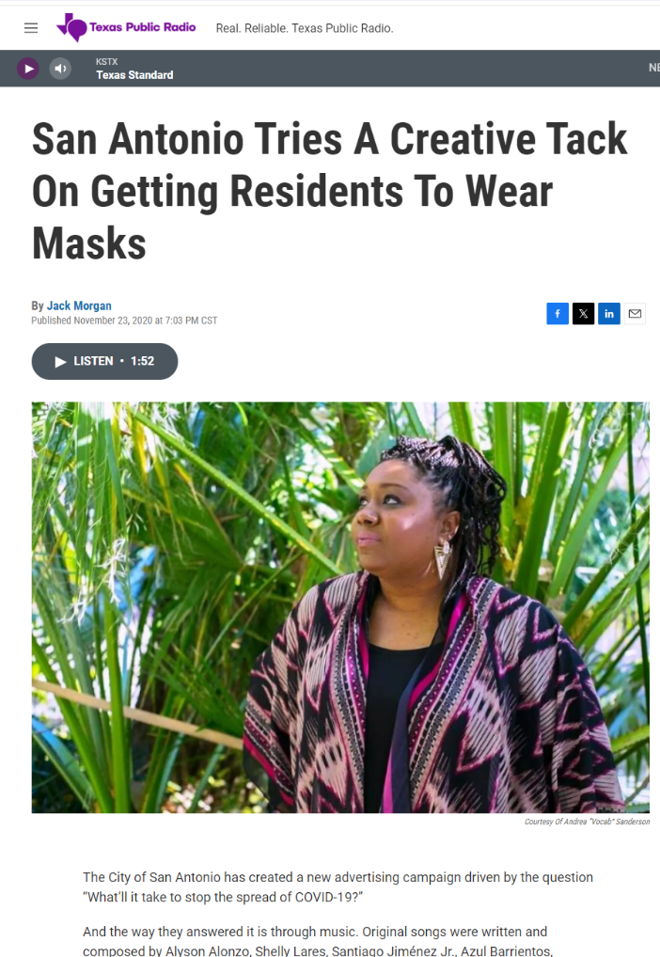
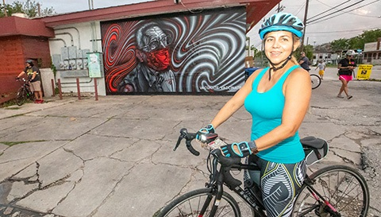
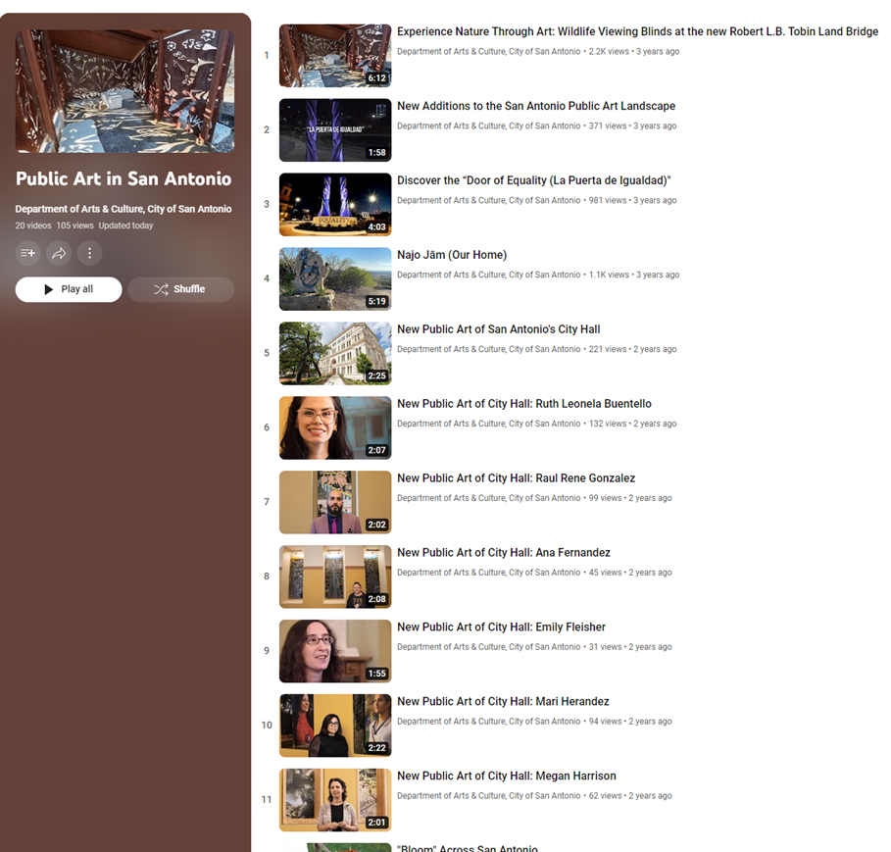
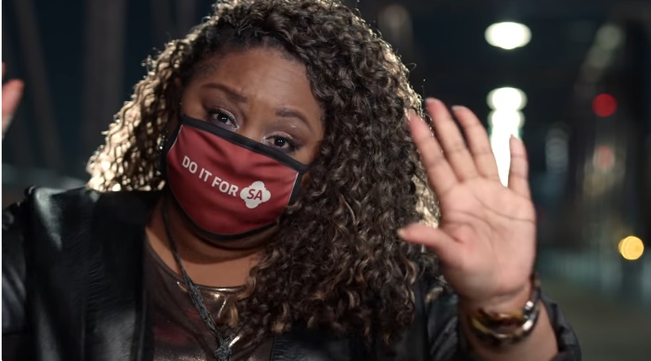

Slide 6
The New World of Engagement
Digital not just requested, it’s a must
Then again, digital burnout – and just plain burnout – is real
Hybrid engagement = new rule of engagement
The MUSTS:
Consider the audience.
Meet them where they’re at.
AND
It doesn’t hurt to make it fun!

Slide 7
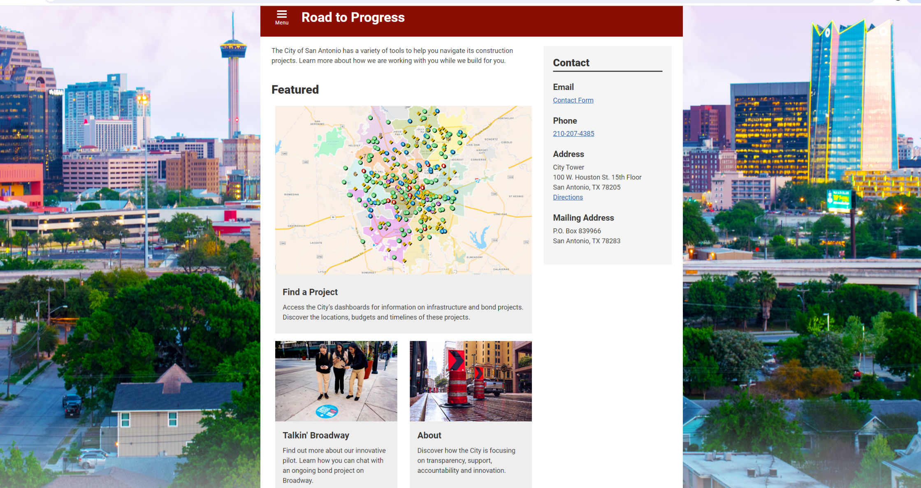
Consider Your Audience: Know & Evaluate Your Content

Slide 8
Road to Progress
Troubled construction project led to comms crisis
City already communicating & engaging – but improvements needed
Gap in digital realm
Fruit of efforts: Road to Progress web page
One site to show all of City's initiatives
New dashboards, project pages, signage, chatbot prototype
Created conceptual framework to categorize these initiatives
Transparency, Support, Accountability, Innovation

Slide 9
Project Dashboards
Hundreds of projects across San Antonio
Dashboards need to satisfy multiple audiences
Council members, small business owners, residents, commuters, City staff
Consider what type of information to present and how to present it
User experience paramount
Focus group with neighborhood leaders and Council staff
15 usability tests with City staff, small business owners and residents
Feedback integrated into design

Slide 10
Public Art Project Dashboard Example
Info about project – from start to finish
Serves as an archive for historical purposes
Home to community engagement survey and results
Links back to Department of Arts & Culture’s Public Art Map
Useful tool for readability: Hemingway

Slide 11
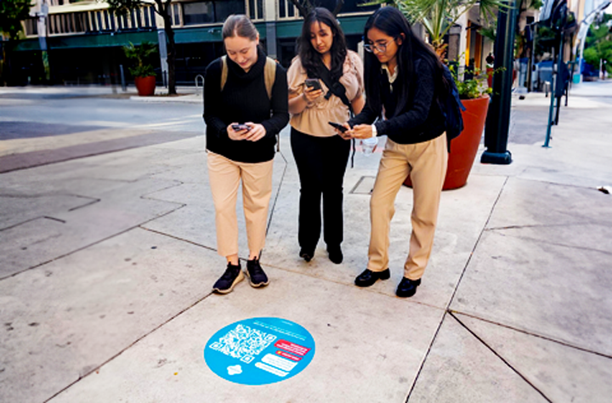
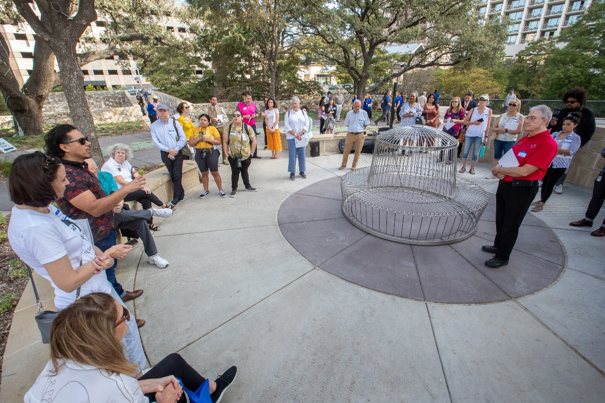
Consider Your Audience: Know Your Stakeholders

Slide 12
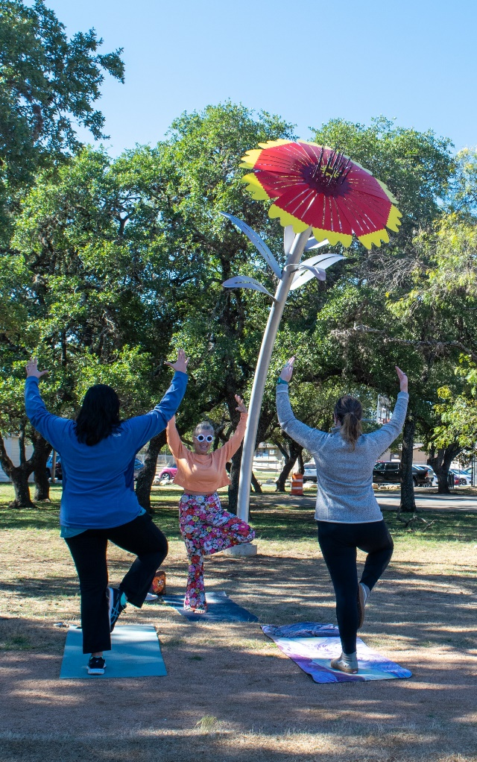
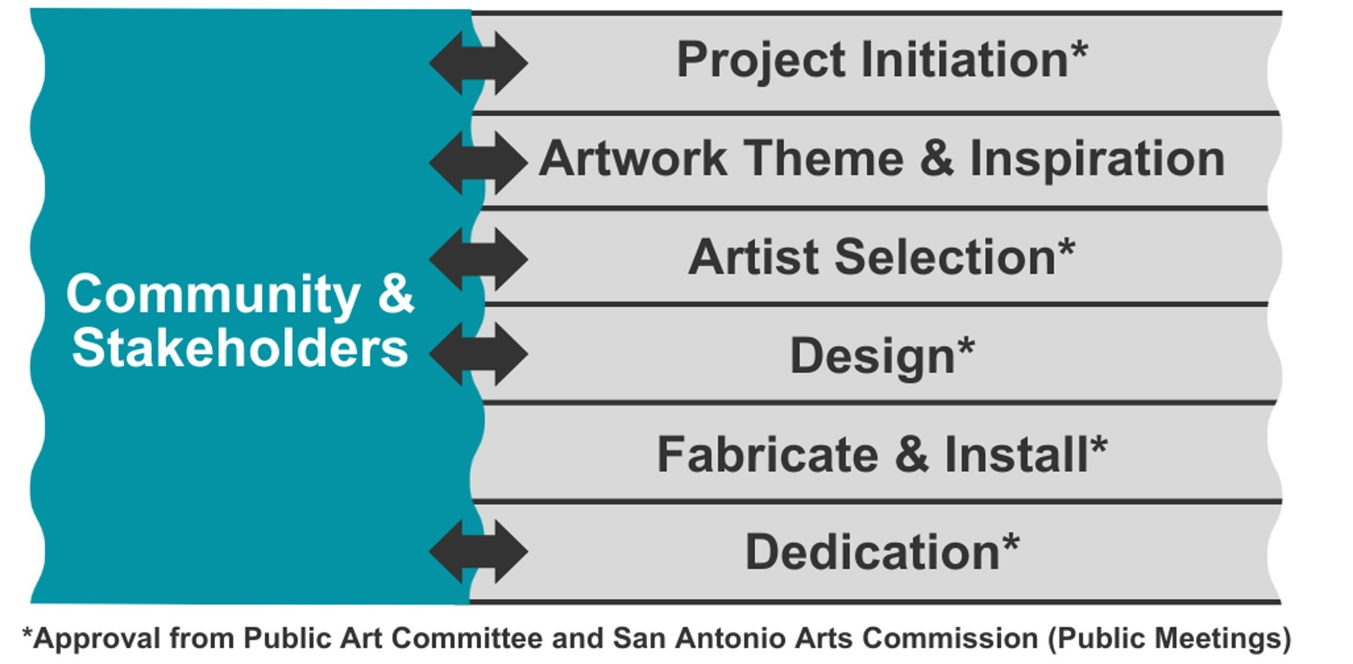
Putting the Public in Public Art

Slide 13
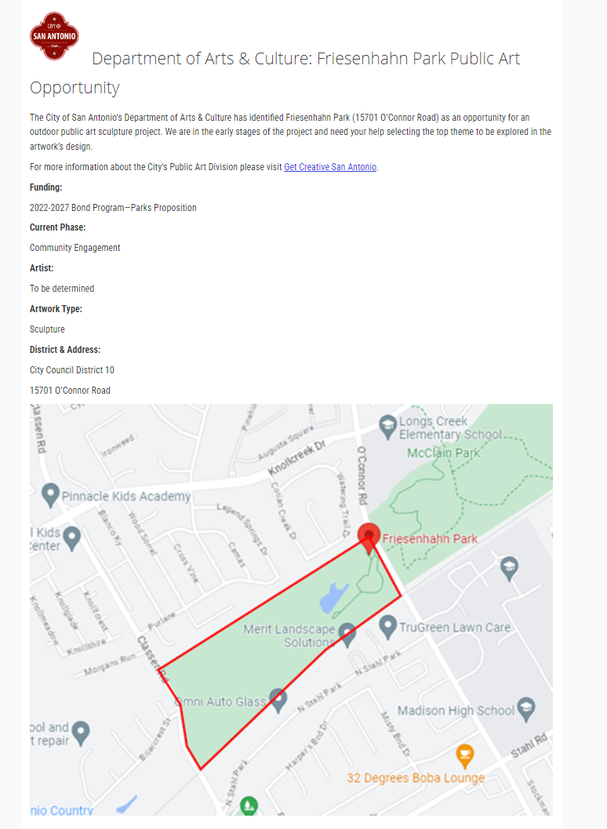
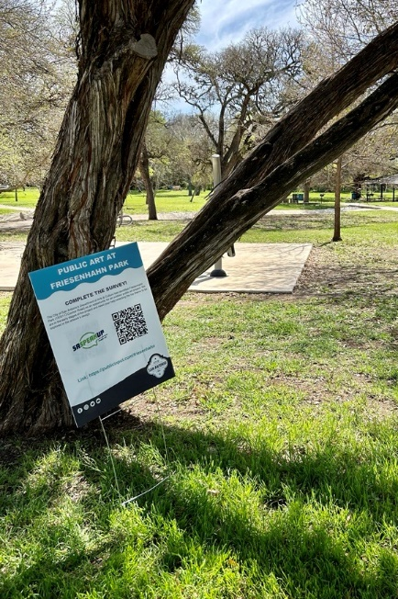
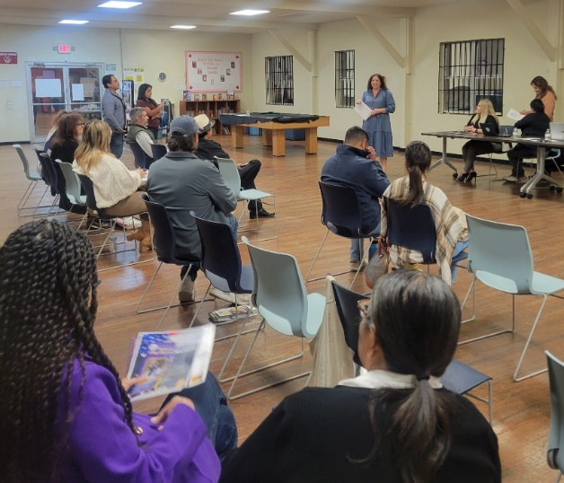
Artwork Theme and Artist Selection
SASpeakUp, including surveys (paper and digital)
Public Meetings (in-person, virtual & recorded)
Direct outreach and meetings with stakeholders
Neighborhood associations
Council Office contacts
Tabling at existing events or high traffic areas
Yard signs with QR Codes
All City channels, eNewsletters, social
Marketing / Public Relations

Slide 14
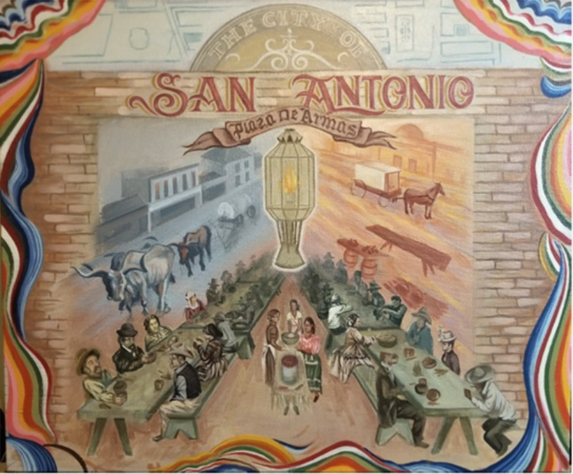
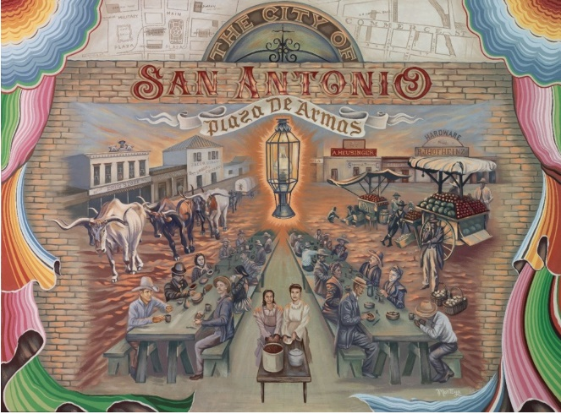
Artwork Designs Shaped by Community Engagement

Slide 15
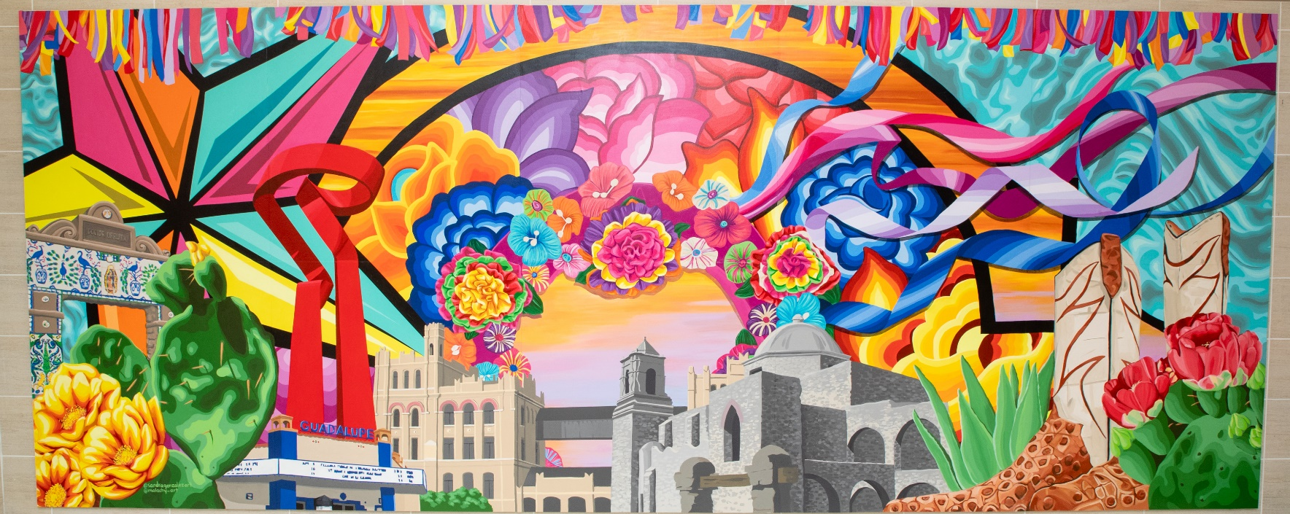
Engaging and Informing Community Through Art

Slide 16
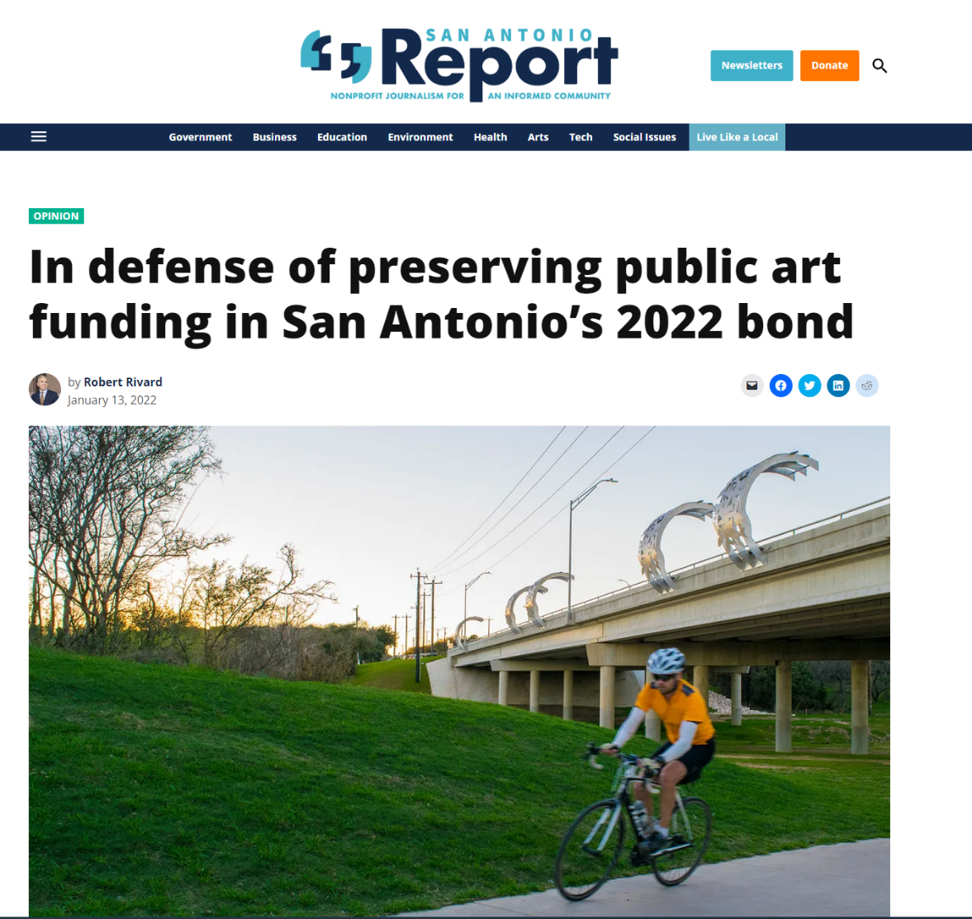
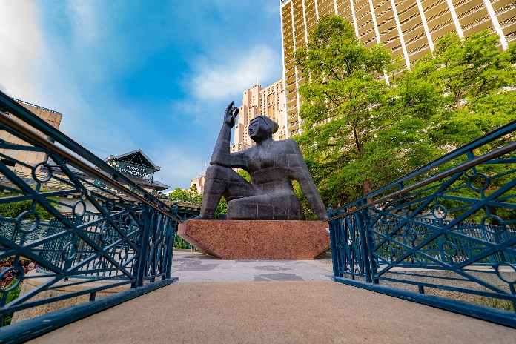
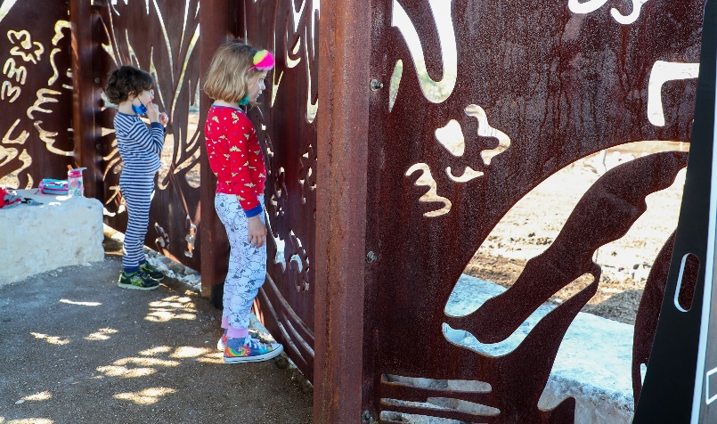
Why Engaging and Informing All Is Important
Public Art originally eliminated or reduced in Bond
All relationships engaged with clear message
Advocates can do what you might not be able to
Result: Public art in Bond AND increased from 1% to 1.5%
Benefit: 36 new public art projects in the next five years

Slide 17
Talkin' Broadway
Council District requested an innovative solution to construction comms issue
Hello Lamp Post offered a custom chatbot
Scan a QR code to begin a text message conversation about Broadway and the project
City gives critical info about construction and businesses, public provides useful feedback
Two videos to promote the new chatbot: a comic skit and a news story
Engagement snapshot:
400 users, 1,800 user messages, 40 visits to Business Directory, 80 to Project Page
Sentiment analysis: 38 percent positive, 32 percent negative = MIXED!

Slide 18
I hath buried the treasure north of the ________ by the beach.

Slide 19
The Data Decides
A great book on AI is "The Alignment Problem: Machine Learning and Human Values" by Brian Christian
Training data will permanently shape the behavior of a deployed system
Word-embedding models bet that words tend to be found near other similar words
To capture similarities, every word is turned into a set of numbers that represents its coordinates in a space
Scatter words randomly in that space, pick a phrase, hide a word
When model guesses wrong, adjust coordinates to nudge correct word toward context words

Slide 20
The Alignment Problem
Systems we attempt to teach sometimes do not do what we want or what we expect
After soft launch, chatbot giving answers that veered far from pre-written knowledge base.
For example, someone who asked for project contact info directed to Mayor's Office.
The culprit? AI
Soft launch not supposed to use AI
Corrected quickly
Fallout included news story: "Emails: Faulty Broadway chatbot stirred panic at City Hall."

Slide 21
Forging Ahead with AI
Surprises happen when experimenting with a prototype
City is pushing forward with the technology
Incorporating AI – deliberately this time
Extensive internal and public testing of V2 before launch
GovAI Coalition
More than 140 government agencies across nation collaborating to ensure effective and responsible use of AI systems in public sector
AI FactSheet is opportunity for vendors to provide transparency

Slide 22
Discussion / Questions

Slide 23
Cutting Through the Noise: Community Engagement in a Hybrid World
Brian Chasnoff, Assistant Director of Communications, City of San Antonio
Krystal Jones, Executive Director of Arts & Culture, City of San Antonio

