Slide 1
Navigating the Known and Unknown In AI –Guidelines, Policies - Applications for Public Managers
Dr. Alan R. Shark, ​
Executive Director, Public Technology Institute​
Associate Professor, Schar School of Policy and Government, GMU ​

Slide 2
Points To Cover
Policy or Guidelines?
What can we learn from the EU’s new Policy?
Examples of State and Local Government Options
Open or Closed AI – What’s the Difference?
Best AI Tools for and applications for public managers.

Slide 3
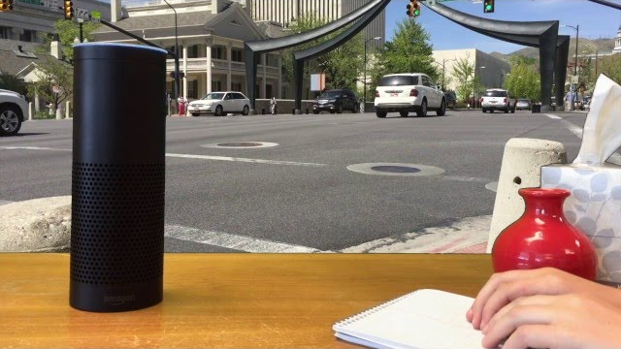
Artificial Intelligence: Transforming the Work of Government
Answering questions – intelligent agents, chatbots
Digital assistants
Citizen service requests
Robotic Process Automation
Speech recognition, translation, NLP
Rules-based expert systems
“Listening” to social media
Cybersecurity threat detection; log analysis
Predictive policing; corrections sentencing
Analyzing big data for patterns

Slide 4
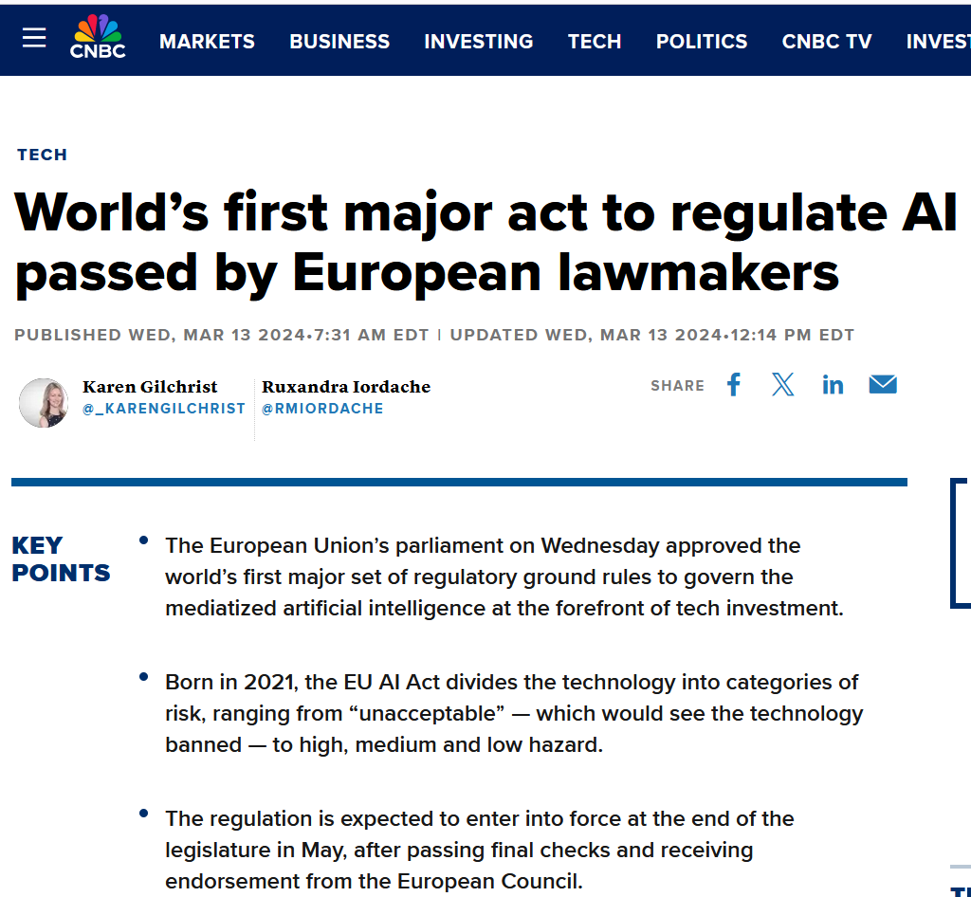

Slide 5
What is the EU Act on Artificial Intelligence?
It aims to protect fundamental rights, democracy, the rule of law, and environmental sustainability from high-risk AI while boosting innovation and establishing Europe as a leader in the field. The regulation establishes obligations for AI based on its potential risks and level of impact.
The Act adopts a risk-based approach, categorizing AI systems into four levels:
Unacceptable risk
High risk
Limited risk,
Minimal or no risk.
Based on the level of risk, each category has corresponding regulatory requirements to ensure that the level of oversight is appropriate to the risk level.
https://www.europarl.europa.eu › news › press-room

Slide 6
Key Takeaways
Developers and operators of these systems must be able to provide clear explanations of how the system works, what data it uses, and how it makes decisions. This is critical to building and maintaining public trust in AI systems and ensuring they are used ethically and responsibly.
The EU recognizes the importance of human oversight in maintaining ethical standards and preventing unintended consequences in sensitive areas such as healthcare and law enforcement.
It clearly sets out requirements for a high-risk AI system, including mandatory testing, documentation, and human oversight.

Slide 7


Open AI: This term is often associated with AI research and development that is transparent, accessible, and collaborative. Open AI initiatives typically involve sharing research findings, datasets, and sometimes even the AI models themselves with the public or the scientific community. This approach aims to democratize AI technology, allowing for widespread use, scrutiny, and contribution from a diverse group of people and organizations.
Closed AI: In contrast, Closed AI refers to AI development that is proprietary, with restricted access to its technologies, datasets, and findings. Companies or organizations that adopt this approach often do so to protect their intellectual property, commercial interests, or for security and privacy reasons. In this model, the AI technology is usually only accessible through specific products or services, and the underlying models and datasets are not publicly shared.

Slide 8
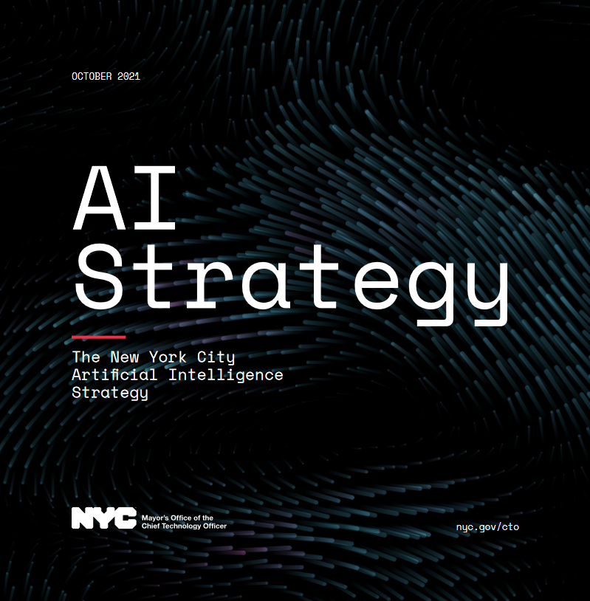

Slide 9
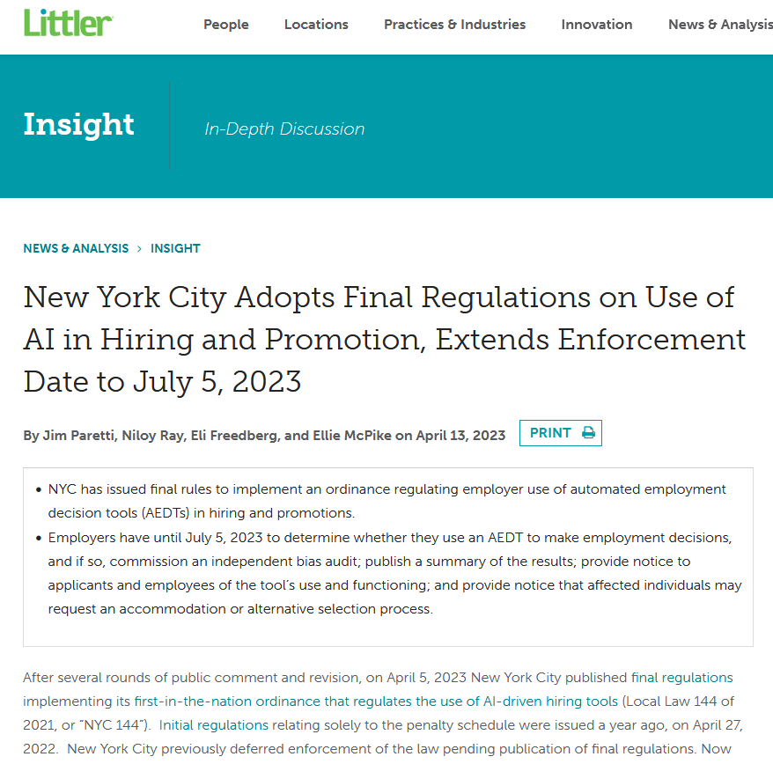

Slide 10
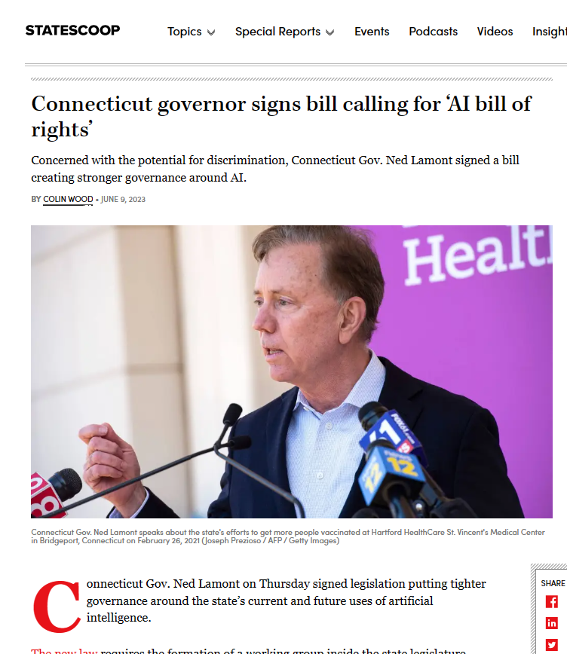

Slide 11
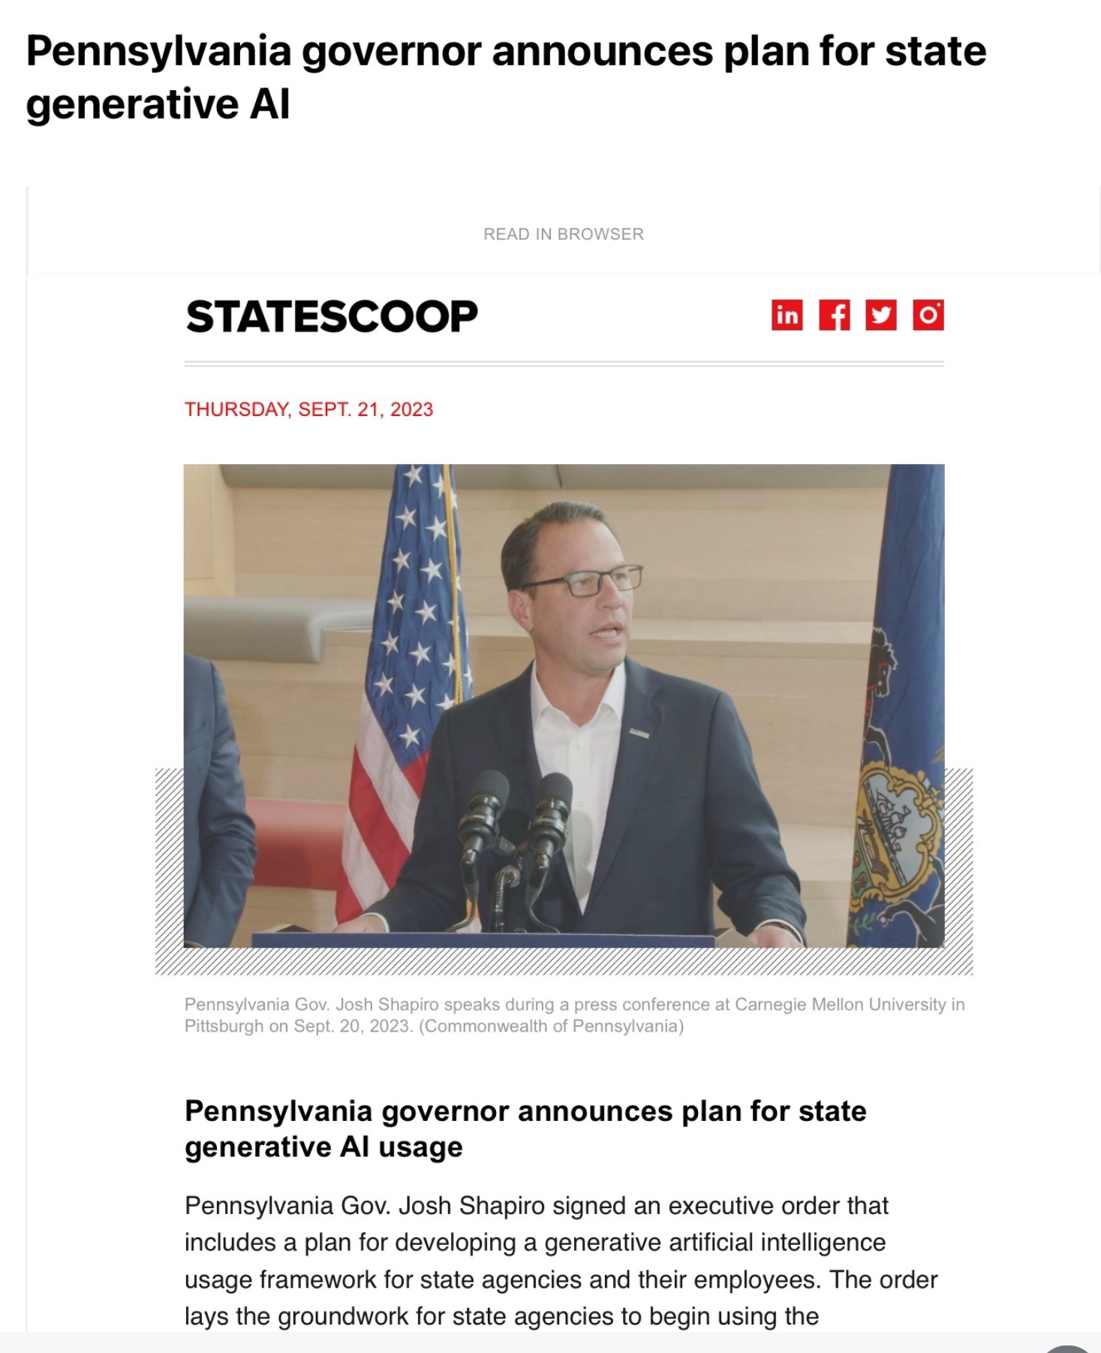

Slide 12
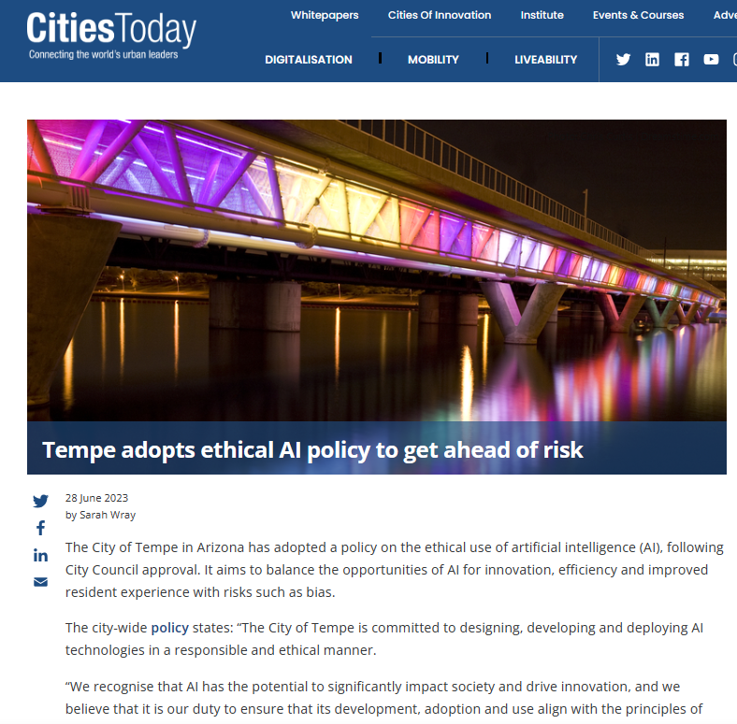

Slide 13
Scope (City of Tempe)
This policy applies to the design, development, and deployment of AI for:
  All departments, agencies, employees, contractors, and stakeholders involved in the development, deployment, and utilization of AI within Tempe.
  Categories of AI inclusive of predictive analytics, machine learning, deep learning,
  generative AI, and automated decision making
  All cases where AI functionality is known to be included, such as new tools for existing products, new products being considered for use or where AI technology is developed by Tempe employees, contractors, partner agencies or other stakeholders.

Slide 14
Policy Scope (City of Tempe)
Purpose and Scope
Human-Centered Approach
Human Responsibility
Human-AI Collaboration
Fairness and Avoidance of Bias
Transparency and Explainability
Accountability and Oversight
Data Privacy and Security
Collaboration and Public Engagement
Continuous Monitoring and Ethical Improvement
Training Programs
Compliance and Legal Frameworks

Slide 15

“Human-AI Collaboration: We will encourage collaboration between humans and AI systems, leveraging the strengths of both to enhance decision-making processes and ensure that ultimate control remains with humans”
City of Tempe, June 2023

Slide 16
Ten states included AI regulations as part of larger consumer privacy laws that were passed or are going into effect in 2023, and even more states have proposed similar bills.
Several states proposed task forces to investigate AI,
Other states expressed concern about AI’s impact on services like healthcare, insurance, and employment.

Slide 17
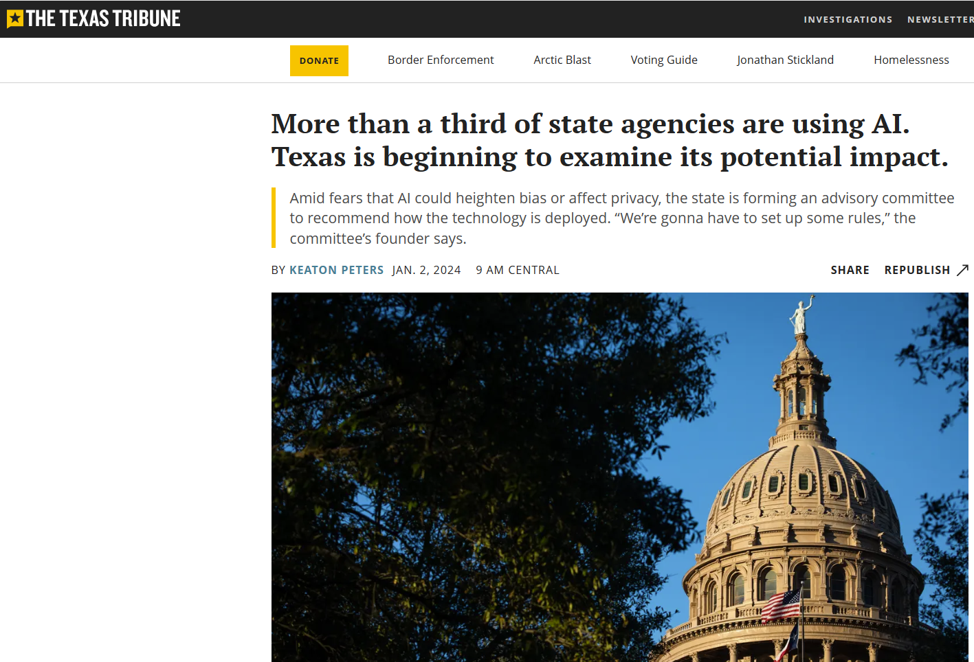

Slide 18

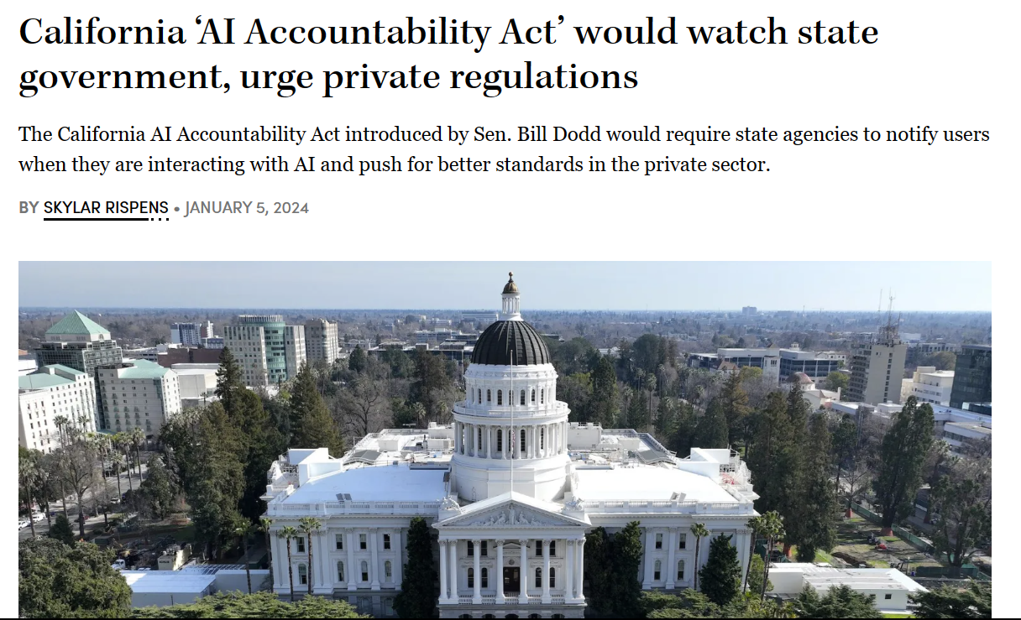

Slide 19
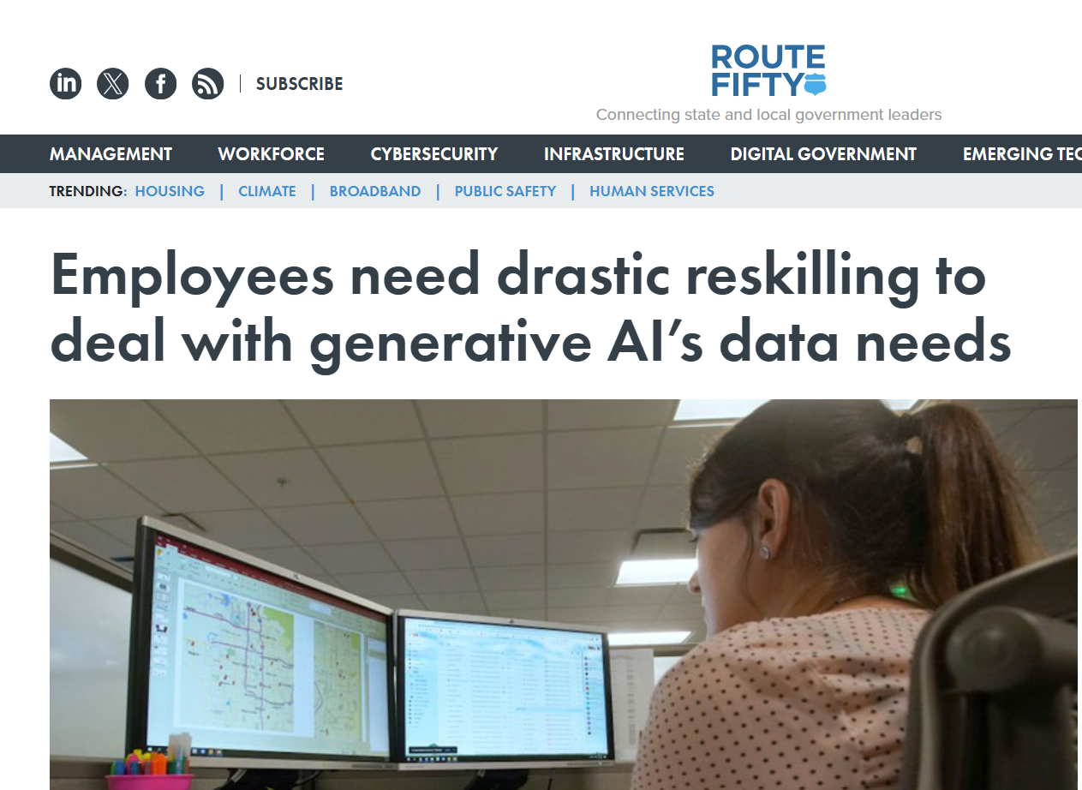

Slide 20

NASCIO Blueprint: 12 Considerations As States Develop Their AI Roadmaps
Align AI initiatives to strategic drivers for the organization.
Establish governance and oversight processes.
Inventory and document existing AI applications.
Address data quality and sourcing.
Collaborate with stakeholders and industry partners
Assess privacy and cybersecurity risks of AI adoption.
Infrastructure and technology.
Create acquisition and development guidelines.
Identify potential use cases.
Expand AI workforce expertise and training
Create guidelines for responsible use, ethics and transparency
Measure and communicate effectively.
Source: NASCIO.org, December 2023

Slide 21
ChatGPT can be used by local governments in several ways to improve their services and communication with citizens
Virtual Assistance: ChatGPT can be integrated into local government websites as a virtual assistant to answer frequently asked questions from citizens. This can reduce the workload on customer service staff and provide prompt, 24/7 assistance to citizens.
Service Request Management: ChatGPT can assist in managing service requests from citizens. For example, it can help residents report potholes, broken streetlights, or other issues and route those requests to the appropriate department for resolution.
Event and News Updates: ChatGPT can provide real-time updates and information on local government events, meetings, and news. This can help keep citizens informed and engaged in their local community.

Slide 22
Surveys and Feedback Collection: ChatGPT can be used to conduct surveys and gather feedback from citizens. This can help local governments understand the needs and opinions of their constituents and make data-driven decisions.
Emergency Response: In times of crisis or emergency, ChatGPT can provide critical information to citizens and help coordinate response efforts.
Accessibility: ChatGPT can provide information and support for people with disabilities, such as those who are visually or hearing impaired.
Language translation: ChatGPT can be used to translate text and speech into different languages, making it easier for people to communicate with each other regardless of their native language.

Slide 23
The Art of the Prompt
Clarity is King: Be clear and specific about what you want the AI to do. Avoid ambiguity by using concise language that precisely conveys your intent.
Context is Key: Provide enough background information for the AI to understand the scenario you're creating. This helps it make sense of your prompt and tailor the response accordingly. However, avoid information overload. Stick to relevant details.
Specificity is your Friend: The more specific you are, the better the AI can understand your desires. Instead of saying, “Write a story,” try “Write a science fiction story about a team of astronauts who discover a sentient planet.“
Keep it Concise: While providing context is important, avoid overly lengthy prompts. Strive for clear and concise instructions that effectively communicate your desired outcome.
Source: Google Gemini

Slide 24
The Art of the Prompt (Continued)
Embrace the Power of Questions: Don't be afraid to use question words like who, what, when, where, and why. These guide the AI in a specific direction and lead to more detailed and useful responses.
Refine and Iterate: The first prompt might not be perfect. Experiment with different phrasings, keywords, and details. Analyze the AI's response and tweak your prompt accordingly. This back-and-forth is how you get the best possible results.
Examples are Golden: If you have a particular style or format in mind, provide an example for the AI to reference. This can be a previous output, a specific writing style, or even an image for creative tasks.
Source: Google Gemini

Slide 25
Here are some example roles and prompts to use for role-playing with ChatGPT:
Role: City council member Prompt: As a city council member, ask me relevant questions and critique my responses as I present elements of my proposal for improving public transportation.
Role: City manager Prompt: As a city manager, provide feedback on my proposed plan to streamline city services using digital technology and suggest potential improvements or areas of concern.
Role: CFO Prompt: As a CFO, evaluate my proposed budget for the upcoming fiscal year, focusing on the allocation of resources to key infrastructure projects.
Role: Concerned citizen Prompt: As a concerned citizen, question the impact of the new housing development on our community’s resources and infrastructure, and suggest alternatives.
Role: Small business owner Prompt: As a small business owner, provide input on my proposal for a new economic development initiative aimed at supporting local businesses.
Role: Parent of a student Prompt: As a parent of a student in the local school district, provide input on a proposed project that the district is considering.
https://www.govtech.com/artificial-intelligence/chatgpt-example-prompts-for-state-and-local-government

Slide 26

Categories for AI
Conversational Interaction
Content Summarization
High-Quality Information
Natural Language Understanding
Learning and Research
Integration with Other Tools

Slide 27

Categories for AI
Data Extraction and Conversion
Scheduling and Coordination
Content & Art Creation
Emotional intelligence (measurement/interaction)

Slide 28
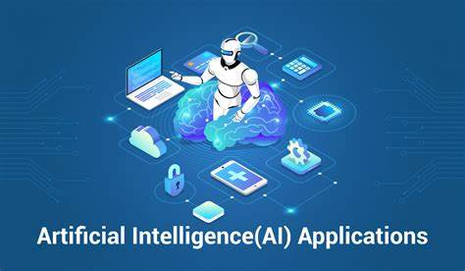
Shark’s Top AI Applications……
ChatGPT
Google Gemini
Perplexity AI
DALLE-E
Grammarly
Microsoft CoPilot
ChatPDF
Otter AI

Slide 29

On My Radar
Hume AI
Replika
Todoist
Voicea
Claude AI
Adobe Firefly
Canva’s Magic Studio

Slide 30
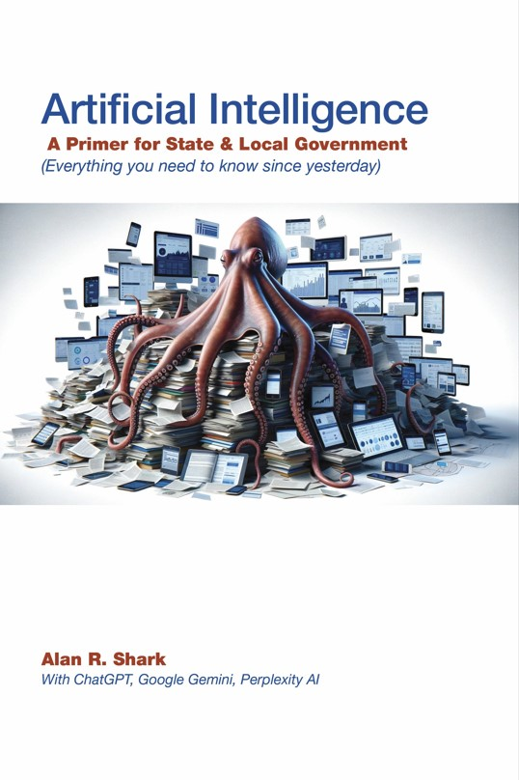

Barnes & Noble (Print)
Amazon Kindle (eBook)
Available Now!

Slide 31


Slide 32



Dr. Alan Shark
Executive Director
Public Technology Institute, a division of Fusion Learning Partners
ashark@pti.org

