Slide 1
AI: More Friend than Foe
Jennifer Robinson, Global Government Strategic Advisor

Slide 2

Agenda
1 Artificial Intelligence
2 Generative AI
3 FAQs
Notes:
When we think of AI, we often think of robots. But, not cute robots like this one…

Slide 3

Agenda
1 Artificial Intelligence
2 Generative AI
3 FAQs
Notes:
Creepy robots like this. Generally, most of us teeter between excitement and concern about the rise of Artificial Intelligence – or AI, as it is commonly known. Today, I’m going to provide for you an overview about what AI is and how it is being leveraged by the public sector.

Slide 4






How we got to where we are today….
…and where we are going in the future
Mathematics
Statistics
Neural Networks
Deep Learning
Generative AI
Next Gen of AI
Machine Learning
Simulation
Prevention
Preparation
Detection
Engagement
Management
Notes:
Analytics companies like SAS have been working for decades to get to this point in our evolution of AI. Beginning with a foundation in mathematics and statistics, machine learning and neural networks were developed. From there, deep learning evolved, and now – Generative AI. And all of these will be the foundation for the next evolution of data science that will further transform our world. Because analytics companies like SAS have deep experience with these technologies – in SAS’ case for nearly five decades – we are leaders of AI.

Slide 5


…and where we are going in the future
How we got to
where we are today….
Mathematics
Statistics
Neural Networks
Deep Learning
Generative AI
Next Gen of AI
Machine Learning
Simulation
Prevention
Preparation
Detection
Engagement
Management
Notes:
AI and Generative AI are unleashing amazing opportunities that will enable governments to be much more productive and effective – getting more done – better, faster, and easier. These technologies will enable us to run virtual simulations before taking real actions, prevent adverse events, prepare for the unknown, detect areas of concern sooner and with greater accuracy, engage in more meaningful ways, and manage our resources better.
Background notes:
Policy Analysis and Decision Making: Governments will be using AI to simulate various policy scenarios – testing the implications virtually so what they roll out has optimal impact.
Public Safety and Security: AI-powered systems will be putting the copious amounts of data collected by law enforcement and national security organizations to work improve safety – we’re talking about surveillance footage, social media feeds, and internal documents…. Generative AI can enhance this by generating synthetic data to augment training datasets for improved accuracy in threat detection.
Disaster Response and Management: AI will analyze satellite imagery, social media posts, and sensor data to detect emerging disasters, coordinate response efforts, and assess the impacts. Our ability to be prepared will be improved by simulating disasters and virtually testing response scenarios.
Healthcare and Public Health: Public Health organizations will be using AI to identify disease outbreaks, track the spread of infectious diseases, and predict healthcare resource needs. Generative AI will enable organizations to create synthetic patient data to train medical AI models, ensuring privacy while still providing valuable insights.
Citizen Services and Engagement: Governments will be able to use AI to improve productivity – providing better customer experiences while tackling their workforce challenges. AI-powered chatbots and virtual assistants will pair up with advanced analytics and AI systems to get the right answers and services to citizens faster.
Infrastructure Planning and Maintenance: AI algorithms can analyze infrastructure data, such as transportation networks and utilities, to optimize maintenance schedules, predict failures, and improve efficiency. Using Generative AI to simulate infrastructure demands, governments will be able to study the impact of capital projects on communities and the environment.

Slide 6



…and where we are going in the future
Prevention
Simulation
Preparation
Detection
Engagement
Management
What is Artificial Intelligence?
AI
Notes:
So, what is AI?

Slide 7
AI
Science of designing computer
systems to support and
accelerate human decisions
and actions.
Notes:
Artificial Intelligence is the science of designing systems to support and accelerate human decisions and actions.”
AI systems perform tasks that normally require human intelligence (Oxford definition). It’s called ARTIFICIAL intelligence because it refers to the simulation of human intelligence in machines that are programmed to learn and think. AI does not replace humans; it augments and accelerates what we do and how we do it, increasing overall efficiency and productivity.
Examples: visual perception, speech recognition, decision-making, comparisons, causes and effects, and translation and interpretation

Slide 8
AI
Natural
Language Processing
Computer
Vision
Machine Learning
Deep Learning
Notes:
When we talk about the different types of AI, we sometimes refer to them as “branches of AI.” Each branch performs different types of tasks.’
Here you see Computer Vision, Machine Learning, and Natural Language Processing. This slide and those that follow show the branches and technologies of AI. I’ll go into further definition of each term later in this presentation.
These three branches of AI are interconnected and often overlap, with advancements in one area often influencing progress in others.
It’s important to note that AI research and development continue to evolve rapidly, leading to the continual emergence of new discoveries and capabilities. This diagram is a high level overview and does not reflect the many dimensions of AI.

Slide 9
AI
Machine Learning
Natural
Language Processing
Computer
Vision
Deep Learning
Generative AI
“GenAI”
Notes:
Deep Learning is a subset of Machine Learning, built upon computer systems modeled on the human brain and nervous system.
.

Slide 10
AI
Machine Learning
Deep Learning
Natural
Language Processing
Computer
Vision
Generative AI
“GenAI”
LLM
Digital Twins
Synthetic Data
Notes:
And, Generative AI – or GenAI - is a subset of Deep Learning.

Slide 11
AI
Machine Learning
Deep Learning
Generative AI
“GenAI”
LLM
Natural
Language Processing
Computer
Vision
Synthetic Data
Digital Twins
Notes:
Three technologies within Generative AI are Large Language Models (referred to as LLMs), Synthetic Data, and Digital Twins.
For those of you who have been hearing a lot about ChatGPT, this is a type of Large Language Model. It is one of technologies that is known to be “Generative AI.”
Notice that the circles for Synthetic Data and Digital Twins fall outside of Generative AI and even the AI bubble. This is because there are many ways to create synthetic (or artificial) data and to create digital twins (or simulations). But today, I’ll be focusing on the aspects of these technologies that are AI.
Later in this discussion, I will discuss with you how this group of Generative AI – Large Language Models or LLMs, Synthetic Data, and Digital Twins – differ from traditional AI.

Slide 12
AI
Machine Learning
Natural
Language Processing
Computer
Vision
LLM
Digital Twins
Synthetic Data
Deep Learning
Generative AI
“GenAI”
Notes:
But, before we talk about Generative AI, let’s discuss traditional AI and what Machine Learning, Deep Learning, Natural Language Processing, and Computer Vision are and how these types of AI are being used in the public sector.

Slide 13

Machine Learning
Systems learn from data, identify patterns, and make decisions with minimal human intervention
Copyright © SAS Institute Inc. All rights reserved.

Slide 14

Property
Valuation
Counties are using Machine Learning (ML) to reassess every residential property in the community every night.
Notes:
Offering/Use Case/Pilot Name: SAS Property Valuation Integrity
What does this solution do?
Helps an assessor’s office quickly and accurately appraise its residential properties.
With machine-learning algorithms, the task of appraising properties becomes easier, faster, more accurate and less subjective. An assessor’s office can reappraise every property daily, based on the tremendous amount of data collected for every sold property. Perhaps most importantly, the intelligence of the model enables the assessor’s office to know the true value of every factor considered for a property, in accordance with other factors present in the property.
The machine learning models provide:
Daily reconsideration of every sale. Thousands of decision trees are run daily using data from property sales. From these decision trees, the algorithms extract the value of every factor for every property.
Factor ranking by importance. The algorithms identify the factors that are most influential in the value of properties.
Reappraisal of all properties. The machine-learning algorithm calculates the value of every property in the community. This allows the assessor’s office to understand market trends for homes, neighborhoods or the entire community
What about this is AI?
Advanced regression tree analysis by machine learning
What industry benefits are accomplished with this AI solution?
Strengthen government decision making with an integrated, real-time view of data.
Optimize resources and improve government effectiveness
Increase public trust while maintaining data privacy and ensuring AI transparency
Be better prepared to quickly respond in times of disruption and uncertainty.
Customer reference(s):
Wake County, NC; Mecklenburg County, NC; Buncombe County, NC
SMEs: Bobby Gutierrez, Jennifer Robinson, Dan Schaub

Slide 15
Investigations Management
Law enforcement agencies use Machine Learning (ML) to pinpoint offenders, identify criminal patterns and trends, and issue alerts about emerging threats.
Notes:
Offering/Use Case/Pilot Name:
What does this solution do?
Improve investigational outcomes using data-driven insights and decisions.
With advanced analytics and machine learning agencies can improve performance and reduce risk. Empower investigators to uncover new insights and
proactively identify patterns of escalating risk. Help managers:
Proactively identify patterns of escalating risk
Understand how to replicate good performance
Make informed policy and workforce decisions to drive results
What about this is AI?
(Steve Serrao will add content here)
Automating many of the manual aspects of analyzing data and extracting evidence—as well as assessing risk and helping officers prioritize cases more efficiently
What industry benefits are accomplished with this AI solution?
Point 1 - Instant access to comprehensive information
Point 2 Investigative decision support capabilities with speed and accuracy
Point 3 Powerful data visualization tools
Customer reference(s):
Delaware State Police Delaware State Police - Customer Success Slide (highspot.com)
Victoria Police (NOT EXTERNAL) Victoria Police - Customer Success Slide (highspot.com)
Australia Federal Police Australian Federal Police - Customer Success Slide (highspot.com)
SMEs:
Steve Serrao
Colin Field
Gordon MacColl
Steve Shirley

Slide 16

Transportation
Cities are using Machine Learning (ML) to understand commutes and predict traffic in real time.
Notes:
Offering/Use Case/Pilot Name: Transportation Excellence
Use artificial intelligence, machine learning and data analytics to predict and optimize Istanbul’s transportation data.
What does this solution do?
They installed thousands of sensors throughout the city and are using machine learning models to predict traffic and the flow of intersections. Being able to predict traffic daily within a 2.8% deviance means that they can take informed action to reduce traffic. And, with machine learning models processing data from thousands of sensors they are able to detect unusual speed drops within 5 minutes. This has resulted in improving traffic flow and reducing carbon dioxide emissions. They estimate that they have captured over 80 thousand tons of carbon dioxide within the year.
They are performing segmentation of commuter data. Machine learning empowers them to analyze in real time the use of commuters’ transit passes. With data from over 20 million passes, they are able to have insights about commuter patterns and trends which is helping them with operations and policy setting.
They are using machine learning in conjunction with blockchain to analyze the aggregated information and send proactive perks to citizens to encourage them to alter their commutes. With targeted notifications via a Mobile Traffic application, approximately 5 thousand vehicles are parked and withdrawn from traffic in just one month as citizens are incented to use public transportation.
What about this is AI?
Machine Learning models in conjunction with advanced analytics
What industry benefits are accomplished with this AI solution?
Reduce travel times
Reduce fuel consumption
Reduce pollution, and
Improve Citizens’ quality of life
Customer reference(s): Istanbul Metropolitan Mobility
SMEs:
Katy Salamati

Slide 17

Natural Language Processing
Enables understanding, interaction and communication between humans and machines.
Copyright © SAS Institute Inc. All rights reserved.
Notes:
Natural Language Processing enables understanding, interaction and communication between humans and machines.
NLP makes it possible for computers to read text, hear speech, interpret it, measure sentiment and determine which parts are important. The overarching goal is to take raw language input and use linguistics and algorithms to transform or enrich the text in such a way that it delivers greater value.
Natural language processing goes hand in hand with text analytics, which counts, groups, and categorizes words to extract structure and meaning from large volumes of content.
Earlier I told you that the branches of AI contribute to one another. The computer can augment human efforts to analyze unstructured text with AI using a variety of modeling approaches by combining the power of natural language processing, machine learning and linguistic rules. NLP and text analytics are used together for many applications, including investigative discovery, subject-matter expertise, and social media analytics.
Note: NLP has five major components:
Syntax. The study of the structure, arrangement, and order of words and phrases within a language to form grammatically correct sentences.
Semantics. The study of the meaning of words, phrases, and sentences within a language and how they convey information.
Discourse. The analysis of language beyond the sentence level, focusing on how language is used in context to convey meaning.
Speech. The production and expression of spoken language through vocalization, involving the articulation of sounds and words.
Dialogue. A conversation between two or more individuals or entities, involving an exchange of ideas, information, or opinions.

Slide 18
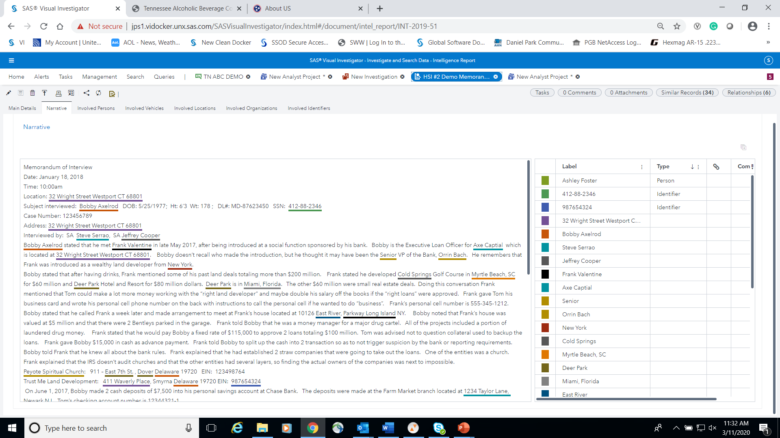






Natural Language Processing
Natural Language Processing
Notes:
Here is one common use of NLP: the extraction of information from text, also known as “unstructured data.” This text could be stored in a number of different applications and online.
For example, crime investigations typically involve a massive amount of intelligence reports. Not only are these reports extremely time consuming to read, the process of extracting key people, addresses, phone numbers and relationships that are pertinent evidence to a case can be cumbersome. New information learned from a crime report demands scouring previously read reports, making the process repetitive and lengthy.
With the use of Natural Language Processing, important points of interest. Taking the people, places, events, objects, phone numbers, and email addresses out of long-form text like crime reports and putting them into tables expedites the discovery of information.

Slide 19
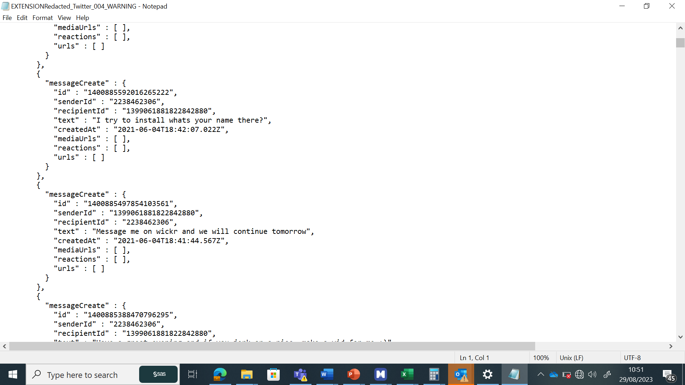
Categorise
Identification elements risk categories
Contextualize
Probable, possible or unlikely events
Tense
Past present or future
Score
High probability risk assessment in a collapsing timeframe
“I intend to abuse a child tomorrow”
“it would be hot to abuse a child”
HIGH
vs
LOW
Contextualize
Possible
Category
Sexual Term
Category
Child Access
Tense
Future
Contextualize
Unlikely
Category
Sexual Term
Category
Child Access
Notes:
The advancement of NLP continues to mature as components of Natural Language Processing are applied in new ways.
By analysing
“Syntax” - structure, arrangement, and order of words and phrases ,
“Semantics” –the meaning of words, phrases, and sentences and
“Discourse” – the analysis of language that focuses on how language is used in context to convey meaning.
…machines are able to find meaning in unstructured data.
In this example, applying linguistics and analytics, an NLP system can extrapolate from sentences the severity of concern. Here, what people write in fantasy chat logs reveal the probability of risk involved.

Slide 20

Child
Exploitation
Law enforcement agencies are using Natural Language Processing (NLP) to investigate crimes.
Notes:
Offering/Use Case/Pilot Name: Child Sexual Exploitation
What does this solution do?
Using AI and advanced analytics, the tool enables Child Sexual Exploitation (CSE) units to prioritize reporting and assess each case to assign a risk score based on data as the investigation progresses.
These risk scores help CSE units identify and prioritize cases where children are at immediate risk and respond quickly to protect them.
The Text Analytics and NLP models provide:
Extracts intelligence from chat logs to identify information about predators and victims as well as the presence of risk
A “Fantasy/Factual” model that using linguistics to determine the degree of risk that a writer poses
What about this is AI?
Visual Text Analytics extracts information required for an investigation from a chat log viewer embedded into SAS Visual Investigator and then uses Natural Language Processing to develop law enforcement taxonomy.
What industry benefits are accomplished with this AI solution?
Identify and respond to most urgent threats faster
Solve more cases with same number of staff
Save & protect more children
Transparent decision making
Officer wellbeing
Examples of impact reported by SAS customers using SAS’ child sexual exploitation (CSE) investigation tool:
89% less time spent searching for intelligence.
73% increase in the amount of intelligence discovered.
100% oversight support and governance over data
Also reduced the amount of potentially distressing material that officers needed to review by more than 99%.
Customer reference(s):
This has been piloted to law enforcement agencies
SMEs:
Ashley Beck and Teresa Jade
Other info:
Studies have shown that tens of thousands of children are being exploited online on a global scale and these numbers are rising which has serious psychological impact on mental health of young people in our communities across the world.
Over 29.3 million intelligence referrals were made to National Centre for Missing and Exploited Children (NCMEC) in 2021 which is a 57% increase in 5 years.
Social Media Companies are legislatively mandated to report any potential online child exploitation to the National Center for Missing and Exploitation Children (NCMEC).
Every police force across the world, receive Cybertipline reports from NCMEC.
The primary objectives of these investigations are:
Find children at risk
Gather intelligence to take action on suspects who commit a crime against children
Investigative text analytics Text analytics helps CSE units review online interactions between predators and their targets much more quickly. By processing large bodies of text automatically in seconds, this capability can save hours of tedious and often distressing work for investigating officers. In addition to identifying entities such as names and locations of persons of interest, the tool may help detect and highlight behaviors, or “conduct,” common in CSE cases, such as predators offering gifts to children or asking them to keep their interactions secret. Deep insights text such as “Tonight I am going to …”, “Next month I am going to …” and “I wish I could …” feeds into risk analysis and helps the tool prioritize cases more accurately. It also gives law enforcement insights into the intention behind behaviors. The tool includes detailed definitions of CSE related criminal behaviors that enable officers to understand offenders’ modus operandi and stay one step ahead as their tactics evolve. Profiling suspects can help to drive targeted, proactive investigations into the most dangerous and prolific offenders. At the same time, a better understanding of victim profiles can help officers develop and distribute preventive guidance and messaging to keep children and families safe.
SAS has a chat log viewer embedded into VI as well as the ability to pull from Visual Text Analytics to extract information required for the investigation. SAS uses NLP to develop a LE taxonomy.

Slide 21

Computer Vision
Enables systems to see, identify and process images or videos in the same way that human vision does.
Copyright © SAS Institute Inc. All rights reserved.
Notes:
Computer vision is a field of AI that trains computers to interpret and understand the visual world. Machines can use deep learning algorithms to accurately identify and classify objects in images and videos— and then react to what they “see.”
Applications of computer vision include facial recognition and surveillance image analysis.

Slide 22
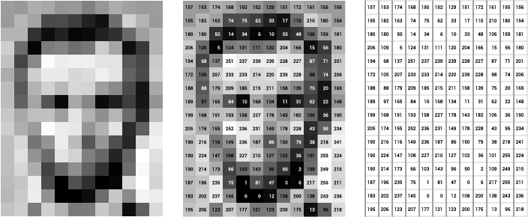
How Computer Vision Interprets Images
Notes:
I like this graphic which illustrates how computer vision works.
On the left, you see a portrait of a famous American. The image is pixelized and then a number is assigned to each pixal shade. On the right, you see how the computer defines the image.

Slide 23

Notes:
There are many types of computer vision that are used in different ways. A few of these are:
Image segmentation which partitions an image into multiple regions or pieces to be examined separately.
Object detection which identifies a specific object in an image. Advanced object detection recognizes many objects in a single image: a football field, an offensive player, a defensive player, a ball and so on. These models use an X,Y coordinate to create a bounding box and identify everything inside the box.
Facial recognition which is an advanced type of object detection that not only recognizes a human face in an image but identifies a specific individual.
Pattern detection is a process of recognizing repeated shapes, colors and other visual indicators in images.
Edge detection is a technique used to identify the outside edge of an object or landscape to better identify what is in the image.
Image classification which groups images into different categories.
Feature matching which is a type of pattern detection that matches similarities in images to help classify them.

Slide 24

Digitization of Paper
Governments use Computer Vision (CV) with Machine Learning and Text Analytics to quickly pinpoint and extract information from paper files.
Notes:
Offering/Use Case/Pilot Name: Document Vision
What does this solution do?
Uses AI to unlock value from untapped Government Data
With Computer Vision, Machine Learning and Text Analytics, Intelligent document processing extracts contextual information from scanned document images for downstream decisioning and analytics.
The CV, ML models with text analytics provide:
Automation of the extraction of key information from images or documents into a structured format, enabling downstream analytics and decisioning
Supplement any current OCR/RPA processes to significantly improve the accuracy and quality of the information extraction, especially with tougher forms like blurry documents, forms with checkboxes, or handwriting.
At this point: data can be leveraged for investigations, alerts can be generated, extracted entities can be made searchable, or the newly structured data can feed existing processes.
What about this is AI?
Computer Vision models, Machine Learning models
What industry benefits are accomplished with this AI solution?
Modernizes government filing and information systems
Significantly reduces man hours required to research and find information
Expands the amount of useful information available for insights
Positions an organization to be proactive in accomplishing their mission whether their mission is citizen services, investigations, operations,….
Customer reference(s):
Used for disability benefit claims, this solution is fully operational today and leverages SAS Document Vision to process about 7 million pages per day, saving about 80 FTEs of work, with an estimated ROI of 12M dollars.
SMEs:
Mary Beth Simmons, Stacey Wang, Matthew McTiernan
https://sas.highspot.com/spots/64f8bee4edbe2f0d91ce2c74?list=6570d56bb3c969ad693f0e77&overview=true
https://sasoffice365.sharepoint.com/sites/CivilianSEs/Lists/AI%20in%20Action/AllItems.aspx?viewid=b50d25dc%2D8904%2D40cd%2D838f%2De14172bc1119&playlistLayout=playback&itemId=13

Slide 25

Maintenance Oversight of Equipment
Utilities are using Computer Vision (CV) to monitor equipment.
Notes:
Offering/Use Case/Pilot Name: Utility Solar Inspection
What does this solution do?
Targeted solar farm inspection with use of drone-collected imagery detects and geolocates panels with contamination build up as well as panels that are not in proper “follow the sun” positioning.
Computer Vision provides:
Point 1
Point 2
Point 3
What about this is AI?
Digital twins that use Computer Vision to process imagery data.
What industry benefits are accomplished with this AI solution?
Inspect with greater ease, greater frequency, and less cost than manual inspections
Enhance performance with proactive cleaning
Extend the performance with proactive maintenance
Customer reference(s):
Anonymous
SMEs:
Steven Enck, Paul Venditti

Slide 26

Deep Learning
A type of machine learning used in recognizing speech, identifying objects in images, generating new content, and more.
Comprised of three or more neural networks.
Copyright © SAS Institute Inc. All rights reserved.
Notes:
Deep learning is a method in artificial intelligence (AI) that teaches computers to process data in a way that is inspired by the human brain.
Deep learning performs nonlinear transformations to its input and uses what it learns to create a statistical model as output. Iterations continue until the output has reached an acceptable level of accuracy. The number of processing layers through which data must pass is what inspired the label deep.
This is kind of a tough concept to digest. So, to explain this in overly general terms, imagine if you are blindfolded and asked to identify a piece of fruit.
First, a person shakes the fruit next to your ear. You don’t hear any loose seeds, so you can eliminate a dried squash (yes, that’s a fruit).
Then, the person asks you to smell the fruit. You eliminate banana, pineapple, peach, and most berries.
The fruit is put in your hands to hold. Touching it, you determine that it is either a nectarine or a plum.
Finally, the person gives you a taste of the fruit and you know: it is a nectarine.
When your blindfold is removed, your guess is confirmed.
In this same way, deep learning uses several levels of models to learn, predict, and take actions.
Now, if you were asked to be blindfolded and guess fruit again, would you start with listening to the fruit? No, you’d go right to tasting the fruit. In the same way, deep learning remembers the best models for a task and builds upon experience.

Slide 27
AI
Machine Learning
Deep Learning
Generative AI
“GenAI”
LLM
Natural
Language Processing
Computer
Vision
Synthetic Data
Digital Twins
Notes:
Three technologies within Generative AI are Large Language Models (referred to as LLMs), Synthetic Data, and Digital Twins.
For those of you who have been hearing a lot about ChatGPT, this is a type of Large Language Model. It is one of technologies that is known to be “Generative AI.”
Notice that the circles for Synthetic Data and Digital Twins fall outside of Generative AI and even the AI bubble. This is because there are many ways to create synthetic (or artificial) data and to create digital twins (or simulations). But today, I’ll be focusing on the aspects of these technologies that are AI.
Later in this discussion, I will discuss with you how this group of Generative AI – Large Language Models or LLMs, Synthetic Data, and Digital Twins – differ from traditional AI.

Slide 28





AI
LLM
Digital Twins
Synthetic Data
Natural
Language Processing
Computer
Vision
Generative AI
“GenAI”
Machine Learning
Deep Learning
What is GenAI?
GenAI

Slide 29
GenAI
An AI method that learns from
real-world data to generate new content, such as text, images, audio, code, videos, and tabular data.
Notes:
You’ve probably heard about Generative AI over the last year since ChatGPT made the scene.
Generative AI (GenAI) is at the forefront of today’s focus, not merely as an advancement of artificial intelligence but as transformative technology that has the power to reshape how businesses, governments, and humans innovate, operate, create and deliver value.
GenAI is an AI method that learns from real-world data to generate new content – and this could be text, images, audio, code, video, or tabular data, with similar characteristics of the data it is trained on.

Slide 30





Large Language Models
Synthetic Data
Digital Twins
Notes:
Three primary applications of Generative AI include Large Language Models (or LLMs), Synthetic Data, and Digital Twins.

Slide 31

Large Language Models (LLMs)
Deep learning algorithms that recognize, summarize, translate, predict, and generate content
Copyright © SAS Institute Inc. All rights reserved.
Notes:
An LLM analyzes huge amounts of text - millions or billions of words – to train itself to be able to know the relationships of words AND then produce human-like text.
For example, how would you finish this sentence, “Boy, after he messed up, he was in the Dog-” Did you say “Dog Treat” or Dog Days of Summer”? No, of course not. You said “Doghouse” because that is a common phrase that you have heard over and over again. “He was in the doghouse” is commonly associated with making a mistake, messing up, acting badly.
The inventors of Large Language Models took the NLP concept of scanning each word in a sentence and translating it in a sequential process to instead reading an entire sentence at once, analyzing all its parts and not just individual words. This provides better context.
So, LLMs track and learn relationships in sequential text – or text in which the arrangement matters - to respond to prompts using similar text.
When we ask an LLM like ChatGPT or Copilot to write a sonnet about our favorite dog and his love of slippers, it seems like the system is being creative and generating completely new ideas. In reality, the system – using millions or billions of data – sequentially lines up the most probable next best word or groups of words. With unlimited compute power and tremendous speed, tasks that would take humans hours, weeks, or even years to perform can be done in seconds.
One of the most prevalent uses of LLMs is as an advanced search engine. Not only does it retrieve information from the far corners of the internet or an internal database, it often assembles the information in a relevant and consumable manner. BUT, it is important to note that:
LLMs alone do not solve business tasks. The key is to integrate it into a decisioning process, layered with orchestration and governance.

Slide 32

Public Commentary/ Regulations
Government agencies
are using Natural Language Processing (NLP) with Large Language Models (LLMs)
to glean insights from
copious amounts of public commentary on regulations.
Notes:
Offering/Use Case/Pilot Name: Public Commentary Analysis
What does this solution do?
Categorize, synthesize, and summarize huge volumes of written feedback
By combining natural language processing, text analytics, and a Large Language Model identifies themes among written commentary, groups feedback into groups, and generates a written summary that highlights the key points. With this approach, the task of receiving written feedback becomes easier, faster, and more accurate.
The models:
Read tens of thousands of pieces of feedback
Identifies recurring themes among commentary
Identifies sentiment such as negative reactions
Compiles recommendations
Summaries the commentary by recurrent, similar, or customer defined themes
What about this is AI?
Natural Language Processing and Large Language Models (GenAI)
What industry benefits are accomplished with this AI solution?
By combining NLP and text analytics with a LLM:
Avoiding Hallucinations: The NLP and text analytics pre-filtering process assimilates the most relevant source data from various documents, ensuring that the generated outputs are more accurate and reliable.
Enhancing Time to Value: By pre-filtering the commentary, a smaller LLM like Llama2 can be used for generative AI as it is processing much less data.
Reducing Costs: Leveraging NLP and text analytics significantly reduces the amount of information sent into the LLMs, leveraging in some cases only 1-5% of the overall data for answers. This eliminates the need for excessive external API calls and reduces the computational resources required for localized LLMs.
Ensuring Privacy and Security: SAS Viya can leverage a local vector database for fine-tuning generative models. This allows SAS to provide only relevant embeddings to the LLMs via APIs or via localized instances of the LLM, ensuring privacy and security of sensitive data.
Supporting Verification: SAS Viya enables end-to-end verification and traceability of LLM answers, results, and summaries. By using text analytics results side-by-side with LLM summary information, users can verify the authenticity of the information and trace it back to the statements from which the summaries were derived, potentially thousands of statements. This traceability feature enhances transparency and trust in the generated outputs.
Customer reference(s):
Southern States Energy Board https://www.sseb.org/programs/secarb-usa/#primacy-sentiment
SMEs:
Tom Sabo

Slide 33

Specialized Copilot
Large Language Models (LLMs) will help governments mine their own data and receive guidance on furthering their investigations or research.
Notes:
Offering/Use Case/Pilot Name: Specialize Copilot for Investigations
What does this solution do?
A Specialized Copilot digs through the piles of intelligence data that has been pre-filtered with analytics and AI to answer powerful questions and pull out the most relevant information.
With large language models in conjunction with investigation analytics, the task of identifying valuable information from intelligence becomes more targeted, faster, and easier.
The large language model on top of an analytics platform:
Sits on top of an investigations system to tease out information that has been collected, resolved, mapped, and related
Coordinates queries and responses between the search engine and the LLM which then uses the new knowledge and its training data to create better responses.
Provides responses that are explainable, auditable and accountable which point to the specific citations and documentation that guided it
What about this is AI?
A GenAI Copilot consumes information prefiltered through an analytics platform to further pinpoint elements of interest and surface opportunities to collect or consider additional information.
What industry benefits are accomplished with this AI solution?
Improves the investigative process, going beyond summarizing information to highlighting potential information that may be of interest to investigators seeking to identify missing data or making associations between data
Enhances the usage of an analytics platform that reconciles information and maps entities from various records and data sources
Identifies the gaps within the investigative process by generating narratives and providing descriptions of key details with the use of organization best practice in an explainable way.
Surfaces information for an investigator while maintaining his or her role as the interpreter of facts
Customer reference(s):
List customer(s) and/or note if the reference is anonymous
SMEs:
Gordon Mullins, Michael McCahill

Slide 34

Synthetic Data
Artificial data that’s
manufactured.
Copyright © SAS Institute Inc. All rights reserved.
Notes:
Synthetic Data is on-demand, self-service, or automated data generated by algorithms or rules, as opposed to traditional data sets gathered from the real world.
Synthetic data reproduces the same statistical properties, probabilities, patterns, and characteristics of the real-world data set from which the synthetic data is trained.
Governments can use synthetic data for various purposes, including research, testing, and analysis, without violating privacy regulations or exposing sensitive information.
Synthetic data is often generated when there is not enough data or conditions are lacking in real-world data. For example, you want to test the concept of making a road improvement, but you only have a few months of traffic data. Creating synthetic data – such as simulated traffic flows – allows you to test possible road improvements. In cases such as this, creating fake data assists in training or testing models, running what-if scenarios, or identifying optimization.
it can also be used to protect sensitive data. Synthetic data can mimic actual data sets without containing any personally identifiable information (PII). So, you could create synthetic data to train and test a system that processes health records, student records, or tax information. It allows governments to harness the benefits of data-driven decision-making while respecting individuals' privacy and data protection rights.
When data is dirty or has gaps, more complete data can be created synthetically to improve the usefulness of the data set.
Synthetic data is found to be 99% statistically valid.
Examples you could pull from:
Potential Uses of Synthetic Data in government include:
Census and Demographics: Creating synthetic population data for demographic analysis, without exposing individuals' personal information.
Healthcare Research: Generating synthetic patient data for medical research, epidemiological studies, and healthcare policy analysis.
Education Planning: Using synthetic student and school data to improve educational planning and resource allocation.
Crime Analysis: Developing synthetic crime data for law enforcement and criminology research without compromising individual privacy.
Transportation Planning: Simulating travel patterns and behavior using synthetic travel data for infrastructure planning.
Economic Analysis: Creating synthetic economic data for economic modeling, forecasting, and policy analysis.
Cybersecurity Testing: Using synthetic network traffic data to test and improve cybersecurity systems and protocols.
Environmental Monitoring: Generating synthetic environmental data for climate and ecosystem research.
Social Services Allocation: Using synthetic data to optimize the allocation of social services like welfare, food assistance, and housing subsidies.
Election Simulation: Simulating elections and voting behavior using synthetic voter data for testing electoral systems.
Urban Planning: Generating synthetic urban data for city planning, including housing, transportation, and utilities.
Public Health: Creating synthetic disease outbreak data to model and test public health responses.
Taxation Analysis: Using synthetic financial data to analyze tax policies and revenue projections.
Weather Forecasting: Generating synthetic weather data to test and improve meteorological models.
Disaster Preparedness: Simulating disaster scenarios and response efforts using synthetic disaster data.
National Security: Developing synthetic data for military training and strategic simulations.
Energy Consumption: Creating synthetic data to analyze and optimize energy consumption patterns.
Agricultural Planning: Using synthetic agricultural data for crop yield predictions and resource allocation.
Immigration and Border Control: Generating synthetic immigration and border-crossing data for testing border security measures.
Historical Analysis: Creating synthetic historical data for historical research and data analysis projects.

Slide 35

Cyber Security
Organizations are using synthetic data and digital twins to simulate system environments in order to identify points of entry and to trick hackers.
Notes:
Offering/Use Case/Pilot Name: Cyber Security
What does this solution do?
Use synthetic data to create a realistic simulated environment.
With synthetic data to produce a digital twin of a real system environment, an organization can test its environment for weaknesses and vulnerabilities. e task of …. becomes easier, faster, more accurate and less subjective. [details here]
The digital twin provides a realistic version of the system environment so an organization can:
Identify points of entry
Trick hackers into thinking they are in the real environment
Watch how hackers move through its system
What about this is AI?
Synthetic Data is created using algorithms which can enable pre- and post- processing data. Data characteristics are replicated including statistical properties and distributions. Additionally, synthetic data quality is assessed with visual, evaluation metrics
What industry benefits are accomplished with this AI solution?
Protect the real environment from Hackers by identifying points of vulnerability before an attack occurs
Trick hackers into believing that are penetrating a real environment
Learn the behaviors and actions of hackers without compromising the real environment
Customer reference(s):
This cyber security environment is run by SAS on its own systems. No government customers use this at this time.
SMEs:
List SAS colleagues

Slide 36

Digital Twins
A virtual model designed to accurately reflect a physical object, system, or environment.
Copyright © SAS Institute Inc. All rights reserved.
Notes:
A digital twin is a virtual model of a physical object or system from the real world. For example, a government might build a digital twin of a road network, a supply chain, or financial system.
This digital twin can be used to make predictions about the real-world impacts, such as when an accident occurs on a highway, when a product shortage might occur, or when an economic disaster impacts taxpayers. What-if analysis can be used to virtually test the effects that certain decisions might have in the real world.
Digital twins can use a combination of historical, real-world data, synthetic data, and system feedback loop data as inputs. These inputs can be processed in batch or in real time. In the supply chain example, real-world data might include IoT data that streams from sensors attached to physical warehouses and machinery.
Examples you could pull from:
Potential uses of Digital Twins:
Smart Cities: Creating digital twins of parts of a city or an entire city to optimize urban planning, transportation, and resource management.
Water Infrastructure: Monitoring and managing water supply and distribution systems, including pipes, reservoirs, and treatment plants.
Traffic Management: Simulating traffic flow and optimizing traffic signal timings to reduce congestion and improve safety.
Public Safety: Planning emergency response, allowing authorities to simulate and plan for disaster scenarios.
Energy Grids: Optimizing the electrical grid to balance supply and demand, reduce outages, and incorporate renewable energy sources.
Waste Management: Tracking waste collection, optimizing routes for garbage trucks, and monitoring landfill usage.
Public Transportation: Simulating public transport networks to improve efficiency and user experience.
Healthcare Facilities: Managing and optimizing healthcare infrastructure, including hospitals and clinics, to enhance patient care.
Agriculture: Monitoring and managing agricultural resources such as soil quality, weather conditions, and crop growth.
Environmental Conservation: Monitoring wildlife and environmental conditions for natural reserves and protected areas.
Public Housing: Optimizing maintenance and energy use in public housing complexes to improve living conditions.
Education: Managing resources and enhance the learning environment for educational institutions.
Government Buildings: Managing government office spaces for efficiency and sustainability.
Customs and Border Control: Enhancing border security by simulating and monitoring border crossings.
Disaster Preparedness: Simulating natural disasters like hurricanes, floods, or earthquakes to plan and respond effectively.
Land Use Planning: Assessing land usage, zoning, and urban development.
Law Enforcement: Monitoring and optimizing police operations.
Election Management: Ensuring secure and efficient elections through simulations of voting processes.
Tourism Management: Enhancing tourism, helping manage crowds and preserve cultural sites of tourist destinations.
Government Procurement: Optimizing procurement processes and supply chain management to reduce costs and improve transparency.

Slide 37

Policy Making
Governments are ascertaining the ‘winners’ and ‘losers’ of potential tax changes before regulations are implemented with the use of digital twins.
Notes:
Offering/Use Case/Pilot Name: Belgium's Federal Public Service Finance
What does this solution do?
Belgium's Federal Public Service Finance uses SAS® Viya® to better understand the effects of tax reform. Getting a better handle on the potential effects of future tax reforms is a valuable contribution to public policy making. The team profiles the “winners” and “losers” before regulations are implemented.
The digital twin of the calculator that processes Belgium’s income taxes, Aurora, includes a copy of Belgium’s personal income tax data, the complex calculations and the multitude of business rules. Regardless of the scope, Aurora, based on SAS Viya, delivers fast, accurate answers. When data scientists need to evaluate the effects of a tax change on a microsection of the population, a sample won’t accurately represent the portion of the population they are hoping to study. They need to look at the entire population.:
The Digital Twin includes a
copy of Belgium’s personal income tax data,
the complex calculations and
the multitude of business rules
What about this is AI?
Digital Twin
What industry benefits are accomplished with this AI solution?
Data scientists at FPS Finance use analytics to help Belgium’s government make precise predictions
Better decisions that benefit the country – and its residents
According to Luyten, “Out of a total of about 67 billion euros, there was a difference of 6.70. But even that depends on rounding margins.”
By combining the correct graphs – visually appealing graphs – on modern digital devices like tablets and smartphones, the data is extremely valuable to our information consumers
Customer reference(s):
https://www.sas.com/en_us/customers/fps-finance.html
SMEs:
Michel Philippens

Slide 38

Flood Prediction
Governments are using digital twins to predict floods, enabling them to anticipate needs and allocate resources.
Notes:
Offering/Use Case/Pilot Name: Flood Prediction and Preparedness
What does this solution do?
With machine-learning algorithms and the use of digital twins, guesswork is taken out of the task of predicting and preparing for floods.
The machine learning models provide:
Real-time insights and situational awareness: current condition monitoring with automated alerting
Future flooding predictions with automated altering
Historical and forensic analysis
Forecasted flood inundation modeling
Simulations for emergency planners, improving modeling for various disasters
While the model has been developed using historical data (I.e. past events and where data was prevalent), this model can be deployed where hyper localized data is scarce. The model, powered by AI, fills in these data gaps.
What about this is AI?
ML models create an early warning detection system and Digital Twin technology enables a Forecasted Flood Inundation model.
What industry benefits are accomplished with this AI solution?
Protect: Improve citizen safety and emergency response services with real-time visibility and flood predictions
Respond: Reduce the impact of flooding incidents on property and infrastructure by automating and streamlining response
Improve: Enhance emergency planning with improved situational awareness and historical insights
Customer reference(s):
Florida Department of Environmental Protection and the Miami Dade Hispanic Chamber
SMEs:
SMEs: Tyson Echentile, Brandon Kooman, Kevin Kalish, Dev Kakde

Slide 39
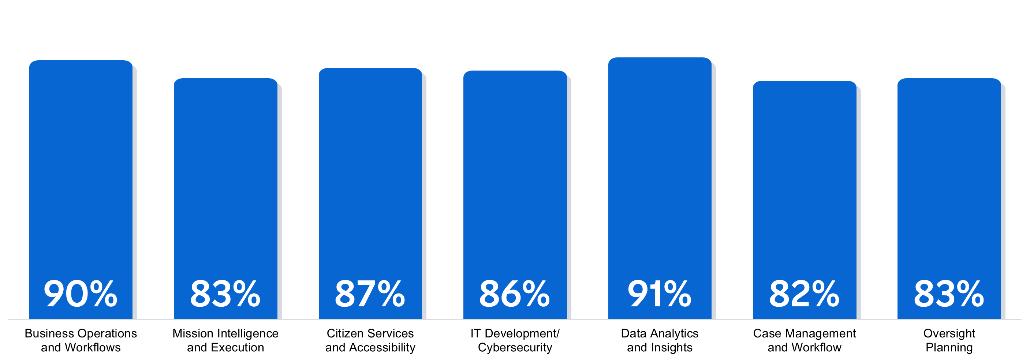
Gauging the Impact of Generative AI on Government
Survey by FedScoop
Top Types of Generative AI Solutions that Organizations Are Assessing:
Notes:
Sources:
https://cdn.fedscoop.com/gauging-impact-of-generative-ai-on-government-report.pdf
https://www.rezolve.ai/blog/generative-ai-government
A recent FedScoop survey of public sector business and IT executives gauged the Impact of Generative AI on Government:
87% Citizen Services and Accessibility
Instant Issue Resolution
Personalized User Support
Accessible Legal Documents
90% Business Operations and Workflows
Automation of Repetitive Tasks and Processes
Automated Report Generation
Automated budgeting and resource allocation
Easy and Effective Tax Collection – tax scenario testing, prediction and prevention of fraud, waste, abuse
91% Data Analytics and Insights
Automated data synthesis to fill in gaps, provide cleaner data sets, or mask PII
Simulations using Digital Twins – for environment, public safety, policy making, ….
Interpretations of analytics output – either verbal or visual
Case Management and Workflow
Streamlined document processing and knowledge management
Oversight Planning
Emergency Preparedness and Public Safety

Slide 40
Gauging the Impact of Generative AI on Government
Survey by FedScoop
Primary Benefits
65%
of respondents
64%
of respondents
Technical Support
Ability to reduce the time required
to complete work processes
Notes:
Sources:
https://cdn.fedscoop.com/gauging-impact-of-generative-ai-on-government-report.pdf

Slide 41



Why now?
Compute
Power
Analytic
Models
Data
Notes:
So, many people ask me: why now? If AI has been in existence since the 1950s, why is it taking off now? It comes down to the maturity of three elements: compute power, data, and analytic models. For anyone who ever did programming, you recall how long it took to churn a report that used a lot of data. In my first programming job, I would run reports before I left work and hoped that they would run without errors over night. Today, computers’ power to churn data is so great that those same reports run in seconds. Second, we have lots of data – especially in the public sector. All of this data is the fuel that AI needs to produce results. And, finally, we have sophisticated analytic models that take emulate tasks previously performed by humans.

Slide 42
What are Humans and Machines good at?
Common Sense
Intuition
Creativity
Empathy
Versatility
HUMANS
Large Data Sets
Complex Calculations
Learning
Automation
MACHINES
Notes:
Even with advancements in machine learning, deep learning, and generative AI, there is still a clear distinction between what humans and machines do well. Humans use common sense, intuition, creativity, empathy, and versatility. Machines take on tasks that humans could perform if we had all of the time in the world and didn’t get fatigued: processing large data sets – not only consuming, but learning from massive amount of data, performing complex calculations, and automating tasks which can be performed without human intervention or assistance.
While the advancement in generative AI suggests that machines will be able to take over the world, let’s remember how machines generate their output. In large language models, when given a prompt, machines grab the most probable next word, line of code, image, etc.. Some marvel at the LLMs creativity. But the creativity occurred when humans put information into the dataset. A machine doesn’t understand what it means to have a broken heart but will finish the sentence “When he left me, he broke my…” with “heart” because millions of people have written that.
A Large Language model is operating without common sense and true intuition. Because this approach is effectively guessing, LLMs only assemble and present what humans have previously rendered.
Example from ChatGPT:
Me
Finish this sentence: when he left me, he broke my...
ChatGPT
When he left me, he broke my heart into a million pieces.
Me
Finish this sentence: when he dropped the tray, he broke my...
ChatGPT
When he dropped the tray, he broke my favorite mug.

Slide 43
When are humans and machines better together?
Making sense of patterns and trends surfaced from large data sets
Interpreting results from
complex calculations
Assessing impacts of
simulated scenarios
Handling exceptional cases apart from those that can be automated
HUMANS
MACHINES
Notes:
Many people have asked me if AI is going to take away their jobs. Of course, we can’t predict the future, but what we are seeing is that AI is being deployed to complement the work of humans.
Making sense of patterns and trends surfaced from large data sets
Interpreting results from complex calculations
Assessing impacts of simulated scenarios
Handling exceptional cases apart from those that can be automated
…and so on…
In short – we expect machines to take on the work that is too cumbersome, too time-consuming – TOO BORING- so that humans can optimize their use of time to improve outcomes.
When a friend of ours from Microsoft is asked the question about whether AI will take over jobs, he says, “No, AI is not going to take your job. Someone who knows how to use AI is going to take your job.”
GOOD AT:
Consuming Large Data Sets and Applying Common Sense
Interpreting Results from Complex Calculations Using Intuition
Learning from Patterns and Creatively Solving a Problem
Automating a Process and Making Exceptions Based on Circumstances
GOOD AT:
The machine can quickly analyze vast amounts of data to identify key patterns and trends as well as points of interest, freeing up the human to use his time to make sense of these revelations.
The machine can handle routine customer inquiries, freeing up the human to dig deep into solving challenging issues that require common sense, intuition, or particular care.
The machine can optimize logistics and processes while the human handles exceptions and makes strategic decisions.
The machine can test complex scenarios, allowing the human to spend his time assessing the impacts of policies, procedures, actions, and decisions.
The machine can customize learning experiences for students, giving the teacher time to identify areas of improvement and provide targeted support.

Slide 44
Trustworthy AI
Developing and
using AI technologies in an ethical manner
Ensuring AI does not harm people
Asking not just, “Could we?”, but also “Should we?”
Building AI that reflects our values as a society
Remembering the people impacted by each decision
Notes:
AI technology is VERY powerful and will become even more so. But as with any great power, there is great responsibility.
At SAS, we know that advances in technology don’t exist in a vacuum and can have far-reaching effects and implications.
We consider trustworthy and ethical AI to set the strategy and guardrails for all AI and GenAI. We must place human-centricity, citizen interests, and doing the right thing first.
SAS is committed to innovating responsibly while inspiring and empowering our customers, partners, and communities to do the same.

Slide 45


Learn more about AI
Learn more about
AI in the public Sector
Learn more about Generative AI at SAS

Slide 46

Thank you.
Jennifer Robinson
jennifer.robinson@sas.com

