Slide 1
Generative AI Policies in Local Government
Chris Teale
Reporter, Route Fifty

Slide 2
Generative artificial intelligence tools like ChatGPT and Google’s Gemini have generated a lot of hype and prompted some local governments to write policies governing their employees’ use of the technology. Hear from some of the first to implement those policies about how they drafted them, use cases that could benefit from generative AI and how they navigated various challenges.
Notes:
Provide practical insights into the process of drafting policies to regulate the use of generative AI tools within local government settings.
Explore use cases for generative AI in local government operations.
Examine the experiences and strategies of early adopters to learn how to anticipate and mitigate risks.

Slide 3
Agenda
My background and why we’re here
AI’s promise for local government
Boston: early mover
Tempe, Arizona: early mover II
Wentzville, Missouri: small city
Takeaways
Questions/discussion

Slide 4
My background
Route Fifty - state and local government at GovExec Media Group
Tens of thousands of subscribers: daily, tech, roundup newsletters
Website, in-person and virtual events, TV spots
Partnership with The Atlas
I report on technology in SLG, including AI
Reported for over a decade – the last 6 on technology

Slide 5
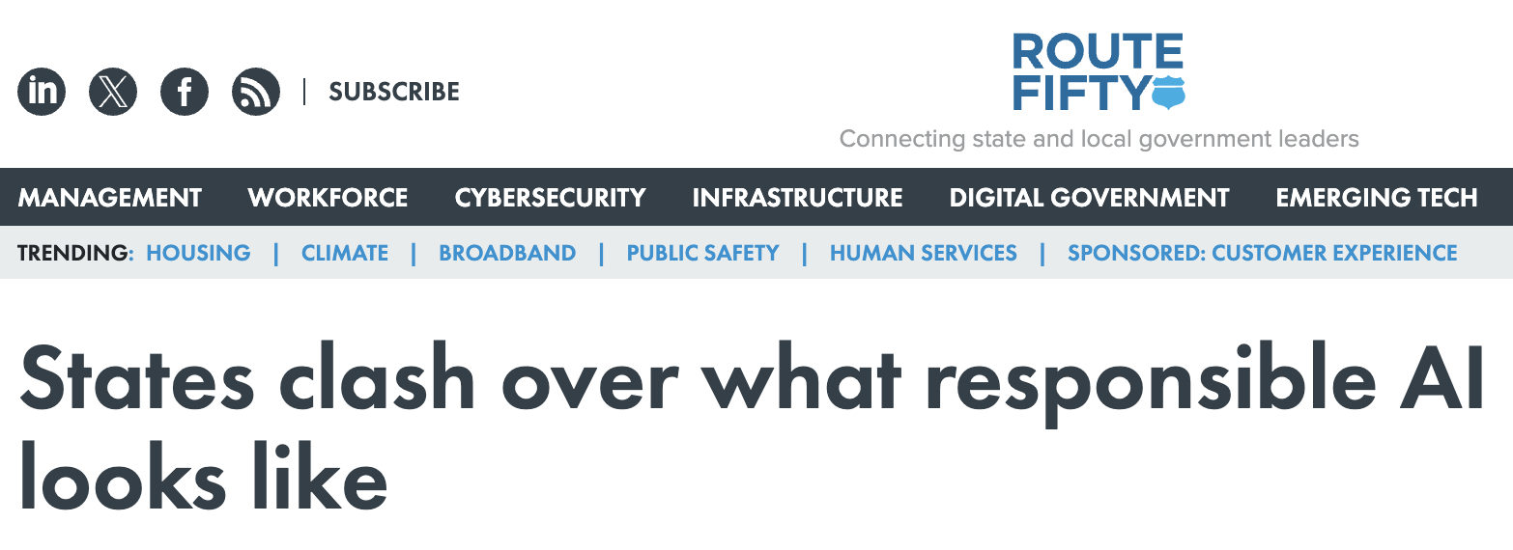
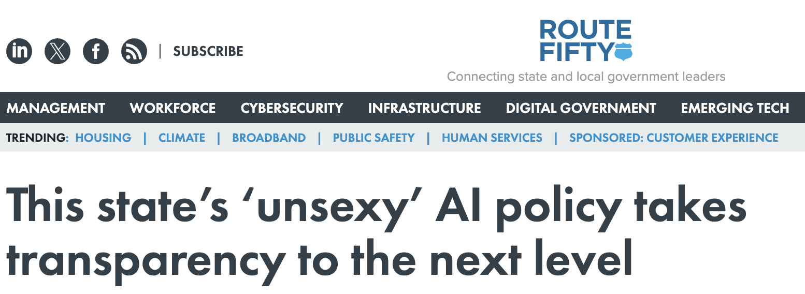
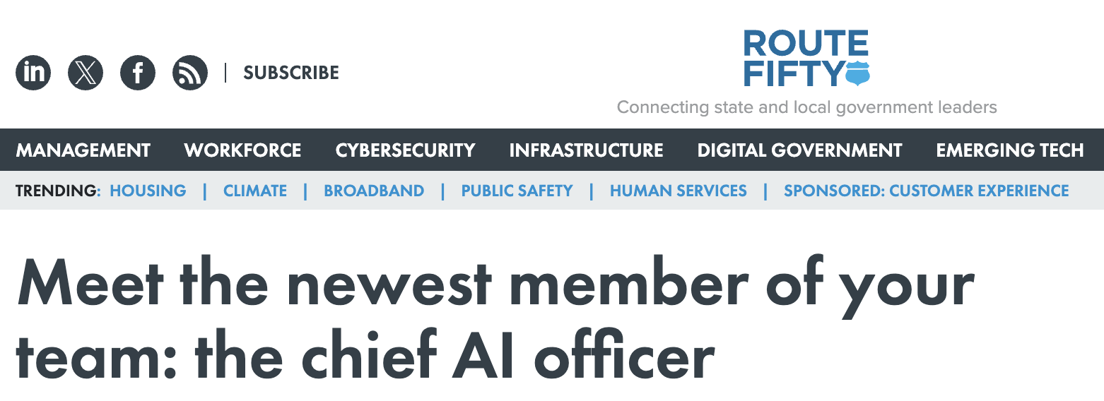
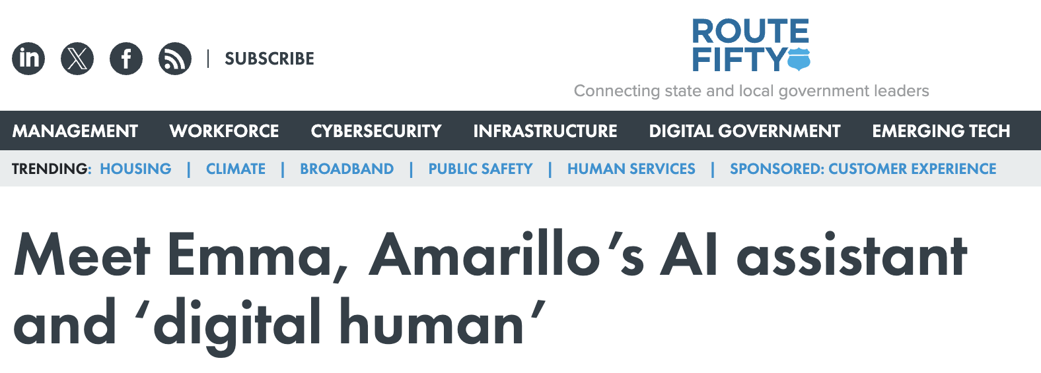
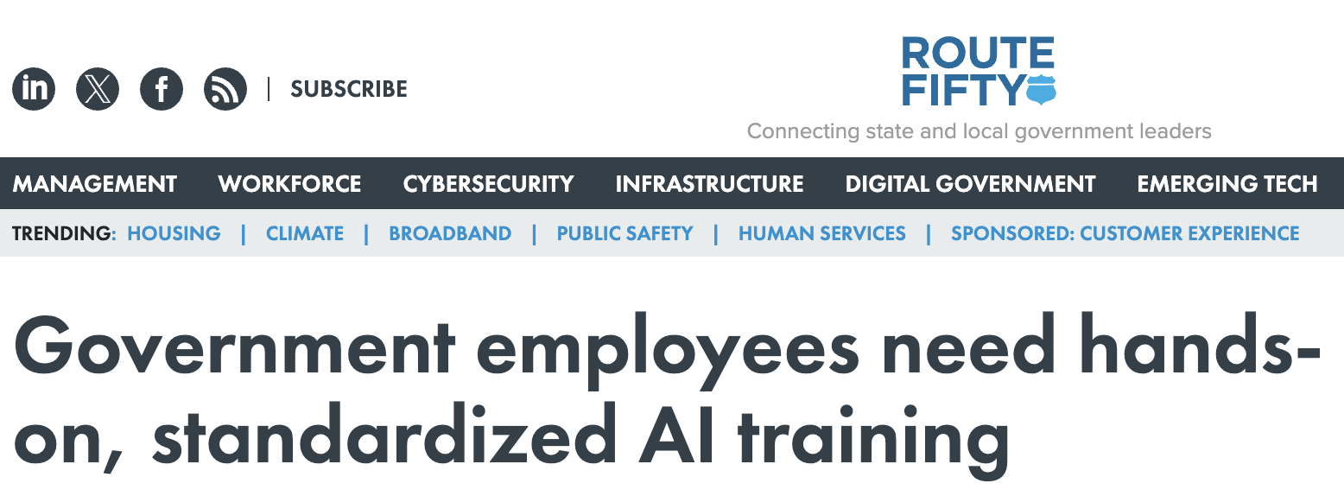

Slide 6
AI’s promise for local government
Accelerated after President Joe Biden’s 2023 executive order on AI
“Co-pilot, not an auto pilot”
Help with permit approvals, administrative tasks, summarizing meetings, writing RFPs
Chatbots, help with public benefits approvals, cybersecurity monitoring
Not replacing jobs, but augmenting them

Slide 7
But…
Oklahoma AI task force: reduce government workforce from 21% to 13% of population
AI is already here!
Michael Mattmiller, Microsoft: “This is not a far-out technology. This is a technology that is here today.”

Slide 8
Early Mover: Boston

Slide 9
Boston’s generative AI policy
Released interim generative AI guidelines in May 2023
“Technology enables our work; it does not excuse our judgment nor our accountability”
Employees banned from using PII when experimenting with generative AI
Using it to improve employee productivity
Transparency
Boston CIO Santiago Garces: “It's a tool that gets you maybe 70% or 80% of the way there, but you still need to have expertise to be able to discern whether it's giving you things that are correct, whether it makes sense in the context of the city”

Slide 10
Boston’s next steps
Plans for other uses: simulated community meetings
Nov. 2023 opinion piece in Fast Company: “Boston experimented with using generative AI for governing. It went surprisingly well” (Garces and Stephen Goldsmith)
Urging other cities to borrow from their guidelines for their own
The city wants to be a leader on AI

Slide 11
Early Mover II: Tempe, Arizona

Slide 12
Ethical AI Policy
Released July 2023
Transparency, fairness, accountability, protection of individual rights
“Human-AI Collaboration” – first explicit use of this
“We will encourage collaboration between humans and AI systems, leveraging the strengths of both to enhance decision-making processes and ensure that ultimate control remains with humans”
At that time, the city hadn’t deployed any “novel AI technologies” like chatbots or automated review

Slide 13
AI Governance
Departments need “clear objective and goals”
Review process
Technology and Innovation Steering Committee
Monitoring, reporting and evaluation of AI solutions
“Define consequences” for non-compliance: discipline, contract termination, remedial measures
Public awareness and education campaigns

Slide 14
Small City: Wentzville, Missouri

Slide 15
Wentzville, Mo.
47,000+ people, just outside St. Louis
Fastest growing city in the state (allegedly)
An early adopter of new technology
Using generative AI to automate some communications
In-person workshops, trainings and electronic training
Saving time from having to rewrite content

Slide 16
Human oversight
Leaned on existing policies – AI policy was not in place at the time
Ethics policy was a big help during the experimentation phase
Human oversight is required – in line with organizational standards for style and tone
Starting small and demonstrating value

Slide 17
Bonus: New York City’s AI Action Plan

Slide 18
New York City’s AI Action Plan
First plan of its kind for a U.S. city – unveiled Oct 2023
Broad framework to evaluate AI and risks, train employees and responsibly implement AI
37 “key actions,” with 29 to be started or completed inside 12 months
“Holistic, adaptable framework” governing AI use
Others have these too!

Slide 19
Takeaways

Slide 20
Takeaways
Human oversight
Augmenting jobs and employees’ work
Working alongside the machines
Still experimenting
Have policies/guardrails in place
Transparency

Slide 21
What comes next?
More EOs coming from states, reports and findings to follow
More cities to issue policies
The technology will keep evolving
Policies must adapt too
New use cases?

Slide 22
“This technology behooves us not to ignore it.”
Santiago Garces, CIO, Boston

Slide 23
Questions?

