Slide 1
A Futurist for the Small City
Sheila Shockey & Mike Scanlon
Founder & CEO Management Consultant
Shockey Consulting Services, llc.

Slide 2
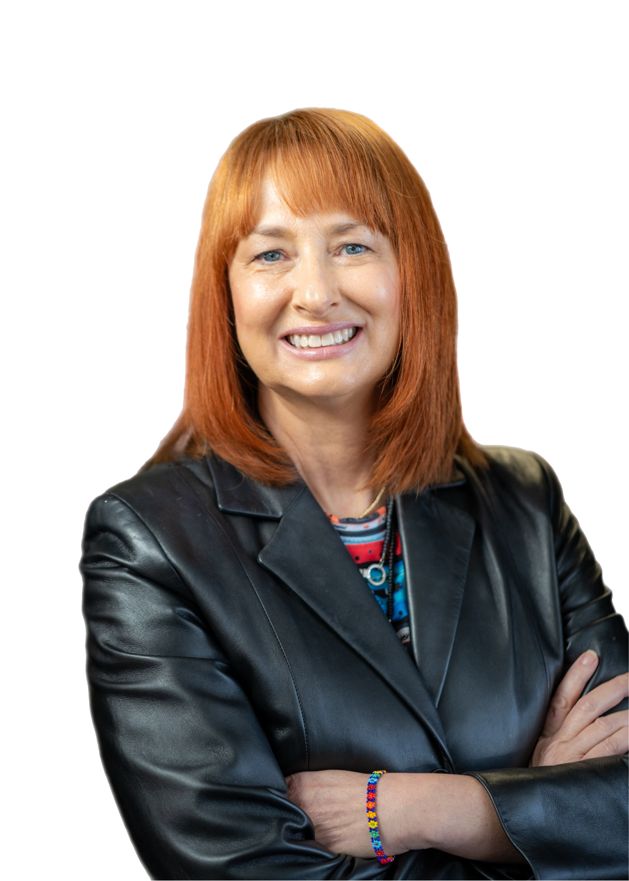
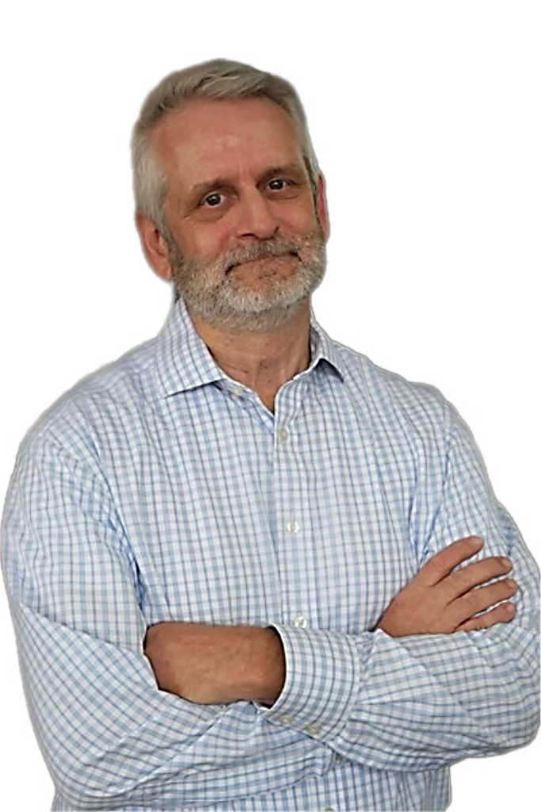
Futurist Thinking
What is it? Why do I need it? What are the challenges?

Slide 3
What is a futurist?
A futurist studies long-term trends from a global perspective, identifying their implications for business and society.
A futurist’s work can range from creating industry forecasts and policy agendas to speculating about how our work, education, healthcare, and families are poised to change.
This is called Strategic Foresight.

Slide 4
What can Strategic Foresight do for my organization & community?
While no one can predict the future, foresight allows us to mine the external environment for trends and issues and leverage those insights to create maps of the emerging landscape.
These well-informed maps of the future will enable us to test our current strategy, develop breakthrough innovations, and create transformative change.

Slide 5
Why Think Like a Futurist?
Telos Thinking – Greek means ultimate aim or purpose
Are you Vision and Mission Driven?
To What End?
Authenian Oath
Notes:
Telos thinking. Telos comes from Greek, and it means “ultimate aim” or “ultimate purpose.” This entails asking yourself one question: “To what end?” As we try to solve a particular problem, we also should think about what will come after we solve it. Physicist and philosopher Thomas Kuhn, who created the term “paradigm shift,” said, “People don’t shift unless they have a vision of what it is they’re shifting to.” That was the power of what Martin Luther King, Jr., did in his “I Have a Dream” speech. He went through the list of contemporary problems and issues, but then he gave a strong understanding of what his dream was and what would come after.​
In our short-term society, we often feel like we don’t have control over the future, that it’s this thing we’re just waiting to wash over us. But that isn’t true. We do have control, but it requires strategic thinking and action on our part, imagining many possible futures, and thinking beyond our own lifespans. We should all try to push past our own lives — it may make us do things that are a little bigger than we thought were possible.​

Slide 6
Why is it difficult for most people to think like a futurist?
PERMANENT PRESENT
NOSTALGIA
CULTURAL LIFE SCRIPT
EXTREME POSITIVITY BIAS
Notes:
Permanent Present: Our brains naturally project what we currently know into the future, seeking certainty and continuity. We tend to ignore clues and ideas that don’t fit with our experiences. We get stuck in our knowledge to date.
This is a mindset called the PERMANENT PRESENT.
To think like a futurist is to think outside of that box. Purposely expand your horizons to imagine ideas and events that haven’t yet occurred.
Imagining the future is a kind of NOSTALGIA because humans predict what the future will be like by using their memories.
This is how things you do repeatedly become routine.
Memory helps people predict what it will be like to do things they haven’t done before.
Where do you see yourself in 10 and 20 years? Your answer likely relies heavily on something called a CULTURAL LIFE SCRIPT.
This is the progression of events that life in a particular culture is expected to contain.
Your accumulated experiences—and your cultural life script—are the only building blocks you must construct a vision of the future.
This can make it hard to expect the unexpected, and it means people often assume the future to be more like the past, or the present than it will be.
Without prompts, data, research, visualizations, and storytelling, it is literally impossible for people to think about the future as something completely different.
It is also difficult for people to identify the challenges because our life script makes us optimistic with extreme positivity bias toward the future.

Slide 7
What Futures Are Coming Soon to You?
SOCIAL * ECONOMIC * POLITICAL * ENVIRONMENTAL * DEMOGRAPHICS * TECHNOLOGY * EDUCATION ETC

Slide 9
What do I like to read?
The Economist World Economic Forum
The Atlantic Institute for the Future
CityLab - Bloomberg Nextcity.org Wall Street Journal Forbes.com
Kiplinger.com Urban.org
Wired Magazine
Disruptordaily.com
Organization for Economic Cooperation and Development Conference-board.org/data/usforecast
International Monetary Fund World Outlook
ICMA American Planning Association
APWA
ASCE
futuristinstitute.org
worldfuture.org
Visual Capitalist - Signals

Slide 10
Who are Top Futurists?
Dr. Andy Hines: - Known for: Faculty member at the University of Houston’s Graduate Program in Foresight, with a focus on applying foresight to local governments. - Areas of focus: Urban futures, strategic foresight, scenario planning. - Affiliation: Principal at Hinesight, co-founder of the Foresight Network.
Michio Kaku: - Known for: Theoretical physicist, author of "Physics of the Future" - Areas of focus: Physics, future of science, technological advancements
Amy Webb: - Known for: Founder of the Future Today Institute, author of "The Signals Are Talking" - Areas of focus: Emerging technologies, data analytics, strategic foresight
Faith Popcorn: - Known for: Founder of BrainReserve, author of "The Popcorn Report" - Areas of focus: Cultural trends, consumer behavior, future of work Ramez Naam: - Known for: Author of the "Nexus" trilogy and "The Infinite Resource" - Areas of focus: Renewable energy, biotech, innovation Daniel Burrus: - Known for: Founder of Burrus Research, author of "Flash Foresight" - Areas of focus: Technology trends, innovation, future of business

Slide 11
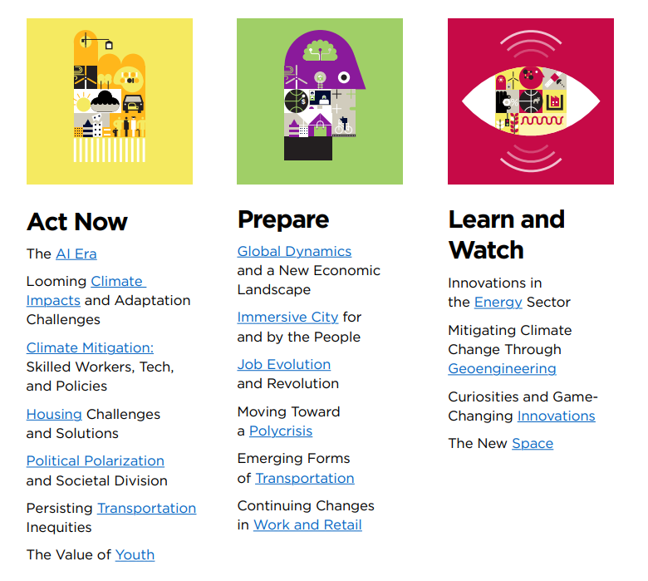
Look for Signals

Slide 12
How do I develop trends?
PROMPT:
Act as an expert futurist.
Ask me clarifying questions.
Identify the top 20 trends that will impact communities under 25,000 populations in the US, specifically in the state of Kansas, more specifically the eastern side of the state. Provide links to your research. Then after you get the top trends, ask ChatGPT to write a paragraph explaining each trend. Make the paragraph five sentences.
Notes:
Permanent Present: Our brains naturally project what we currently know into the future, seeking certainty and continuity. We tend to ignore clues and ideas that don’t fit with our experiences. We get stuck in our knowledge to date.
This is a mindset called the PERMANENT PRESENT.
To think like a futurist is to think outside of that box. Purposely expand your horizons to imagine ideas and events that haven’t yet occurred.
Imagining the future is a kind of NOSTALGIA because humans predict what the future will be like by using their memories.
This is how things you do repeatedly become routine.
Memory helps people predict what it will be like to do things they haven’t done before.
Where do you see yourself in 10 and 20 years? Your answer likely relies heavily on something called a CULTURAL LIFE SCRIPT.
This is the progression of events that life in a particular culture is expected to contain.
Your accumulated experiences—and your cultural life script—are the only building blocks you must construct a vision of the future.
This can make it hard to expect the unexpected, and it means people often assume the future to be more like the past, or the present than it will be.
Without prompts, data, research, visualizations, and storytelling, it is literally impossible for people to think about the future as something completely different.
It is also difficult for people to identify the challenges because our life script makes us optimistic with extreme positivity bias toward the future.

Slide 13
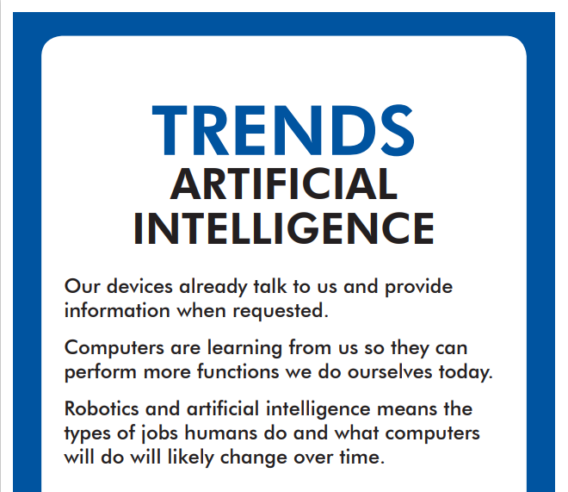
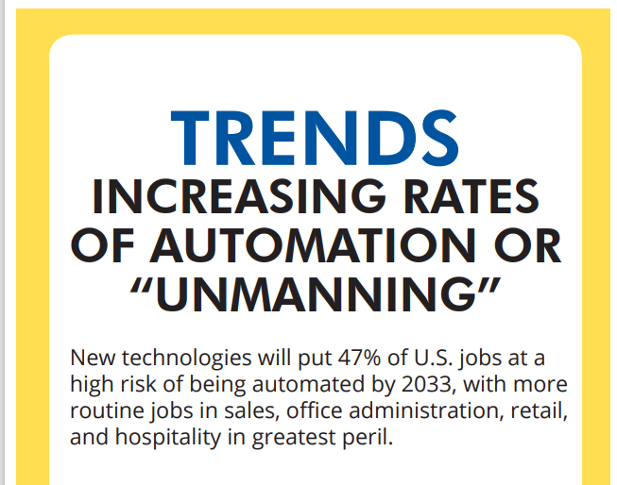
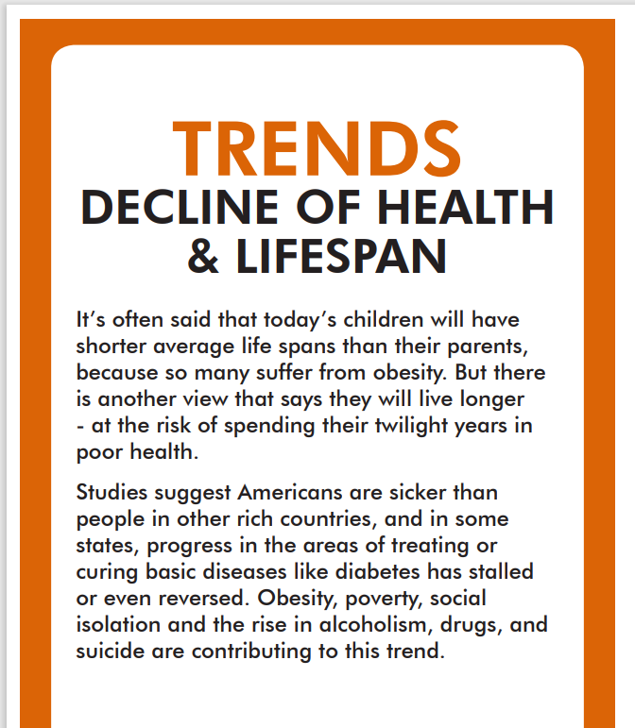
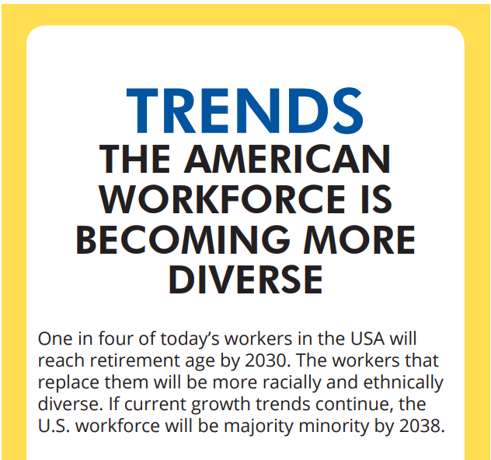
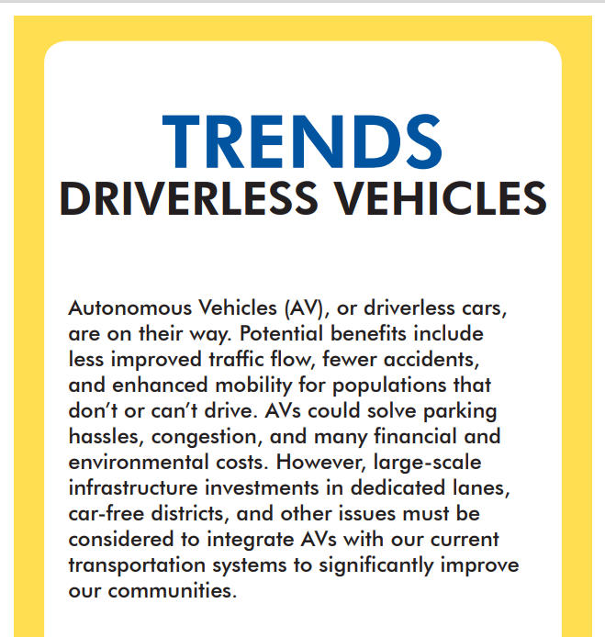
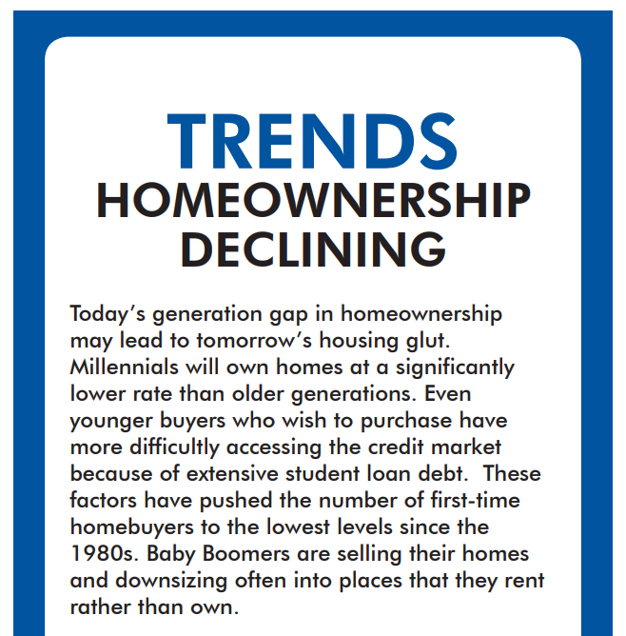
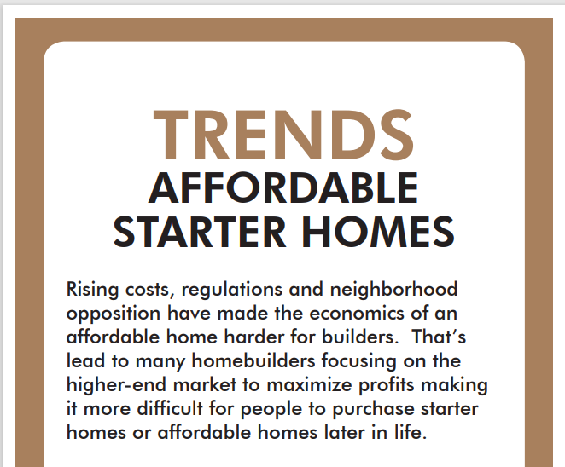

Slide 14
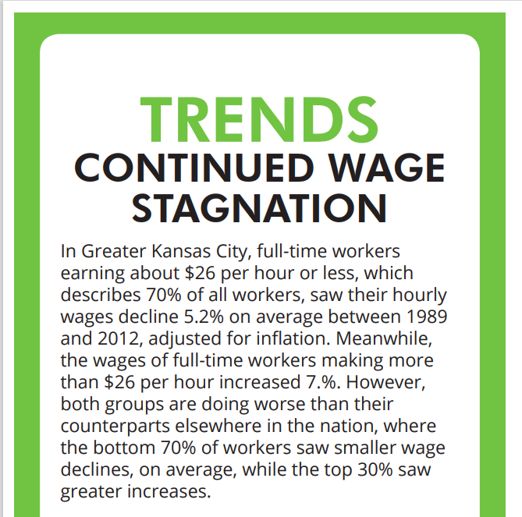
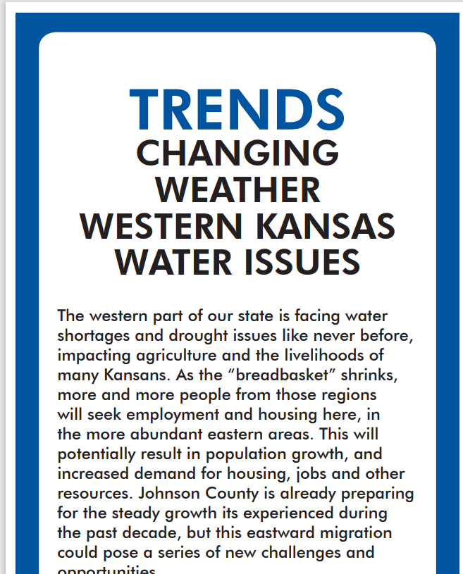
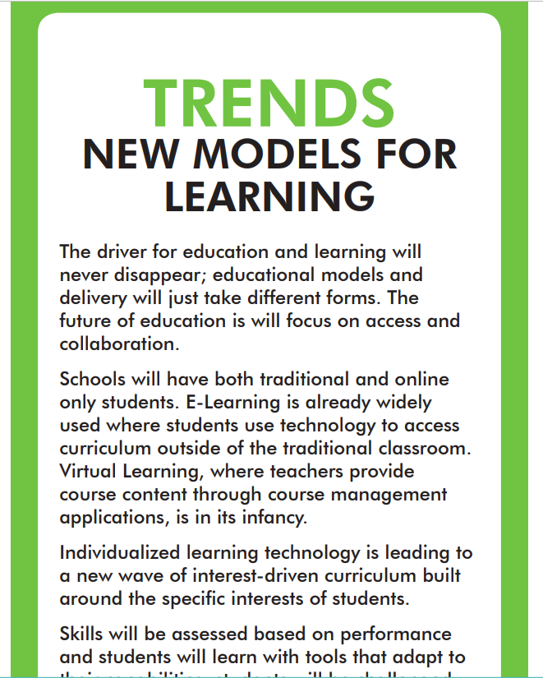

Slide 15
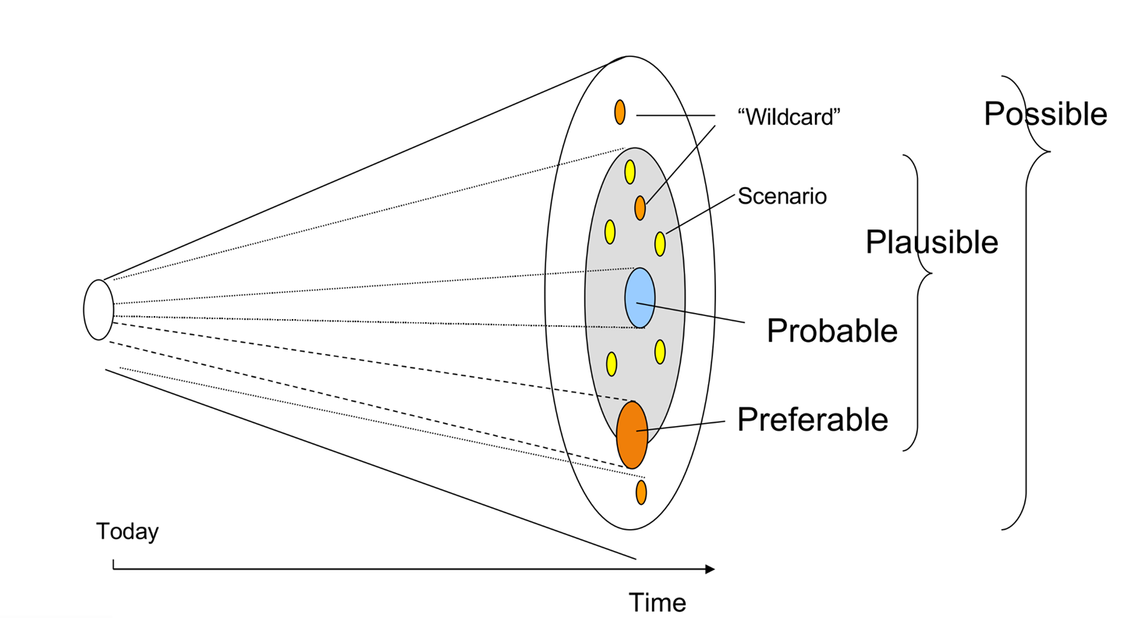
Types of Futures
Possible - “might” happen (future knowledge)
Plausible – could” happen (current knowledge)
Probable - “likely to” happen (current trends)
Preferable - “want to” happen (value judgements)
Notes:
Plausible is a deep driver
Probable is a trend.

Slide 16
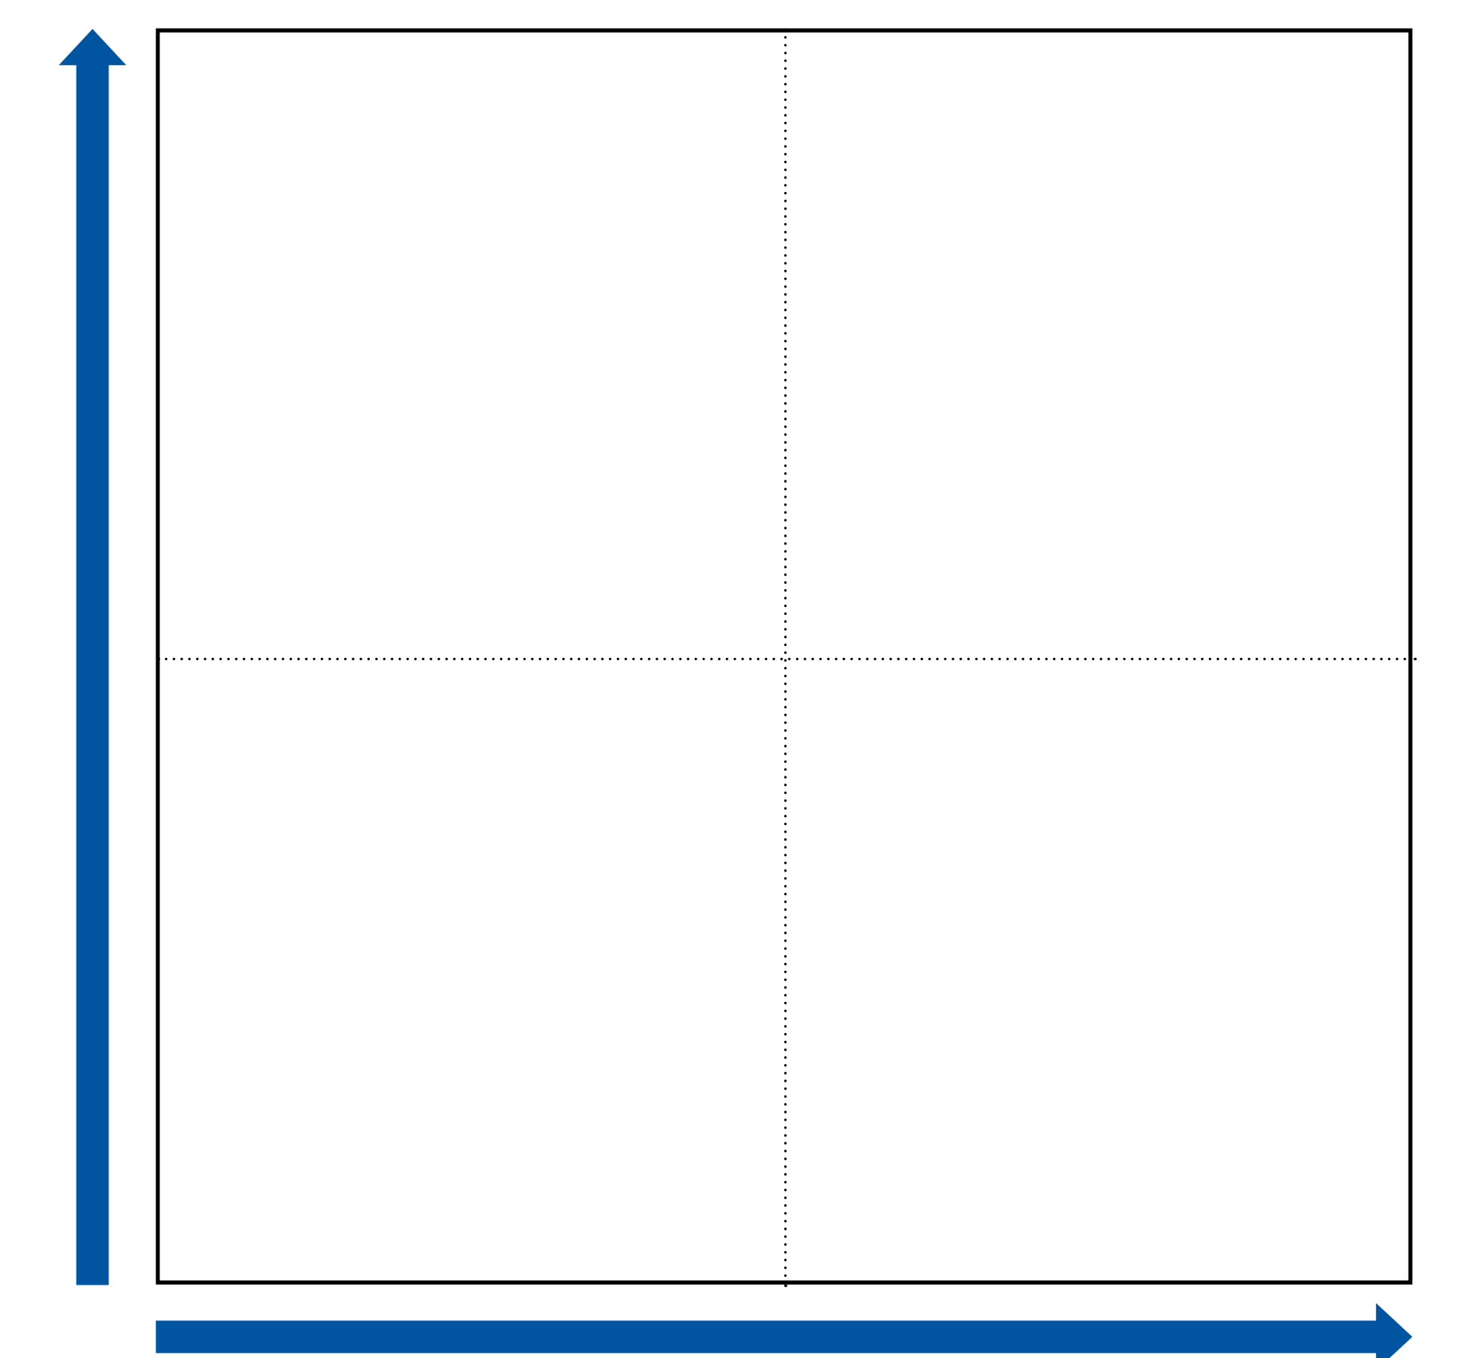
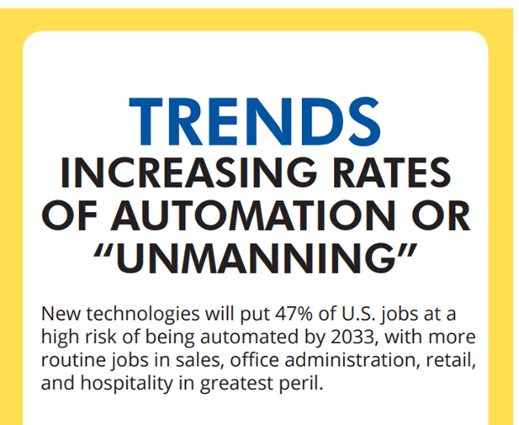
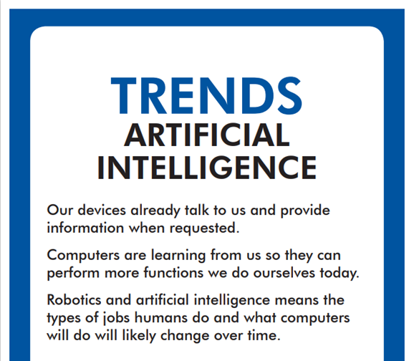
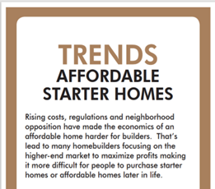
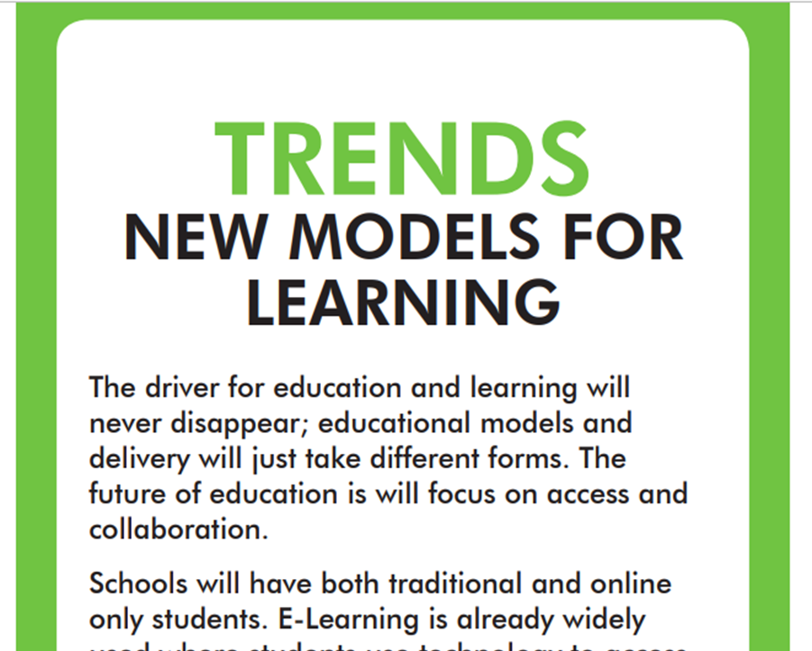
Trend Sort
HIGH IMPACT
LOW PROBABILITY
HIGH IMPACT
HIGH PROBABILITY
Impact
Focus on “Act Now” Quadrant
Don’t put in between – decide – you are likely to be wrong so embrace the unknown.
Come to consensus
LOW IMPACT
HIGH PROBABILITY
LOW IMPACT
LOW PROBABILITY
Probability

Slide 17
Trend Analysis
Strengths, Weakness, Opportunities, Threats (SWOT)
Goal Setting
Transgenerational Thinking
Scenario Planning

Slide 18
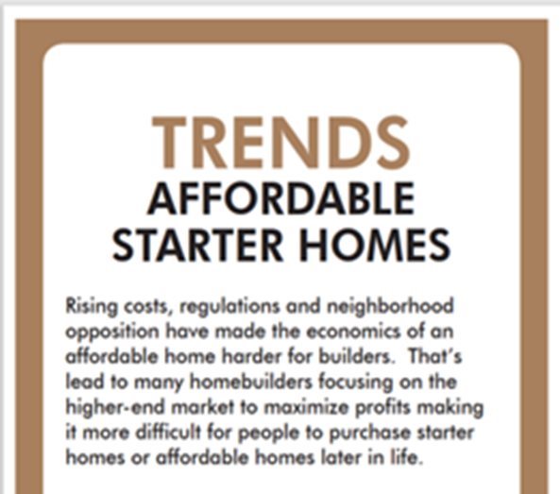
SWOT To Analyze Trend
HELPFUL
HARMFUL
TOWARD ACHIEVING VISION
STRENGTHS
WEAKNESSES
INTERNAL
TO ORGANIZATION OR COMMUNITY
EXTERNAL
OPPORTUNITIES
THREATS

Slide 19
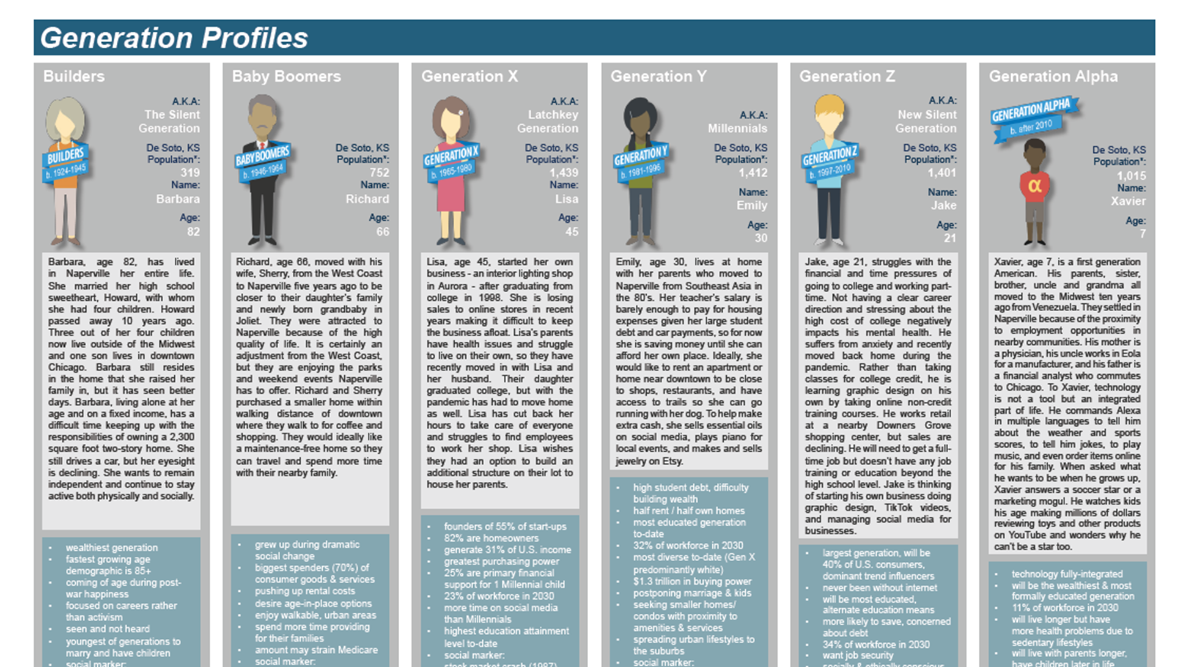
Transgenerational Thinking
Put yourself in the shoes of others and think about what they need now and will need in the future!
Notes:
Transgenerational thinking. When we think about doing good in the world, almost all of us think about doing it sometime between our birth and our death. But with transgenerational thinking, you can expand how you think about problems, your role in solving them and the consequences. ​

Slide 20
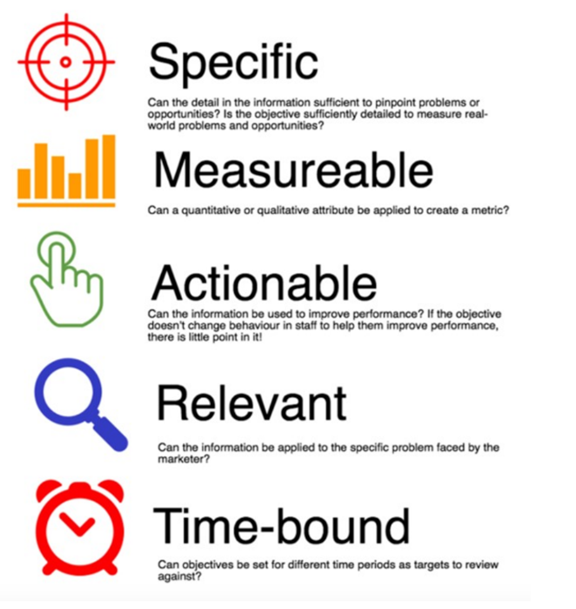
Set Goals

Slide 21
Strategies & Actions

Slide 22
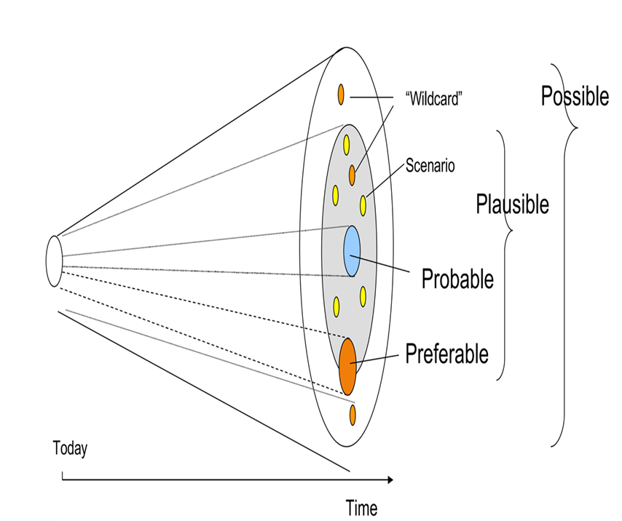
Scenario Planning
Enhanced Efficiency and Augmented Workforce
In this scenario, AI is used to augment the workforce in city government, leading to significant improvements in efficiency and productivity. Routine and repetitive tasks are automated, allowing city employees to focus on more complex and strategic activities.
Workforce Reduction and Redeployment
In this scenario, the adoption of AI leads to significant downsizing within city government. Many administrative and operational roles are automated, resulting in a reduction in the workforce.
Strategic AI Integration
In this scenario, AI is integrated into the decision-making processes of city government, providing data-driven insights and recommendations to improve policy and management.
AI-Driven Community Interaction
In this scenario, AI plays a central role in enhancing citizen engagement and participation in local government. AI-powered platforms facilitate communication, feedback, and collaboration between the government and residents.

Slide 23
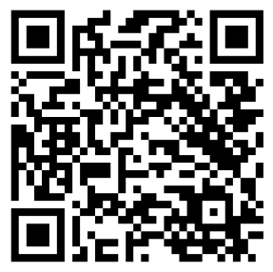
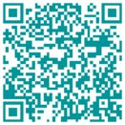
Let’s Connect!
Sheila Shockey
Founder & CEO
Mike Scanlon
Management Consultant

