Slide 1




Collaborating for Change:
How the Estes Valley is Tackling Workforce Housing and Childcare Challenges
Travis Machalek, Town Administrator, Town of Estes Park
Jason Damweber, Deputy Town Administrator, Town of Estes Park
Notes:
-Cheesy but very apropo title
-Presentation will focus on how we jumped on an opportunity to create a dedicated revenue source to address housing and childcare issues
-Success in the local ballot measure is owed completely to strong collaboration, as is putting the newly created revenue source to work

Slide 2
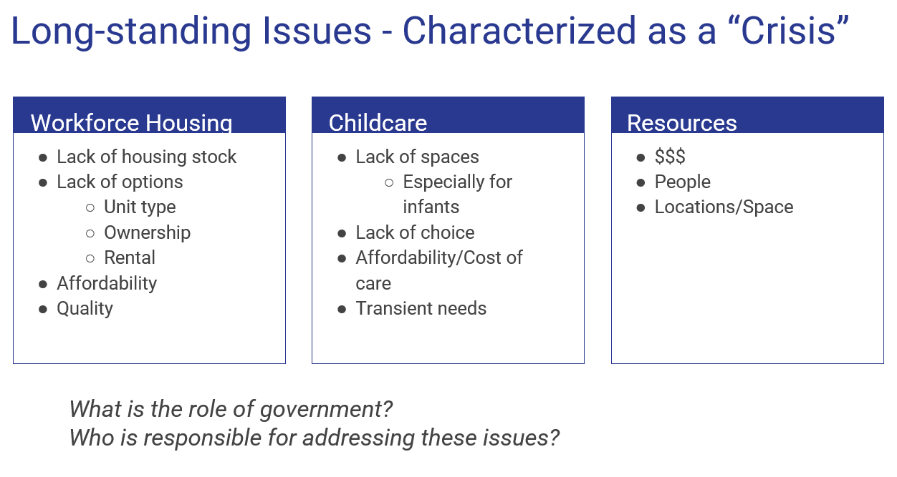
Notes:
-You are acutely aware of these issues, so I won’t dwell on the problem…
-For decades there were philosophical questions about the role of government and who should really be responsible for addressing the issues

Slide 3

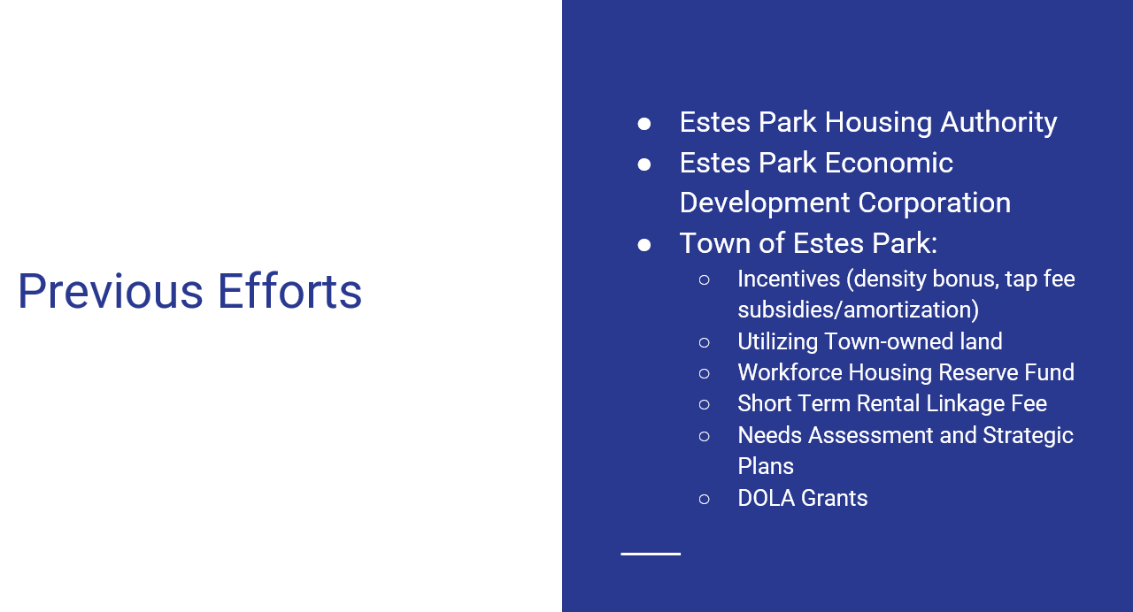
Notes:
-There was collaboration, but not really impactful results…
-More recently, the Town took some actions to better poise us for the future, but again, it was really drops in a bucket that would take a long time to work

Slide 4
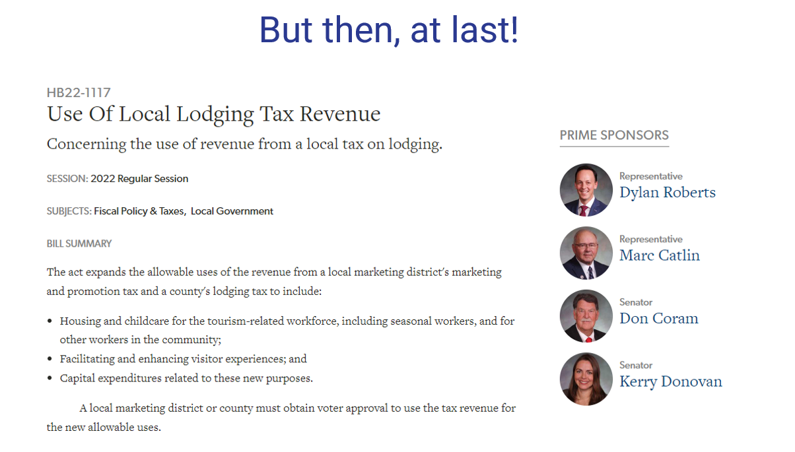
Notes:
-Finally, a door was opened with enabling legislation that allowed LMDs to use revenues to address housing and childcare issues…
-Collaboration in the effort really started with our joint lobbying efforts (VEP, Town, EPHA)
-Had to decide whether to have a ballot measure at all and, if so, what it would ask for
-How to get it passed
-How money would be spent, administered, accounted for, etc.

Slide 5
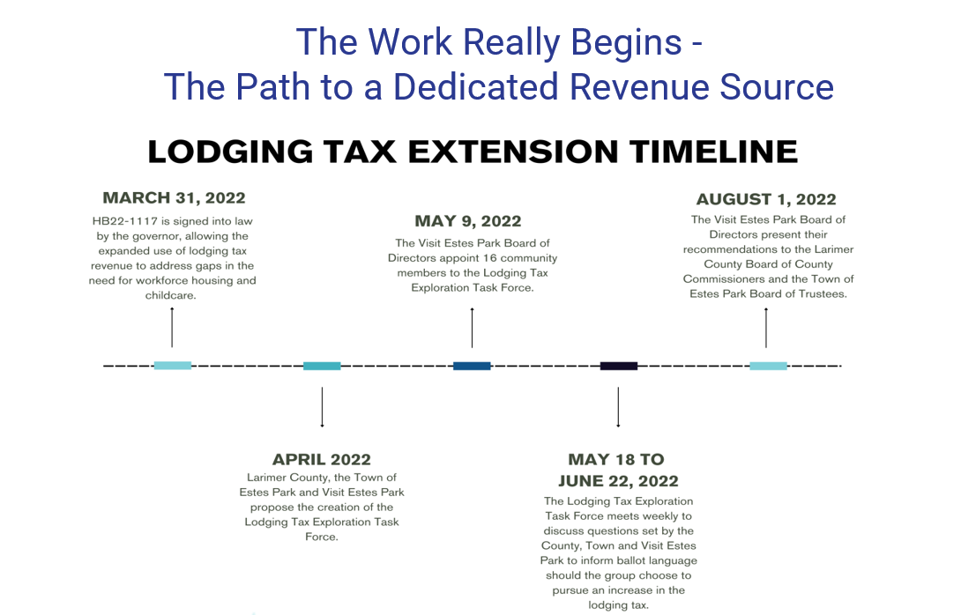

Slide 6
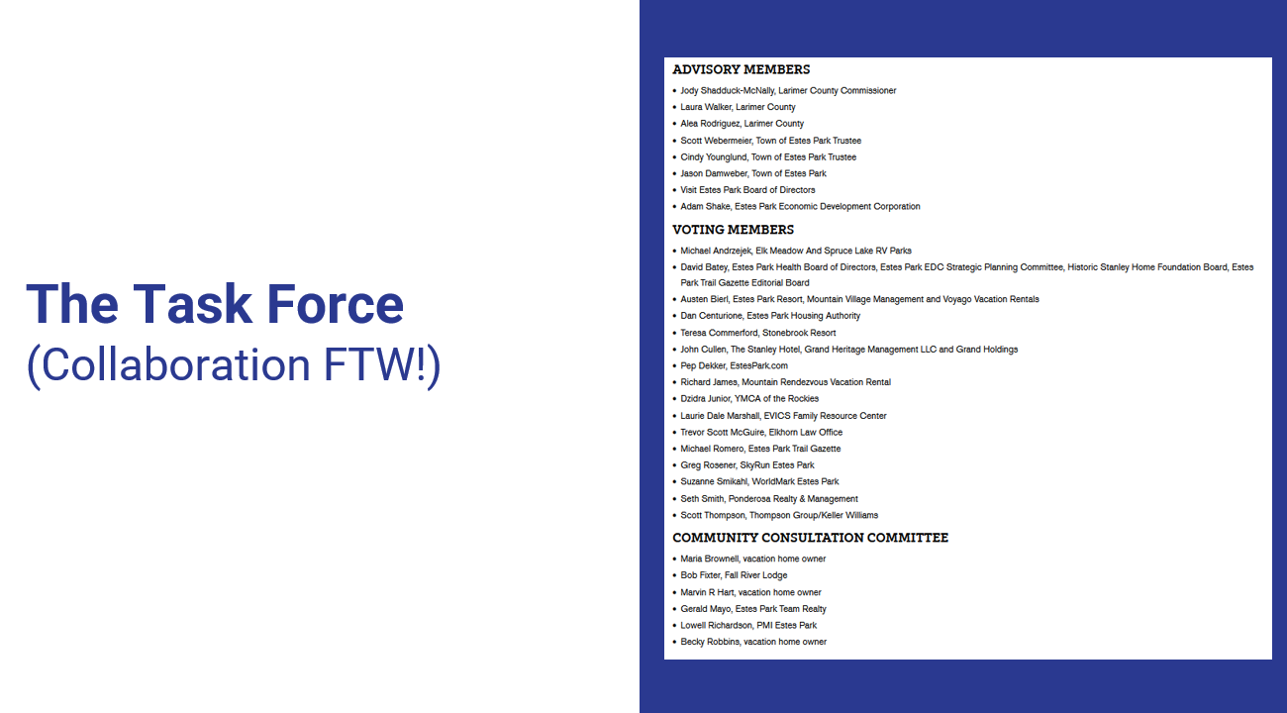
Notes:
-Just a glimpse of those formally included in the task force (COLLABORATION)
-Elected, business leaders, nonprofit leaders, local government staff, vacation rental owners, real estate agents, etc.

Slide 7
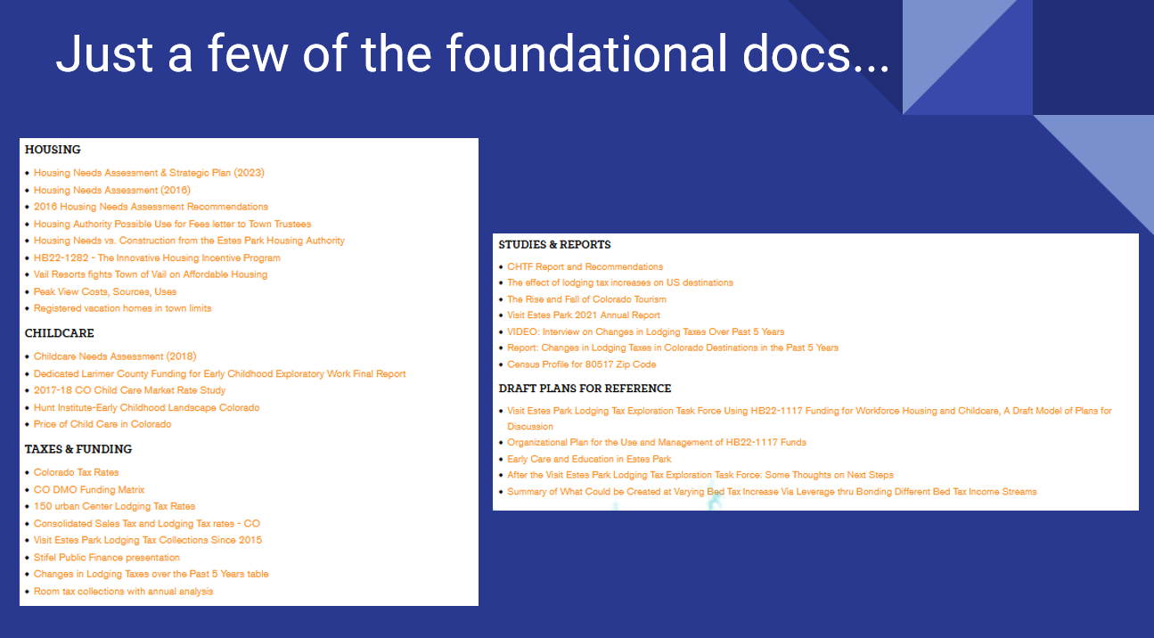
Notes:
-Needs assessments, strategic plans
-Studies on demographic trends, taxes, interrelationships between taxing sources, market analyses
-Tourism reports and white papers
-Feedback from interviews, surveys, focus groups, etc.

Slide 8
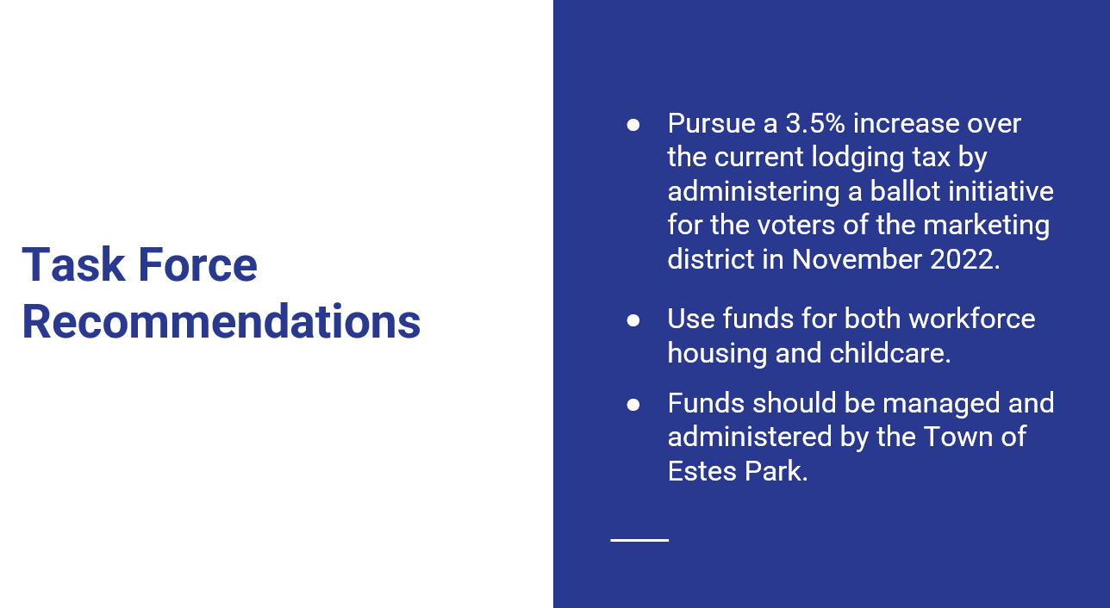
Notes:
-In the end, the Task Force recommended…

Slide 9
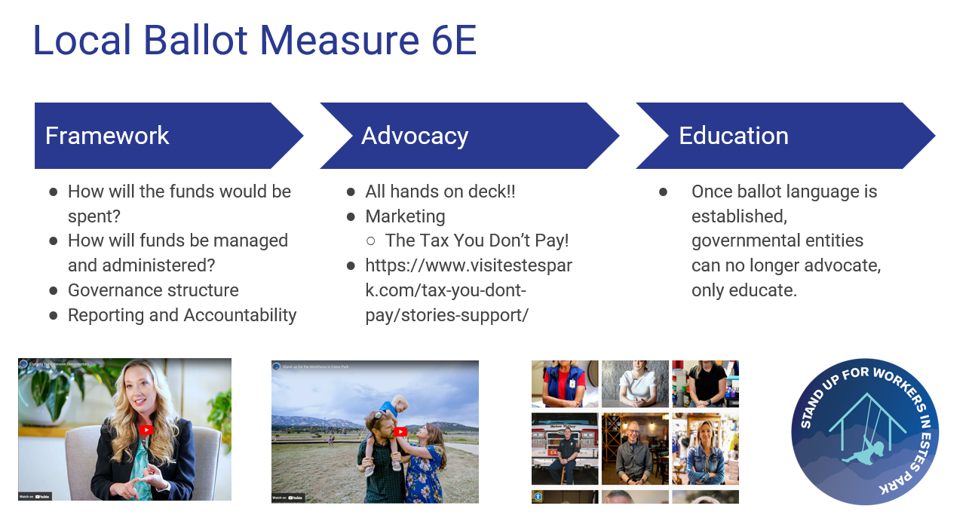

Slide 10
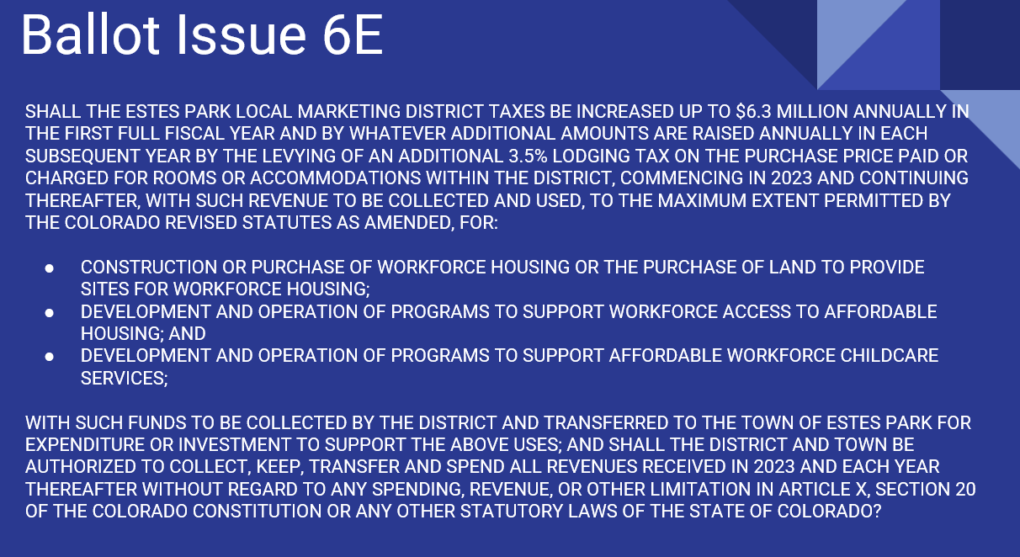

Slide 11
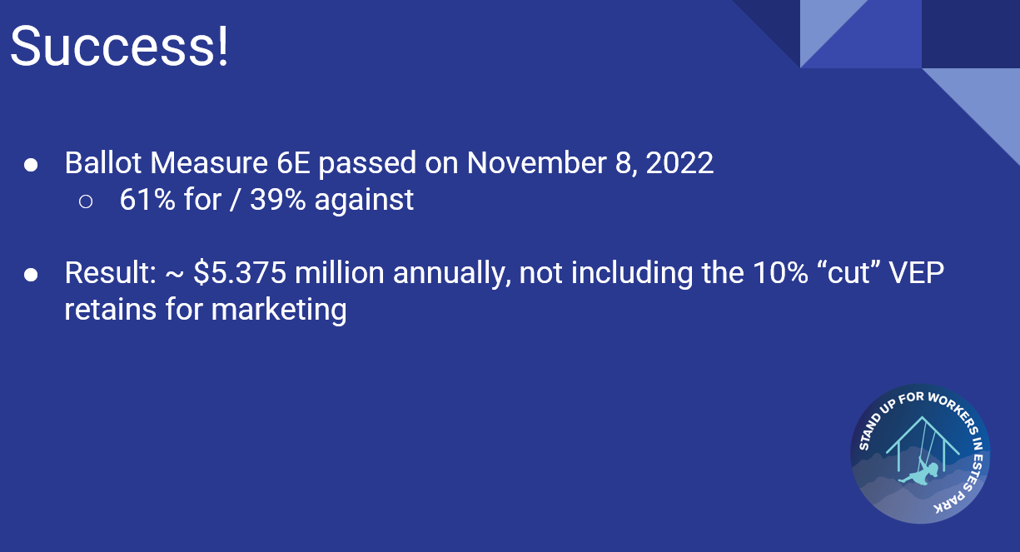

Slide 12
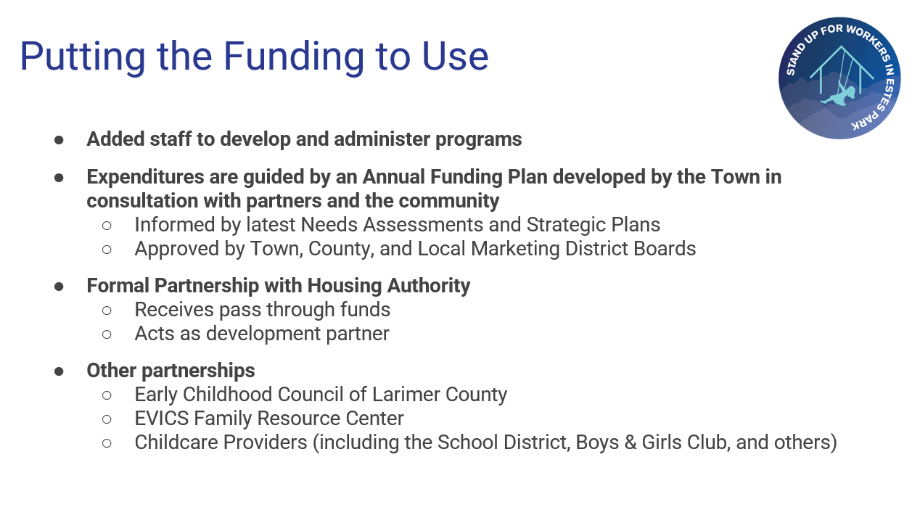

Slide 13
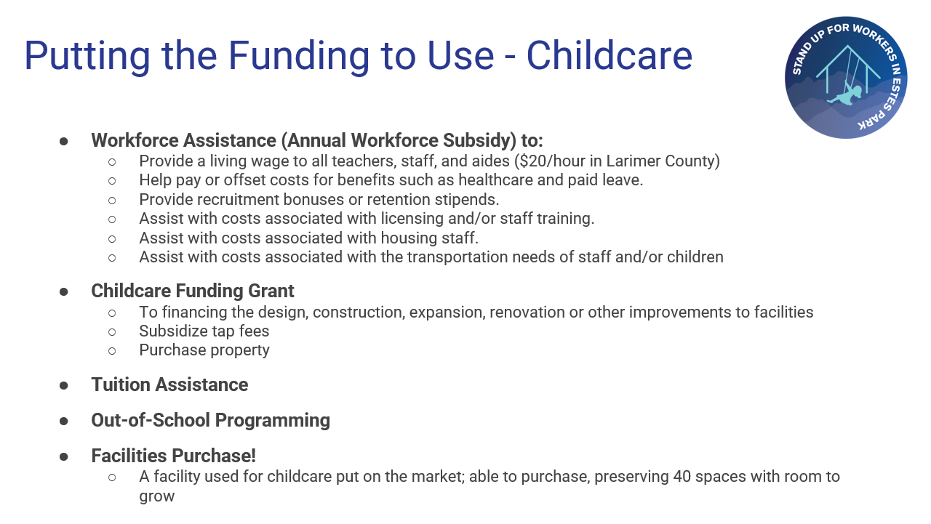

Slide 14
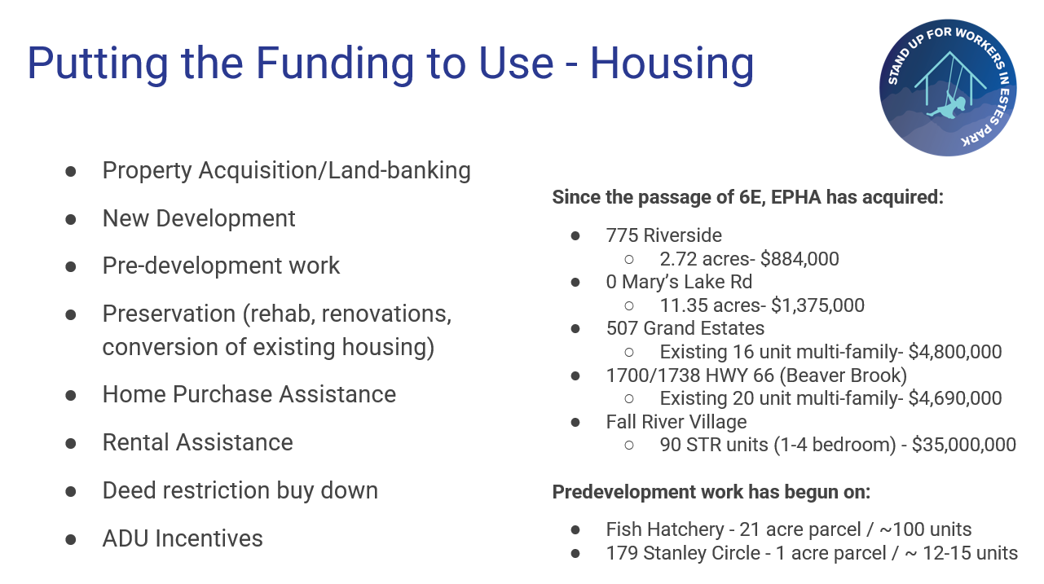

Slide 15
