Slide 1
CivicPlus: Accessibility is About People
A strategic approach to web accessibility
Don Torrez, Director of Partnerships, Certified Accessibility Coordinator

Slide 2

Don Torrez
PARTNER MANAGER
Certified ADA Coordinator
Don Torrez has collaborated with over 400 local governments to enhance their understanding of web accessibility and ensure compliance with relevant laws and guidelines.
He has successfully addressed accessibility challenges alongside the Department of Justice, the Office of Civil Rights, and the Department of Homeland Security.
As a Certified Accessibility Coordinator under the ADA, Don has developed comprehensive training curricula on web accessibility and is an outspoken advocate for greater awareness of electronic disability issues. His mission is to eliminate the fear and confusion surrounding accessibility, making it more approachable and actionable for all.
Notes:
Brian and Don – Field room for their roles in P&R (director/leadership, rec coord., IS/IT, etc...)
Don has solved accessibility issues with the Department of Justice, the Office of Civil Rights, and the Department of Homeland Security.

Slide 3
Disclaimer
We Are Not Attorneys

Slide 4
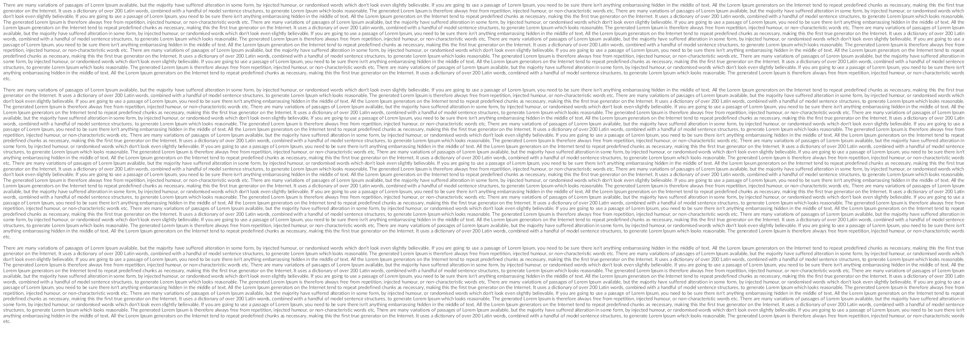
Disclaimer

Slide 5
Agenda
How we can help
Introduction and Scope
What should you do?
Accessibility Landscape - Why?
Questions

Slide 6
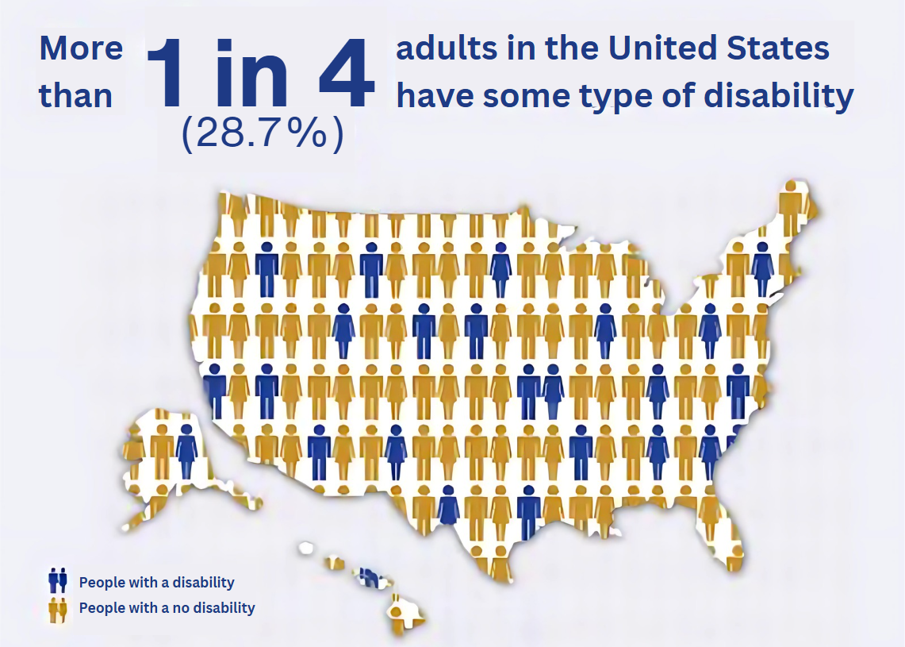
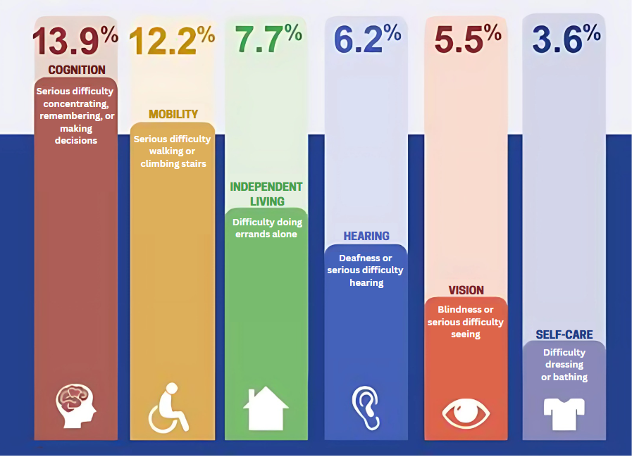
Significance
28+% of adults
Lack access to basic services
Higher unemployment, less access to health care
*CDC.gov Disability and Health Statistics - 2025
Notes:
Statistics from the CDC website
https://www.cdc.gov/disability-and-health/articles-documents/disability-impacts-all-of-us-infographic.html?CDC_AAref_Val=https://www.cdc.gov/ncbddd/disabilityandhealth/infographic-disability-impacts-all.html

Slide 7
Accessibility – Why?

Slide 8
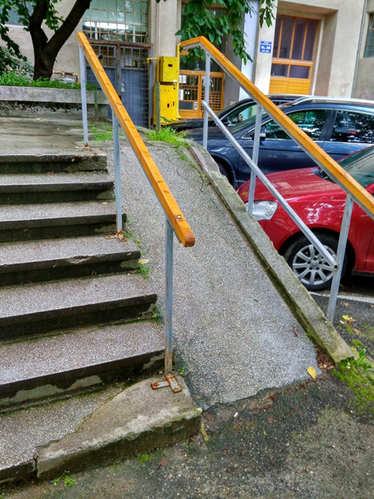
Accessibility is about people

Slide 9
Significance
28+% of adults
Lack access to basic services
Higher unemployment, less access to health care
*CDC.gov Disability and Health Statistics - 2025
Notes:
THIS SLIDE IS INTENTIONALLY REPEATED to set the story in context.

Slide 10
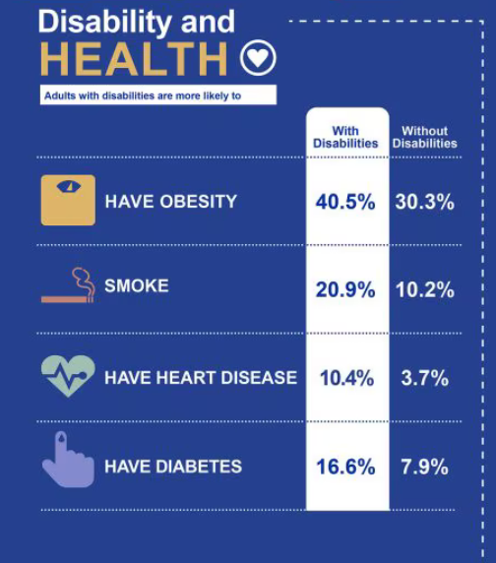
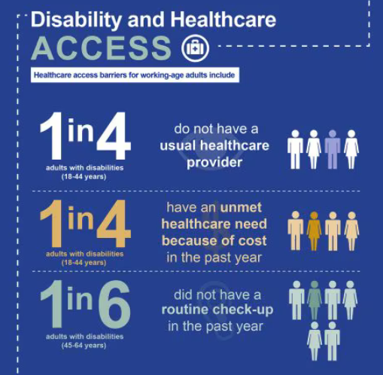
Significance
Comorbidities make life difficult, and access to services is crucial
Covid demonstrates that Government is key to overall health and information.
*CDC.gov Disability and Health Statistics - 2025
Notes:
THIS SLIDE IS INTENTIONALLY REPEATED to set the story in context.

Slide 11
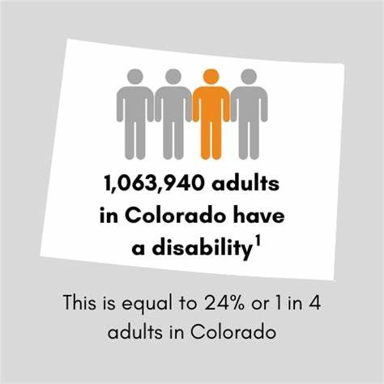
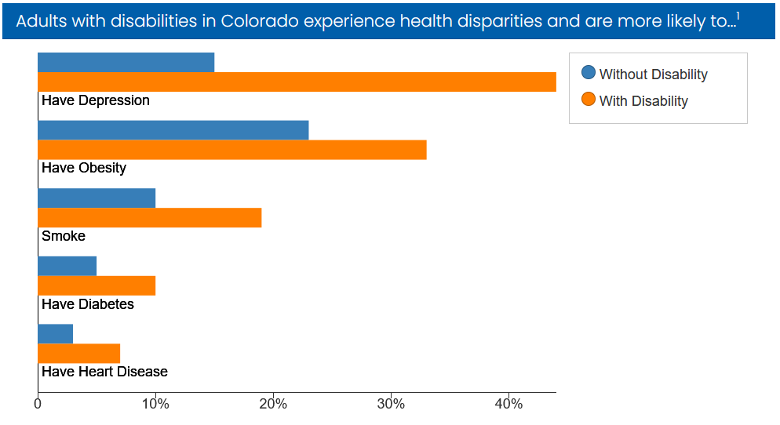
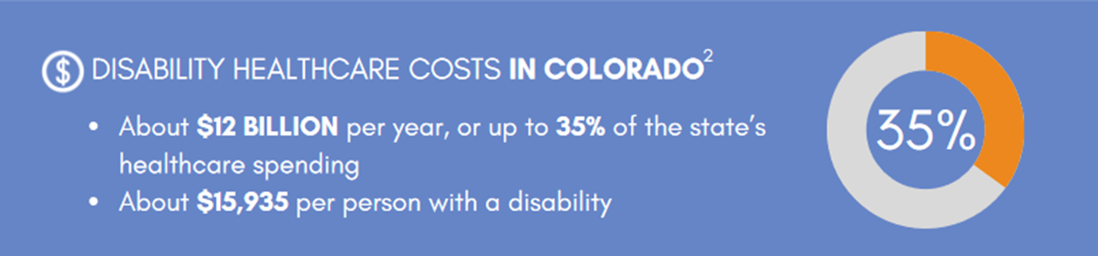
Colorado
*CDC.gov Disability and Health Statistics - 2025
Notes:
Statistics from the CDC website
Disability & Health U.S. State Profile Data: Colorado | CDC

Slide 12
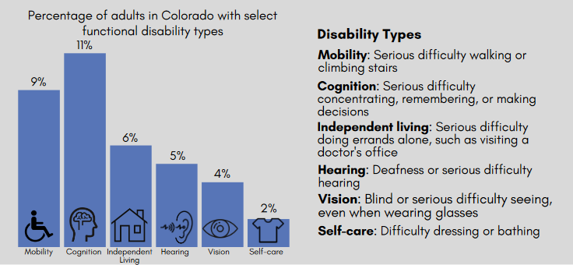
Colorado
*CDC.gov Disability and Health Statistics - 2025
Notes:
Statistics from the CDC website
Disability & Health U.S. State Profile Data: Colorado | CDC

Slide 13
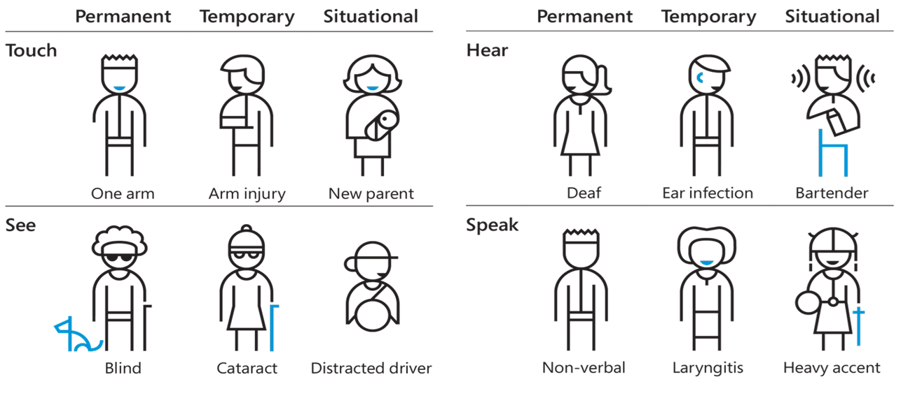
Removing Barriers
Accessibility is about the usability of the software for people who need your service.
#1 question: What programs and services would you like to participate in but can’t?

Slide 14

The Supreme Court and Web Accessibility
In 2016 a visually disabled man sued Domino's Pizza because he couldn’t order a specialty pizza on the website using his screen reader.
Domino's argued that the ADA applies to physical locations and not online platforms.
The Court of Appeals sided with the plaintiff, writing that websites “are places of public accommodation” covered by Title III of ADA.
Domino's urged the U.S. Supreme Court to review the decision, arguing that online platforms were not envisioned when the ADA was passed in 1990.
In October 2019, the U.S. Supreme Court denied the petition–a win for disability advocates.
Notes:
https://blog.ericgoldman.org/archives/2021/06/domino-pizzas-website-violated-the-americans-with-disabilities-act-ada-robes-v-dominos.htm
https://accessibe.com/blog/trends/what-does-the-dominos-ada-case-mean-for-small-medium-businesses

Slide 15
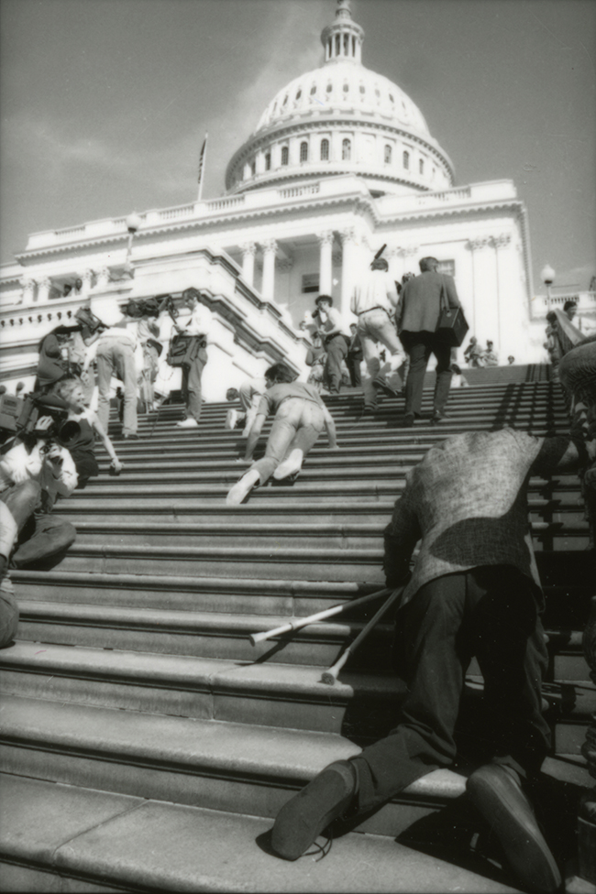
Federal Mandates
Title II and III of the ADA
Title II specifically applies to state and local governments
Protects qualified individuals with disabilities from discrimination based on disability in services, programs, and activities provided by state and local government entities
Title III extends these protections to public accommodations
Local governments are both
Notes:
Don
“…to symbolize the barriers confronting disabled people, more than 60 activists abandoned their crutches, wheelchairs, powerchairs, and other mobility-assistance devices and began crawling up the 83 stone steps that lead to the Capitol.”
March 12, 1990
The final version of the bill was signed into law on July 26, 1990, by President George H. W. Bush.
Jennifer Keelan, a second grader with cerebral palsy, was videotaped as she pulled herself up the steps, using mostly her hands and arms, saying "I'll take all night if I have to."

Slide 16
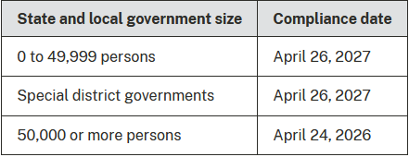
Federal Mandates
DOJ renewed focus
  DOJ published ADA Title II rulemaking for websites April 2024
  Accessibility is the law now, but a runway is given for enforcement
    Three years for small governments
    Two years for large
*Department of Justice, April 2024
Notes:
Web Accessibility Laws Set To Enter New Era As DOJ Gears Up For Spring Rulemaking (forbes.com)

Slide 17
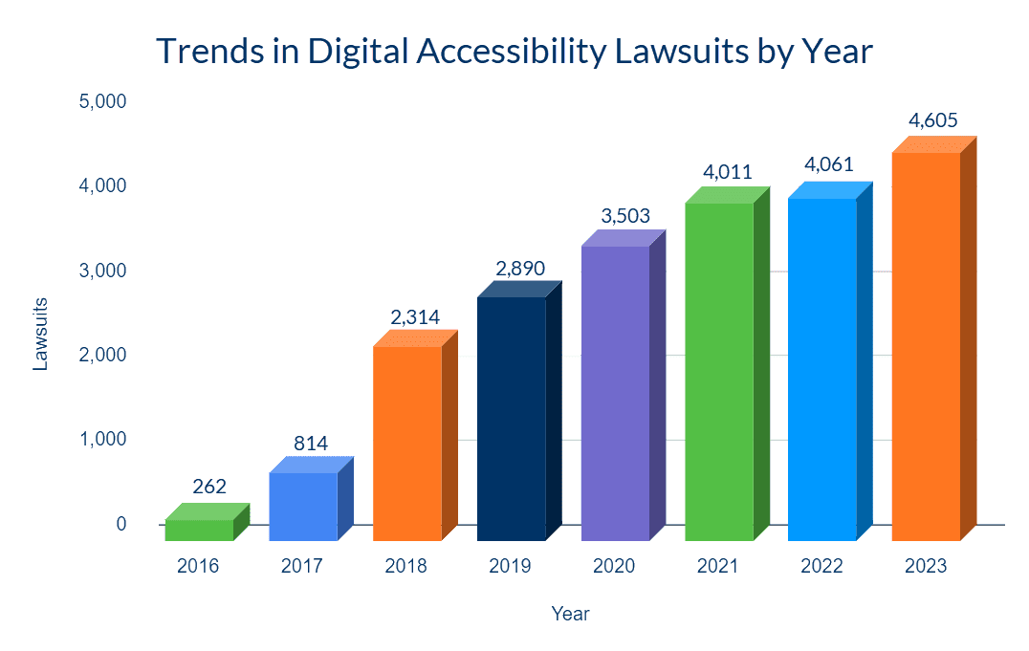
Lawsuit Activity
Significant increase in lawsuits from 2017 to now.
Local, and national
Single plaintiffs sending numerous complaint letters
First complaint letter, then lawsuit
*Equidox Accessibility Resource Library, 2024
Notes:
https://equidox.co/resources/accessibility-education-tools/digital-accessibility-lawsuits/
In 2024, over 4,000 ADA lawsuits related to digital properties were filed. Federal cases saw a slight decline, offset by increased state-level lawsuits, particularly in New York and California.
Source: https://blog.usablenet.com/2024-digital-accessibility-lawsuit-report-relased-insights-for-2025

Slide 18
Colorado House Bill (HB) 21-1110
Requires state and local public entities to meet established website accessibility standards. Under the law, government websites must provide reasonable accommodations for people with disabilities.
Websites must implement accessibility plans by July 1, 2024.
OIT has statutory authority in C.R.S. 24-85-101 to establish statewide accessibility standards. Previously, there was no formal process and little enforcement.
Any Colorado government entity that doesn’t meet OIT’s web accessibility standards could be subject to injunctive relief, meaning a court order to fix the problem; actual monetary damages; or a fine of $3,500 payable to the plaintiff, who must be someone from the disability community.
Notes:
Accessibility Law for Colorado State and Local Government | Office of Information Technology
https://oit.colorado.gov/standards-policies-guides/guide-to-accessible-web-services
2023a_244_signed.pdf (colorado.gov)
https://leg.colorado.gov/sites/default/files/2023a_244_signed.pdf
https://docs.google.com/presentation/d/1lBBDZGfH3sOLvTA27qCsQKUA81PDRwkunqPQNu2T0-I/edit#slide=id.g1f922d61f20_0_85

Slide 19
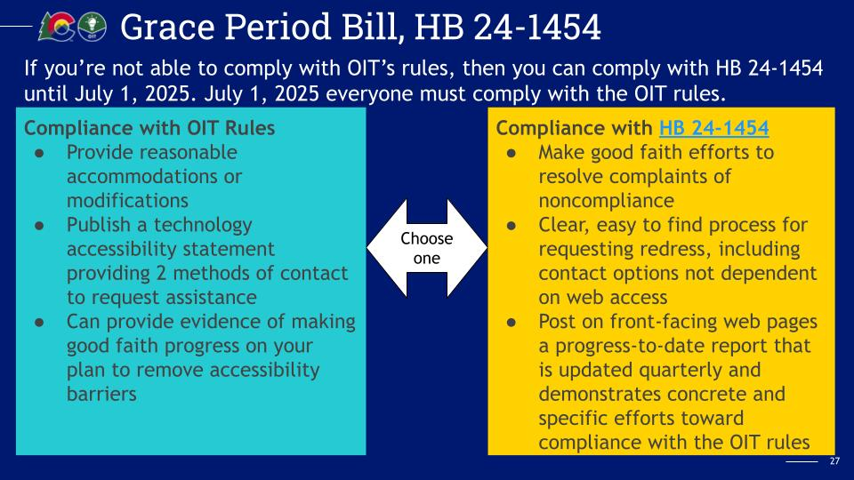
Colorado House Bill (HB) 21-1110 - Update!
HB24-1454 - A one-year extension of the deadline
Must demonstrate a good faith effort toward compliance
Sent to Governor May 23, 2024
Intent to encourage continued diligent progress toward accessibility without imposing immediate penalties
Notes:
https://leg.colorado.gov/bills/hb24-1454
https://leg.colorado.gov/sites/default/files/documents/2024A/bills/2024a_1454_enr.pdf
https://oit.colorado.gov/accessibility/news/may-2024

Slide 20
CivicPlus Response
Accessibility and the usability of our products is a top priority at CivicPlus. We are auditing our software using manual testing including screen readers, the best professional engineering tools at our disposal, and human testing to ensure we have a strong assessment of our compliance.
Testing across our portfolio of product.
Contracted with accessibility experts to test and identify areas for improvement.
As part of our dedication to transparency, we will have Voluntary Product Accessibility Templates (VPATs) available in 2024 to demonstrate our progress towards meeting accessibility requirements.
CivicPlus stays informed about legal requirements and accessibility laws through close collaboration between our in-house legal counsel, accessibility partners, and listening to our clients.
Notes:
https://leg.colorado.gov/bills/hb24-1454

Slide 21
What should you do?

Slide 22
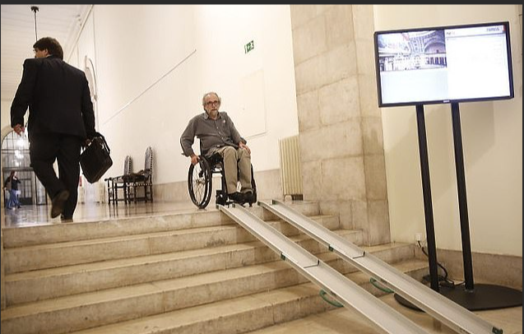
Accessibility is about people.

Slide 23

What the DOJ Requires
Plan​
To become compliant
Audit​
Audit your work: internally, then externally
Remediation​
Solutions
Ongoing Maintenance​
Quarterly is recommended
Notes:
Don
https://www.ada.gov/ada_title_II.htm
https://www.ada.gov/regs2010/titleII_2010/title_ii_primer.html

Slide 24
WCAG 2.2
WCAG Success Criteria – 3 levels
Level A (minimum) – Basic web accessibility.
Level AA (mid-range) – Most common barriers for disabled users
Level AAA (highest) – Highest level of web accessibility
ADA (Section 508) expected to conform to WCAG 2.1 Level AA

Slide 25

Plans, Policies and Best Practices
Critical plans and their purpose
Locate your accessibility statement
Understand your gaps and how to move forward to close them

Slide 26
Accessibility Policy Checklist
Civil Rights
Rhyme with Equal Opportunity, HIPAA, or Security Policy
Extension of civil rights.
Technical Standards
WCAG 2.1 AA generally accepted
Establish Timeline
Not all work can occur at one – Prioritize
Electronic Communication
Accessible by all
Create in Accessible Format
Public facing and screen reader compatible

Slide 27
Accessibility Changes To Make Now
Missing or Inaccurate Alternative Text
Accurate alt text also has benefits for search engine optimization (SEO), and you’ll only need to spend a few seconds writing descriptions for each image
2. Color Contrast Issues
  WCAG recommends a minimum color contrast ratio of 4.5:1 for normal text and 3:1 for large-scale text.
Keyboard Traps
  Audit your website for keyboard accessibility issues and perform occasional self-checks by tabbing through your content.
Notes:
5 Easy Web Accessibility Issues to Fix Right Now (boia.org)
Color Contrast Accessibility Validator (a11y.com)

Slide 28
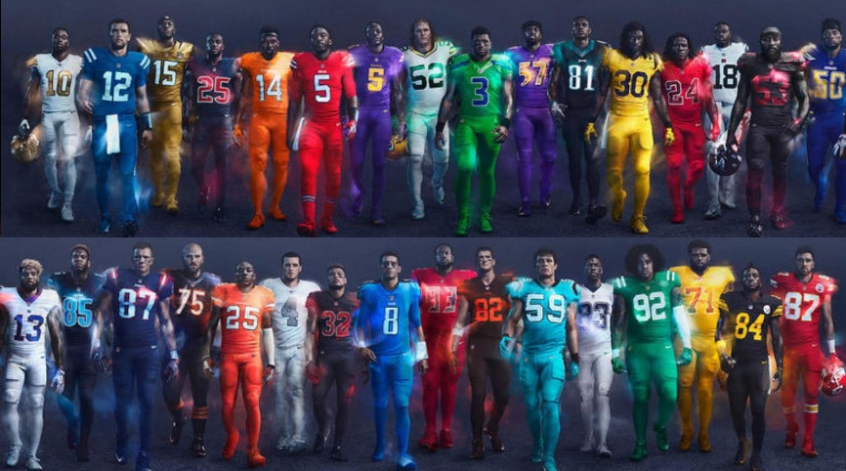
Color Contrast… what is that you ask?
The NFL launched color rush uniforms
Notes:
Don

Slide 29

Bills vs. Jets
4.5% of the population is color-blind
Notes:
Don

Slide 30
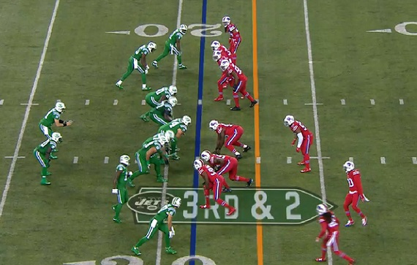
Bills vs. Jets
The broadcast to a fan that is not color-blind
Notes:
Don

Slide 31
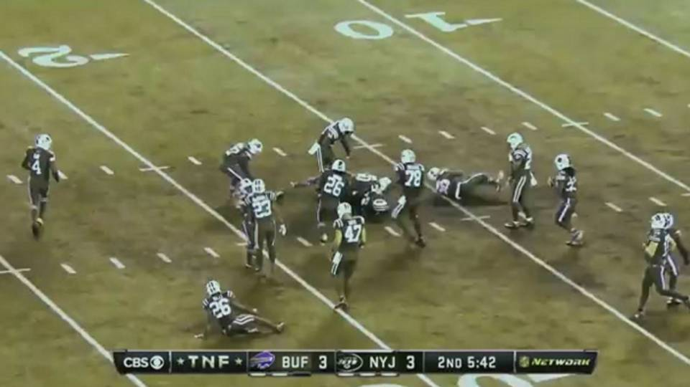
Bills vs. Jets
The broadcast to a fan that is color-blind
Notes:
Don

Slide 32

What About Software?
Notes:
Don – Show a common error?

Slide 33

Foraging in the United States
Poisonous Berries
Safe Berries
Chokeberries
Cloudberries
Gooseberries
Holly berries
Huckleberry
Ivy berries
Jerusalem cherries
Mistletoe
Mulberries
Pokeweed berries
Notes:
10 Tasty Wild Berries to Try (and 8 Poisonous Ones to Avoid) (healthline.com)

Slide 34
THIS is what it may look like to someone with colorblindness
Poisonous Berries
Safe Berries
Chokeberries
Cloudberries
Gooseberries
Holly berries
Huckleberry
Ivy berries
Jerusalem cherries
Mistletoe
Mulberries
Pokeweed berries
Notes:
10 Tasty Wild Berries to Try (and 8 Poisonous Ones to Avoid) (healthline.com)

Slide 35
Best Practice:
Never use only color to differentiate
Safe Berries
Chokeberries
Cloudberries
Gooseberries
Huckleberry
Mulberries
Poisonous Berries
Holly berries
Ivy berries
Jerusalem cherries
Mistletoe
Pokeweed berries
Notes:
10 Tasty Wild Berries to Try (and 8 Poisonous Ones to Avoid) (healthline.com)

Slide 36
Accessible Documents
Begin with an Accessible Platform
Advocate for the use of authoring tools and document converters that enable users to easily create accessible documents. Where possible, upgrade existing tools (e.g., Microsoft Office or Adobe Acrobat) to the latest version. Benefits include:
  Authoring and evaluation features that make it easier to create accessible documents;
  Conformance to requirements for software-authoring tools requirement in the Revised 508 standards.
Create in an accessible format
Save documents as .docx format to preserve accessibility features. Other formats that can be produced by Microsoft Word (RTF, DOC, TXT, and ODF) may not be accessible.
Build processes around best practices
Develop reusable accessible design templates to reduce the level of effort to create accessible electronic content.
  Follow responsive design principles that support accessibility on different types of devices.
Notes:
Create Accessible Documents | Section508.gov
Document Accessibility (talentlms.com)

Slide 37

Remediation Plan
Make a timeline to fix existing errors.
Ensure visuals include strong, descriptive alternate text.
Create color contrast.
Website should be navigable by mouse and keyboard elements.
Screen readers must experience entire page.
Most PDF documents are not accessible; use HTML when possible.

Slide 38




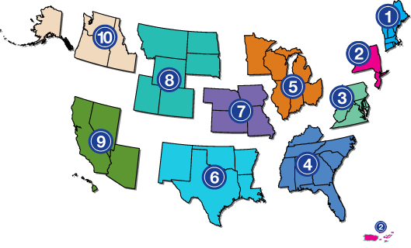
Audit
Free Single Page Scans:
Wave www.wave.webaim.org (Wave is named by the Colorado OIT)
ANDI https://www.ssa.gov/accessibility/andi/
Accessibility Insights https://accessibilityinsights.io/
Web Browser tools
Microsoft Tools
Adobe
The World Wide Web Consortium (W3C):
  www.w3.org
Your Regional Center for ADA:
  https://rockymountainada.org/
*ADA National Network
Notes:
https://docs.google.com/presentation/d/1lBBDZGfH3sOLvTA27qCsQKUA81PDRwkunqPQNu2T0-I/edit#slide=id.g1f922d61f20_0_85

Slide 39
Appendix

Slide 40

Accessibility Policy Statement
What plaintiffs look for when deciding to sue/who to sue
Express a desire for accessibility
Good faith matters
Easy to find
Easy to communicate issues and barriers for disabled residents.

Slide 41
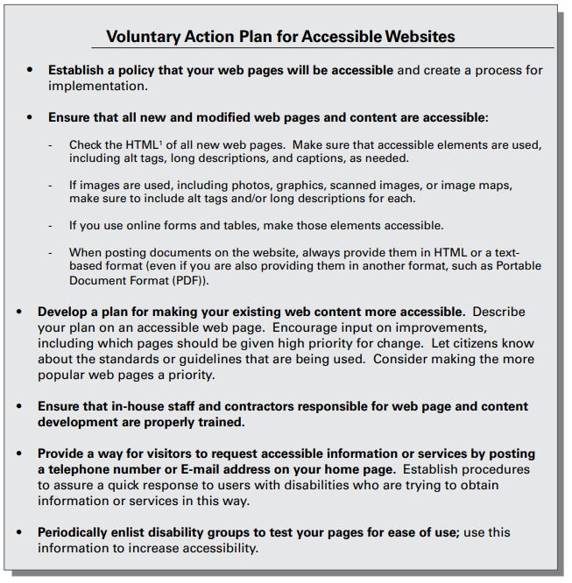
Action Plan – Department of Justice

Slide 42
Resources and Research
Homepage | Rocky Mountain ADA
Home | Office of Information Technology (colorado.gov)
FAQ: HB21-1110 Colorado Laws For Persons With Disabilities | Office of Information Technology
Justice Department Issues Web Accessibility Guidance Under the Americans with Disabilities Act | OPA | Department of Justice

Slide 43
Resources:
Colorado OIT:
  Regular Website Updates
  Accessibility Newsletter
  Accessibility Website Toolkit
Rocky Mountain ADA:
  Regional Center for ADA support
  National Organization
  World Wide Web Consortium (W3C)
  Publish WCAG
  Tutorials, examples
  Forecast criteria
Notes:
https://adata.org/national-network
https://rockymountainada.org/
The ADA National Network provides information, guidance and training on how to implement the Americans with Disabilities Act (ADA) in order to support the mission of the ADA to “assure equality of opportunity, full participation, independent living, and economic self-sufficiency for individuals with disabilities.”
Funded by the National Institute on Disability, Independent Living, and Rehabilitation Research (NIDILRR), the network consists of 10 Regional ADA Centers located throughout the United States and an ADA Knowledge Translation Center (ADAKTC).
Each Regional ADA Center focuses on its region’s unique needs. This regional focus is critical to ensuring that ADA National Network services meet the needs of a diversity of populations and stakeholders throughout the country

Slide 44

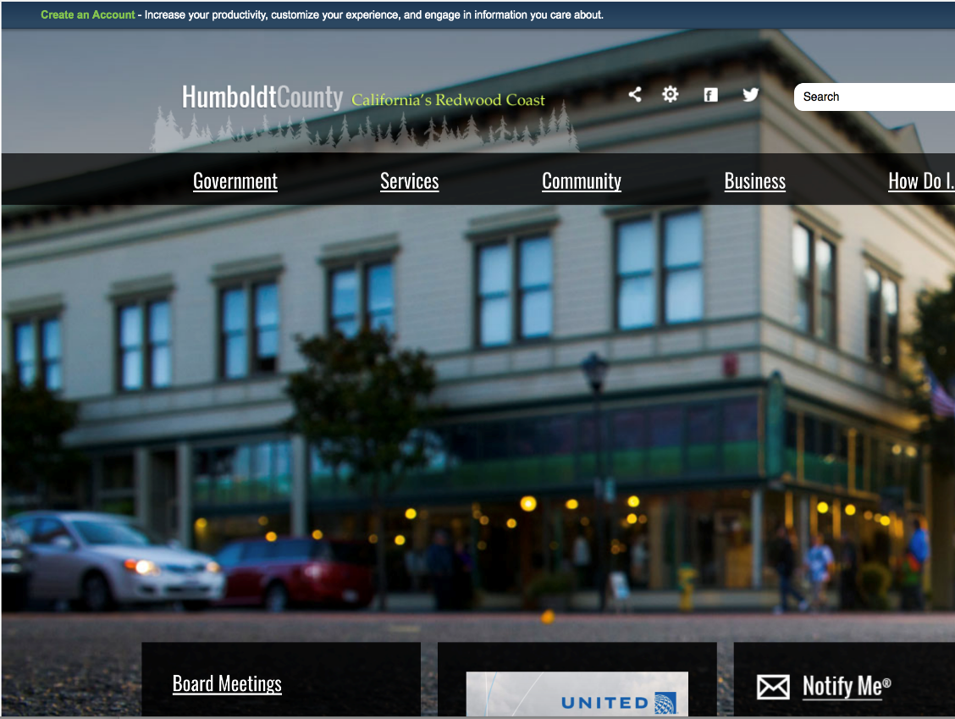
Humboldt County, CA
Began with facilities issues – scope widened to include website.
Fined $275,000 in 2016.
Initial estimates for full compliance: $17 million+.
CivicPlus built accessible website.
Among lowest errors in California.
Continuous improvement.
Together responded to the Department of Justice.
AudioEye Remediation
BETA tested innovation in city government.
A future-proofed solution
Ally Toolbar for personal experience.
First U.S. county with automated remediation.

Slide 45


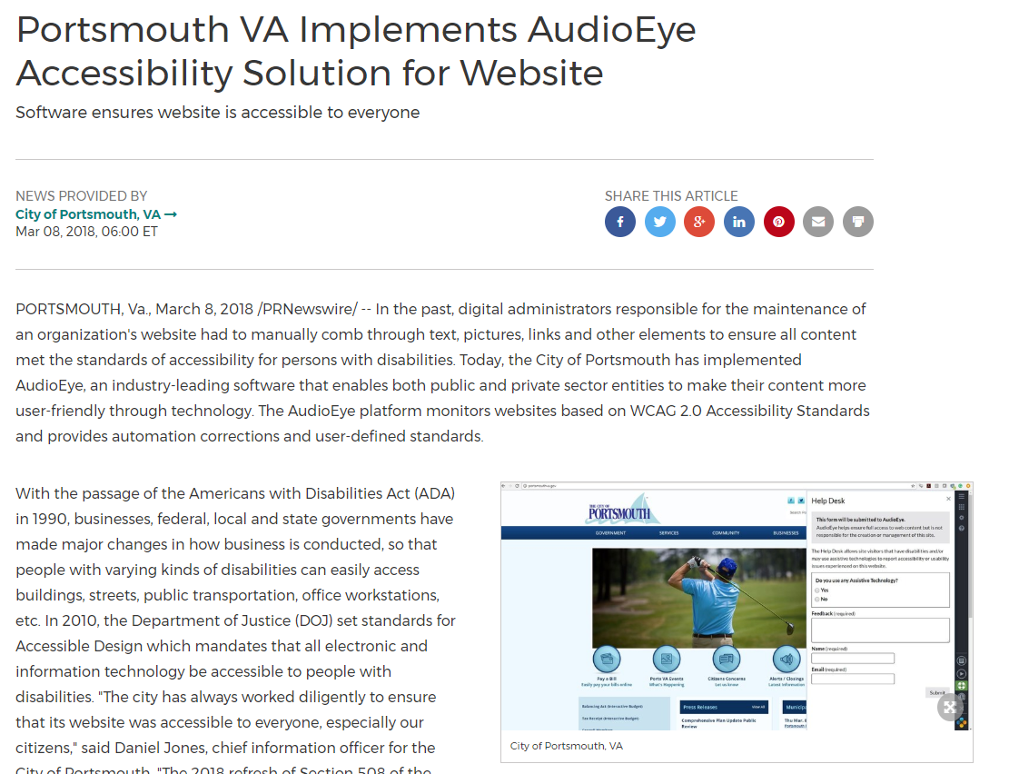
Portsmouth, VA
Portsmouth led innovation
First to see value.
Coordinated plan response.
AudioEye Remediation
Scan and remediating.
Ally Toolbar for personal experience.
Client #1 remediation complete

