Slide 1
How Small Communities Accomplish Audacious Goals
John Cattles, Assistant County Manager for Sustainable Operations
Cathie Pagano, AICP CEP, Assistant County Manager for Community and Economic Development

Slide 2
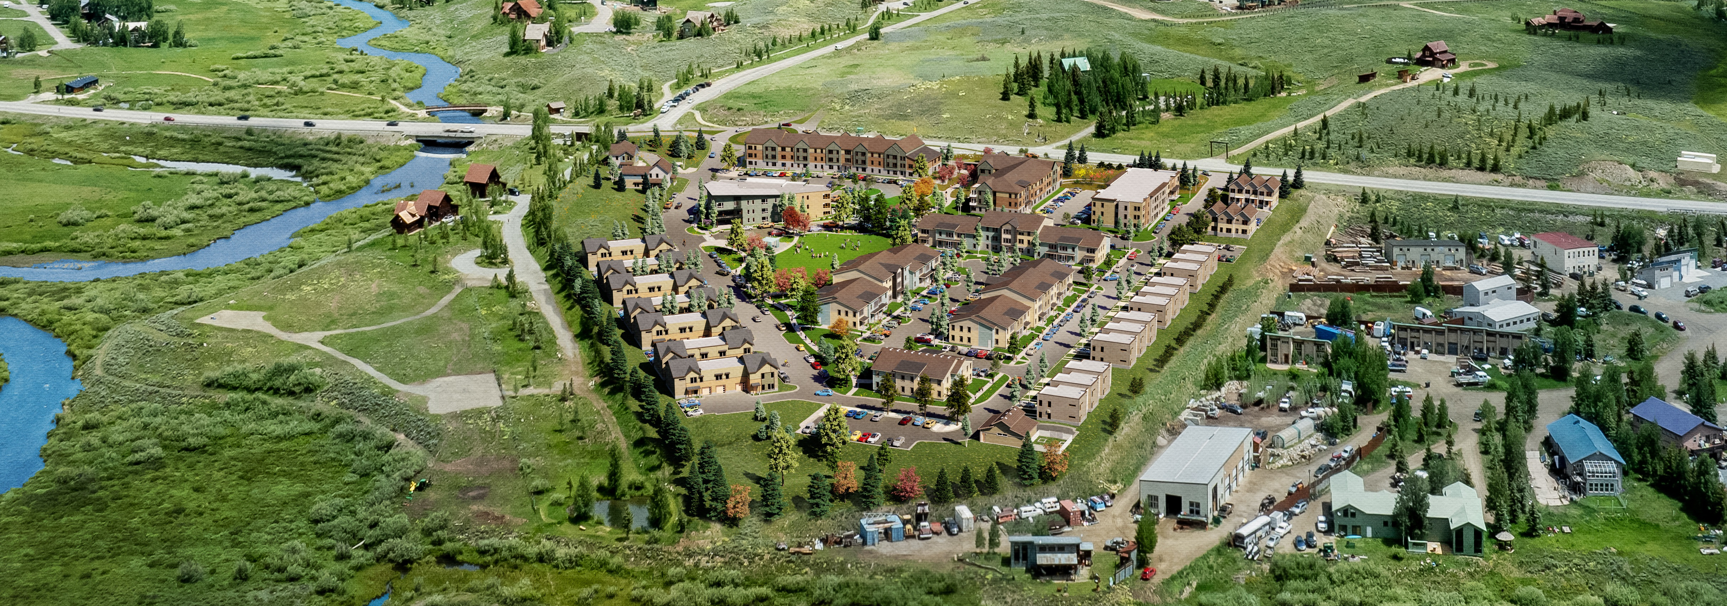
Strategic Planning, Discipline, Leadership

Slide 3
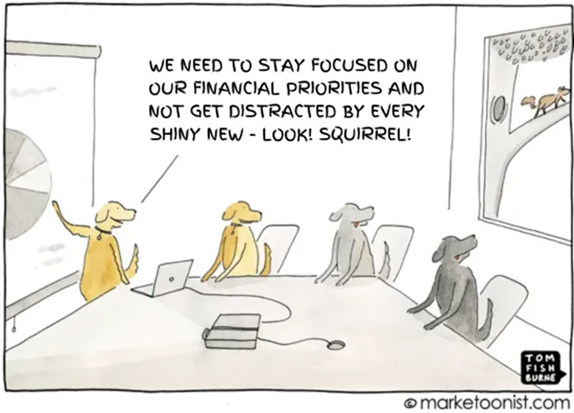
Does your community have issues that the community persistently brings up despite best efforts to address them?
Do you have plans that have never been implemented?
Do you have goals that get recycled from year to year with little progress?
Does your community know how you plan to address pressing issues?
Cathie
Notes:
What goals are you working on or have had difficulty accomplishing in your community?

Slide 4
Effective Strategic Planning
“Strategy is choosing what not to do.” M. Porter
Why does our organization exist?
Values: set core values and high-level areas of focus
Review what is or is not currently working
Develop specific, time bound, measurable goals within the above constraints. Goals should be outcome based, no tactics or policy
Engage staff in developing tactical approach to achieving outcomes of goals set by elected leadership
Cathie
Notes:
Talk about story of our approach to strategic planning
Real and perceived power and limitations

Slide 5
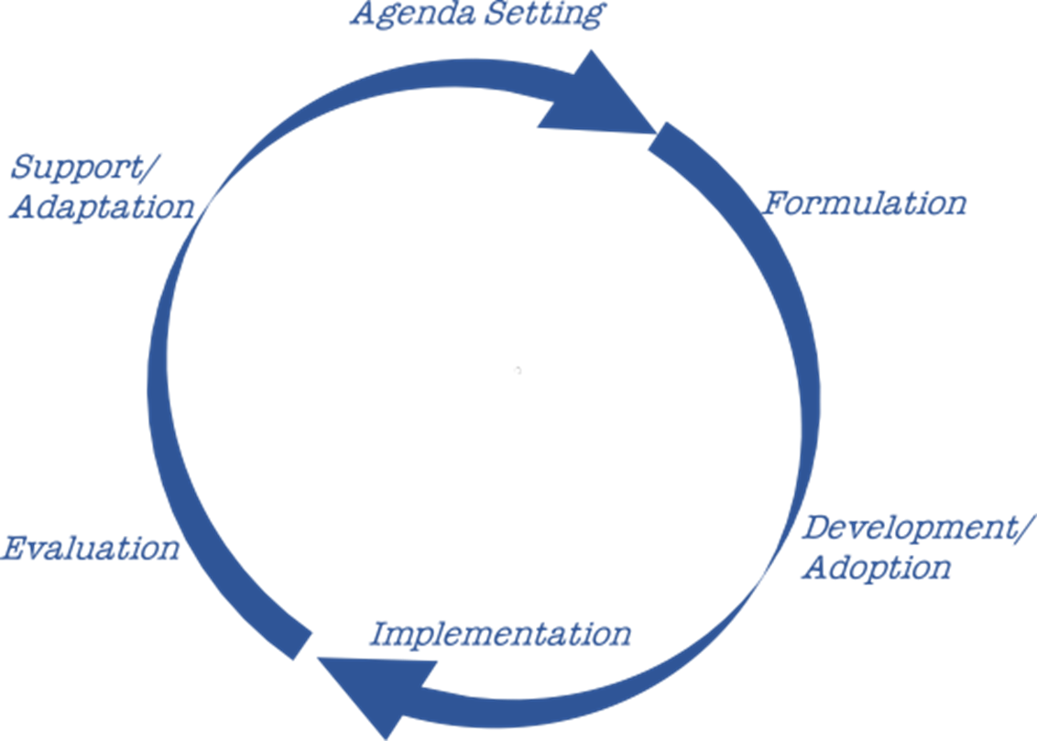
Disciplined Process
Agenda = public and political attention
Formulation = consolidate political desires into strategic goals
Development = policy development
Implement/Capacity = assign responsibility at staff level and budget accordingly
Measure, evaluate, and communicate
Adapt and repeat
Process may start small and build as repeated.
Virtuous cycle of increased credibility and capacity.
John
Notes:
The policy process should not skip steps. For example: it can be tempting to skip the formulation step and short-circuit development and move in a reactionary way from agenda to implementing tactics that may not be appropriate.
It is also important to complete the cycle; it may be tempting to adopt a plan or policy and not invest in implementation. If the public doesn't see/ feel the effect of our work in their lives then the issue will become a zombie issue at the agenda (public attention) level that keeps coming back.

Slide 6
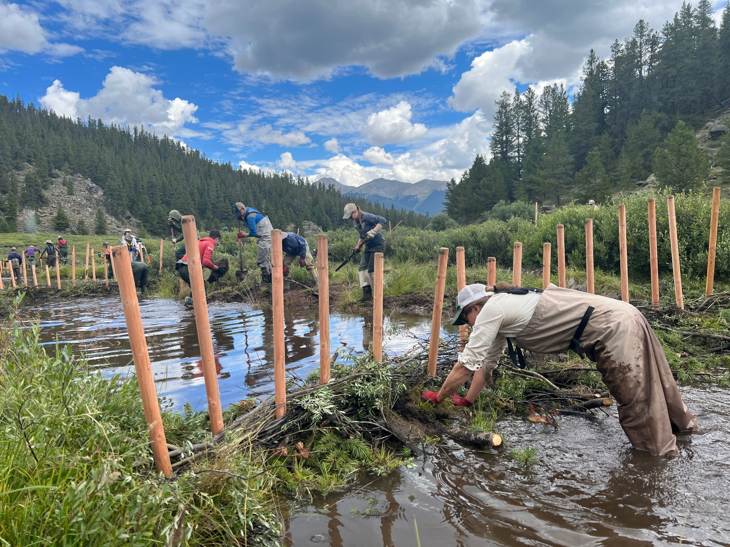
Setting the Agenda: Public Pressure on Politicians to act on an issue
Impacts on public lands, environment, and recreation
Increased pressure and impacts on public lands, recreation, environment, and user experience pressured County Commissioners to address sustainable tourism and outdoor recreation.
The agenda was outlined by the public—do something about the resource damage and overuse of public lands.
Formation of the Sustainable Tourism and Outdoor Recreation (STOR) Committee with 23 members that include federal and state partners, local nonprofits, and advocacy groups.
Cathie
Notes:
STOR created strategic plan, partnered with National Forest Foundation to create a stewardship fund, received grant awards, and implemented on the ground projects (designated camping, trail maintenance, installation of bathrooms, beaver habitat restoration). Took disparate concerns from community and consolidated concerns to deal with them holistically rather than one issue at a time, so that we managed and planned for issues rather than reacting.

Slide 7
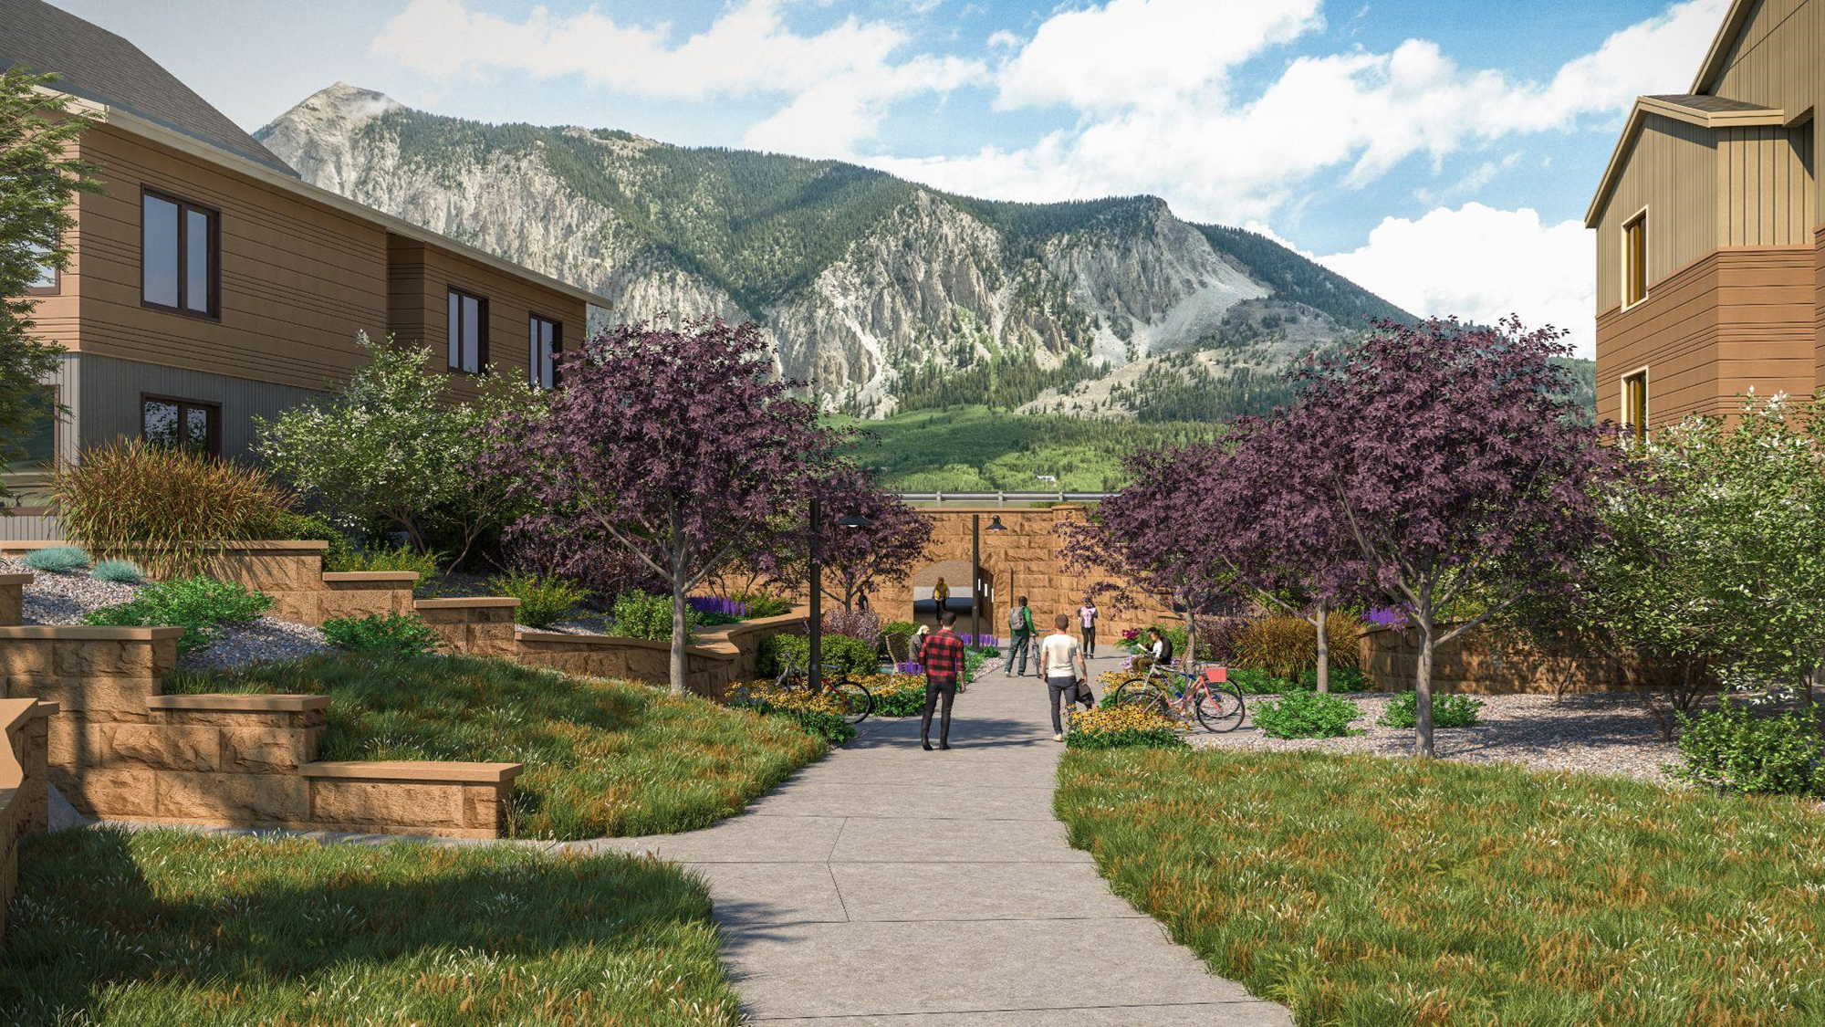

Formulation: Consolidate Political Desires into Strategic Goals
County Commissioners wanted to develop hundreds of new workforce housing units in response to community needs and campaign promises
Started with inclusion of developing 200 new units within 3 years in strategic plan, “By December 31, 2020, Gunnison County will increase the volume of available housing by facilitating the construction of 200 new affordable units.”
Development of new workforce housing units has been included in the County Strategic Plan for 7 years and 386 have been built or are under construction.
John
Notes:
Tell the story of Brush Creek, Paintbrush, Sawtooth, Whetstone. We started with reliance on outside private partner—led to challenges and lack of control over public engagement and process. We were able to get some housing units this way but we began to realize the developer didn’t have some magical formula that we couldn’t replicate and do ourselves. We know our community best, we know what the areas of contension will be, what if we acquire land, hire a design team and consultants and design a process and plan to reflect our community needs. Then let’s also own it, operate it, and collect an ongoing revenue stream.

Slide 8
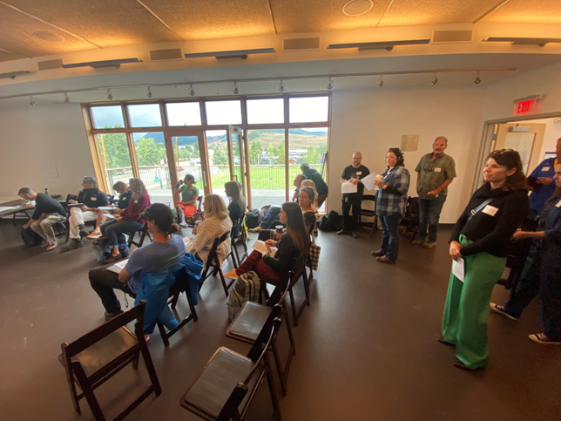
Development: Codify and fund tactics in support of strategy
Strategic Plan goal to develop comprehensive plan which will be a high-level advisory document
The secondary goal in strategic plan is amend regulatory standards and processes to align with the desired outcomes of the comprehensive plan.
Collaborative effort with municipalities and utility providers to ensure that there is utility capacity
Cathie
Notes:
Operationalize policy documents! We completed 2005 Corridor Comp Plan but never modified land use standards to align with desired outcomes and now we have a disconnect. Lose trust and create frustration. Collaborate with partners and stakeholders to ensure success in implementation. Don’t just create rainbow and unicorn plans without consideration and really analysis about how it will be implemented.

Slide 9
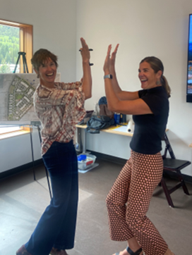
Strategic Plan: Implementation and Capacity
Delegate outcome of results to staff, encourage cross-departmental teams when appropriate
  Tactics to achieve goal outcomes developed by staff
  Incorporate into departmental plans
  Assign staff responsibility for tactics and include in annual performance reviews
Budget
  Prioritize discretionary (non legislative) budgeting by strategic goals
  Resist funding initiatives and programs that are not aligned with the strategic plan
John
Notes:
Reference STR and BOCC’s attention/discipline. Ideal situation leaves tactics to staff or gives them input so that the employee culture begins to align with strategic outcomes
Tasks are operationalized as part of individual staff review.
Budgeting

Slide 10

Measure, Evaluate and Communicate
County implemented several different tactics over the years in pursuit of energy reduction strategic goals.
Measuring the impacts: we tracked energy use to understand what provided the biggest bang for the buck.
Energy cost savings benefited the Facilities Department, maintained buy-in and support for additional measures
John
Notes:
What about communicate and budget? Communication has been a challenge—we provide performance reports. Hiring a comms director this year, a more robust approach would be helpful to share our success more broadly with public.

Slide 11
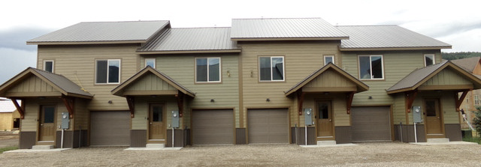

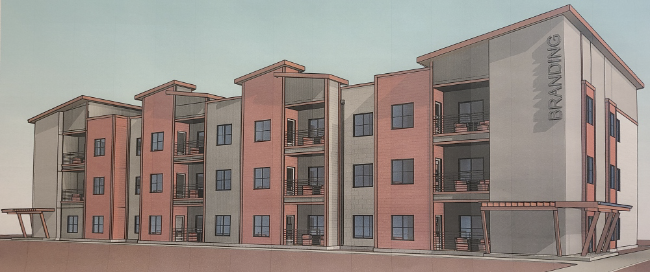
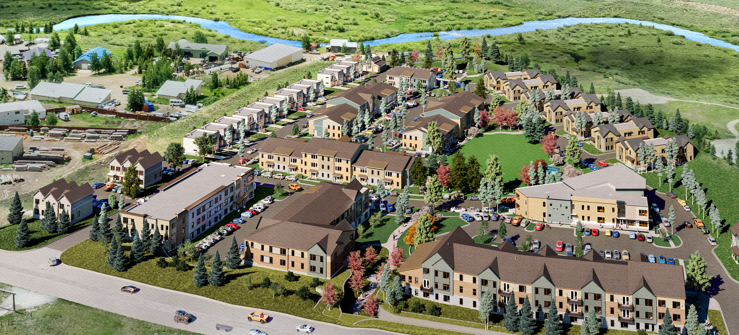
Adapt and Repeat
Virtuous Cycle
$
Apply lessons learned from measuring
Repeat, improve, expand
Housing Strategy
Projects generate marginal excess revenue after operations and debt.
Reinvest/ pledge revenue to next project.
Start small and incrementally expand scope.
$
$
John

Slide 12
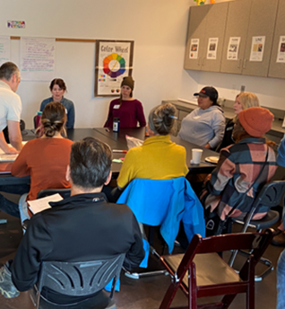
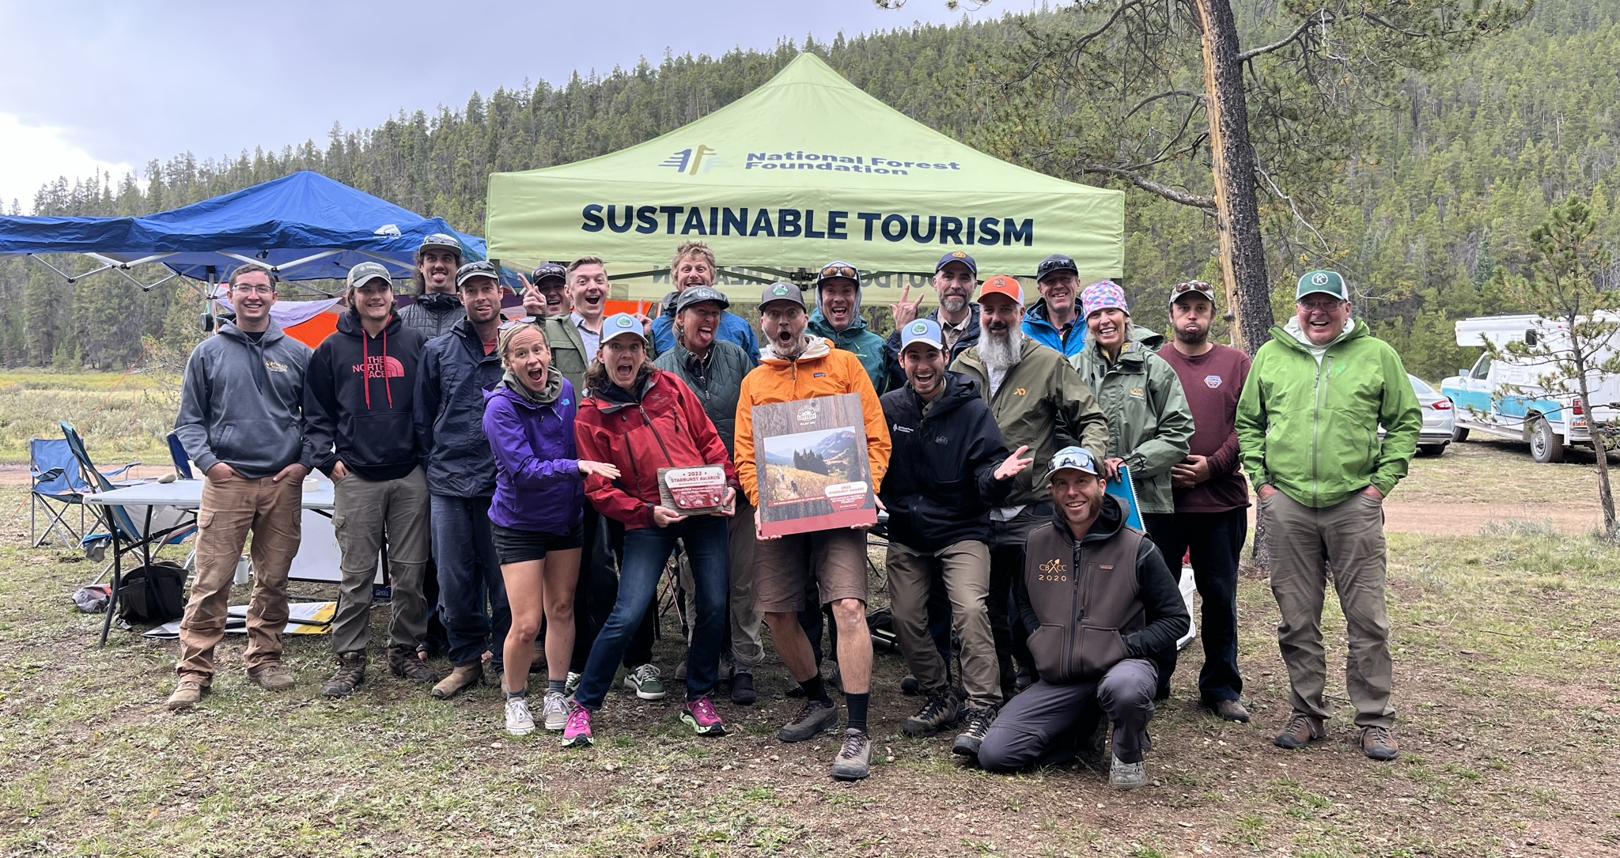
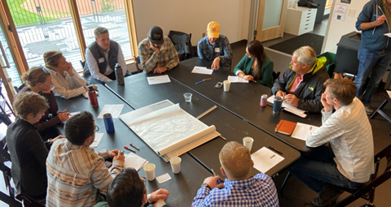
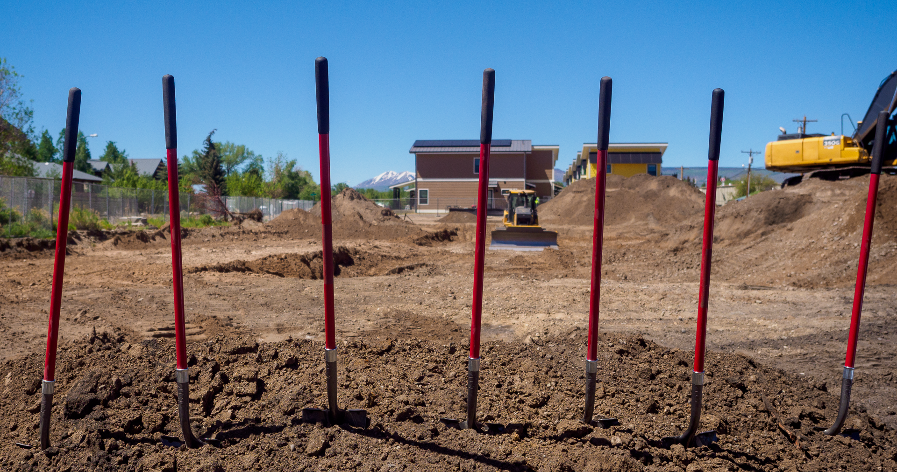

Outcomes
Cathie and John
Notes:
Gain momentum and build credibility with funders and public. Start small and build. Housing started with 4-8 units, now we’re doing a 252-unit, $125M project that we own. Awarded largest TAHG grant in state, $10M, $2M for energy, $15M for safe streets. We are successful because we get results and are disciplined. STOR started with regional partnership, strategic plan and was able to receive grant because regional partnership/plan was unique. That grant enabled staffing and results and we’ve been able to get more funding since.
Electrification of buildings, started small and now includes all government buildings and our new housing units.
New airport, library, courthouse, significant remodel of 100-yr old buildings
Must be disciplined!!! Elected officials will get distracted by a multitude of issues—you can do hard things but you can’t do them all at once!

Slide 13
Get it Done!
Listen to your community, identify values and set the agenda
Consolidate the hopes and dreams into strategic goals (by X date we will do Y)
Develop policies that will help achieve your goals
Implementation/Capacity-assign goals and tasks to departments and staff, fund the work!
Measure, evaluate, communicate. Track your progress, report it, and identify where you need to adjust. Do you need more time, more staff, different policies?
Adapt and repeat. Did you succeed? Great! Now go do it again!
Cathie
Notes:
Don’t forget DISCIPLINE

Slide 14
Questions?
John Cattles, Assistant County Manager for Sustainable Operations
jcattles@gunnisoncounty.org
Cathie Pagano, AICP CEP, Assistant County Manager for Community and Economic Development (cpagano@gunnisoncounty.org)

