Slide 1
What Impact are Cannabis Regulations Having on Municipal Leaders Building Thriving
Local Economies and Livable Communities
Garland S. Doyle, M.P.A., MiPMC, CNP
City Clerk, City of Pontiac, Michigan
President, National Council on Municipal Cannabis

Slide 2
Session Description

Slide 3
This session will focus on giving local government administrators the tools and resources they need to effectively manage cannabis regulatory programs that build thriving local economies and livable communities.

Slide 4
Municipal cannabis regulators are expected to do it all. They have to implement legislative policies, design local regulatory frameworks, evaluate cannabis operator applications and ensure compliance from cannabis license holders. They have to do all this while managing relationships with stakeholders from local elected officials, operators, state regulators, consultants and community leaders.

Slide 5
Ice Breaker

Slide 6
LEARNING OBJECTIVES

Slide 7

As a result of this training, you will be able to:
Determine if your municipality has the staff capacity to manage cannabis regulations or if you need to engage the services of a consultant
Develop Application and Evaluation Process Frameworks for Cannabis Licensing
Know how to create and maintain stakeholder relationships
Apply tips for managing social equity and community benefits programs

Slide 8
Agenda
Establishing Municipal Cannabis Regulations
Learning Objective 1 - How can municipalities determine if they have the staff capacity to manage cannabis regulations or do they need a consultant
Learning Objective 2 - Application and Evaluation Processes for Cannabis Licensing Applications
Learning Objective 3 - How to create and maintain stakeholder relationships
Activity
Learning Objective 4 - Tips for Managing Social Equity Programs
Learning Objective 5 - Tips for Managing Community Benefits Programs
Resources

Slide 9
Establishing Municipal Cannabis Regulations
What type of authority has your state law given municipalities in the licensing process?
  Zoning
  Opt-in/Opt-out
  Allow for municipalities to have their own application process

Slide 10
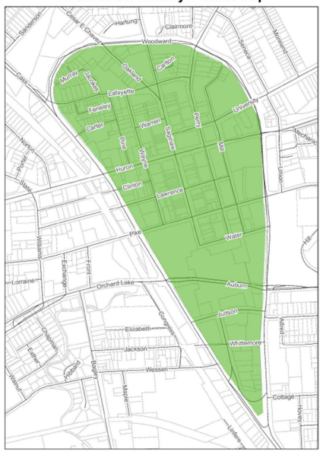
Establishing Municipal Cannabis Regulations
Municipal Ordinances
  Regulatory Ordinance
  Zoning Ordinance
      Zoning Classifications
        Commercial
        Industrial
        Overlay Districts

Slide 11
To build thriving local economies and livable communities, enact ordinances that protect the community interests.
Zoning Restrictions
  Schools
  Playgrounds
  Residential

Slide 12
How can municipalities determine if they have the staff capacity to manage cannabis regulations or do they need a consultant

Slide 13
There are many methods that can be used to manage cannabis regulations after a municipality has adopted an ordinance.
Develop an application review process
  The review process can have phases
  Applications can be reviewed by license types (i.e. growers, processors, retailers, etc.)
Update the public regularly on the status of the application review process (i.e. monthly report)
Utilization of 90-day calendar to manage workflow
Create an Application Review Process Manual
  Step-by-step process on how to conduct all things related to marijuana processes such as receiving applications, conducting reviews, conditional approvals, appeals process, license transfers and renewals

Slide 14
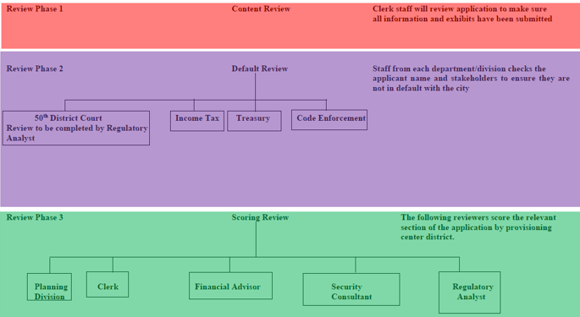
Application Review Process

Slide 15
Questions to Ask Yourself to Determine if You Are Going to Manage Your Program with Internal Staff or a Consultant
Does anyone on our staff have the capacity and time to manage cannabis regulations?
Do we need to create a new position?
Do we want to invest in staff professional development?
  Conferences, Seminars (Cannabis Regulators Association)
  Professional Development Organizations Memberships (National Council on Municipal Cannabis, Municipal Cannabis Regulators Network, Cannabis Regulators of Color Coalition)
Do we need to hire a consultant to help establish our municipal cannabis regulations program? After the program has been established, then we will manage it internally.
Do we want to hire a consultant to manage the cannabis regulations program?

Slide 16
To build thriving local economies and livable communities, staffing decisions should be based on the ability to perform cannabis business compliance and monitoring.

Slide 17

Let’s Review!
Learning Objective 1: How can municipalities determine if they have the staff capacity to manage cannabis regulations or do they need a consultant
Tips
  Develop an application review process
  Update the public regularly on the status of the application review process
  Utilization of 90-day calendar to manage workflow
  Create an Application Review Process Manual
  Develop a list of questions to determine if you are going to manage your program with internal staff or a consultant

Slide 18
Application and Evaluation Processes for Cannabis Licensing

Slide 19
Application and Evaluation Processes for Cannabis Licensing Applications
Types of Application and Evaluation Processes
  One-time application period
  Lottery
  Date received
  Satisfactory/Unsatisfactory
  Scoring and Ranking Systems

Slide 20
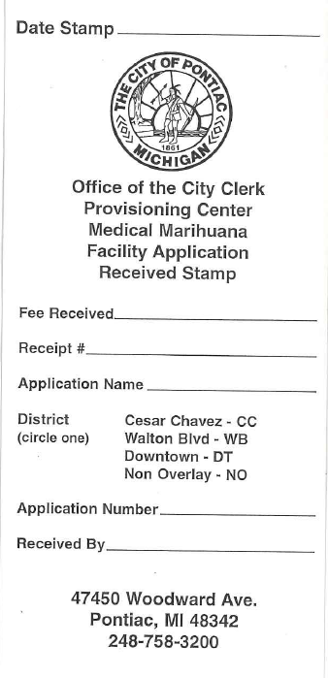
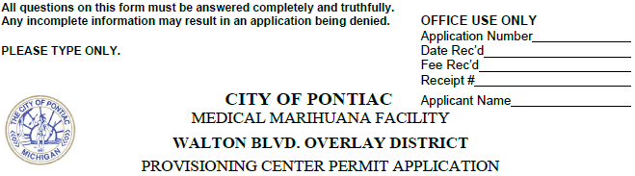
Application and Evaluation Processes for Cannabis Licensing Applications
Date Received
  Applicant shall submit original application along with copies
  Make sure to keep receipts and time stamps of applications for record

Slide 21
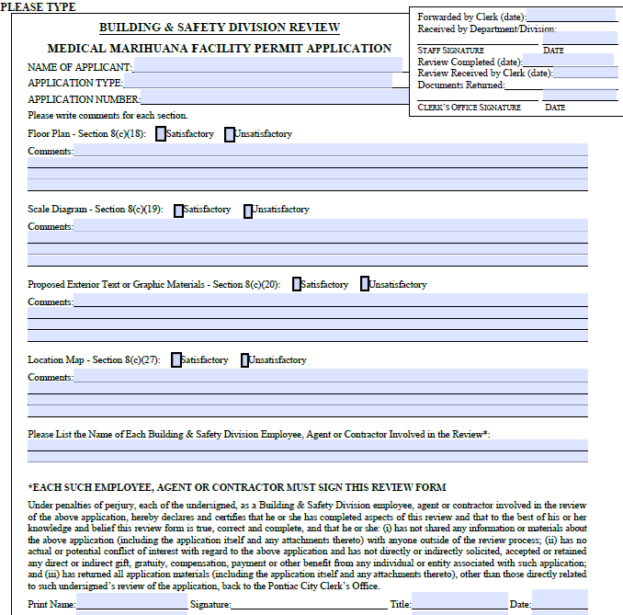
Application and Evaluation Processes for Cannabis Licensing Applications
  Satisfactory/Unsatisfactory

Slide 22
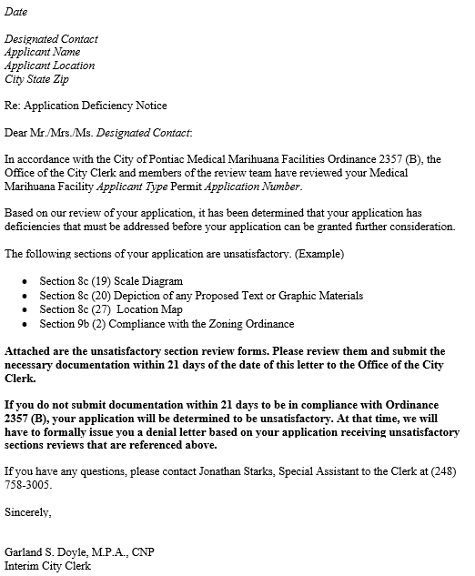
Application and Evaluation Processes for Cannabis Licensing Applications
  Satisfactory/Unsatisfactory

Slide 23
Application and Evaluation Processes for Cannabis Licensing Applications
Scoring and Ranking Systems
  This format makes the application process competitive
  Scoring Guide
  Scoring Criteria
  Scoring Review process is conducted by various, qualified reviewers usually department heads or external consultants
  Compliance Reviews
  Appeals Process

Slide 24
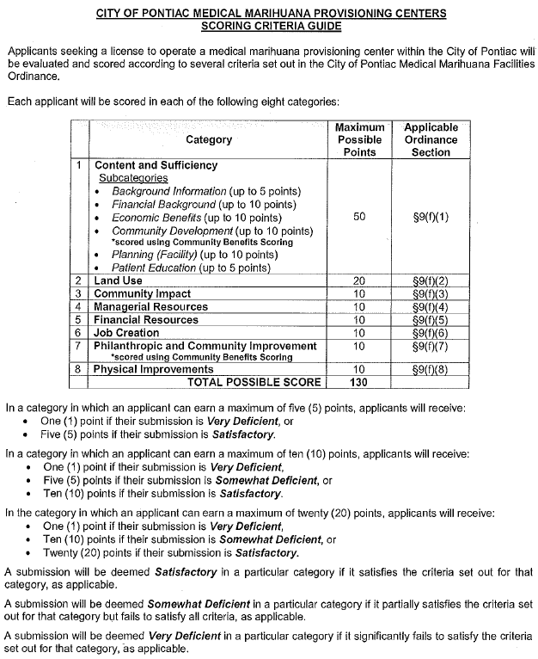
Application and Evaluation Processes for Cannabis Licensing Applications
Scoring Guide
  Scoring Categories (Financial, Community Impact, Planning, Job Creation, etc.)

Slide 25
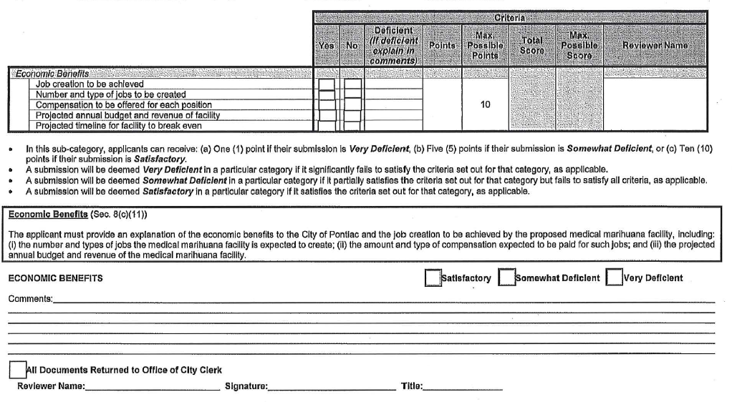
Application and Evaluation Processes for Cannabis Licensing Applications
Scoring Criteria
  Satisfactory, Somewhat Deficient or Very Deficient

Slide 26
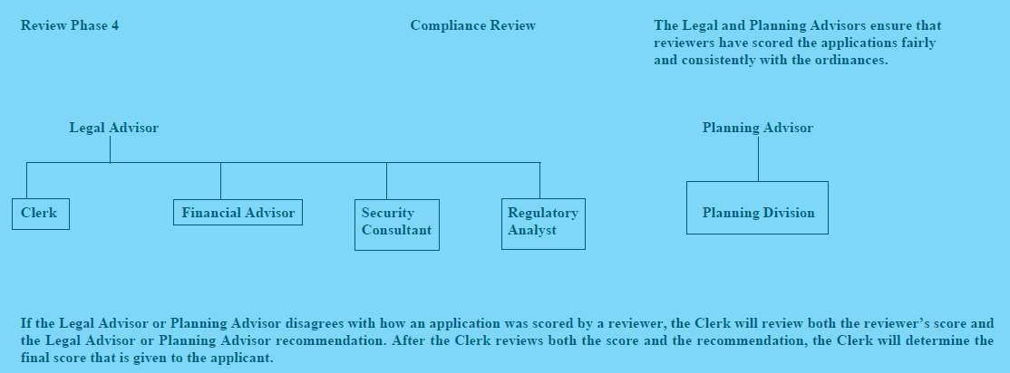
Application and Evaluation Processes for Cannabis Licensing Applications
Compliance Review
  The legal and planning advisors ensures that Satisfactory, Somewhat Deficient and Very Deficient scoring for Provisioning Centers has been consistently applied by reviewers.

Slide 27
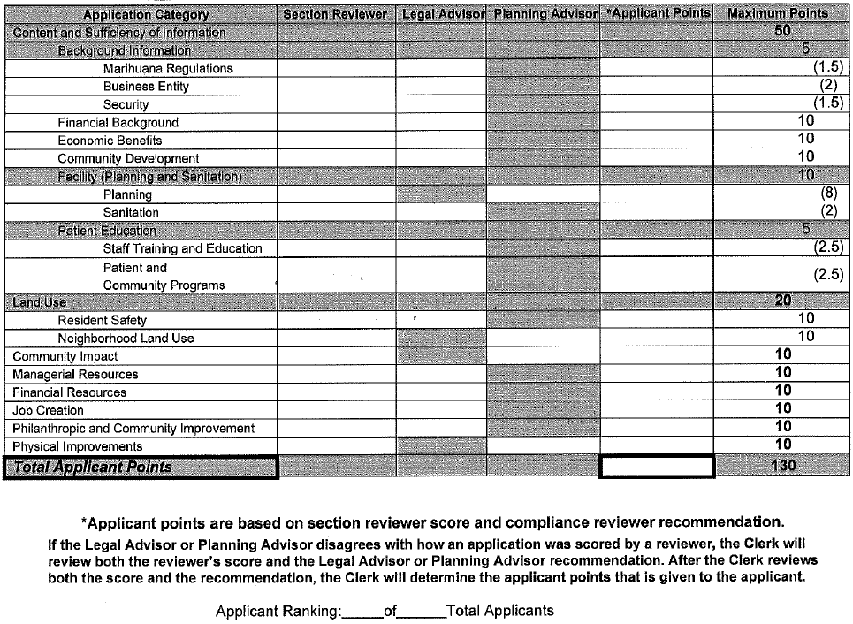
Application and Evaluation Processes for Cannabis Licensing Applications
Scoring and Ranking Systems
  Applicant Rankings

Slide 28
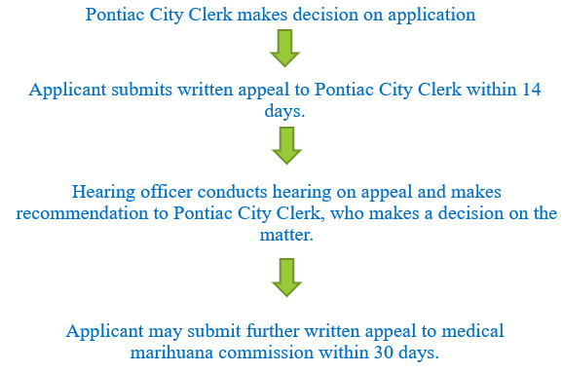
Application and Evaluation Processes for Cannabis Licensing Applications
Scoring and Rankings – Appeals Process
This process makes the application process fair and competitive
  Applicants are given the opportunity to have their voices heard and given reason to why their application should have gotten a spot
  2 steps of Appeal Process
    Hearing Officer
    Marihuana Commission

Slide 29
Litigation is often a part of the application and evaluation process.
How to prepare for lawsuits
Legal Fund
Hiring outside legal counsel

Slide 30
To build thriving local economies and livable communities, develop application and evaluation processes that can with stand legal challenges.

Slide 31
Let’s Review!
Learning Objective 2: Application and Evaluation Processes for Cannabis Licensing Applications
Types
  One-time application period
  Lottery
  Date received
  Satisfactory/Unsatisfactory
  Scoring and Ranking Systems

Slide 32
How to create and maintain stakeholder relationships

Slide 33
How to create and maintain stakeholder relationships
Mayor/City Council
  Assist in the development of regulatory and zoning ordinances
  Trusted Resource
  Gain an understanding of what are the legislative priorities of your elected officials (i.e. social equity, zoning)
Operators/Consultants
  Open Door Policy
  Develop frequently asked questions
  Share information with operators as a group so everyone gets the same message

Slide 34
How to create and maintain stakeholder relationships
Community Leaders
  Develop mechanisms to keep the community informed (i.e. newsletters, attend community meetings, etc.)
State Regulators
  Develop a working relationship with state regulators
  Develop a professional network to advocate on your behalf (i.e. Municipal Cannabis Regulators Network - MCRN)

Slide 35
Different Approaches Used to Improve Coordination between Municipal and State Level Regulations
Grant Programs
Reimbursement Programs
Community Listening Programs
Quarterly Meeting with Municipalities
Municipal Reference Guide
Sharing Tax Revenue

Slide 36
To build thriving local economies and livable communities, engaging stakeholders on all levels is key.

Slide 37
Let’s Review!
Learning Objective 3: How to create and maintain stakeholder relationships
Tips
  Stakeholders
  Mayor/City Council
  Operators/Consultants
  State Regulators
  Community Leaders

Slide 38
Activity

Slide 39
Tips for managing social equity programs

Slide 40
Tips for managing social equity programs
Verification qualifications
Social Equity Plans
Establishing municipality social equity goals
Mitigating Corporate Dominance
Social equity program types
Staffing

Slide 41
Tips for managing social equity programs
Qualifications
  Social equity programs should separate themselves from the larger companies, allowing for those smaller entities to get into the market
  Applicants should be a resident with at least 50% ownership of business
  Targeted for applicants who have been disproportionately impacted by War on Drugs and enforcement of cannabis
    Minority Owned Businesses
    Women Owned Businesses
    Veterans

Slide 42
Tips for managing social equity programs
Verification Qualifications
  Who qualifies to participate in the program?
What is a social equity plan?
  A social equity plan promotes and encourages participation and ownership in the marijuana industry by local residents that have been disproportionately impacted by marijuana prohibition and that positively impacts local residents.

Slide 43
Tips for managing social equity programs
Establishing municipality social equity goals
Hiring Practices
  Permitees must use good-faith efforts in hiring employees who have been negatively impacted by marijuana prohibition. Adult-use marijuana businesses should use good-faith efforts to hire and retain 25% of its employees who are low income or live in the City of Pontiac.

Slide 44
Tips for managing social equity programs
Social Equity Fund
  A fund administered by the City used to promote social equity in the City of Pontiac, a negatively impacted community, by promoting advocacy around criminal justice issues related to marijuana prohibition, supporting youth who have been negatively impacted by war on drugs as it relates to the prohibition of marijuana, and community education on adult-use marijuana in general. The fund details are being developed
  Donations made to the fund will support reentry and restorative justice programs, adult-use cannabis education forums, cannabis-use youth prevention and after-school programs.

Slide 45
Tips for managing social equity programs
Mitigating Corporate Dominance
  The city requires social equity applicants to demonstrate and document 51% or more ownership by social equity qualifying applicants, including ownership structure of the entity that identifies the ownership percentage held by each stakeholder.

Slide 46
Social Equity Program Types
Technical Assistance
  Offering residents and aspiring entrepreneurs' access to workshops and webinars on courses dealing with:
    Cannabis Banking
    Cannabis Financing
    Marketing
    Branding
    Retail Strategy

Slide 47
Social Equity Program Types
Incubator Services
  Cohort programs
  Connecting startups with partners, investors and industry leaders
  Office space with support services

Slide 48
Social Equity Program Types
Loan and Grant Programs
  Low-interest loans
  Start-up grants

Slide 49

Tips for managing social equity programs
Staffing v Outsourcing

Slide 50
To build thriving local economies and livable communities, social equity programs promote and encourage participation and ownership in the cannabis industry by local residents that have been disproportionately impacted by marijuana prohibition and enforcement.

Slide 51
Let’s Review!
Learning Objective 4: Tips for Managing Social Equity Programs
Tips
  Verification qualifications
  Social Equity Plans
  Establishing municipality social equity goals
  Mitigating Corporate Dominance
  Social equity program types
  Staffing

Slide 52
Tips for managing community benefits programs

Slide 53
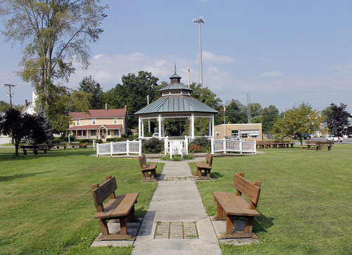
Tips for managing community benefits
Applicants must have a plan and a commitment to the community it plans on conducting business in
Develop an evaluation process for community benefits
Publish Community Benefits Pledges so neighborhood associations, community groups and property owners will know operator’s commitments
Community Development Agreements
Monitoring

Slide 54
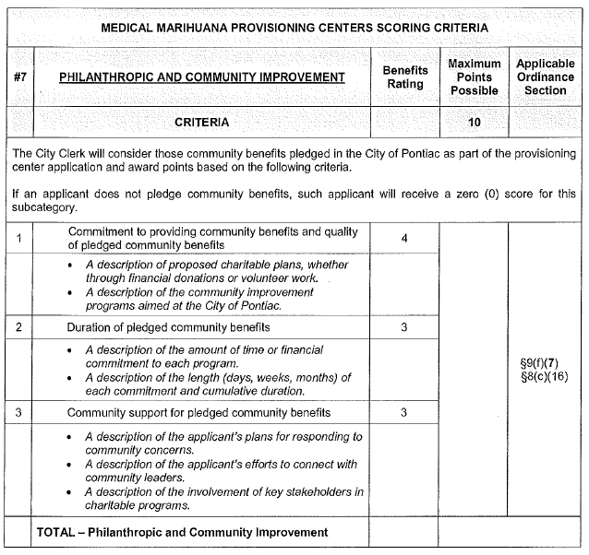
Community Benefits Scoring

Slide 55
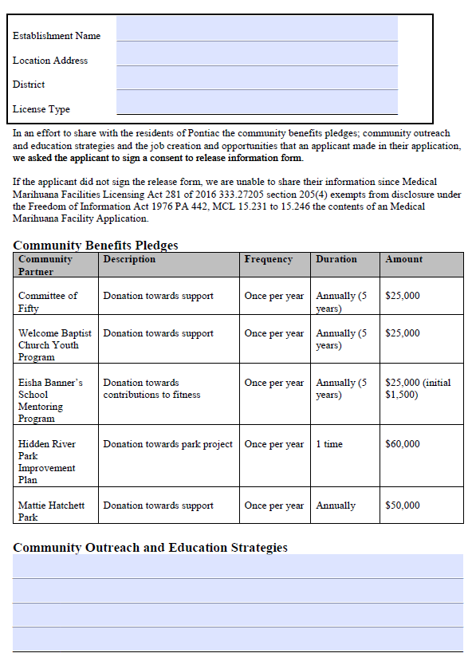
Tips for managing community benefits
Community Benefits Applicant Profile
  Applicant profile would explain their commitment/pledges to the community

Slide 56
Community Benefits
Citizens Monitoring Taskforce

Slide 57
To build thriving local economies and livable communities where cannabis businesses are operating, community benefits are a key ingredient to their success.

Slide 58
Let’s Review!
Learning Objective 5: Tips for Managing Community Benefits Programs
Tips
  Applicant Commitments
  Develop an evaluation process for community benefits
  Publish Community Benefits Pledges
  Community Development Agreements
  Monitoring

Slide 59
Resources
National Council on Municipal Cannabis
https://municannabis.org/
National Survey on Local Government Cannabis Regulations and Administration
http://regulatorsearch.com/national-survey

Slide 60
References
City of Pontiac, Michigan
https://pontiac.mi.us/departments/clerk/medical_marihuana.php

Slide 61

Questions and Answers

