Slide 1
Elevating Employee Experience to Drive Organizational Success
John Nelsen, PHR/SHRM-CP
Director of People & Culture, Adams County

Slide 2

Who are you at your best?

Slide 3
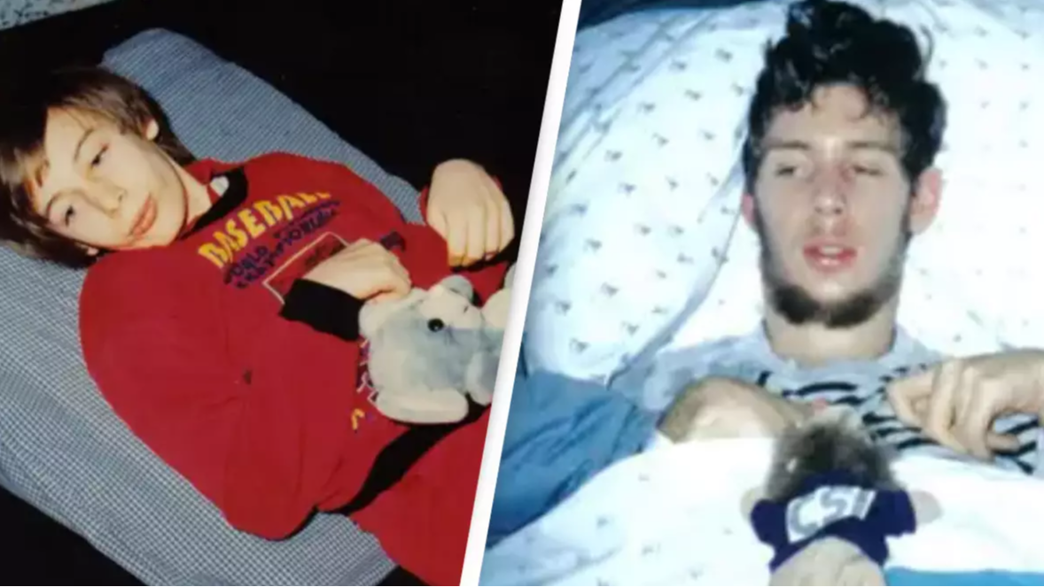
Let me introduce you
to Martin Pistorius.
Source: MartinPistorius.com

Slide 4
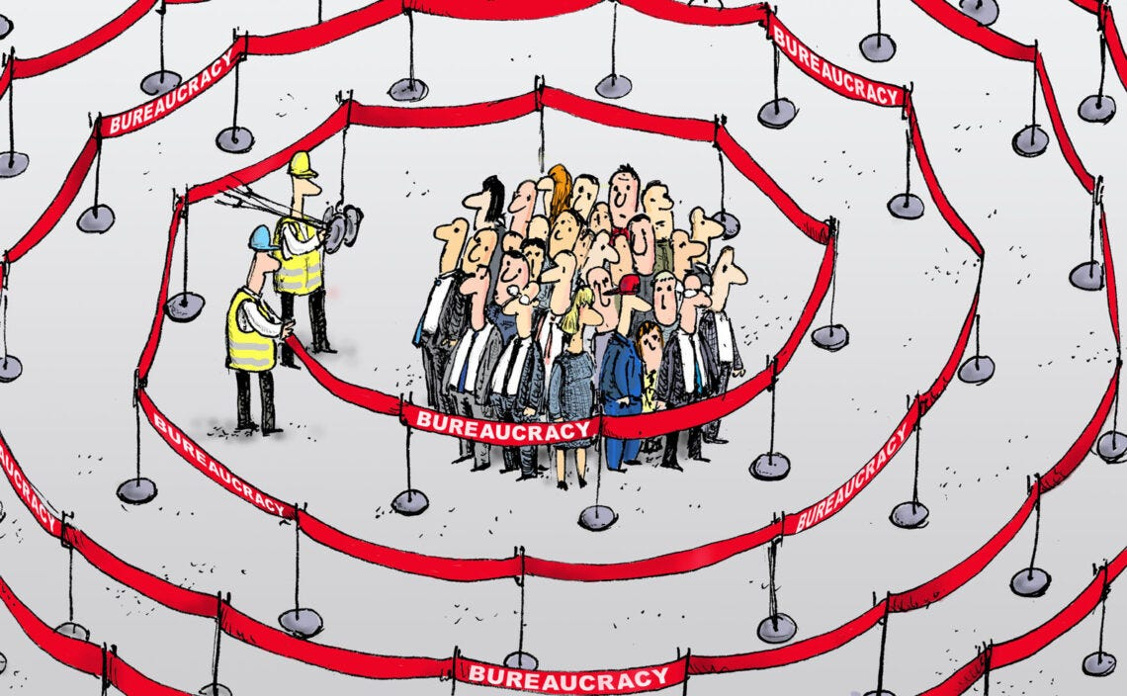
Source: Geopolitical Intelligence Services AG

Slide 5
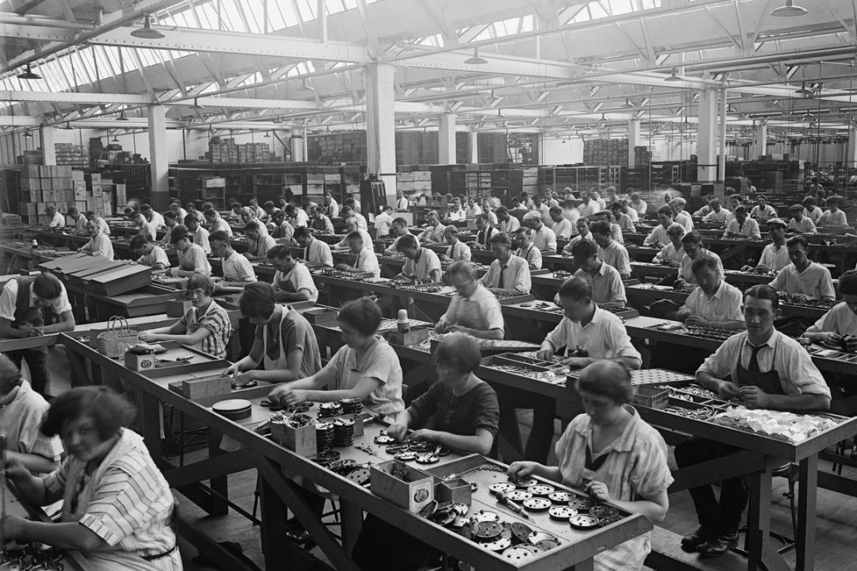
Process > People
Rules > Relationships
Efficiency > Engagement
Source: Library of Congress

Slide 6
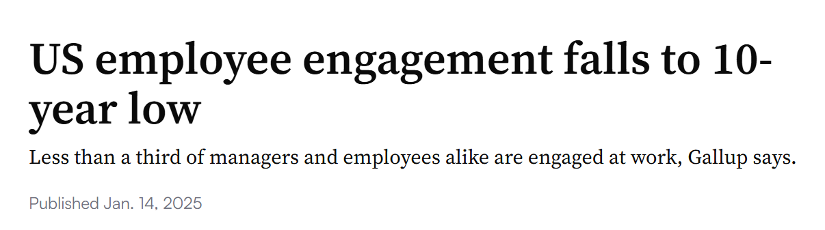

31%
17%
50%
Source: Gallup.com
$8.9 Trillion

Slide 7
Not Equipped for the Modern Workforce:
Rigid Hierarchical Structures
Inflexible Work Arrangements
Resistance to Change
Lack of Continuous Learning
Failure to Embrace Belonging

Slide 8

Control → Empowerment
Compliance → Culture
Processes → People
Source: IT Gurus

Slide 9
Be Bold.
Be Kind.
Be Better.

Slide 10
Be Better.

Slide 11





Clarify the Vision
Invest in People
Challenge the Status Quo
Un-HR HR

Slide 12
What is the End Goal?
What are We Spending Time, Money, Effort
Resources on that People Don’t Value?
What do Employees Want/Need that We
Aren’t Doing?
What Barriers Exist that Prevent Serving Our
People?

Slide 13
Be Kind.

Slide 14



  Psychological Safety
  Trust & Accountability
  Empower Kindness

Slide 15
Be Bold.

Slide 16



Consultative Mindset
Lead with Yes
The “Hot Shot” Rule

Slide 17
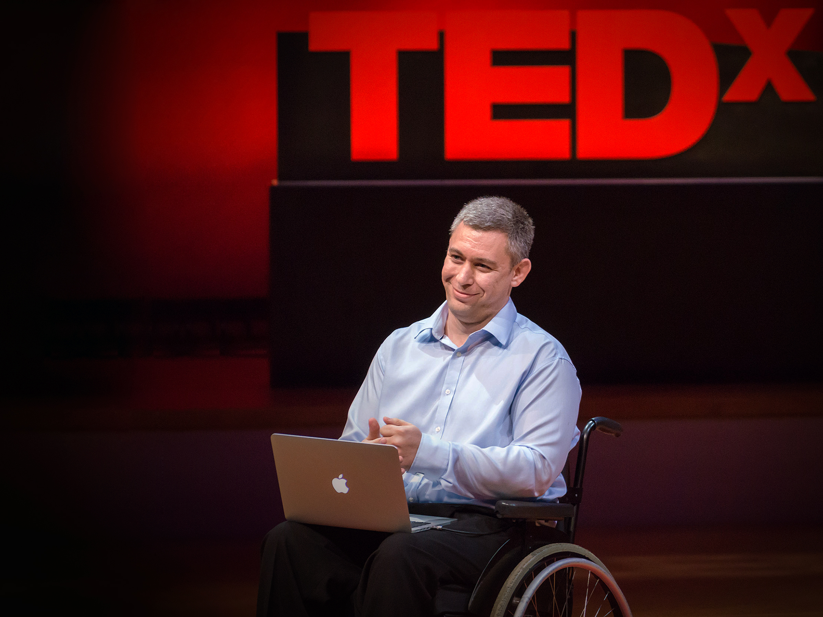
The rest of the story…
Source: TED.com

Slide 18
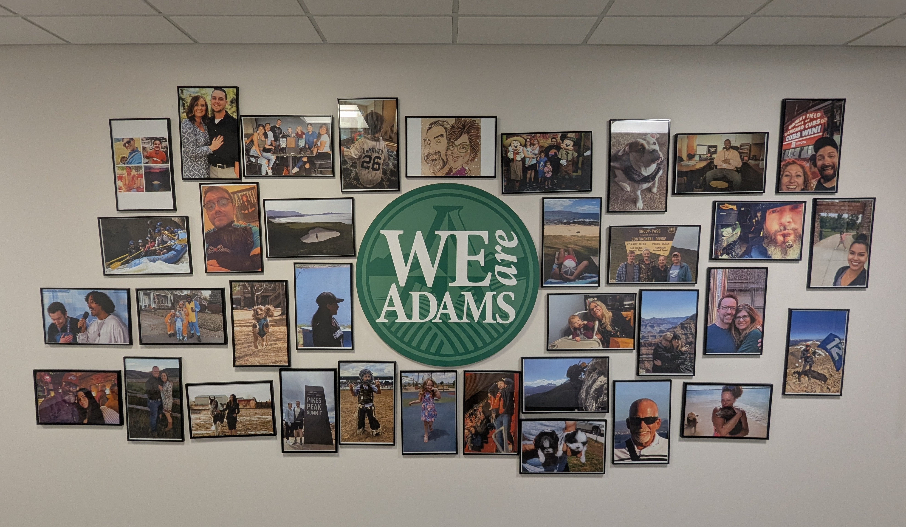

Slide 19
What do you see?

Slide 20
  Not everything that is faced can be changed, but nothing can be changed until it is faced.
  ~James Baldwin

Slide 21
John Nelsen, PHR/SHRM-CP
Director of People & Culture, Adams County jnelsen@adcogov.org (720) 523-6215
Source: TED.com
Thank You!

