Slide 1
Leveraging Intergovernmental Agreements Between Cities to Advance Sustainability: The Opportunities and Challenges
Mel Englund, Sustainability Program Manager, Cities of Englewood and Sheridan
Andrew Rogge, Community Development Director, City of Sheridan

Slide 2

Agenda
Defining Intergovernmental Agreement
Table Activity
Background of the Cities of Englewood and Sheridan
Background of Partnerships
How the Roles are Structured
The Opportunities and Challenges
Key Takeaways
Q&A

Slide 3
Intergovernmental Agreement
Any agreement that involves or is made between two or more governments in cooperation to solve problems of mutual concern.
(Source: Colorado Dept. Of Local Affairs)
Notes:
Governments use IGAs for cooperative planning, development review, resource sharing, joint planning commissions, building inspection services, and more.

Slide 4
Table Activity
Using IGAs to Get the Job Done

Slide 5
Directions
Each table will get one of three prompts
Take ten minutes with your table to come up with how you think an IGA could be used to solve the challenge at hand
The demographics, income, appetite for collaboration, etc., of surrounding communities is completely up to you to determine. (Ex: the surrounding communities all have high amounts of funds to bring to the table OR the surrounding communities have high council support for collaboration, etc.)

Slide 6
Report Out
What solutions did your table come up with?

Slide 7
Background on the Cities of Englewood and Sheridan

Slide 8
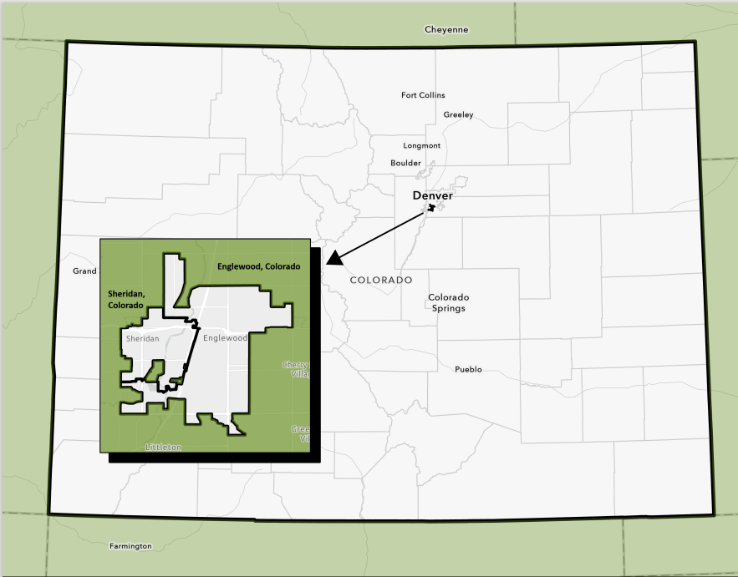
Map of where Englewood and Sheridan are​

Slide 9
Englewood
Sheridan
Population: 34,275
Median Household Income: $79,375
Environmental Top Concerns:
  Air quality
  Aging infrastructure increasingly stressed due to climate change
  Lack of multi-modal accessibility
Population: 5,908
Median Household Income: $53,707
Environmental Top Concerns:
  Air quality
  Landfills
  Flooding / waterway pollution
Notes:
Air Quality: (heavy industry, traffic congestion, ozone, and wildfire smoke)

Slide 10
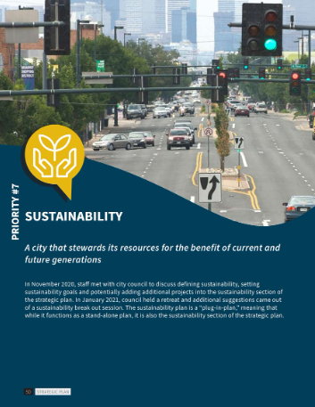
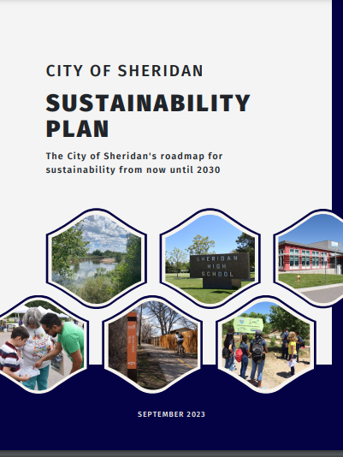
Background of Partnerships - SPM
Sustainability Program Manager (SPM)
  Englewood established position in 2021 (part-time), Sheridan partnered via IGA in 2022 transitioning position to full-time.
  Englewood immediate need: overseeing and implementing already established plan
  Sheridan immediate need: creation of Sustainability Plan
City of Englewood Sustainability Plan
City of Sheridan Sustainability Plan

Slide 11

Background of Partnerships - SBP
Sustainable Business Partnership (SBP) Program
  Both communities' greenhouse gas (GHG) inventories showed commercial sector largest emitter
  State had free green business program, but needed staff to implement
  Utilized plastic bag fee funds to hire Green Business Program Coordinator

Slide 12
How the Roles are Structured
Time and cost shared
  Sustainability Program Manager (SPM) 4 days Englewood, 1 day Sheridan
  Green Business Coordinator (GBC) 2.5 days Littleton, 2 days Englewood, .5 days Sheridan
Payroll via one city (Englewood) with the other cities on contract
One supervisor for the positions (Englewood)
SPM contract good for three years, then reviewed; GBC good for one year, then reviewed

Slide 13
The Opportunities and Challenges

Slide 14
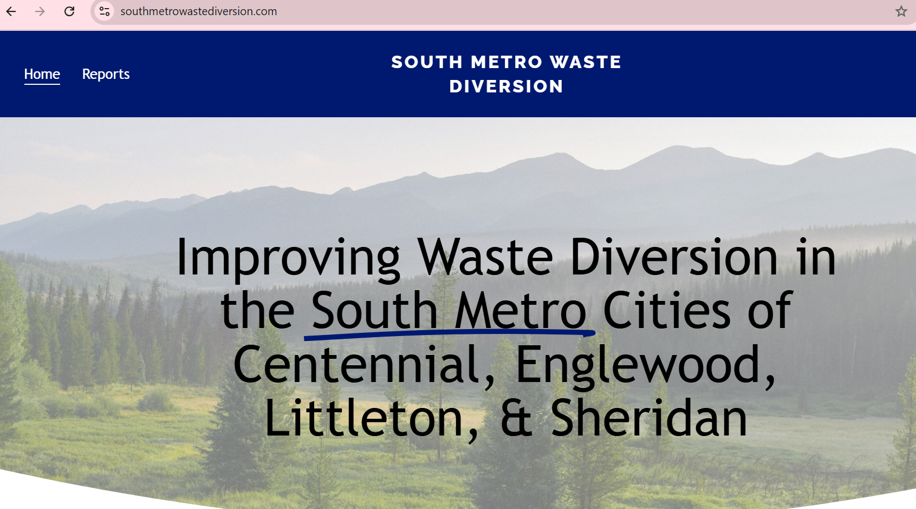
Potential Opportunities
Strengthening of relationships between the entities involved
Relieves current staff time for entities involved for projects, especially those that would be outside their realm of expertise
Grant funding
  Streamlines applications, especially if grant applies to all entities involved
  Oftentimes partnerships between cities is an application strengthener
Project Highlight: South Metro Waste Diversion Project

Slide 15
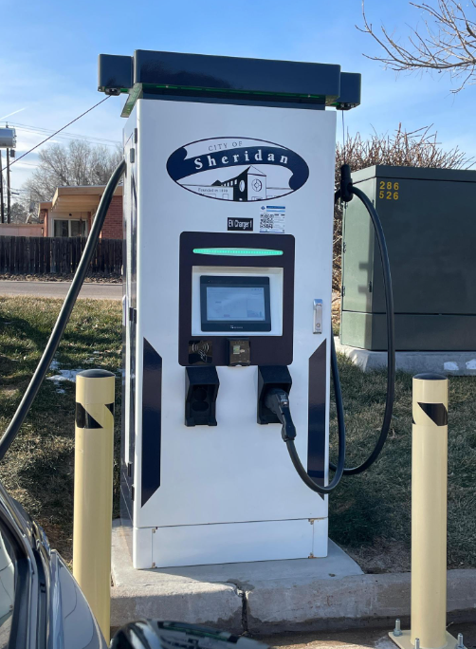
Potential Opportunities - Continued
Co-learning from different cities on best practices / collaborating regionally on issues
  EX: Electric vehicle charging stations
Simultaneous partnered projects between entities can see overall project time and/or cost reductions
  EX: Public building electrification
Positive signal to residents of responsible spending and collaborating with neighbors

Slide 16
Potential Challenges
Conflicting pay scales for the position
Conflicting work cultures / unhappiness at one city leading to unhappiness in general
Fallout if one city wants to pull participation in position / program and who would pick up that cost or how
Leveraging of similar projects increases efficiency, but the 2+ communities may have completely different priorities

Slide 17
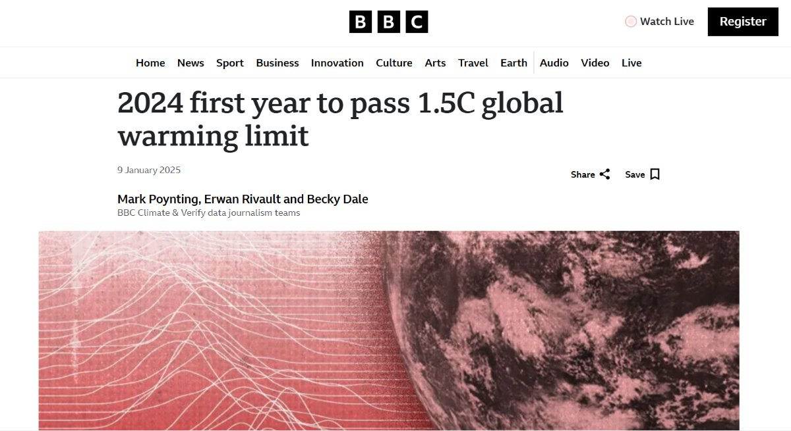
Potential Challenges - Continued
High demand on the one person (or team), especially as climate change intensifies
  Ensure effort or program utilizing IGA for is appropriate: EX) Large cities like Denver and Boulder doing an IGA for a sustainability staffperson would be inappropriate due to scale of work
Source: https://www.bbc.com/news/articles/cd7575x8yq5o
Notes:
: 2+ city councils, communities to engage with (with increasing demand for swift action on climate change), internal staff to collaborate with and check-in with

Slide 18
Top Takeaways

Slide 19
Top Takeaways
The entities involved in the IGA need to have at least somewhat of a healthy working relationship
Have one main supervisor for the role if IGA involves hiring of a position (too many cooks in the kitchen lead to confusion)
Have check-ins to ensure partnership is going smoothly
Encourage your IGA staffperson(s) to find what projects can be done at the same time for efficiency and potential time and cost savings
Respect that each entity will have its own unique goals and needs, don't try to standardize both communities for uniformity – be flexible and responsive!

Slide 20
Thank You!
Mel Englund
Sustainability Program Manager
Cities of Englewood and Sheridan
E: Menglund@englewoodco.gov OR sustainability@ci.sheridan.co.us
C: 303-870-2047
Andrew Rogge
Community Development Director
City of Sheridan
E: arogge@ci.sheridan.co.us
O: 303-438-3307

