Slide 1
Fellowships, Internships, and Apprenticeships:
The Role of Talent Development Programs in Attracting and Retaining Talent
G. Dylan Russell
Lead for NC and Public Service Matters
The UNC School of Government

Slide 2
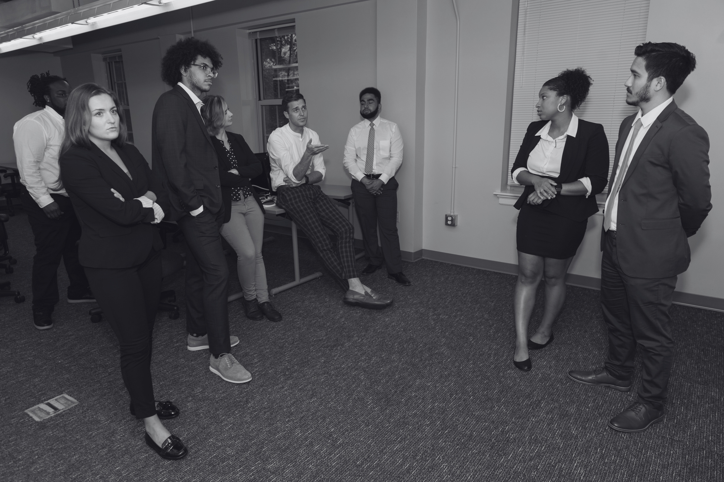
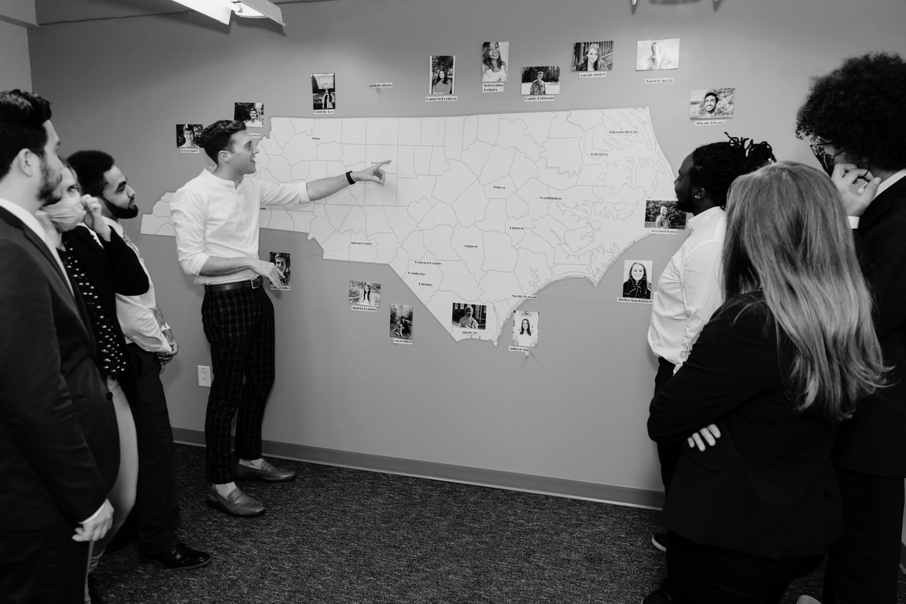
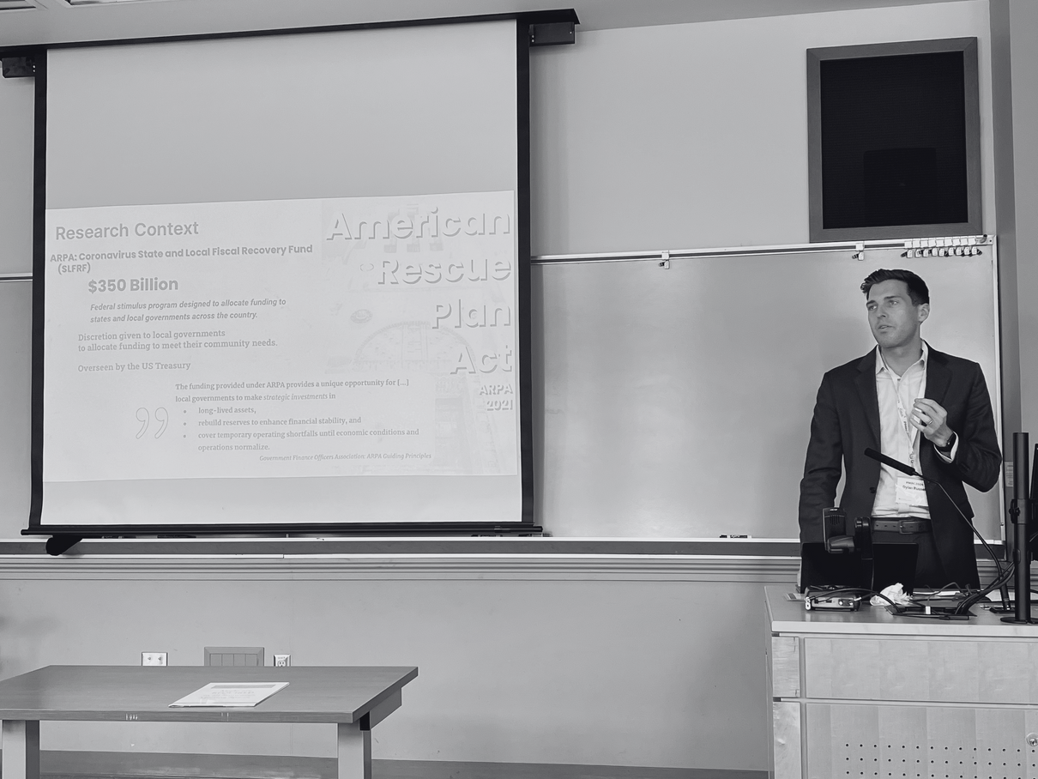
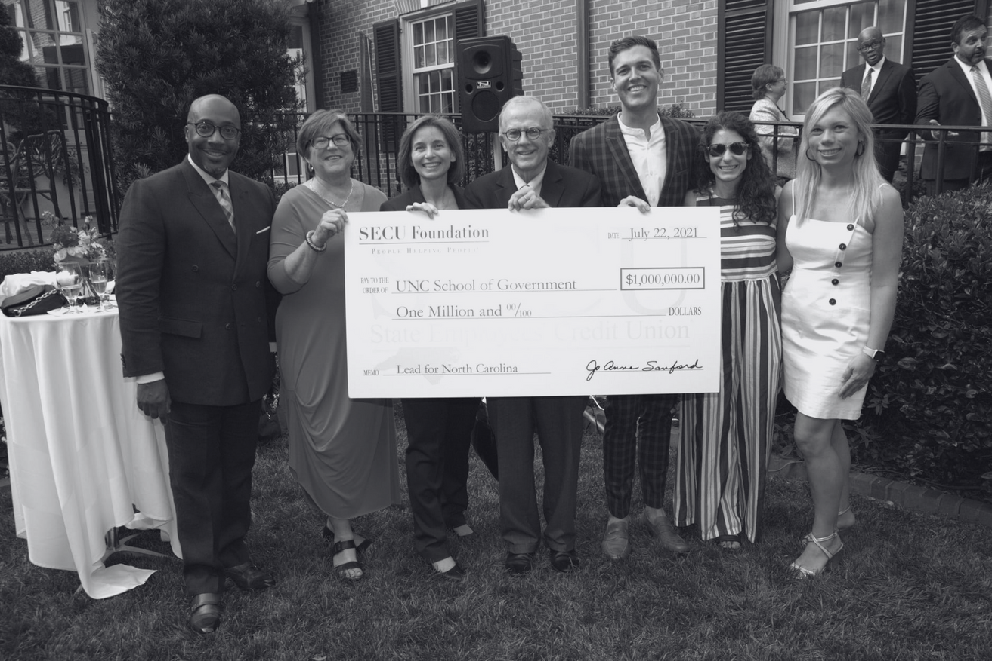

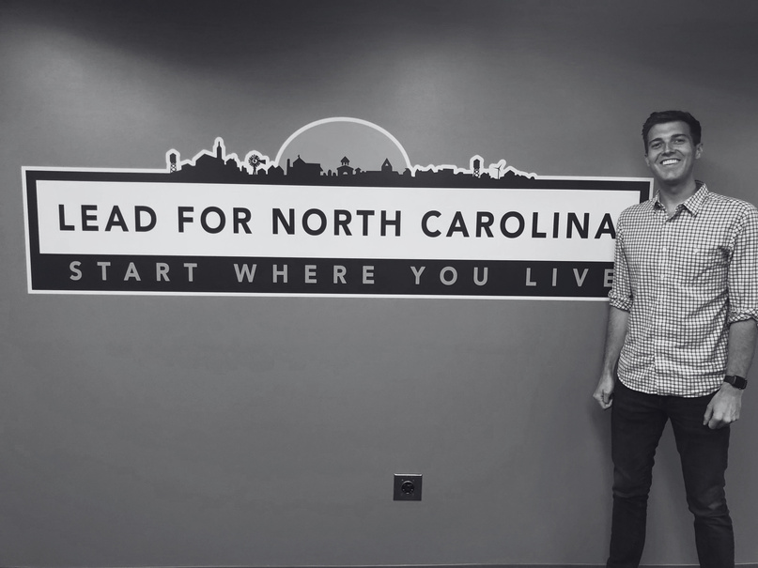
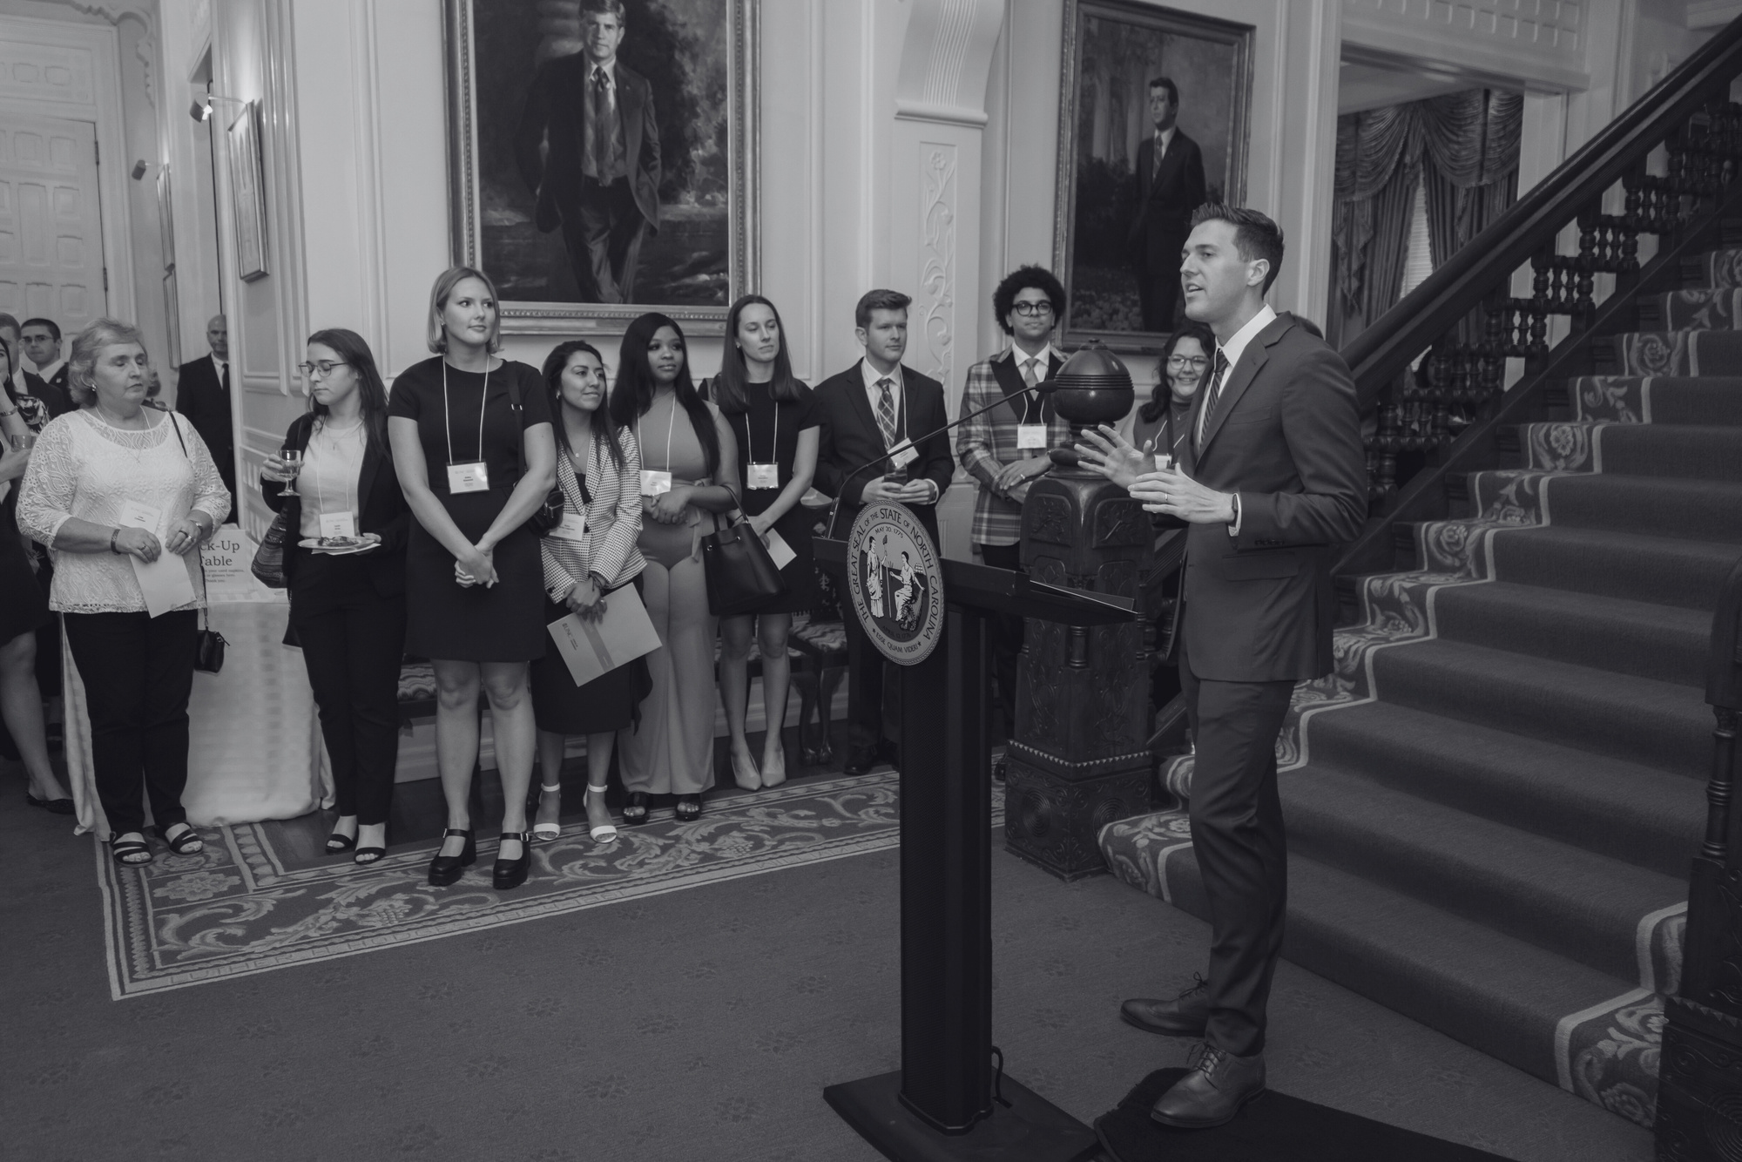

PUBLIC
SERVICE
PRACADEMIC

Slide 3

70%
of
local government leaders
in North Carolina
are eligible to retire.
This percentage is exacerbated in rural and economically distressed communities.
In NC's most rural counties, local governments employ
as many as one out of every three workers.

Slide 4
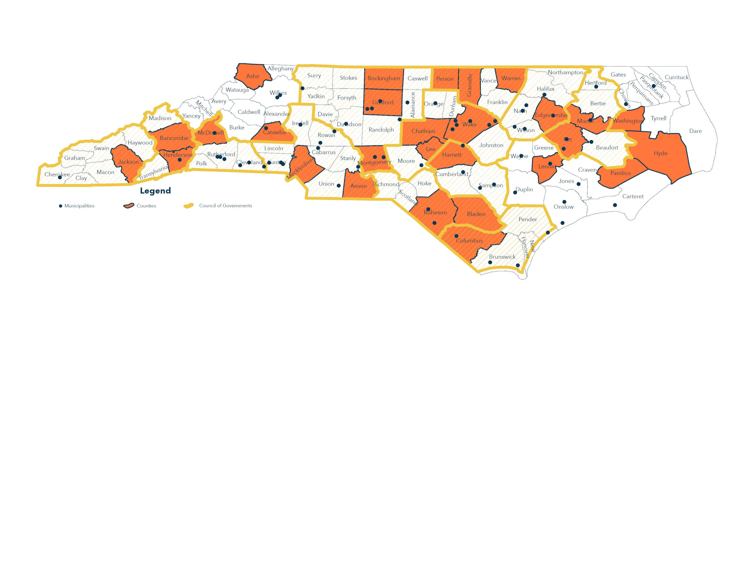


Lead for NC Goals
Generate a pipeline of
talent to
local governments.
150 FELLOWS
ACROSS NORTH CAROLINA
ACCOMPLISHMENTS
SINCE 2019...
56% of the 50 LFNC Alumni are enrolled in graduate programs in public affairs.
92% of LFNC Alumni (not in graduate school) are employed in the public sector
70% of LFNC Alumni remain in North Carolina for graduate education or full-time employment
60% of our Lead for NC Fellows worked for their host site or another local government in NC after the fellowship.
$100+ Million
Secured in grants
to advance key community initiatives.
$7+ Million
Estimated in cost savings to jurisdictions because of their service.
125+
New partnerships reported because of their service.
Notes:
- 56% of the 50 LFNC Alumni are enrolled in graduate programs in public affairs.
- 60% of those students are attending graduate programs in North Carolina.
- 86% of LFNC Alumni (not in graduate school) are employed in the public sector (20 in local govt. 7 in nonprofit
- 70% of LFNC Alumni remain in North Carolina for graduate education or full-time employment
- 59% of our Lead for NC Fellows worked for their host site or another local government in NC after the fellowship.

Slide 5


How does participation in a fellowship program impact
long-term public sector employment and retention?

Slide 6
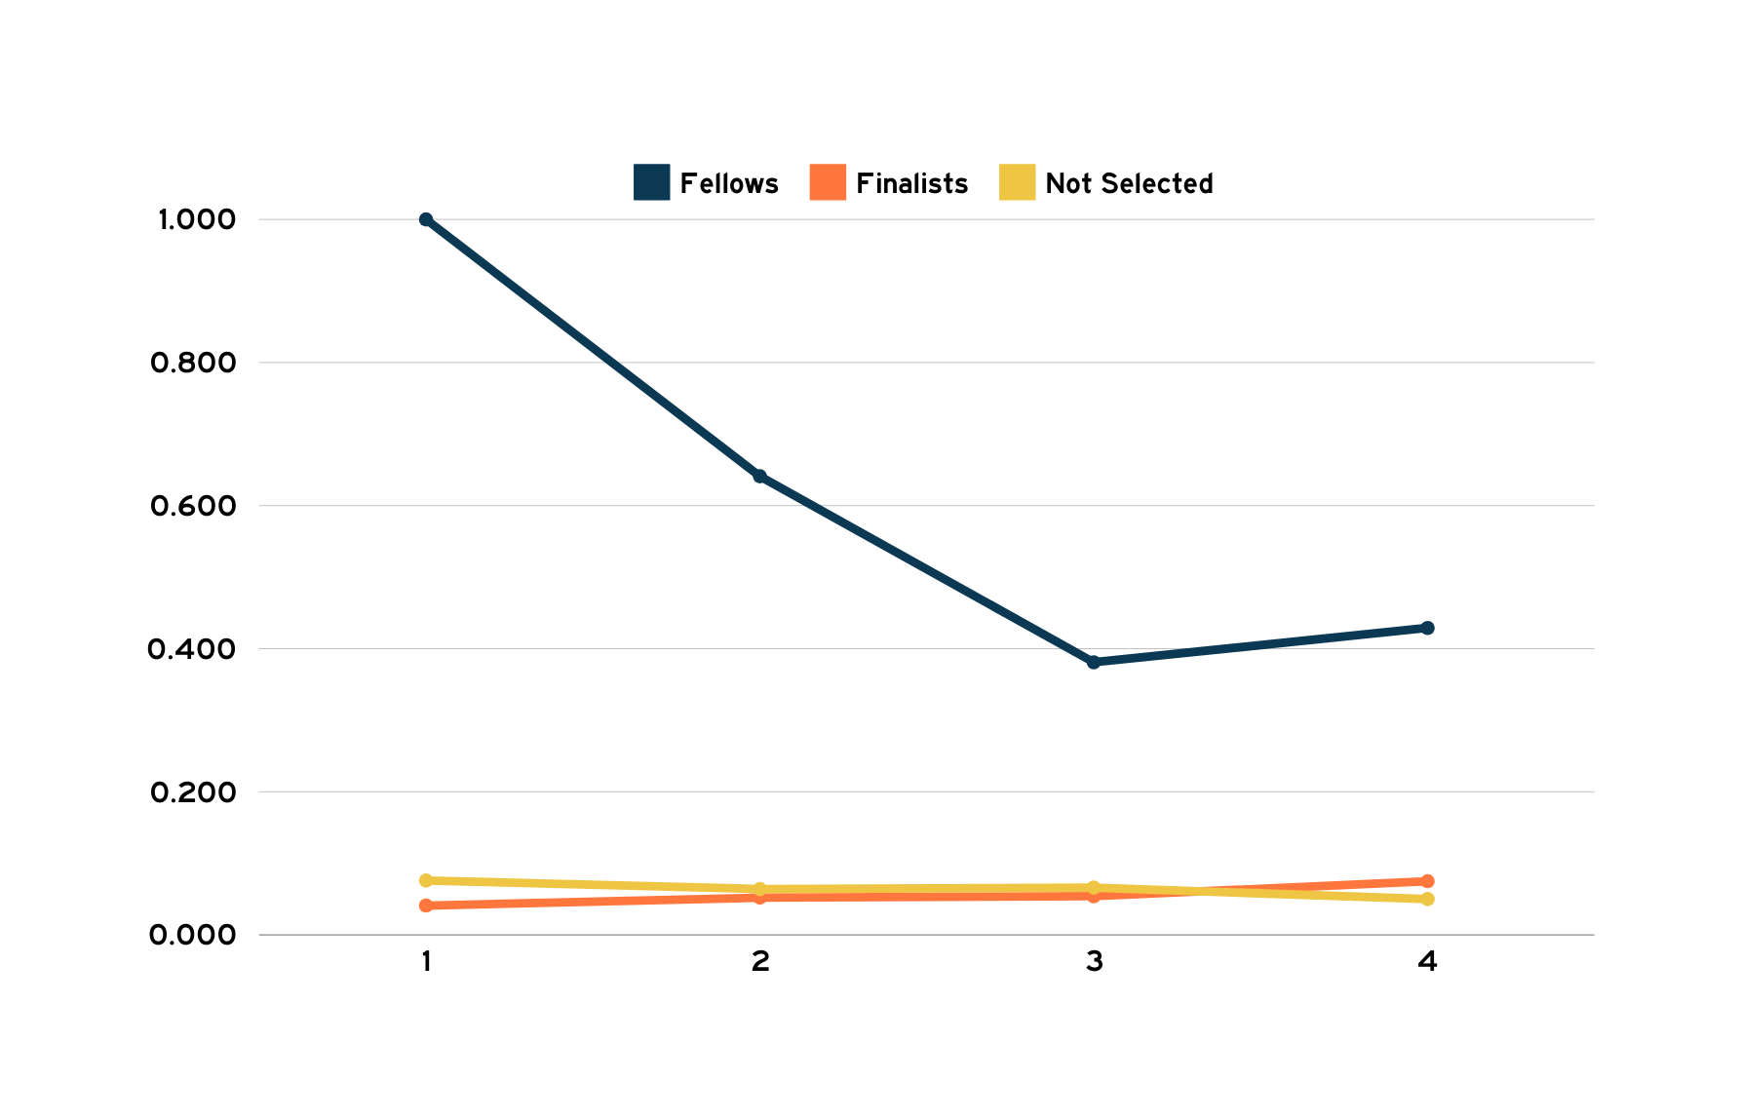
Employment in Local Government
95% Confidence Interval
n=367
n=326
n=299
n=294
Year(s) Since Application

Slide 7
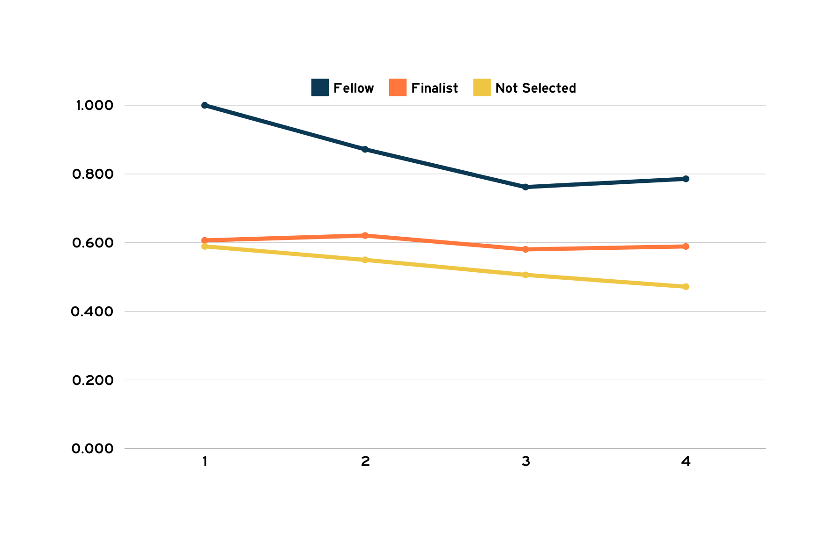
Employment in Public Sector
95% Confidence Interval
n=367
n=326
n=299
n=294
Years Since Application

Slide 8

Employment in Public Sector
95% Confidence Interval
Takeaways Ahead
  Talent will not stumble into your organization - targeted interventions are essential to expand the talent pool.
To
  Leadership development programs matter . . .
but if you want to keep talent,
what does that look like for you as a leader…
n=367
n=326
n=299
n=294
Years Since Application
(Bradt, 2012; Carucci, 2018; Tsipursky, 2023)

Slide 9


Slide 11



Session Objectives
Design
Implement
Evaluate
Design effective talent acquisition programs to attract new talent.
Implement strategies to enhance these programs for better talent retention.
Evaluate the impact of programs on workforce recruitment and retention.

Slide 19
Considerations for how you advertise positions
Tik Tok launched application portal
A majority apply through cell phone!
Biggest complaint through public service hiring...the length to hear from orgs.
76% want organizations to be responsive!

Slide 21
Nearly 1/3 of Gen Z applicants don’t know where to start the application!
Use social media and current employees
TikTok launched hiring platform
Opportunity to apply through their cell phone
75% use their free time online

Slide 22

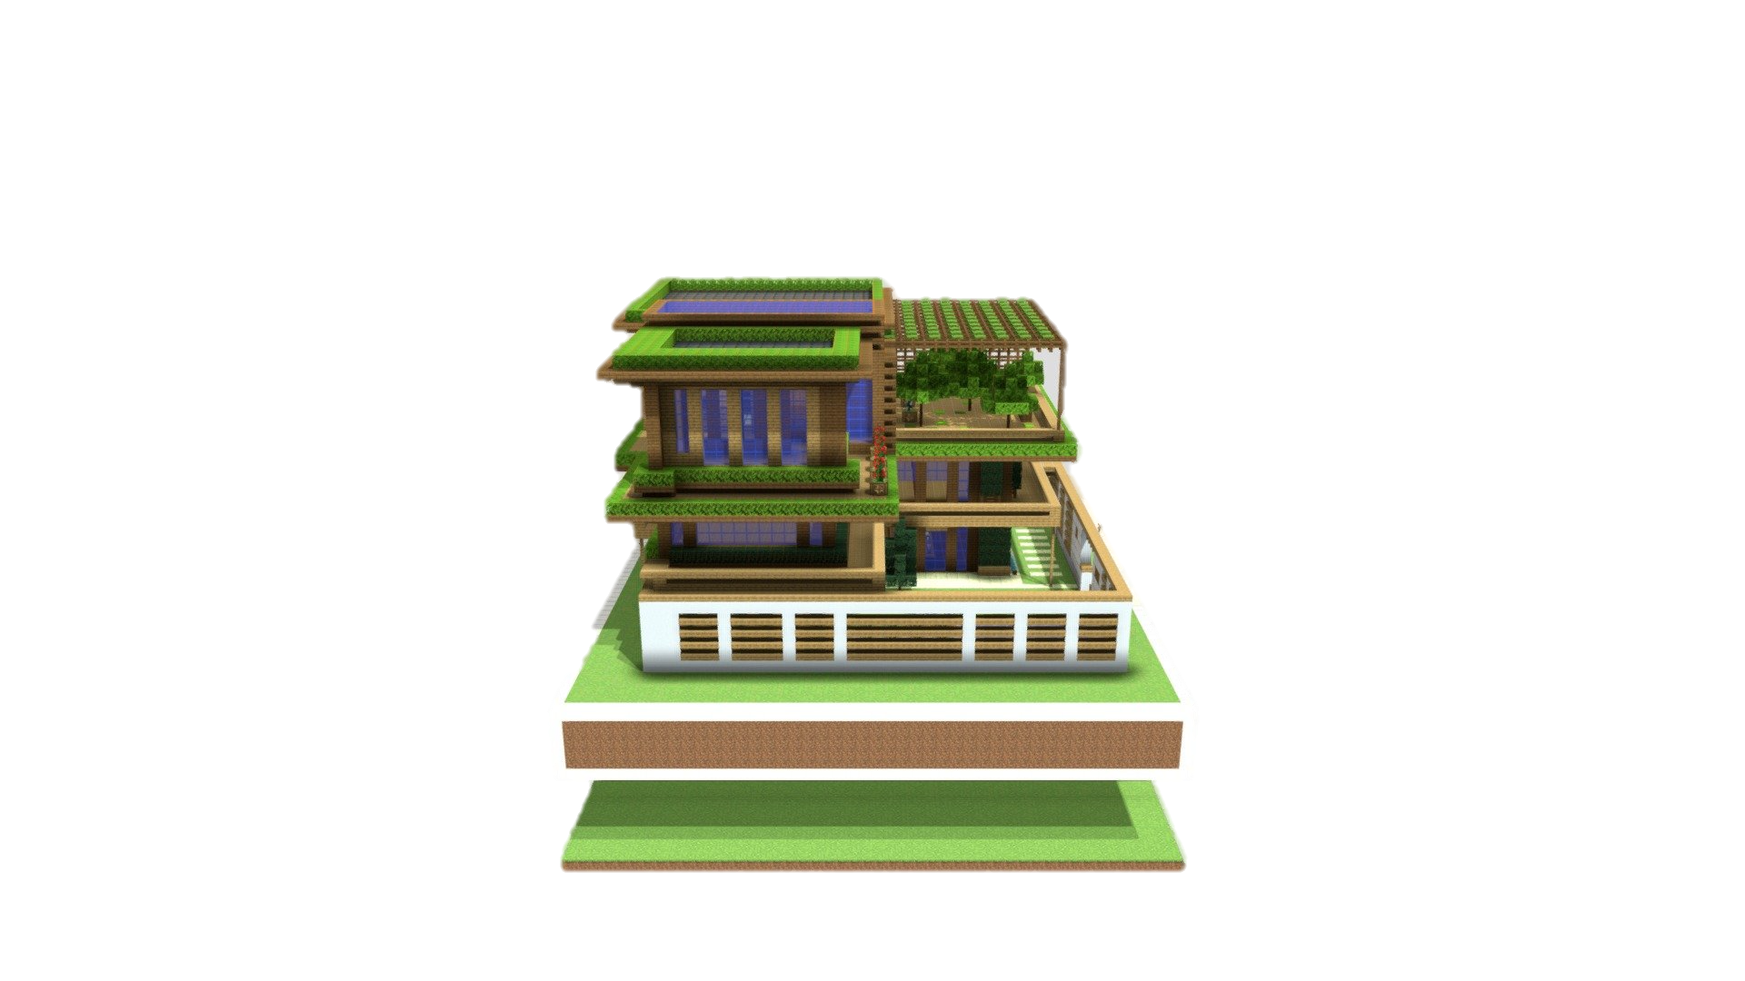
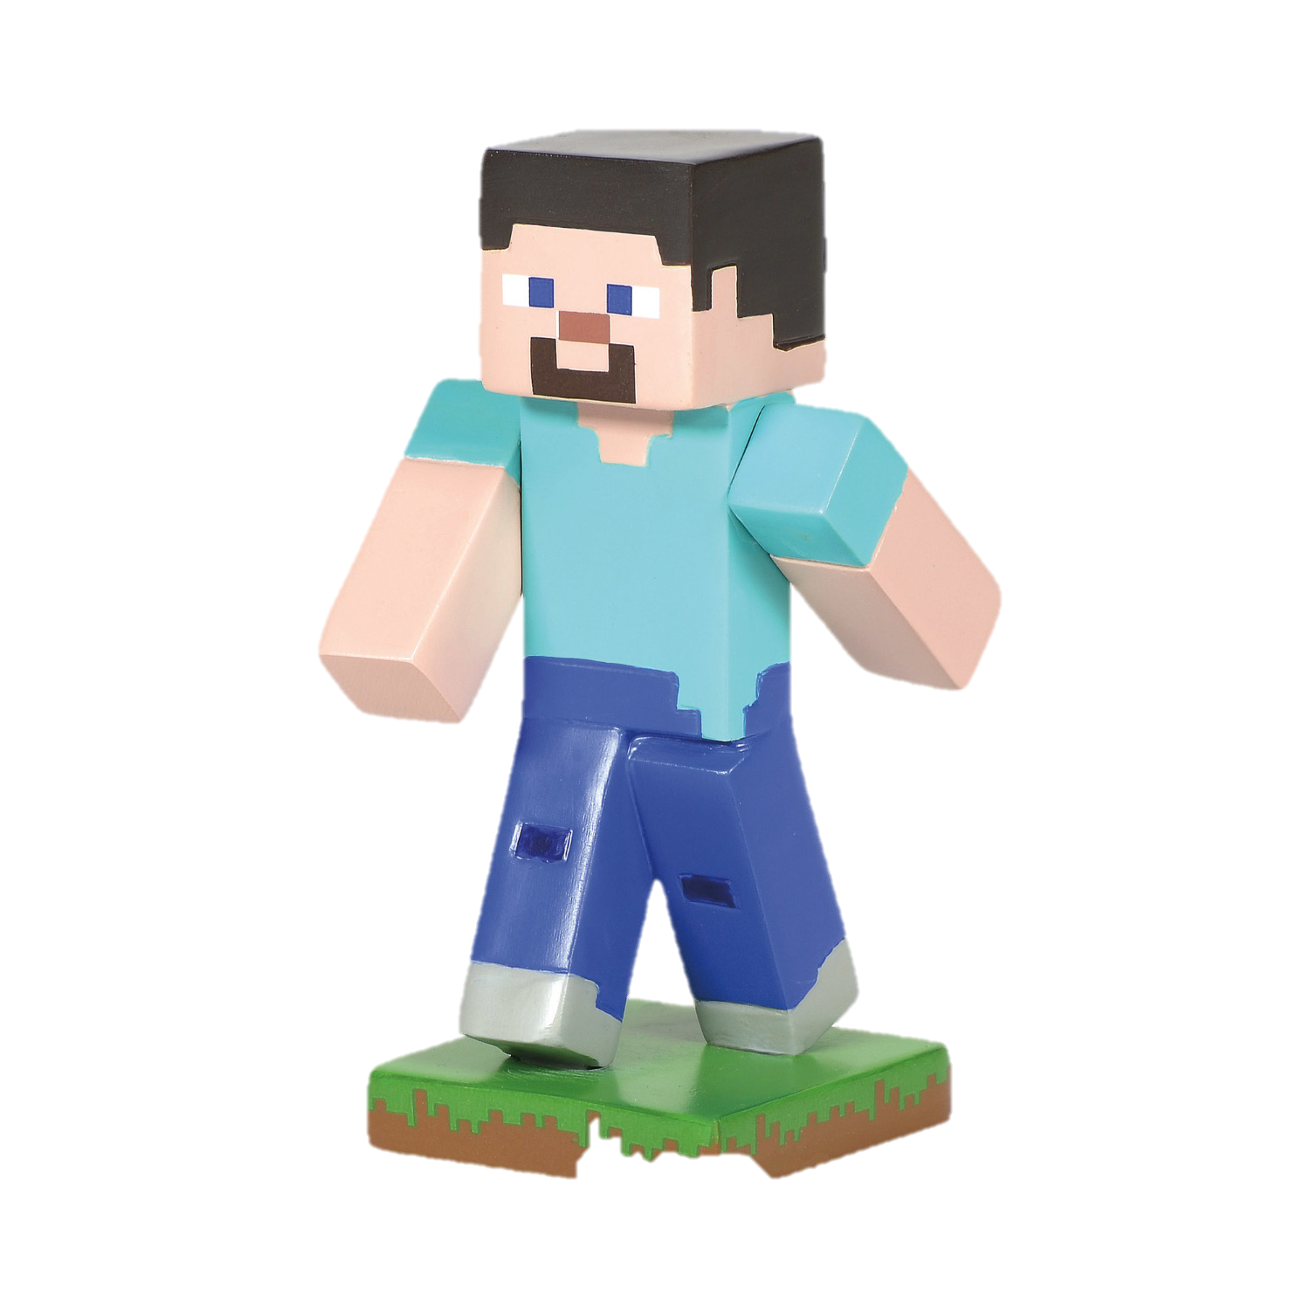

Everything is
Changing.

Slide 23











No knowledge of a world before the internet or smartphones. Influences their career expectations.
(Marginean, 2021)
Gen Z is entering the workforce with less professional experience compared to any other generation.
(Vieira et al., 2024)
1997 - Now...
The world has changed...
but the way we think about talent acquisition
has largely remained the same...

Slide 24






A Changing
Workforce
Early Departure
Voluntary Turnover
Recruiting Struggles
High Attrition
Managers w/Empathy
Diverse & Educated
80% of new employees reported it is acceptable to leave a new job before six months if expectations are not met
(Tomb, 2022).
Voluntary turnover is the primary driver of government vacancies
(Evangelist, 2022)
A quarter of state and local government employers report they were unsuccessful in recruiting Gen Z
(Young, 2023)
Over half of state and local government employees are thinking about leaving their jobs
(Lucia, 2022).
Gen Z ranks empathy as the second most important trait in a supervisor
(Brigham, 2024).
Gen Z is the most racially and ethnically diverse generation, and the most well-educated generation
(Parker & Igielnik, 2020).
Is your organization ready to support the next generation of public leaders?
The Management Imperative of
Understanding the Next Generation of Public Leaders.

Slide 25
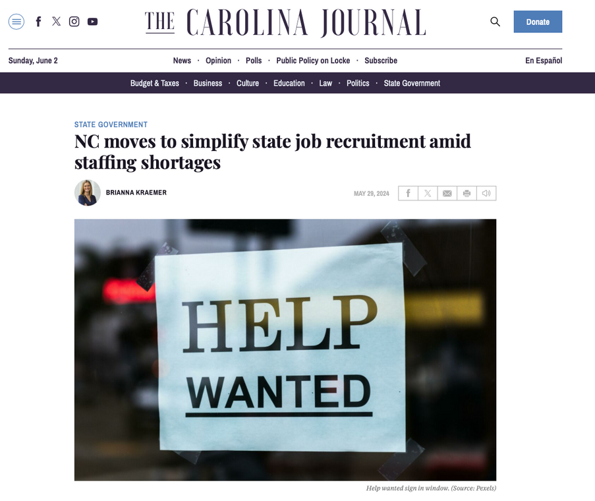
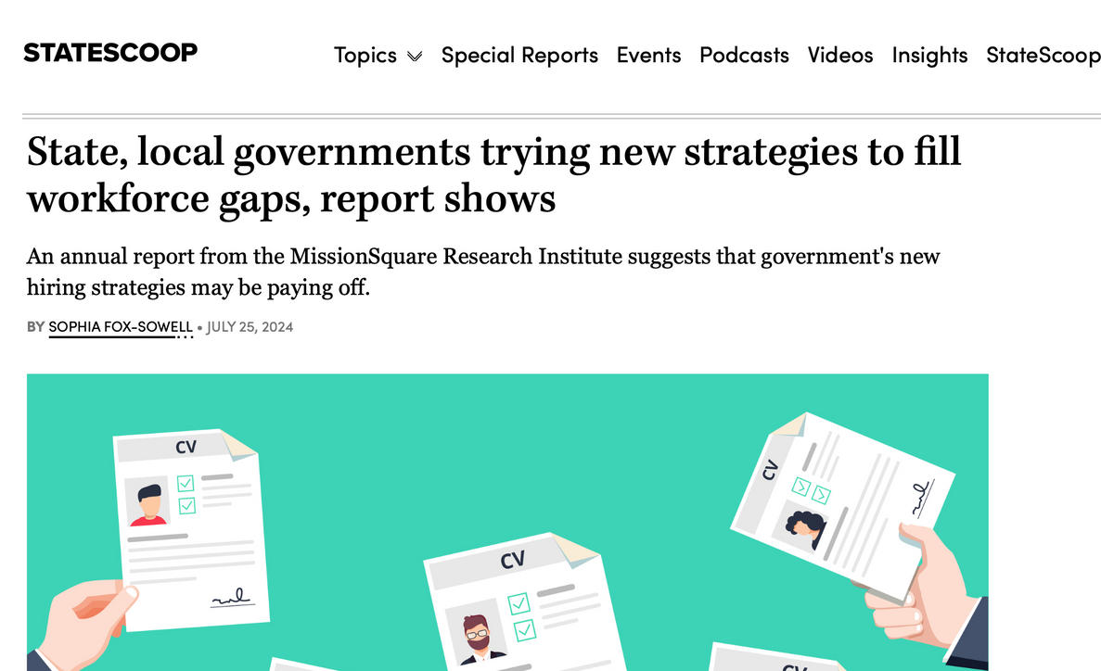
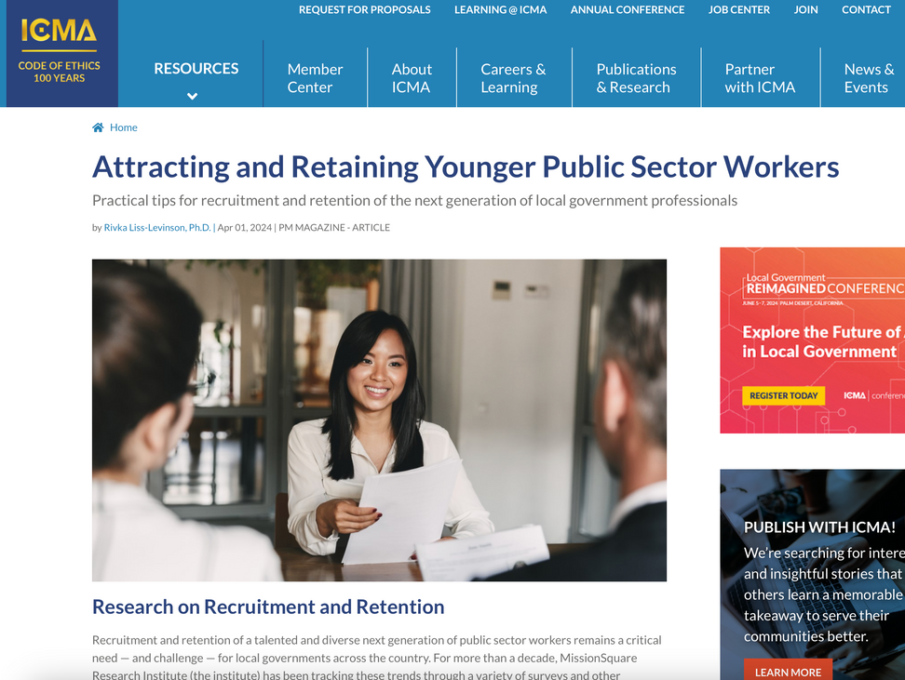
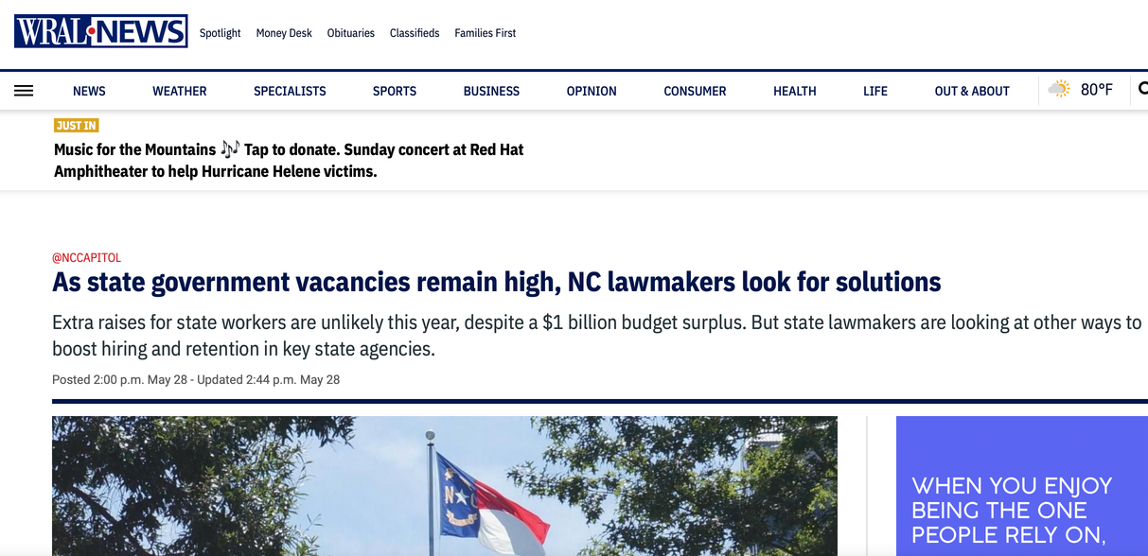
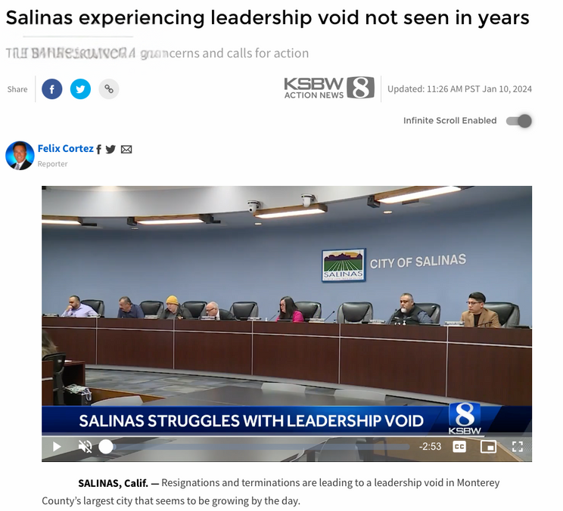
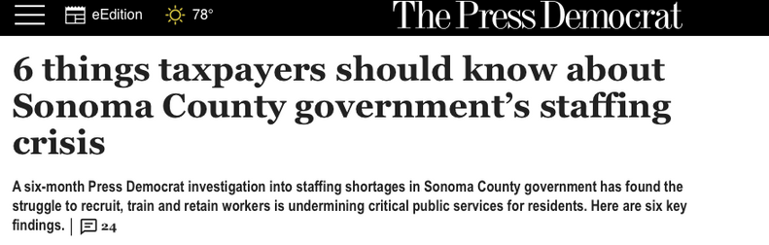
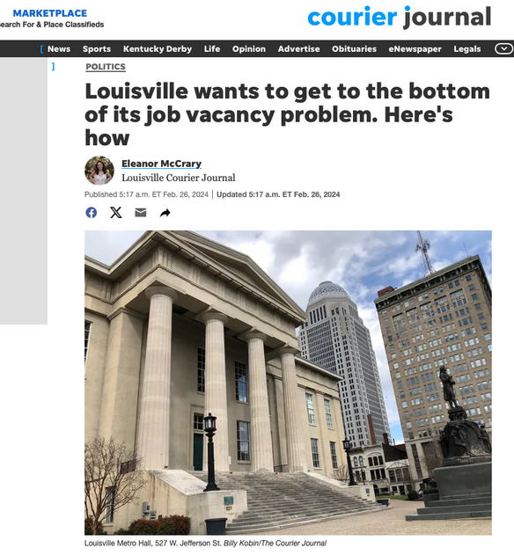
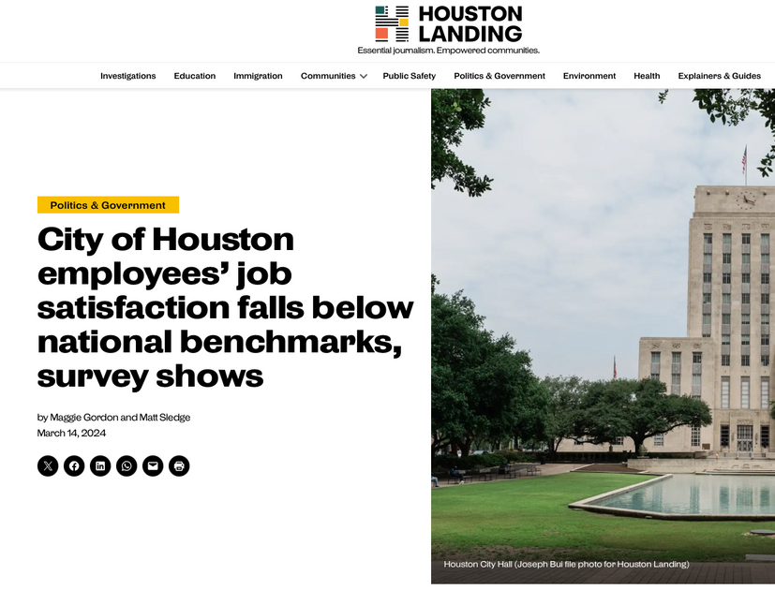
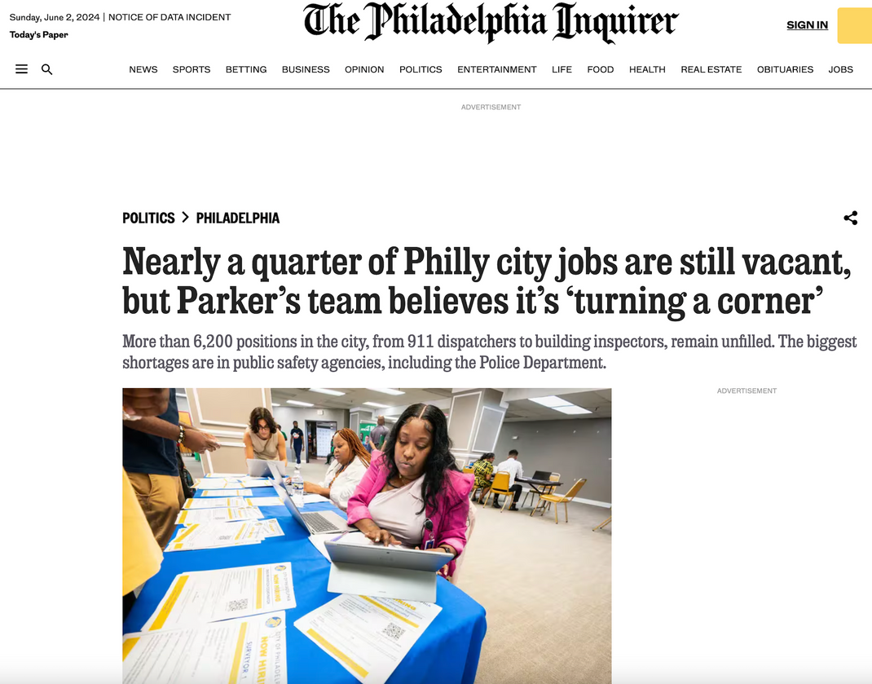
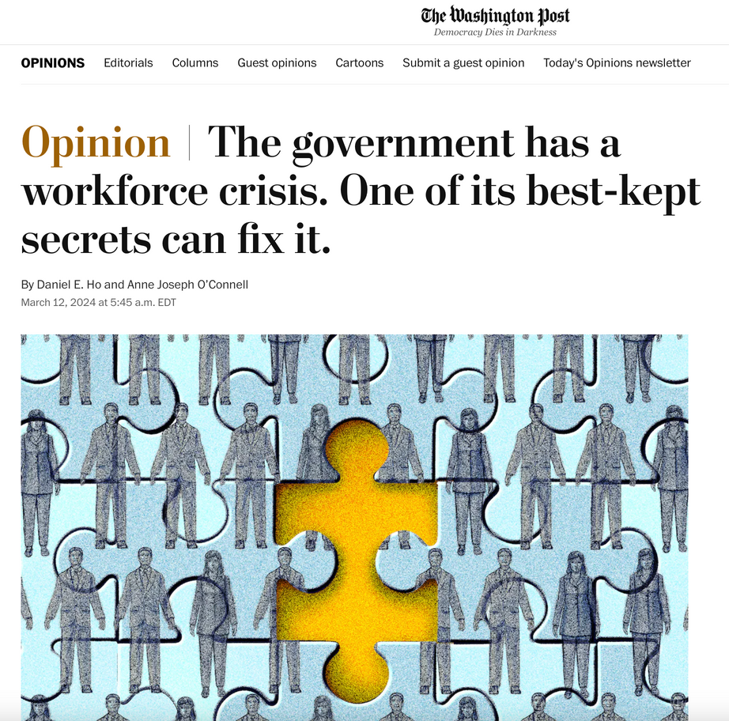
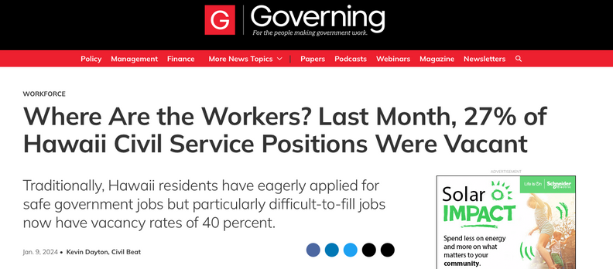

Slide 26
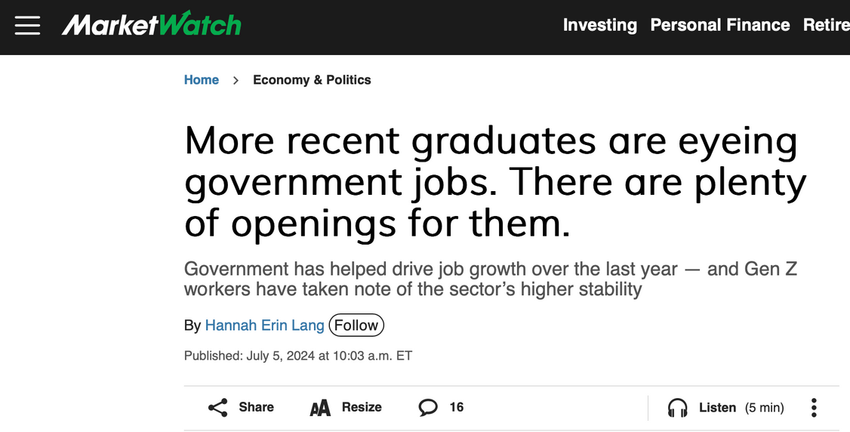
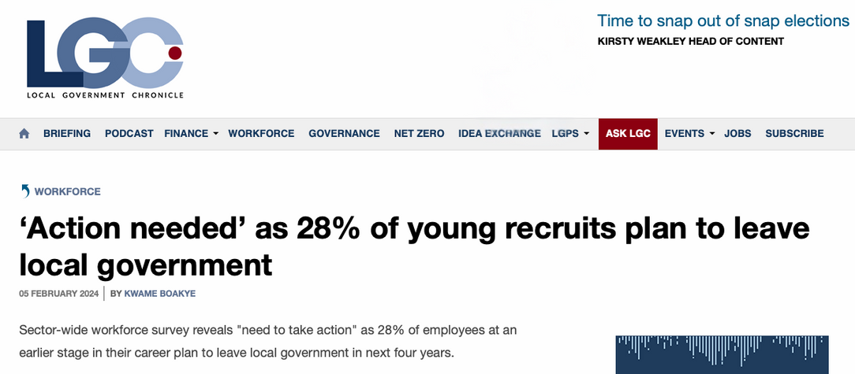

Slide 27
Why should we care about interns, fellows, or apprentices?

Slide 28

Talent Development is About…
Impact
Strategy
Leadership

Slide 29
Talent Development is About
Impact
Strategy
Leadership
Impact.
Leaders build stronger communities
by investing in new talent.
Notes:
Leaders are responsible for future leaders.

Slide 30
Talent Development is About Impact
Better
Performance
Fresh
Perspectives
Community
Trust
Diverse teams drive better performance—studies show organizations with greater age diversity excel in problem-solving and innovation.
Interns, fellows, and apprentices bring fresh perspectives, enhancing public service effectiveness.
Investing in talent strengthens community trust and engagement, ensuring sustainable, high-quality governance.

Slide 31
Talent Development is About
Impact
Strategy
Leadership
Strategy.
Leaders keep their organization
future-ready in a rapidly changing world.
Notes:
Leaders are responsible for future leaders.

Slide 33
The Workplace Feels Different Today…
The median age of workers is rising, creating both opportunities and challenges.
The U.S. will add 11.9 million jobs but only gain 1.4 million new workers due to demographic shifts.
AI may replace 300 million jobs. That represents 9.1% of all jobs worldwide.

Slide 34
Automation of Services
Driverless Transit
Automatic Meter Readers
Robotic Cleaning and Landscape Equipment
Smart Parking Meter Readers
Electronic Monitoring – Public Safety / Traffic Enforcement
AI and the Future of
Local Government
Process Automation
Las Vegas launched a chatbot that cut customer service call volume by 30%.
Los Angeles, 80% of resident questions are now handled fully by automated bots.
Notes:
And as employers start to bring in gen Al at much larger engagements, we are going to come to this realization that people are going to lose their jobs.
That's just the reality.
And so you've got to take it upon yourself to realize that I may not want to be learning new things, but the alternative is it's going to be very, very difficult to stay in that current role unless not only you're current, but you're thinking about the future.

Slide 35
Talent Development is About
Impact
Strategy
Leadership
Leadership.
Leaders are responsible for future leaders.
Leaders are responsible for future leaders.
Notes:
Leaders are responsible for future leaders. Their principles for how you retain talent to some extent remain people's user manual for how to do this well. Unfortunately, we are now in a world, as the pandemic showed us, in which preferences matter more
sometimes than a couple of extra dollars.
Even if dollars are the fungible good that people could
conceivably use to solve their own problems, it's not necessarily working anymore.

Slide 36

Leadership
is a concept of
owing certain things to the institution.
It is a way of thinking about institutional heirs,
a way of thinking about stewardship,
as contrasted with ownership
Max De Pree

Slide 37



Growing Leaders - The Environment
What workplace environment lends itself to more successful internship / new entry experiences?
Challenging
Job Assignment
Learning from Others
Hardships and Setbacks
Training and Education
Assign meaningful, problem-solving work.
Provide projects built from the ground up.
Offer opportunities to present findings.
Facilitate mentorship and networking.
Consider a cohort model.
Involve interns in leadership discussions.
Support learning from mistakes.
Guide interns through challenges.
Provide feedback for resilience.
Provide training and workshops.
Integrate professional development.
(CCL, 2024)

Slide 38
Growing Leaders
The Four Roles You Can Play
Coach
Exemplar
Mentor
Teacher
A coach empowers individuals by fostering self-discovery and hands-on leadership experiences.
Leaders shape others through their own actions—people learn leadership from those they admire and respect.
A mentor is a trusted advisor who supports professional development through sustained relationships and shared wisdom.
A teacher equips leaders with the tools, frameworks, and experiences necessary for professional growth and public service excellence.
Expands comfort zones
Guides without micromanaging
Leads with integrity
Influences through actions
Builds trust consistently
Provides career guidance
Shares wisdom and experience
Facilitates structured learning
Encourages continuous growth

Slide 39
Effective Talent Development Strategies
Program Design, Best Practices, and Retention Objectives

Slide 40

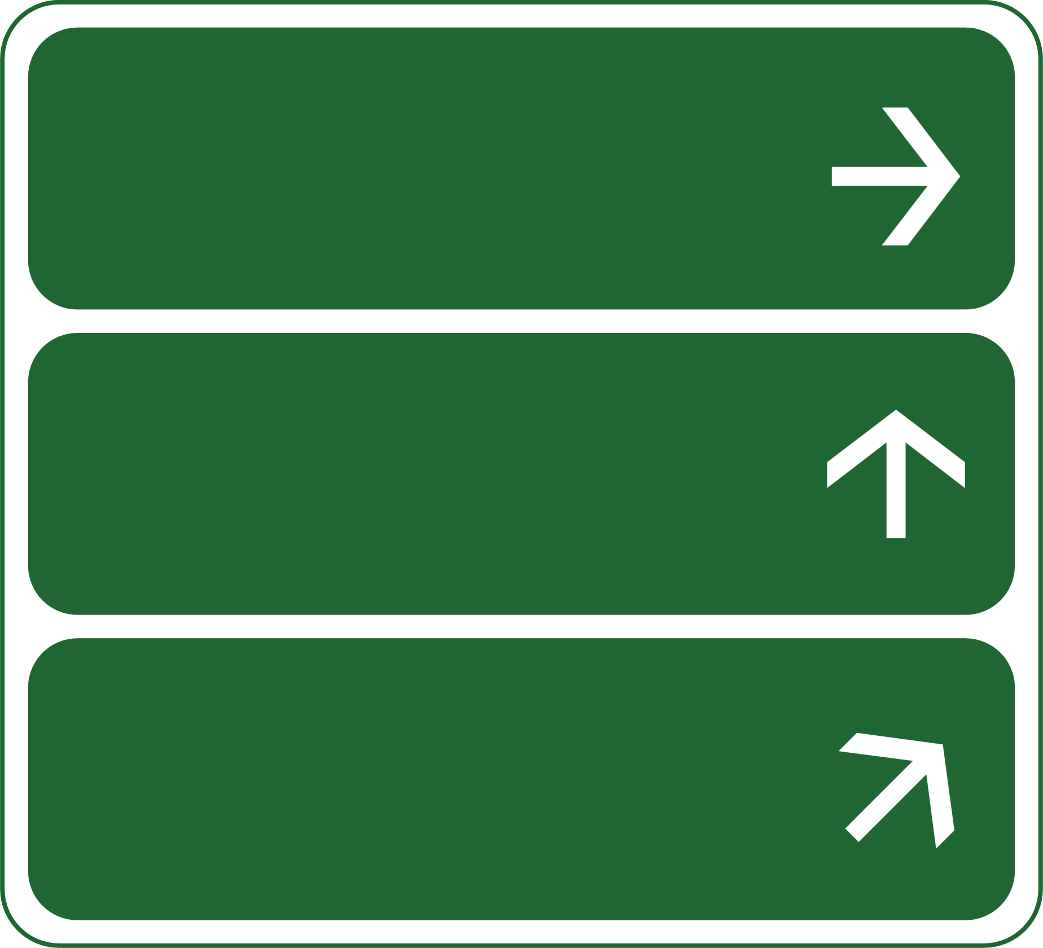




Ask yourself:
  What are our organization's long-term goals for hosting a student?
  What are our organization's immediate needs?
  What is our ideal outcome from hosting a young person?
Ask yourself:
  Determine internal needs for hosting a student (ongoing tasks, workload, what projects are on the back burner)? What would a work plan look like?
  Allocate resources. Consider financial resources, time, materials, technology that are required for success.
  Identify coordinator and mentor
  What is the duration and timing?
    Short-term, long-term? Part-time? Full-time?
PLAN
Increase organizational capacity?
Create next generation
of leaders?
Engage diverse
perspectives?
START
WITH
YOUR
GOALS
  Consider roles within organization where you frequently hire new employees.
  Consider skill areas required by your organization that are typically not learned in the classroom.
Consider the Student
  Practical experience
  Mentoring
  Networking
  Class Credit

Slide 41

Types of Student
Internships.
Duration:
Usually, a few weeks
to several months.
Part-Time
Summer
Remote
  Works best for filling specific needs
  Encourages flexibility, especially during academic year
  Students typically want to obtain course credit
  Often referred to as management interns
  Rotation through departments
  Graduate students expect compensation
Works best when
students have
  Resume-building tasks
  Access to upper management
  Previous frontline experience
  Clear expectations

Slide 42
Handbook on Internships
"In a very real sense, interns are employees of the host organization and should be treated as such.
Their position should be integrated into the organizational structure as any other position would be,
and their assignments and responsibilities should reflect the needs and priorities of the local government. "
ICMA
Internships should be viewed
as educational experiences
designed to attract students
to meet your organization’s needs.

Slide 43
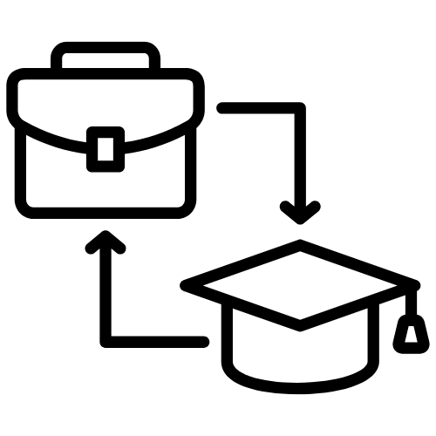
Types of Student
Duration:
Usually several months
to a year +.
Fellowships.
What are
Fellowships?
Why Fellowships
over Internships?
Key Focus Areas
for Fellowships
Funded, short-term opportunities.
Focus on professional, academic, and leadership development.
Sponsored by key stakeholders:
  associations,
  institutions (higher education),
  or government agencies.
Address Workforce Gaps – Attract emerging professionals
Develop Future Leaders – Build expertise in governance & public policy
Support Recruitment & Retention – Provide structured entry points into public service
Enhance Organizational Capacity – Fellows contribute to priority projects
Public Policy & Governance Research – Data-driven decision-making
Community Development Initiatives – Strengthening local impact
Specialized Training in Local Operations – Budgeting, planning, administration
Exposure to Public Service Careers – Early career exploration

Slide 44










Lead for NC
SUMMER
ACADEMY
WHAT CONTENT
CAN YOU
REPURPOSE?
The Power of a Cohort
Fellowships
Local
Government 101
Communication &
Project Management
Statutory
Analysis
Reseach /
Data Analysis
Working in the
Real World
Case
Studies
Economic
Development
Cohort
Building
Zoning

Slide 45

Types of Student
Duration:
Usually, a year +.
Apprenticeships.
Key Focus Areas for
Local Governments
Finance and Budgeting
Public Safety & Emergency Services
Public Services - Water management, public works, IT
Health & Human Services Social work, public health, aging services
Benefits to
Local Governments
Cost-Effective Workforce Development
  Reduce hiring gaps and turnover
Skill-Building for Public Sector Needs
  Customized training programs
Retention of Local Talent
  Keep skilled workers in the community
Stronger Community Engagement
  Apprentices serve local needs
  Paid, hands-on training programs
  Structured learning pathways leading to full-time employment
  Typically lasts 1+ years with progressive responsibility and mentorship

Slide 46



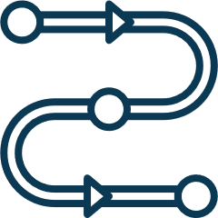


FACTORS IN
PUBLIC SECTOR RECRUITMENT
Size of Labor Pool
& Location
Pay &
Benefits
Breadth & Quality
of the Process
Job
Quality
Organizational
Image
Organizational Zone
of Control

Slide 47






Gen Z Considerations
How can we show Gen. Z all the
career pathways that exist within government?
Gen Z has the shortest attention span
Trainings and recruitment events need to feature less workshops and lectures and more mentorship, simulations, and communication skills
Gen Z expects inclusion across race, gender, and religion
Organizational branding must be reflective
of inclusion
Gen Z is more competitive than millennials.
They prefer to be judged on their independent accomplishments vs. collective impact
Covid-19 impacted graduates and their access to career services and traditional college experiences
Programs should provide more services to give graduates the support they need
Graduates from the class of 2025 will never have had a normal
full-academic year during their collegiate experience.

Slide 48






TO REACH GEN Z, DITCH EMAIL
CONSIDER TEXT MESSAGING...
The average SMS open rate is 98%
compared to email's rate of 20%
(Ruby, 2021)
3:15 pm
On average, most texts receive a response in 90 seconds compared to 90 minutes for emails
Can I do my interview on Thursday
at 11:30 am?
(Ruby, 2021)
03.20.2021
Candidates who received SMS notifications during the hiring process
rated their hiring experience
50% higher than those who did not.
Yes! That sounds great. Our team
looks forward to interviewing
with you then!
(Ruby, 2021)
Platforms that use texting
  Calendly
  Pinpoint
  Textus
Wonderful. Thanks for sending the
zoom link.
Thanks again for allowing me to coordinate this via text.
Today

Slide 49


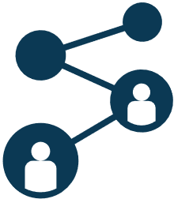
CANDIDATES APPLY
Recruitment Strategies
GATEKEEPERS
REFERRALS
SOCIAL MEDIA
Throughout the years, our program has built a database of 5,000+ faculty and staff email addresses from across the state. We rely on gatekeepers to push out information to students.
Our LFNC AmeriCorps Fellows are the best ambassadors of the program. Relying on them to pass out information is essential to our recruiting efforts.
Social media plays an integral role in connecting with students. Most success through LinkedIn, Facebook, and Handshake. We prioritize using communication tools that resonate with this generation.

Slide 50




NORMING AROUND EXPECTATIONS
PROFESSIONAL DEVELOPMENT FOR ALL APPLICANTS
RESUME SUPPORT
INFO SESSIONS
VIDEO FEEDBACK
We provide a template for candidates to copy that provides advice and shows how to format a resume and use action verbs. We also edit resumes and provide feedback to our candidates.
Our goal is to help ensure candidates understand the contours of our program and how it aligns with their professional goals. Our info sessions are conducted by staff, program participants, and alumni.
We also provide interview tips.
After candidates interview with our LFNC team, we send the recording and provide feedback. We collect data via google forms and most of this is automated.

Slide 51
  Start locally...
    Reach out to your closest institutions of higher education (Community Colleges, Colleges, & Universities)
    Search for Career Development Offices - reach out directly to staff member and share information
    Reach out directly to faculty...go to relevant departments
    Reach out directly to service clubs and organizations - particularly staff / faculty advisors
    Build a database of this info!
      Have an intern expand on these contacts for your organization during their service
  Get on Handshake!
    Most state schools are on handshake and colleges will refer you to post your position there
BUILDING THE
EDU 2 GOVT
PIPELINE
STRATEGIES TO CONNECT
WITH STUDENTS

Slide 52
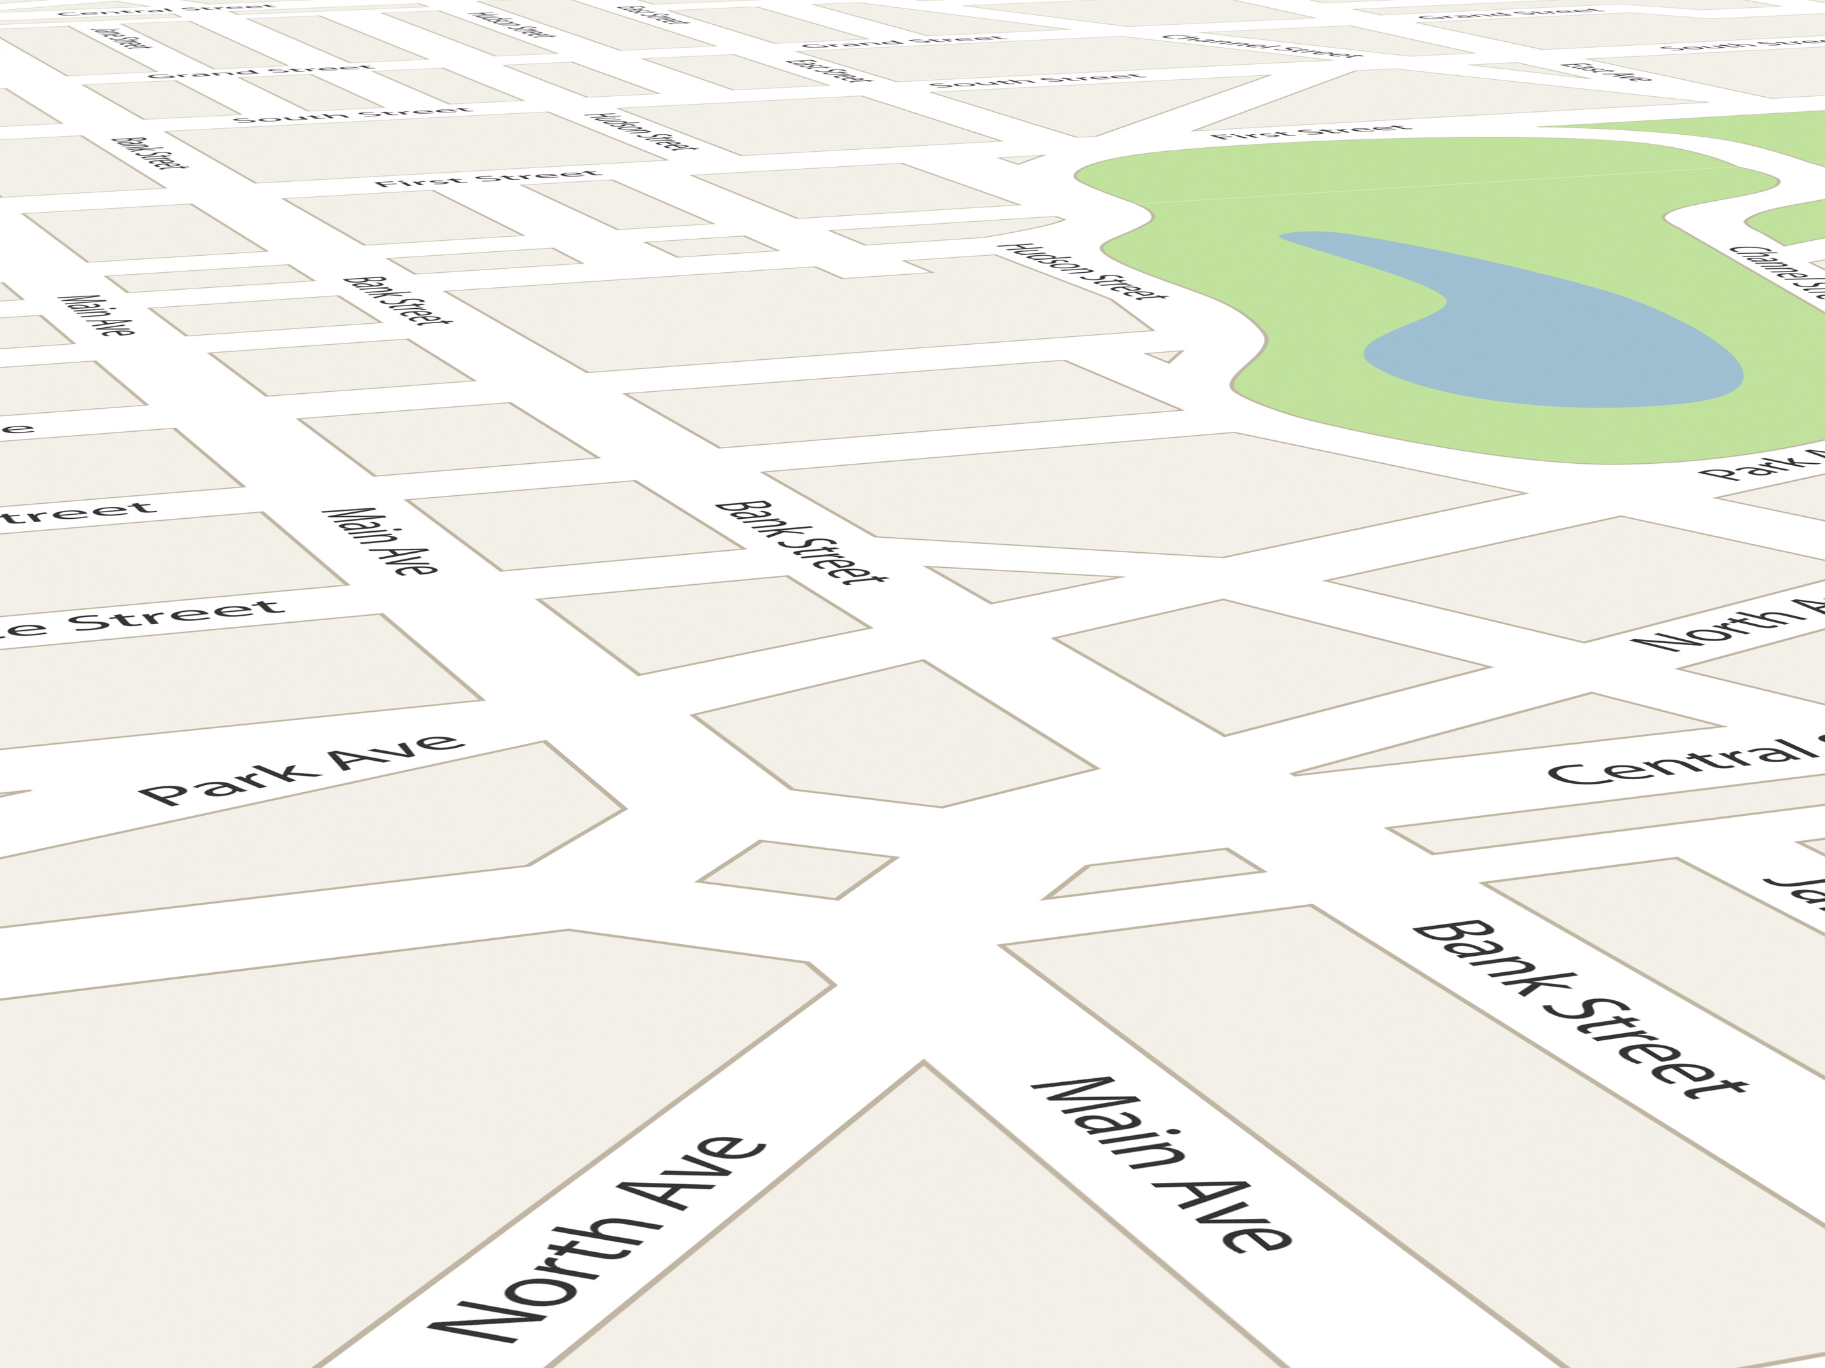
STRATEGIES FOR WHEN...
To Say No
You Want To Do More
You Need Clarity
You Feel Like an Imposter
Know your priorities and communicate them to your supervisor.
Ask your supervisor and come with a plan and options for them to consider.
The sooner you ask for clarity - the better. Don't wait.
Acknowledge your fears come from imposter syndrome. Name the problem.
Build trust with your boss and colleagues. Consider the impact of no
Check in with other fellows - what products are they working on?
Request frequent meetings (one-on-one), quarterly reports, monthly project check-ins.
Share your fears with your cohort members and trusted colleagues in the workplace.
Seek guidance from other staff if you need more work - check with supervisor first. Consider shadowing other teams.
Don't just say no...Bring up an alternative and solution to the problem. Remember you are problem solving.
Make sure you have everything in writing - roles and responsibilities to gain clarity.
Stop comparing yourself to others.
Work on boiler plate projects - creating resources and documents (grant writing)
Ask about how you are accountable for work and assignments? How is performance measured? Understanding your evaluation can help you gain clarity.
Write down everything you do that you are proud of every single day.
Learn negotiation statements
  Yes, I can do that, but what would I give up to make sure I do it in a manner that would be high quality
  I'm a little overwhelmed with all my assignments right now, can we talk about this some more?
  Can I have some time to think about it to see how this would fit considering my other assignments?
Take luck out of the equation. Acknowledge your hard work to get where you are today.
Do the research and propose new projects - "monthly HR check-ins, citizen engagement initiatives, etc."
Reframe negative thoughts - engage in positive self-talk.
Go to Council / Commissioner Meetings / Staff Meetings
What are the topics discussed? What products can you prepare?
Increase your connections in the workplace and community.

Slide 53
STRATEGIES FOR
THOSE UNCOMFORTABLE MOMENTS...
Refocus the Conversation
  I'm not comfortable discussing that. What was the next item on the agenda?
  How is that relevant to our work?
  I'd like to move on.
  Use humor to soften a call-out.
Focus on Action,
Not the Person
  "That comment could be interpreted as a rude stereotype of women" vs. "you're sexist"
  Also disarm by giving benefit of the doubt - "I know you would never intend this, but I wanted to let you know how that comment could appear to be..."
  Appeal to better instincts "John, I have seen you be fair-minded and wasn't expecting you to make that kind of comment."
  "I know it wasn't your intent, but that made me uncomfortable."
Ask Them to Explain
  I do not understand what you are saying?
  Can you explain the joke?
  You may want to be more careful about that stereotype.
  Ask a reflective question -if someone says "What I really want is for Susan to be less boss." Repeat using their word of choice "Bossy?"
Pause
  Slow down. Think about what the comment was. Helps avoid defense accusations.
  People often don't like silence and will invariably speak up to fill the void. They may feel awkward enough not to do it again.
Share Personal Experiences
  Talk about your personal experience and how comments have affected you.
Share Info
  It's not your role...but you can if you want to.
    Leaving office early - men / women
WHEN IN DOUBT...
TALK TO X, Y, Z

Slide 54






PERSON-ENVIRONMENT FIT
Person - Position
Person - Organization
Person - Community
Person - Group
Person - Supervisor
(Kristoff, et al. 2005)

Slide 55
Fit Associated with Organizational Arrangements
Person-
Position
Person-Supervisor
Person-Organization
The alignment between the member and the position requirements and tasks they perform while service.
Goals: Clear communication.
Tools: Work scope published with application, relationship building with alumni throughout application process, initial training.
The perceived match between a member and their supervisor's characteristics (values, personality, and behavioral styles).
Goals: Require structure.
Tools: Work plan, pre-placement screening, training to the member on self-advocacy.
The perceived match between a member's values / culture and the organization’s culture.
Goals: Reduce ambiguity.
Tools: Work plan, frequent 1o1 meetings, monthly data monitoring, class requirements (listening tour, place-based dialogues).

Slide 56
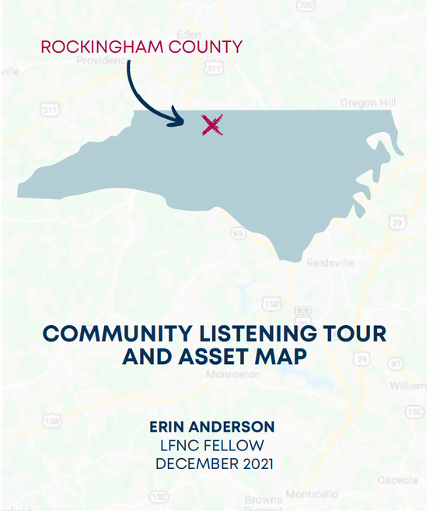

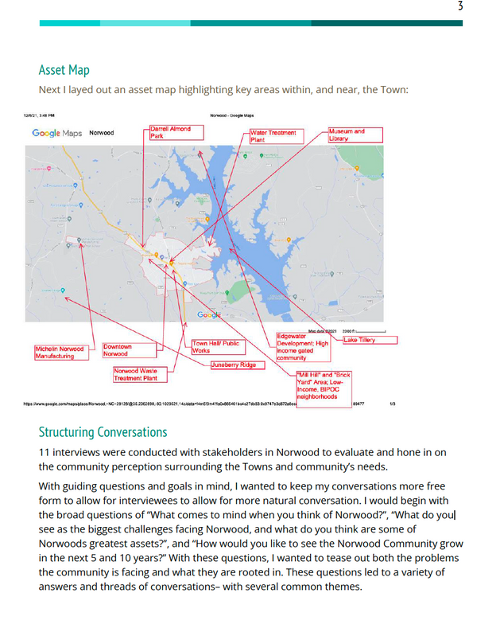
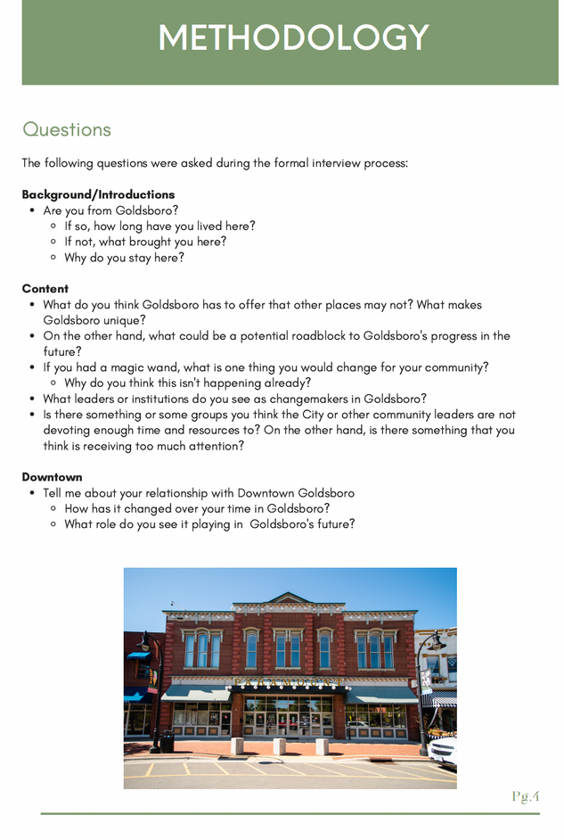
Fit Associated with Community Contexts
Person-
Group
Person-Community
The alignment between the member and the entire cohort of service members.
Goals: Sustaining bonds.
Tools: Collaborative class assignments, initial training, ongoing training and classes
The alignment between the member and their host community.
Goals: Practice placemaking.
Tools: Placemaking embedded into class readings and assignments (listening tour), host site encouragement, live in community.

Slide 57

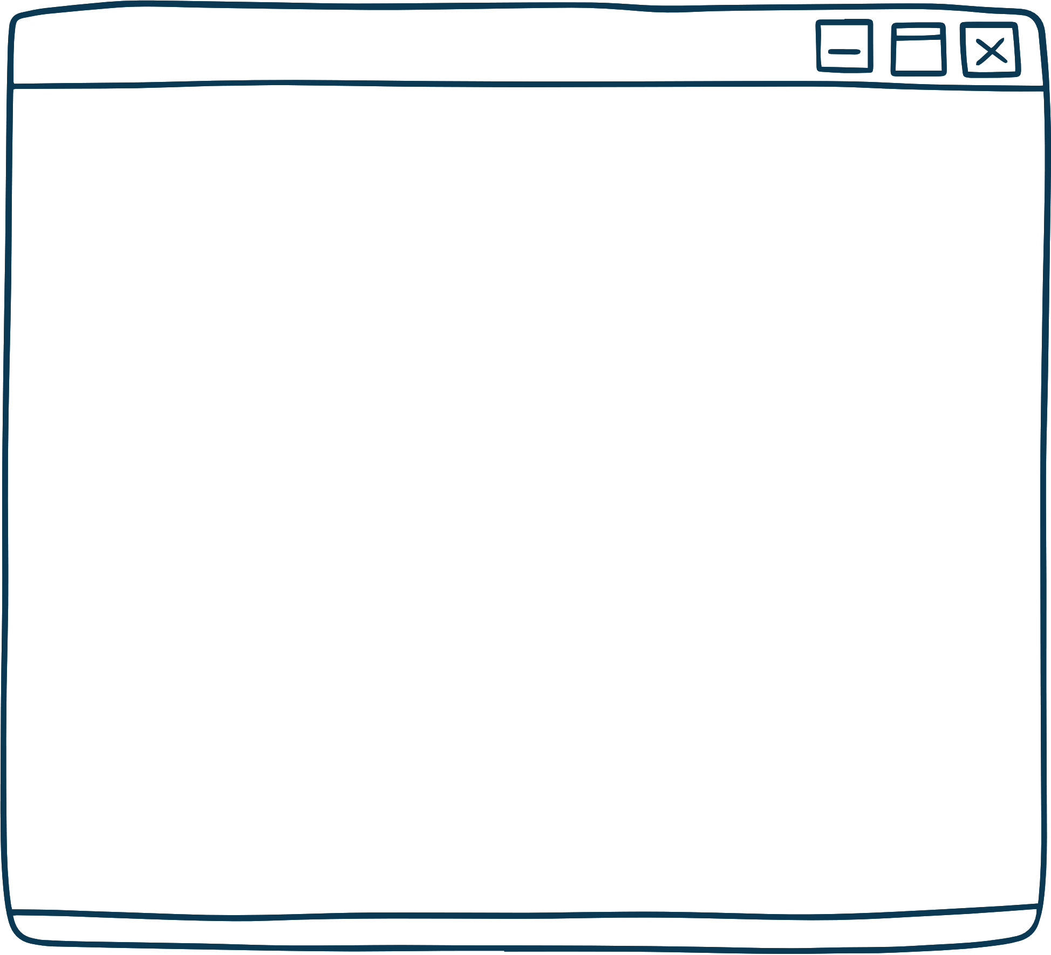

General
Guidance
CHALLENGE
AND SUPPORT
ACKNOWLEDGE SERVICE ENVIRONMENT
THERE'S POWER IN THE JOB TITLE
Our best success stories are about interns who were challenged, allowed some room to dig into meaningful projects, but given regular feedback/mentoring.
Don’t underestimate
their abilities - reframe intern mindset...they are aspiring public servants.
Thank the intern for their service.
Acknowledge compensation reality and be thankful for their service.

Slide 58



Complete the interview questionnaire with your intern to make sure intern understands workplace / culture
Tips for the first two weeks...
Create three to five work plans to make sure the intern is clear on their assigned projects / contributions
Introduce the intern to key community stakeholders (elected officials/ community leaders)
Consider taking the intern to your favorite neighborhood coffee shop to get to know the fellow better in a relaxed environment
Have the intern shadow
different departments
at your workplace
Have the intern attend department meetings and summarize action items
Consider allowing the intern to introduce themself at a board meeting
Let the intern interview colleagues to see areas for improvement in the workplace

Slide 59








Student / Supervisor
Prepare Your Team!
Make sure your office is ready for the intern!
Email Staff and Introduce the Intern
Connect with the Intern's School / Professor
Onboarding
Work Plans &
Job Assignments
Office Life
and Culture
Facilitate Group
Check-Ins
Plan a Goal-Setting Retreat
with Staff/Interns
Community

Slide 60
ICMA's Top 10 Best Practices
  Access. Allow the intern access to staff and the chief administrative official and encourage the intern to attend meetings and events.
  Variety and meaningful work. Provide various projects and participatory experiences in a number of different departments. Tasks that are important to the goals of the organization will attract quality interns. Résumé-building experiences often are more valuable than a paycheck.
  Individuality. Each intern will have their own set of career goals. Help meet the intern’s needs and interests by eliciting input from various departments and agencies for potential work projects. Discuss the intern’s career goals and provide an opportunity for the intern to work with departments in the organization to meet those goals.
  Education. Educate people in the community about careers in local government and seek out opportunities to promote the internship program. In particular, target nearby colleges or universities to ensure a sustainable internship program.
  Frontline Experience. Provide an opportunity for the intern to learn to appreciate and respect the work of frontline service providers who exhibit good management practices.
  Mentoring. Provide the intern with a stable mentor to offer guidance and encouragement throughout the internship experience. ReIntern, today’s interns are tomorrow’s leaders. Avoid putting interns in basements. Instead, provide them with workspaces near as many people as possible so they can engage with other staff.
  Supervision. Avoid having the intern report to a supervisor who may lack the experience to provide the intern with tools for learning.
  Flexibility. Remember that interns may have difficult academic schedules. Discuss projects and deadlines with interns and their academic counselors to ensure that everyone’s needs are being met. If necessary, allow for flexible work hours.
  Evaluate. Give interns feedback throughout their tenure and have them evaluate their own experiences before leaving. Remember that this is a growth experience for them. Help them work through their learning mistakes and offer guidance and/or help when needed.
  Assimilate. Make the program a routine part of the organization. Train regular staff to expect and appreciate the value added by interns. Continue to seek out qualified candidates and to share enthusiasm for local government. Budget funds each year for internships and, if possible, spread the funds out among several cost centers so that the financial impact extends throughout the organization.

Slide 62




lfnc.sog.unc.edu
facebook.com/Lead4NC
@leadfornc
G. Dylan Russell
Director, Lead for NC and Public Service Matters
Teacher, UNC School of Government
Doctoral Candidate in Public Administration
(828) 964-3144
russell@sog.unc.edu

