Slide 1
Community as an Asset, Not a Liability: Innovative Approaches to Partnership for Disaster Management and Resilience
Patrick Howell, IBTS
Daniela Garcia, Adams County, CO

Slide 2
Section Divider Title

Slide 3
Agenda
Strategic Partnerships and Resilient Communities (SPARC)
Long-Term Recovery & Resiliency Strategic Plan
Best Practices and Lessons Learned
Q&A

Slide 4

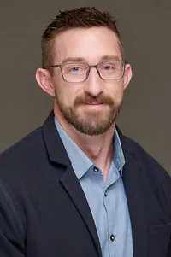

Patrick Howell, Community Resilience Program Manager
Institute for Building Technology & Safety (IBTS)
Daniela Garcia, Recovery and Major Initiatives Administrator
Adams County, CO

Slide 5
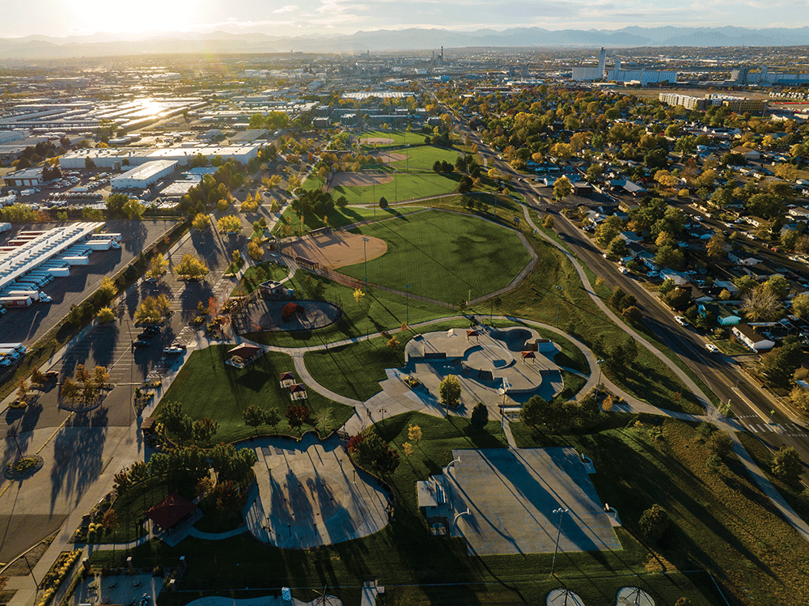

Office of Strategic Partnerships and Resilience Communities (SPARC)

Slide 6

Community Challenges
  Post-COVID Recovery
  Environmental Justice
  Increasing Risk from Natural Hazards
SPARC Objectives
  Equitable distribution of funding, services, and resources
  Building Strong Community Partnerships
  Stakeholder and Neighborhood Engagement

Slide 7
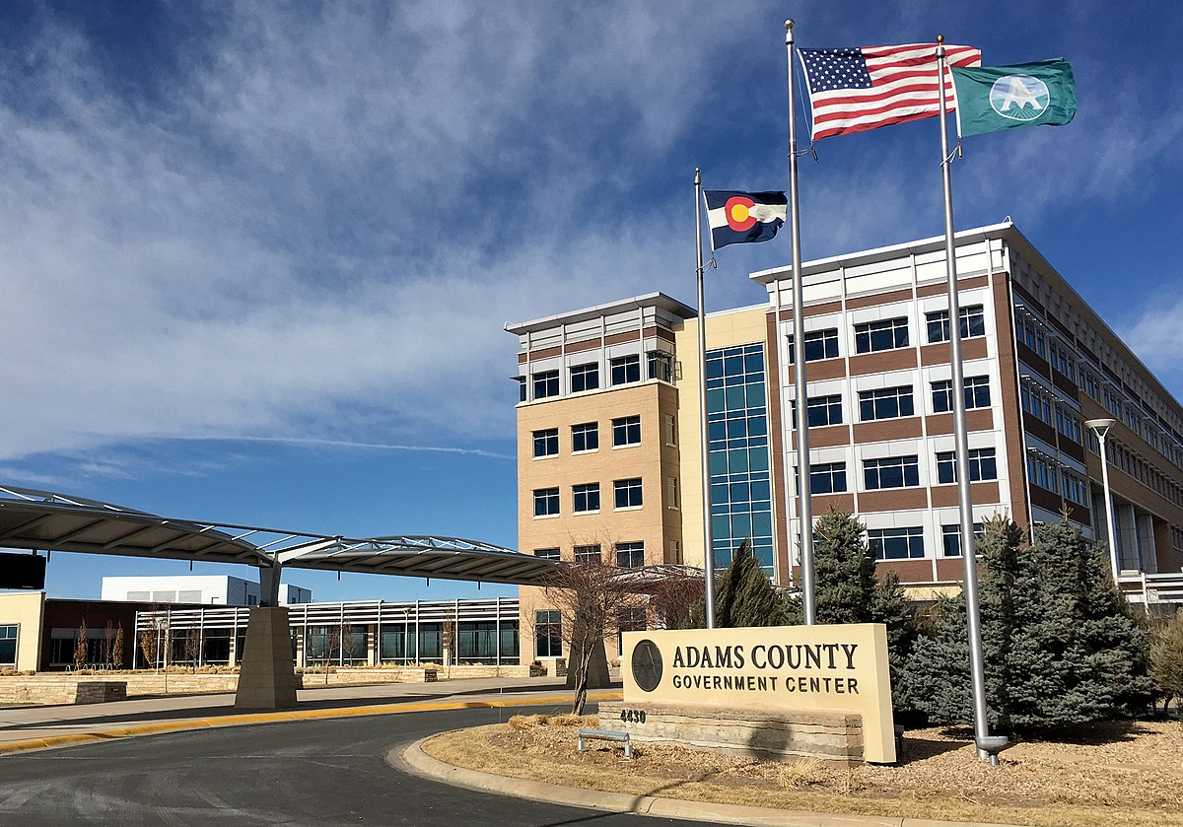
Implementing SPARC Priorities
Resides in Senior Deputy County Manager’s Office
Three SPARC Teams:
  Grants
  Community Partnerships
  Cross-Functional Initiatives

Slide 8
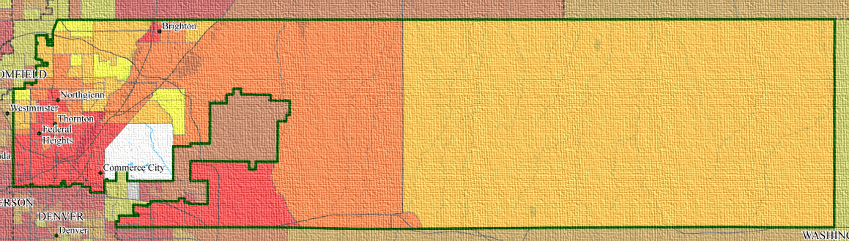
Long-Term Recovery & Resiliency Strategic Plan
Notes:
Map from CO Enviroscreen showing composite of environmental, health, and socioeconomic vulnerabilities

Slide 9

Long-Term Recovery and Resiliency Strategic Plan
Plan Objectives
  Build organizational capacity to better address disruptions
  Develop a dedicated process for resiliency
  Define and catalyze resilience priority projects
A County Resiliency Plan that will create strategy, systems and best practices for community adaptation and resiliency to natural and manmade disruptions, particularly serving low-income and under-represented and vulnerable neighborhoods and communities.
Excerpt from the Adams County RFP

Slide 10



Recovery and resilience framework
Communication & Consensus Building
Organizational Capacity
Stakeholder Engagement
Adams County
Long-Term Recovery & Resiliency Strategic Plan
Data Utilization
Funding & Finance
Within this framework, there are 15 Goals and 60 Actions to advance recovery and resilience priorities

Slide 11

Recovery and Resiliency Plan Priorities
Data-driven Decision Making
Building Organizational Resilience
Whole-of-Government Approach
Community Partnerships
Sustainable Funding

Slide 12
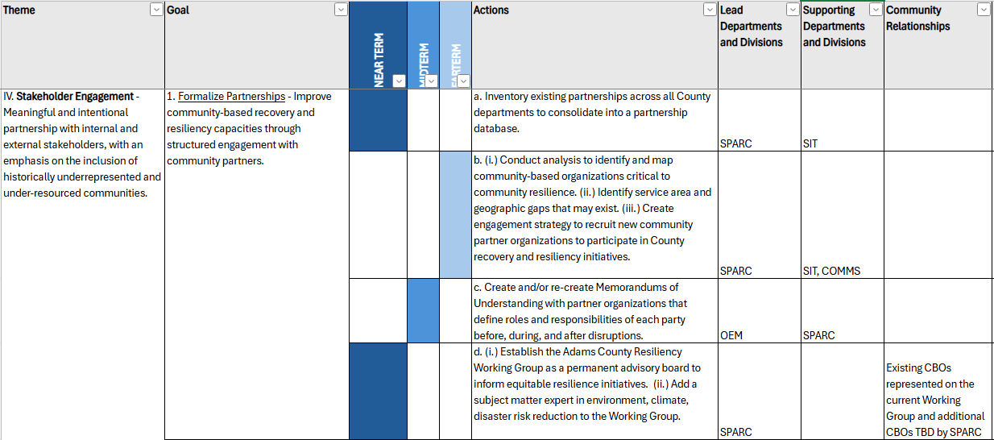
Recovery and Resiliency Plan Implementation

Slide 13

Best Practices and Lessons Learned
Leveraging the Power of Force Multipliers
Fostering cross-departmental collaboration and buy-in
Continuous Partner Engagement
Flexible and Adaptive Planning and Implementation

Slide 14
Audience Q&A

Slide 15
Thank You!
Patrick Howell
Community Resilience Program Manager
Institute for Building Technology & Safety (IBTS)
phowell@ibts.org
Daniela Garcia
Recovery and Major Initiatives Administrator
Adams County, CO
dxgarcia@adcogov.org

