Slide 1
Utilizing Local Economic Development to Their Full Potential in Rural Communities
Derek Lumsden, MSARP
Jones County Economic Development

Slide 2
THE BIG QUESTION
What is a City’s role in economic development?

Slide 3
BASIC SERVICES
Infrastructure Maintenance
Public Safety
Other City Services like Libraries, etc.
Economic Development, which includes:
A. Job Creation
B. Attracting New Businesses
C. Supporting/Expanding Existing Businesses
D. Placemaking and Quality of Life Amenities

Slide 4
ECONOMIC DEVELOPMENT
How does a local economic development agency fit into the City’s plans for growth?

Slide 5
MISSION STATEMENT
Jones County Economic Development is a public-private partnership dedicated to strengthening the economic base in Jones County by assisting existing businesses, attracting new investments and jobs, and fostering a business climate favorable for economic growth.
Mission & Investment Partners:
A. County and city governments
B. Non-profit organizations like Chambers and Tourism
C. Local Businesses

Slide 6
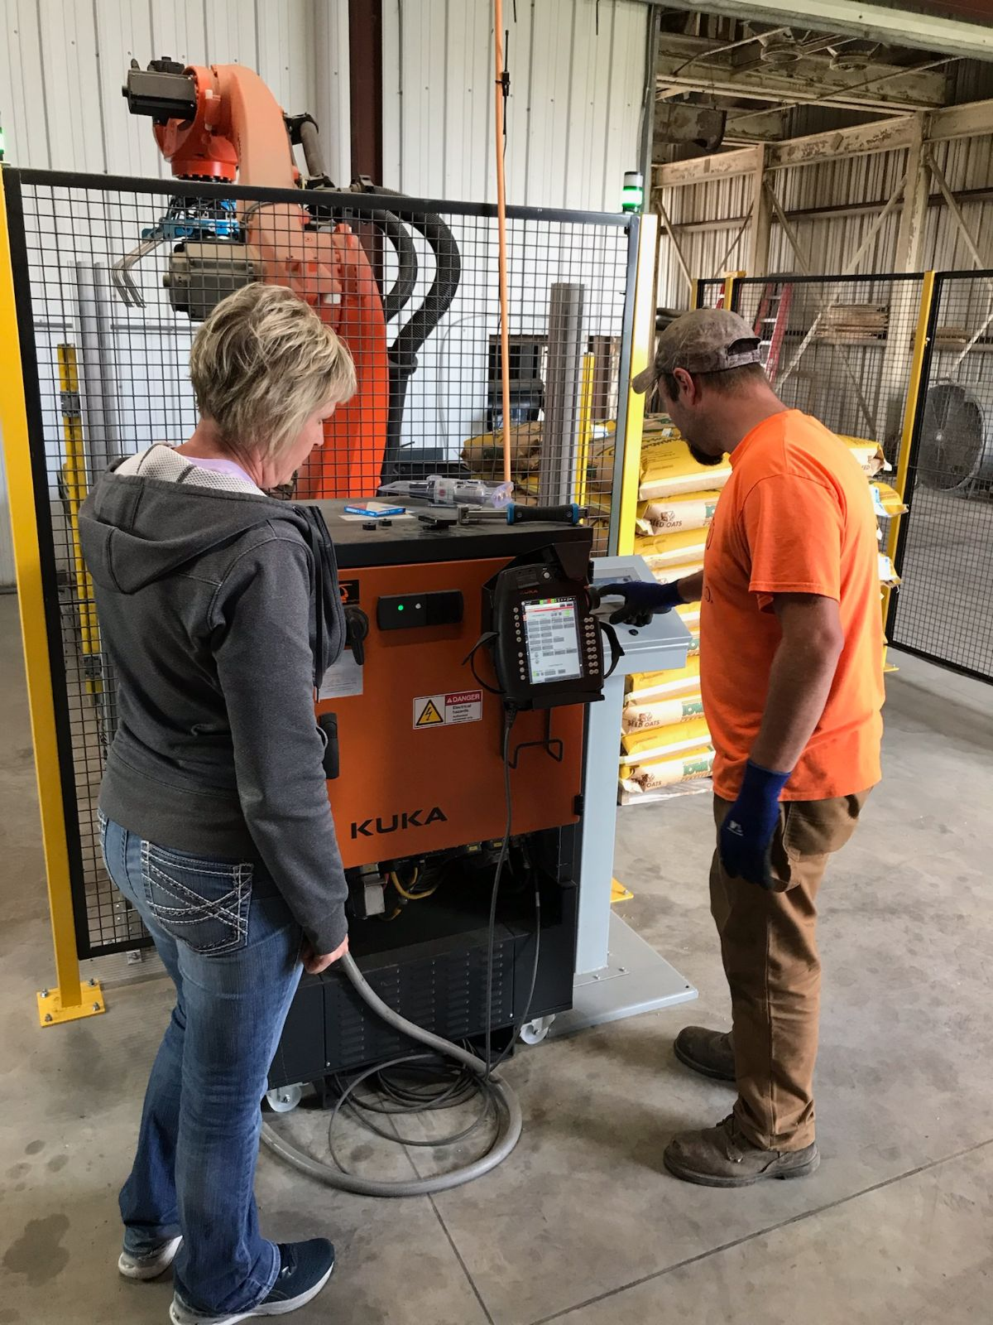
TRADITIONAL ECONOMIC DEVELOPMENT
New Business Growth
New Job Creation
Supporting/Expanding Local Business Growth

Slide 7
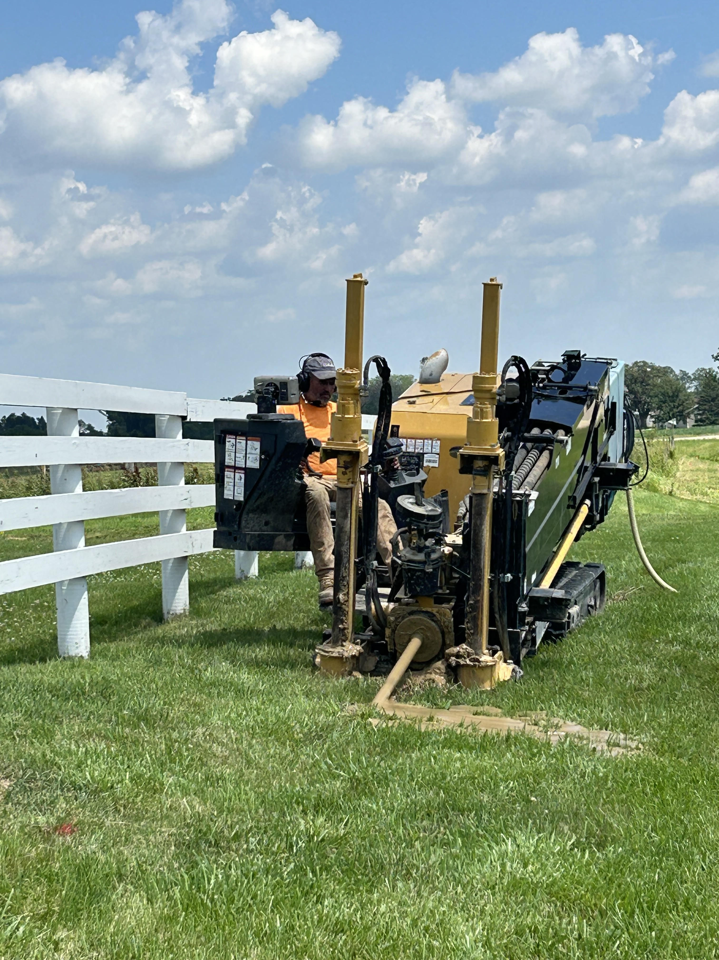
CURRENT ECONOMIC GROWTH
Existing Business Growth: Home-based and entrepreneurs
Fiber Internet to Every Home & Business
Incentives & Ordinances Reviews
Placemaking and other Quality of Life Amenities

Slide 8
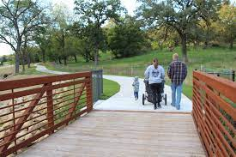
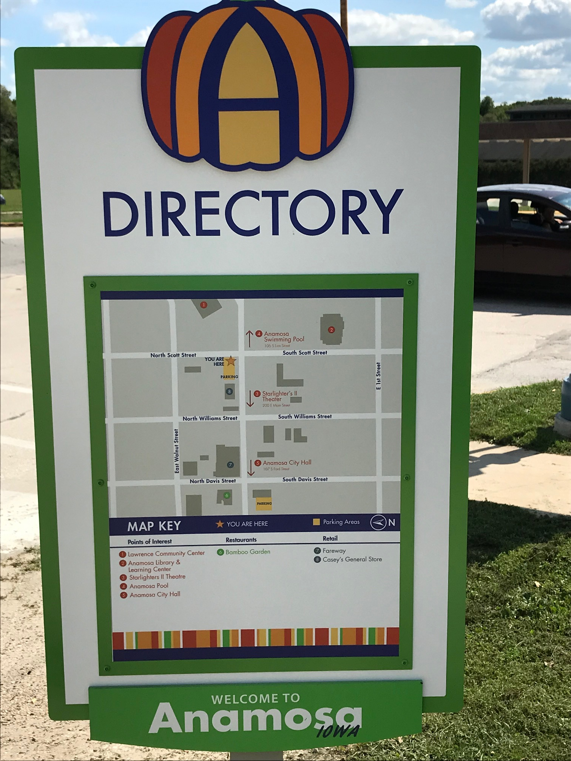
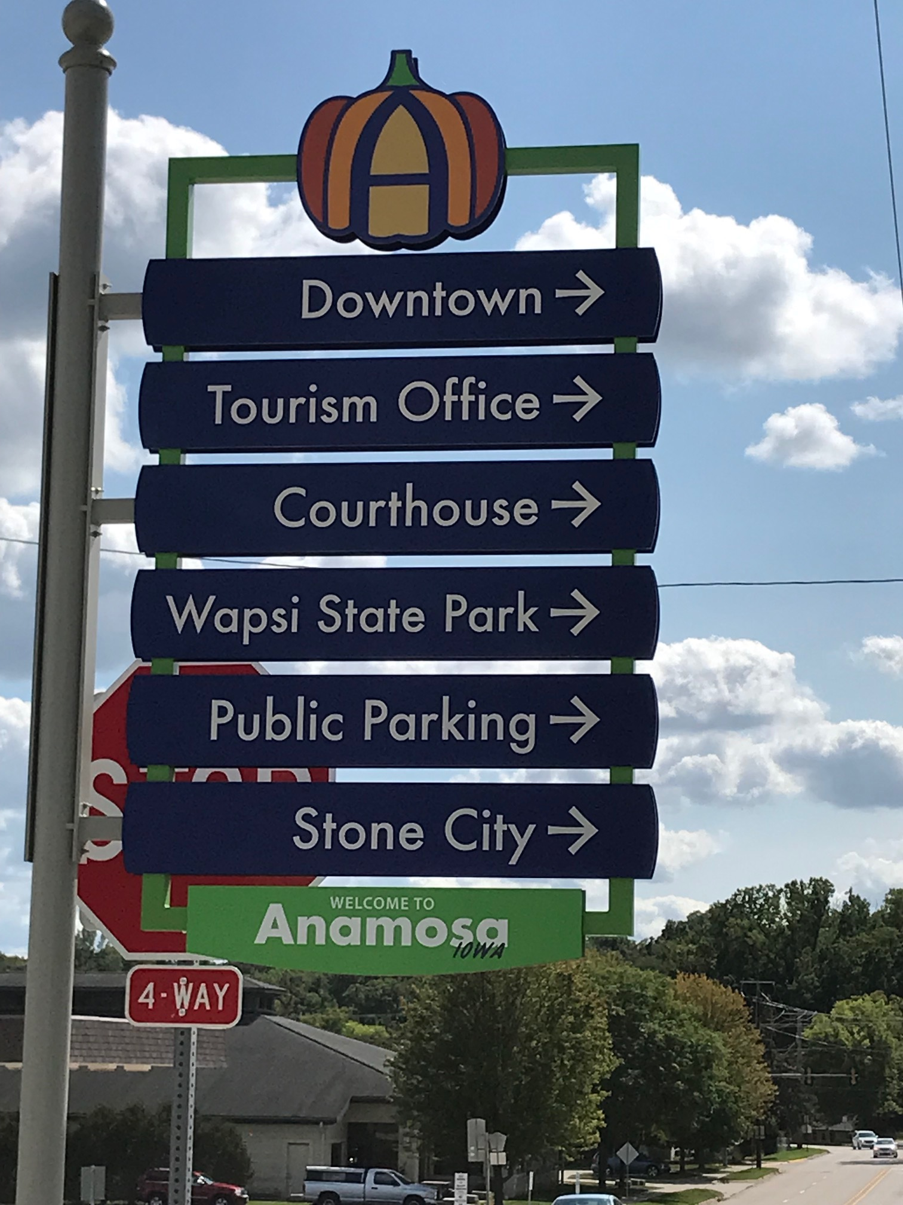
PLACEMAKING (Part 1)

Slide 9
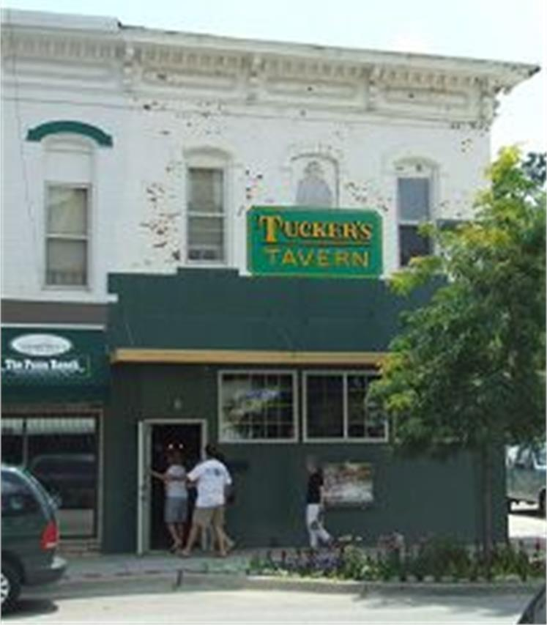
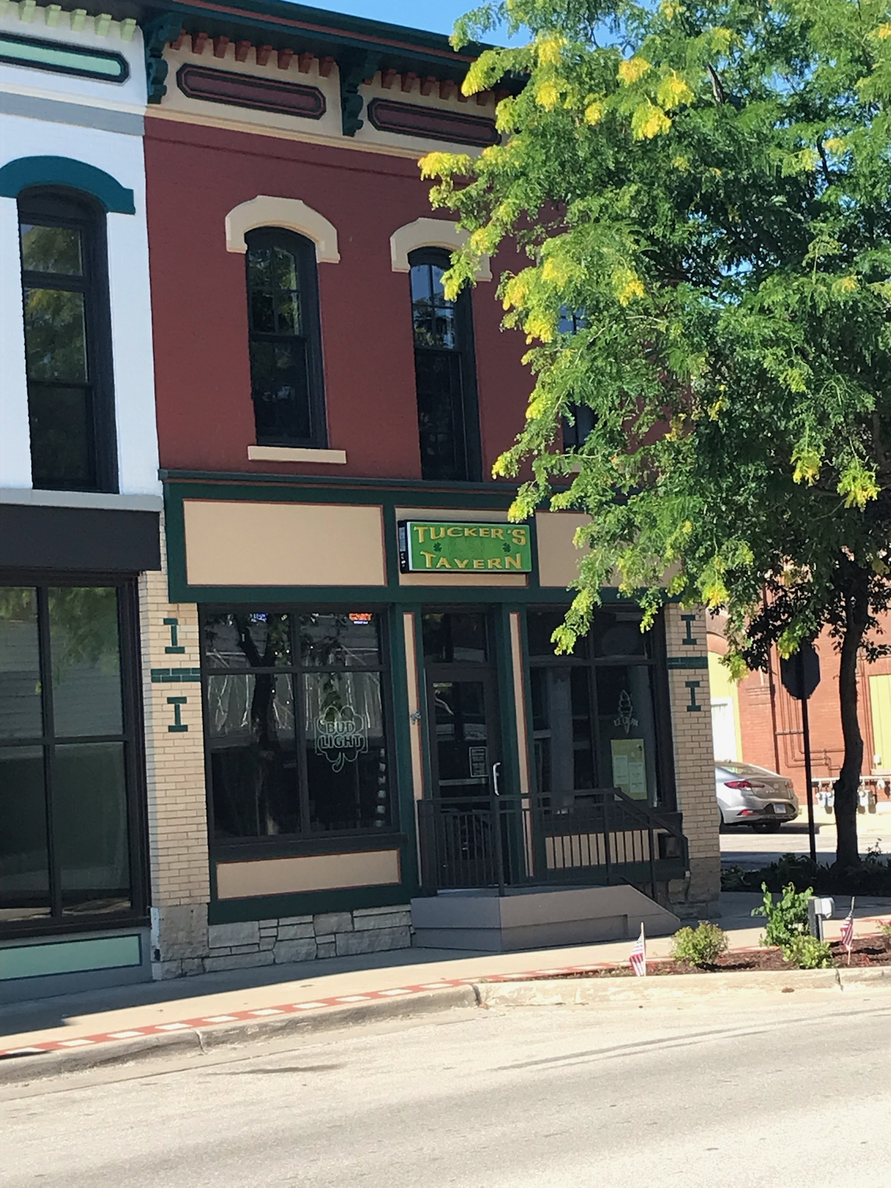
PLACEMAKING (Part 2)
Downtown Revitalization
Historic Preservation
Community Catalyst Growth

Slide 10
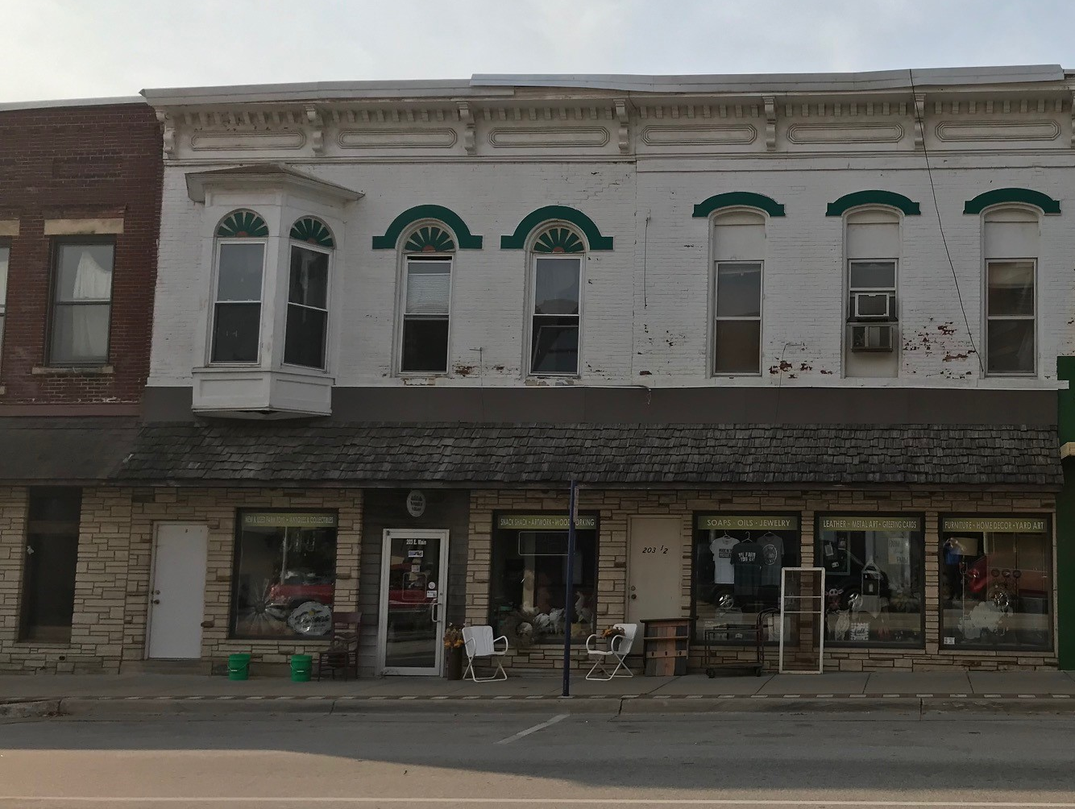
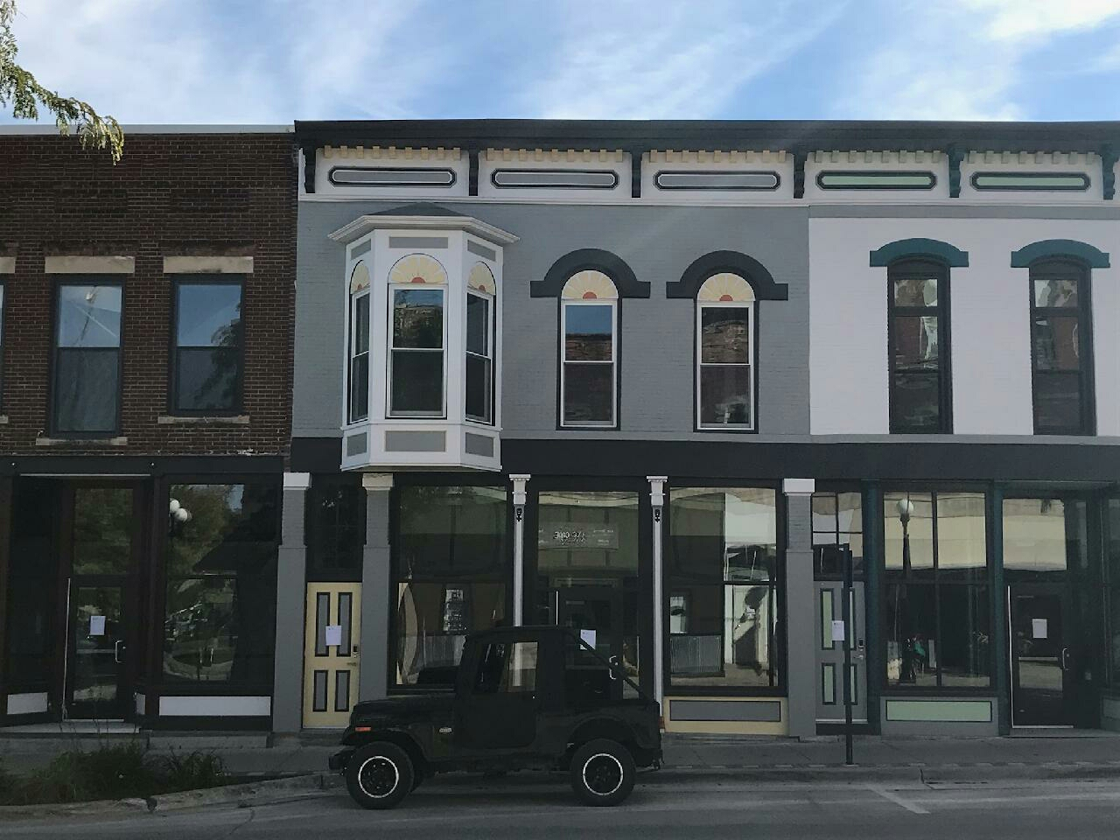
PLACEMAKING (Part 2 continued)

Slide 11
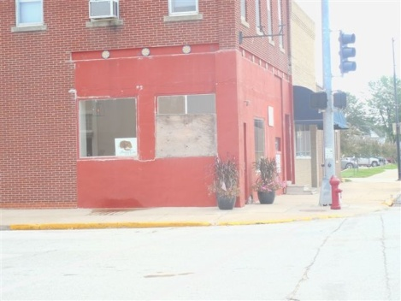
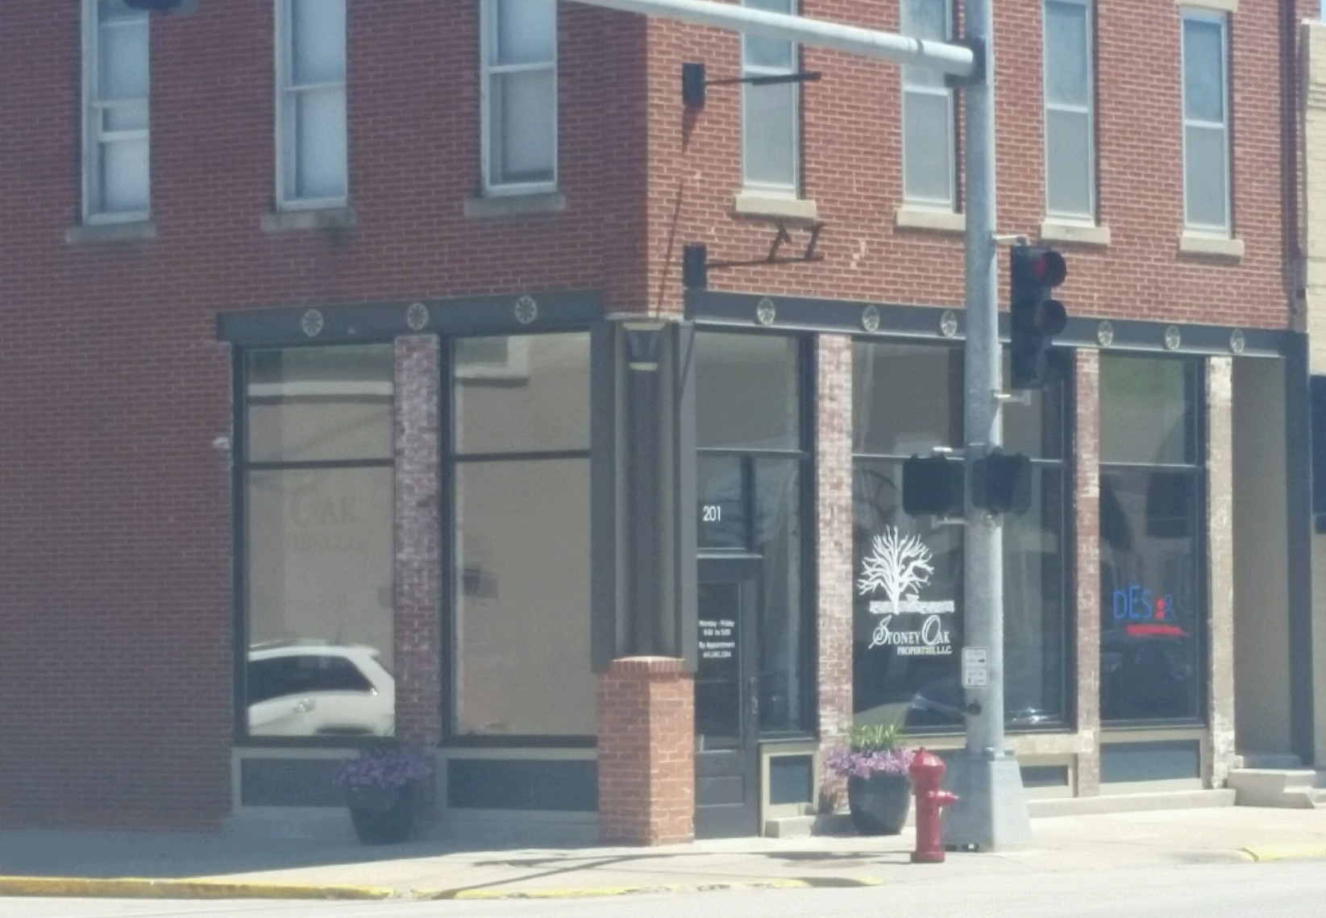
PLACEMAKING (Part 2 continued)

Slide 12
CURRENT ECONOMIC GROWTH
Existing Business Growth: Home-based and entrepreneurs
Fiber Internet to Every Home & Business
Incentives & Ordinances Reviews
Placemaking and other Quality of Life Amenities

Slide 13
Services & Partnerships with Economic Development
Incentives & Ordinances
Video Development of businesses and community
Business Plan & Marketing Assistance
Grants/Tax Credit Assistance
Program Management

Slide 14
FINANCIAL PARTNERSHIPS
Direct Cash
Office space and other in-kind services
Programs and services fees
Grant administration and writing fees
Project Management

Slide 15
NEXT STEPS
Find your local contact
Prioritize what you need done
Develop a plan for what it would cost you versus what you would be willing to pay
Set up a meeting and offer a partnership

Slide 16
QUESTIONS?
DEREK LUMSDEN, MSARP
Jones County Economic Development
319-480-7446
director@jonescountydevelopment.com

