Slide 1
Succession Planning Shouldn’t Suck
Kathryn Mortensen, Budget and Performance Manager, Brighton, CO
Kayla Barber-Perrotta, Deputy City Manager, Albany, OR

Slide 2

Kathryn Mortensen
Budget and Performance Manager
Kayla Barber-Perrotta
Deputy City Manager
Brighton Performance & Leadership Academy​
Black Belt from the Denver Peak Academy​
ELGL Traeger Award Winner & Knope of the Month​
Master’s in Public Administration
Management of Internal Service Departments
ELGL Traeger Award Winner​
Black Belt from the Denver Peak Academy​
Disney Way Champion for City of Royal Oak
Brighton Performance & Leadership Academy​

Slide 3
Current Budget and Performance Manager
Previous Budget and Performance Manager

Slide 4
Succession Planning Overview

Slide 5
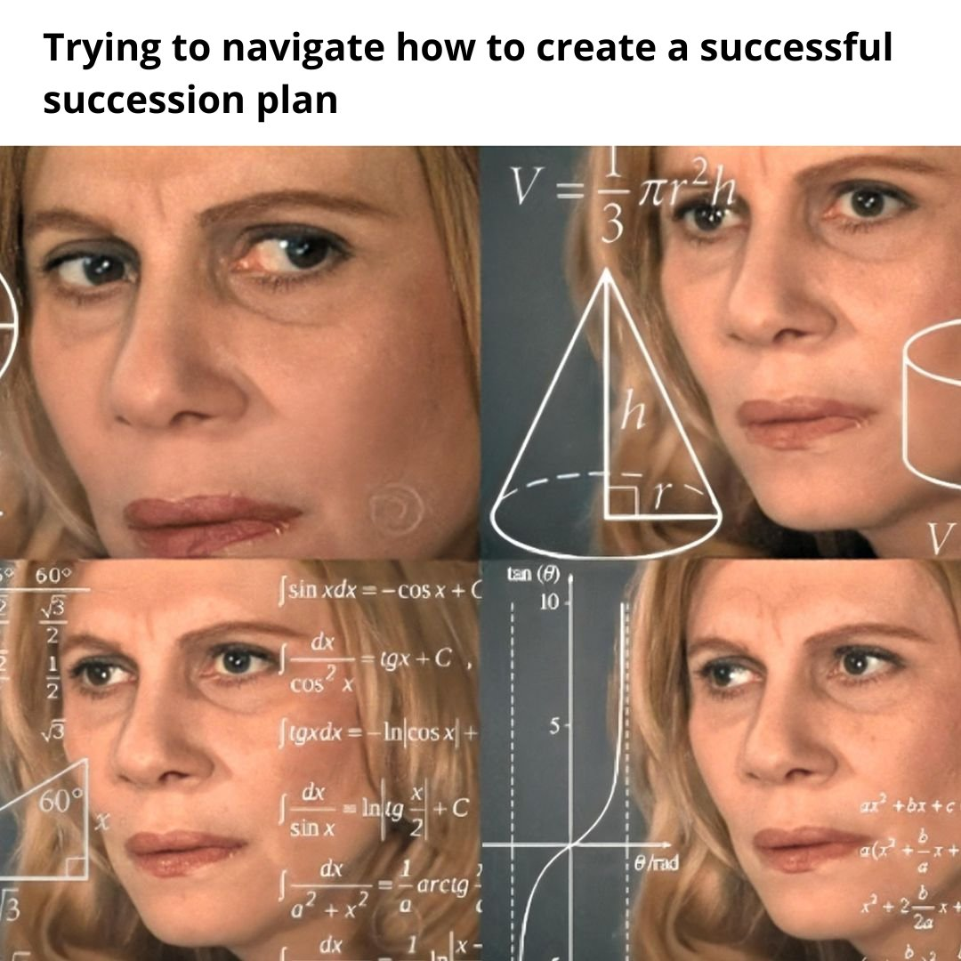
What is Succession Planning?
Proactive strategic planning for turnover and growth
Where is my organization today?
Where do I want to be tomorrow?
What is the best path for getting there?
  Internal?
  External?

Slide 6
Why does it matter?
Impacts to your bottom line
Diminished Service
Lost productivity
Burnout and turnover

Slide 7
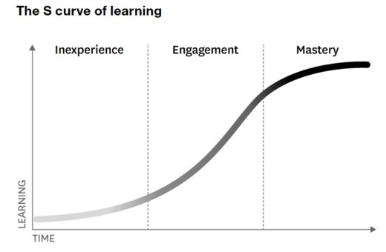
Turnover is reality
Everyone has an S curve​
“If a person can’t grow with a company, they will grow away from it”​
Most employees will eventually hit a ceiling
Keep them engaged
The best teams are a collection of curves​
(Gandhi, Vipula; The 'Great Resignation' Is Really the 'Great Discontent’; gallup.com, July 22, 2021)
(Johnson, Whitney; Building an A Team; Harvard Business Review Press; 2018)

Slide 8
Top Reasons Workers Leave Jobs
Bab Bosses
Too Much workload
No recognition
Broken commitments
Relationship with Coworkers
No flexibility
Lack of advancement opportunities

Slide 9
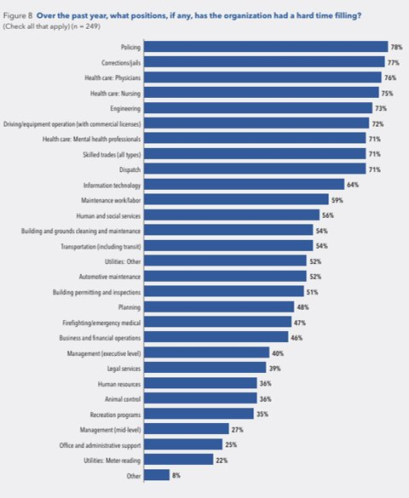

The Public Sector Challenge
Funding constraints
Lower pay scales
Public distrust in government
Higher standards
  Additional laws on top of knowledge needed
Hard to fill positions

Slide 10
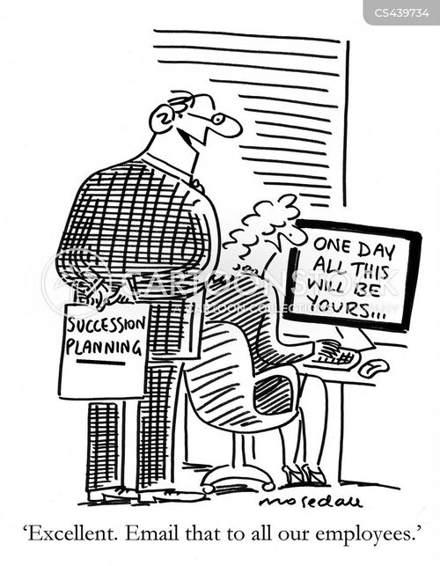
Common Pitfalls to Succession Planning
Not telling the employee you think could be good in the position
Not being okay with employees’ career goals being outside the organization
Not being realistic that sometimes employees need to leave
Putting all your eggs in one basket
Treating succession planning as an add, not a lens
Fear of replacement

Slide 11
The Power of Culture
Us
Shared Purpose/Values
Leadership
Practices and Processes
Rituals, Stories, Traditions
Relationships with Customers

Slide 12
Tools for Effective Succession Planning

Slide 13
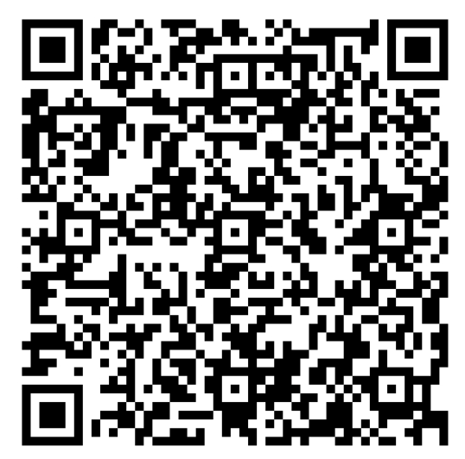
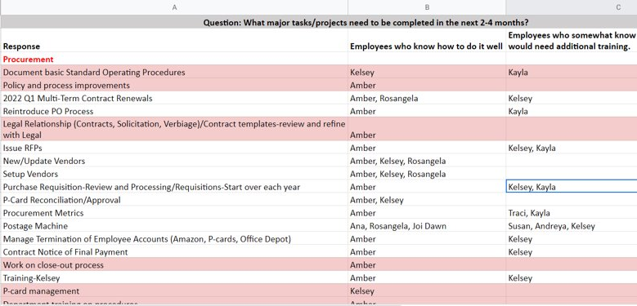
Conduct an Organizational Assessment
Start early
Identify key positions
  Institutional knowledge
  Specialized positions
Assess your gaps
  Organizationally and within Departmental and teams
Can existing staff fill this role?

Slide 14

Continuing Education Mindset
Identify goals and skills
Identify opportunities
Discuss development needs
Check-in regularly
Implement the plan

Slide 15
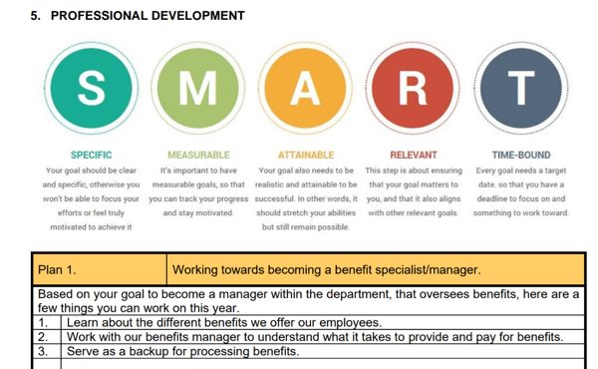
Performance and Goals Discussions

Slide 16
Succession Planning Tools
Professional Development
Mentorships/coaching
Trainings
Practical Application
Shadowing
Cross-training
Structure
Leveled positions
Conferences
Certificates
Self-training
Stretch projects
Delegating
Growth pathways
Overlap for key positions
“Acting”
Documentation

Slide 17
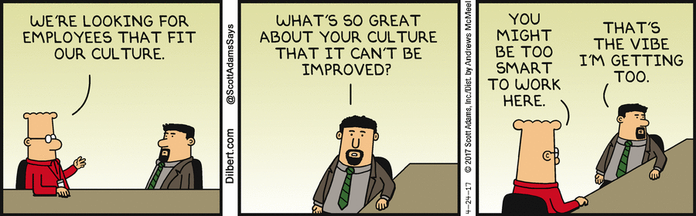
What if you don’t have an Internal Candidate?
Is this still the right position for the team?
Hiring for Fit Vs. Add
What skills does this position need to perform?
What education and background does an employee need?
Does your job posting reflect this?

Slide 18
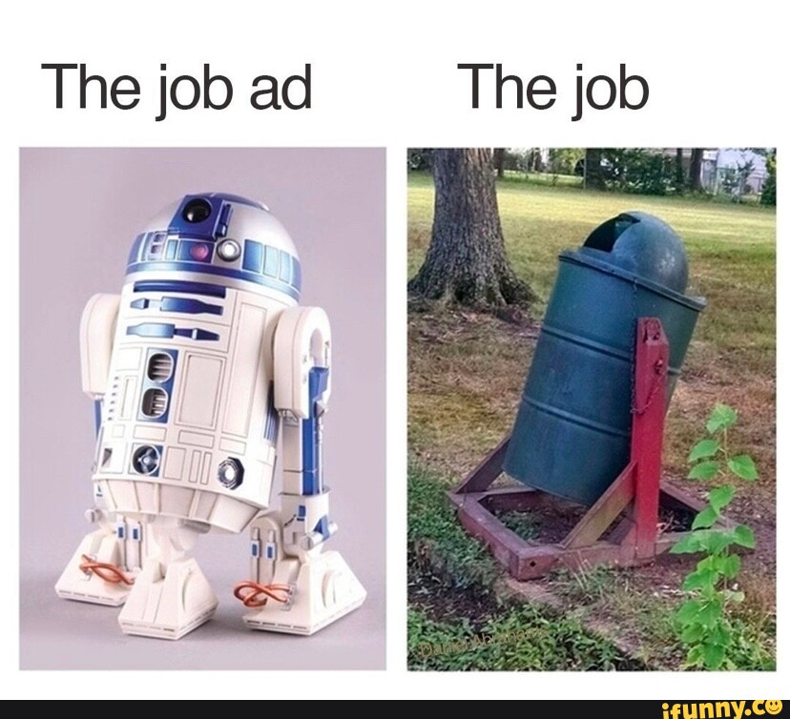
Job Postings
Way for employers to recruit candidates for vacant positions​
Introduce your company to a potential employee​
One page
Include culture and pictures​
Be clear, honest, and sell the opportunity​

Slide 19

Job Postings
Avoid a “wish-list approach” to qualifications ​
Seek out potential not just proficiency​
Examine motivations ​
Understand team dynamic impacts​
Identify tasks you want the new hire to perform​
Capacity of low end vs. high end curve ​

Slide 20
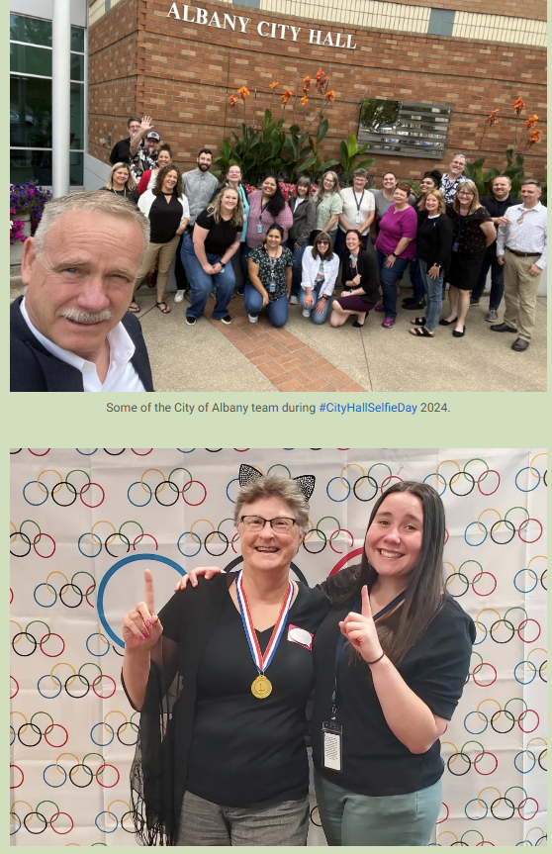
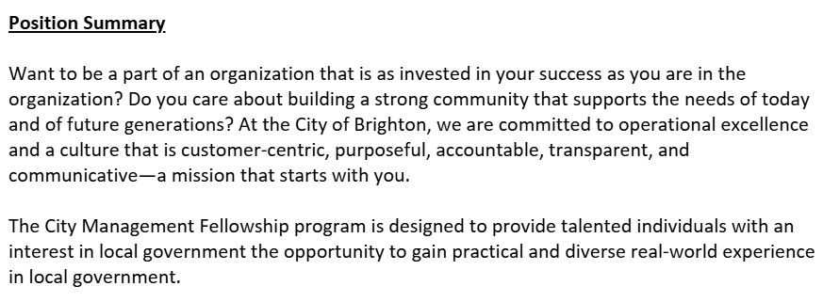
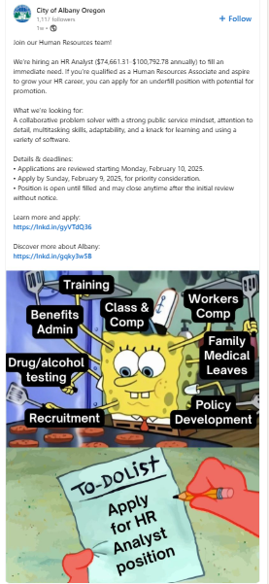
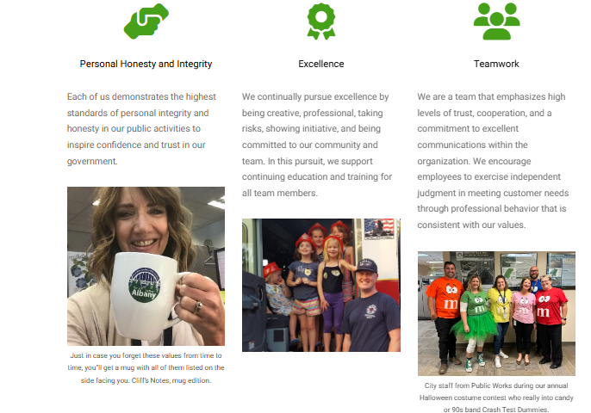
Job Postings

Slide 21
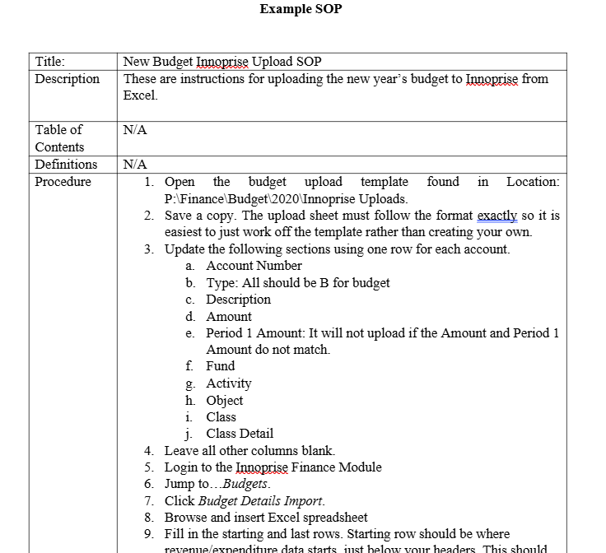
Processes
Do you have SOPs?
Use new people to test
Use last two weeks to gather information not get as much work done as possible
Empower people to innovate – they will be more bought in
As you create new processes – is this doable by someone if I win the lottery and leave tomorrow?

Slide 22
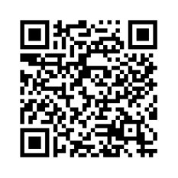
Kathryn Mortensen
Budget and Performance Manager
Kmortensen@brightonco.gov
Questions?
Learn more about the Brighton Performance and Leadership Academy
Kayla Barber-Perrotta
Deputy City Manager
Kayla.Barber@albanyoregon.gov

