Slide 1
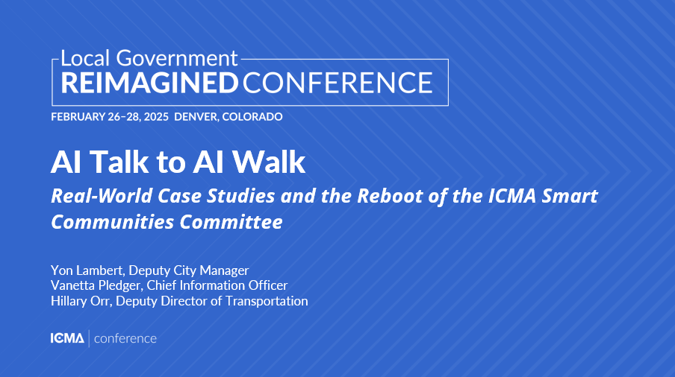


Slide 2

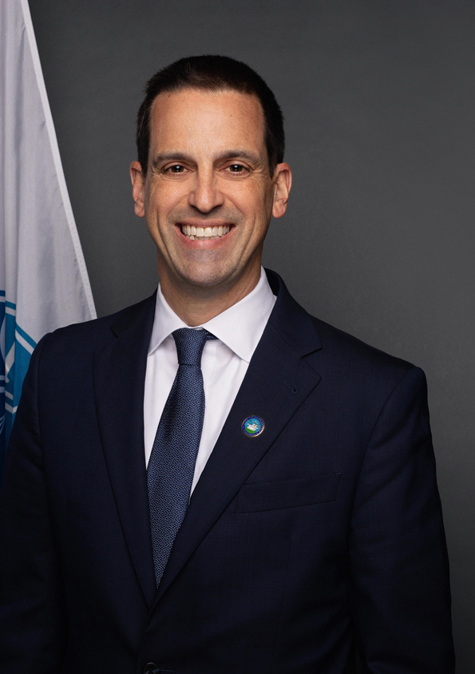


Who we are
YON
VANETTA
HILLARY
DEPUTY CITY
MANAGER
CHIEF INFORMATION OFFICER
DEPUTY DIRECTOR OF TRANSPORTATION

Slide 3







Alexandria, VA - Quick Facts
Est. 1749​
​
Pop. 160,000​
​
Part of DC Metro Area​
​
Independent City in a Dillon Rule State​
​
Council-Manager form of government

Slide 4



Please download and install the Slido app on all computers you use
Which of the following best describes your role?
ⓘ Start presenting to display the poll results on this slide.

Slide 5


Please download and install the Slido app on all computers you use
How familiar are you with AI and its applications in your field?
ⓘ Start presenting to display the poll results on this slide.

Slide 6

Please download and install the Slido app on all computers you use
If you don’t use AI regularly, what is the biggest barrier?
ⓘ Start presenting to display the poll results on this slide.

Slide 7

Please download and install the Slido app on all computers you use
What is your favorite prompt??
ⓘ Start presenting to display the poll results on this slide.

Slide 8









The WHY behind the WHAT
  AI utilization is a low priority for their local government
48%
  AI as high priority for service delivery
6%
  AI awareness as significant barrier
77%
  Best for resident engagement
55%
Notes:
Almost half of respondents (48%) say that AI utilization is a low priority for their local government, while less than 6% of respondents have placed a high priority on utilizing AI in local government service delivery.
The top area identified for AI potential is resident engagement (55%), including streamlined service interfaces and AI chatbots for FAQs. Local policy applications, such as budget modeling and policy analysis, are seen as having significant potential by 38% of respondents.
The most significant barrier is a lack of AI awareness and understanding, cited by 77% of respondents.
•The top concern is the use of AI-generated disinformation/misinformation to illegitimately impact public policy, cited by 70% of respondents. Similarly, over half of respondents (56%) indicated concerns about public perception and trust associated with use of AI.

Slide 9

Two Paths...
AI for Optimization
  strengthens internal operations by streamlining and automating processes for speed, cost savings, and efficiency
  increases organizational efficiency
  enhances productivity
AI for Exploration
  gathers and interpret external data
  discovers new insights
  detects patterns & trends
  informs strategic decisions
Notes:
1. Operational vs. Strategic AI
Operational AI (Internal Efficiency & Effectiveness): AI used to optimize workflows, automate repetitive tasks, improve decision-making, and enhance productivity within an organization.
Strategic AI (External Discovery & Insights): AI used to analyze external data, identify market trends, predict customer behavior, and generate new opportunities for growth and innovation.
2. Inside-Out vs. Outside-In AI
Inside-Out AI: AI that strengthens internal operations, streamlining processes, reducing costs, and increasing organizational efficiency.
Outside-In AI: AI that gathers and interprets external information to uncover new opportunities, understand customer needs, and inform strategic decisions.
3. AI for Optimization vs. AI for Exploration
Optimization AI: Focuses on making existing processes faster, cheaper, and better through automation, predictive analytics, and efficiency improvements.
Exploration AI: Focuses on discovering new insights, detecting patterns, and finding innovative pathways by analyzing external data sources.

Slide 10
AI for Optimization
Internal Efficiency & Effectiveness vs. External Discovery & Insights
  Job descriptions
  Memos & written communication
  Data analytics for story telling & insights
  Organize thoughts to communicate to an audience
  Emails to Councils, residents, and staff
  Meeting notes and summaries
  Conference submissions, bios, etc.

Slide 11



  Prioritize Privacy
  Ensure Transparency
  Protect Sensitive Data
  Provide Explainable Decisions
  Secure AI Infrastructure
  Require Human Oversight
  Assess Accountability before Deployment
  Ensure Responsible Use
  Prevent AI Misuse and Protect Residents

Slide 12

ICMA Smart Communities Committee Reboot

Slide 13


Refocusing on Member Needs
Ensure the committee is a useful resource for members
Make it easier to understand and apply case studies

Slide 14



Streamlining Case Study Collection & Sharing
Share insights via magazine articles, web content, and conferences
Capture case studies through member input
Curate existing case studies for practical use

Slide 15


Expanding Membership & Collaboration
Grow participation to enhance knowledge-sharing
Leverage partnerships to strengthen resources

Slide 16


Driving Real-World Impact
Help members think about how these efforts apply to their communities
Provide actionable insights for easy implementation

Slide 17

Real World Case Studies

Slide 18

Ground Truthing Technology for Urban Solutions
Notes:
OR - Smart Intersections and Technology Testing Model

Slide 19

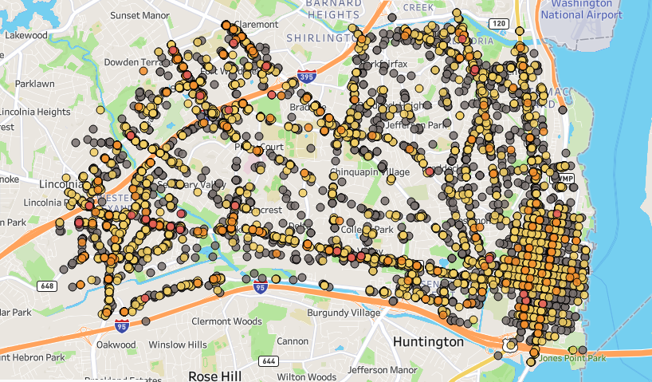

The Problems
2015-2024 Crash Data
Traffic crashes
Fatal
31
Serious Injury
208
Non-Severe
2n462
Property Damage
7,482

Slide 20


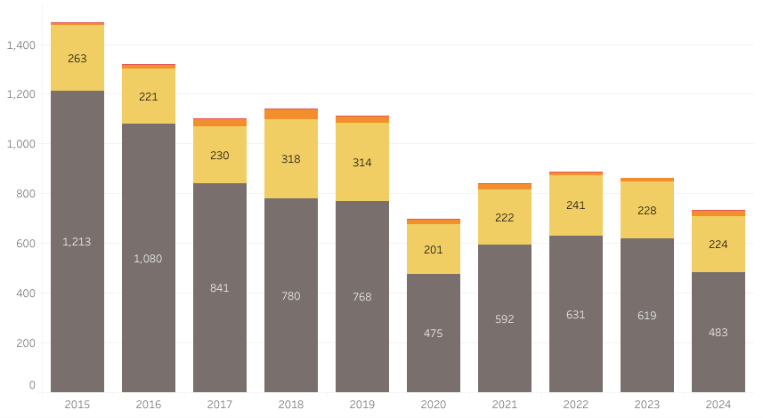
The Problems
Crash Data

Slide 21






The Problems
Limited resources to vet numerous vendor solutions

Slide 22
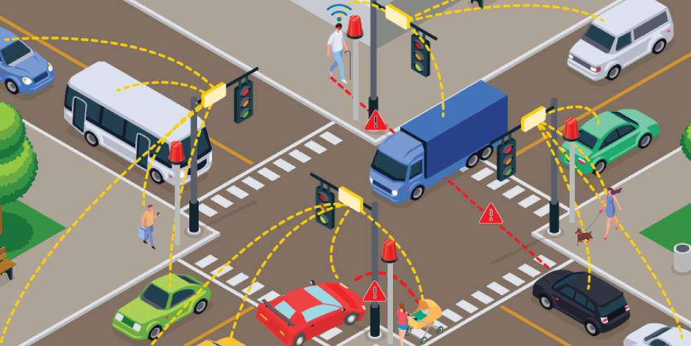
The Solution
Smarter, AI powered intersections
Source: U.S. Department of Transportation

Slide 23







The Pilot
Partner
Install
Run
Validate
Share Findings
Scale up

Slide 24
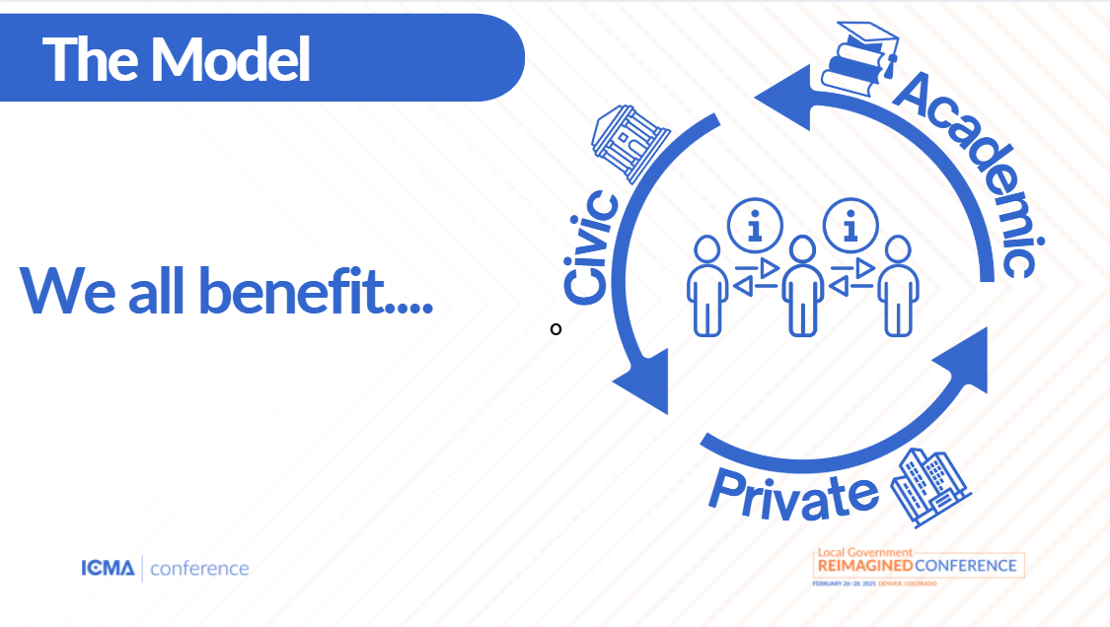





The Model
Academic
Civic
We all benefit....
o
Private

Slide 25

Integrated Public Safety & Justice
Notes:
OR - Smart Intersections and Technology Testing Model

Slide 26

The Problem
Disconnected data across multiple public safety systems

Slide 27














What we did
Use Reports for Decision-Making
Cleaned and connected data across multiple systems
Used AI to scan reports & ID safety concerns
Made information easier to use with full picture of person’s intersections with public safety systems
Identified duplicates & matched records across systems

Slide 28



Why it Matters
Before
Now
New System
Officials manually searched for connections between records, which was time-consuming & sometimes inaccurate.
AI finds patterns, flag risks, and ensures better responses, leading to safer outcomes
Makes Alexandria’s public safety data more accurate, accessible, and useful, ultimately helping to better serve and protect residents.
Notes:
Making Data Work Smarter for Public Safety in Alexandria
Alexandria partnered with Peregrine and AWS to build a smarter system for managing public safety and justice data. The goal was to connect scattered information across different departments to make better decisions and improve services.
What Was Done:
Cleaning and Connecting Data – AI was used to organize and link information from multiple sources, such as arrest records, court cases, and police reports.
Removing Duplicates – A special AI tool helped match records of the same person across different systems, even when names were slightly different.
Using AI to Read Reports – AI now scans police narratives to identify important safety concerns that might otherwise be missed.
Making Information Easier to Use – Instead of searching through different databases, officials can now see a full history of a person’s interactions with public safety services in one place.
Why It Matters:
Before this, officials had to manually search for connections between records, which was time-consuming and sometimes inaccurate. Now, AI helps find patterns, flag risks, and ensure better responses—for example, alerting officers if someone has a history of violence or identifying when someone might need additional support.
This new system makes Alexandria’s public safety data more accurate, accessible, and useful, ultimately helping to better serve and protect residents.

Slide 29

Call to Action
  Establish an AI Policy
  Experiment with AI
  Empower Your Innovators
  Share Your Success
Notes:
Experiment with AI – Start small and test AI tools in your workflows.
Establish an AI Policy – Set guidelines to ensure responsible and effective AI use.
Empower Your Innovators – Identify AI champions in your organization and support their efforts.
Share Your Success – Document and share case studies to help others learn.

Slide 30
Thank You and
Connect with us!
Hillary.Orr@AlexandriaVA.gov
Vanetta.Pledger@AlexandriaVA.gov
Yon.Lambert@AlexandriaVA.gov

