Slide 1

Employee Mentorship Program: Engaging Employees Across the Organization
Liz Ramsey, Management Fellow
Tim Dodd, Deputy City Manager

Slide 2


Ice Breaker: Your Two Minute Life Story

Slide 3

Two Minute Life Story
Pair with someone you do not know, and share your two minute life story, using these prompts as a suggested outline:
Where are you from? Share a happy memory from your childhood!
Describe your family, such as the number of siblings you have
Where did you go to school and what did you study? How did you choose your schools/ career tracks?
Where and how did your career begin?
What do you currently do for work, and where do you work?
What you like to do in your free time?

Slide 4

The Beginning

Slide 5


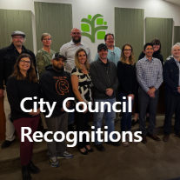


Engaging Employees

Slide 6
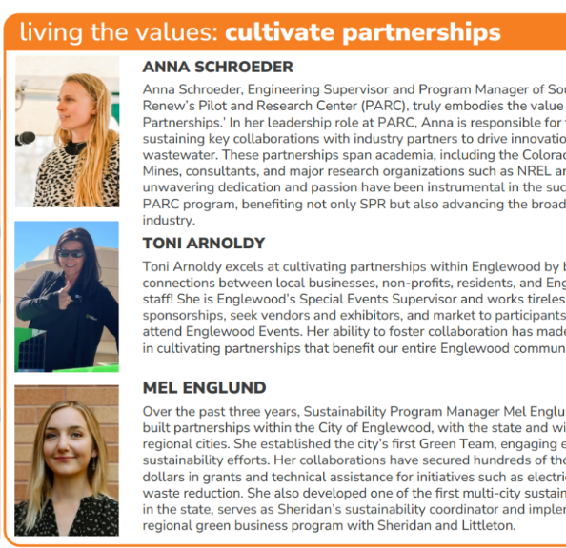
Mission, Vision, and Values
Mission: The City of Englewood is dedicated to enhancing the quality of life for those we serve
Vision: Advancing the community together
Values: Value people; resilient leadership; one team; cultivate partnerships; pride in Englewood; and foundation of trust

Slide 7
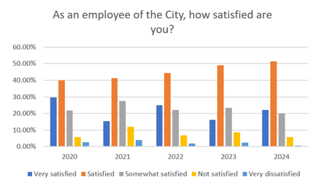
Employee Survey Data

Slide 8
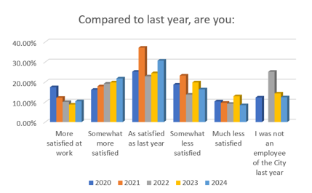
Employee Survey Data

Slide 9
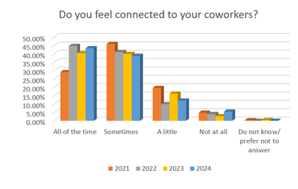
Employee Survey Data

Slide 10
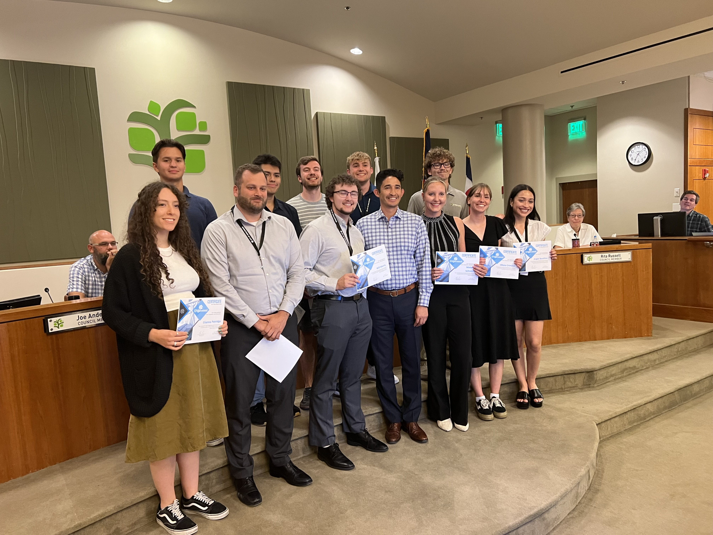
The Why: Why We Believed Englewood Would Benefit From a Mentorship Program

Slide 11
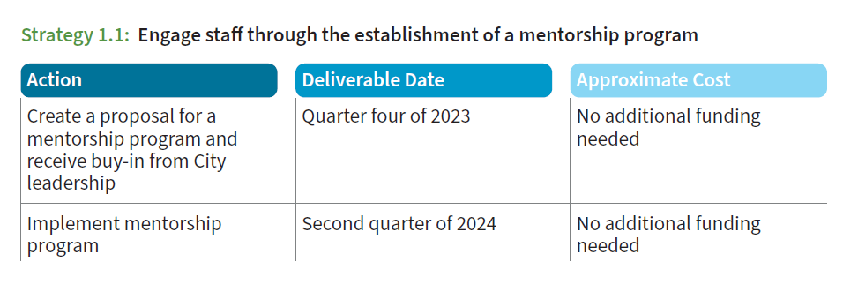
Initial Goal
Inclusion, Diversity, Equity, and Accessibility (IDEA) Committee Project Plan

Slide 12
The Why
Interest in established professional development programs (Pre-Supervisory Academy, High Performance Leadership Academy)
01
Silos still exist; employees at different levels experience silos to varied degrees
02
Englewood has many employees with knowledge to share
03
Employee survey data was telling us that there was not enough professional growth opportunities
04

Slide 13
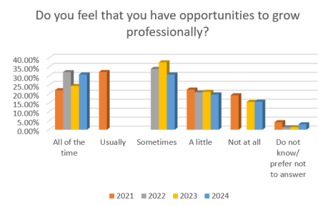
Professional Growth Opportunities

Slide 14
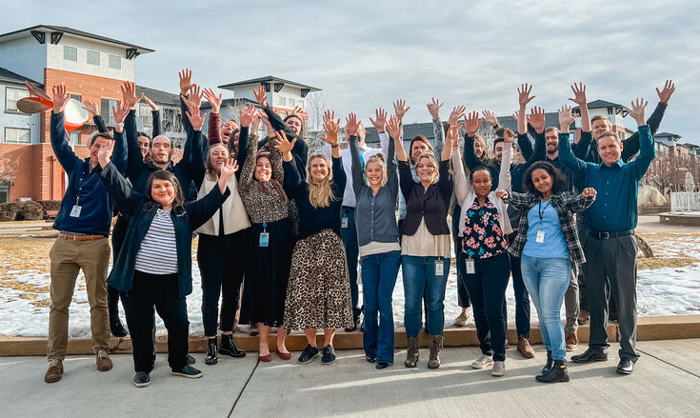
The What:
Describing an Employee Mentorship Program

Slide 15
What is a Mentorship Program?
A structured initiative to foster relationships between experienced employees and less experienced employees
Designed to promote professional development, skill-building, and knowledge sharing.
Promotes mutual and guided learning

Slide 16
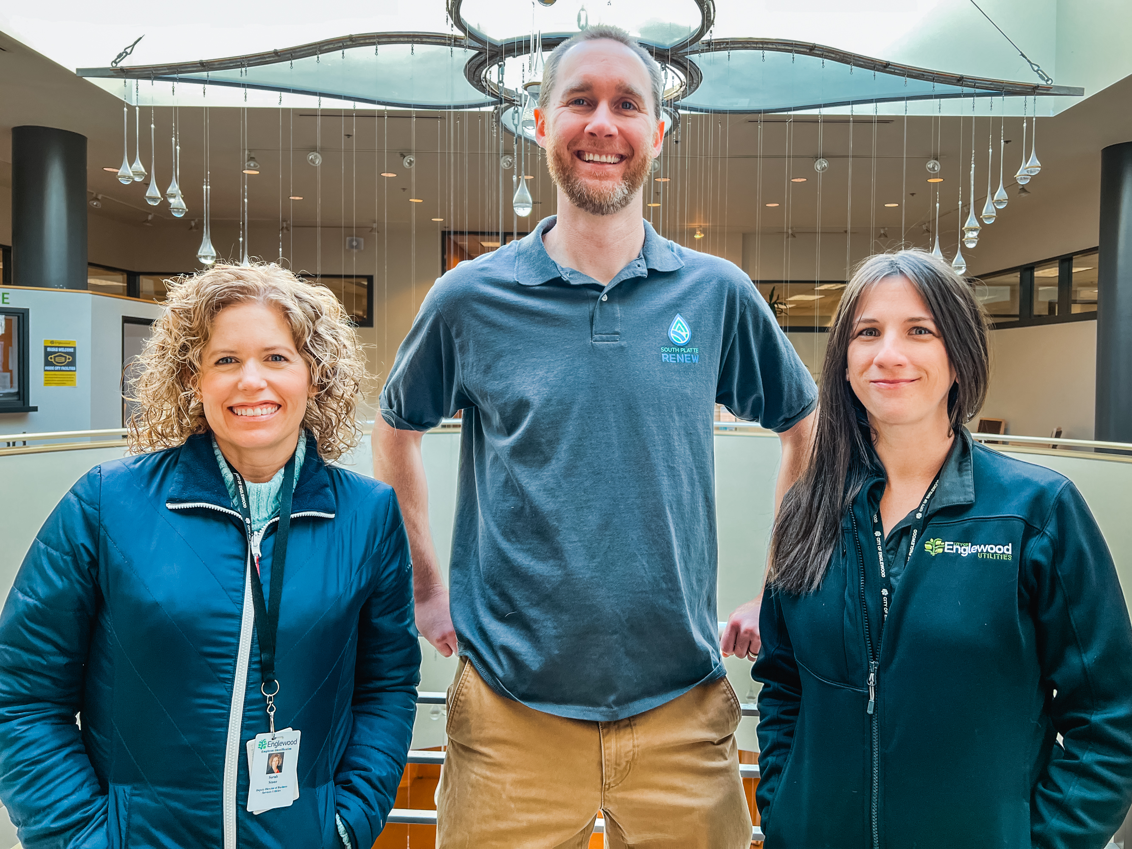
The How: How the City has Embraced and Managed a Mentorship Program

Slide 17

Englewood's Model
The mentorship program operates under HR, with a program facilitator
A survey-style application was sent out to the entire city to recruit participants and gather information to set up mentorship pairs, such as professional development goals and personality traits.
HR and the program facilitator reviewed applications, created pairs, and notified participants of matches
The program provides a guidebook to all mentorship pairs as a resource, which contains how to serve as a mentor/mentee, and best practices

Slide 18
Program Expectations
Participate in the program for one full year
Follow all City policies
Meet with mentor/mentee once a month

Slide 19

Preparing for Success:
Tips for Crafting A Mentorship Program
Funding, length of program, and level of program management
Applications explore personality type and professional goals
Create goals
Establish support
Program format: one-on-one mentoring, small group mentoring, or peer mentoring

Slide 20
Lessons Learned
Involve HR in the mentor/mentee matching process and review of applications
Be prepared to recruit mentors for mentees if the applicant pool is unbalanced
Mentorship programs can be as simple or as complex as you make them
Be flexible

Slide 21
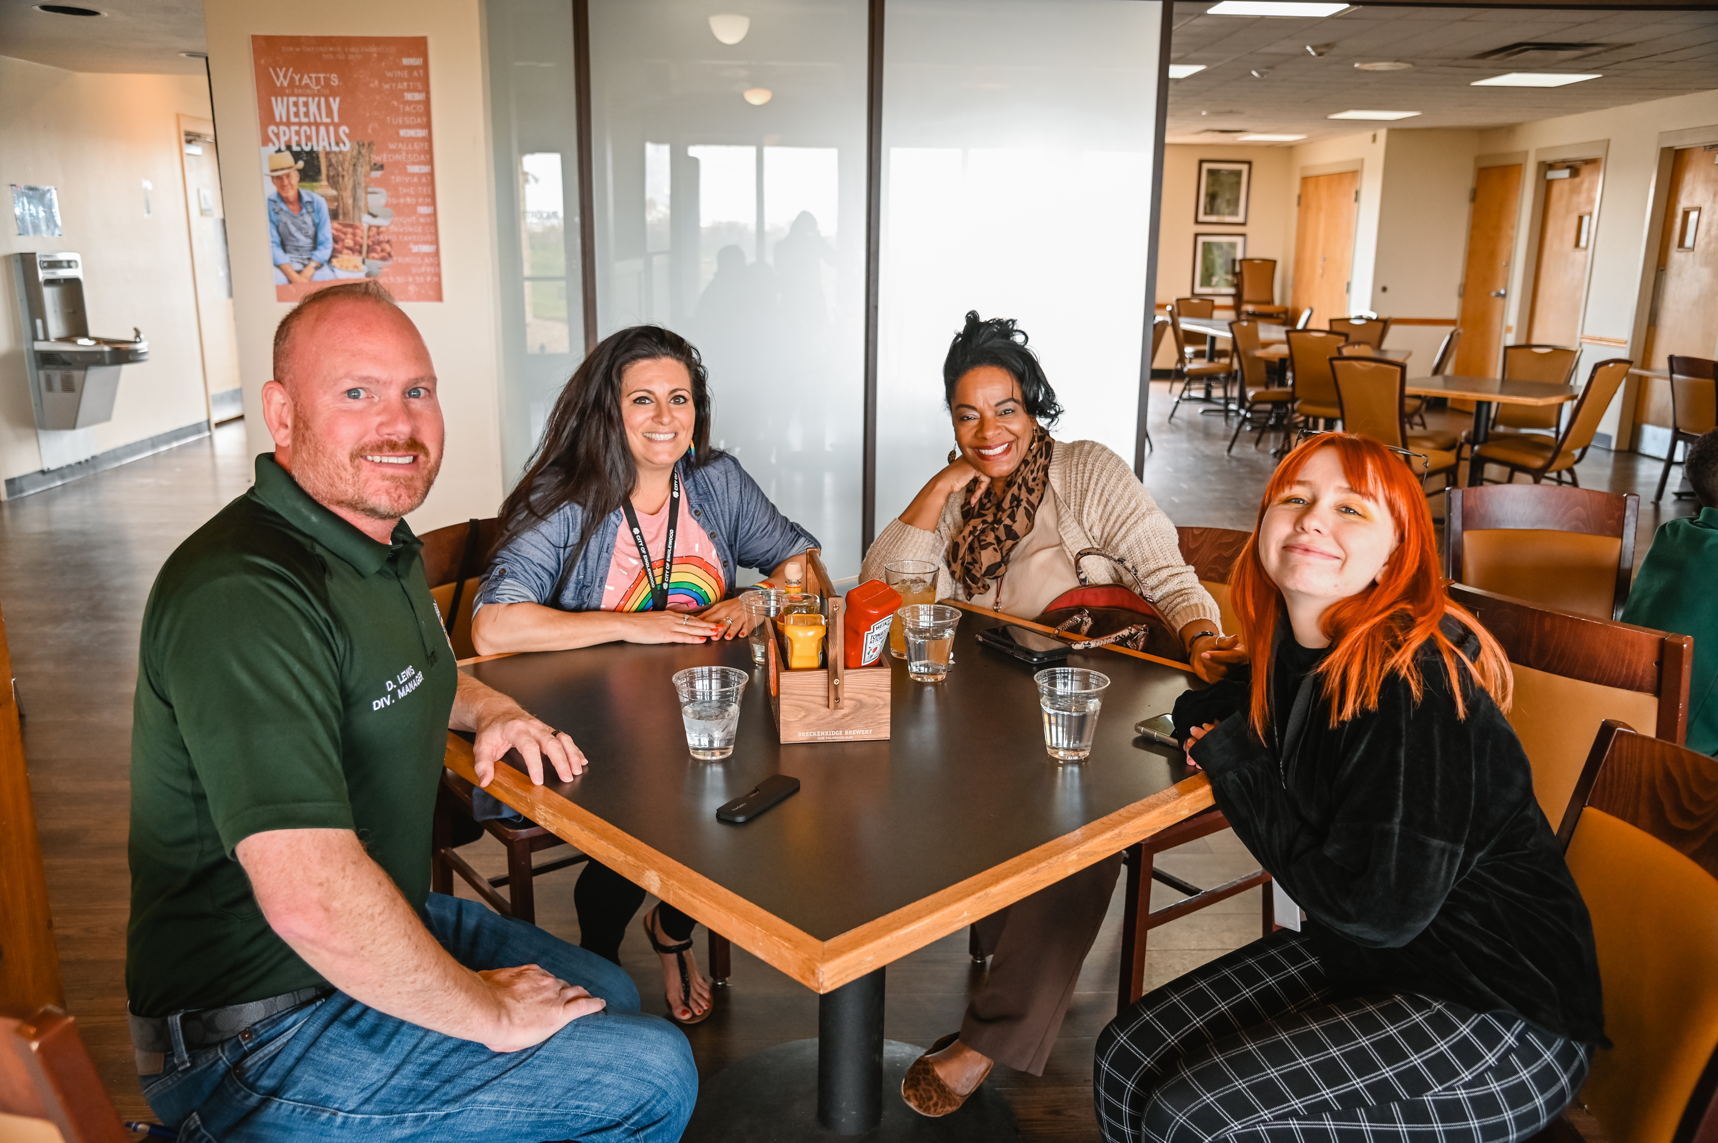
The Impact

Slide 22
The Impact
Eighteen employees signed up, creating 9 pairings of mentors/mentees in the first round of applications
Connections have been built across departments and seniority levels
Increased employee engagement
Reinforcing culture of known, matter, and included

Slide 23
Questions?

