Slide 1
The Engagement Gap: The Massive Social Media Opportunity Cities Overlook
Isobel Sylvian PARTNER, DIRECTOR OF CAMPAIGNS COMPETE DIGITAL, LLC
Chris Ricci PARTNER COMPETE DIGITAL, LLC
Ryan Pané SOCIAL AND EMAIL COORDINATOR COMPETE DIGITAL, LLC

Slide 2
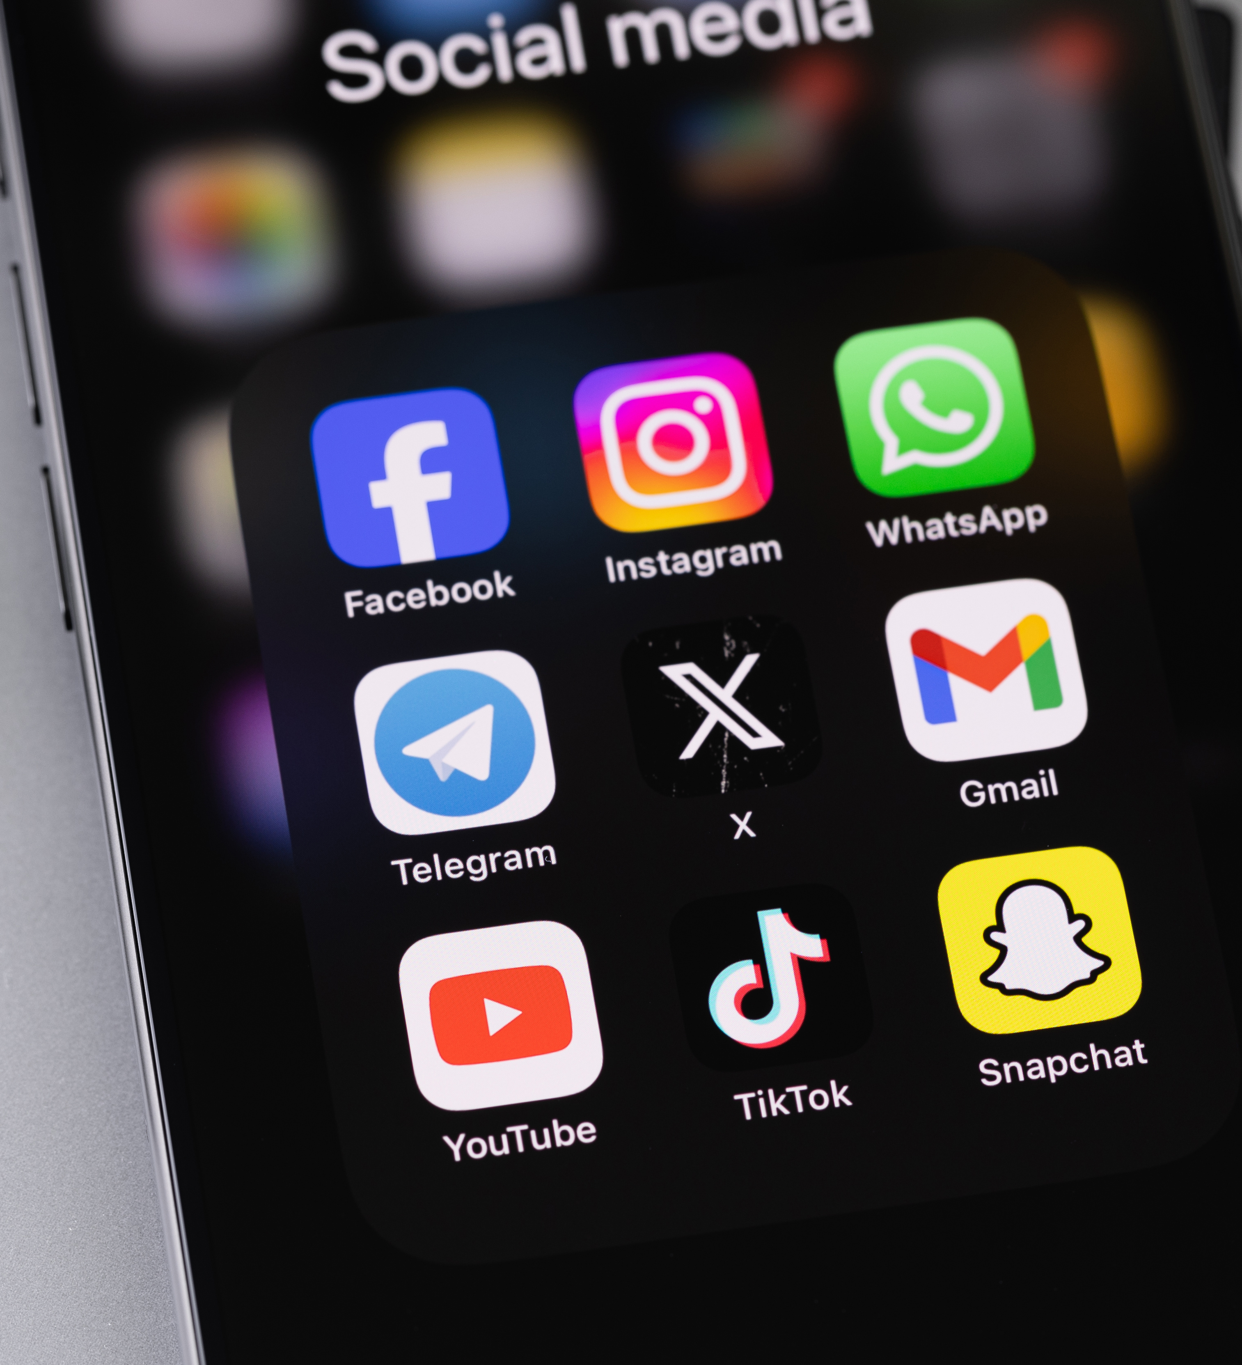
Results-Driven Social Media: Drive The Agenda In Your City.
Social Media is the opportunity to build a daily relationship with residents.
It’s the opportunity to build your own narrative without the media filter.
Sometimes does it feel like you are doing good work every day, but nobody knows?
You can share the stories of what your city does every day.

Slide 3
Traditional Media is Dying.
Newspapers are consolidated or owned by Hedge funds. Focus is on clicks and maintaining subscriptions.
New Business Model - If it bleeds it leads.
Now it’s clicks mean cash. Social Media is now a first stop.
You can share the stories of what your city does every day.
Good social media is a newspaper if it were only headlines.
But wait -- there’s more…

Slide 4
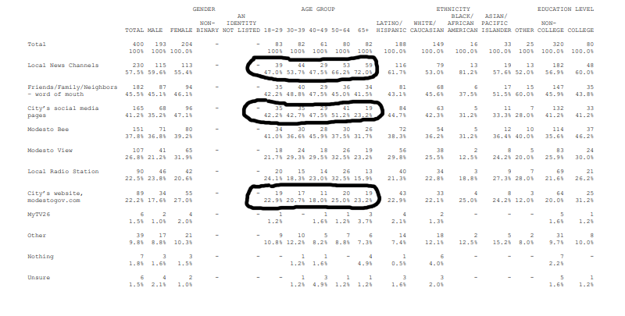

Slide 5
Organic Social Media is about Resident priorities
Organic social media is not advertising, but cities use it for both anyway.
Good Organic social media gets consistent engagement. Advertising on organic social media isn’t effective

Slide 6
Good Use of Organic Social Media

Slide 7
Good Use of Organic Social Media

Slide 8
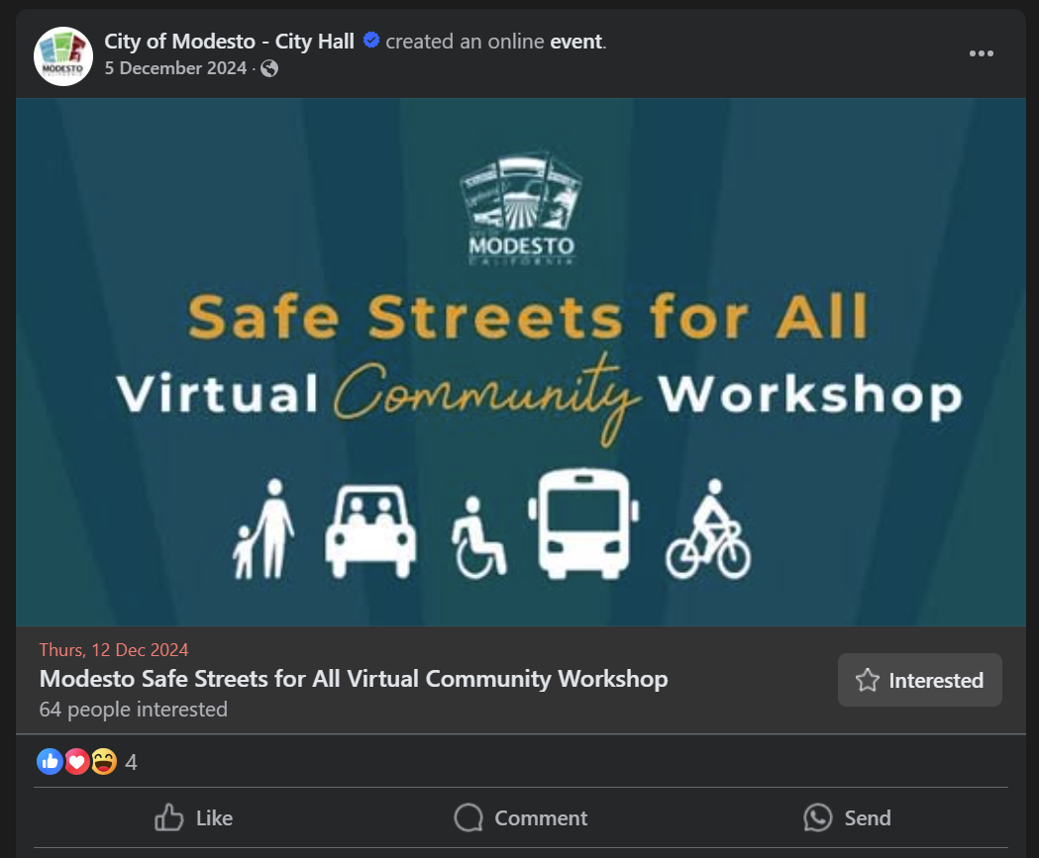
Bad Use of Organic Social Media

Slide 9
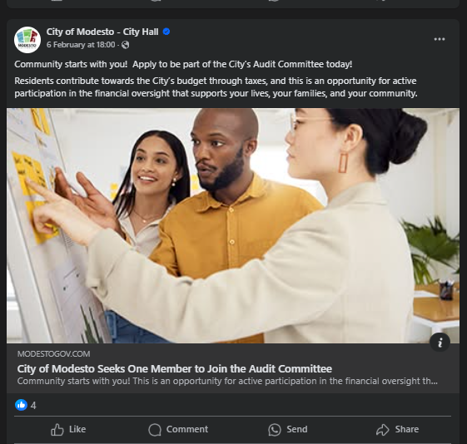
Bad Use of Organic Social Media

Slide 10
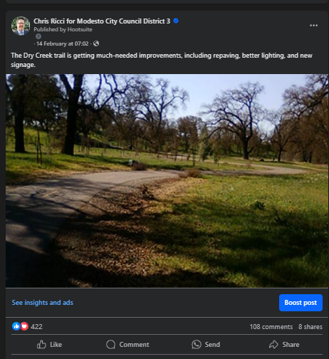
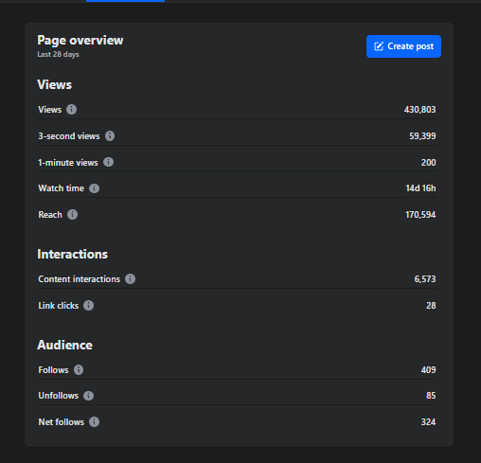
Social Media Works

Slide 11
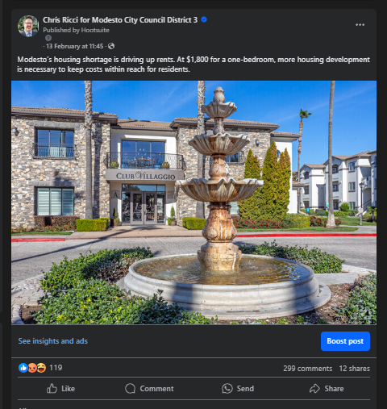
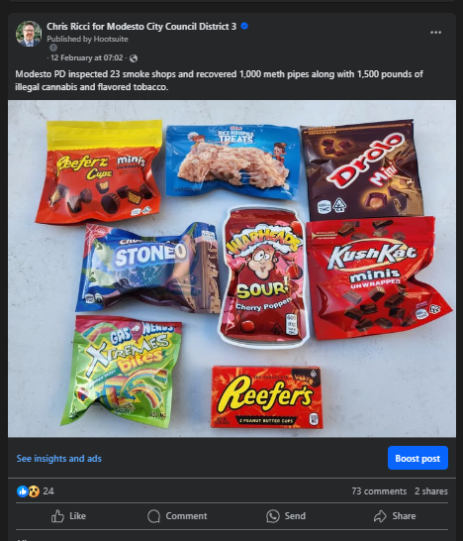
Social Media Works

Slide 12
Pathways to Civic Social Media Success
Become a trusted source of critical information for your community.
Reliable. Authentic. Transparent. Honest.
Don’t worry about your bias. Everyone has one and residents already know that.
People trust their cities every day. They also want information they can trust.
How do we do this?

Slide 13
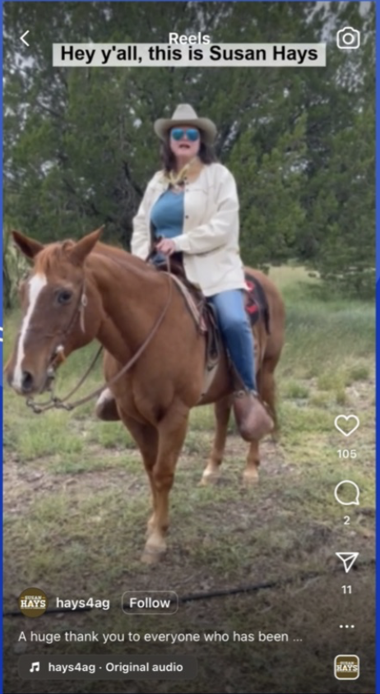
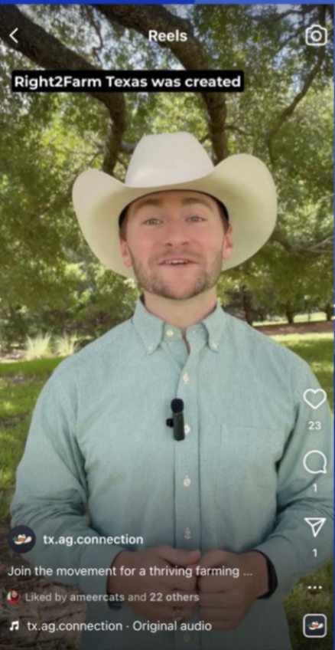
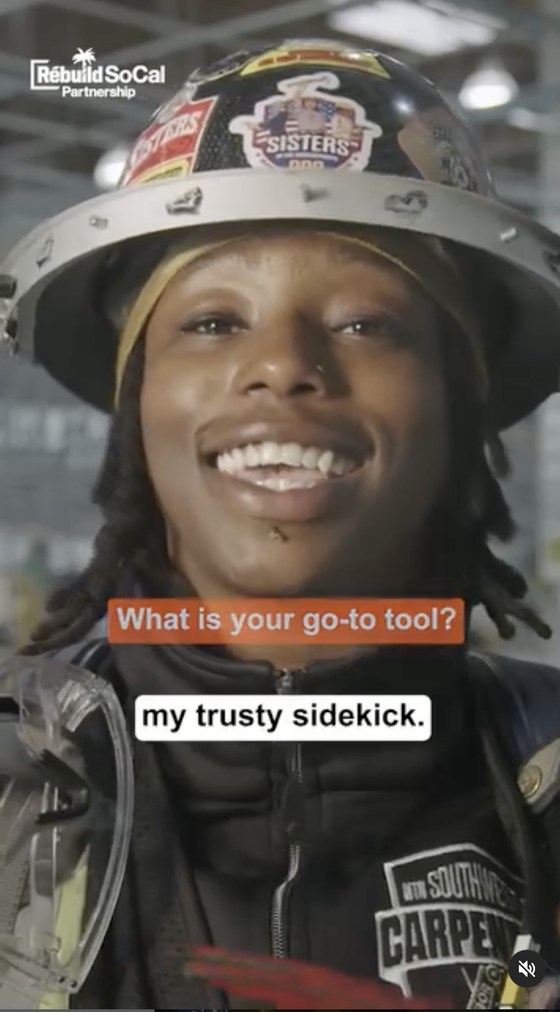
Building a Successful Social Media Presence
How do we do it?
Build Trust
Be Honest
Be Reliable and Consistent
Be Transparent
Be On-Message
Be Timely

Slide 14
AOC Vs. Trump Split Ticket Votes
Survey Captured the Below Quotes:
“I feel you are both outsiders compared to the rest of DC.”
“…both of you push boundaries and force growth.”
“I feel like Trump and you are both real.”

Slide 15
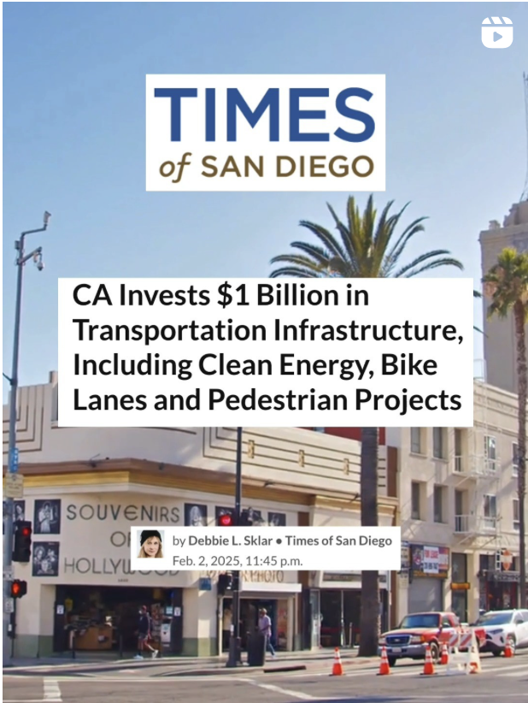
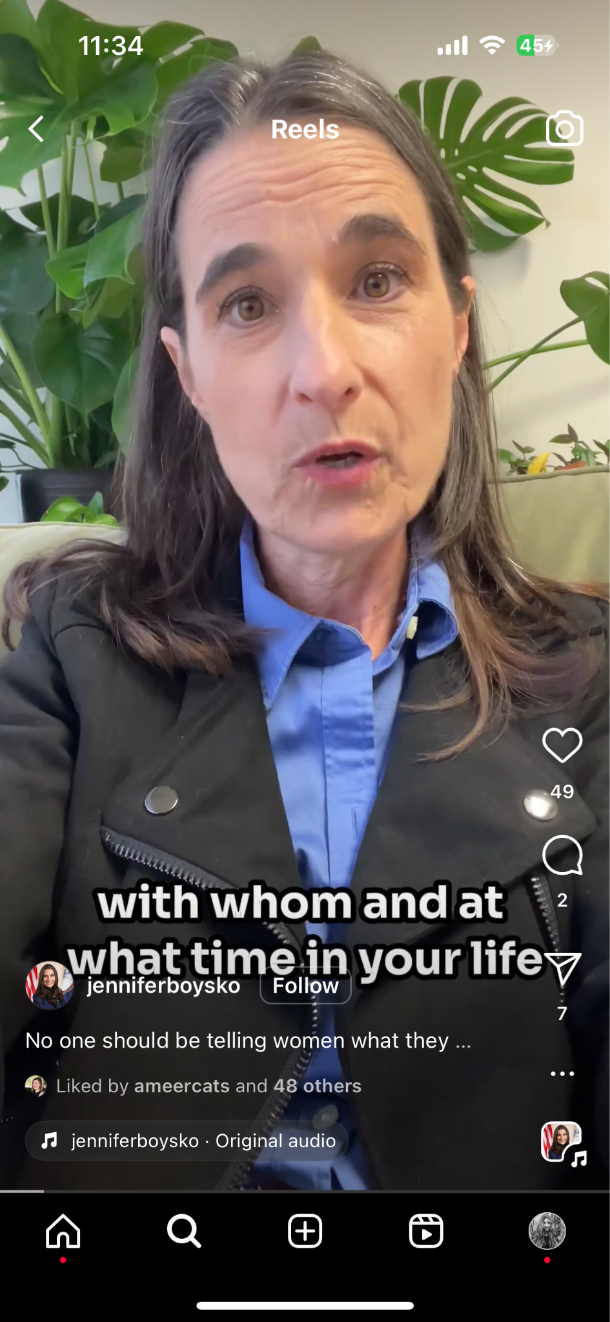
What Does My Audience Want to Know?
Always ask yourself:
What is my community interested in knowing?
What do they care about?
What concerns do they have?
What should we lean into and lean away from?

Slide 16
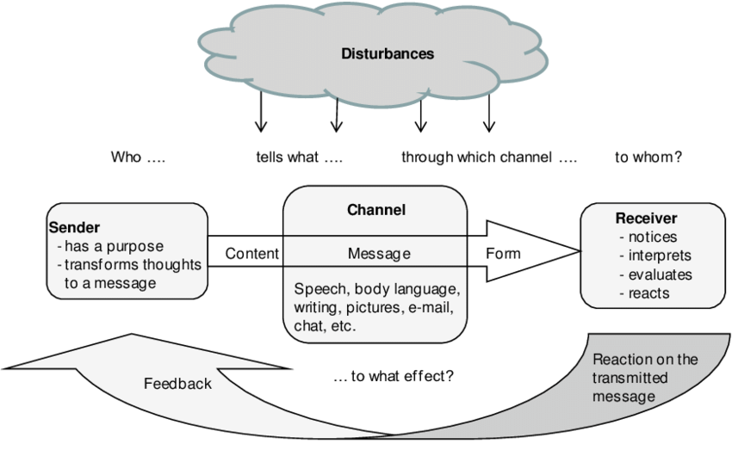
How Do We Build Trust Online?
The old fashioned way… just like how we build trust with a new friend: Two-Way Communication
Communicate
Listen
Respond/ Give Feedback

Slide 17
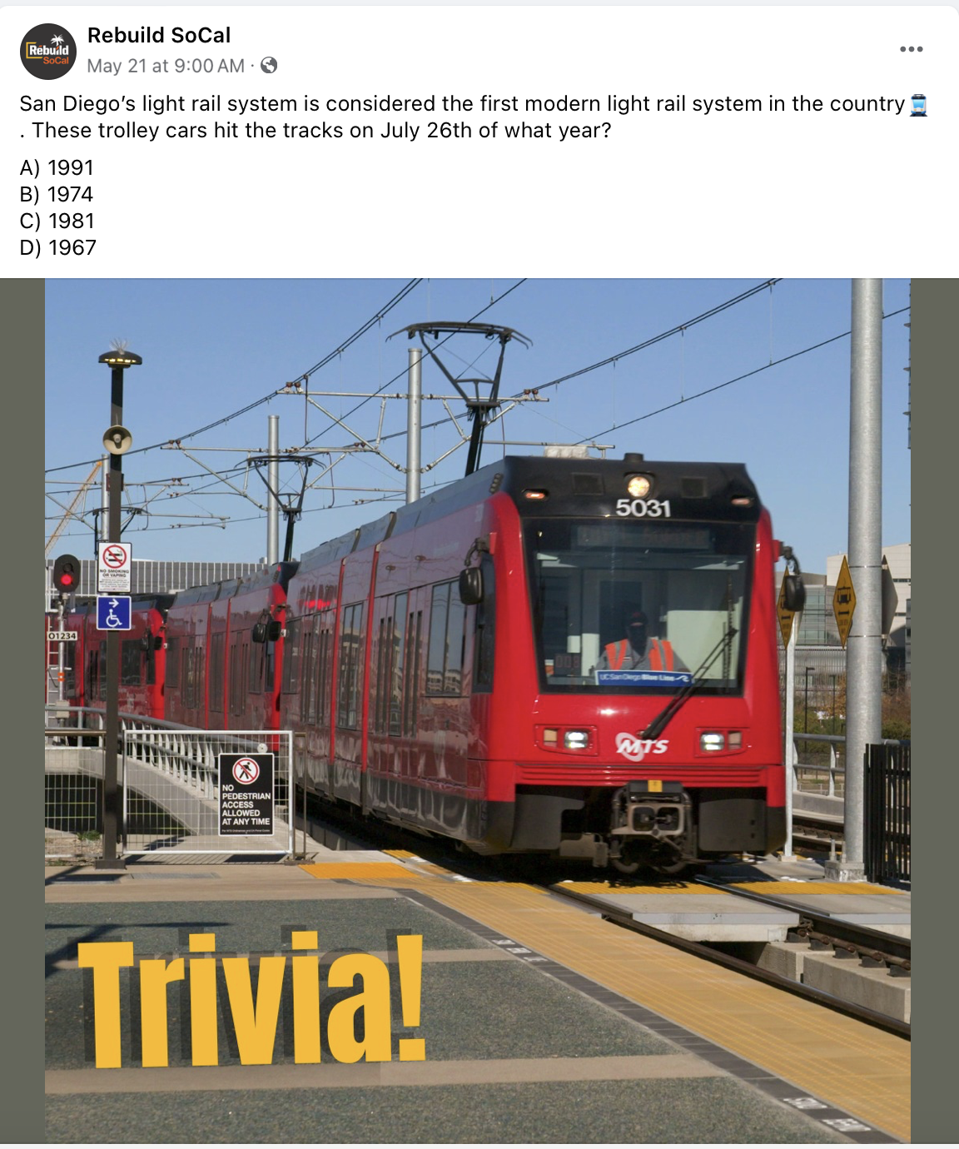
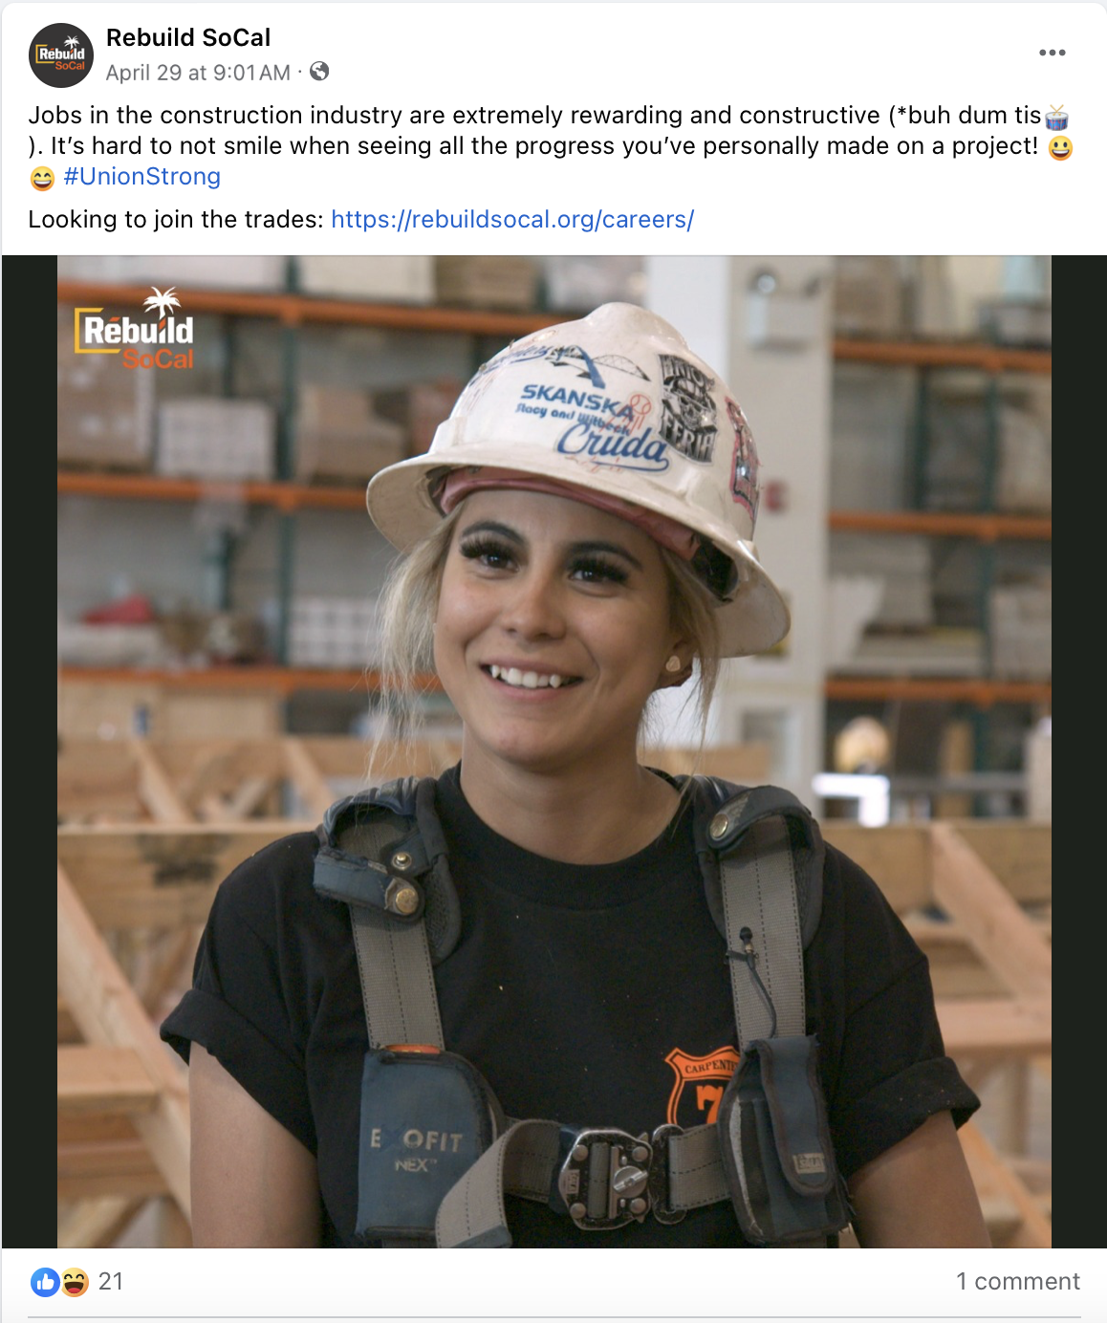
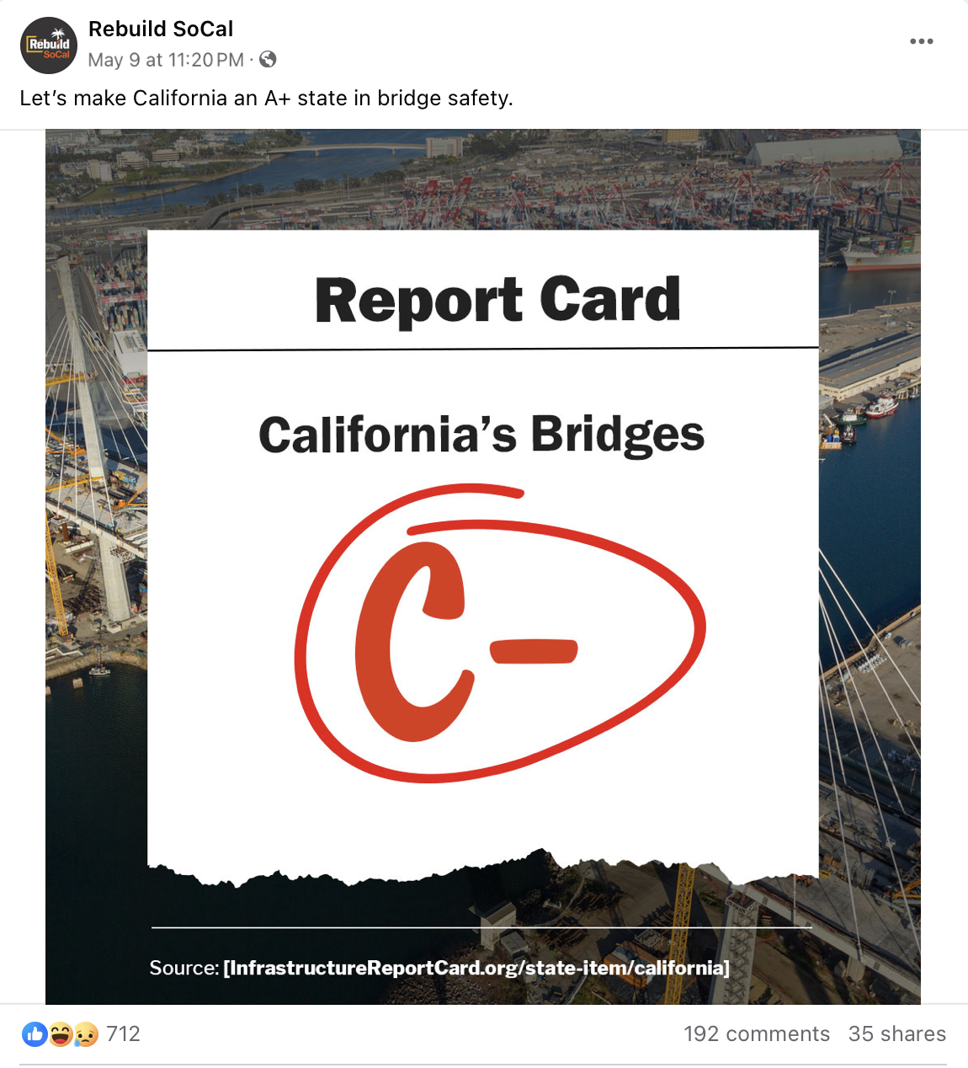
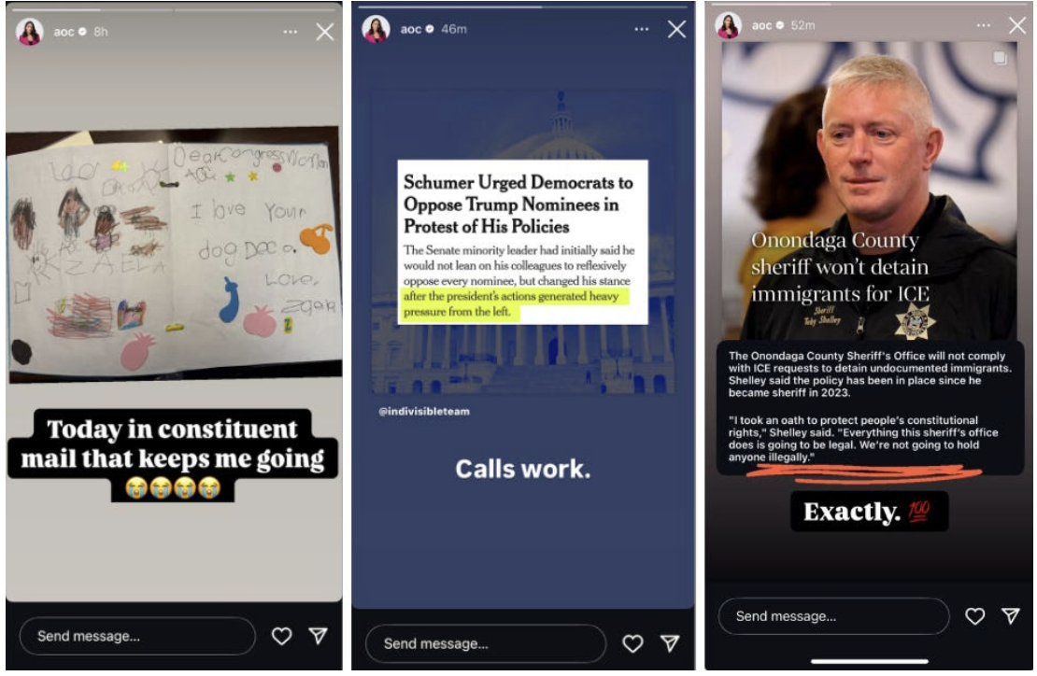
Post Consistently and Often
Posting Infrequently - Not Buildable
Posting once a month or even once a week doesn’t work
No community investment
Posting Infrequently - Not Buildable
Have a daily presence
Helps test messaging and posts to quickly learn what is working and not working
Gets in front of people frequently
People can begin to invest

Slide 18
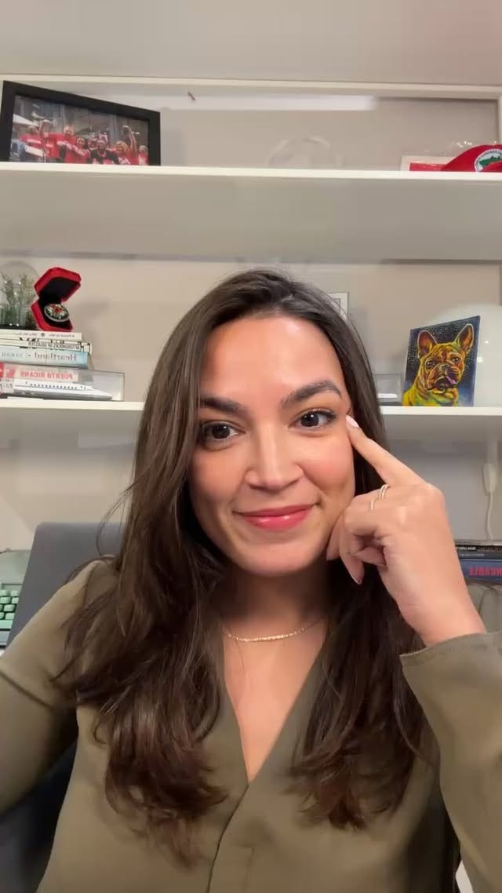
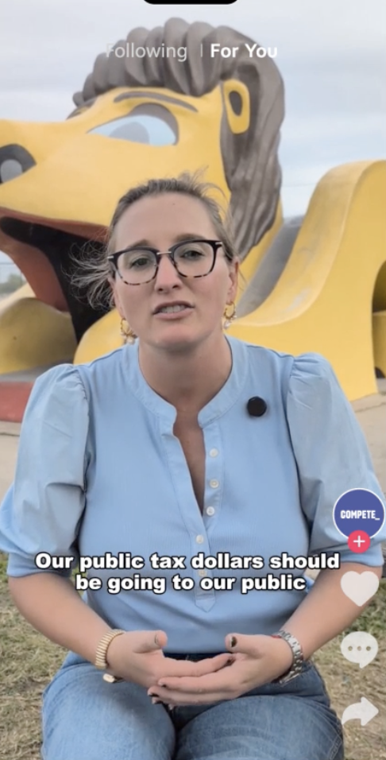
Be Transparent and Real
Perfection in the Imperfection
Show understanding
Share in your community’s frustrations
Share in your community’s wins
Be open and transparent about issues your city may be facing
Ask questions
Take risks! It pays off and builds trust.

Slide 19
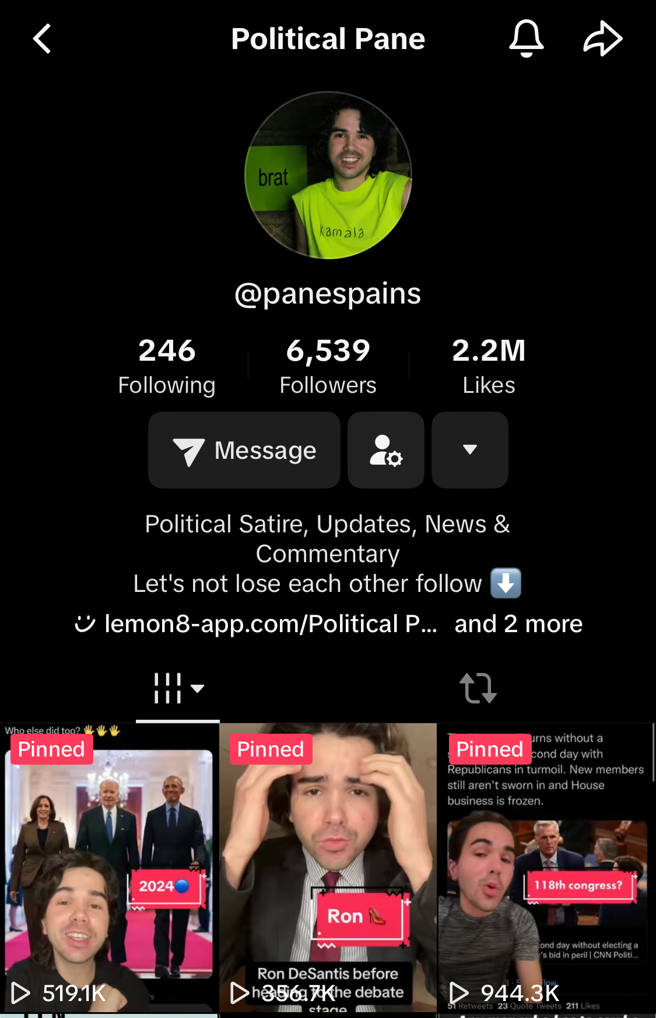
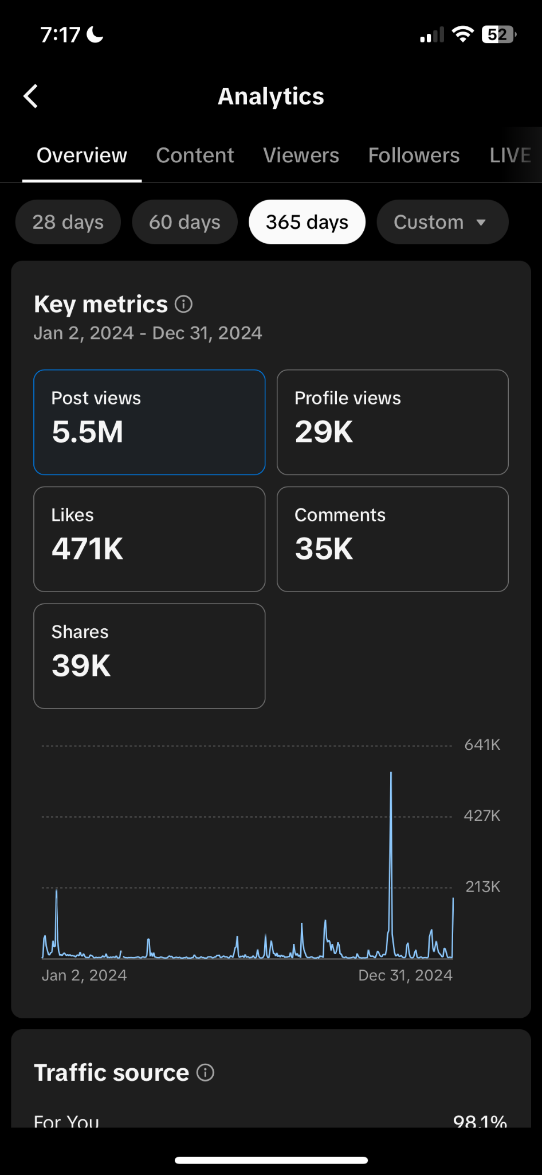
Using Social Media Correctly
Increase your followers, reach and engagements with proven strategies that we know that works.
How? We use them.

Slide 20
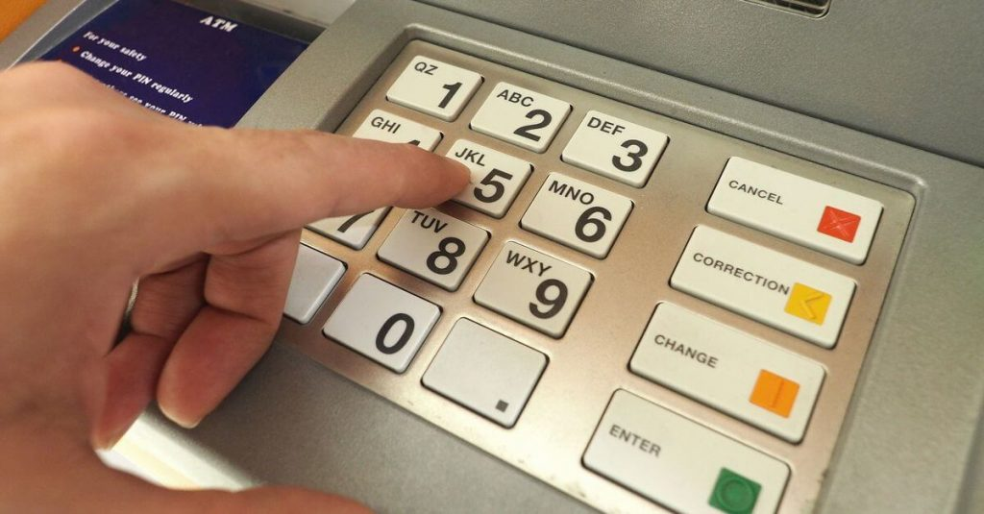
Using Your ATMS
Authenticity- we want your content to sound like you.
Tone - we need to adjust how we speak to people. We don't need a holier-than-thou approach. We need to meet them where they are and at their level.
Messaging - we need to hit your main talking points over, and over, and over again. We need to bring things back often to your main points and make them a part of your image.
Shareability - we want your content to spread and spread far. That means users, followers, and voters need to and want to share what it is that you are talking about, when creating anything we need to think about why should joe shmoe put this in their story. Why is Lisa sending this to the group chat?

Slide 21
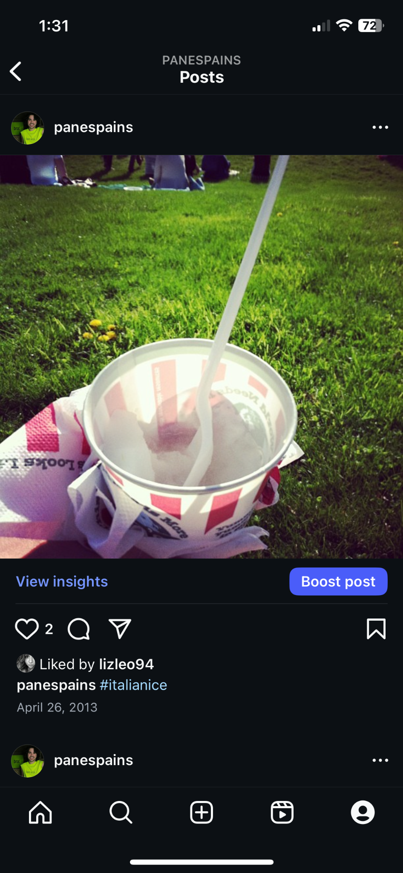
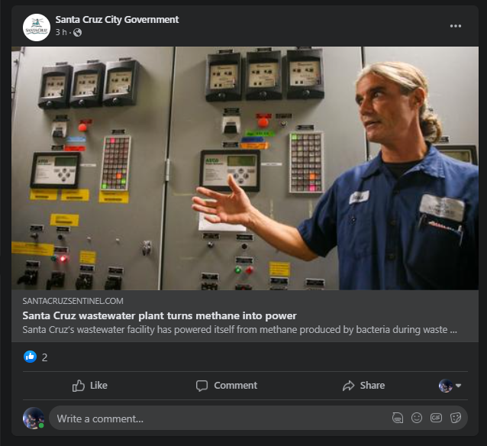
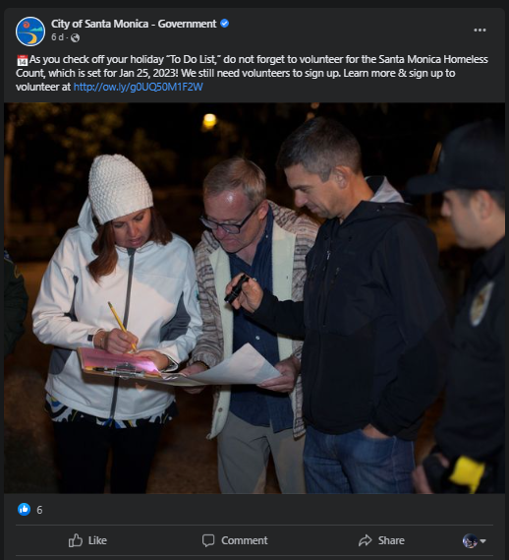
Bad Socials
Non descriptive and Cheugy
What happens when we don't use our ATMS?
A link with no context
Not eye catching/ Can’t see a face
Uninspiring and forgetful
No cohesive brand/identity. Simple changes could drastically improve these posts

Slide 22
Tips and Tricks to improve your socials
When taking photos or filming, make sure to not point the camera directly into the sun
It didn't work when we used film cameras and it doesn't work now on iPhones
We want the light/Sun to be on our subject and what we are capturing
If you're filming a video, don't do it in a loud or noisy place.
No filming next to busy roads, construction sites or that one loud coworker
Where is this going?
Before even snapping a shot we gotta think about where’s this posting to. Are we putting this in our story, making a Reel or Tiktok, or just taking a quick pic for the gram and Facebook. Where we post will dictate how we shoot because different applications or features require different aspect ratios

Slide 23
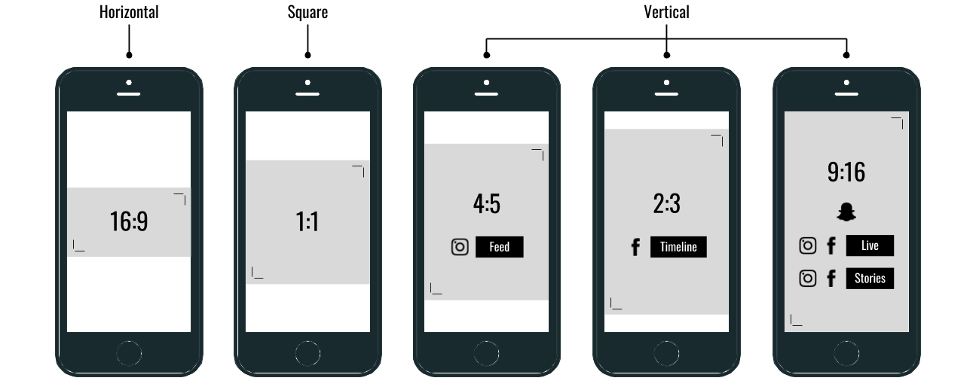
Tips and Tricks to improve your socials
What’s an aspect ratio?
I'm so happy you asked. This is the sizing that we would use and for most things you have a few types to keep in mind.
Timely
Post at the right times of day 8am-10am or 6pm-9pm
Engaged
Speak to your audience engage with them and listen to their feedback
But also block and ignore the trolls! Protect your peace.
Tag
Give credit and shout outs
BEWARE handles can be different from platform to platform and you might be tagging the wrong person if you are not careful.

Slide 24
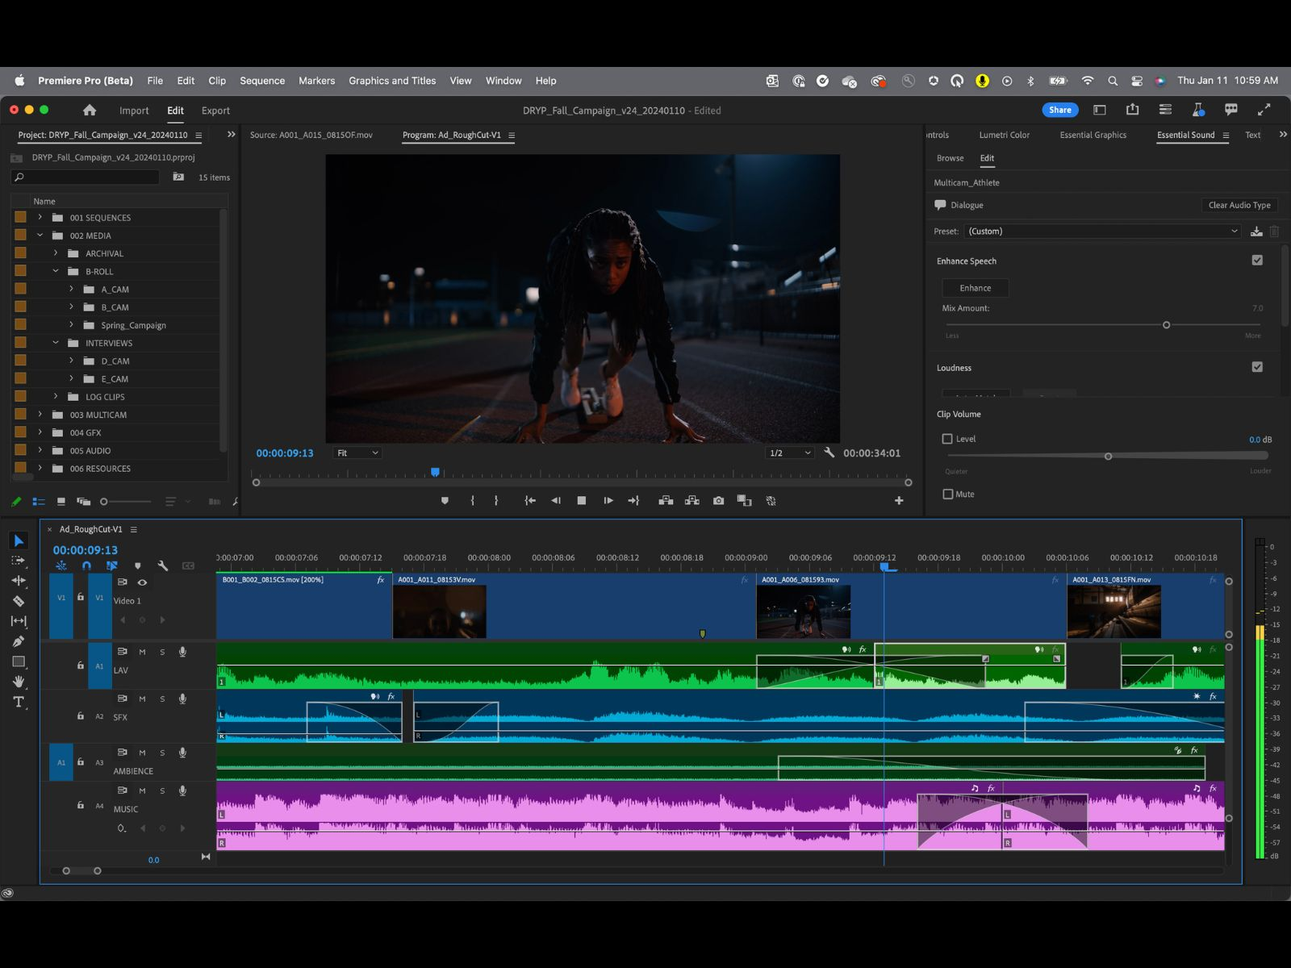
Tips and Tricks to improve your socials
Edit your videos!
Simple editing makes a world of difference. All of us born before 2000 guess what we have what's called the millennial pause. We wait for that red light on a camcorder or for someone to say ACTION before we start talking. GenZ doesn't do that they just go. We have approx 3 seconds to capture a viewer before they scroll away. Let’s not waste it on us staring fish-faced into the camera.
Take a look at these 2

Slide 25
Tips and Tricks to improve your socials
Unedited and (unfortunately) Posted video
Took 3 seconds before Speaking
No supplementary material
No subtitles
Kept filming after speaker was done

Slide 26
Tips and Tricks to improve your socials
Edited video that took 10 mins to do
Added:
Subtitles
A place for supplementary materials
Trimmed out dead space to get to what is important

Slide 27
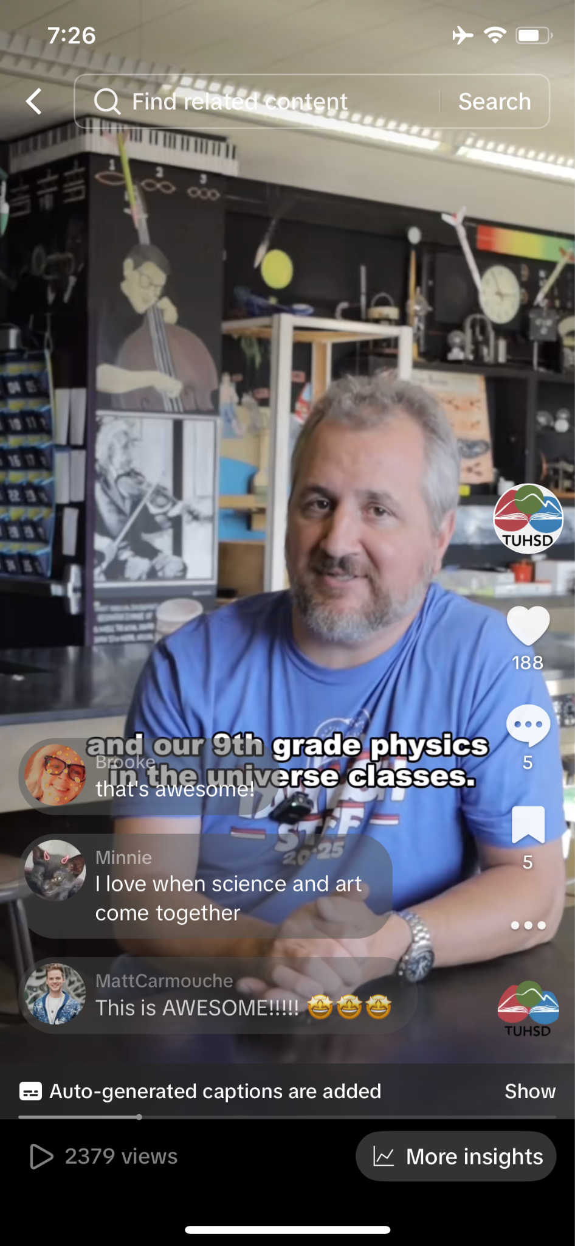
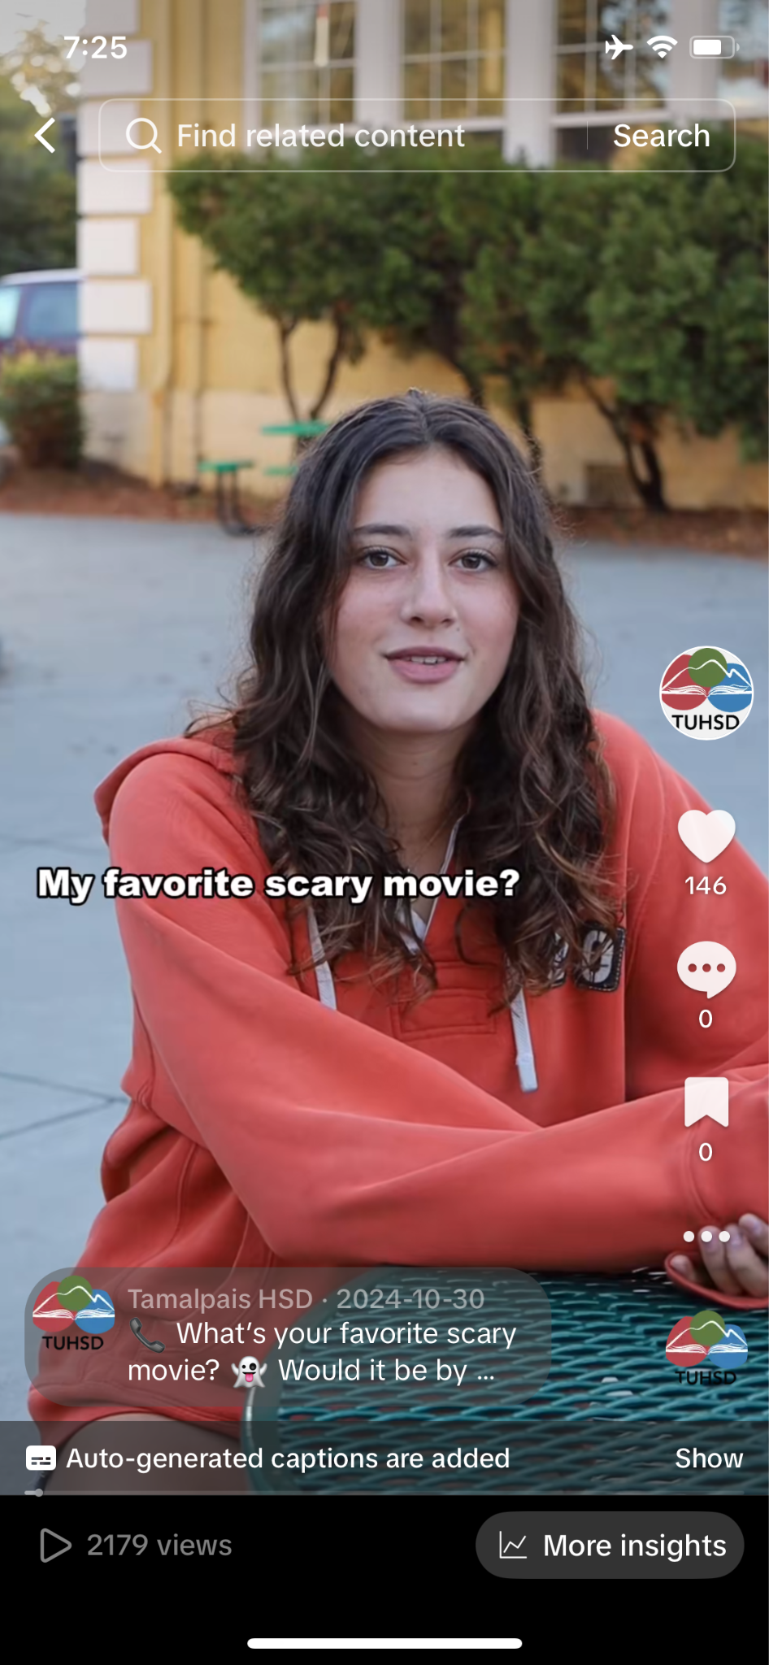
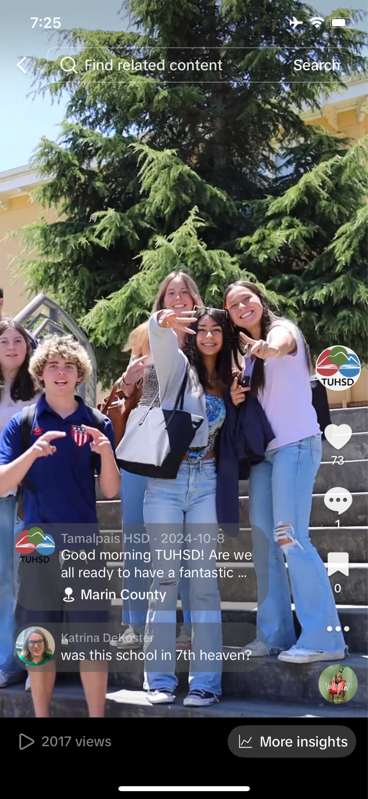
Good Socials Moving forward
As we move forward into 2025 and beyond we can guarantee that having a robust and strategic social media presence will be vital and quintessential to any elected, city or causes success.
Users want to build a relationship with those that they follow, to trust them for accurate information as we hurtle through the disinformation age.
We want to emulate good posting like these >

Slide 28
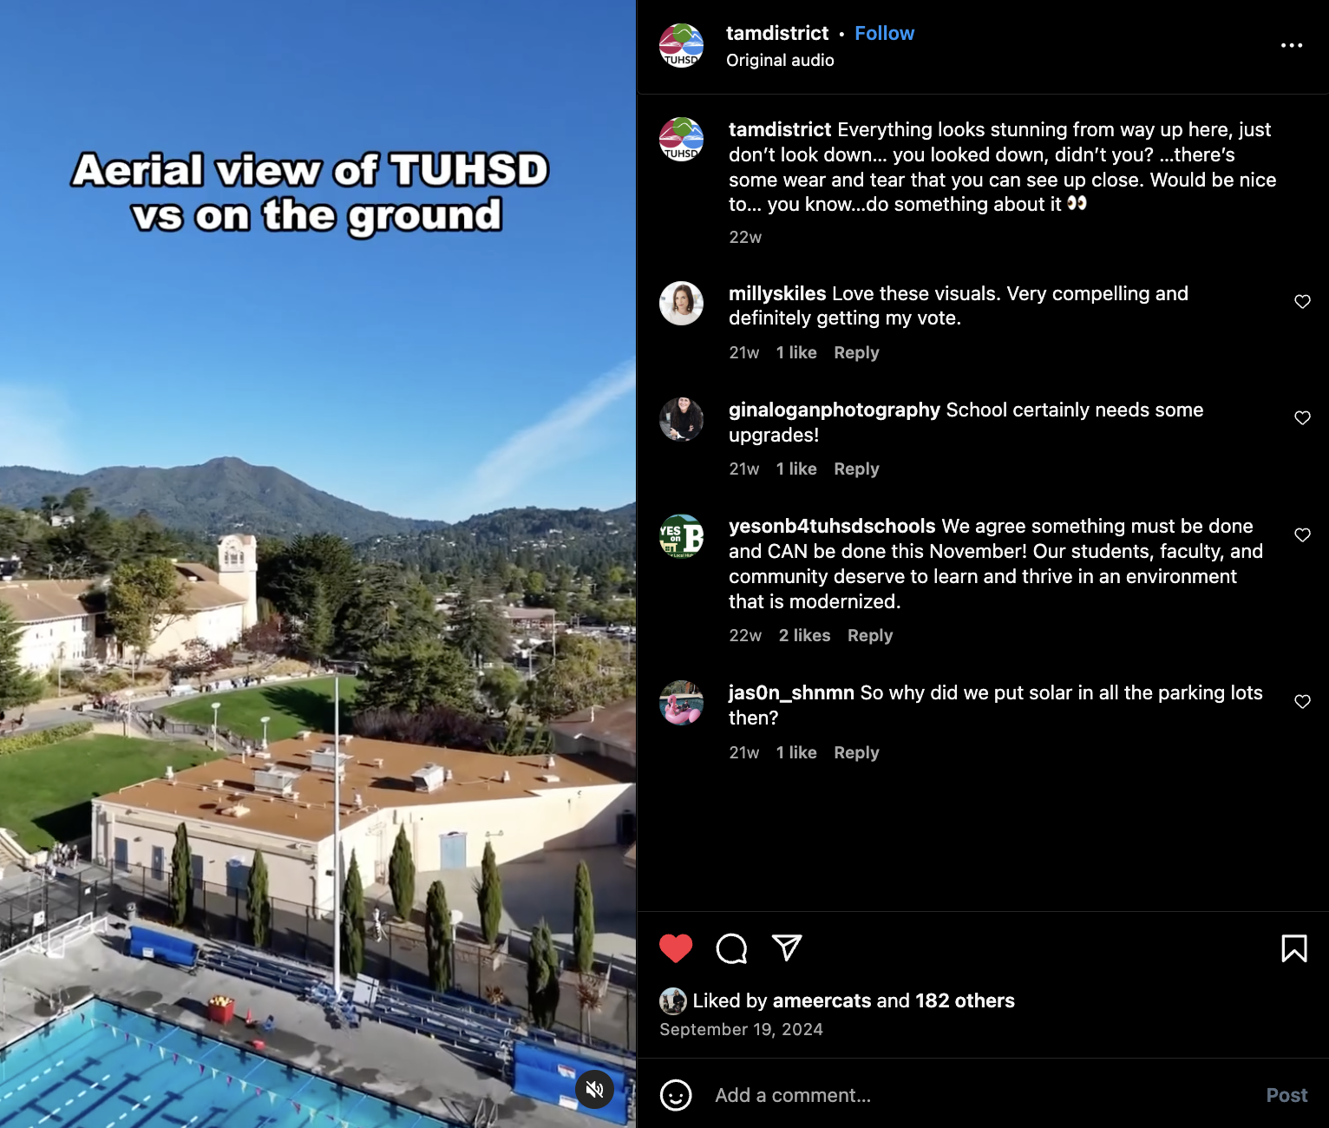
Posts that speak to their audiences, are current with trends and are visually appealing. We have a small window to capture people and these posts have been successful at doing just that.

Slide 29
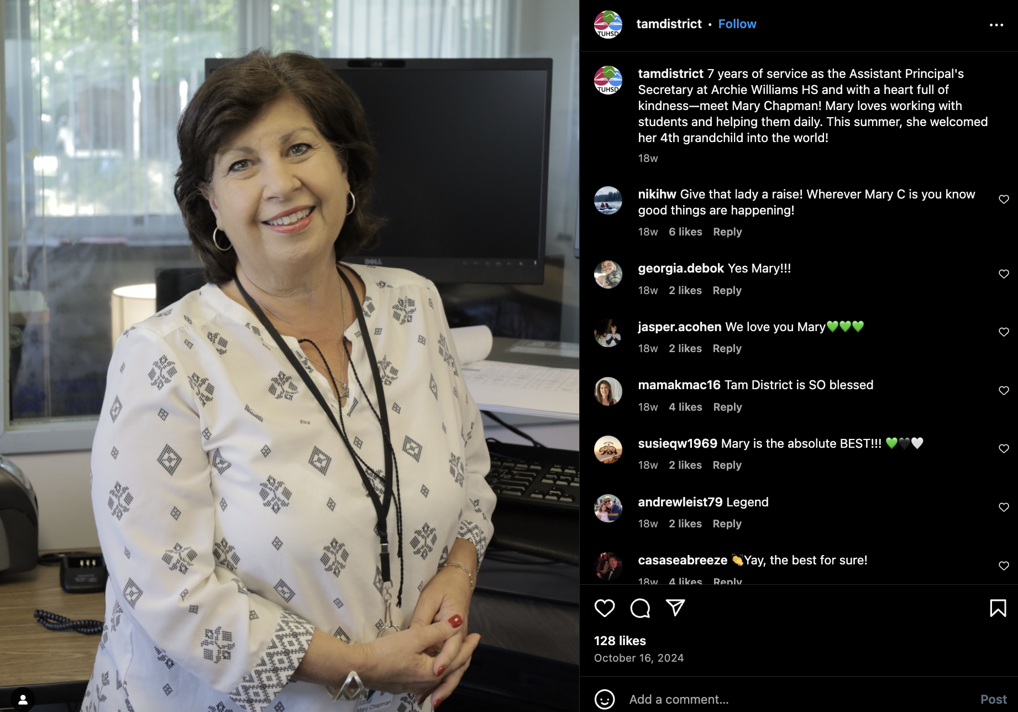
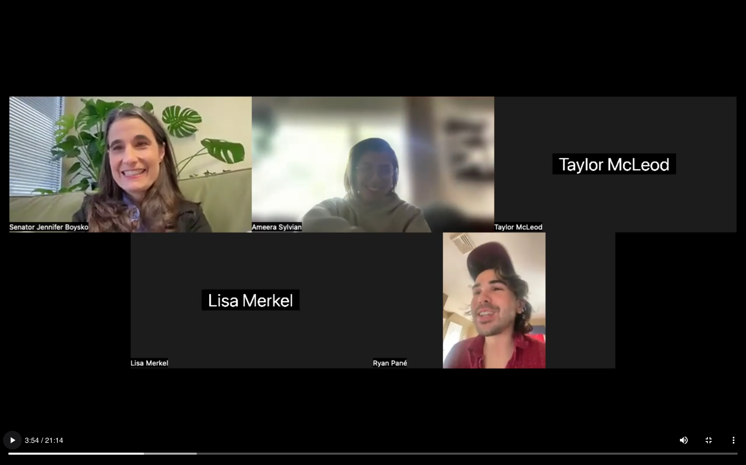
Capturing Content
Remote filming: All that’s needed is a laptop and iPhone. iPhone films and from the laptop, we direct.
Videographers: Sending a skilled professional to the locations needed with a shot list, scripts, and directions to capture high-quality footage.
Remote Filming
Videographer Captured

Slide 30
Capturing Content
Turning the Tides
“ The opposition is backing down after that last video”
Showed the public the deterioration of the facilities and made it difficult to counter
Use what is at your disposal- Volunteers, Local TV stations
No excuses for not capturing good content

Slide 31
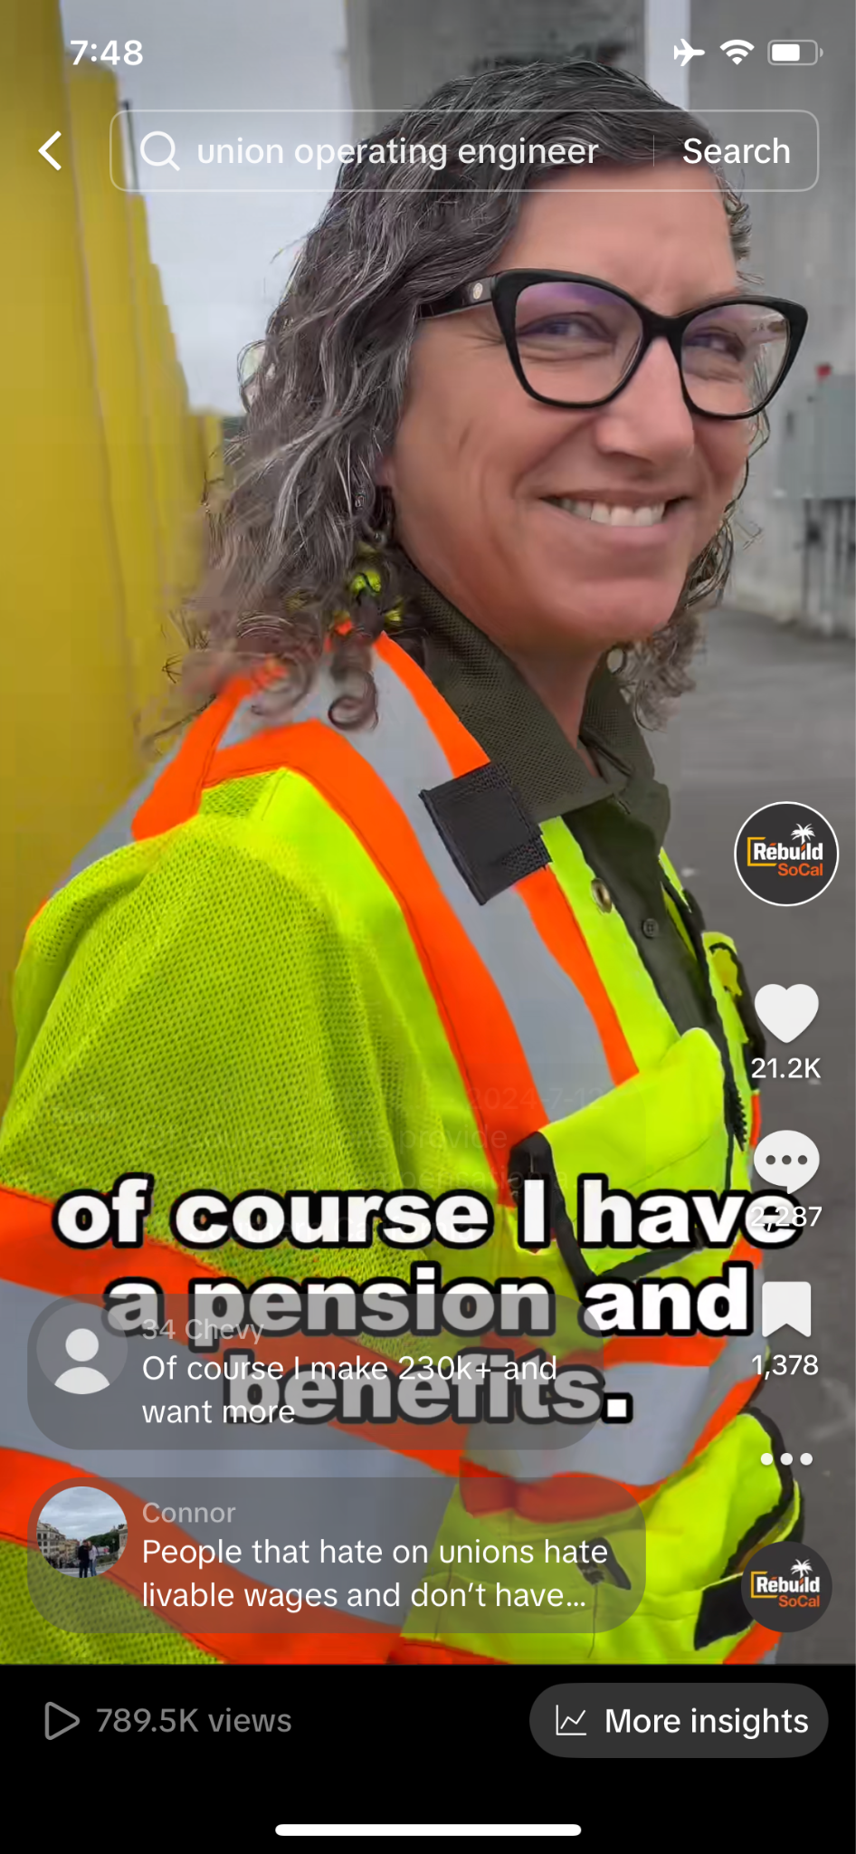
Snap it, Tweet it, Repost it, Gram it, TikTok it. Just Post it
Turning the Tides
Are videos needed?
YES Platforms are pushing video.
People are not reading long articles or op-eds.
Take risks, be creative and watch it pay off —--------->
Apply what we have learned

Slide 32
Tamalpais Unified High School District Case Study

Slide 33
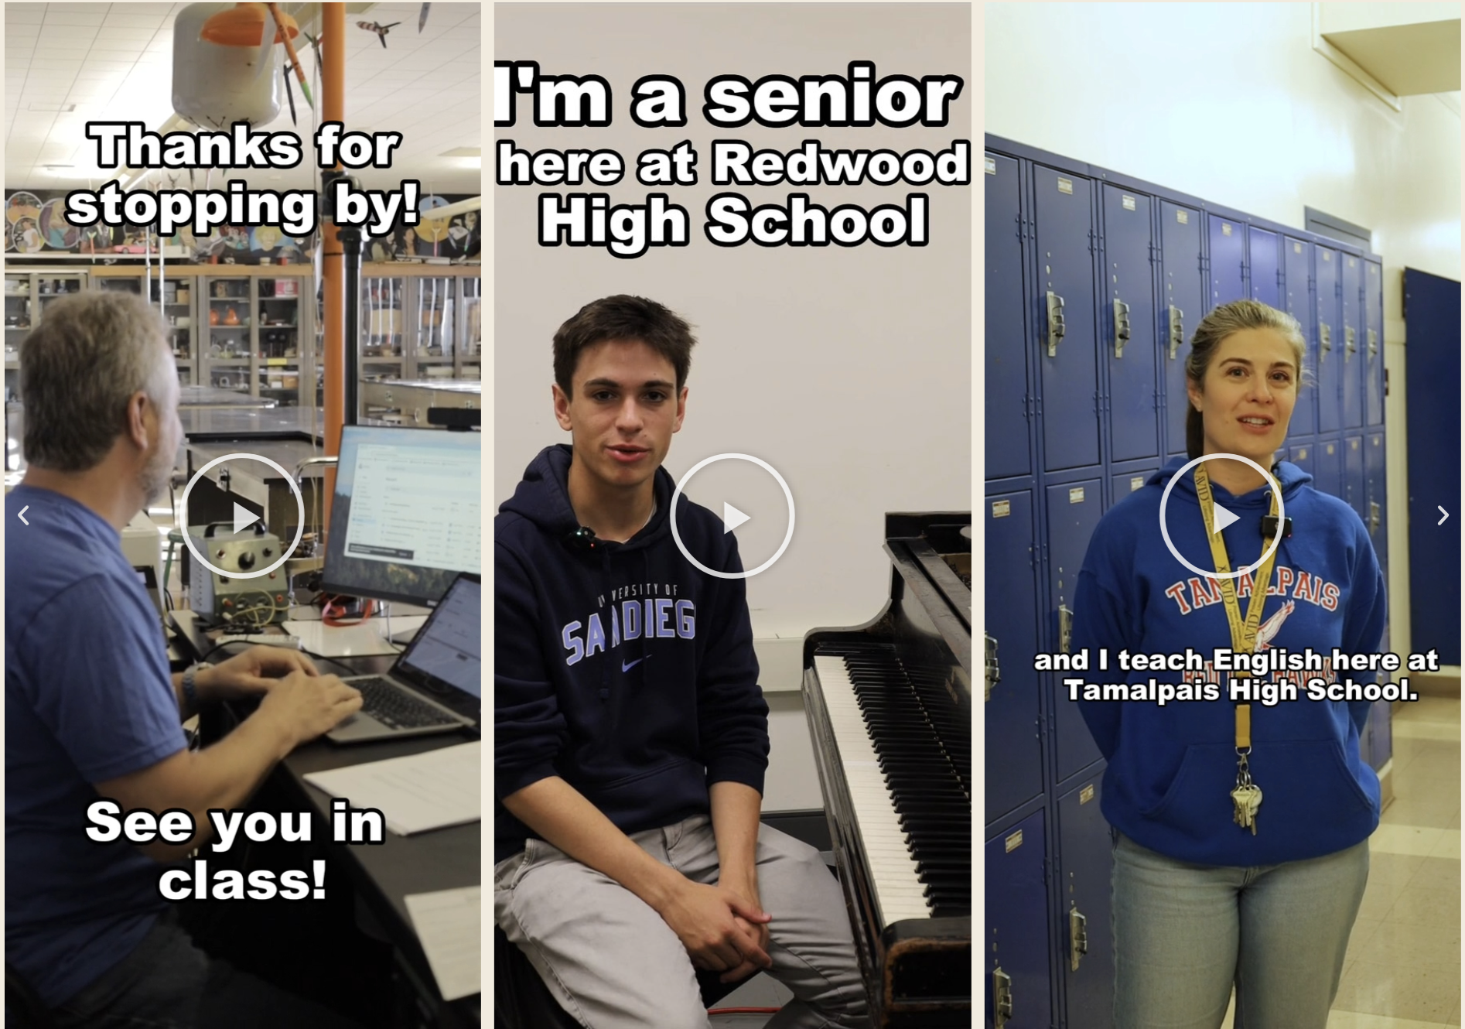
Tamalpais Unified High School District Case Study
A bond measure that had lost months earlier passed with a little help from good socials.
Started from zero
Phase 1: Build trust with the community by showcasing students, faculty, and school
Phase 2: Introduce the necessary repairs and bond measure
Showed authentic, raw, content that reinvested the community into the kids, teachers, and school

Slide 34
Tamalpais Unified High School District Case Study
A bond measure that had lost months earlier passed with a little help from good socials.
Brother EW video turned the tides: opposition backed off after
Created community pride and then asked “why do these kids we care so much about have to be in a school in desperate need of upgrades and repairs”

Slide 35
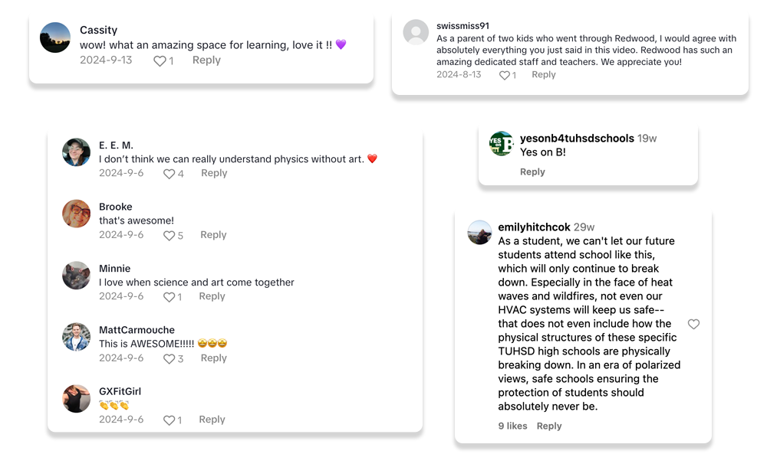
Tamalpais Unified High School District Case Study

Slide 36
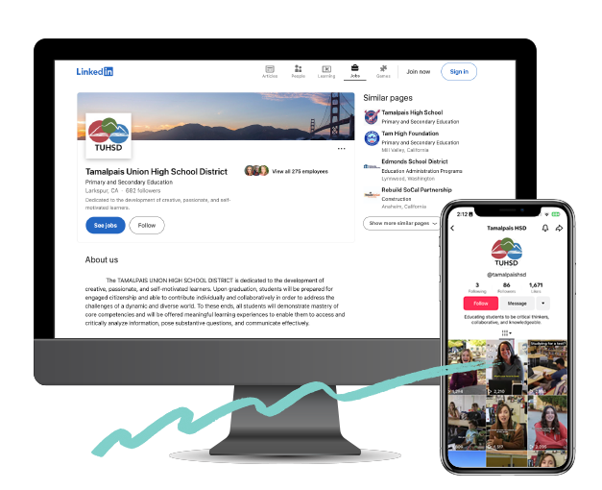
Tamalpais Unified High School District Case Study
Takeaways
Social media programs not only help build a conversation and community - you can influence
When people trust what you are doing, they are much more likely to pass your next big thing”
Cities! You are losing out on a big opportunity to engage and influence. Beat the negative narrative, shape the conversation, and influence your community. Close the engagement gap and experiment with your social media presence today.

Slide 37
Thank you

