Slide 1

What Do Your Employees Really Want?
Zhikun Liu, Ph.D., CFP®
Vice President, Head of MissionSquare Research Institute

Slide 2

Aspects of What Your Employees Care About
The Ripple Effects of Student Loan Debt
Retirement Plan Participation and Understanding
Default Retirement Plan Options
Job Security and Satisfaction
What Factors Attract Talents
Succession Planning
Financial Security and Stress
Notes:
Outline of the presentation.

Slide 3
Factors Attract Talents
What motivates employees and attract them to work in the public sectors?

Slide 4

The 35 and Under in Public Sector Survey
March/April 2023 national online survey of 1,004 S/L government employees aged 35 and under.
Assessed motivations for working in the public sector, views on employee benefits, retirement, morale, job satisfaction, and retention issues.
Data weighted by gender, income, race, and industry type to reflect the distribution of the S/L government workforce according to the U.S. Census Bureau’s Current Population Survey and the U.S. Census of Governments.
Source: 35 and Under in the Public Sector: Why Younger Workers Enter and Why They Stay (or Don’t) – MSRI 2024
Notes:
Introduce the survey on the screen.

Slide 5
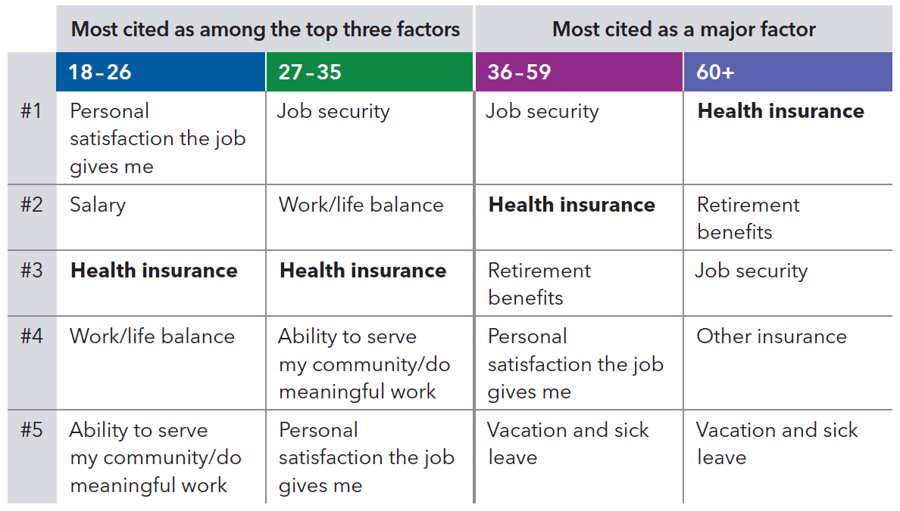
Factors Attract Workers in the Public Sector
Source: 35 and Under in the Public Sector: Comparisons by Age, 2024 – MSRI 2024
Notes:
Look at the data from our survey of employees 35 and under and our more general survey on morale and retention, the priorities and career motivations differ by age group. (Discuss the top priorities in each group, which generally are NOT focused on wages first.) Hope we can gain actionable insights to address financial concerns, enhance recruitment strategies, and develop retention initiatives tailored to the needs of each age cohort.

Slide 6
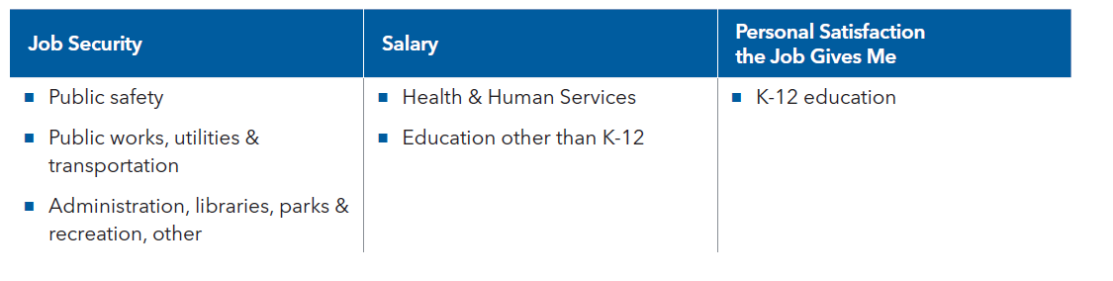
Motivation by Occupations
Top ranked factors that attracted you to work in the public sector
Source: 35 and Under in the Public Sector: Comparisons by Industry, MissionSquare Research Institute, 2024
Notes:
When participants were asked about their top-ranked motivation factor to work in the public sector, different industry workers gave different answers. For example, public safety sector employees say that job security is the #1 factor that attracts them to work in the public sector.

Slide 7
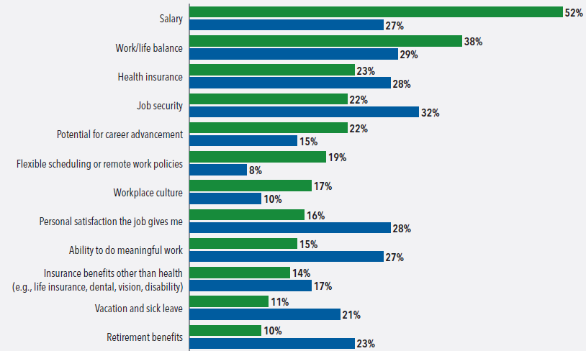
Motivation
Please rank the top 3 factors that attracted you to work in your current employment sectors.
Source: Student Debt Impacts on Public and Private Sector Employees, MissionSquare Research Institute, 2024
Notes:
Why employees selected their sector of the job market is also a key factor in their likelihood of remaining. Among private sector employees, the top three priorities most often included salary (52%), followed by work/life balance (38%) and health insurance (23%). By comparison, when this same question was asked as part of MissionSquare Research Institute’s study of public employees 35 and under, the top priorities were job security (32%), personal satisfaction (28%), and tied for third, salary and the ability to do meaningful work (27%).

Slide 8
Financial and Job Securities
Financial stress, job security and satisfaction, long-term plans, and succession planning

Slide 9
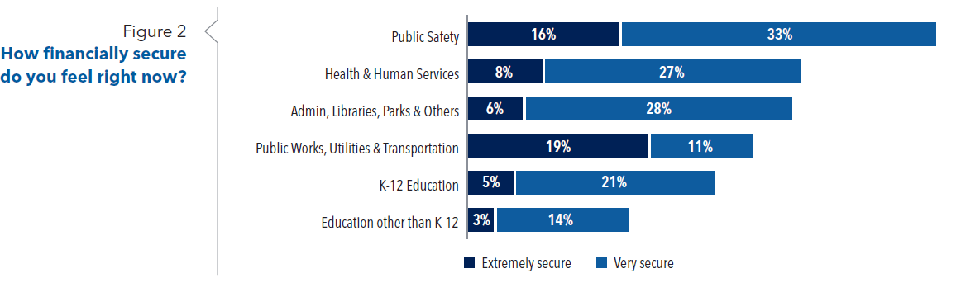
Financial Security
How financially secure do you feel right now?
Source: 35 and Under in the Public Sector: Comparisons by Industry, MissionSquare Research Institute, 2024
Notes:
With 49% of public safety sector workers indicate that they feel financially secure (extremely + very), they ranked top among all the public sector employees in our survey.

Slide 10
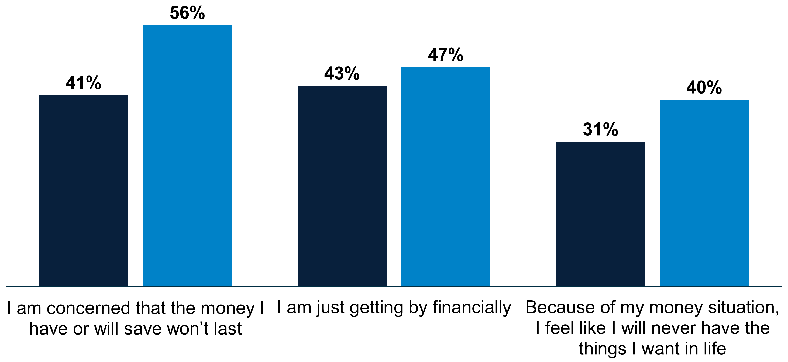
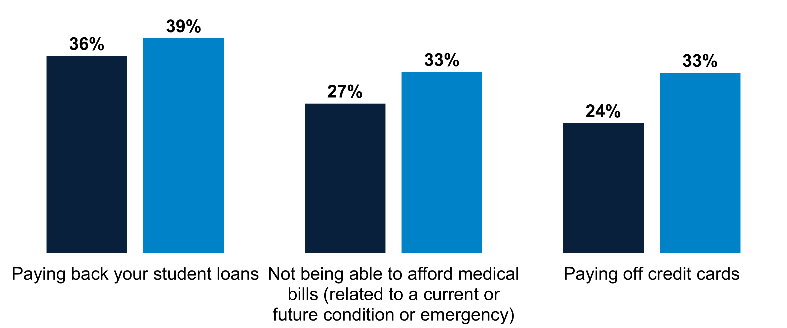

Financial Stress
Describe your financial situation and stress (concerned about…)
Source: Student Debt Impacts on Public and Private Sector Employees, MissionSquare Research Institute, 2024
Notes:
The sources of stress public sector employees include personal finances, the economy, and their work.
In addition, women were more likely to express stress about student loans and other aspects of their finances…
In part this relates to investment behavior and a tendency to be more risk-averse, but it also relates to very concrete differences by gender in earnings and retirement benefits.

Slide 11
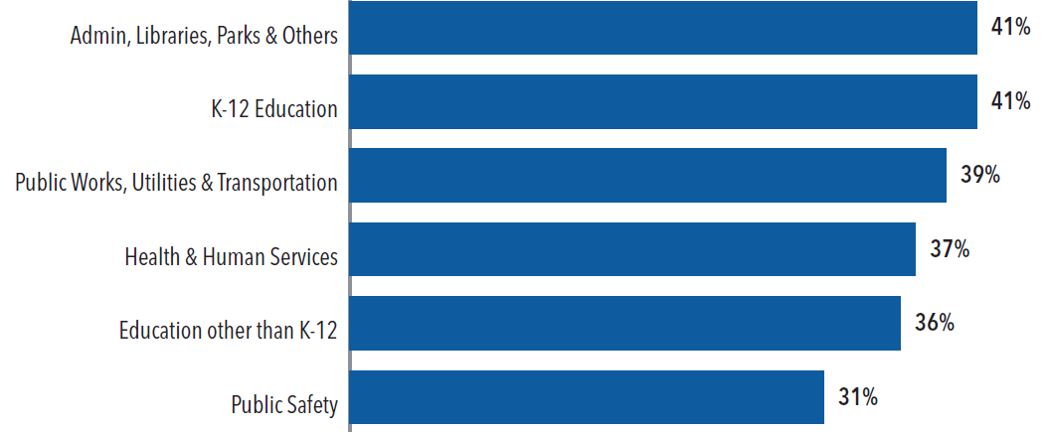
Job Security
Are you considering changing jobs in the next 2 years or sooner?
Source: 35 and Under in the Public Sector: Comparisons by Industry, MissionSquare Research Institute, 2024
Notes:
The public safety sector worker has the lowest turnover rate, with only 31% of young workers in this sector considering changing jobs in the next couple of years or sooner.

Slide 12
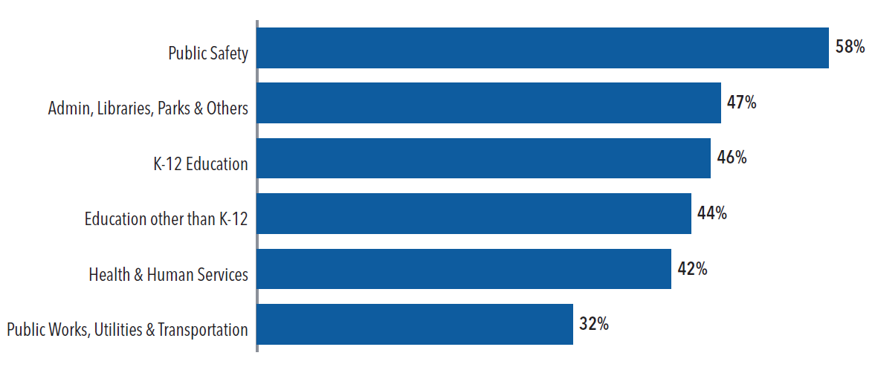
Job Satisfaction – Longer Tenure
Do you intend to stay in public service as a career until you retire?
Source: 35 and Under in the Public Sector: Comparisons by Industry, MissionSquare Research Institute, 2024
Notes:
With more 58% of workers saying that they intend to stay in public service as a career until they retire, public safety is ranked #1 in job satisfaction in terms of longer tenure.

Slide 13
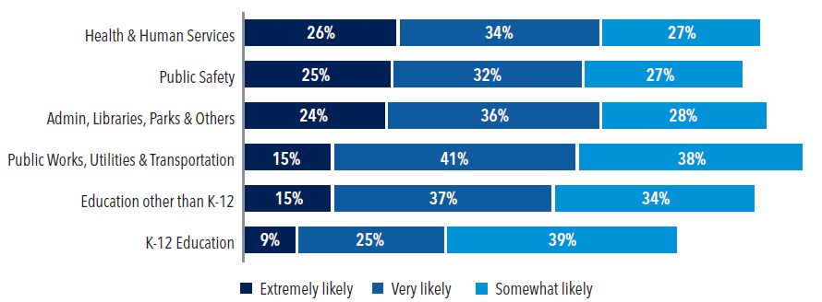
Recommendations and Longer-Term Plans
Likelihood of recommending the public sector to a friend or family member
Source: 35 and Under in the Public Sector: Comparisons by Industry, MissionSquare Research Institute, 2024
Notes:
When asked about the “Likelihood of recommending the public sector to a friend or family member,” 25% of public safety sector employees said they were “extremely likely” to recommend, 32% “very likely,” and 27% “somewhat likely.” It ranks second next to the health and human services sector.

Slide 14

2024 Workforce Survey
The collaborative efforts of MissionSquare Research Institute, PSHRA, and NASPE
Tracking trends from the Great Recession (2009) through the Post-Pandemic (2024).
Helping governments better attract and retain talented public servants.
Source: State and Local Government Workforce Survey Report, 2024 – MSRI 2024
Notes:
Introduce the survey on the screen.

Slide 15
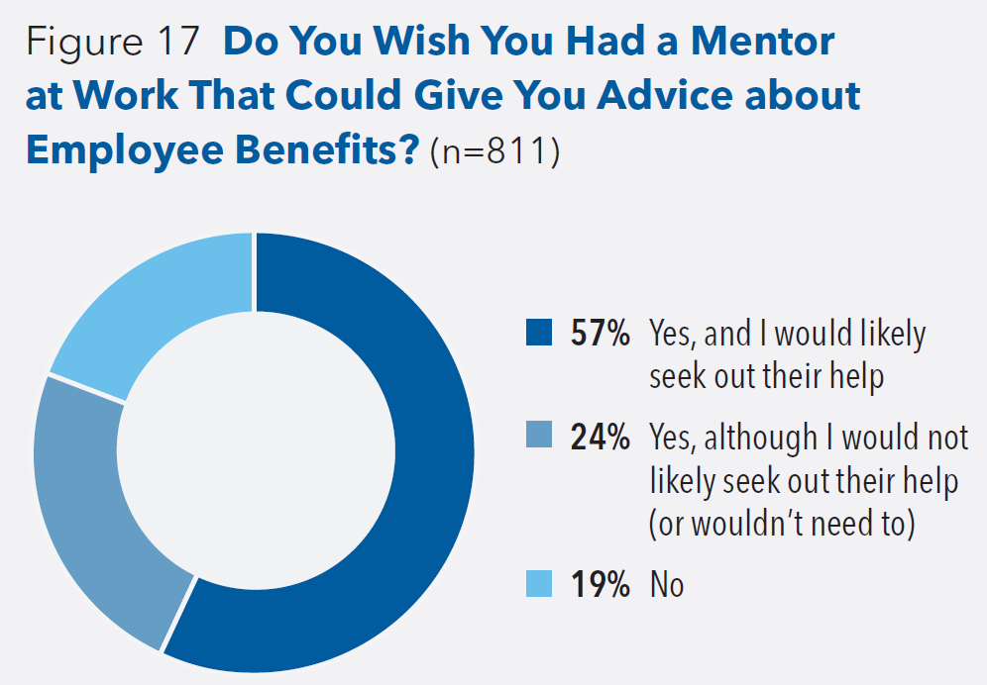
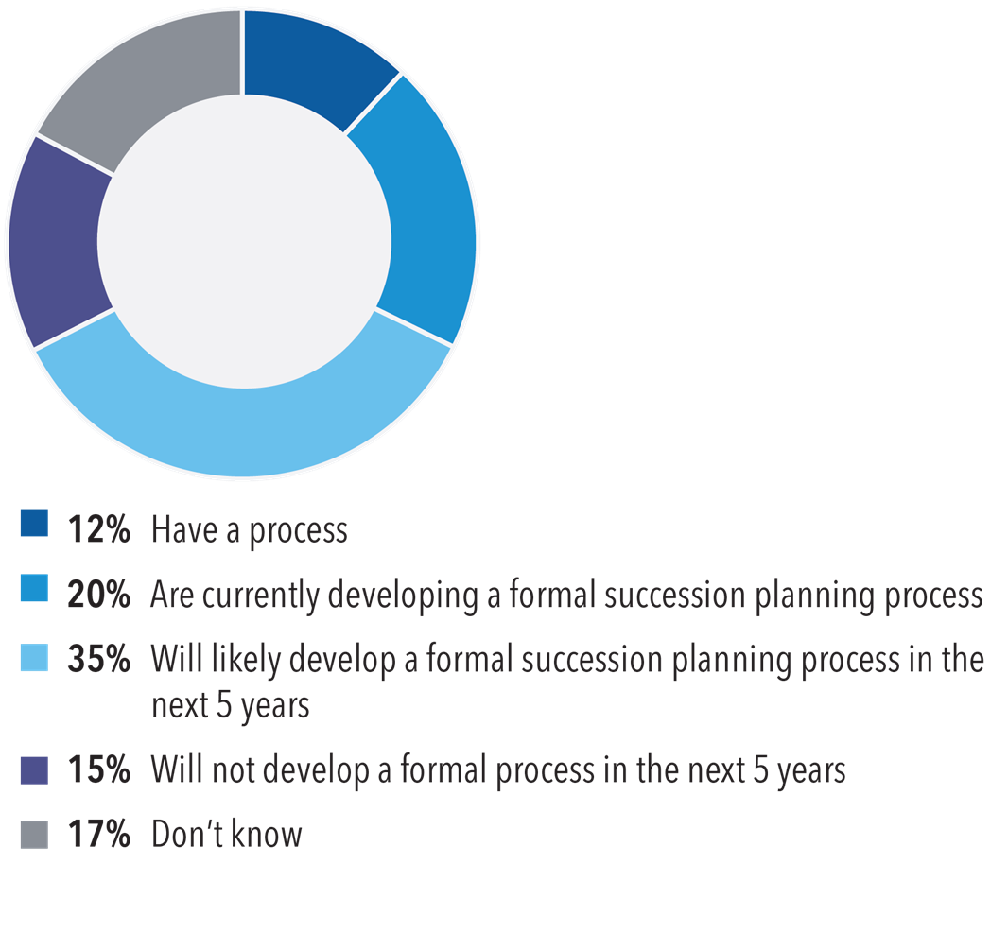
Mentoring and Succession Planning
Mentoring Succession Planning
81% of those not mentioning a mentor wish they had a mentor at work who could give them advice
32% have or are developing a process for succession planning
Source:
35 and Under in the Public Sector: Comparisons by Industry 2024,
State and Local Government Workforce Survey Report, 2024, – MissionSquare Research Institute
Notes:
Mentoring is a key issue in employee engagement, and it declined during the pandemic – from 25% with mentoring programs in 2018 to 7% in 2023. That bounced back somewhat in 2024 to 12%.
In the 35 and under survey, 81% of those who did not have a mentor at work said they wished they had one they could turn to for benefits advice.
One of those very important priorities that we would suggest placing greater emphasis on is succession planning. As the data we shared pointed out, there is both:
A large wave of retirements coming, and
A contingent of younger staff who are leaving because they don’t feel they have sufficient opportunities for advancement
Given that, and the fact that 11% had a succession planning process in 2016, there should probably be a lot more than 12% who have a plan in place today. That’s a reason for Deferred Retirement Option Plan (DROP) w/ public safety. (Drop was offered in pockets and is not widely adopted yet.)
If governments are going to be ready when the wave of retirements hits or even as other changes come to their workforce, they will need to emphasize that succession planning is not just an important priority for the future but an essential step to take now.
Planning for succession may involve preparing a larger cohort of multiple qualified staff who are given access to professional development, cross-departmental teams with leadership opportunities, job rotations, mentoring, and other support.

Slide 16
Talk Openly (debt is not an off-limits topic)
Student loan debt and its ripple effects

Slide 17

The 2024 Student Loan Debt Survey
May 2024 national online survey of 1,001 state and local government employees and 1,035 private sector employees.
Assessed workers’ perceptions of student loan debt and its impact on their career, morale, and personal finances.
Data weighted by gender, income, race, and industry type to reflect the distribution as found in the U.S. Census Bureau’s Current Population Survey and the U.S. Census of Governments.
Source: The Ripple Effect of Student Debt: Shaping Careers, Financial Choices, and Well-Being in Public and Private Sectors, MissionSquare Research Institute, 2025
Notes:
Introduce the survey on the screen.

Slide 18
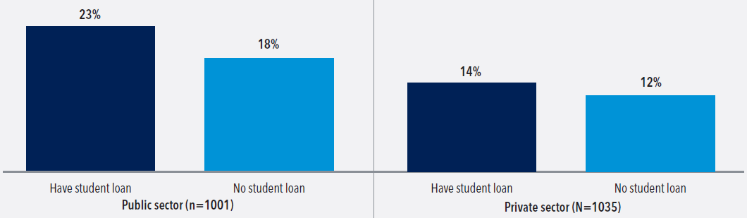
Student Loan Debt and Work Morale
Percentage of employees reporting negative work morale by student debt status and sector
Source: The Ripple Effect of Student Debt: Shaping Careers, Financial Choices, and Well-Being in Public and Private Sectors, MissionSquare Research Institute, 2025
Notes:
Illustrates the relationship between student debt and work morale, with a statistically significant effect found in the public sector. Specifically, public sector employees with student debt are more likely to report negative work morale than their counterparts without the debt.

Slide 19
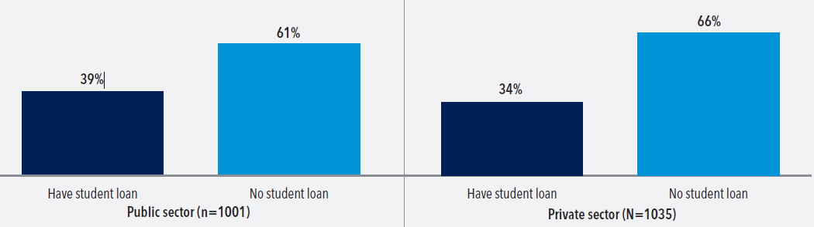
Student Loan Debt and Job Tenure
Would like to stay with their current employer, by student debt status and sector
Source: The Ripple Effect of Student Debt: Shaping Careers, Financial Choices, and Well-Being in Public and Private Sectors, MissionSquare Research Institute, 2025
Notes:
Shows that student debt holders are less likely to remain with their current employer than non-holders of the debt, with the public sector more susceptible to retention challenges.
“Grass is greener on elsewhere.”

Slide 20
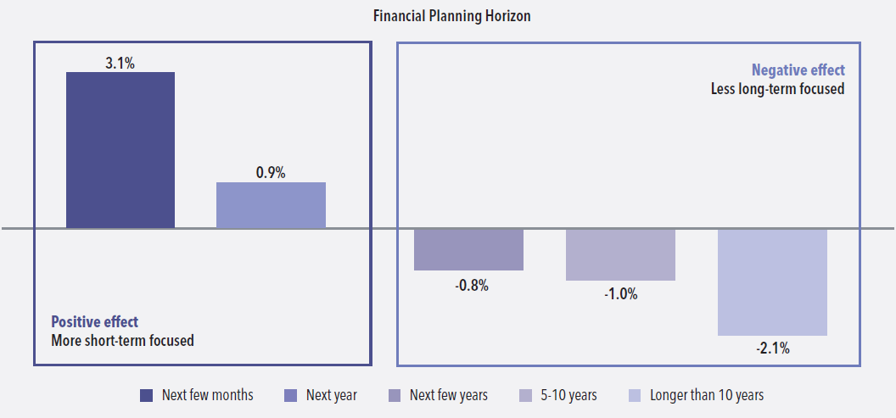
Student Loan Debt and Financial Planning Horizon
Student debt’s impact on financial planning horizon
Source: The Ripple Effect of Student Debt: Shaping Careers, Financial Choices, and Well-Being in Public and Private Sectors, MissionSquare Research Institute, 2025
Notes:
Illustrates the effect of student debt on the financial planning horizons of student debt holders compared with those without student debt. Having student debt is associated positively with short-term financial planning horizons (next few months and next year) and negatively with long-term planning horizons (next few years, 5-10 years, and longer than 10 years).

Slide 21
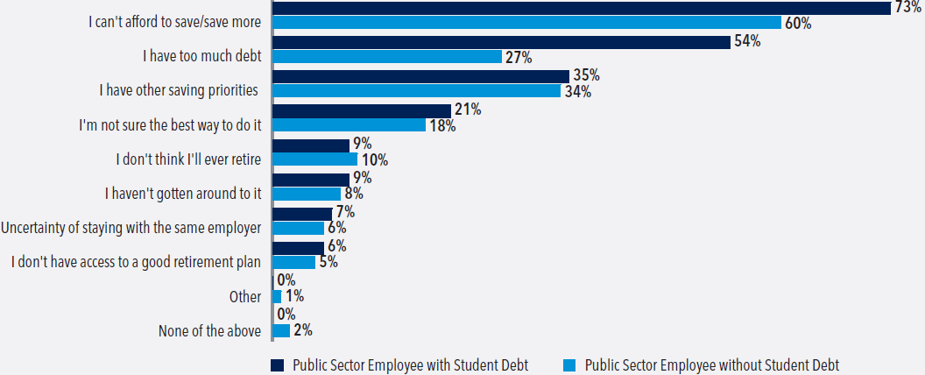
Student Loan Debt and Savings Adequacy
Reasons for perceived retirement savings inadequacy among public sector employees
Source: The Ripple Effect of Student Debt: Shaping Careers, Financial Choices, and Well-Being in Public and Private Sectors, MissionSquare Research Institute, 2025
Notes:
Reveals that most employees in the public sector cited lack of resources and excessive debt as reasons for perceived retirement savings inadequacy. The survey allowed respondents to select multiple responses.

Slide 22
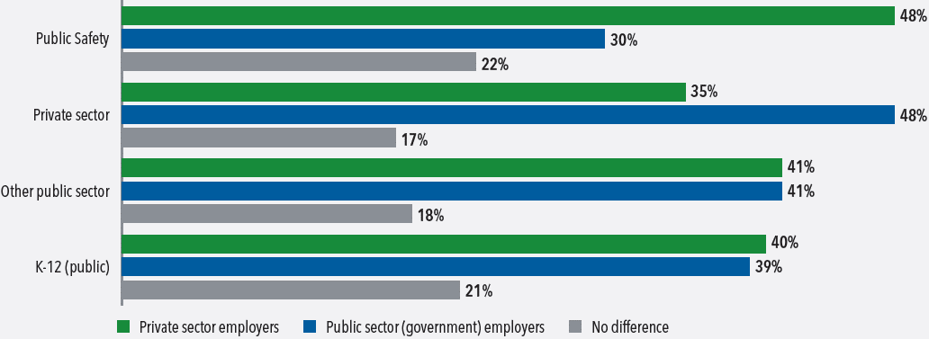
Student Loan Debt and Employer Perception
If you had to guess, what type of employer do you think is more generous with their employees when it comes to helping with student loan debt?
Source: Student Debt Impacts on Public and Private Sector Employees, MissionSquare Research Institute, 2024
Notes:
On student debt assistance, the grass is always greener elsewhere: Private sector employees are more likely to view the public sector as being more generous, and public sector employees are more likely to view the private sector as being more generous.

Slide 23
Retirement Benefits and Decisions
Understanding, participation and employee expectations

Slide 24
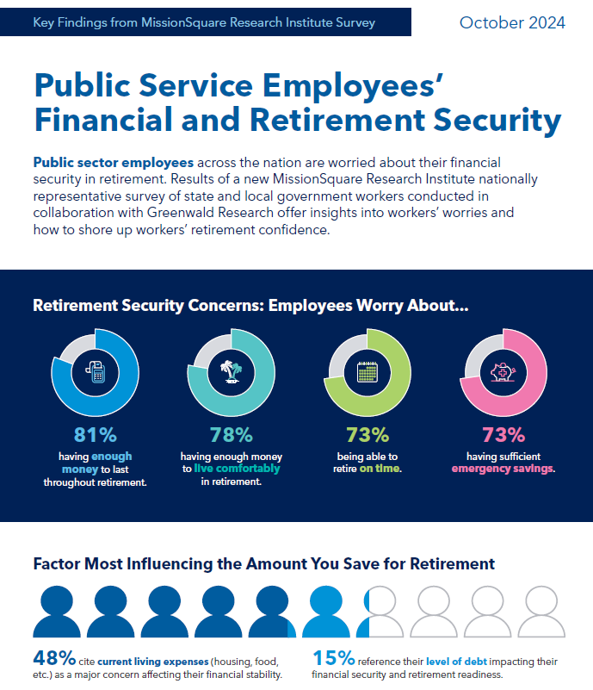
The 2024 Retirement Security Survey
September/October 2024 national online survey of 1,009 state and local government employees.
Assessed S/L public sector workers’ perceptions regarding retirement readiness, financial well-being, workplace benefits, investment, and decumulation strategies.
Data weighted by gender, income, race, and industry type to reflect the distribution of the S/L government workforce according to the U.S. Census Bureau’s Current Population Survey and the U.S. Census of Governments.
Source: Infographic: Public Service Employees' Financial and Retirement Security, MissionSquare Research Institute, 2024

Slide 25
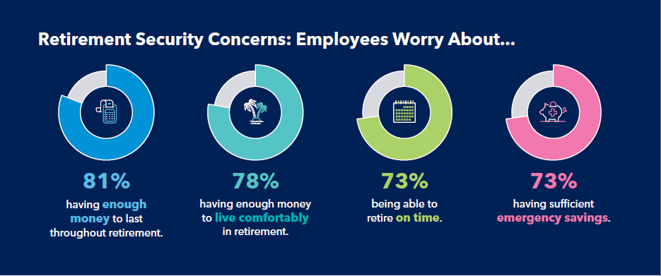
Retirement Security Concerns
The current economic conditions and market volatility make you worry about?
Source: Infographic: Public Service Employees' Financial and Retirement Security, MissionSquare Research Institute, 2024
Notes:
This infographic reveals the vast majority of public employees (81%) are concerned they won’t have enough money to last throughout their retirement years. In addition, 78% say they won’t have enough money to live comfortably in retirement, and only 9% say the benefits provided through their employer are “very sufficient” to meet their retirement needs.

Slide 26
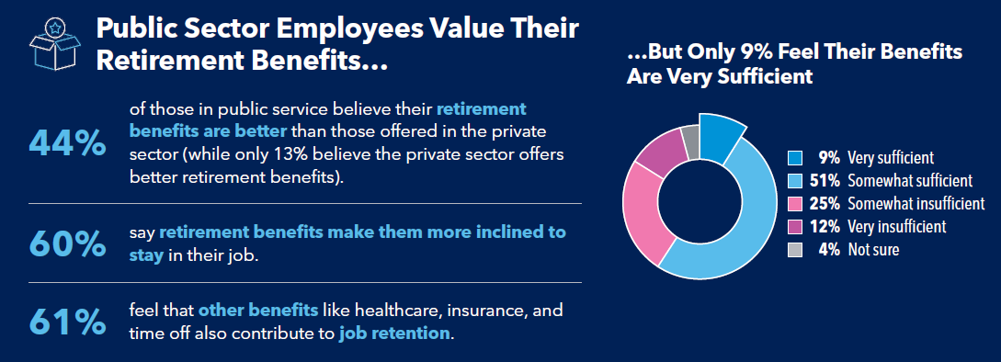
Retirement Benefits Perception
Are employer-provided retirement benefits sufficient to meet your retirement needs?
Source: Infographic: Public Service Employees' Financial and Retirement Security, MissionSquare Research Institute, 2024
Notes:
When it comes to public sector employees’ retirement benefit perceptions, 60% say employer-provided retirement benefits make them more included to stay in their jobs. However, only 9% feel their benefits are “very sufficient,” with 37% indicating “somewhat or very insufficient.”

Slide 27
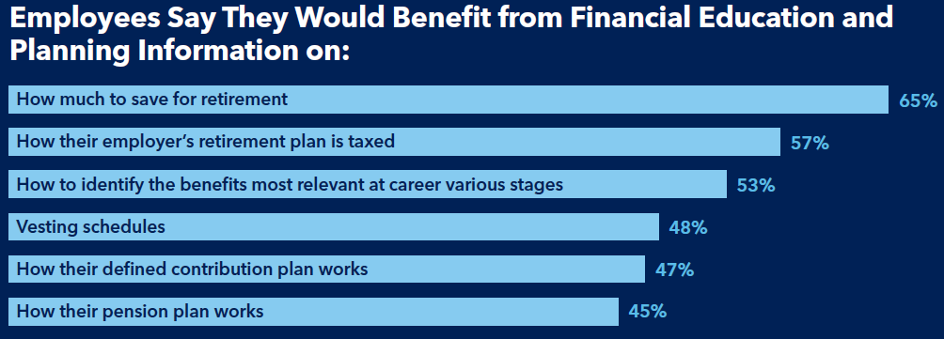
Retirement and Financial Education
Financial planning areas you feel you could use more education or information?
Source: Infographic: Public Service Employees' Financial and Retirement Security, MissionSquare Research Institute, 2024
Notes:
Top 3 Actions Employers Could Take to Bolster Retirement Readiness
1
78%
suggest higher wages would improve their retirement readiness.
2
54%
advocate for better retirement benefits.
3
50%
recommend better healthcare benefits in retirement.

Slide 28
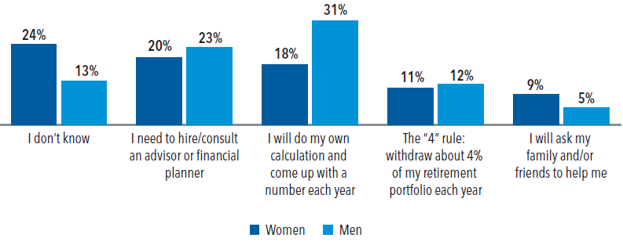
Retirement Spending Strategies
What spending strategies you will use for your retirement portfolio or IRA?
Source: Retirement Security Survey: Breakouts by Gender, MissionSquare Research Institute, 2024
Notes:
Retirement spending strategies breakouts and discussions.

Slide 29
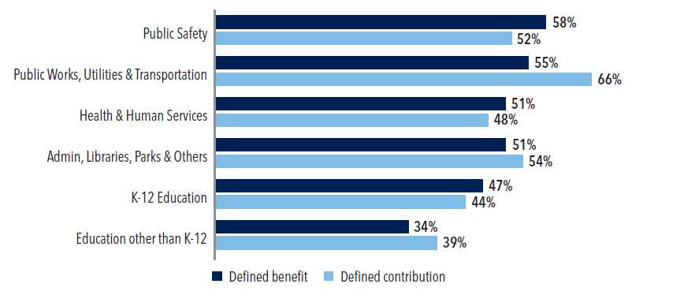
Retirement Plan Participation in Public Sector
Current Retirement Plan Participation by Sectors
Source: 35 and Under in the Public Sector: Comparisons by Industry, MissionSquare Research Institute, 2024
Notes:
Retirement participation rates are not very high among young public sector workers. For example, 58% of public safety employees participate in employer-sponsored defined benefit plans, which ranked #1 in the public sector workforce. As for defined contribution plans, the participation rate for public safety works is 52%, which ranked #3.

Slide 30
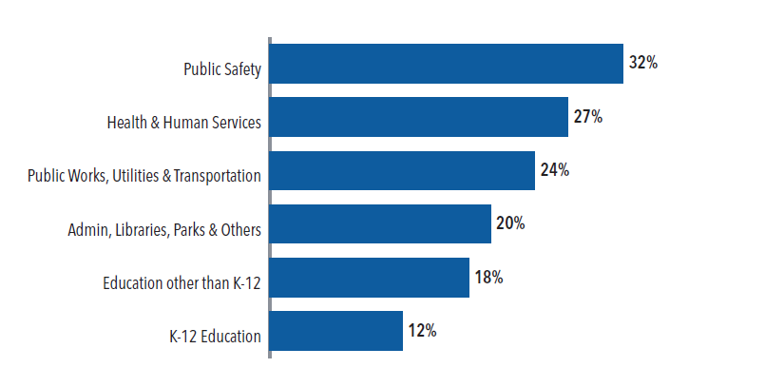
Retirement Benefit Understanding
How well do you understand retirement benefits?
Source: 35 and Under in the Public Sector: Comparisons by Industry, MissionSquare Research Institute, 2024
Notes:
When it comes to retirement benefits understanding, only a small percentage of workers say that they understand the benefits “very well”.

Slide 31
Retirement: Expectation vs. Reality
Distribution of Expected vs. Actual Retirement Age
For Retired Participants between 50 and 60 Years Old in 1992
Source: Retirement Expectations vs. Reality, MissionSquare Research Institute, 2024
Notes:
Retirement security is one of the most important aspects of financial security that the public workforce is facing. The importance of retirement timing decisions to retirees’ economic well-being makes it crucial for policymakers, financial advisors, and plan sponsors to provide effective financial education and services in the years prior to retirement.
The distribution of older Americans’ expected retirement ages is often centered around two Social Security Benefit claiming ages – the early retirement age and the full retirement age. However, actual retirement ages are more likely to be somewhat earlier than expected.

Slide 32
Retirement: Expectation vs. Reality
Actual Retirement Age Minus Expected Retirement Age
Source: Retirement Expectations vs. Reality, MissionSquare Research Institute, 2024
Notes:
Using the actual retirement age minus the expected retirement age, the distribution of these differences also implies a higher likelihood of retiring before expectations.
Are there any gaps between the expected and actual retirement ages?
Yes. Only one in six retired at the age they expected.
Including those who accurately forecast their retirement age, 36 percent retired within one year of the expected retirement age, and about 64 percent retired within three years of range.
Almost 5 percent retired more than ten years away from the retirement age forecasted when the participants were in their 50s.

Slide 33
Retirement: Expectation vs. Reality
COVID-19 Had Little Impact on Retirement Expectations
Source: Retirement Expectations vs. Reality, MissionSquare Research Institute, 2024; Data Source: Health and Retirement Study (1992 – 2020)
Notes:
“Although there is generally a natural upward trend for older American adults to expect a later and later retirement age, this natural trend of delaying retirement has no statistically significant relationship with the COVID-19 pandemic.”

Slide 34
Retirement: Expectation vs. Reality
COVID-19 Had Little Impact on Retirement Expectations
Source: Retirement Expectations vs. Reality, MSRI, 2024; Data Source: Financial wellness assessment by Prudential Financial (2017-2021)
Notes:
This exhibit shows the average expected retirement age by month and age group. The fluctuations during and shortly after the COVID-19 period are not significantly larger than those before the pandemic period. Meanwhile, although different ages responded differently, their responses within age groups did not differ meaningfully during vs. shortly before and after the COVID-19 period.
If COVID-19 did not alter participants’ retirement expectations significantly, what does?

Slide 35
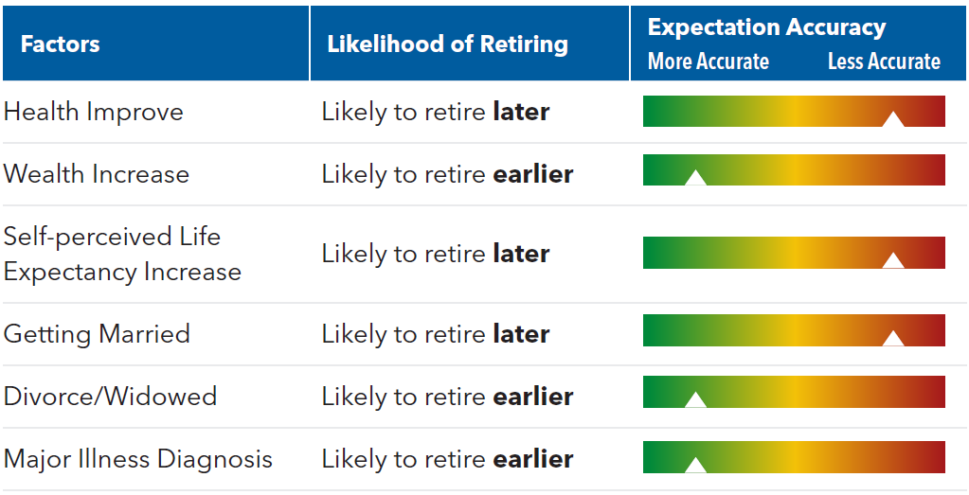
Retirement: Expectation vs. Reality
If COVID-19 Did Not Impact Retirement Expectations Significantly, What Did?
Source: Retirement Expectations vs. Reality, MSRI, 2024; Data Source: Financial wellness assessment by Prudential Financial (2017-2021)
Notes:
This exhibit shows the average expected retirement age by month and age group. The fluctuations during and shortly after the COVID-19 period are not significantly larger than those before the pandemic period. Meanwhile, although different ages responded differently, their responses within age groups did not differ meaningfully during vs. shortly before and after the COVID-19 period.
If COVID-19 did not alter participants’ retirement expectations significantly, what does?

Slide 36
Help Participants with Default Retirement Plan Options
Default investment acceptance among public defined contribution plan participants

Slide 37
Public DC Plan Participants Default Investment
Initial Default Investment Acceptance by Age and Default Investment Types
Source: Default Investment Acceptance among Public Defined Contribution Plan Participants, MissionSquare Research Institute, 2024
Notes:
The increasing availability of and participation in defined contribution (DC) plans are fundamentally changing the way Americans save and invest for retirement. One important innovation in DC plans is default investments that are thoughtfully designed to make it easy for participants to invest in a professionally managed portfolio, such as a target-date fund or stable-value fund.
MissionSquare Research Institute found that the default investment acceptance rate in the public sector is very high, typically into a target-date fund, generally exceeding 80% for all ages.

Slide 38
Market Volatility Affects Default Decisions
Default Acceptance in the 2020 Calendar Year by Month and Age Group
Source: Default Investment Acceptance among Public Defined Contribution Plan Participants, MissionSquare Research Institute, 2024
Notes:
First, default investment persistently declines with age.
Second, and perhaps more interesting, default investment acceptance declined significantly during the middle of 2020 by age group.
This is likely due to the significant market volatility caused by the COVID-19 pandemic.
Default investment did not change much at all for younger participants, but there was a notable drop among older participants (i.e., those aged 60-70), with the default investment for this group dropping to approximately 50% from an earlier steady-state closer to 90%.
This clearly suggests that recent market performance is more likely to affect the default investment decisions among older participants than those who are younger.

Slide 39
Default Acceptance Decline with Age and Income
Target-Date Initial Default Investment Acceptance by Age and Income
Source: Default Investment Acceptance among Public Defined Contribution Plan Participants, MissionSquare Research Institute, 2024
Notes:
First, default investment persistently declines with age.
Second, and perhaps more interesting, default investment acceptance declined significantly during the middle of 2020 by age group.
This is likely due to the significant market volatility caused by the COVID-19 pandemic.
Default investment did not change much at all for younger participants, but there was a notable drop among older participants (i.e., those aged 60-70), with the default investment for this group dropping to approximately 50% from an earlier steady-state closer to 90%.
This clearly suggests that recent market performance is more likely to affect the default investment decisions among older participants than those who are younger.

Slide 40
Default Acceptance is Higher in Public Sector
Default Acceptance by Age and Income: Public vs. (minus) Private Sector DC Participants
Source: Default Investment Acceptance among Public Defined Contribution Plan Participants, MissionSquare Research Institute, 2024
Notes:
Public sector DC plan participants, compared to private sector 401(k) participants, are more likely to accept default investment options provided by their retirement plan sponsor.

Slide 41
Default Acceptance Is Higher among Females
Difference in Target Date Default Acceptance by Gender (Female Minus Male)
Source: Default Investment Acceptance among Public Defined Contribution Plan Participants, MissionSquare Research Institute, 2024
Notes:
Default investment acceptance rates decline with age and income level and appear to be higher among female participants.

Slide 42
Public Plan Default Investment Retention Rate
Opt-Out Rate by Age over Time among Target-Date Default Investment Participants
Source: Default Investment Acceptance among Public Defined Contribution Plan Participants, MissionSquare Research Institute, 2024
Notes:
Default investment acceptance rates decline with age and income level and appear to be higher among female participants.
This information could be useful for employers, plan sponsors, and consultants who are interested in how well their plans are doing in terms of getting participants to leverage the default investments.
Since public sector DC plan participants are more likely to accept and stay within default investments, plan administrators and advisors should consider taking more responsibility/actions for designing default options that would better facilitate participants making appropriate saving and retirement planning decisions.

Slide 43

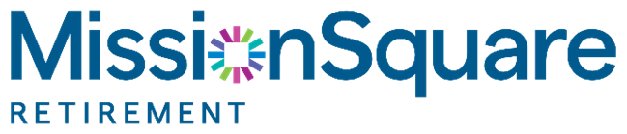
Questions and Discussions
Web:
https://research.missionsq.org
Email:
zliu@missionsq.org

