Slide 1
AI in Government: 1 Year of Lessons + Hard-Earned Wisdom
Erica Olsen, CEO + Co-Founder of Madison AI Matt Unmacht, Assistant City Manager – Chanhassen, MN
Notes:
Talk Track:
Problem
Possible Solutions – People, Process, Technology
Technology – Buy or Build
Buy – Off the shelf or purpose built (show the difference)
The thing with AI... that we've learned, to hit the mark, it needs to be purpose built
What does it look like for real (WASHOE)
Tips – Not expensive, try little things, role alike groups

Slide 2
What Challenges Are Government Leaders Facing Today?
Workforce: Retention and Attraction.
Jurisdictions in metropolitan areas are competing for talent between other metro areas. Rural communities are challenged to attract quality candidates due to pay competitiveness, housing limitations and resource limitations.
Financial / Budgetary Constraints.
Federal funding is becoming more limited and local government stimulus funds have been expended. An increased interest rate environment and the threat of eliminating tax-exempt financing options.
Technology Integration into Service Delivery.
Jurisdictions are having to continually upgrade technology to address data retention, cyber security, and increased digital accessibility. Expected demands for on-demand services and instant responsiveness to questions or concerns.
Aging Capital Infrastructure.
Jurisdictions are having to deal with significant cost escalation related to repairing or replacing of public buildings, utilities, and roads.

Slide 3
What we’re hearing in the field….
1
Can AI help us be more efficient and reduce cost? There are opportunities we can tackle, like expediting housing permitting and reducing/automating administrative tasks.
Will AI help with data-driven decisions?
AI can begin to help us tackle items like Capital Improvement predictive maintenance and transportation mobility/reducing congestion.
Can AI improve citizen self-service and engagement?
Chatbots and Virtual assistants for here for citizen self-services.
2
3

Slide 4
What if AI could save you 5 hours a week on repetitive tasks?
Think asking/answering questions, summarizing documents or previous actions, and drafting repetitive, time intensive reports.

Slide 5
Off the Shelf vs. Purpose Built AI for Gov Leaders
“Off the Shelf” AI is Great for…
Quick research and answers – Quickly key points from a few documents, quick summary
Simple workflows – Like drafting professional, timely email responses to vendors or internal communications.
“Creative” Content – Uses “open” data as a reference and won’t limit collaboration to a specific set of information. Think speech writing or creative writing.
Purpose Built AI is Great For…
Comprehensive answers – Quickly key points from a few documents, quick summary
Complex workflows – Like drafting a cited, complete staff report referencing previous action from your council.
Sited, Complete Content – Uses a data and fact from your government with protection from AI hallucination. Think creating a complete history of a topic.

Slide 6
Off the Shelf vs. Purpose Built AI for Gov Leaders
“Open” Generative AI Tools/Systems
Purpose-Built GovTech AI

Slide 8
So, What Does that Look Like in Action?

Slide 9
The “Old Way” of Drafting Staff Reports
Dig Through Thousands of PDFs and Files to Find What You Need
Dig Through Even Older Archives that are Hard to Search
Read and Synthesize All of the Previous Information
Draft a Staff Report From Scratch
Senior Staff Review of Every Report
Add to Your Official Agenda and Packet
Anywhere from 4-6+ Hours of Staff Time

Slide 10
Using an AI Assistant
AI
AI
Madison AI Researches, Summarizes, and Drafts a Staff Report using Thousands of your files + Decades of Information
Senior Staff Review
Add to Your Official Agenda + Packet
~30 Minutes of Staff Time, Including Review

Slide 11
Under the Hood
AI
AI
1
2
3
4
Collect 10+ Years of Files
Convert 10,000—20,000 Files
Summarize Information with 91% Accuracy
Synthesize a Staff Report Ready for Your Clerk

Slide 12
Using Microsoft Co-Pilot for Staff Reports
Draft a staff report approving the construction of additional permanent bathrooms and shower facilities at the CaresCampus in the amount of $232,000.

Slide 13
Madison AI + Washoe County Staff Report Writer
Draft a staff report approving the construction of additional permanent bathrooms and shower facilities at the CaresCampus in the amount of $232,000.

Slide 14
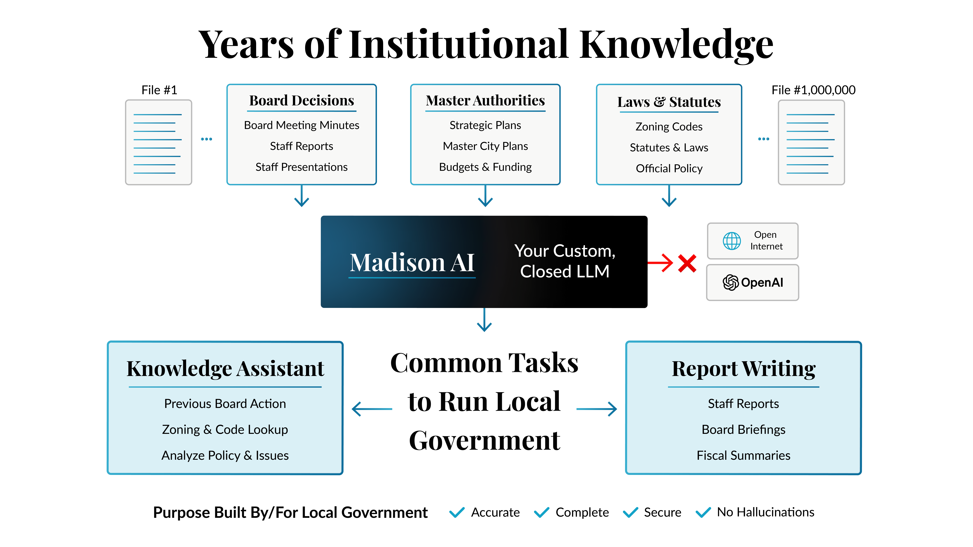
Washoe County saved ~236 Staff Hours in the Last 30 Days
For Research
266
.5
130
95
Number of Searches in 30 Days
Number of Staff Hours Saved Per Search
30 Day Active Users
Hours Saved in 30 Days
For Staff Reports
29
4
116
21
Number of Reports in 30 Days
Number of Staff Hours Saved Per Search
30 Day Active Users
Hours Saved in 30 Days
Source: Fathom Analytics
Notes:
~2900 staff hours per year.

Slide 15
Pro-Tip: Files must be converted to be read by AI.
Pdfs, Word docs, Excel files, scans, presentations, and budget books with tables must be correctly converted to be used by AI assistants.

Slide 16
What would you do with 5+ more hours in your work week?
Notes:
Why does this make sense for you – and what are you trying to accomplish. Affordable Housing and Permitting - How to do we help us AI to get through red tape for a 60 approval process. Administrative acceleration – Madison AI

Slide 17
12 Months in Building AI Assistants – Our Pro Tips
When using AI assistants…
Narrow your search. Be specific.
Use years. Spell out what you are asking for. Refine your prompts when something doesn’t work.
Treat it like a conversation, not Google.
Start a new session (conversation) when you switch topics.
Custom AI assistants are a “closed” dataset.
It does not know it is 2025. It does not know what DOGE is ☺. Its only trained on your information.
Be patient.
We have prioritized accuracy over speed.
Data conversion is a must. Tools can’t read all of your files “out of the box.” It requires converting your file set for AI to read ALL of the data in a file.
It’s not perfect. It will only get better!
This tech is advancing every day.

Slide 18
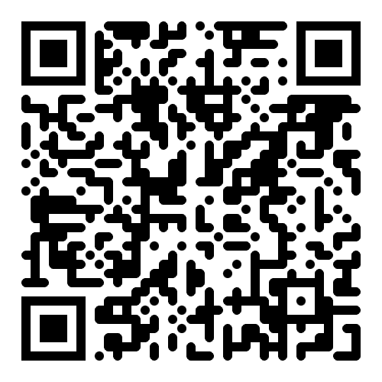
Get Your Free AI in Government Playbook!
PS – Want to connect? Drop us a line! www.MadisonAI.com I Hello@MadisonAI.com

