Slide 1
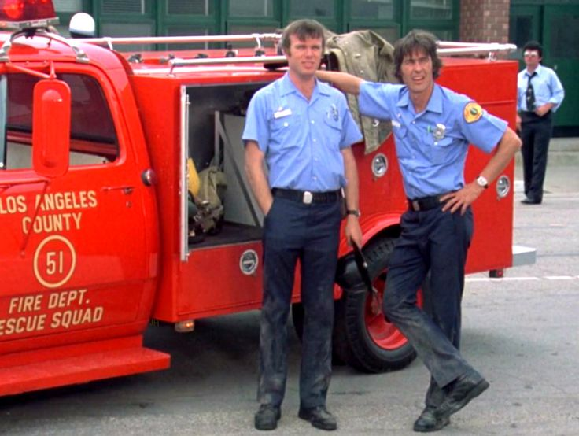
Reimagined: Is ‘Regression’ the Key to Future Emergency Medical Services Delivery?
Thomas Wieczorek, Director, Center for Public Safety Management
Matt Zavadsky, EMS SME, Center for Public Safety Management

Slide 2
Common misconceptions about EMS response
Majority of 911 EMS calls are for a potentially life-threatening condition.
Response times make a difference in patient’s outcomes.
There should be a paramedic on every EMS response.
  And 2 are better!
The more paramedics in the EMS system the better.

Slide 3

Economic Challenge…
Cost Drivers
  Response time
    Faster = More cost
    ‘Slower’ = Less cost
  ALS vs. BLS
    All ALS = More cost
    Tiered (ALS & BLS) = Less cost
  Deployment Model
    Fixed (24/48, or 48/96 schedule) = More cost
    Flexible (10’s & 12’s, peak staffing) = Less cost

Slide 4
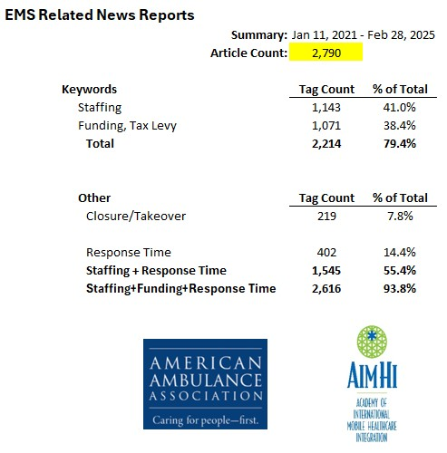
https://aimhi.mobi/news

Slide 5
System Design Hallmarks?
BLS Ambulances
Little to no response time expectations
ALS QRV – ‘Intercept’

Slide 6
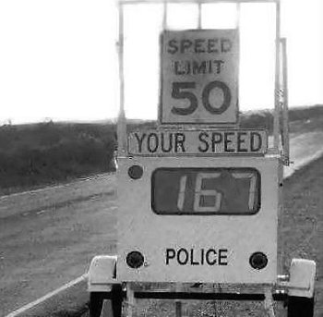

Where did this “Need for Speed” come from…
Cardiac Resuscitation in the Community
  Importance of Rapid Provision and Implications for Program Planning
“If CPR was initiated within four minutes and if definitive care was provided within eight minutes, 43% of patients survived. If either time was exceeded, the chances of survival fell dramatically.
The time to initiation of CPR and definitive care are factors directly influenced by emergency medical service program decisions.
A realistic option to improve time to initiation of CPR is widespread citizen CPR training. A possible option to improve the time to definitive care is the training of emergency medical technicians in defibrillation.”
JAMA. XXXX May 4;241(18):1905-7. doi: 10.1001/jama.241.18.1905

Slide 7





1979!!

Slide 8
Jarvis J, Taigman M. Using Red Lights and Sirens for Emergency Ambulance Response: How Often Are Potentially Life-Saving Interventions Performed?
Prehospital Emergency Care, 25(4), 549–555.
https://pubmed.ncbi.nlm.nih.gov/32678993/
Conclusions: In this large national dataset, RLS responses were very common (86%) yet potentially life-saving interventions were infrequent (6.9%). These data suggest a methodology to help EMS leaders craft targeted RLS response strategies.
Price L. Treating the clock and not the patient: ambulance response times and risk.
Qual Saf Health Care. 2006;15(2):127–130.
https://pubmed.ncbi.nlm.nih.gov/16585114/
Conclusions: The results of this study suggest that the 8 minute response time is not evidence based and is putting patients and ambulance crews at risk. There is a need for less simplistic quality indicators which recognise that there are many stages between a patient's call for help and safe arrival in hospital.
Lights and Siren Use by Emergency Medical Services (EMS): Above All Do No Harm
NHTSA Study & Report by Dr. Doug Kupas
https://www.ems.gov/assets/Lights_and_Sirens_Use_by_EMS_May_2017.pdf
Summary: The time saved by using L&S during response and transport has been evaluated by several studies. These all show that a relatively short amount of time is saved by L&S use. While this may be of clinical importance to patient outcome in critical time-sensitive conditions like cardiac arrest, the consensus among the researchers in this field is that the time is not significant in most of the responses or transports.
Pons P, Markovchick V. Eight minutes or less: does the ambulance response time guideline impact trauma patient outcome?
J Emerg Med. 2002;23(1):43–48.
https://pubmed.ncbi.nlm.nih.gov/12217471/
Conclusions: After controlling for other significant predictors, there was no difference in survival after traumatic injury when the 8 min ambulance RT criteria was exceeded (mortality odds ratio 0.81, 95% CI 0.43-1.52). There was also no significant difference in survival when patients were stratified by injury severity score group. Exceeding the ambulance industry response time criterion of 8 min does not affect patient survival after traumatic injury.

Slide 9
Swor R, Cone D. Emergency medical services advanced life support response times: Lots of heat, little light.
Acad Emerg Med. 2002;9(4):320–321.
https://pubmed.ncbi.nlm.nih.gov/11927458/
Conclusions: In this observational study, emergency calls where RTs were less than 5 minutes were associated with improved survival when compared with calls where RTs exceeded 5 minutes. While variables other than time may be associated with this improved survival, there is little evidence in these data to suggest that changing this system's response time specifications to times less than current, but greater than 5 minutes, would have any beneficial effect on survival.
Pons P, Haukoos J, Bludworth W, Cribley T, Pons K, Markovchick V. Paramedic response time: Does it affect patient survival?
Acad Emerg Med. 2005;12(7):594–600
https://pubmed.ncbi.nlm.nih.gov/15995089/
Conclusions: A paramedic response time within 8 minutes was not associated with improved survival to hospital discharge after controlling for several important confounders, including level of illness severity. However, a survival benefit was identified when the response time was within 4 minutes for patients with intermediate or high risk of mortality. Adherence to the 8-minute response time guideline in most patients who access out-of-hospital emergency services is not supported by these results.
Jarvis J, Johns D, Ratcliff T, et. al. The impact of using time critical intervention-based dispatch thresholds on lowering lights and siren use to EMS 911 incidents.
JACEP Open 2024;5:e13232
https://doi.org/10.1002/emp2.13232
Conclusions: Using Time Critical Intervention-based dispatch thresholds, we decreased L&S use and increased accuracy with minimal increased response time. Our results support the use of this methodology to determine EMS response modes.
Jensen, J.T., Møller, T.P., Blomberg, S.N.F. et al. Racing against time: Emergency ambulance dispatches and response times, a register-based study in Region Zealand, Denmark,
2013–2022. Scand J Trauma Resusc Emerg Med 32, 108 (2024).
https://doi.org/10.1186/s13049-024-01284-0
Conclusions: Even though response times increased during the study period, improving these may not be a solution to improve overall patient outcomes, because the diagnoses where shorter response times are important ultimately represent only a smaller proportion of the patients that are dispatched to an emergency ambulance.

Slide 10
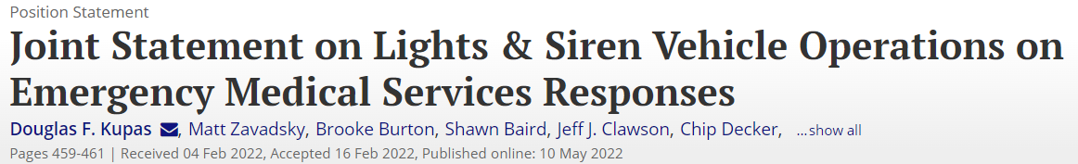
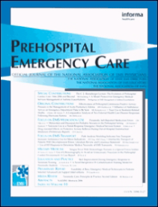
This document is a joint position statement with the Academy of International Mobile Healthcare Integration, American Ambulance Association, American College of Emergency Physicians, Center for Patient Safety, International Academies of Emergency Dispatch, International Association of EMS Chiefs, International Association of Fire Chiefs, National Association of EMS Physicians, National Association of Emergency Medical Technicians, National Association of State EMS Officials, National EMS Management Association, National EMS Quality Alliance, National Volunteer Fire Council, and Paramedic Chiefs of Canada.
https://pubmed.ncbi.nlm.nih.gov/35475941/

Slide 11
The sponsoring organizations of this statement believe that the following principles should guide L&S use during emergency vehicle response to medical calls and initiatives to safely decrease the use of L&S when appropriate:
The primary mission of the EMS system is to provide out-of-hospital health care, saving lives and improving patient outcomes, when possible, while promoting safety and health in communities. In selected time-sensitive medical conditions, the difference in response time with L&S may improve the patient’s outcome.
EMS vehicle operations using L&S pose a significant risk to both EMS practitioners and the public. Therefore, during response to emergencies or transport of patients by EMS, L&S should only be used for situations where the time saved by L&S operations is anticipated to be clinically important to a patient’s outcome. They should not be used when returning to station or posting on stand-by assignments.
Communication centers should use EMD programs developed, maintained, and approved by national standard-setting organizations with structured call triage and call categorization to identify subsets of calls based upon response resources needed and medical urgency of the call. Active physician medical oversight is critical in developing response configurations and modes for these EMD protocols. These programs should be closely monitored by a formal quality assurance (QA) program for accurate use and response outcomes, with such QA programs being in collaboration with the EMS agency physician medical director.
https://pubmed.ncbi.nlm.nih.gov/35475941/

Slide 12
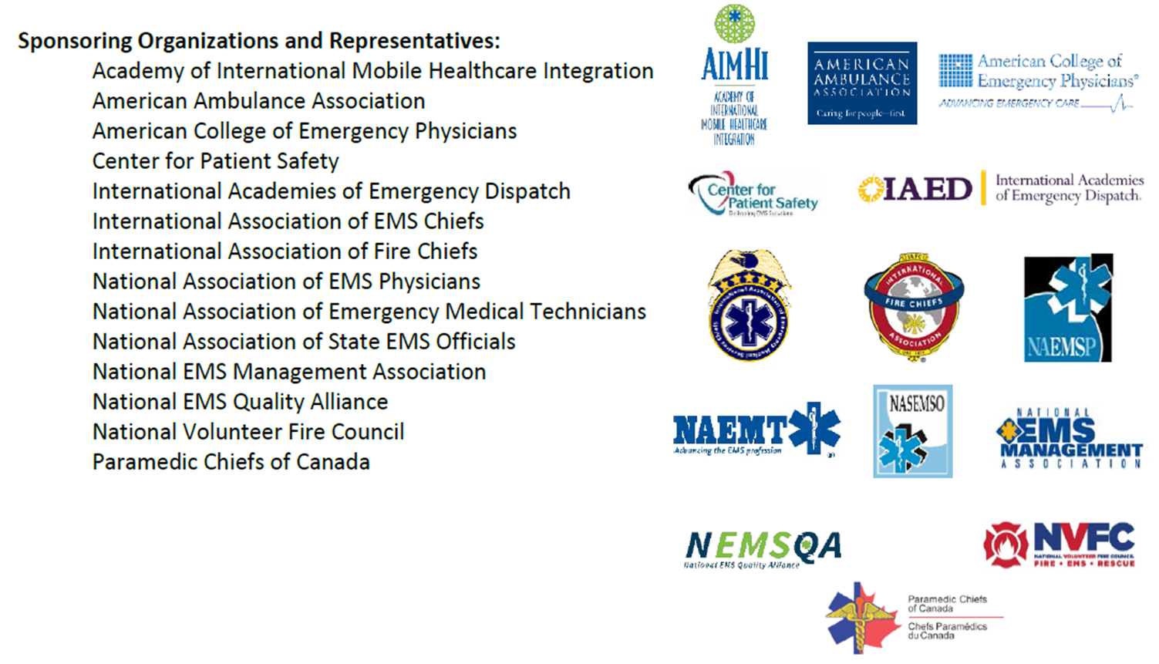
The sponsoring organizations of this statement believe that the following principles should guide L&S use during emergency vehicle response to medical calls and initiatives to safely decrease the use of L&S when appropriate:
Municipal government leaders should be aware of the increased risk of crashes associated with L&S response to the public, emergency responders, and patients. Service agreements with emergency medical response agencies can mitigate this risk by using tiered response time expectations based upon EMD categorization of call. Quality care metrics, rather than time metrics, should drive these contract agreements.
https://pubmed.ncbi.nlm.nih.gov/35475941/

Slide 13
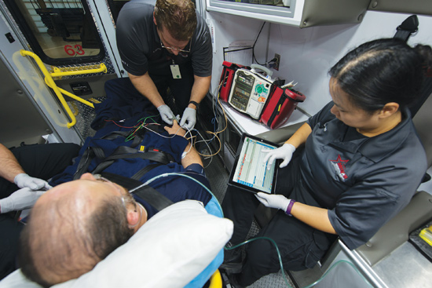
Where did this all-ALS thing come from?

Slide 14
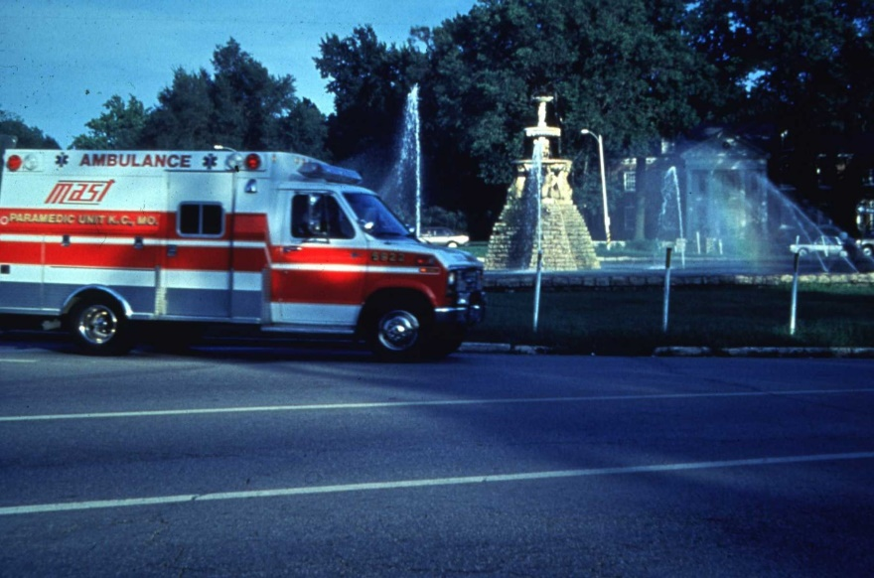
The Impact of the Public Utility Model

Slide 15
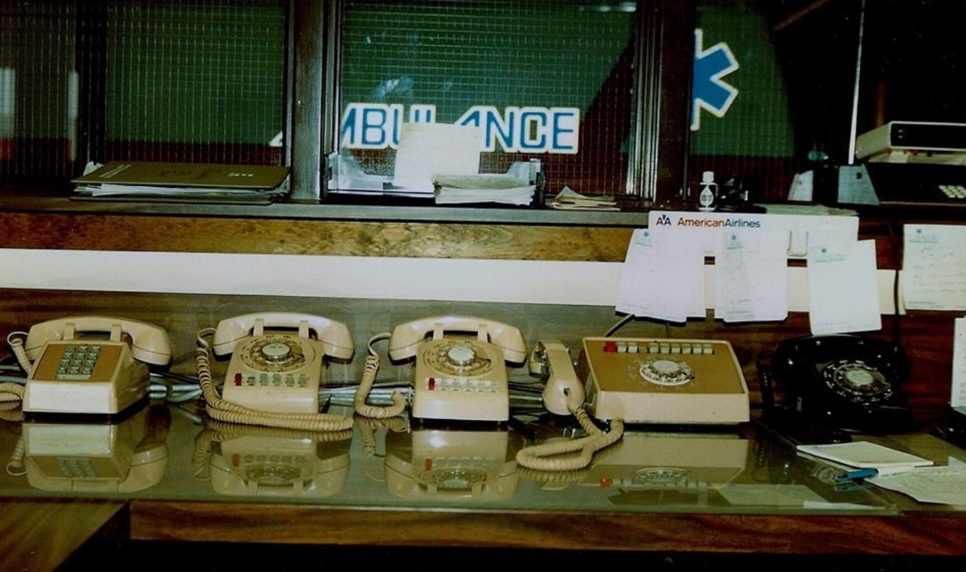
ALL ALS - The Rationale

Slide 16

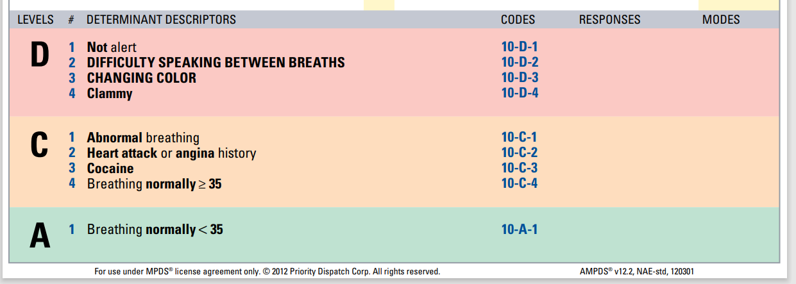
The NEXT Year

Slide 17
Sanghavi P, Jena AB, Newhouse JP, Zaslavsky AM. Outcomes after out-of-hospital cardiac arrest treated by basic vs advanced life support.
JAMA Intern Med. 2015 Feb;175(2):196-204.
https://pmc.ncbi.nlm.nih.gov/articles/PMC4314335/
Conclusions: Patients with out-of-hospital cardiac arrest who received BLS had higher survival at hospital discharge and at 90 days compared with those who received ALS and were less likely to experience poor neurological functioning.
Band RA, Salhi RA, Holena DN, Powell E, Branas CC, Carr BG. Severity-adjusted mortality in trauma patients transported by police.
Ann Emerg Med. 2014 May;63(5):608-614.e3
https://pmc.ncbi.nlm.nih.gov/articles/PMC5912155/
Conclusion: We found no significant overall difference in adjusted mortality between patients transported by the police department compared with EMS but found increased adjusted survival among 3 key subgroups of patients transported by police. This practice may augment traditional care.
Levy, M. J., Crowe, R. P., Abraham, H., Bailey, A., Blue, M., Ekl, R., … Myers, J. B. (2024). Dispatch Categories as Indicators of Out-of-Hospital Time Critical Interventions and Associated Emergency Department Outcomes.
Prehospital Emergency Care, 1–6.
https://www.tandfonline.com/doi/full/10.1080/10903127.2024.2342015
Conclusions: In general, Determinant levels aligned with time-critical responses; however, a notable minority of lower acuity Determinant level Protocols met criteria for unsafe to hold. This suggests a more nuanced approach to dispatch prioritization, considering both Protocol and Determinant level factors.

Slide 18
Dyson K, Bray J. Paramedic Exposure to Out-of-Hospital Cardiac Arrest Resuscitation Is Associated With Patient Survival
Circulation: Cardiovascular Quality and Outcomes Volume 9, Number 2
https://www.ahajournals.org/doi/10.1161/CIRCOUTCOMES.115.002317
Conclusions: Patient survival after OHCA significantly increases with the number of OHCAs that paramedics have previously treated.
Vrotsos, K. M., Pirrallo, R. G., Guse, C. E., & Aufderheide, T. P. (2008). Does the Number of System Paramedics Affect Clinical Benchmark Thresholds?
Prehospital Emergency Care, 12(3), 302–306.
https://www.tandfonline.com/doi/full/10.1080/10903120802101355
Conclusions: These data show a decreased opportunity and a wide variability in the frequency of successfully completed paramedic technical skills and experiences in this EMS system.
Persse, David E. et al. Cardiac arrest survival as a function of ambulance deployment strategy in a large urban emergency medical services system
Resuscitation, Volume 59, Issue 1, 97 – 104
https://www.resuscitationjournal.com/article/S0300-9572(03)00178-3/abstract
Conclusions: This study shows improved outcomes for a subset of patients with cardiac arrest when they are cared for in an area that uses tiered response compared to an area that uses a uniform response EMS system.

Slide 19
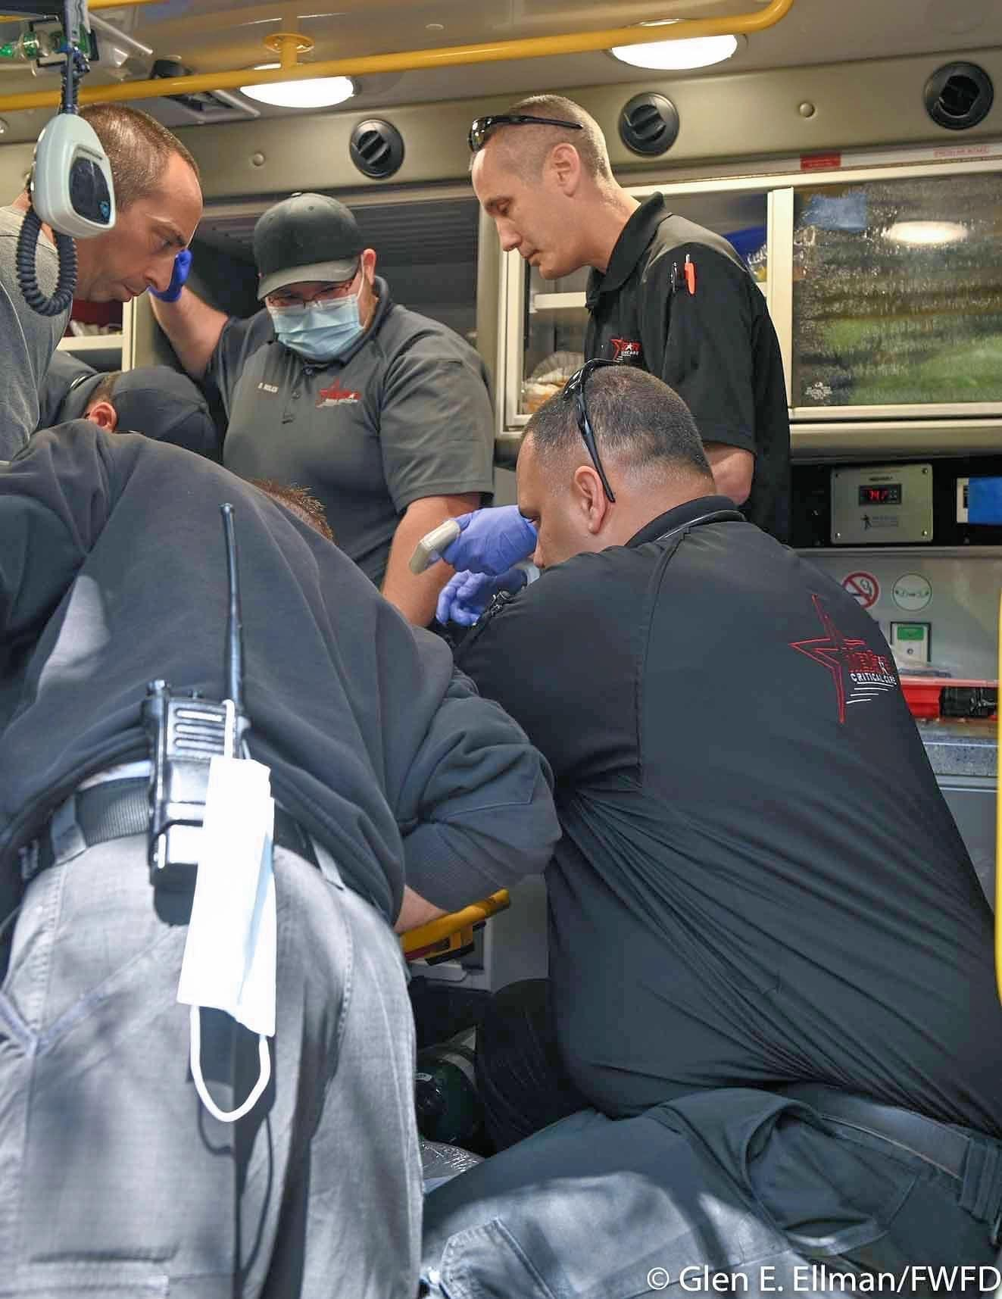
System Redesign…
Service delivery model
  Patient navigation vs. transport
All ALS to Tiered Response
  Right Resource ➔ Right Patient
    ALS/BLS/NP/PA/Community Paramedic/Behavioral Health
Changing response time expectations
  9 minutes?
  11 minutes?
  30 minutes?
  60 minutes?
  At all…?
    Call Triage/Alternate Response

Slide 20
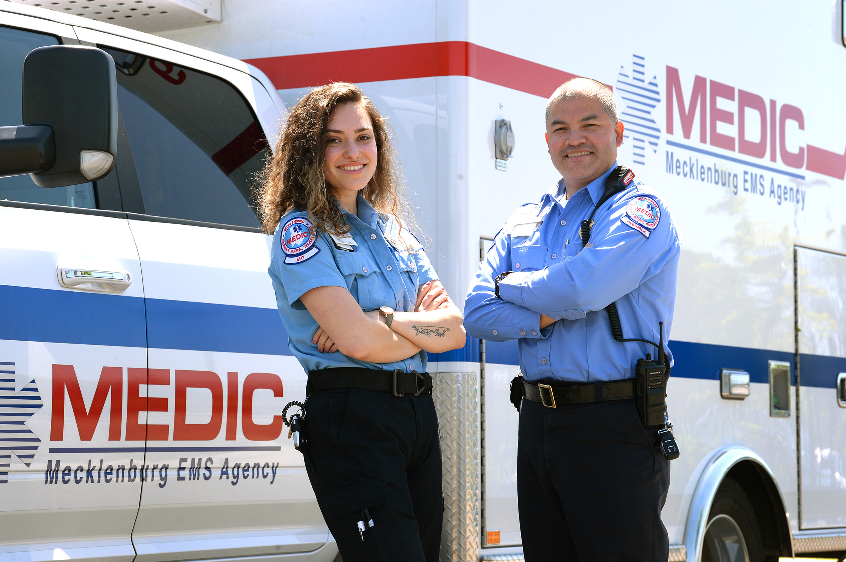
Response Configuration Change
New Configuration
  E/D 10:59 – FR RL&S; Ambulance RL&S
  C/BH 12:59 – FR RL&S; Ambulance RL&S
  Sierra 30:00 – FR RL&S; Ambulance No RL&S
  BC/A 60:00 – No FR; Ambulance No RL&S
  OTO 90:00 - No FR; Ambulance No RL&S

Slide 21

Colorado Springs Fire Department debuts new emergency response system for 911 calls
By Debbie Kelley
Mar 1, 2022
As of Tuesday, some Colorado Springs residents may hear something different when they call 911.
"A unit will respond when a unit is available," call takers will say to residents in the south part of town who contact the emergency service for non-emergency situations — for example, when symptoms indicate the flu, a sprained ankle or a fractured hip.
Instead of immediately dispatching an ambulance, firetruck or other substantial vehicle, new Community Medicine Response Units — in medically outfitted SUVs that are on back order — will arrive at the scene.
The appropriate response could be EMTs requesting an ambulance to transport the patient to a hospital; setting a telehealth appointment for the patient; sending the patient to an urgent care center; or applying a splint, dispensing pain medication and helping the person get connected with an orthopedic center, said Fire Chief Randy Royal.
"With an ankle sprain, you may not want to sit in an emergency department for several hours," said Dr. Matt Angelidis, co-medical director for the Colorado Springs Fire Department.
https://gazette.com/news/local/colorado-springs-fire-department-debuts-new-emergency-response-system-for-911-calls/article_8a6caa10-99a8-11ec-bb56-3791da481e37.html

Slide 22


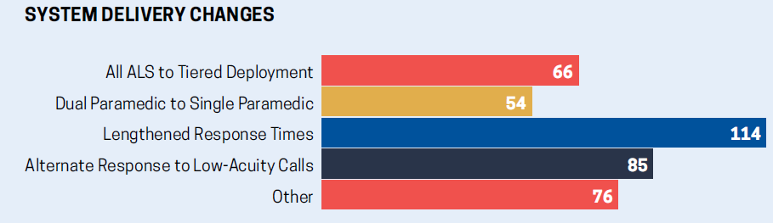
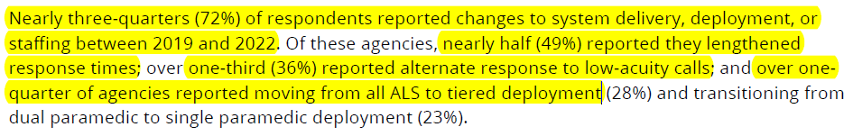
https://naemt.org/docs/default-source/ems-data/ems-economic-and-operational-models-survey-02-20-2023-final.pdf?sfvrsn=1fb9f493_2

Slide 23
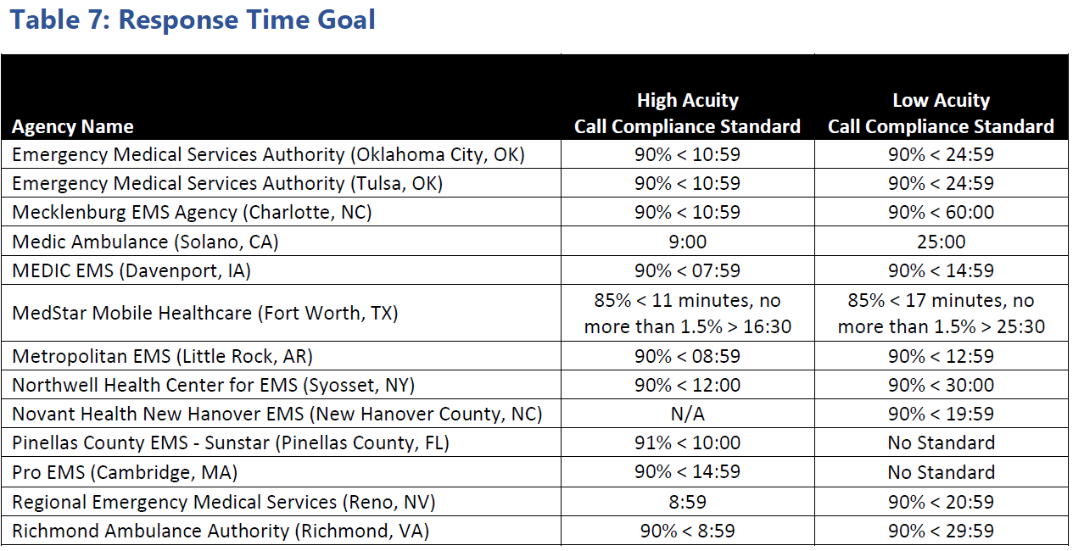

https://aimhi.mobi/page-18073

Slide 24
Take-Home Messages…
We created this mess!
  It’s up to us to change the expectations through education & evidence
Design changes being implemented today would have been considered heresy 5 years ago
  Tiered Deployment
  Extending response times
  BLS systems with paramedic QRVs
  Dispatch triage

Slide 25
Take-Home Messages…
EMS Systems are the most challenged they have been, EVER
  Regardless of the provider/delivery model
    Staffing
    Economics
    Supply Chain
Systems are being re-designed based on science and evidence
  Realistic public expectations
    Economic and customer service balance
Response time is NOT a quality measure
  EMS Systems should be evaluated on what matters
    Clinical outcomes/bundle compliance
    Cost of service delivery
    Patient experience

Slide 26
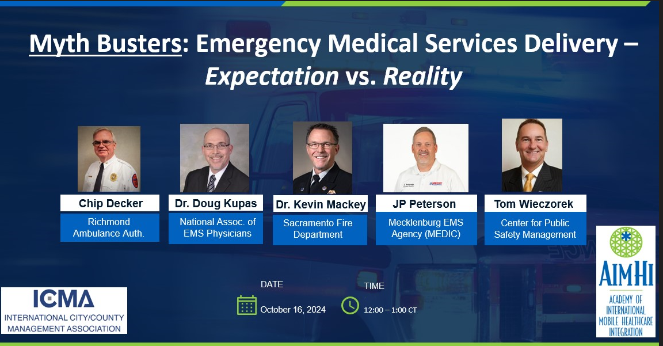
https://youtu.be/uTPTaKe7_us

Slide 27


Contact Information
Thomas Wieczorek
TWieczorek@cpsm.us
616-813-3782
Matt Zavadsky MS-HSA, NREMT
MZavadsky@cpsm.us
817-991-4487

