Slide 1
Building Trust and Enhancing Emergency Preparedness: Lessons from 'The Boy Who Cried Wolf'
Travis Teesch, MSA, EMTP
Fire Chief, Neenah-Menasha Fire Rescue
Notes:
Speaker Notes: "Good [morning/afternoon], everyone. I’m Chief Travis Teesch from Neenah-Menasha Fire Rescue. Today, I want to share a unique perspective on emergency preparedness and risk assessment—through the lens of a timeless fable, The Boy Who Cried Wolf. This story offers lessons we can apply to public safety, trust-building, and community readiness."Add notes on my bio ……….. (Tell them who I am)
Farm Boy ……. Never Dreamed of being a fire fighter
Find out who is in the audience ….. Where are they from – what do they do ….. Anyone involved in Emergency Management?

Slide 2
Traditional Moral of the Story
The traditional moral of Aesop's fable 'The Boy Who Cried Wolf' is that a liar will not be believed, even when they tell the truth.
This story teaches the importance of honesty and the consequences of losing trust through deceit.
Notes:
Speaker Notes: "The traditional moral is clear: once trust is broken, even truthful warnings fall on deaf ears. In public safety, that trust is essential. If our warnings aren't credible, our communities may not respond appropriately—even in real danger.“
Aesop’s Fables – collection of oral stories 620-564 BCE from Ancient Greece ……………. William Caxton, the first to translate Aesop’s Fables into English (1484)
Fables were religious, social, ethical, and political in nature used for the education of children
Early Jewish, Indian, and Buddhist stories exist with similar themes …….Lion and mouse
Used to educate children………when thought of in those terms the story we are familiar with makes sense……….when we hear the story, we have only interacted with it in one way, As a…….
Traditional interaction with the story….passerby that hears the villager's side.
They stopped responding to the alarm …… desensitizes ………. Example hearing a tornado-sire and not going to the basement because you think the tornado won’t hit your house……. More on that later

Slide 3
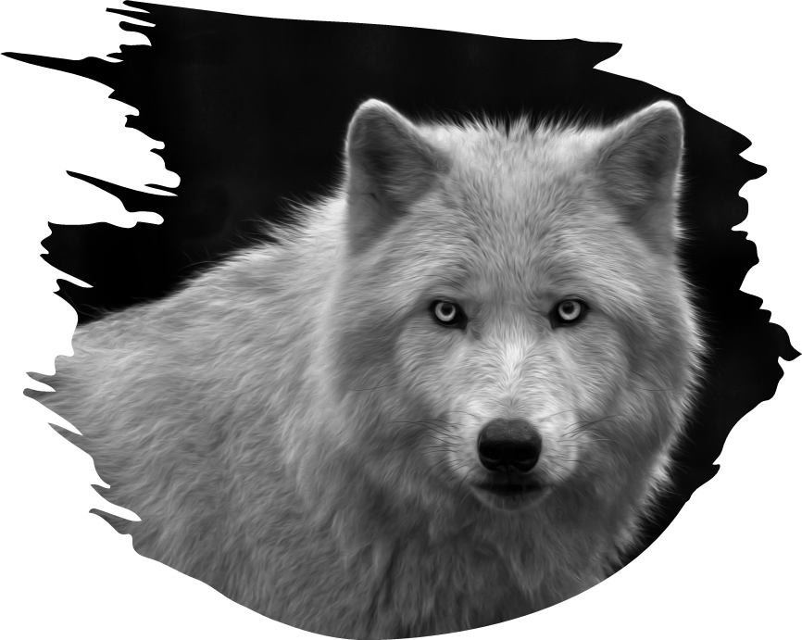
The story of "The Boy Who Cried Wolf" provides an interesting analogy for Risk Assessment Emergency Preparedness Planning & Mitigation particularly in the context of trust, communication, and response readiness.
Notes:
Speaker Notes: "This story serves as an analogy for three key areas: risk assessment, emergency preparedness, and mitigation planning. It helps us think critically about how trust, communication, and readiness intersect—and where failure can occur.“
There is more the story can teach us, if we are willing to interact with it in a different way.
What about the boy’s side….what about the wolf’s perspective.

Slide 4
Notes:
Isn’t it the same thing? ………………. Doesn’t it all Fall under Emergency Management …. What is that anyway?
Handout to explain in their own words…..
three-minute table discussion to produce definition ASK for their definitions
Round table discussion ………… on their definition and the ask for key factors

Slide 5
What is Risk Assessment?
Identifying, analyzing, and evaluating risks to prioritize actions.
Notes:
Speaker Notes: "Risk assessment is about identifying what could go wrong, analyzing the potential impact, and evaluating how to prioritize our response. It sets the foundation for making smart, proactive safety decisions."
Assessing risks of floods based on geography, weather patterns, and history.
Risk assessment is the process of identifying, analyzing, and evaluating risks to determine their potential impact and likelihood. It helps in understanding vulnerabilities and prioritizing measures to mitigate risks.

Slide 6
What is Emergency Preparedness?
It is being ready with a plan, supplies, and training to respond to emergencies.
Notes:
Speaker Notes: "Preparedness is more than having a plan on paper—it's about being trained, equipped, and ready to act when the moment comes. Think of it as the muscle memory we build through planning and exercises.“
Emergency preparedness involves planning, organizing, and implementing measures to ensure an effective response to emergencies. It aims to minimize the impact of disasters and emergencies through coordinated efforts.
STOP HERE AND ASK FOR KEY FACTORS of EMERGENCY PREPAREDNESS and RISK ASSESSMENT
Round table discussion ………… on their definition and the ask for key factors

Slide 7
Risk Assessment – Key Elements
Identification
Analysis
Evaluation
Prioritization
Mitigation
Notes:
Speaker Notes: "Each step here builds on the last. From identifying risks to taking action to mitigate them, this cycle ensures that we’re not just reacting—we’re preparing ahead of time.
Identification: Identifying potential hazards and threats.
Analysis: Analyzing the likelihood and impact of identified risks
Evaluation: Assessing the acceptability of risks and determining the need for mitigation.
Prioritization: Ranking risks based on their severity and likelihood
Mitigation: Developing strategies to reduce or eliminate risks.

Slide 8
Emergency Preparedness – Key Elements
Planning
Training
Resources
Drill & Exercises
Communication
Notes:
Speaker Notes: "These components are critical: planning, training, having resources in place, conducting drills, and clear communication. Without any one of these, our response could fall apart."Emergency Preparedness: Focuses on readiness and response strategies to ensure effective action when a threat occurs.
Risk Assessment: Involves understanding the likelihood and potential impact of risks to prioritize mitigation measures.
Example: In our story ……………… Preparedness involves villagers being ready to act on any wolf sighting, while risk assessment involves evaluating the boy's credibility and the actual threat level.

Slide 9
Notes:
Example: Preparedness involves villagers being ready to act on any wolf sighting, while risk assessment involves evaluating the actual threat level. ………..repeated false alarms…………….story of false fire alarms at Nursing Home.
What happened in the Story? ……… Repeated False Alarms
STOP HERE have key differences small group discussion
KEY DIFFERENCES
Emergency Preparedness:
Immediate action plan
response strategy
drills
Risk Assessment:
Prevention
understanding vulnerabilities
long-term safety planning

Slide 10
Key Differences
Emergency Preparedness:
Immediate Action Plan
Response Strategy
Drills
Risk Assessment:
Prevention,
Understanding Vulnerabilities
Long-term Safety Planning
Notes:
Speaker Notes: "This comparison helps highlight the distinction: Risk assessment is long-term and strategic. Emergency preparedness is immediate and tactical. We need both to be effective.“
Example of Emergency Preparedness Fire drills and emergency evacuation plans.
Creating an evacuation plan for a building.
Training employees on how to use fire extinguishers.
Stockpiling emergency supplies like food, water, and medical kits.
Example of Risk Assessment Evaluating risks of floods based on geography, weather patterns, and building structures.

Slide 11
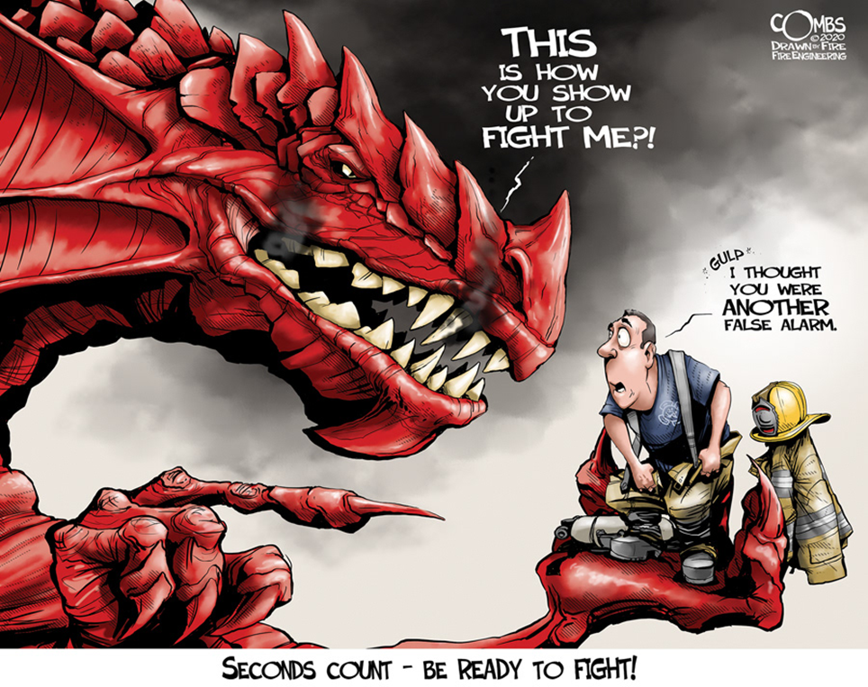
Notes:
Credit for drawing to Paul Combs
Paul Combs - Illustration - Bio (paulcombsart.com)
BE HONEST …… I’VE BEEN caught with my pants down!
Nursing home … Fire Alarm …… comment …….. that sure wasn’t the boy that cried wolf!
My background
I'm a firefighter so guess what I spend 80% of my time doing? ……….. Going on EMS calls!
So, did village do a risk assessment …YES …… we know that because they had a plan. 1. they had the boy watching the sheep 2. they responded the first couple of times ………. They just became complancent

Slide 12
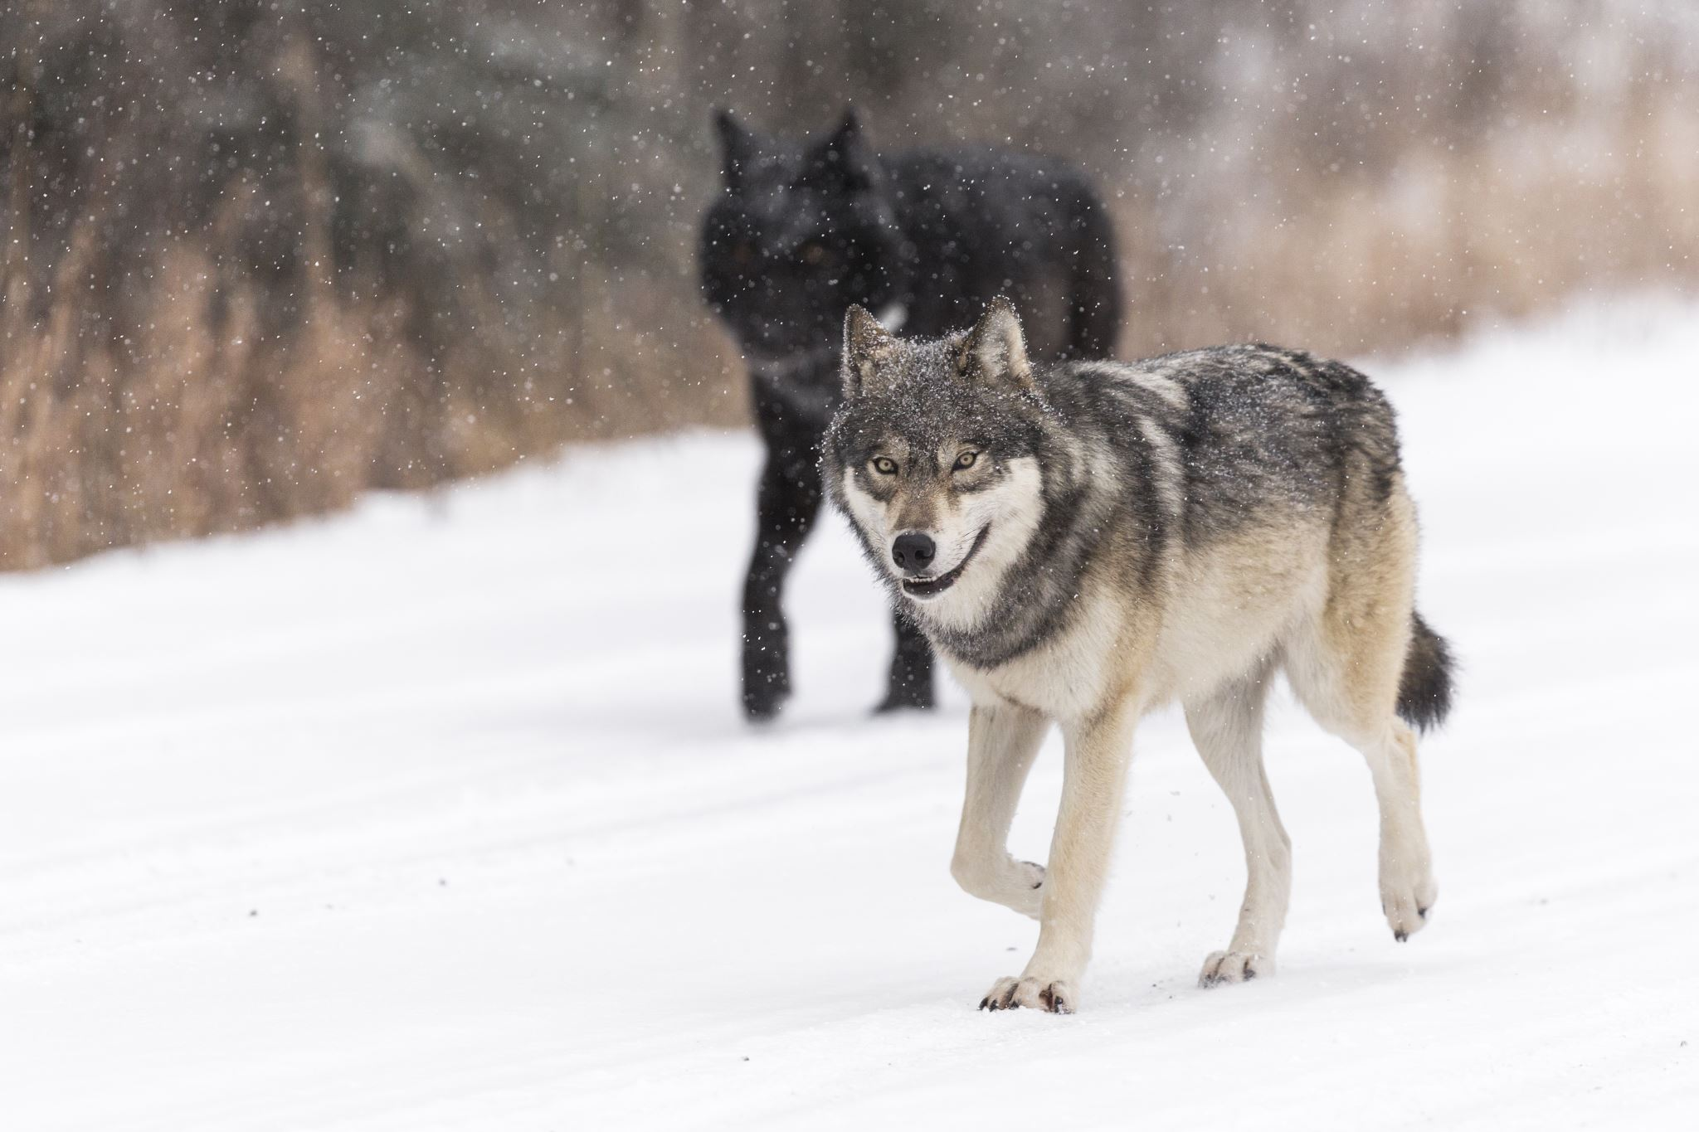
Preventing Complacency and Improving Vigilance
To avoid complacency, communities should:
Vary training scenarios to keep engagement high
Involve everyone in preparedness efforts
Use real-life incidents to highlight risks
Encourage continuous improvement and vigilance
Notes:
Speaker Notes: "One of the biggest threats isn’t the emergency—it’s complacency. Repetition can lead to tuning out. We combat that by varying training, engaging the whole community, and emphasizing real-life relevance.“
Maintain consistent communication………………..what would have happened if the villagers checked on the boy, would he have been lonely like in some versions of the story?

Slide 13
Risk Assessment Perspective
Evaluating and refining response strategies continuously
Identifying ongoing risks even with false alarms
Analyzing the frequency and severity of potential threats
The villagers failed to evaluate the ongoing risk of a wolf attack due to complacency from repeated false alarms. Effective risk assessment involves:
Risk Assessment Perspective
Notes:
Speaker Notes: "The villagers didn’t re-evaluate the risk of a wolf attack—they got too used to the false alarms. In my (our) world, that might look like ignoring weather alerts or downplaying fire dangers due to past false alarms.“
Evaluating Response Strategies ……………… how were false alarms verified as “FALSE” Traditional telling ………… the boys cries wolf and the villagers come running, don’t see a wolf and they go back down the hill………DID ANYBODY CHECK THE WOODS?
Identify ongoing risk & analyzing frequency and severity
PROPORTIONATE ALERTS: Avoid overreacting to minor risks or sending frequent non-critical alarms. Escalate communication based on the severity of the risk (e.g., minor issues warrant reminders, while serious threats require immediate action).
TIERED ALERT SYSTEMS: Use a color-coded or tiered system (e.g., green, yellow, red) to communicate the level of urgency clearly. This allows people to differentiate between routine precautions and high-risk scenarios.
EVIDENCE-BASED ALERTS: Make it clear when and why a particular risk is real, and back up warnings with data or observable facts.
MULTIPLE SOURCES OF INFORMATION: Ensure that alerts and warnings come from verified, reliable sources. Having multiple layers of verification, such as sensors, human checks, or multiple observers, increases credibility.

Slide 14
Emergency Preparedness Perspective
Establish a verification system for threats
Maintain consistent communication
Conduct regular training and drills
Build trust and avoid alarm fatigue
The story illustrates the dangers of complacency and desensitization to repeated warnings. To ensure effective response, it is crucial to:
Risk Assessment Perspective
Notes:
Speaker Notes: "This is where preparedness intersects with psychology. When people hear warnings too often, they stop responding. That’s why we need diverse, regularly assessed plans and a strong culture of vigilance.“
EDUCATION AND TRAINING: Regularly educate people about the risks they face and how to respond. Training helps build trust because people feel prepared and knowledgeable.
EMPOWERMENT: Give individuals and teams the tools and resources to act on risk assessments, so they feel involved in the process. This increases confidence in the system.
PROPORTIONATE ALERTS: Avoid overreacting to minor risks or sending frequent non-critical alarms. Escalate communication based on the severity of the risk (e.g., minor issues warrant reminders, while serious threats require immediate action).
TIERED ALERT SYSTEMS: Use a color-coded or tiered system (e.g., green, yellow, red) to communicate the level of urgency clearly. This allows people to differentiate between routine precautions and high-risk scenarios.
EVIDENCE-BASED ALERTS: Make it clear when and why a particular risk is real, and back up warnings with data or observable facts.

Slide 15
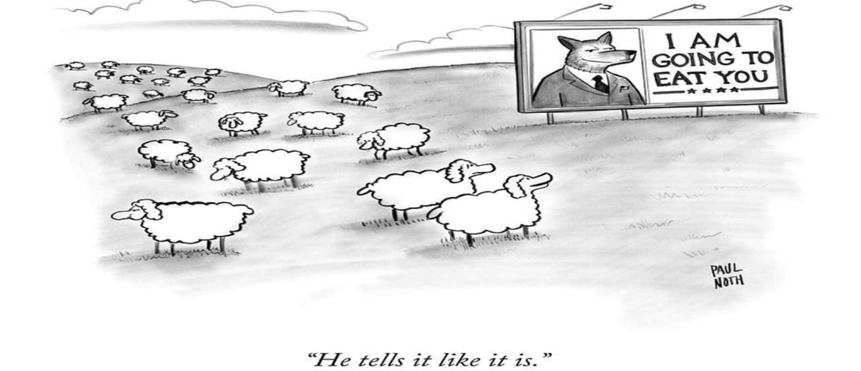
Diversified
Regularly Assessed
Supported by Vigilant Monitoring
Notes:
The wolf’s success in the story teaches valuable lessons in risk management and emergency preparedness.
To avoid being exploited by unforeseen threats, systems must be
Diversified
Regularly Assessed &
Supported by Vigilant Monitoring

Slide 16
The Wolf's Strategy:
Analyzing and Exploiting the System
Notes:
Speaker Notes: "Let’s not forget the adversary. In this case, the wolf observed the system, found its weaknesses, and waited for the right moment to strike. That’s exactly how real threats—natural or human—behave."

Slide 17
Strengths of the Warning System
Initial strong responses: The villagers reacted quickly to the boy’s cries.
Alertness to potential danger: The wolf recognized that the boy’s role was to signal a threat.
Community effort: The villagers acted together when responding to the warnings.
Notes:
Speaker Notes: "Even though the warning system existed—the boy yelling 'wolf'—it lost its value because it was misused. A strong system must be supported by trust, policy, and procedure.“
The Wolf is hunger ……….. First time he goes out he see’s a strong response ………………. Learns the boy is there as the “Warning System” found out there was a community effort / villagers acting together

Slide 18
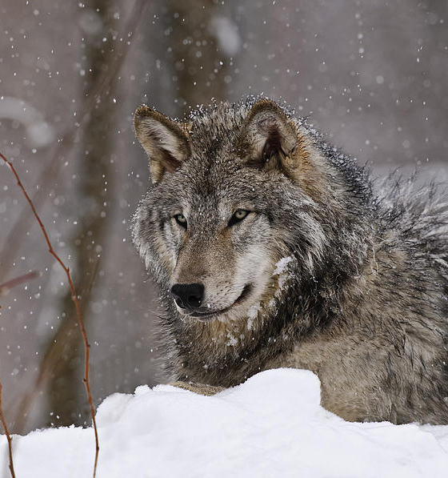
The Wolf's Exploitation Strategy
Patiently Waited
Calculated Approach
Bypass Defenses
images.fineartamerica.com
Notes:
Speaker Notes: "The wolf waited. It wasn’t impulsive. It shows how threats exploit routine, predictable patterns. We must assess how and where we might be vulnerable to exploitation—whether through gaps in training, communication, or procedures.“
https://images.fineartamerica.com/images/artworkimages/mediumlarge/1/1-timber-wolf-in-winter-michael-cummings.jpg
The wolf patiently waited until the villagers stopped responding to the boy’s warnings. Once the system had failed—due to complacency—the wolf attacked when the villagers were least prepared. This calculated approach allowed the wolf to bypass the village's defenses.

Slide 19
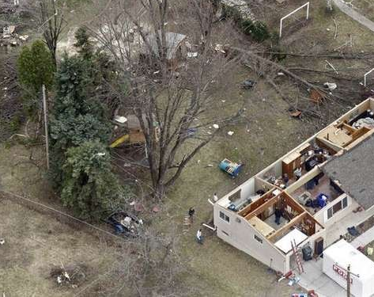
What do you do when you hear a Tornado Siren?
Go outside and Look?
Go to the Basement?
Notes:
Speaker Notes: When the sirens go off, do people react appropriately—or just look outside and go about their day? Complacency has real-world consequences. “What we train, we reinforce.“
Do you ignore the siren because you heard it before, and they were “false” alarms? ……….. Just like villagers not responding to the boy's cry of wolf
This is my house ………….. Thank God, my family and I were in the basement ……………. Tell story
Daughter learning about Tornados that week in school
Roof rafters sticking out of my bed

Slide 20
Preventing Complacency and Improving Vigilance
To avoid complacency, communities should:
Vary training scenarios to keep engagement high
Involve everyone in preparedness efforts
Use real-life incidents to highlight risks
Encourage continuous improvement and vigilance
Notes:
Where is the failure? ……………… the wolf ate the sheep ……………. How did that happen there was a system in place to prevent that!

Slide 21
Lessons Learned
Complacency can create vulnerabilities in emergency preparedness systems.
Over-reliance on a single warning source increases risk.
Consistent evaluation of threats and verification of alarms is crucial.
An adaptable strategy, like the wolf’s, exploits weaknesses in preparedness.
Notes:
Speaker Notes: "To reinforce vary training, involve everyone, use real incidents, and encourage ongoing improvement.
Trust isn’t automatic—it’s earned, tested, and maintained over time."

Slide 22
Discussion
Notes:
Speaker Notes: "Let’s open it up—what lessons stand out to you from this story? How can we apply them locally to improve emergency preparedness and public trust?"

