Slide 1
Building Trust and Social Capital In Marginalized Communities
Mitch Berg, Ph.D. & Scott Burgins

Slide 2
Outline
Introduction
Ice-Breaker
The “So What” and Definitions
What can lead to distrust
Traditional methods of trust-building
Case Scenario: Indiana
How can we improve on our engagement
Crookston Welcoming and Inclusivity Study
Lessons learned and Takeaways

Slide 3
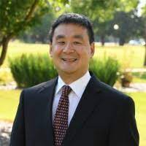
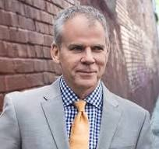
Introductions
Mitchell Berg, Ph.D. Scott Burgins, MPA
City Administrator for 16+ Years Community Development Consultant
Clinical Assistant Professor Clinical Assistant Professor

Slide 4
Why Look at this Issue?
Communities are not able to thrive when just some of the people are working together. If some are not working together a community cannot be healthy without the participation of the entire community.
Bridging social capital consists of relationships that permit diverse individuals, organizations and groups to work together. This bridging of social capital reduces the time and effort needed to mobilize resources, and is essential for getting things done.
When it comes to tackling wicked social issues, we can only succeed when we are able to mobilize the resources across the entire community.

Slide 5
Definitions
Marginalized populations
Moree (2018) defines Marginalized populations as people who have fewer possibilities and options in their lives than those studying them.
Marginalized (urban) communities
Cahyani and Widaningsih (2019) define marginalized urban community “as a group of people who do not have access to the economic and formal infrastructure of the city.
Social Capital The leadership competency of developing and maintaining relationships that allow us to work together and share resources in spite of our differences.
Trust
A belief in the character, ability and strength of the other party
To believe that someone is good and honest
Trust is earned
Respect
Someone held with high regard

Slide 6
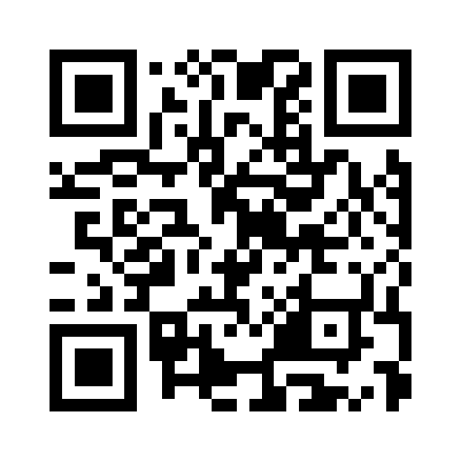
Question
Think of a time where you led or participated in a tense public engagement session, and think of what were the contributing factors that led to the tension?

Slide 7
What can Lead to Distrust
Lack of trust
Racism
Feeling of being underrepresented
Lack of communication
Feeling of not being recognized or heard

Slide 8
Who Feels Underrepresented?
A Cautionary Tale

Slide 9
Highlights
Justified or not, many Americans feel underrepresented and left behind.
Issues extend beyond racial and ethnic identities, and include economic and regional ones.
Failure to recognize and act on these concerns pose a danger to efficient government planning.

Slide 10
Sinking Middle Class
The share of Americans who are in the middle class is shrinking.
1971 = 61%. 2023 = 51%, according to Pew Research Center.
The share of total U.S. household income held by the middle class has plunged.
As a result of widening income inequality, many Americans are more financially apart.
This has not gone unnoticed ...

Slide 11
Sinking Middle Class
55% of Americans say their income isn't keeping up with the cost of living and they are falling behind, according to Pew Research Center.

Slide 12
As an Administrator with a Plan to Finish, I Don’t Gain Anything by …
Cursing the macro socio-economic mistakes that led us to this sad state.
Speculating that voters may have contributed to their own economic problems.
Complaining that these people still have privileges unafforded to many minority Americans.
Ignoring that fact that – rightly or terribly wrongly – these people feel underrepresented, and that they are scared and angry about it.

Slide 13
Owen County, Indiana
Population: 21,532.
Largest Town: Spencer, pop: 2,224.
Bachelor's Degree or More: 17%. (U.S. Average = 36%)
Per Capita Personal Income: $51,946 (Indiana Average = $61,243)

Slide 14
It Was on Fire When I Lay Down on It

Slide 15
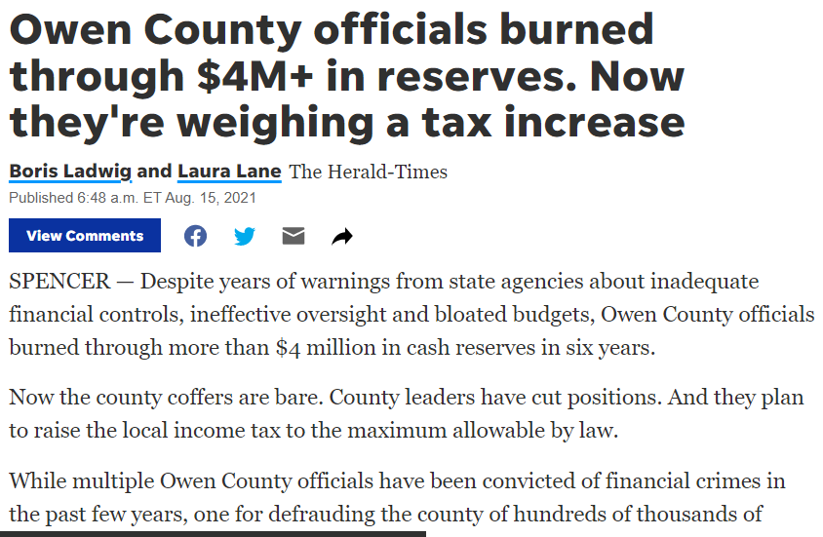

Slide 16
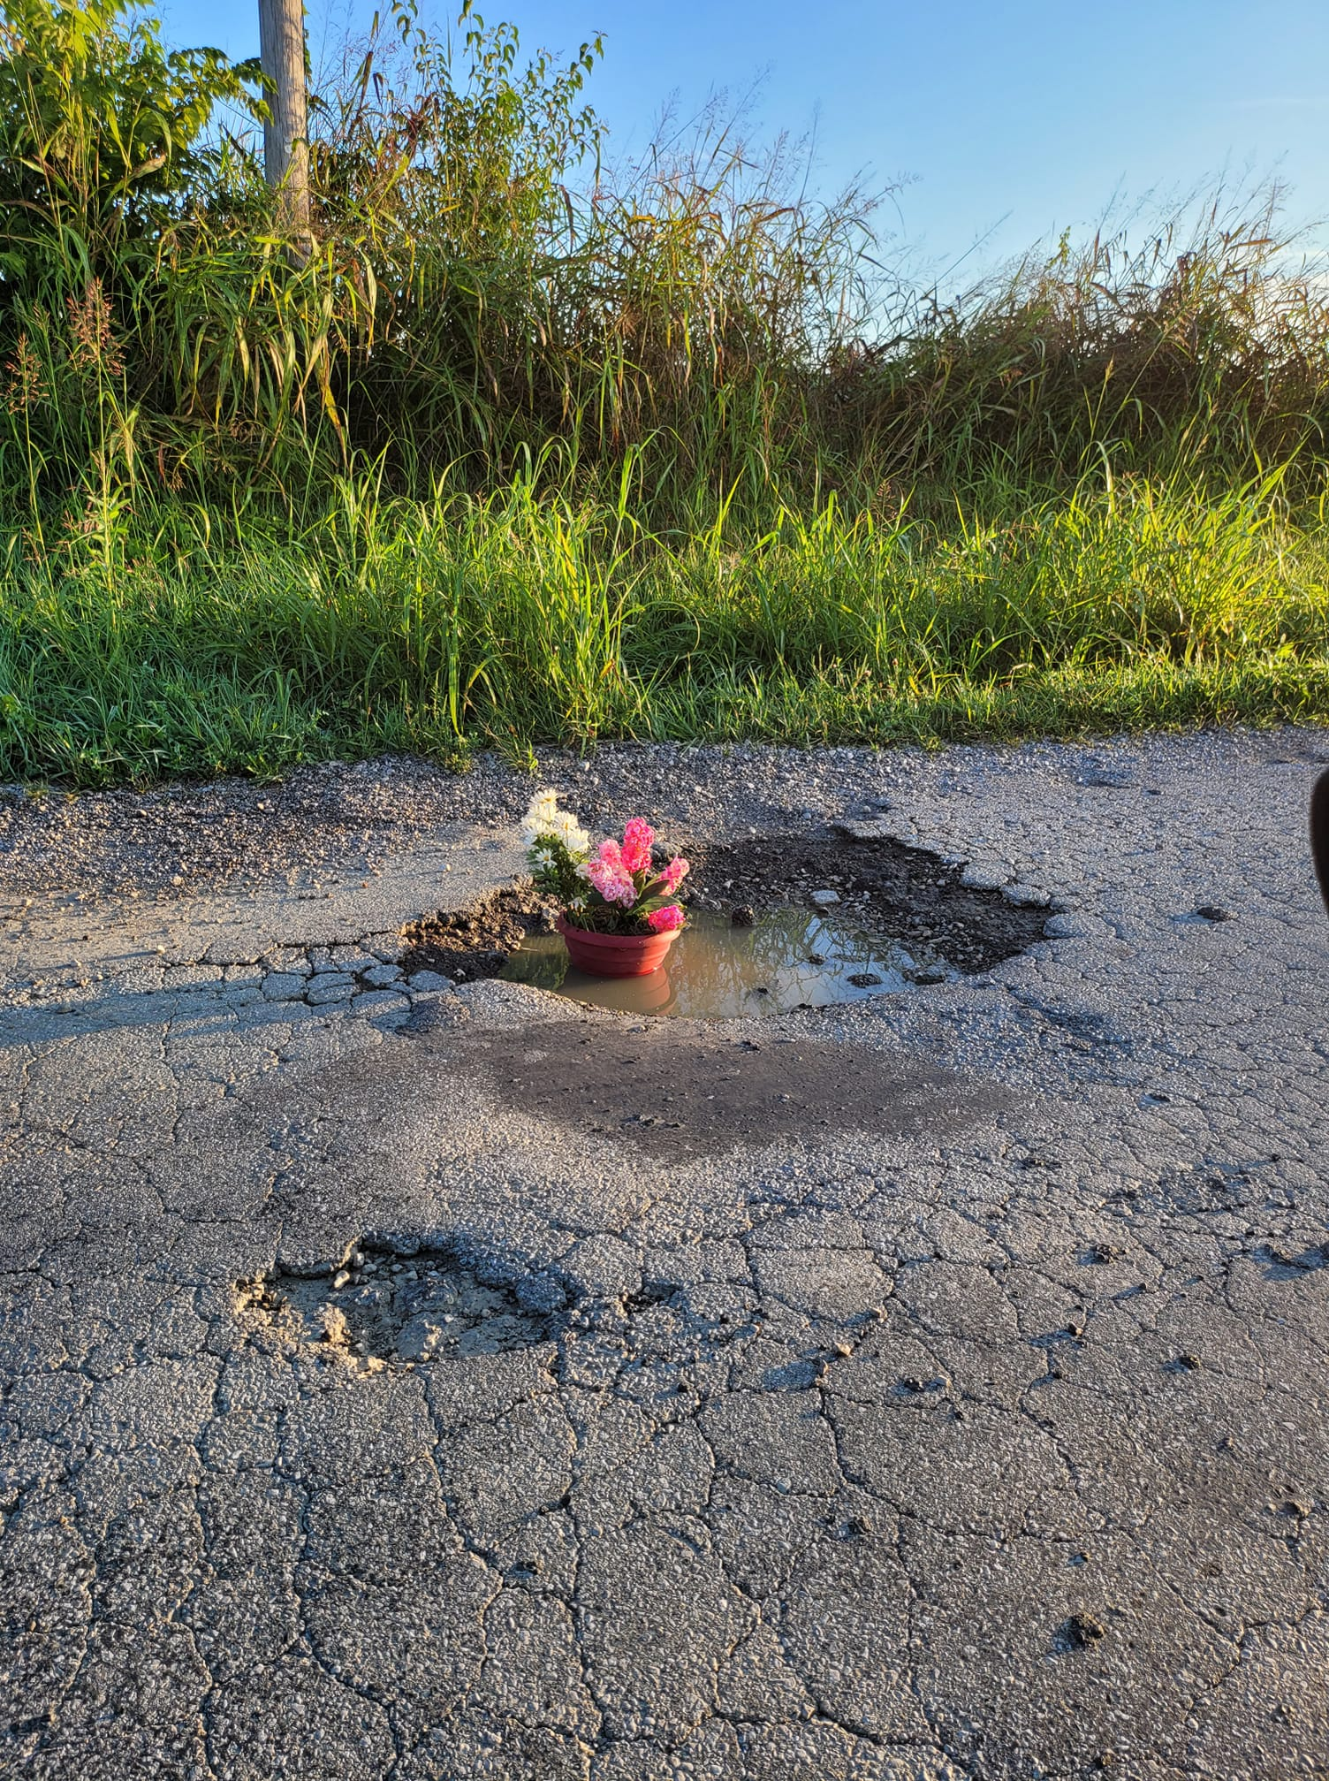

Slide 17
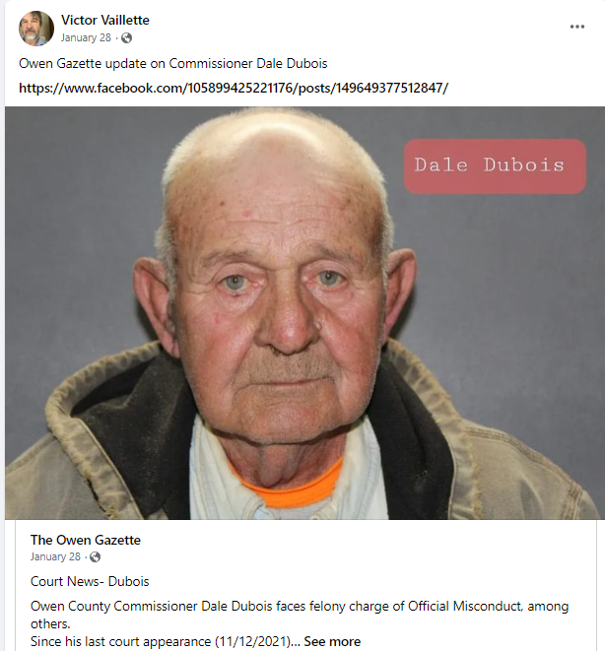

Slide 20
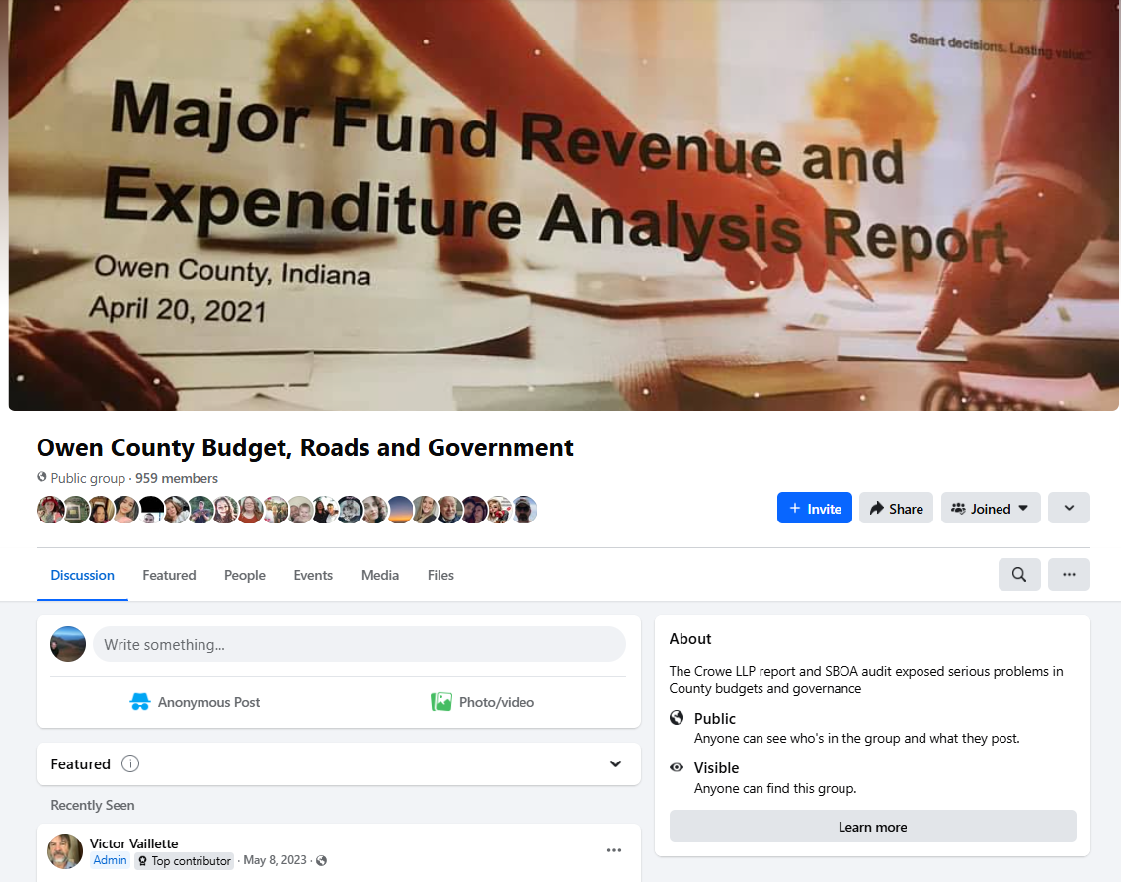

Slide 22
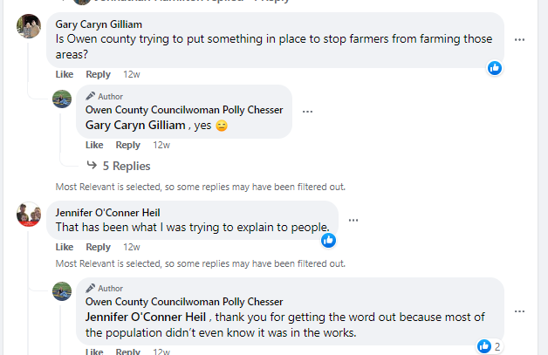

Slide 24
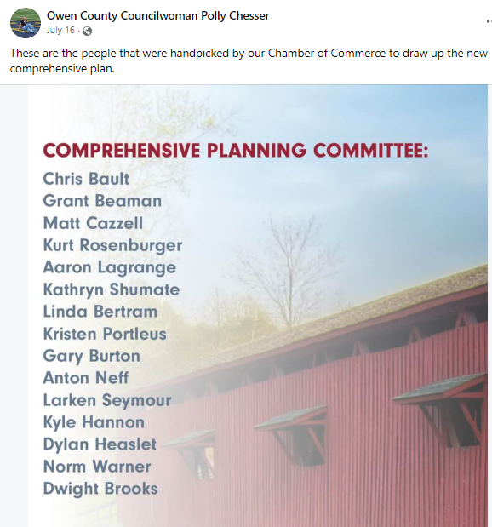

Slide 25
After being identified on social media, half the steering committee quit.

Slide 26
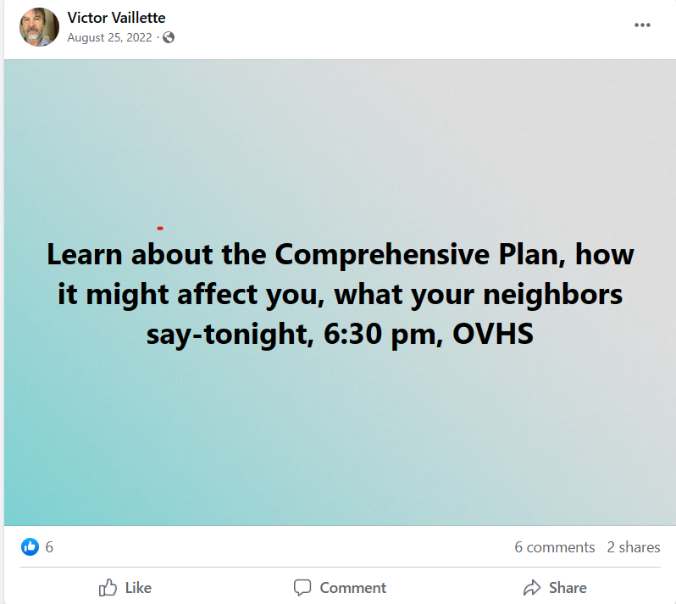

Slide 29
Fight or Flight?
Launch a fact-filled counter-attack on social media or put your head down and plow through with the meeting?

Slide 30
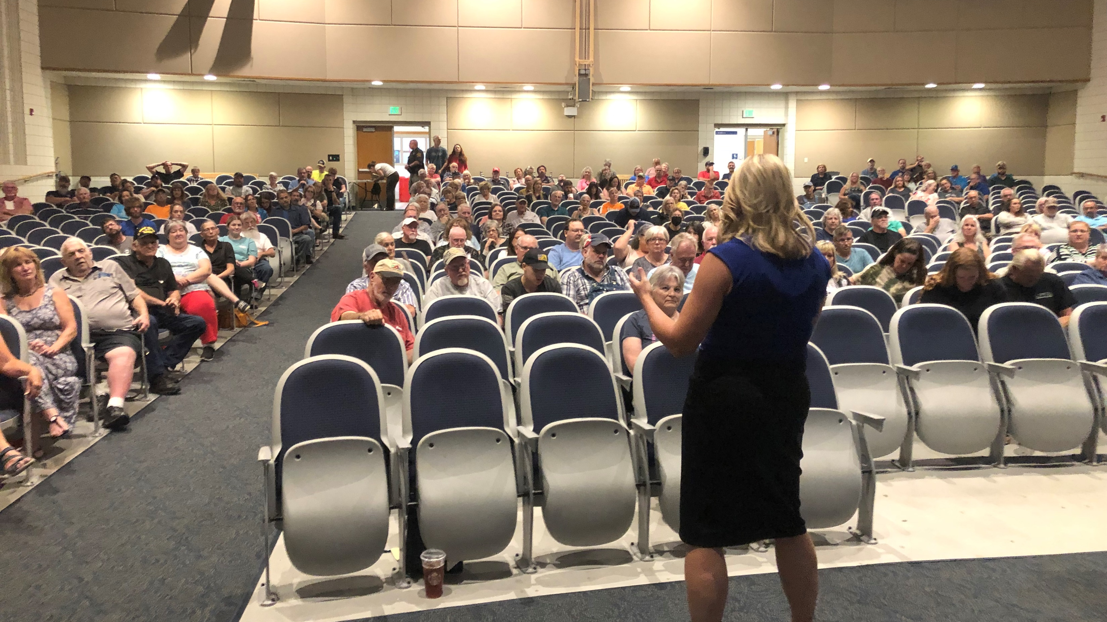

Slide 32
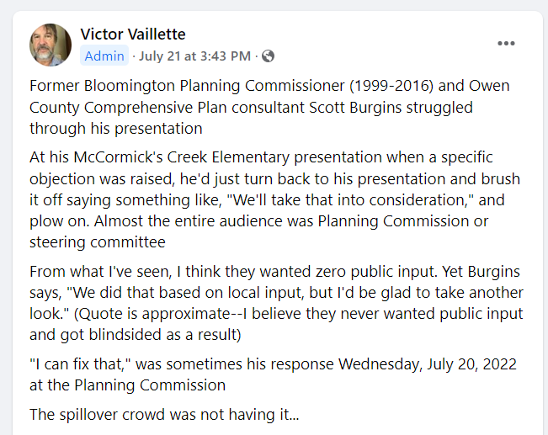

Slide 35
The Costs of Fixing the Problem
Added 8 members from agricultural community to steering committee.
Sent a public survey to all 22,000 county households.
Added two more countywide public meetings.
Tacked on 3 extra months to planning process.

Slide 36
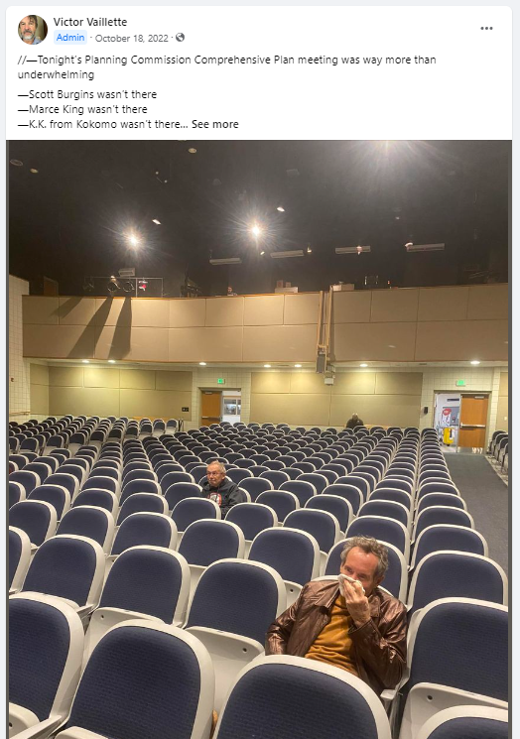

Slide 37
City of Crookston, MN
Welcoming and Inclusion Study

Slide 38
Highlights
City of Crookston has seen it’s growth of non-white citizen double to 19.07% from 2010 to 2020.
The community sits on land that was both Dakota and later Ojibwe land.
The community is home to a rich and diverse Hispanic community that migrate to the region in the 1920’s.

Slide 39
Concerns going into the study
There would be a lack of engagement because in the past the city did not have a positive history of being inclusive to the Hispanic community.
There would be pushback from the community on the survey results, whatever they may be.
There was a concern since the community leaders were all mostly “white” that no change would come out of the report.

Slide 40
Question
Reflect to the earlier question: Think of a time where you led or participated in a tense public engagement session, what helped to bridge or eliminate the tension?

Slide 41
Key’s to (re)building trust – Before you initiate Public Engagement Plan
Develop an advisory group of the community to help you prepare the engagement plan
When mapping out the process be flexible and nimble.
For example, if receiving a grant work with the funder to be patient and flexible.
Understand what led to any of the breakdowns of trust in the first place and what has contributed to an ongoing breakdown of trust.
For example, has there been a historical injustice; is there institutional distrust; is there a misuse of data
Explore where there are areas of systematic and structural racism
Map and evaluate the current institutional and power structures within the community

Slide 42
Engaging the community
Acknowledge differences in culture
Frame differences as assets
Create opportunities for people of different cultures to interact
Establish healthy patterns and conflict management
Find common goals

Slide 43
Steps after the engagement is done
Address some of the smaller tasks first - e.g. those that are “low-hanging fruit.”
This can demonstrate that you can work together on something, which in turn can help to gain or reestablish trust.
Find ways to continually build and rebuild trust.

Slide 44
Highlights and Takeaways
Create an action plan. This could take on the form of a racial equity theory of change which can help you identify what can hinder or help, what you must know, and what you must do in able to be successful in achieving your projects outputs and outcomes.
Building trust takes time; build this into your project
Be aware of your own biases; conscious or unconscious, and be willing to acknowledge other cultures and credit opportunities for people of other cultures to interact.
Find ways to continually build and rebuild relationships and trust, long after the engagement has occurred.

Slide 45
Resources
Build Trust in Communities | Social Capital | UMN Extension
Qualitative Approaches to Studying Marginalized Communities | Oxford Research Encyclopedia of Education
Identification of the Marginalized Urban Communities Charact…
Blandin Community Leadership Handbook
Berg (2019) Promoting tribal, city, and county relationships.

Slide 46
Questions
Mitchell Berg Scott Burgins
bergmi@iu.edu rburgins@iu.edu

