Slide 1
Clean Energy Funding Strategies to Meet Audacious Goals
Nikki Vandivort, FUSE Executive Fellow – Clean Energy & Electrification, City of Cincinnati Office of Environment & Sustainability

Slide 2

Opener: Show of Hands
Photo by Frank Kehren: https://www.flickr.com/photos/fkehren/9402071730/
Notes:
Opener: Show of hands:
-Whose City has a sustainability or climate action plan?
-Raise your right hand if you have a big community-wide carbon neutrality or net zero goal, like being carbon neutral by 2050
-Raise your left hand if you have a big clean energy goal for city operations, like 100% Renewable Energy by 2035
-Cool! Congratulations on setting big goals. You can put your hands down. Last one – I want to take the temperature in the room and see the confidence you have in meeting those goals. Raise your hand high if you’re very confident, maybe down by your face if you’re feeling progress is being made but could be better, and maybe down here if you’re pretty worried about reaching those goals.
-Got it. They’re audacious goals, I get it. Merriam-Webster defines “audacious” as intrepidly daring, and used it in the phrase “an audacious mountain climber”. For some cities, the mountain may be Mt. Rainier – daunting, but doable, thanks to an abundance of support and resources. For others, their mountain is Everest. But people do ascend Mount Everest every year, and even those who make it to base camp have hiked for about 6-8 days and accomplished something worthy. I’m hoping to help guide you to resources and strategies to help you make progress on your audacious goals.

Slide 3
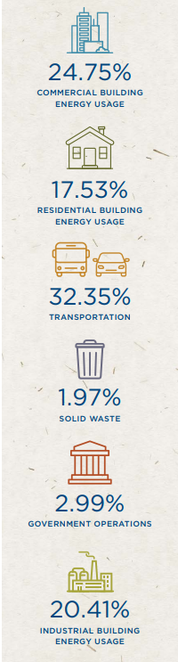
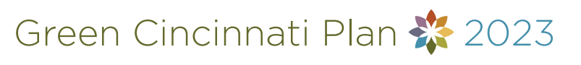
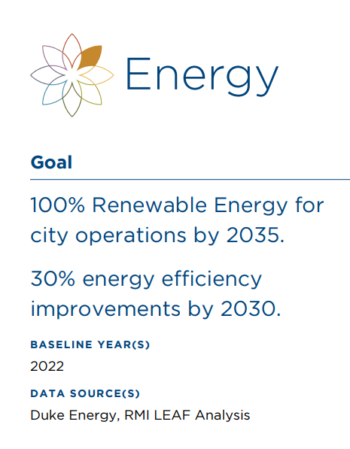
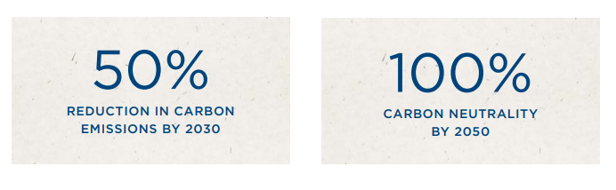
< 2022 Community Carbon Emissions
Cincinnati’s Community-wide Climate Targets
City Operations
Energy Goals >
Notes:
Cincinnati has goals for both city operations and community-wide.
Based on our 2022 community carbon emissions estimates, city operations is responsible for only approximately 3% of our total community-wide emissions, but it is important we lead the way on emissions reductions.
It also means that we have to work in collaboration with many partners. So those are the first two takeaways: your municipality can lead the way, even if it’s not a huge contributor to your community’s emissions, and that this work takes a coalition of stakeholders to drive down emissions across all these sectors.

Slide 4
Operations or City-wide
Funding Sources & Strategies
Notes:
Set the Stage
In anticipation of this audience, I expected there to be some folks here with clean energy or carbon neutrality goals for city operations and those who are thinking about community-wide clean energy or carbon neutrality goals. This presentation has something for everyone.
That said, I’ve divided the presentation into [Funding sources] like tax credits and direct pay and [Strategies] like policies and programs. How to find new funding resources? And how do you meet your goals? Two similar but different lenses

Slide 5
Federal Funding & Incentives
Inflation Reduction Act (IRA)
Bipartisan Infrastructure Law (BIL, also known as IIJA)
Congressionally Directed Spending or Community Project Funding (i.e. Congressional Earmarks)
Notes:
Federal Incentives
In the past few years there have been several pathways for federal funding of clean energy and other energy-related projects, policies, and programs: the Inflation Reduction Act (IRA), the Bipartisan Infrastructure Law (BIL, also known as the IIJA Infrastructure Investment and Jobs Act), and congressional earmark spending. This last one is not my area of expertise, but organizations like the Urban Sustainability Directors Network, or USDN, are promoting this as a funding route that is still being prioritized by Congress* (will need to remove if the Gov’t Shutdown passes a year-long continuation bill). Consult with your intergovernmental and policy staff on approaching your Congressional offices.
The BIL was signed into law (11/15/21) 9 months before the IRA (8/16/22), and a lot of that funding has already been disbursed. But there is funding that is currently being held up at the federal level coming from the BIL. Probably most pertinent for this crowd is the Energy Efficiency Conservation Block Grant (EECBG) formula funding that was awarded to state energy offices for distribution among local governments. If your municipality received an EECBG award, …
There are still aspects of the IRA that local governments can take advantage of.

Slide 6
IRA Programs
A Sample of IRA Incentives
Program | For Whom
Tax Credits & Elective Pay | Individuals, Businesses, Tax-Exempt
Tax Deductions | Commercial, Tax-Exempt
Low-Cost Loans | Individuals, Commercial, Tax-Exempt
Solar For All | Single-Family & Multifamily
Home Energy Rebate Programs | Single-Family & Multifamily
Energy Audits
Energy Efficiency
Electrification
Clean Energy
Notes:
IRA Programs
-The IRA consists of tax credits, grant and loan programs that represent a historic investment in energy upgrades to buildings, vehicles, manufacturing, and energy generation sources. There are incentives built in for seemingly everyone, from individuals, to businesses, to tax-exempt organizations – which includes local governments, public institutions like schools and publicly-owned utilities, traditional nonprofits, and houses of worship, contributing to cleaner indoor and ambient air, more comfortable and weatherized homes, more affordable utility bills, and pathways to stable, living wage green jobs.
-A particularly special part of the IRA was the introduction of the Elective Pay process, which allows tax-exempt entities to claim particular tax credits in the form of a direct payment or refund. Can I see a show of hands, who in the audience is from a municipality that has already taken advantage of Elective Pay? Cool!

Slide 7
IRA Tax Credits & Elective Pay
IRA Tax Credits Eligible for Elective Pay and Relevant for Local Governments
IRC | Tax Credit Name | Direct Pay | Efficiency | Electrify | Renewables & Storage
45W | Commercial Clean Vehicles | ✓ |  | X
30C | Alternative Fuel Vehicle Refueling Property Credit | ✓ |  | X
48/48E | Investment Tax Credit (ITC) | ✓ |  |  | X
45/45Y | Production Tax Credit (PTC) – more common for utility-scale | ✓ |  |  | X
Bonus | ITC/PTC Bonus Credits: 10%-20% extra Low-Income Communities (competitive), 10% Energy Communities, and 10% Domestic Content | ✓ |  |  | X
Notes:
IRA Programs
-The IRA consists of tax credits, grant and loan programs that represent a historic investment in energy upgrades to buildings, vehicles, manufacturing, and energy generation sources. There are incentives built in for seemingly everyone, from individuals, to businesses, to tax-exempt organizations – which includes local governments, public institutions like schools and publicly-owned utilities, traditional nonprofits, and houses of worship, contributing to cleaner indoor and ambient air, more comfortable and weatherized homes, more affordable utility bills, and pathways to stable, living wage green jobs.
-A particularly special part of the IRA was the introduction of the Elective Pay process, which allows tax-exempt entities to claim particular tax credits in the form of a direct payment or refund. Can I see a show of hands, who in the audience is from a municipality that has already taken advantage of Elective Pay? Cool!

Slide 8
Investment Tax Credit (“48” and “48E”) & Bonus Credits
70%
60%
50%
40%
30%
20%
10%
0%
Clean energy projects <1 megawatt qualify for the 30% base credit without prevailing wage or apprenticeship programs
Energy Communities: 10% Bonus
Domestic Content: 10% Bonus
Low Income Communities: 10 or 20% Bonus. Competitive. Projects must be < 5MW
**Low-Income Residential Building
Project or Economic Benefit Project
**
*
*Low-Income Community
or Tribal Land
Domestic Content
Energy Community
Base Credit

Slide 9




IRA Tax Credits & Elective Pay (A.K.A. Direct Pay)
Before Direct Pay
After Direct Pay
Tax Exempt
$
Private Company
Tax Exempt
Financing Agreement
Tax Exempt entities can take advantage of the full clean energy tax credits directly
$
Private company claims federal tax credits. Nonprofit gets a “discount” on clean energy project.

Slide 10
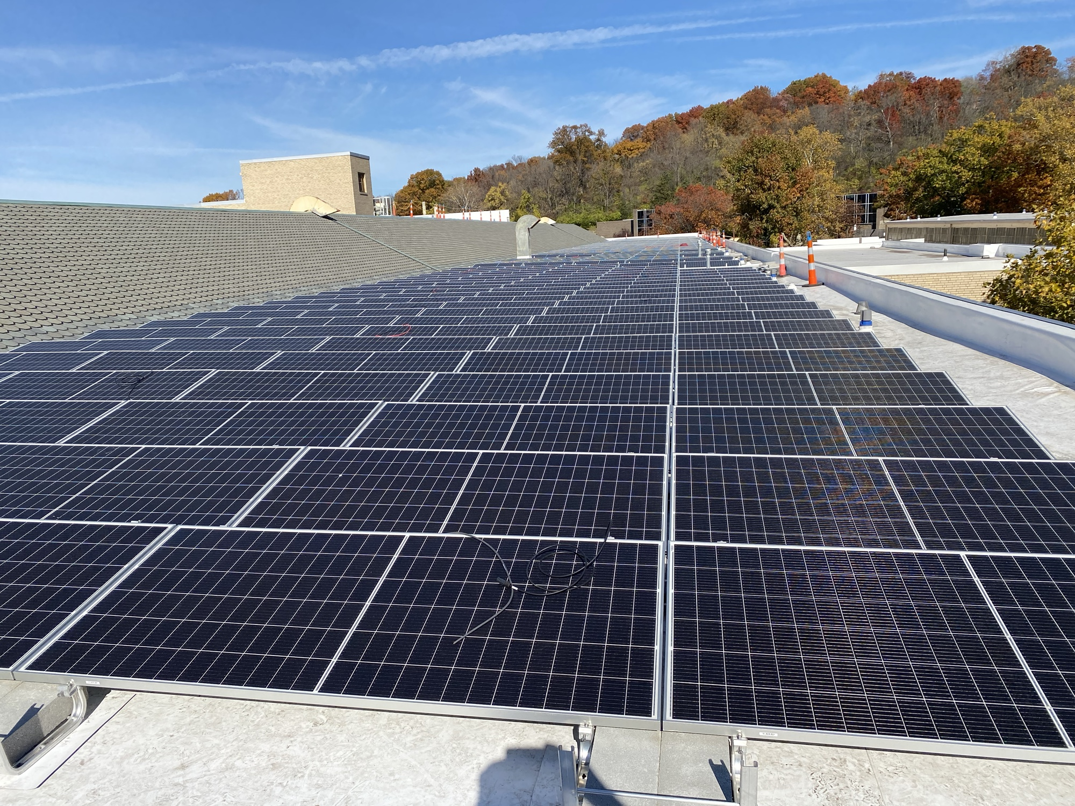
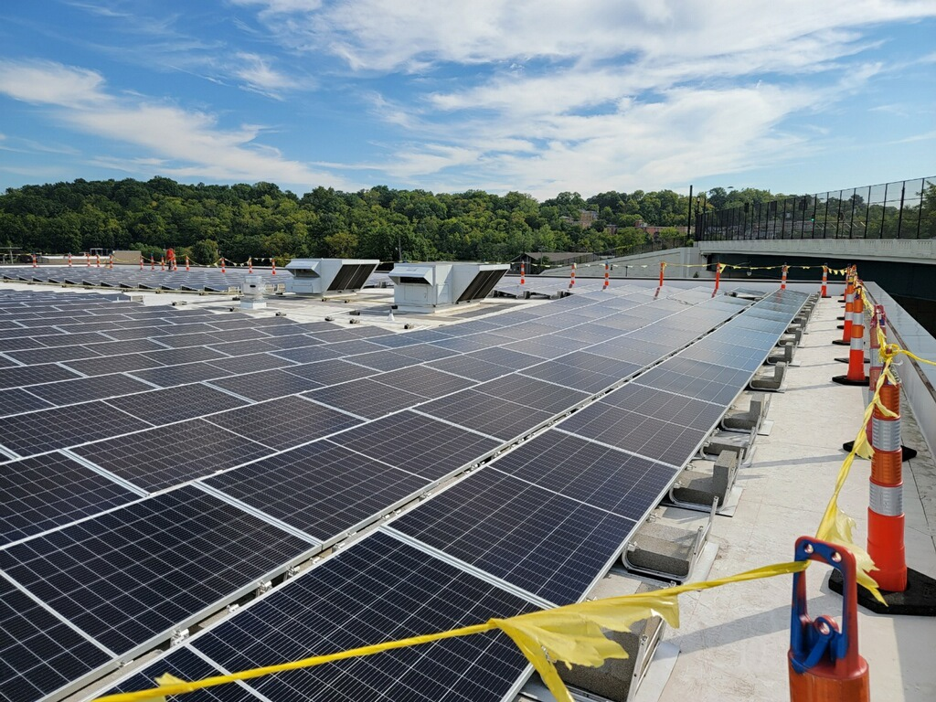
The City of Cincinnati is pursuing Investment Tax Credits through Elective Pay for solar installations at 8 city facilities: 5 from FY2024 and 3 from FY2025. Other eligible technology includes ground-source heat pumps, battery backup storage, small wind, and more (but solar is probably most common). Images: McKinstry
Notes:
Mention the City’s revolving loan fund for facilities

Slide 11



Tax Exempt (local gov’t, nonprofits, public institutions, faith communities)
Homeowners, renters
Businesses
IRC | Tax Credit/Deduction Name | For Whom | Efficiency | Electrify | Clean Energy & Storage
45W | Commercial Clean Vehicles |  |  | X
30C | Alternative Fuel Vehicle Refueling Property Credit |  |  | X
48/48E | Investment Tax Credit (ITC) |  |  |  | X
45/45Y | Production Tax Credit (PTC) – more common for utility-scale |  |  |  | X
 | ITC/PTC Bonus Credits: 10%-20% Low-Income Communities, 10% Energy Communities, and 10% Domestic Content |  |  |  | X
25C | Energy Efficient Home Improvement |  | X | X
25D | Residential Clean Energy |  |  |  | X
25E | Used Clean Vehicles |  |  | X
30D | New Clean Vehicles |  |  | X
179D | Commercial Buildings Energy-Efficiency Tax Deduction |  | X
168e3B | Cost Recovery for Energy Property Tax Deduction |  |  |  | X
45L | New Energy Efficient Homes |  | X

Slide 12
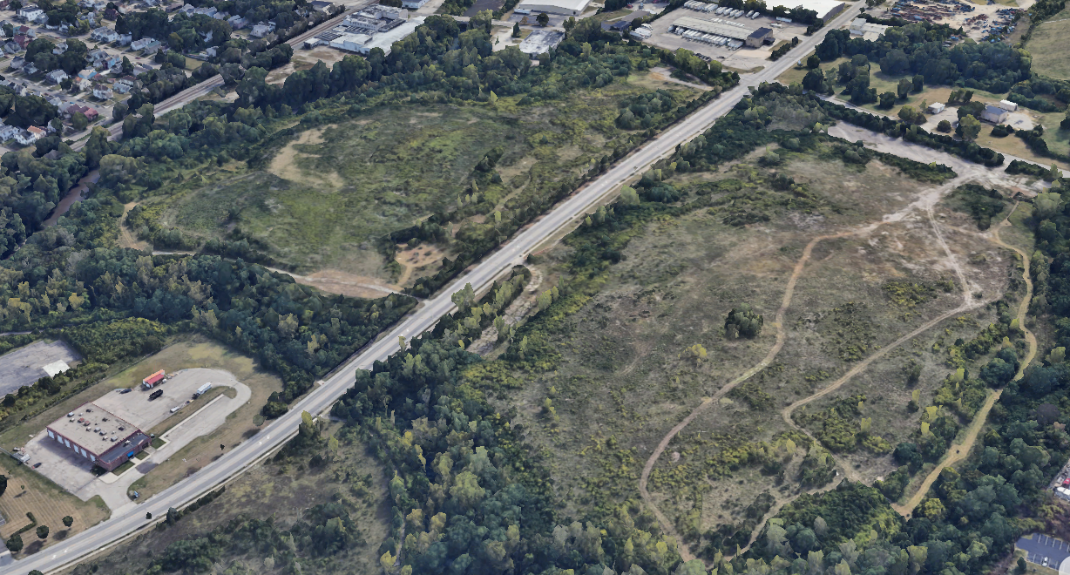

Report: January 2024
The City-owned Center Hill Landfill is a closed municipal landfill. The City of Cincinnati is considering adding up to 5 megawatts of solar at the landfill with a Solar For All grant and potential ITC tax credits. Image: Google Earth

Slide 13

IRA: Solar For All Awards
60 awards: 49 states, 6 Tribes/Tribal Coalitions, and 5 multi-state awards
Funding:
Single-family and Multifamily solar
Community solar
Workforce training
Technical assistance, education, and outreach
What can you do to ensure that your city and residents are positioned to draw state award funding?

Slide 14
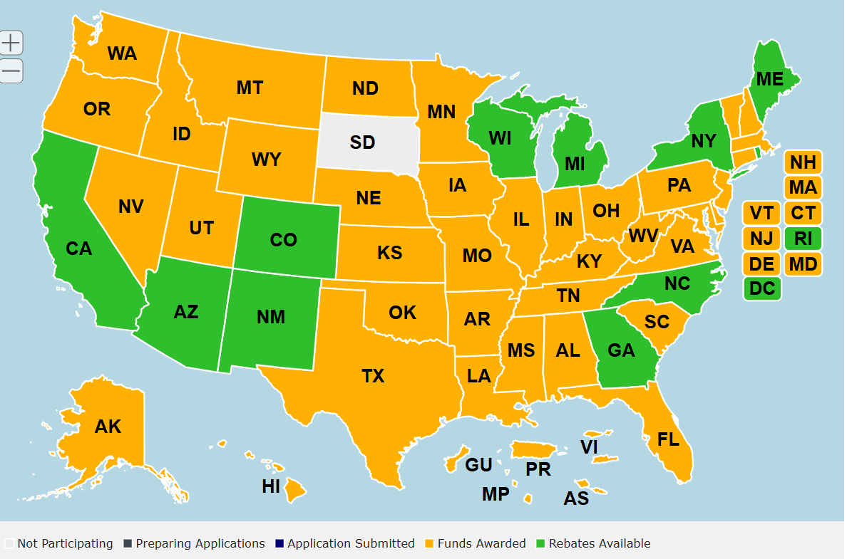
IRA: Home Energy Rebate Programs
55 states and territories awarded
Single-Family & Multifamily Households
Energy Audits
Weatherization (e.g. insulation, air sealing, ventilation)
Electrification (e.g. heat pumps for HVAC, water heating, and clothes dryers; electric/induction stoves; electric wiring & panels, etc.)
Again: What can you do to ensure that your city and residents are positioned to draw state award funding?
Current Source: Internet Archive, https://web.archive.org/web/20250122075747/https:/www.energy.gov/scep/home-energy-rebates-progress-tracker
Original Source: January 17, 2025, https://www.energy.gov/scep/home-energy-rebates-progress-tracker

Slide 15
Large Scale Clean Energy Strategies
Power Purchase Agreements
  Cincinnati, OH | Washington D.C. | Pendleton, OR | Fremont, NE
Community Solar
Community Choice Aggregation
Benchmarking & Building Performance Standards
  St. Louis, MO| Reno, NV | New York City, NY | Vancouver, BC | 2030 Districts
Green Tariffs
  Bozeman & Missoula, MT | Charlotte, NC
Climate Millage, Carbon Tax, Carbon Fee
  Ann Arbor, MI | Denver & Boulder, CO | Athens, OH
Notes:
Federal Incentives
In the past few years there have been several pathways for federal funding of clean energy and other energy-related projects, policies, and programs: the Inflation Reduction Act (IRA), the Bipartisan Infrastructure Law (BIL, also known as the IIJA Infrastructure Investment and Jobs Act), and congressional earmark spending. This last one is not my area of expertise, but organizations like the Urban Sustainability Directors Network, or USDN, are promoting this as a funding route that is still being prioritized by Congress* (will need to remove if the Gov’t Shutdown passes a year-long continuation bill). Consult with your intergovernmental and policy staff on approaching your Congressional offices.
The BIL was signed into law (11/15/21) 9 months before the IRA (8/16/22), and a lot of that funding has already been disbursed. But there is funding that is currently being held up at the federal level coming from the BIL. Probably most pertinent for this crowd is the Energy Efficiency Conservation Block Grant (EECBG) formula funding that was awarded to state energy offices for distribution among local governments. If your municipality received an EECBG award, …
There are still aspects of the IRA that local governments can take advantage of.

Slide 16
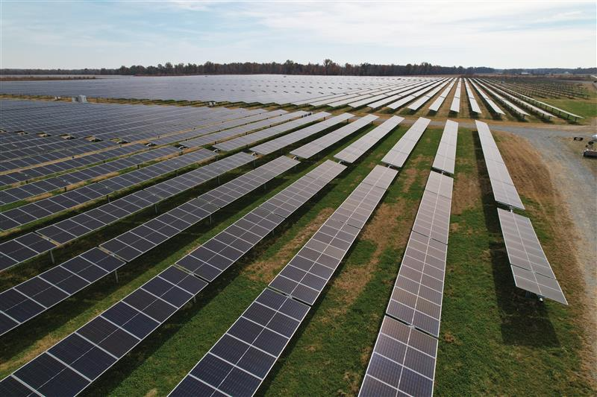
Strategy:
Power Purchase Agreements
New Market Solar Project
900 Acres, Highland County, OH
Power Purchase Agreement (PPA)
35 MW cover ~25% of the City’s annual operations (completed early 2022)
65 MW cover ~8% of total residential electricity usage (completed Spring 2024)
Estimated $1.8 million savings over 20 years
Image: Algonquin Power & Utilities Corp.

Slide 17
States where PPAs and Community Choice Aggregation (CCA a.k.a. CCE) are allowed
Arizona
Arkansas
California
Colorado
Connecticut
Delaware
Georgia
Hawaii
Illinois
Iowa
Maine
Maryland
Massachusetts
Michigan
Nebraska
Nevada
New Hampshire
New Jersey
New Mexico
New York
Ohio
Oregon
Pennsylvania
Rhode Island
Texas
Utah
Vermont
Virginia
Washington
West Virginia
Also:
Puerto Rico
Washington D.C.
Sources: PPAs: https://www.cnet.com/home/energy-and-utilities/does-your-state-allow-power-purchase-agreements-find-out-here/; https://ncsolarcen-prod.s3.amazonaws.com/wp-content/uploads/2023/11/DSIRE_3rd-Party-PPA_Nov_2023.pdf CCA: https://www.epa.gov/green-power-markets/community-choice-aggregation#three

Slide 18
Community Solar
Projects in 44 states, including Washington D.C.
23 states and D.C. have policies that support community solar
About 73% of installed community solar is in four states:
    Florida (2,085 MW-AC)
    New York (1,764 MW-AC)
    Massachusetts (1,014 MW-AC)
    Minnesota (910 MW-AC)
Sources: https://www.cnet.com/home/energy-and-utilities/which-states-have-community-solar-find-out-here/
https://www.nrel.gov/state-local-tribal/community-solar.html

Slide 19
Small-Medium Clean Energy Strategies
Develop implementable plans (e.g. Fleet Electrification Plan; EV Readiness Community Plan)
Property Assessed Clean Energy (PACE) programs
Solarize programs (Example: Solar United Neighbors)
Sustainable Energy Utility (Example: Ann Arbor, MI)
Team with local lenders to offer an energy improvement/clean energy low-cost loan program for homeowners (Example: Hamilton County, OH HIP and Revive + Thrive programs)
Fund energy audits for businesses and tax-exempt buildings
ESCO’s/Performance Contracting for City Facilities
Energy Ready Programs: SolSmart, Charging Smart, and Small Wind Smart
Notes:
Federal Incentives
In the past few years there have been several pathways for federal funding of clean energy and other energy-related projects, policies, and programs: the Inflation Reduction Act (IRA), the Bipartisan Infrastructure Law (BIL, also known as the IIJA Infrastructure Investment and Jobs Act), and congressional earmark spending. This last one is not my area of expertise, but organizations like the Urban Sustainability Directors Network, or USDN, are promoting this as a funding route that is still being prioritized by Congress* (will need to remove if the Gov’t Shutdown passes a year-long continuation bill). Consult with your intergovernmental and policy staff on approaching your Congressional offices.
The BIL was signed into law (11/15/21) 9 months before the IRA (8/16/22), and a lot of that funding has already been disbursed. But there is funding that is currently being held up at the federal level coming from the BIL. Probably most pertinent for this crowd is the Energy Efficiency Conservation Block Grant (EECBG) formula funding that was awarded to state energy offices for distribution among local governments. If your municipality received an EECBG award, …
There are still aspects of the IRA that local governments can take advantage of.

Slide 20
Resources:
Open Federal Funding & Incentives
EPA Thriving Communities Grantmaking Grants:
  https://www.epa.gov/inflation-reduction-act/thriving-communities-grantmaking-program
Notes:
Note sure whether to include this anywhere? Seems to be one of the only remaining BIL programs still open.

Slide 21
Thank you!
Check out our ElectrifyCincy.org Website!
Contact:
Nikki Vandivort
FUSE Executive Fellow – Clean Energy & Electrification
nikki.vandivort@cincinnati-oh.gov

