Slide 1
FRAUD.THEFT.LIES. $3.2M in Taxpayer Funds...GONE. A Community Turned Upside Down. What Happened Next?!
Eden Ratliff- ICMA-CM, M.A.
Deputy City Manager- Charlottesville, Va

Slide 2
You are escorted to a second-floor conference room of Town Hall where you are greeted by the elected body for your first in person interview. You notice an office door wrapped in “Police Line. Do Not Cross” tape.
What do you say to the elected body when they say,
“Tell us what you know about our community?”

Slide 3
FRAUD.THEFT.LIES. $3.2M in Taxpayer Funds...GONE. A Community Turned Upside Down. What Happened Next?!
Eden Ratliff- ICMA-CM, M.A.
Deputy City Manager- Charlottesville, Va

Slide 4
Kennett Township, Pa
Second Class Township
8,000 Population
3 Member Board of Supervisors
$12.5M Budget ($5.5M General Fund)
~30 Employees
Mushroom Capital of the World

Slide 5
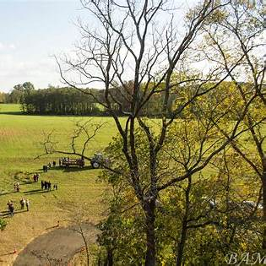
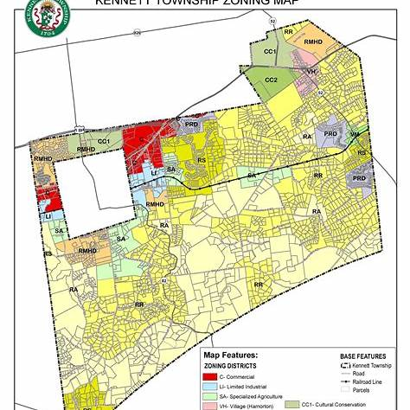
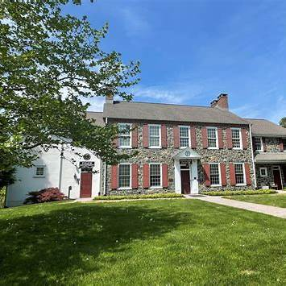

Slide 6
Timeline of Events
April 2019- Strange Phone Call from CapitalOne
May 2019- Termination of Manager
Summer 2019- Investigation and Search for new Manager
December 2019:
https://www.youtube.com/watch?v=wib55iNjBW8

Slide 7
Timeline of Events
Discovery
Investigation
Criminal Charges
Prosecution
Recovery

Slide 8
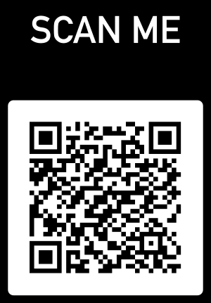
Quick Facts
$3.2M in Fraud over a 7-year period
Checks, Direct Deposits, Credit Cards, E- Trade Account
115 Felony Counts

Slide 9
Manager Transition
Township Manager, Crisis Manager, Therapist
Building a Budget
Assembling a Team (Fraud Team and Township Team)
Having a Plan
Eye on the Prize

Slide 10
Fraud Response Team
Forensic Accountant (Marcum LLP., Ricardo Zayas)
Chester County District Attorney’s Office
Counsel for the Township (Blank Rome, Joseph G. Poluka, Esq.)
Public Relations Counsel (Envision Strategies, Carl Francis)
Township Manager and Board of Supervisors

Slide 11
Inside the Township Building

Slide 12
Communications- The Strategy
Who Committed the Crime. Who is responsible for fixing it?
Do not play “hide the ball”
Receiving Information should be Easy

Slide 13
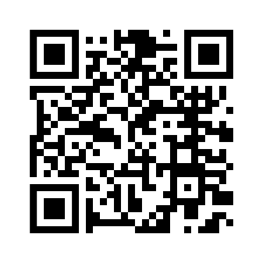
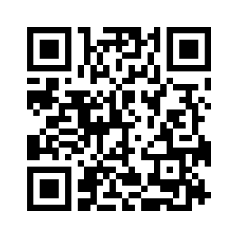
Communications- The Strategy
https://www.youtube.com/watch?v=4UP1XlL5uVE&t=5432s
https://www.youtube.com/watch?v=gqUckKQNU90&t=7s

Slide 15
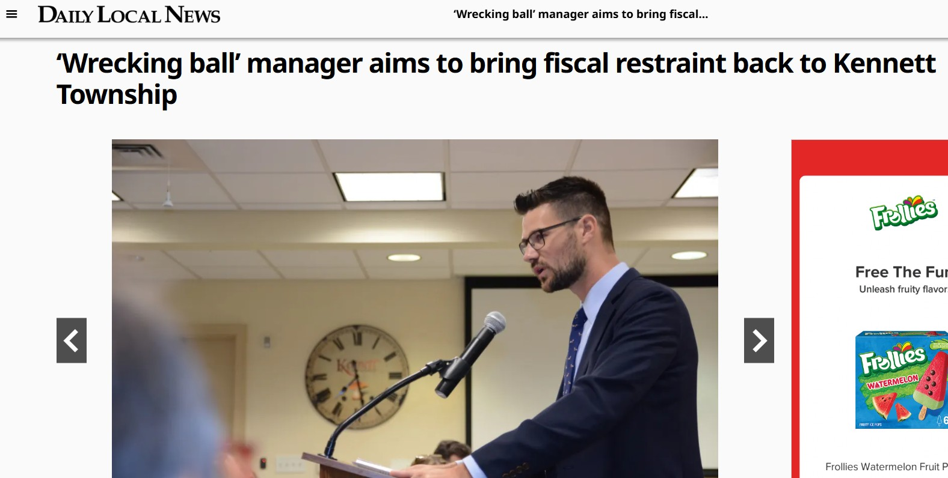

Slide 16
Prosecution
Hurry Up and Wait
COVID-19

Slide 17
Recovery
Who should have known about the crimes as they were being committed?
Insurance
The accused
80% recovery of stolen funds and cost
Note: Diminishing rate of return

Slide 18
Local Government Services
We still had a government to run!

Slide 19
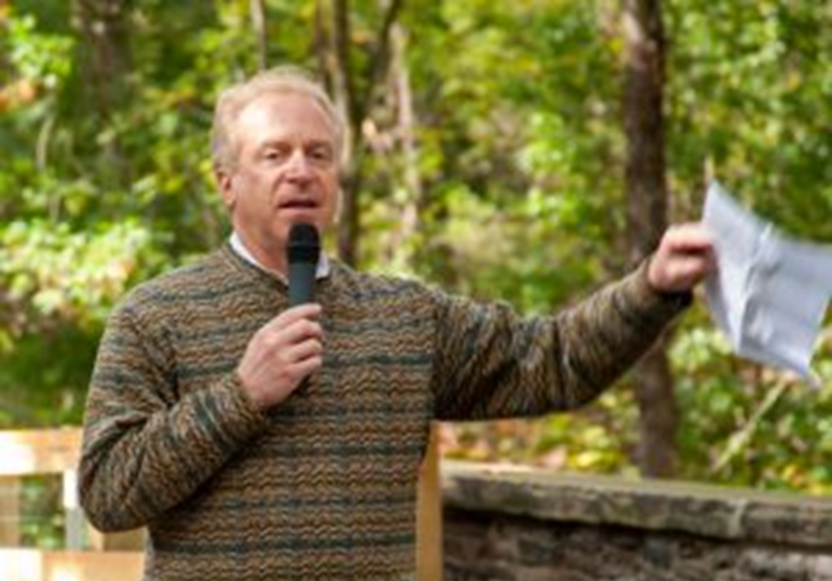
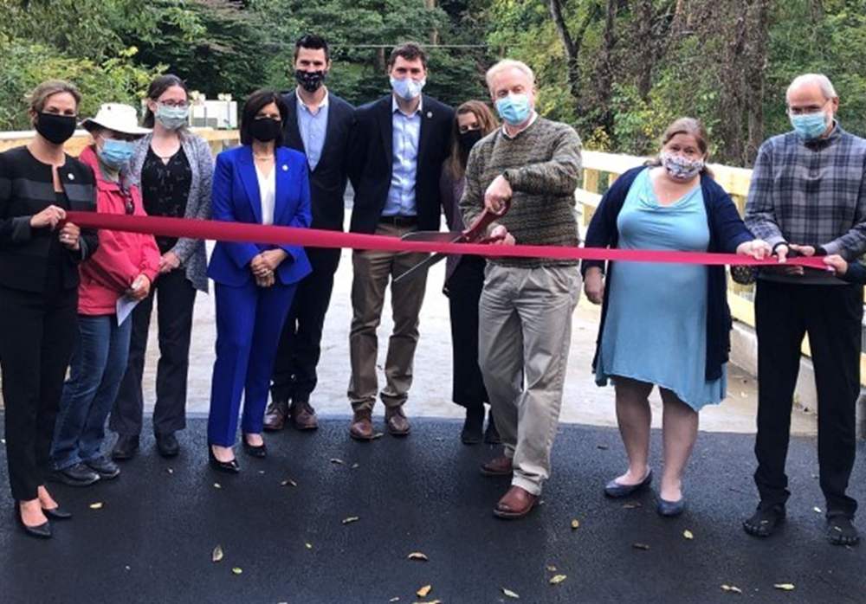
Local Government Services

Slide 20
Lessons Learned
Fraud can happen anywhere
Never “Check the Box”
The Spotlight can be very bright
Sometimes there is no playbook

Slide 21
Questions
What did it feel like? Was it fast pace?
Were there any municipal elections during this timeframe?
Does the public still talk about it?
What was the employee experience?

Slide 22
Thank you!

