Slide 1
From Data to Action: How Normal, IL Transforms Survey Insights into Community Impact
Cathy Oloffson, Luis Carranza

Slide 2
Our Vision
A world where strong trust between communities and the government agencies that serve them radically improves life in every community.
Our Mission
Zencity is setting the standard for how state and local governments get community input, understand it, and use it to take effective action.

Slide 3
350+ government organizations
use Zencity every day to
improve services, increase satisfaction & build trust
The platform allows us to understand the needs and concerns of our residents to make the best decisions.
Todd Gloria, San Diego Mayor

Slide 4
Local government keeps our world running
We start from the belief that

Slide 5
Building trust with your community is the key to success
“Trust helps government connect with residents and encourages voluntary compliance with rules and regulations.”
Deloitte Center for Government Insights

Slide 6
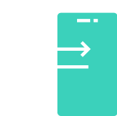
A complex problem requires
a comprehensive solution,
built for our time.
Everyone is online
>93% Of US adults use the internet
A multi-model approach
Combining passive and proactive tools is required to ensure effective engagement
AI productivity boom
Average productivity growth through use of AI is 66%
PEW Research, 2021
The Responsive City Cycle Report, 2022
Nielsen Research Group, 2023

Slide 7
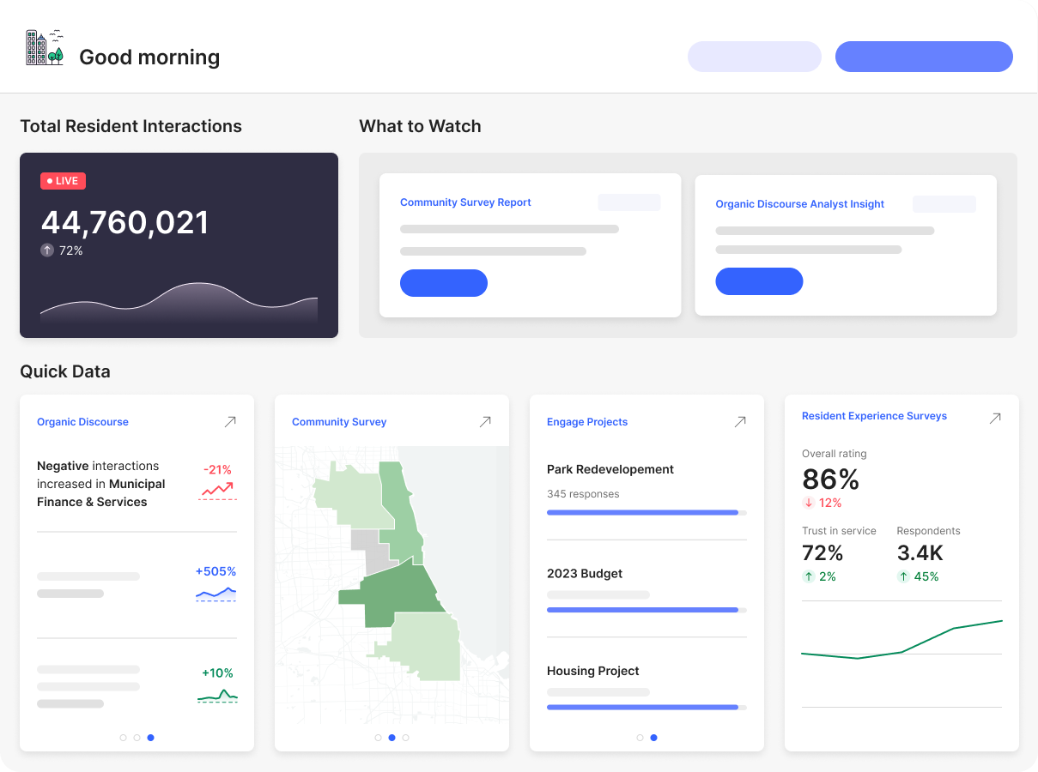
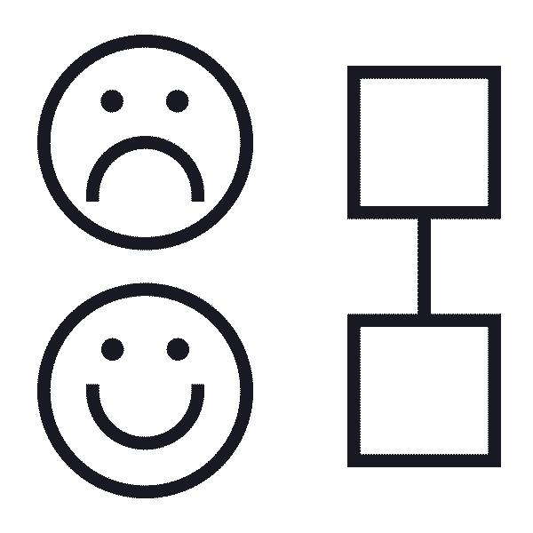
The Zencity Platform
Inclusive, timely and actionable source of truth for community input.
Budget & Resource Allocation
Performance Management
Sentiment analysis
Community surveys
Capital Projects
Annual & Strategic Planning
Messaging & Communications
Public Safety & Trust
Digital engagement
Experience surveys
Capital Projects
Collect input
Analyze
Build trust

