Slide 1
From Paperwork to Productivity: Streamlining Operations & Connecting with Residents in the Digital Age
Rebecca MacLaren, Vice President, Product & Development
Cate Ryba, Director, My Civic & Resident Engagement

Slide 2
Before local government can roll up its sleeves and serve its Residents, it needs to first equip its staff with the right tools, training, and a solid game plan. Because a team that’s ready to tackle challenges is the real backbone of any great service.

Slide 3
Transforming Operations
Importance of Staff Productivity and Efficiency
Key Technologies to Boost Staff Productivity
Building Staff Trust in Technology
Case study examples

Slide 4
Importance of Staff Productivity and Efficiency
2000
2025
Notes:
2000 to Now (2025):
Efficiency: The shift from paper-based, manual processes to digital, integrated workflows has greatly streamlined government services, leading to faster and more efficient delivery to residents.
Workload & Burnout: With the rise of automation and AI-driven tools, governments have been able to offload repetitive tasks from staff, reducing workload and burnout. The adoption of task management software and remote work capabilities has further empowered employees to work more efficiently while maintaining a better work-life balance.
This technological transformation has not only improved service delivery but also contributed to more satisfied, productive government staff.

Slide 5
Importance of Staff Productivity and Efficiency
2000
Paper based and siloed
Departments operated independently
Limited integration and automation
Slower response times
2025
Automation and digitization, creating fast processing
Cloud Computing, centralizing data
Digital Platforms, (Covid), online services and payments
Notes:
2000
Paper based and siloed
Departments operated independently
Limited integration and automation
Slower response times
2025
Automation & Digitalization: Today, many government functions are fully automated or digitized, allowing for faster processing of applications, requests, and services. For example, departments now use integrated platforms that connect multiple services, such as tax filing, social services, or permits, improving coordination across agencies.
Cloud Computing has enabled governments to centralize data, allowing staff to access records and process information in real-time from anywhere. This reduces delays and errors, improving overall efficiency.
Digital Platforms: Government services such as paying taxes, applying for permits, or requesting maintenance are now commonly available online, providing residents with faster access and reducing the need for in-person visits.

Slide 6
Key Technologies to Boost Staff Productivity
Task Management, workflow and Scheduling tools
Mobile solutions for field staff
Communication platforms
Notes:
Summary of my notes below:
2000 to 2025:
Task Management has evolved from basic, manual processes to advanced digital platforms that allow for real-time tracking, collaboration, and reporting. This shift has drastically improved productivity, accountability, and coordination across teams.
Mobile Solutions have transformed field operations by providing real-time updates, enabling paperless workflows, and improving communication between field staff and back-office teams, leading to quicker response times and increased efficiency.
Communication Platforms have replaced fragmented communication methods (e.g., emails, phone calls) with integrated tools that enable seamless, real-time communication, breaking down barriers between departments and improving service delivery and issue resolution.
These technological advancements have made government operations far more efficient, collaborative, and responsive, ultimately enhancing both staff productivity and service quality.
Task Management, Workflow, Scheduling tools
2000:
Limited Digitalization: In the early 2000s, task management was often done manually or through basic, outdated software (e.g., spreadsheets or simple databases). Many government departments relied on paper calendars or sticky notes for scheduling, which led to disorganization, missed deadlines, and inefficient workflows.
Lack of Integration: Different departments often used separate systems, leading to challenges in tracking progress and aligning tasks across teams.
Adoption of Advanced Task Management Software: Today, government agencies widely use tools like Trello, Asana, and Monday.com to manage tasks and schedules. These tools allow for:
Task Assignment & Tracking: These platforms enable teams to assign tasks, set deadlines, and track progress in real-time, ensuring clear accountability and transparency.
Collaborative Planning: Multiple team members can contribute to a project, add comments, and track updates in one centralized platform. This eliminates silos and improves coordination across departments.
Automated Reminders & Notifications: These tools send automated reminders and updates, reducing the risk of missed deadlines and ensuring timely task completion.
Reporting & Analytics: Built-in reporting features help managers track performance and identify bottlenecks, improving overall productivity.
Mobile Solutions for Field Staff
2000:
Limited Mobility: In 2000, field staff in government often relied on paper forms, phones, or fax machines to communicate and submit reports. Communication was slow and required staff to return to the office or a fixed location to report findings or access necessary information.
Manual Updates: Field staff had to manually track service requests, maintenance schedules, or inspections, leading to delays, errors, and a lack of real-time information.
2025:
Mobile Apps Revolutionize Fieldwork: Today, mobile solutions have significantly improved field operations. Government employees, such as maintenance workers, inspectors, or emergency responders, now use mobile apps to:
Real-Time Updates: Apps allow field staff to receive immediate updates on service requests, inspections, or tasks, ensuring they can act quickly and efficiently.
Track Progress & Report Issues: Field staff can update records in real-time, submit reports, and mark tasks as complete directly from their mobile devices. This reduces downtime and eliminates the need for time-consuming paperwork.
GPS & Navigation: Mobile apps now offer built-in GPS and route optimization, helping field staff find the quickest routes to their destinations, reducing delays.
Collaboration with Back-office Staff: With mobile apps, field staff can instantly communicate with back-office teams, request support, or escalate issues that require immediate attention.
Communication Platforms
2000:
Traditional Communication Methods: Prior to the rise of modern communication platforms, government departments relied heavily on traditional methods like phone calls, emails, and memos to communicate. These methods were often slow, inefficient, and fragmented across different departments, causing delays in decision-making and issue resolution.
Limited Cross-Department Collaboration: Communication between teams was often disjointed, requiring back-and-forth emails or face-to-face meetings, which could delay project timelines and service delivery.
2025:
Modern Communication Platforms: Tools like Slack, Microsoft Teams, and Zoom have transformed communication in government, enabling:
Seamless, Real-Time Communication: These platforms allow for instant messaging, video calls, and file sharing, enabling teams to communicate quickly and efficiently regardless of location.
Cross-Department Collaboration: With channels dedicated to specific projects or topics, teams across different departments can collaborate in real-time, share documents, and resolve issues faster.
Integrated Workflow: These platforms are often integrated with other tools like task management software (e.g., Asana, Trello), enabling streamlined communication and task tracking in a single environment.
Transparency & Accountability: By using these platforms, all team members can view conversations, updates, and files related to ongoing projects, ensuring everyone is on the same page.

Slide 7
Staff Training and Adoption of new Tech
Culture of support
Foster growth and innovation
Encourage transition
Ongoing support and continuous learning
Dedicated internal trainers
Workshops
Tutorials
Notes:
Summary: as we transition into a future where new technologies are a regular part of local government operations, the key to success lies in ongoing training and fostering a culture of adaptability. This not only helps with smoother technology adoption but also ensures that our teams remain forward-thinking, efficient, and ready to serve their communities effectively.
with an influx of sophisticated platforms like citizen engagement tools, asset management software, and data analytics systems, the complexity of training has increased dramatically.
Ongoing Support:
Need for continuous learning: As technology evolves rapidly, we cannot rely on a one-time training session. Local governments now need to provide ongoing support, including regular workshops, access to tutorials, or dedicated internal trainers to ensure staff are comfortable with new systems and updates. Peer mentorship is also vital as seasoned staff can assist others in navigating new tools.
Practical example: For instance, when a new platform like (competitors CivicPlus or Cityworks) is introduced, the team should not only undergo initial training but also have access to refresher courses and problem-solving resources as they use the platform in real-world scenarios.
Building a Culture of Adaptability
From 2000 to 2025: The mindset towards technology has shifted. In the early 2000s, there was resistance to change due to concerns about automation replacing jobs. Today, however, technology is seen more as a tool for growth that can free up staff to focus on higher-value tasks.
Fostering Adaptability:
To ensure successful adoption, it's vital to build a culture that embraces change and sees technology as an opportunity for growth and innovation rather than a threat. We need to encourage staff to see themselves as lifelong learners, where learning new systems and processes is part of their professional growth.
Example of Change: When transitioning from manual forms to an online permit system, a mindset shift is required. Staff should be encouraged to see this as an opportunity to improve efficiency and focus on citizen service, rather than viewing the software as an extra task.

Slide 8
Staff Trust in New Tech
Inclusion and Transparency
Involve the staff in selecting tools
They are the ones that use them!!
Explain the why. Reducing workload, alleviating stress
Address Concerns
Encourage open dialogue
Notes:
Summary: the key to successful technology adoption in local governments from 2000 to 2025 lies in inclusion and transparency. By involving staff in the selection of tools and reassuring them that technology is a support system, we create an environment where everyone feels heard, valued, and empowered. When staff understand how technology can make their jobs easier, they become champions of the change, leading to better outcomes for the entire community.
Inclusion and Transparency
Involve staff in selecting tools to ensure they feel heard and understand how technology will benefit their roles.
Addressing Concerns: Reassure staff that technology is designed to support them, not replace them. Digital tools reduce stress and help with workload management.
From 2000 to 2025, the way local governments interact with technology has transformed not just in the tools we use, but also in how we involve our staff in decision-making. As technology becomes central to day-to-day operations, it's essential that staff feel included in the process and understand how these tools will ultimately support their work
Involving Staff in Tool Selection
From 2000 to 2025: Back in 2000, many local governments implemented new technologies without much input from staff, assuming top-down decisions would suffice. However, we've learned that involving staff in the selection process is key to achieving successful adoption and fostering a positive environment around these changes.
Why Involvement is Important:
Ownership and Buy-In: When staff are involved in selecting tools, they feel a sense of ownership and investment in the process. They're more likely to embrace the technology and use it effectively if they have a say in its selection. This is a shift from the earlier approach, where decisions were often made solely by leadership or IT departments.
Understanding the Benefits: When staff have input, they can better understand how the tools will directly benefit their roles. This understanding leads to smoother transitions, increased adoption, and better overall outcomes.
Practical Example: For instance, when implementing a new communication platform for public engagement, involving department heads and front-line staff in the selection process ensures the platform is tailored to meet their needs. By gathering their feedback on features like ease of use or integration with existing systems, you avoid the common pitfall of adopting a tool that doesn’t align with their daily workflows.
Addressing Concerns: Reassuring Staff (1 minute)
From 2000 to 2025: In 2000, there was often a fear of technology replacing human jobs, especially with the rise of automation and digital systems. Today, however, there’s a better understanding that these tools are designed to support staff, not replace them. This shift in mindset is critical to successful adoption.
Reassurance about Technology:
Supporting, Not Replacing: The primary role of new digital tools is to reduce workload and alleviate stress. By automating repetitive tasks like data entry or scheduling, these tools give staff more time to focus on higher-level tasks that require critical thinking and creativity.
Example: Consider a tool that helps streamline permit processing. While the software may handle document review or status tracking automatically, it frees up staff to engage with citizens more effectively, answer questions, and solve problems, rather than spending time on administrative duties.
Reducing Stress and Improving Workload Management:
Technology can reduce stress by helping staff manage their workloads more efficiently. Tools that automate reminders, create task lists, or track progress can reduce the burden on employees and create more predictable workdays. This transparency into workload management ensures that no one feels overwhelmed or left behind.
Encouraging Open Dialogue: It’s important to create an open dialogue with staff during the implementation of new tools. This means proactively addressing concerns and reassuring them that these tools are designed to help, not harm, by focusing on the benefits and by addressing specific concerns such as job displacement.

Slide 9
Case Study: City of Rancho Cordova, California

Slide 10
City of Rancho Cordova

Slide 11
Challenge
Diverse, steady growth community
Organizational efficiency
Community development and biz licenses
Current process was extremely paper heavy even though they had software, it was outdated
“We had our legacy system for over 10 years. It was not user friendly, and it was problematic for staff,” says Kelly Whitman, city of Rancho Cordova planning technician II. “It was not built to suit our needs, so the staff was getting frustrated with the issues. We knew we needed change, so we decided to find something that was more well suited for our staff and our community.”
Notes:
Rancho Cordova is a diverse and steadily growing community. The city of Rancho Cordova’s ability to ensure organizational efficiency and responsiveness in community development and business licensing processes are key priorities. Unfortunately, the city was using outdated software that relied heavily on a cumbersome paper-based process and manual data entry. The system was not configured for online services and confused the city’s citizens, resulting in incorrect submittals. The outdated system created extra work for staff and frustrated citizens attempting to use the system.
The city knew it needed an enterprise permitting, planning, code management, and licensing solution that allowed it to connect and engage easily with citizens online.
“We had our legacy system for over 10 years. It was not user friendly, and it was problematic for staff,” says Kelly Whitman, city of Rancho Cordova planning technician II. “It was not built to suit our needs, so the staff was getting frustrated with the issues. We knew we needed change, so we decided to find something that was more well suited for our staff and our community.”

Slide 12
Solution
An intelligent system with advanced features that would direct citizens to the correct applications.
Improved efficiencies
Provided Cloud based permitting, planning, code management and licensing
Online public facing portal (Civic Access)
Notes:
Solution
In response to the challenge, Rancho Cordova set out to deploy an intelligent system with advanced features that would direct citizens to the correct applications and improve efficiencies.
“We started with releasing a request for proposal, and we interviewed several software companies about their products,” says Whitman. “Tyler’s Enterprise Licensing & Permitting was the only solution that was unanimously voted on by all departments that would be using the software.”
Tyler’s Enterprise Permitting & Licensing provided a cloud-based permitting, planning, code management, and licensing solution with a portal and back-office functionality that was easily navigated and user-friendly for internal and external customers.
The process started with phase 1 in 2018 with licensing and Civic Access (Enterprise Permitting & Licensing’s online public-facing portal), followed by phase 2 in 2021 with building, planning, public works, and code enforcement.
A crucial part of Rancho Cordova’s success was the implementation of Tyler’s Decision Engine, an easy-to-navigate digital guide that helps applicants navigate the online permitting and licensing process.

Slide 13
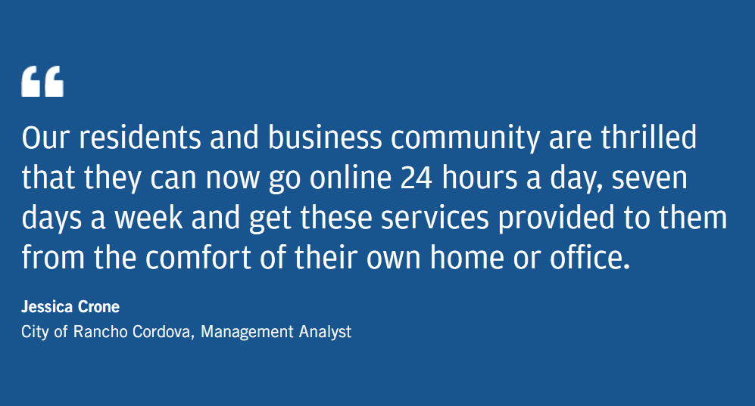
Highlights
Decreased wrong application submissions by 76%
5,000 registered users since adoption of Civic Access
Enabled online license and renewals 24/7
Notes:
Decreased wrong application submissions by 76%
Served more than 5,000 registered users since adoption of Civic Access
Enabled online license applications and renewals

Slide 14
Case Study: Grovetown, GA

Slide 15
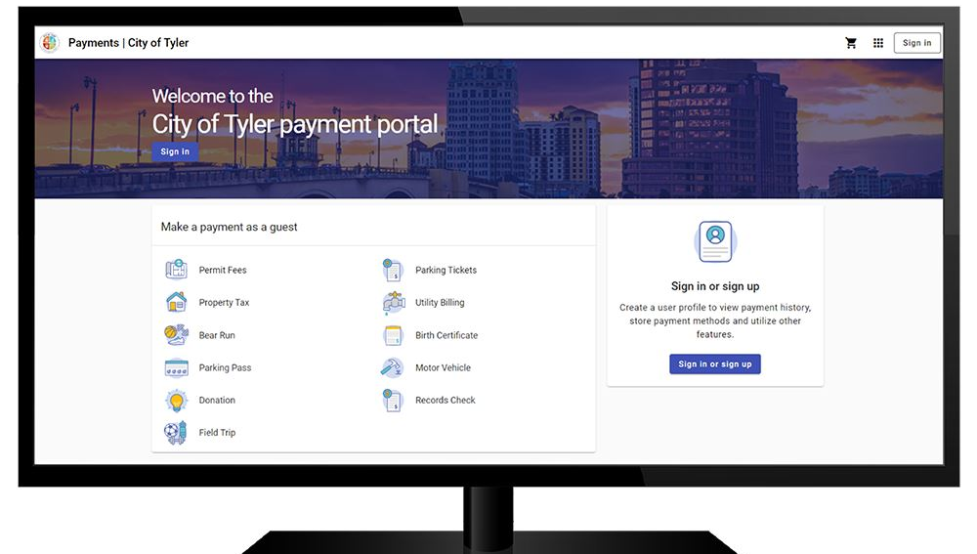
Scaling to Connect to Residents
Growing city, aging system
Move to the cloud
Public Satisfaction
Connecting to Community
Notes:
Payments, finances, and budgeting are the backbone of local government. Without useful data and systems, financial accuracy suffers, and governments can struggle to identify efficiencies.
The city of Grovetown, Georgia, saw how an aging financial solution negatively affected their employees and residents. Switching to a modern, cloud-based solution offered numerous benefits, and empowered the city to reshape its payment and budgeting setup.
Grovetown’s legacy solution worked well before it stopped receiving updates in 2014. This required the nine finance employees to spend several years entering data manually from other portals and resolving user complaints for utility or other public payments.
“Due to the potential for error, omissions, and lost documentation in manual entry, the financial information in the old system wasn’t always reliable,” Staff Accountant Kristal Singletary said.
These challenges, along with issues on the public-facing side of the solution, stressed the nine-person finance department. They dealt with occasional delays in posted payments, which could trigger a late payment penalty or utility shutoff, even though a resident’s payment was made. A lack of self-service options meant there was lots of staff time spent helping users with basic questions. The legacy solution was clearly not the way forward for a growing city of about 17,000.

Slide 16
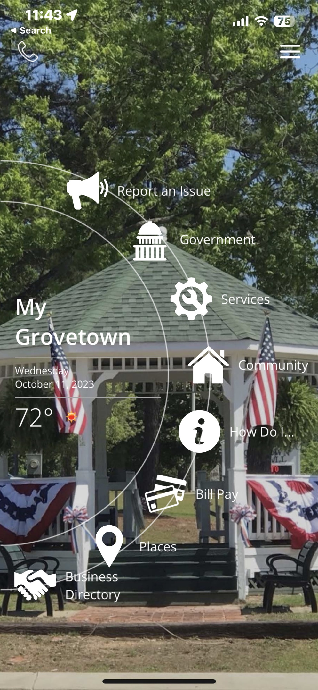
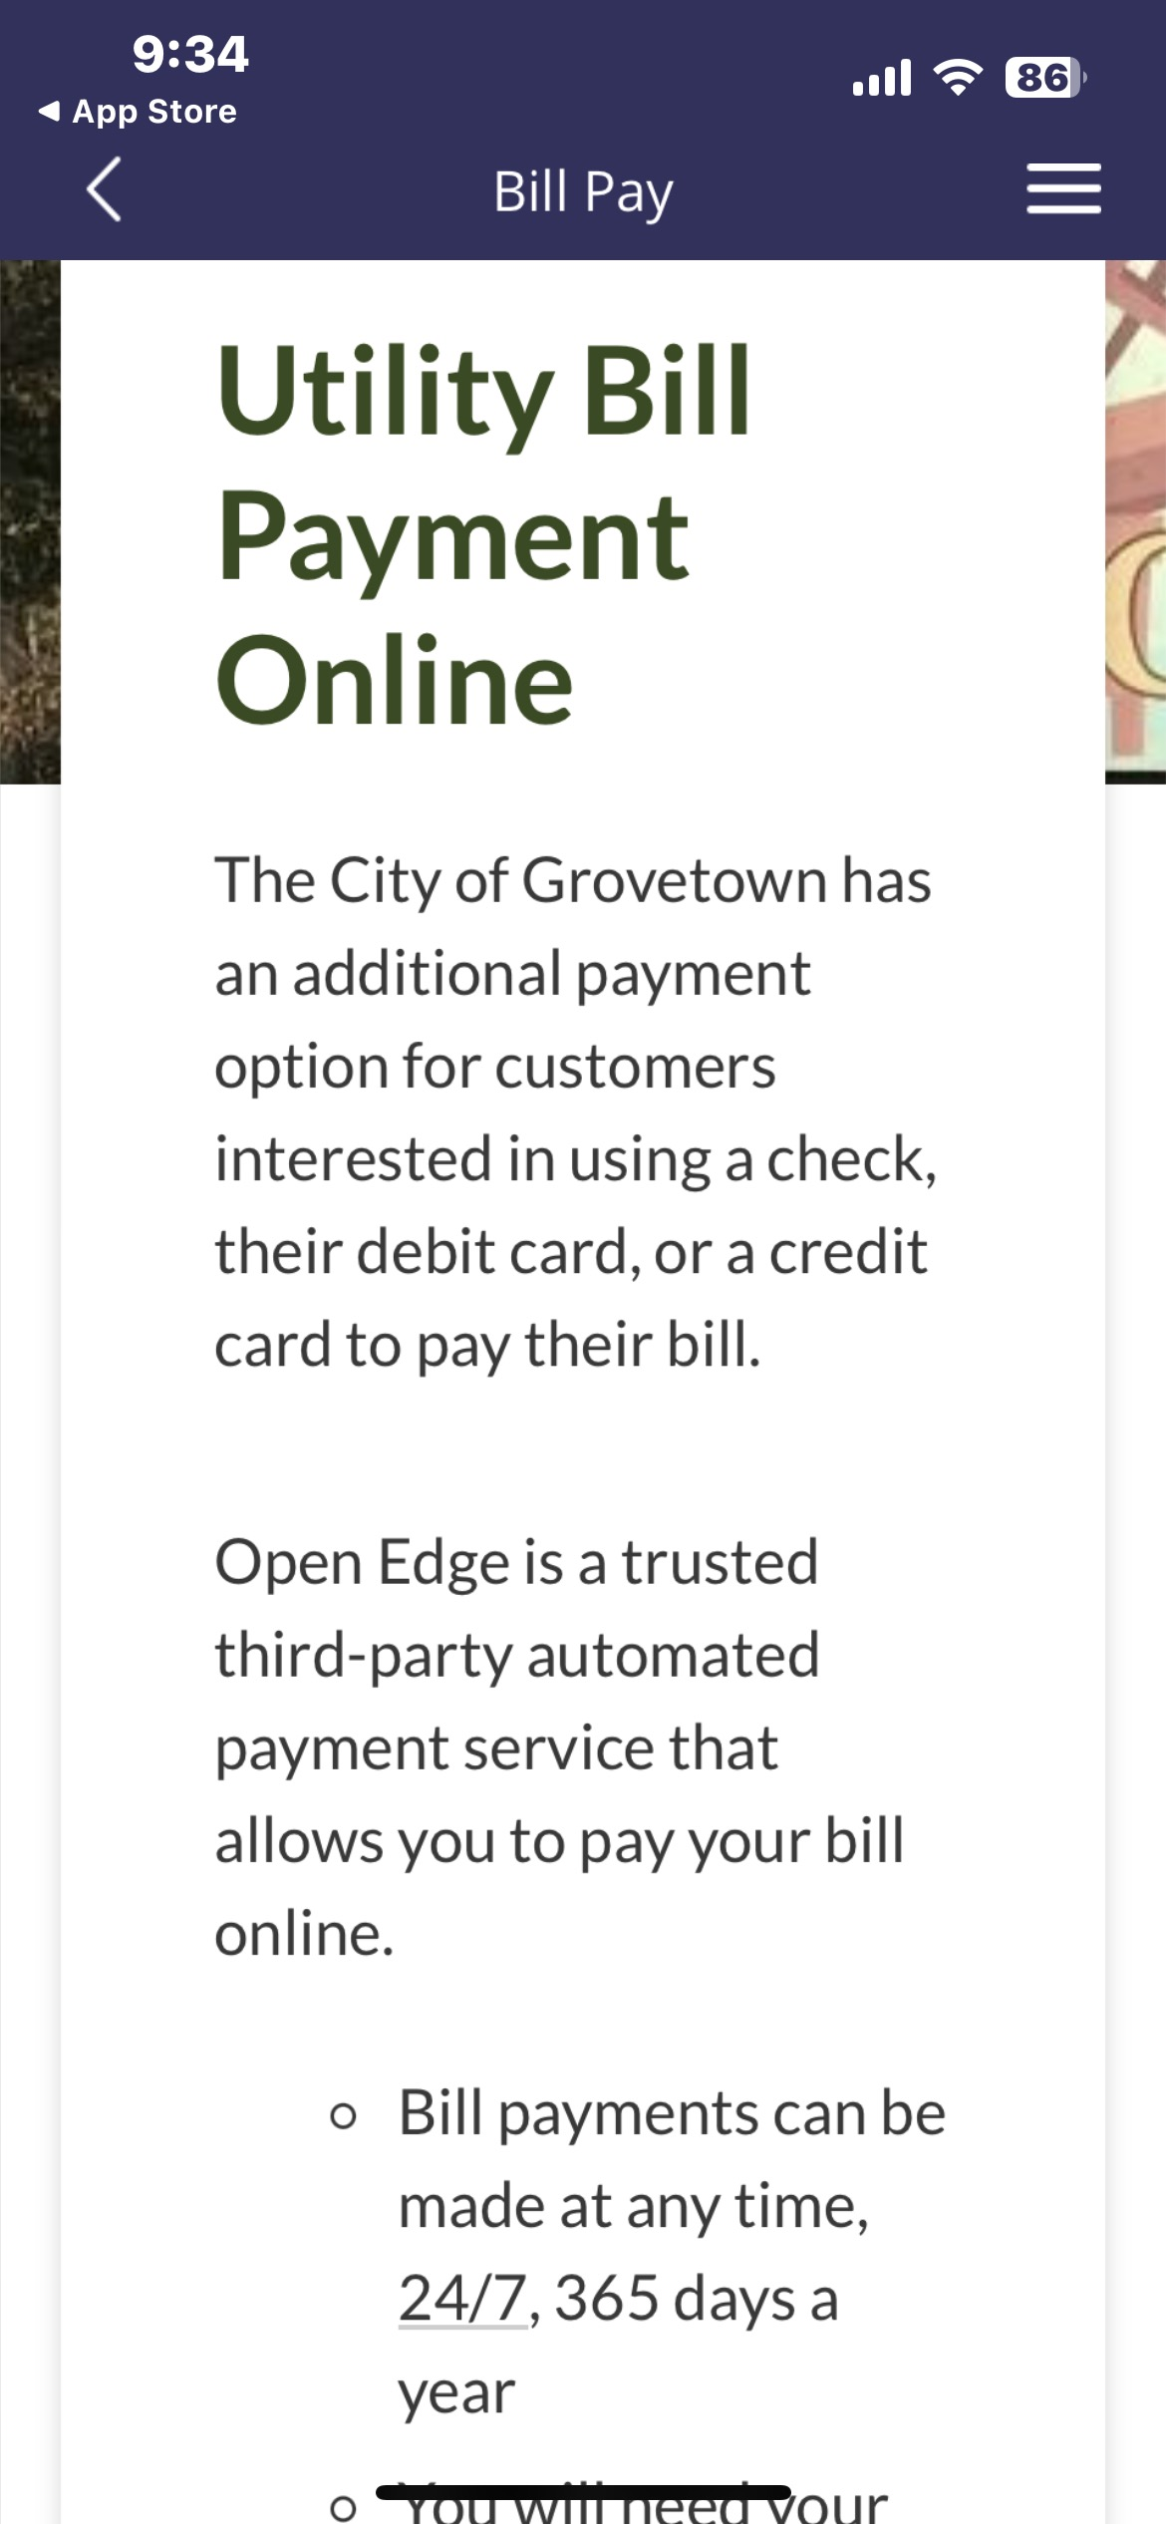
Driving online payments
Education & outreach led to 10% of residents with mobile app in first 9 months
30% more online payments after app launch
70% of payments made online

Slide 17
Cate Ryba
Tyler Technologies
Director of My Civic & Resident Engagement

Slide 18
Resident Digital Experience Timeline
1990s
Mid 2000s
2010s
First websites and emergence of search engines
The social media revolution
Big data, personalization of services, and automation
The mobile revolution
Focus on accessibility, privacy, AI and security
The rise of e-government initiatives
Late 2000s
2020s
1990s-2000s
Notes:
Show timeline, briefly discuss, move forward to explore each era.

Slide 19
The Early Days…
Static websites: the kitchen sink!
Basic forms and downloads available
Email newsletters (still around!)
Siloed technology in city departments
Notes:
In the early days of e-government, static websites with limited interactivity were the norm.
Basic PDF forms and downloadable documents were available. Digital communication channels were limited, primarily involving email.
At the same time, technology systems were largely siloed within government departments, leading to a fragmented resident experience.
Give example of economic dev dept needing better mapping data, had to barter w/Public Safety to get it.

Slide 20
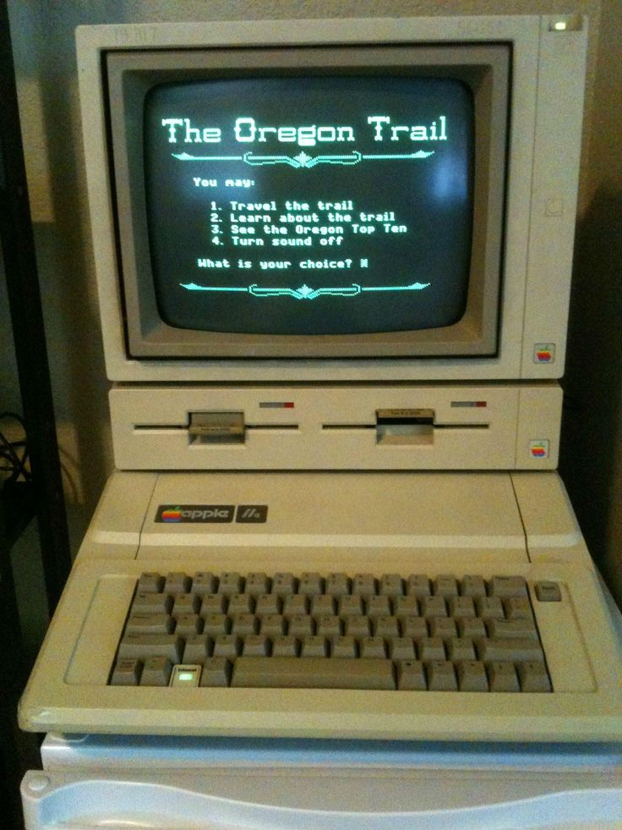
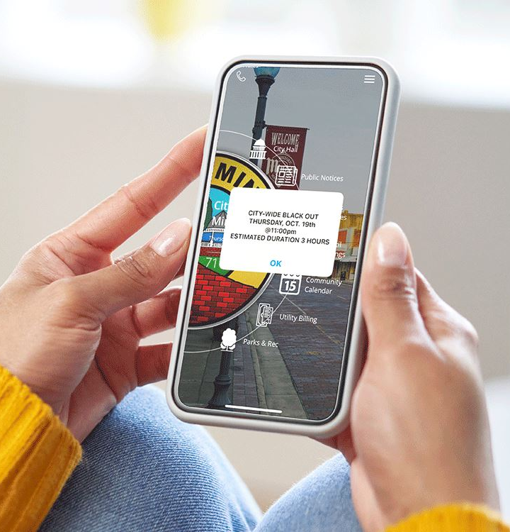
Notes:
Remember the days of green screen? I remember using HTE green screen software in my first government job, trying to get permit data for better understanding economic development trends in my City.
Mobile apps for specific services were introduced, online transactions and forms became more prevalent, and preliminary efforts were made to connect data and systems across departments and jurisdictions. The rapid adoption of social media made two-way communication between governments and the public possible.

Slide 21
Channels change, as does the pace
Rise of Social Media
Online retailing
Residents' expectations: personalized experiences
Notes:
The rise of social, mobile, and integration heralded a new era for the digital public experience, mirroring the trends seen in the retail sector. Just as consumers were becoming accustomed to personalized online shopping and banking experiences, residents expected the same level of convenience and customization from government services.
Local governments needed to compete with language, reach and savvy of national brands to reach their residents, which can be really tough when you’re also just trying to fill the next pothole or balance your budget.

Slide 22
Multi-channel Service Delivery
Integrated, resident-centric experiences
Robust web portals
Mobile apps
Data driven decision making
Notes:
As governments recognized the importance of a connected, integrated resident-centric experience, robust web portals and mobile apps became the standard.
Multi-channel service delivery allowed for more effective communication to residents, while advanced data analytics improved government transparency.
Integration and interoperability across government departments and systems became a priority, enabling secure, digital engagement with residents.
When I was on city council, we implemented a storm water fee – countless staff hours were spent on outreach meetings, mailers, emails, news stories. Yet, still, I got angry phone calls once the fee was in place that people had never heard about it. You have to use ALL channels available to you.

Slide 23
Where are your residents?
9 in 10
U.S. ADULTS HAVE A SMARTPHONE
Notes:
The vast majority of Americans – 98% – now own a cellphone of some kind.
Nine-in-ten (91%) own a smartphone, up from just 35% in the Pew Center’s first survey of smartphone ownership conducted in 2011.
Today, 15% of U.S. adults are “smartphone-only” internet users – meaning they own a smartphone but say they do not subscribe to a home broadband.

Slide 24
Meet your residents where they are!
Online payment portals
Mobile solutions
Engagement on socials
On site information driving towards mobile/online
Every outreach alerts to other engagement channels

Slide 25
Case Study: El Cajon, CA

Slide 26
El Cajon, CA
Population = 106,215
Total City Staff (FTE) = 421.5
Size = 14.1 square miles
Source: California Department of Water Resources

Slide 27
The Pothole Challenge
The Motivation Behind the Challenge
How the Pothole Challenge Was Executed:
Promotion on Local News and Social Media
Involvement of Public Works Team

Slide 29
"The community response meant that our phenomenal Public Works team was doing the equivalent of filling a year's worth of potholes in five days."
-Sara Diaz, IT Director

Slide 30
In-Field Efficiency Tools
Execute tasks quickly with access on-the-go
Service more requests in a year (50x more!)
Utilize existing staff in more capacities

Slide 31
"We are doing our best to show the citizens that 'hey, if you submit an issue with the city, we are going to respond to it and we are going to respond quickly.' This is how good government works."
Councilmember Phil Ortiz

Slide 32
Case Study: Village of Hampshire, IL

Slide 33
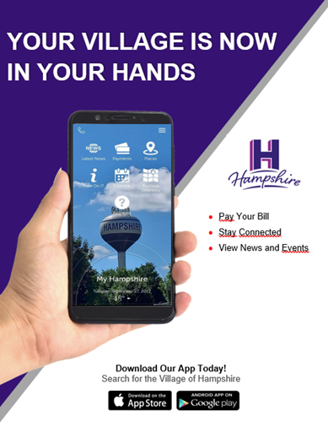
Driving Resident Adoption
Prioritized marketing to residents
Innovative approaches to driving downloads
Giveaways
Contests
Over 22% of residents use the app

Slide 34
Engagement → Efficiency
Asked residents’ help for snow emergency
Usage skyrockets pre-storm
Staff coordinates based on data
Gamechanger for snow removal

Slide 35
“Our myHampshire app has saved us countless staff hours and increased our levels of service. We love that it is our own Hampshire brand, too.”
-Jay Hedges, Village Administrator

Slide 36
Case Study: Kansas City, MO

Slide 37
Data Driven Decisions
Residents reported missed trash pickups
Used work order system
Refunds for missed pickups
Changed vendor

Slide 38
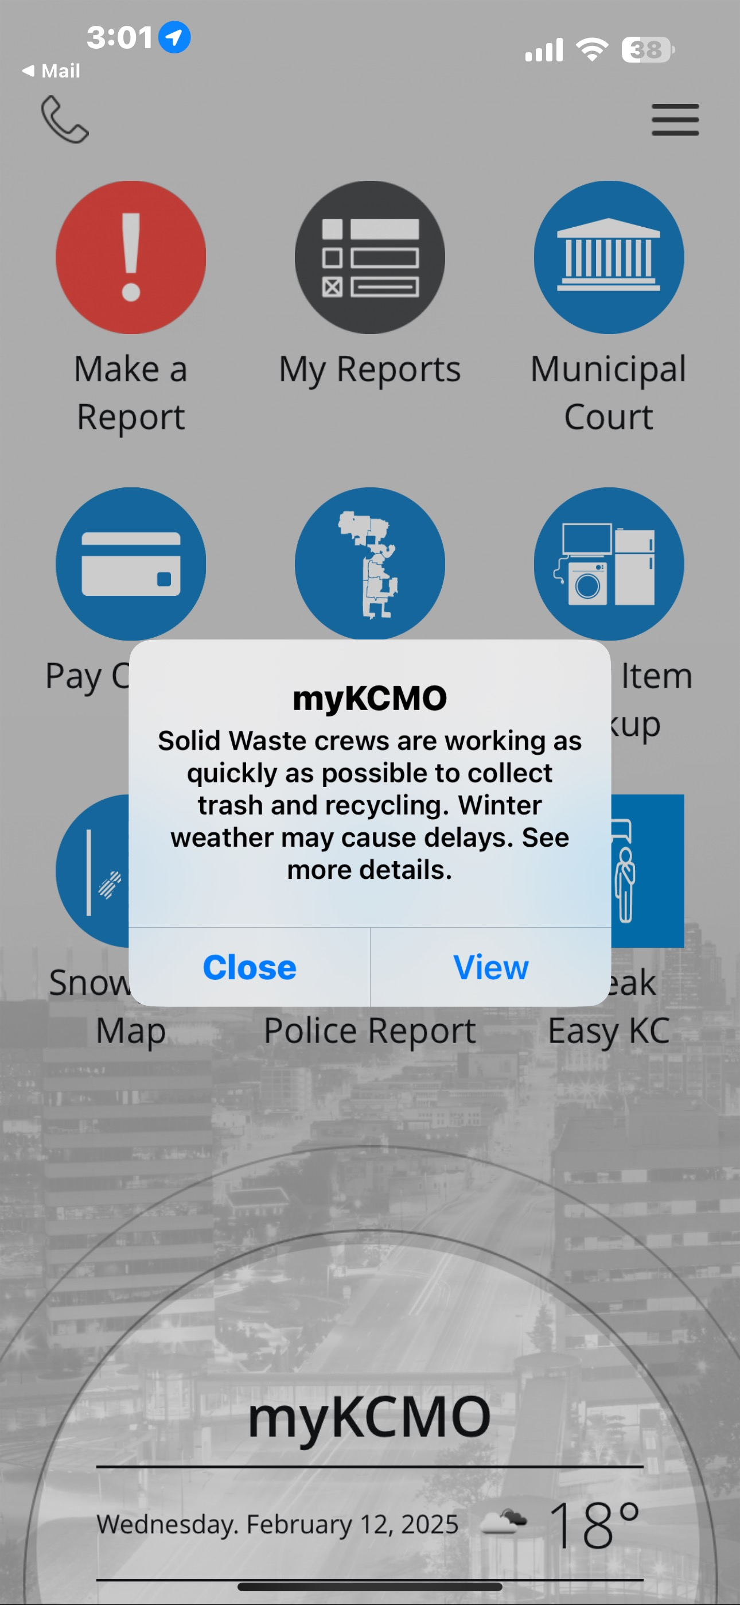
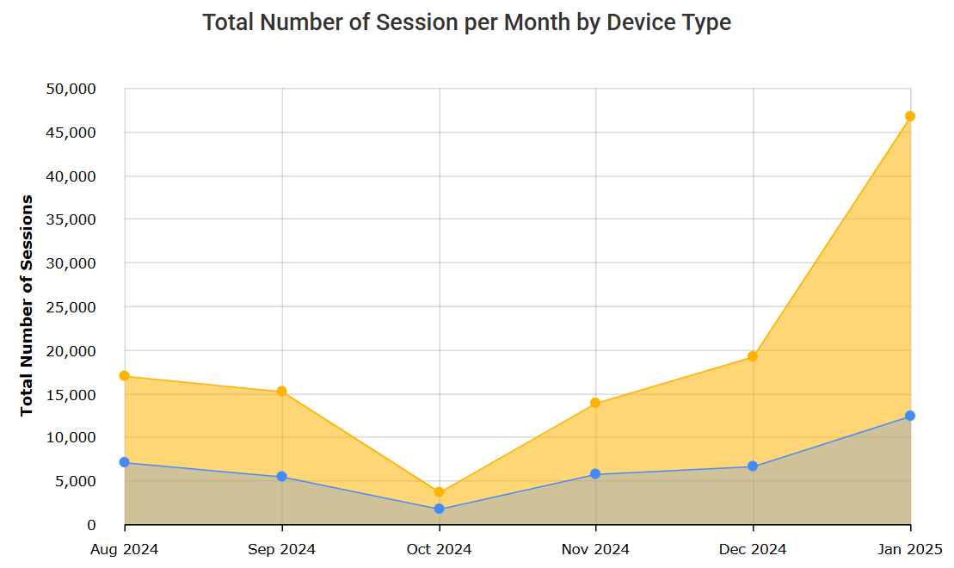
myKCMO
42,000 active devices
Push notifications
Police Reports
Budget Surveys

Slide 40
What’s next in the Resident Digital Experience?
Artificial Intelligence and Chatbots
Hyper-Localized Communication
Integrated Data Ecosystems
Mobile First Solutions
Notes:
AI-powered tools can provide instant, personalized responses to resident inquiries, even during high-demand periods. For instance, AI tools can help residents find evacuation routes, apply for aid, or get real-time updates during emergencies. Advanced AI could also analyze community sentiment and predict potential issues before they escalate. Ex: post-Helene
Technologies like geofencing and location-based notifications allow governments to deliver targeted information to residents in specific areas. This ensures that messages reach the right people at the right time without overwhelming others.
Future platforms will integrate data from various government departments, private organizations, and even citizen-generated sources like social media or sensor data. This holistic approach ensures quicker, more informed decision-making and streamlines access to services for residents. This is the One Tyler vision.
With mobile usage dominating, future solutions will emphasize user-friendly, mobile-first platforms that allow residents to engage with their government easily. Features like offline capabilities or low-bandwidth functionality will also be critical in ensuring access for underserved areas or during a disaster. A reminder that 97% of people have smart phones, but many don’t have computers or internet access.

Slide 41
Strengthen YOUR Residents’ Digital Experience
Prioritize listening to residents
Invest in scalable, flexible technology
Emphasize accessibility
Leverage data to drive decision making
Focus on transparency & trust
Foster a culture of innovation
Notes:
Prioritize Listening
Regularly engage with your community to understand their needs, concerns, and expectations. Use surveys, town halls, and online forums to collect feedback.
Build mechanisms for two-way communication so residents feel heard and valued.
Invest in Scalable, Flexible Technology
Choose technology platforms that can scale with your community’s needs and adapt to changing circumstances. Look for systems that are interoperable and capable of integrating with future innovations.
Cloud-based solutions for flexibility during crises, ensuring continuous service delivery even when physical infrastructure is disrupted.
Emphasize Accessibility
Design systems that are inclusive, ensuring access for residents with disabilities, limited digital literacy, or language barriers.
Address the digital divide by promoting initiatives like free Wi-Fi in public spaces or community access points for those without internet at home.
Leverage Data to Drive Decision-Making
Use data analytics to identify trends, allocate resources effectively, and make informed decisions during both routine operations and emergencies.
Build a data governance framework that ensures transparency, security, and ethical use of resident information.
Focus on Transparency and Trust
Be transparent about decision-making processes, especially during a crisis. Share updates frequently, even when challenges arise, to maintain public trust.
Use technology to provide visibility into government actions, such as dashboards showing resource allocation or project progress.
Foster a Culture of Innovation
Encourage teams to explore new technologies and experiment with pilot projects.
Stay informed about emerging trends in civic tech and be open to adopting solutions that could enhance resident engagement.

Slide 42
Questions
What new technologies are you currently using or planning to use internally to increase staff efficiency?
Do you have any successes or failures to share around resident engagement using technology?
What has been the biggest roadblock or concern with the evolution of digital government?
How do you share knowledge, training and technology across government agencies?

Slide 43
Questions

Slide 44
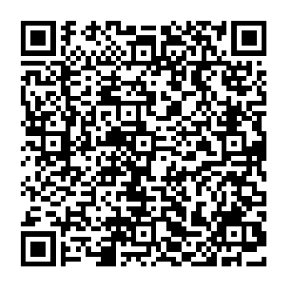
Learn More About Tyler’s Work
with City & County partners

