Slide 1
If You Package It, They Will Come
Jordan Twardy, Economic Development Director
City of Dearborn, Michigan

Slide 2
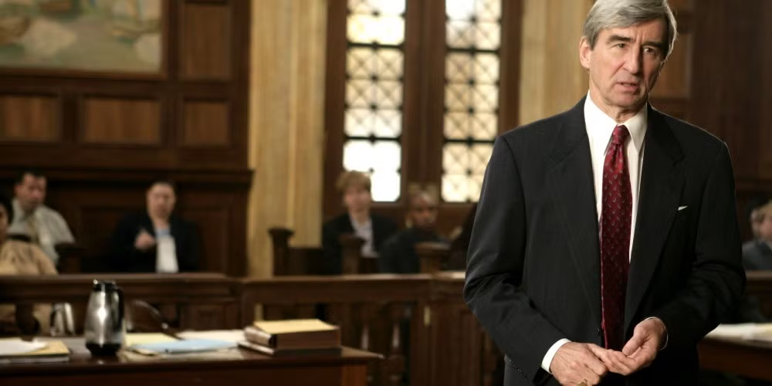
What is “Packaging”?
Lining up all the variables to maximize success before a project even begins.
Clear vision that defines success
Favorable zoning/regulatory landscape
Clear & supportive approval processes
Image Credit: Law & Order
Notes:
Main takeaway - the point of packaging is to line everything up and get as close to foolproof as circumstances allow.

Slide 3
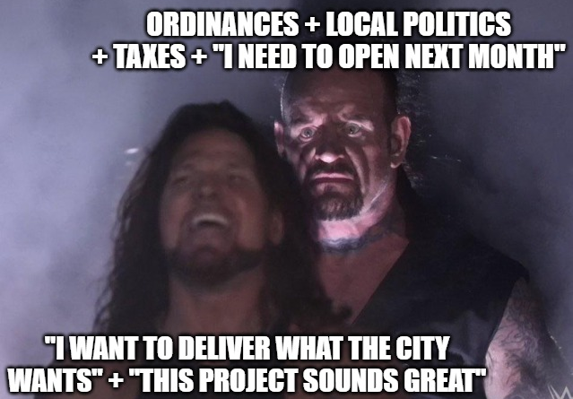
Why Should We
Package Sites?
Image Credit: imgflip.com Meme Generator
Notes:
Everyone wants to do cool/great projects. Everyone wants prosperity in their town. Many variables can bring down even the best project. Packaging helps identify and work through the issues to maximize certainty around success and build momentum toward the goal.

Slide 4
Packaging Benefits Developers and Communities
Foster alignment between government processes and priorities
Facilitate better matching between projects and locations
Cultivate a reputation of success for your community
Attract stronger, more impactful projects
Notes:
Packaging turns assumptions into strengths by working through them toward a feasible path to success. - working through what you can control and what you need will help you on a specific project to proactively line up what you can to maximize success. It will also nurture a culture of strategic thinking that helps you discern where your time and focus are best spent and weeding out serious opportunities from distractions.

Slide 5
Framework for Planning & Action:
Dearborn’s Approach to Packaging
Notes:
Many cities across America do this. This is our approach and what we focus on.

Slide 6
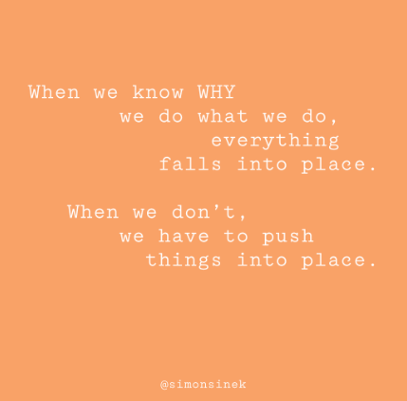
Vision: What is it?
What does the community want?
Is there stakeholder buy-in?
How does your project serve the goal?
Image Credit: Simon Sinek, simonsinek.com
Notes:
TAKEAWAY: A meaningful, resonant, well-thought out and supported reason will drive momentum from idea to ribbon cutting, especially when things get tough. Master Plan? Strategic Plan? Investor idea? These provide varying levels of credibility and rationale for moving forward. “Start with Why”

Slide 7
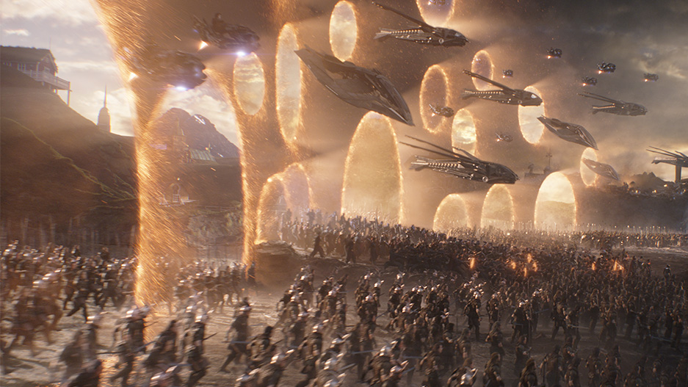
Packaging the Vision
Image Credit: Marvel Studios
Image Credit: Marvel Studios
Clarity | Define & connect to the goal.
Credibility | Assemble diverse supports to garner resources & momentum.
Potent Sources: Adopted City Plan, Budget, CIP, Stakeholders
Notes:
What we did - housing study, master plan, strat plan, allocated money CLARITY: Spell it out! You need housing, green space, or more retail. This site is the perfect location, with great access, zoning, etc. CREDIBILITY: Master Plans, Strategic Plans, Studies, Priority Site Designations - instill investor confidence and community consensus.

Slide 8
Favorable Zoning & Regulatory Landscape
Do your zoning laws allow the vision? Do they enable it?
How many steps would be needed to gain approval for your vision?

Slide 9
How would Drake react to your community?
Image Credit: imgflip.com
Notes:
What we did - changed ordinances - form based code, noncoms, lot covg, ; updated policies; rezoned properties; State HRI grant

Slide 10
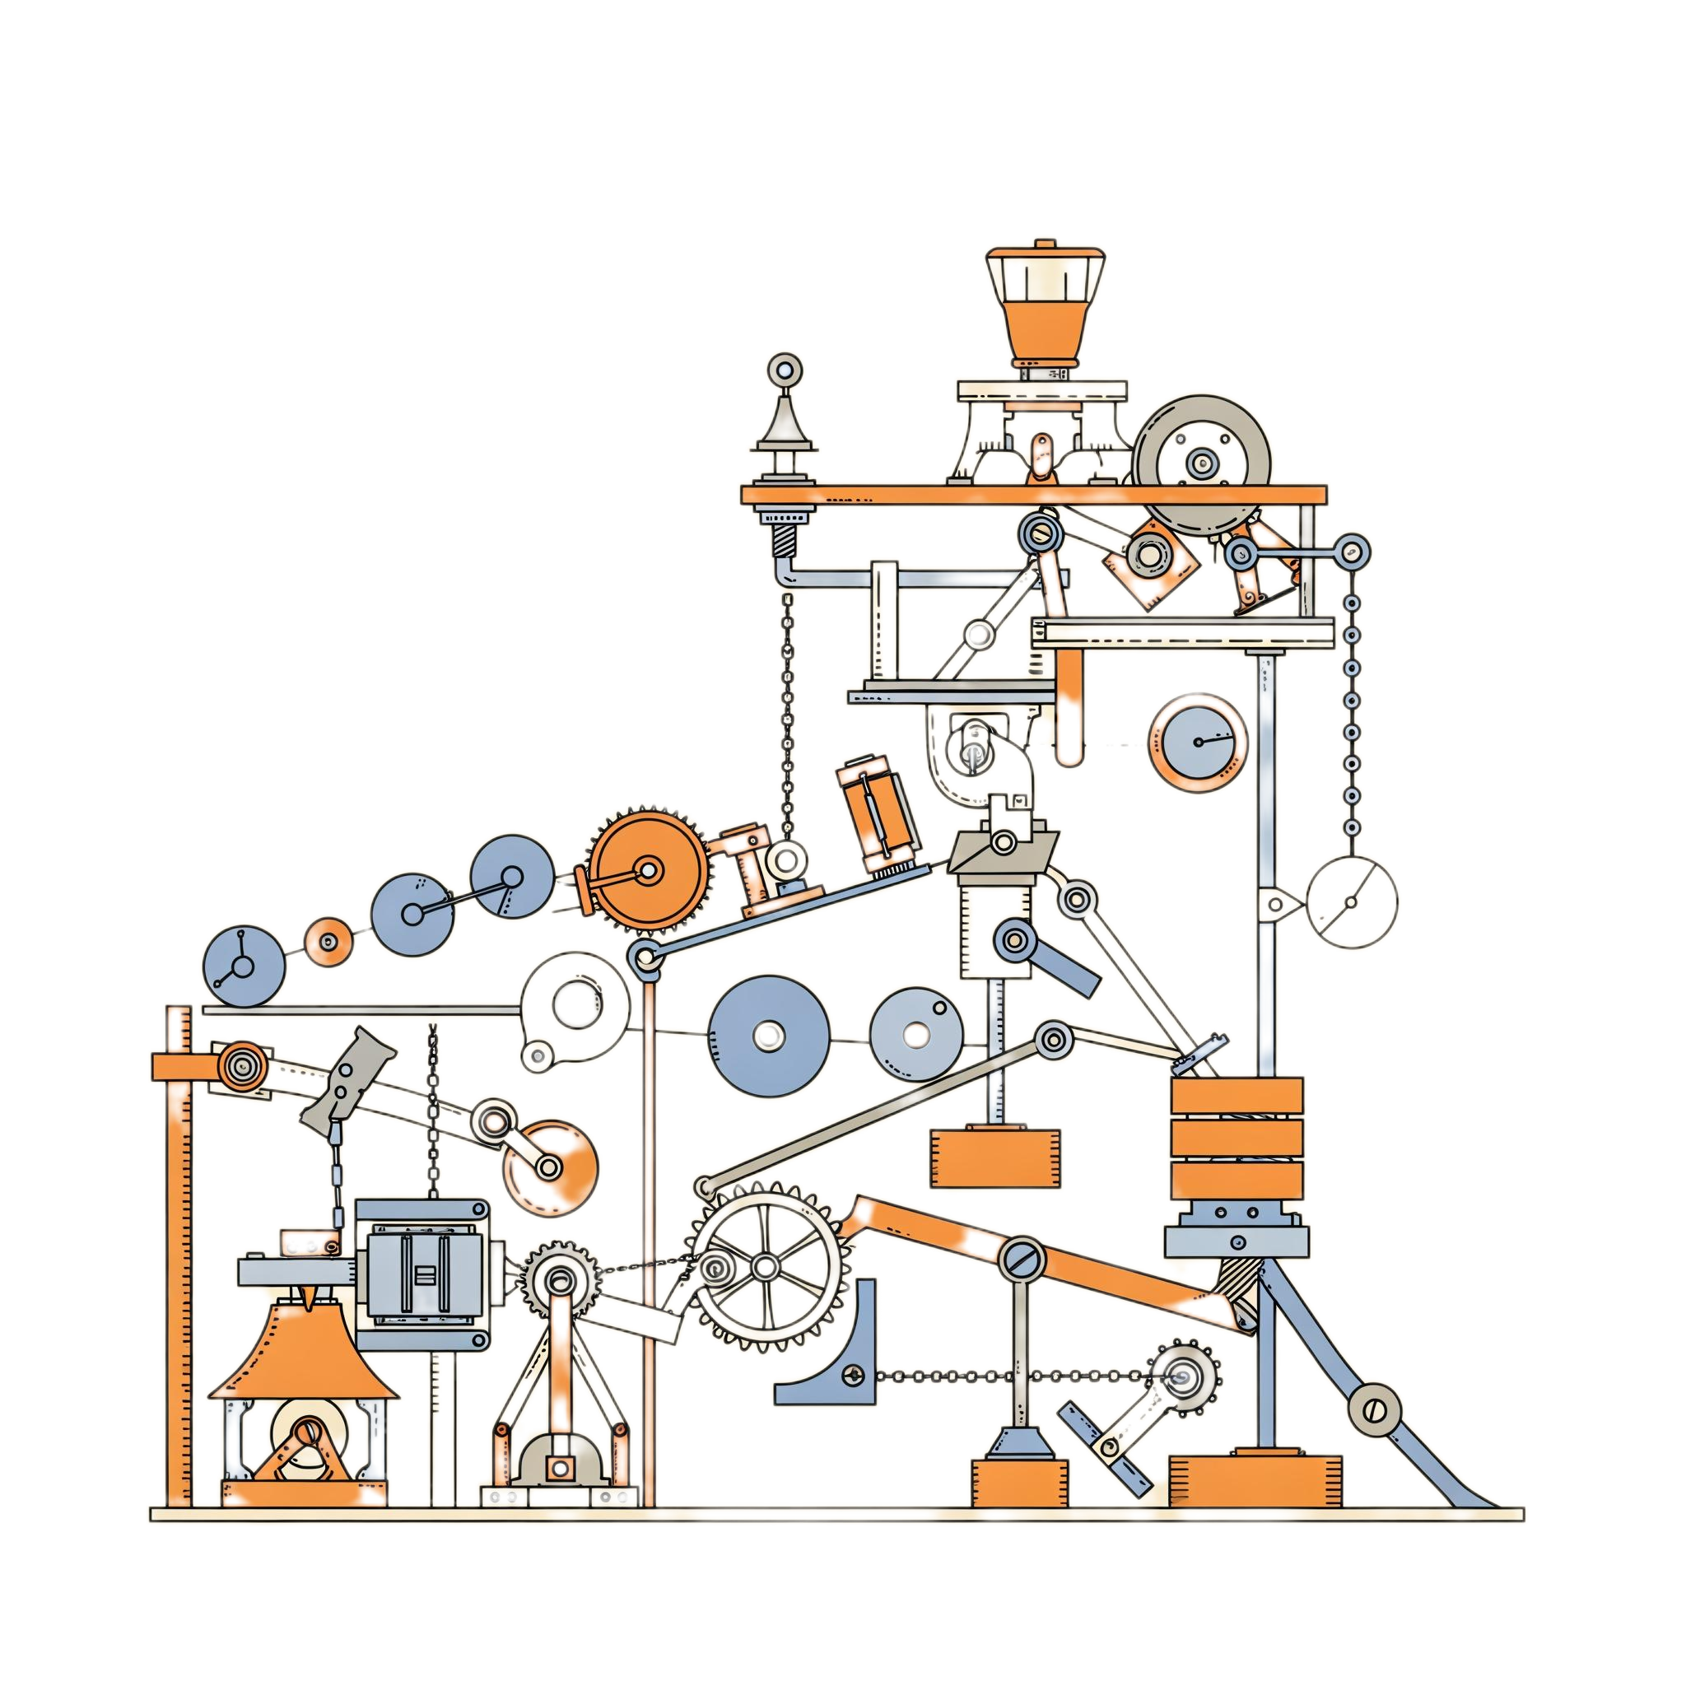
Packaging Zoning and Regulatory
Maximize the reach of staff approvals
Proactively ID success factors for public approvals
Update zoning ordinances to remove roadblocks.
Incentivize outcomes you want: give them the least time, complexity, and uncertainty.
Notes:
What we did - changed ordinances - form based code, noncoms, lot covg, ; updated policies; rezoned properties; State HRI grant

Slide 11
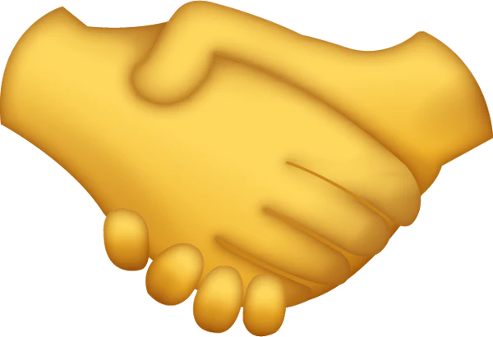
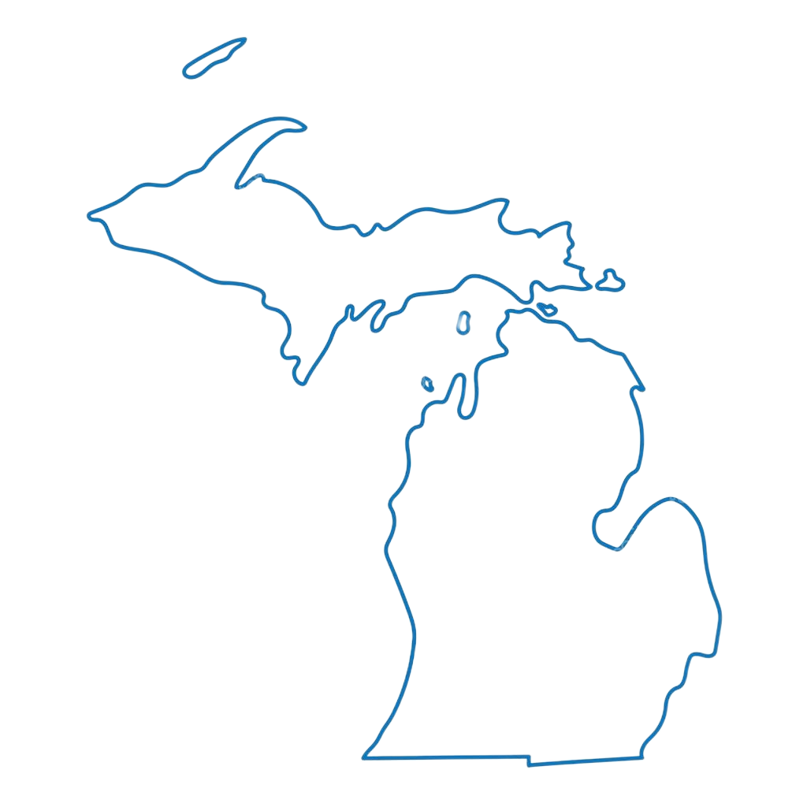
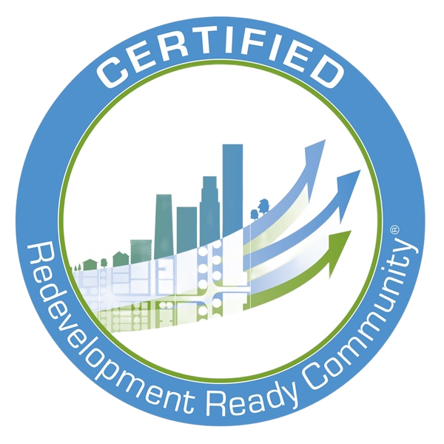
Dearborn’s Approach: Regulation Vision
Aligned FBC with mixed use construction needs
Parking exemption for downtown districts
Stopped sending easy decisions to ZBA
Investing $500K+ in Master Plan, zoning update
Aligned with state BMPs/goals
Housed all land use services within Econ Dev
Notes:
What we did - changed ordinances - form based code, noncoms, lot covg, ; updated policies; rezoned properties; State HRI grant

Slide 12
Clear & Supportive Processes
Can you clearly and easily articulate every approval needed?
Are all process stakeholders biased toward delivering the vision?
Do the processes prioritize the desired outcomes?

Slide 13
Packaging Clear & Supportive Processes
https://www.justwatch.com/us/tv-show/voltron
All processes and applications succinct and organized.
Build decision-maker buy-in and organize them around success.
Have a progress champion to prioritize process commitments.
Notes:
Re-structured ED functions; Work in Progress - improved comms, updating materials, updating processes; State RRC

Slide 14
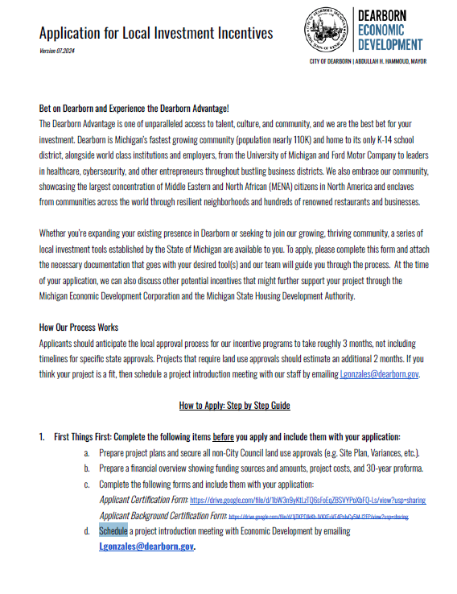
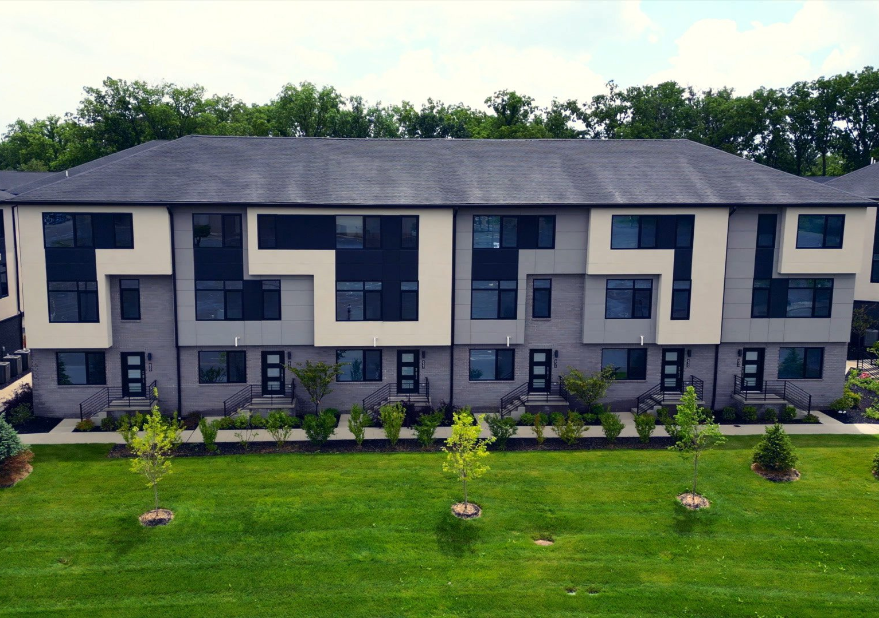
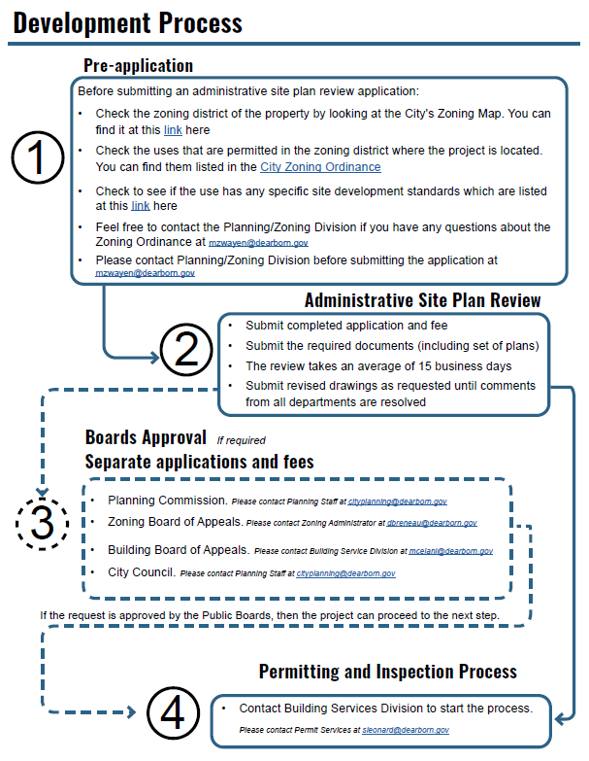
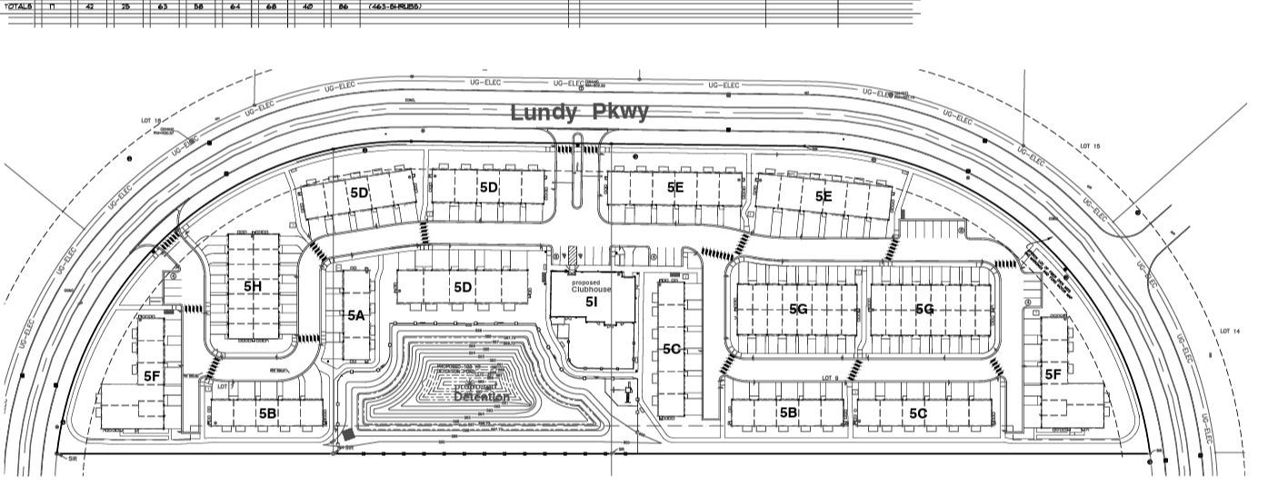
Example: A Dearborn Package
Image credit: Waza Construction
Vision: City needs 1,500 housing units
Zoning: Staff outlined path up front - SLU & Variance
Developer brought a second project to undeveloped site
City proactively laid out approval path and flagged key variables
Processes are tight and tracked; all stakeholders briefed and aligned
Notes:
Smart Town North - pre-submittal mtg; laid out approvals, key concerns, incentives process. Land use approvals done, incentives under way, proj expected to break ground in 2025.

Slide 15
When the basic package isn’t enough…
We have opportunity and interest in our housing vision, but not a lot of movement.
Housing is expensive and uncertain.
We had a reputation of being difficult.
Local owners/investors are new to this work.
We decided to get the party started!
Notes:
In process - our big bet; be first on the dance floor to get others going. spend money to catalyze confidence. Hotel study, fairlane, etc. These are activities that developers or property owners typically do. They also cost money, which, at least for us, has led developers to hesitate to do any of them, causing stagnation on sites despite strong interest in making something happen. In short, they are waiting for someone else to go first and showcase the likelihood of success. We are absorbing that risk and cost to “prove the market” and mitigate risk for them to come in and make something happen. Image idea: high school prom dance floor.

Slide 16
Pre-Development - Dearborn’s ultimate playlist
Knowing our strengths, we decided to focus on things that would build certainty and trust:
Site control and clarity
Preliminary concept approvals
Industry recruitment and engagement
Notes:
In process - our big bet; be first on the dance floor to get others going. spend money to catalyze confidence. Hotel study, fairlane, etc. These are activities that developers or property owners typically do. They also cost money, which, at least for us, has led developers to hesitate to do any of them, causing stagnation on sites despite strong interest in making something happen. In short, they are waiting for someone else to go first and showcase the likelihood of success. We are absorbing that risk and cost to “prove the market” and mitigate risk for them to come in and make something happen. Image idea: high school prom dance floor.

Slide 17
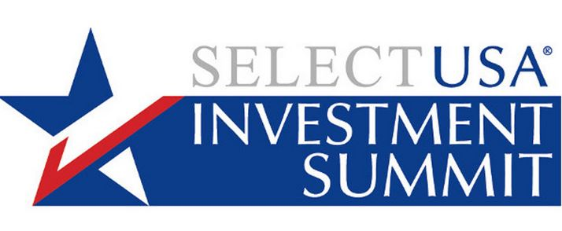
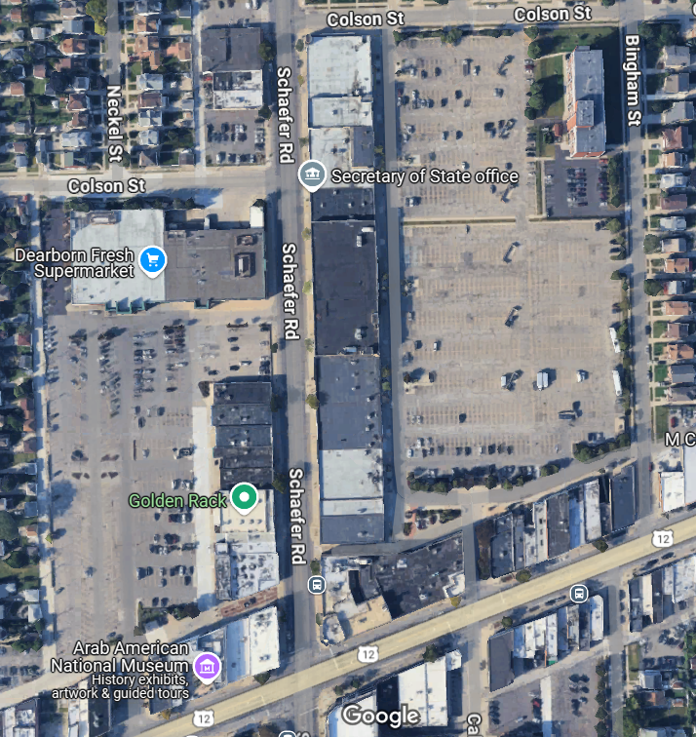
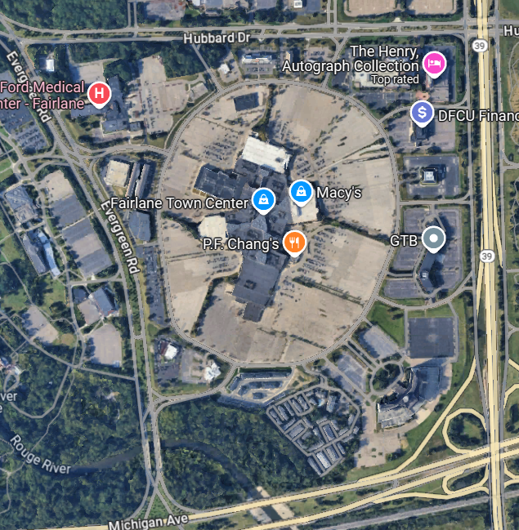
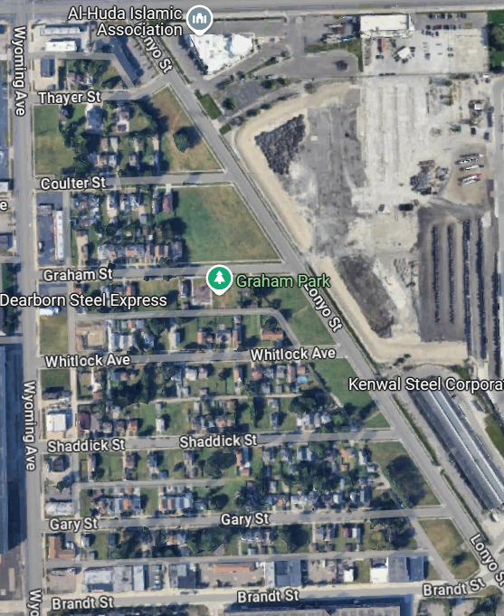
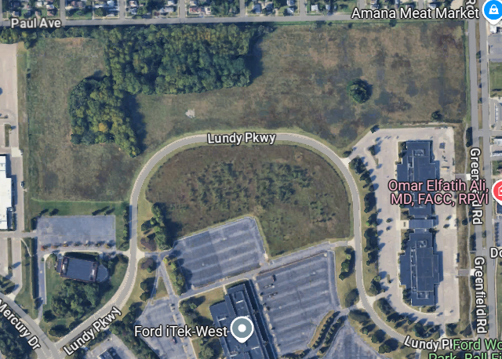
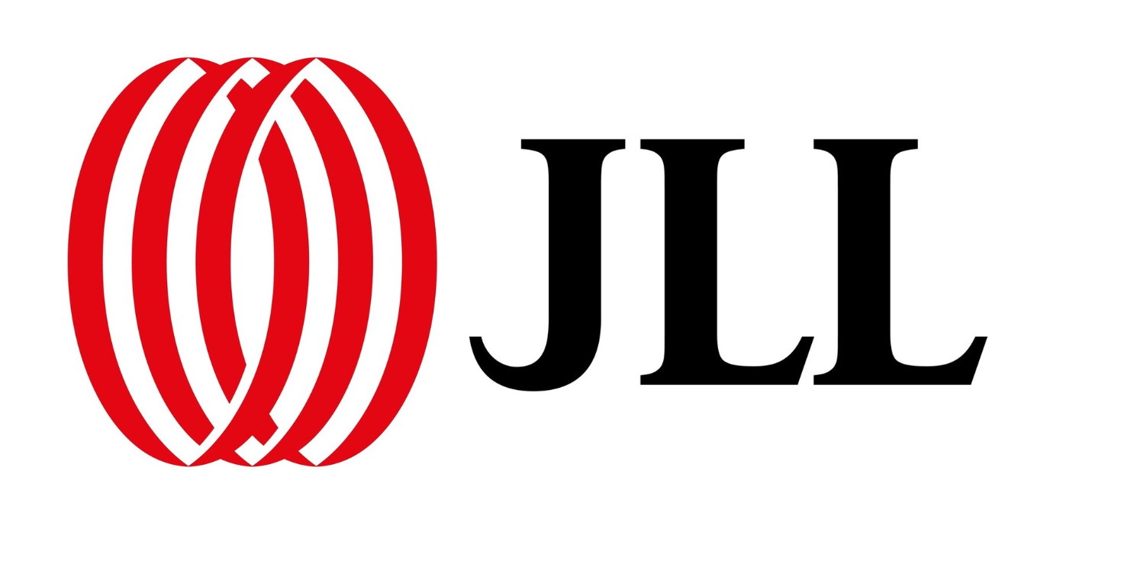
Building credibility for our vision
Process Re-Org (2022)
Ordinance Updates (2024)
Housing & Hotel Market Studies (2025)
Mayor’s Strategic Plan (2025)
Data & Self-Improvement
Direct investment in our goals
Industry Engagement
Notes:
Midtown; 5050 lot;

Slide 18
Colson St. Lot: a closer look at a scary site
800-space parking lot assembled by eminent domain
In significant disrepair
Adjacent to distressed retail
Vision: high density housing and green space
Our focus:
Development envelope
Preliminary PUD Approval
RFP for Developer
Image credit: Cartoon Network
Notes:
Midtown; 5050 lot;

Slide 19
Let’s start your package!
What is your vision? Is it clear? What gives it credibility?
Are your processes likely to advance the vision as is?
Do you anticipate pitfalls/pushback? Can pre- development work mitigate any?
Where do you have leverage, resources, and/or allies?
What are 1-2 actions you can take in the next 2 weeks to move forward?

Slide 20
Thank You!

