Slide 1
NASPO and Cooperative Procurement Overview
Dan Kruger, Chief Strategy Officer
Courtney Iversen, Deputy Chief Strategy Officer

Slide 2
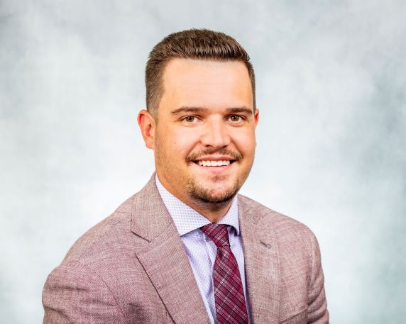
Courtney Iversen Deputy Chief Strategy Officer, NASPO civersen@naspo.org
Dan Kruger
Chief Strategy Officer, NASPO
dkruger@naspo.org

Slide 3
Session Agenda
NASPO – Who We Are
2025 NASPO Top 10 Priorities
Procurement Modernization & Resources
Professional Development
NASPO ValuePoint & the Cooperative Procurement Process
Q&A

Slide 4
National Association of State Procurement Officials
Members are the CPOs of all
50 states, DC and the
US Territories
NASPO was established in 1947
to dispose of surplus property
following WWII.

Slide 5
MISSION
VISION
Your strategic partner for public procurement solutions.
GOALS
1. To help our members achieve success as public procurement leaders.
2. To promote best practices, education, professional development, research, and innovative procurement strategies.
3. To promote government excellence by delivering superior procurement solutions for the benefit of the public.
To promote innovative and efficient procurement by states, promoting superior contracts with integrity and transparency for the public sector.

Slide 8
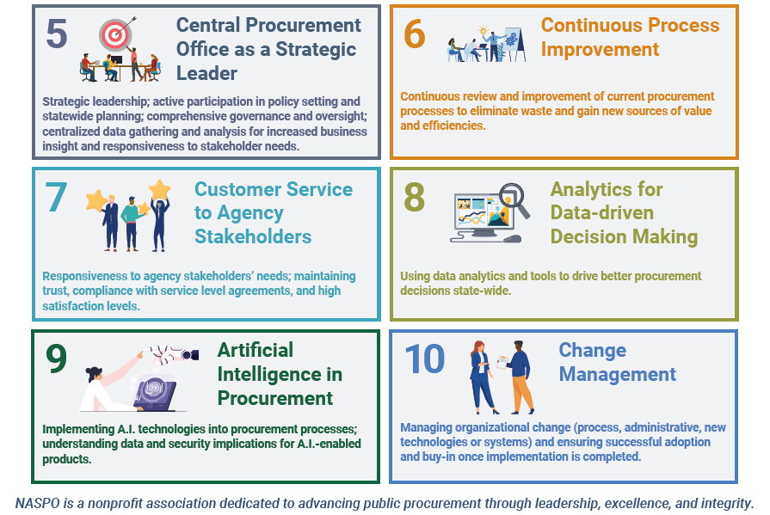

Slide 9
What is Procurement Modernization?
Procurement modernization refers to the process of updating and improving procurement practices, systems, and technologies within an organization. This often involves integrating new technologies such as e-procurement systems, automation tools, data analytics, and cloud-based solutions to make procurement more strategic and responsive to business needs.

Slide 10
FREE Procurement Courses & Videos
85+ contact hours of free learning
Procurement focused courses, including topics like market research, RFPs, ethics, foundations of procurement and more!
Skill Focused Catalog
Courses focused on developing professional skills such as data analytics, project management, leadership, and more.
60+ on-demand courses and certificates
300+ accredited CEUs

Slide 11
Procurement U Course List
Procurement 101
Sustainable procurement
Bid protests
Ethical procurement
Ethical strategies
Talent management
Communication
Work life balance
Cooperative procurement
Service contacts
Sole source procurement
Negotiations
Terms and conditions
Requests for proposals
Market research
AND MORE!
All funded by NASPO at NO COST to you or your staff!

Slide 12
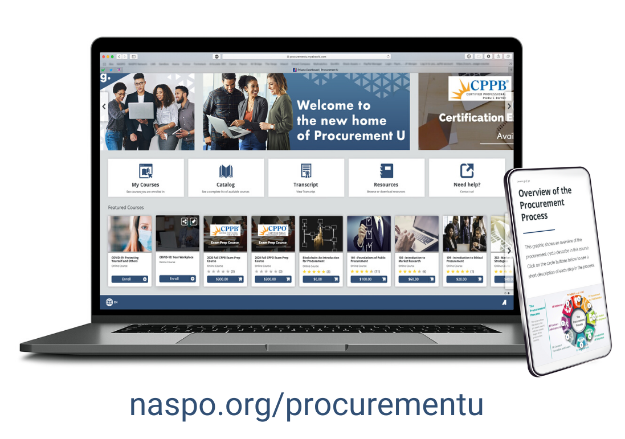

Slide 13
Repository of State Practices
Publications & Content Library
Research & Innovation Resources
Survey of State Procurement Practices
Procurement Pulse Blog and Podcast
Practical Guide
Webinars

Slide 14
NASPO ValuePoint Overview
The cooperative purchasing division of the National Association of State Procurement Officials (NASPO), facilitating cooperative public procurement solicitations using a Lead State Model™. NASPO aggregates the demand of all 50 states, the District of Columbia, the US territories, their political subdivisions, and other eligible entities, spurring best value, innovation, and competition in the marketplace. NASPO ValuePoint delivers high-value, reliable, and competitively sourced cooperative contracts - offering public entities outstanding prices, favorable terms and conditions, and value-added services.

Slide 15
Our Goal
Create best value contracts through a transparent competitive process, leveraging the buying power of all 50 states and US territories, and maximizing the opportunity for all state and local public entities to utilize.

Slide 16
Over 60 Portfolios
Nearly 500 Contracts
25B in Revenue

Slide 17
BENEFITS OF MASTER AGREEMENTS
Favorable pricing by using nationwide purchasing power in lieu of smaller individual state or local government entity purchasing power.
Vetted & educated suppliers to meet the purchasing needs of purchasing entities nationwide.
Brands, solutions, and suppliers you can trust using a process you can trust. The RFP is bid competitively and transparently using the Lead State Model.

Slide 18
What is the Lead State Model?
Lead State: the state that issues the RFP.
Multistate Sourcing Team: the group of individuals assisting the Lead State with solicitation and contracting activities, which may include but are not limited to development of this RFP, evaluation of proposals, negotiation of Master Agreements, and evaluation of Contractor performance.
NASPO’s role is to provide expert guidance and resources for the development, implementation, and administration of cooperative contracts for our membership, including eligible local and political sub-divisions.

Slide 19
How Can My Organization Participate in ValuePoint Contracts?
States participate in ValuePoint contracts by executing a “Participating Addendum.”
Political subdivisions of a participating state may utilize a Master Agreement, in accordance with their procurement authority, unless the State’s Participating Addendum excludes them from participating.
If a state has not signed a Participating Addendum, political subdivisions or other eligible entities of state may utilize the Master Agreement if permitted by the Chief Procurement Officer of the relevant state, working through NASPO ValuePoint.

Slide 20
What is a Participating Addendum?
Select Contractors.
Include their own State Administrative Fee.
Include required (unique) terms and conditions.
Identify options for States or their political subdivisions.
Request state-specific reporting or other requirements.

Slide 21
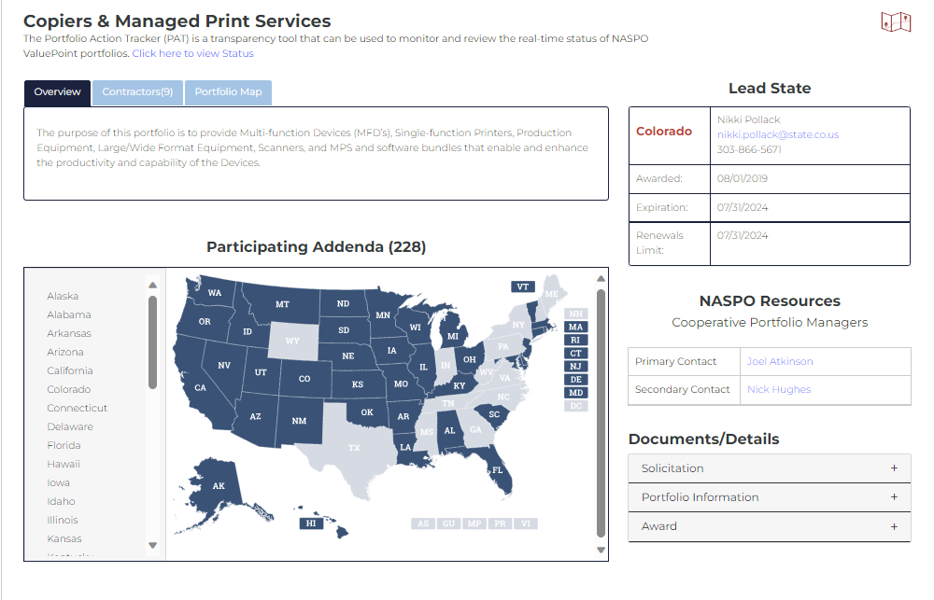
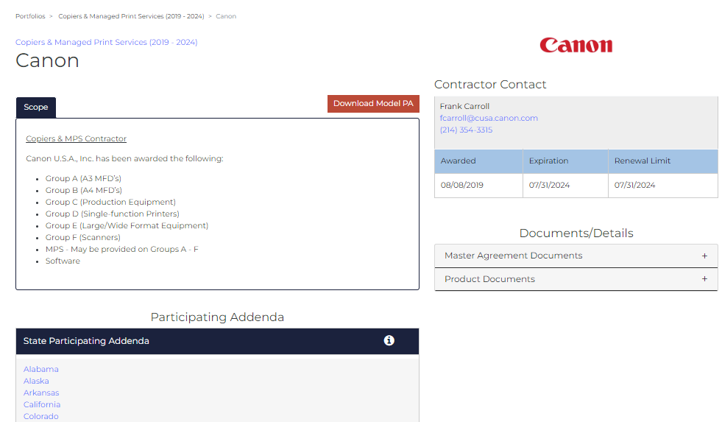
NASPOValuePoint.Org

Slide 22
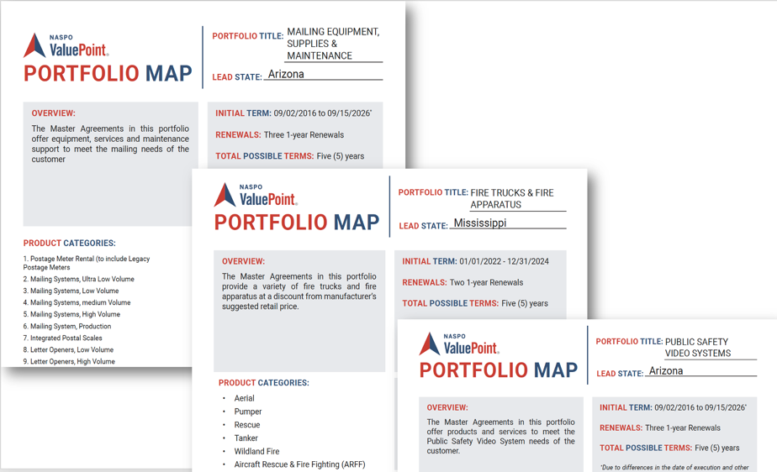
Portfolio Maps
A tool highlighting the procurement process, evaluation, awarded contractors and scope of work.
Developed from the Executive Summary for Award.
Posted with the Portfolio on NASPO ValuePoint's website.

Slide 23
Recap of Resources
Repository of State Practices
Publications & Content Library
Procurement Pulse Blog and Podcast
Survey of State Procurement Practices
Practical Guide
Webinars
NASPO ValuePoint TEAM
Cooperative Contracts
NASPO.ORG/
NASPOVALUEPOINT.ORG

Slide 24
Unify and elevate the profession.
Recognition of Procurement as a profession.
Create pathway for new practitioners in the profession.
Globally recognized certification standard.
Education and professional development.
Advocacy and a unified voice.
Develop a funding model (RFxPremier) to support the organization.

Slide 25
Q&A

Slide 26
CONTACT US!
PROCUREMENT U
STRATEGY TEAM
COOPERATIVE TEAM
Jordan Henson
Deputy Chief Learning Officer jhenson@naspo.org
Dan Kruger
Chief Strategy Officer
dkruger@naspo.org
Solomon Kingston
Deputy Chief Procurement Officer
skingston@naspo.org
procurementu@naspo.org
Courtney Iversen
Deputy Chief Strategy Officer
civersen@naspo.org
Megan Holmlund
Director of Supplier Engagement
mholmlund@naspo.org
RESEARCH & INNOVATION
Rebecca Montaño-Smith
Deputy Chief Learning Officer
rmsmith@naspo.org
Brandi Ann Willard
Director of Partnerships
bawillard@naspo.org
Lee Ann Pope
Director of Cooperative Outreach
lpope@naspo.org
info@naspovaluepoint.org

