Slide 1
Productivity in PJs: Exploring the New World of Remote Work
Steve Stuart, City Manager, City of Ridgefield
Lee Knottnerus, Deputy City Manager, City of Ridgefield

Slide 2
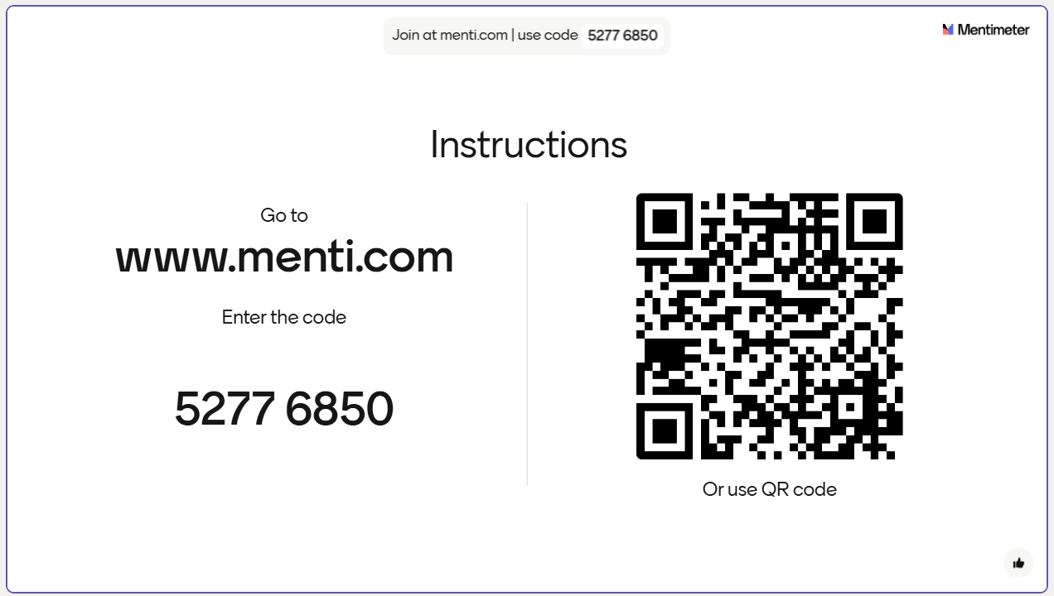

Slide 3
Define It: What is Remote Work?
A flexible work arrangement where employees perform their job duties from a location outside the traditional office, often their home, using digital tools for communication and collaboration.

Slide 4
History and Trends

Slide 5
Remote Work Over Time
1965 = 0.5%
—
Less than 1% of all paid workdays were full days from home. Remote work definition relatively archaic and stagnant.
2000 = 1%
—
Low percentage of workforce BUT marked the beginning of an increase in access to broadband internet over the next decade (from 0-60% of homes able to access).
2003
—
Skype launched as one of the first free voice over internet call services. Shutting down in May 2025.

Slide 6
2010-2019 = 4%-6.5%
Steady Growth
—
60% of population had access to broadband internet, more internet teleconferencing software started coming online (Zoom in 2013; MS Teams and Google Meet in 2017)
2020 = 36%
COVID-19
—
Sea change, prompted by a pandemic and supported with available technology.
Majority of employees in 2020 indicated they would like to continue after pandemic.
Employers in 2020 expected 20% of workforce to be fully remote after the pandemic (up from baseline of 7% before COVID)

Slide 7
2023 = 27%
POST-COVID WORLD
—
Why did it stick?
- Proved its practical
- Created support systems
Back to Work Movement?
- Percentages don't support theory of significant movement away from remote work
- BUT some large organizations (e.g. Amazon, Apple, Citigroup, Tesla, Boeing) and jurisdictions (Federal Government, Portland OR, other?) are seeking to drive change
- Why? Culture, collaboration/teamwork, team energy, justifying capital costs
- Ulterior motives? Get people to quit, test motivation/commitment, leadership who just doesn’t support idea
- Unforeseen consequences? In Fall 2022, foot traffic in central business districts had recovered BUT only 60% of pre-pandemic levels in cities with 1.5 million or more employees. Residential and commercial values stagnated in urban centers (while spiking in suburbs (Zillow US home price index rose 40% in exurban, 32% in suburban, 18% in high-density areas, and 9% in city centers)
2025 -
What’s Next? Why? How?

Slide 8
The Future of Work: The arm wrestling match will wage on.
In the meantime, back-to-the office or remote?

Slide 9
Benefits of In Office Work
Face-to-face collaboration, socializing and networking
Clearer work/personal life boundaries.
Face time with manager.
Managers familiar with performance management in office.
Structured Environment: Regular schedules and dedicated workspaces.
Access to resources and better equipment.
More opportunities for mentorship.
Fosters a sense of belonging.

Slide 10
The Future of Work: How can a fully in-person policy be successful?
Doing the same thing over-and-over again and expecting different results?
Notes:
Offer some examples about reinventing the workplace and open to discussion.

Slide 11
What do employees want?
32% prefer to work fully remotely
41% prefer a hybrid work set up
52% of men and 60% of women would rather quit than return to the office full time.
69% of men and 80% of women consider remote work one of the most important factors when searching for new employment opportunities.
Quantum Workplace.com/future-of-work/remote-work-statistic

Slide 12
Do generations view remote work differently?
Generation | Desire for Remote Work | % in Workplace Now | % Increasing/Decreasing
Baby Boomers (1946-1964) | 32% | 15% | Decreasing Rapidly*
Gen X (1965-1980) | 49% | 31% | Decreasing Slightly
Millennials (1981-1996) | 84% | 36% (75% by 2030) | Increasing
Gen Z (1996-2012) | 74% | 18% | Increasing
*10,000 reaching retirement age and retiring every day; 4.1 million annually 2024-2027.
FlexJobs.com

Slide 13
What do Millennials Want?
84% want full-time remote opportunities.
35% would leave their job for full-time remote work.
91% report being more productive.
84% want better work-life balance/integration
82% expressed higher loyalty to an employer with a remote work program.
Is a generation more likely to use technology for collaboration & communication.

Slide 14
Are we asking the right question?
Should we be asking whether to offer remote work, or how to overcome the challenges to offer effective remote work?

Slide 15
Benefits of Remote Work
Increased productivity: focus on work without distractions. (97% federal workers)
Increased candidate pool
Employee Retention (35% reduction in quit rates)
Reduced Absenteeism (12%)
Flexibility and Work Life Integration (no commute)
Lower stress levels (82%) and Increased Morale (80%)
Environmental
Cost Savings for employers and employees.

Slide 16
Challenges of Remote Work
Meaningful communication: fewer spontaneous conversations, feeling disconnected.
Collaboration, engagement, innovation and strong organizational work culture.
External questions: customers and City Council.
Productivity, performance management and career development.
Accessibility: to public, boss and coworkers.
Unaddressed conflict.
Fairness concerns from employees who are unable to work remotely.

Slide 17
The Future of Work: Is a structured hybrid model the answer?
43% of employers offer a structured hybrid model of remote work with a minimum number of days in the office: 3 days = 66% and 2 days = 23%
25% of employers are fully remote.
32% full time in office.
Government = 62%

Slide 18
The Future of Remote Work: Challenges and Responses
Notes:
Offer examples and open to discussion.

Slide 19
Implementing an effective remote work program – Internal Challenges
Develop a clear and fair structure.
Provide the tools and equipment necessary for job.
Create expectations.
Communicate.
Monitor and Adjust.
Notes:
Provide some examples and then open to discussion

Slide 20
Implementing an effective remote work program – External Challenges
Communicate expectations and opportunities.
Create buy-in from elected leaders and stakeholders.
Create, measure and report performance metrics.
Monitor and Adjust.
Notes:
Provide some examples and then open to discussion

