Slide 1
Promoting Careers in Local Government: LOGO Career Expo
Emily Lucas, Deputy County Manager, Wake County
Lee Worsley, Executive Director, Central Pines Regional Council

Slide 2
What are some of the most significant recruitment issues you face?
Take about 4-5 minutes
Talk with those at the table
We will get some examples at the end of 5 minutes

Slide 3
Learning Objectives
Upon completion, participants can replicate the model Wake County, Central Pines Regional Council, and other local jurisdictions used to host a successful job fair.

Slide 4
Defining the Problem
Overview of Wake County, CPRC, and local government’s labor shortage

Slide 5
About Wake County
Largest county in North Carolina (1.2 million residents)
Seat of state government, 6 colleges and universities, Research Triangle Park, three hospital systems, and strong bio-tech industry
12 municipalities within the County
Wake County Government:
Approximately 4,800 FTEs across 26 departments/offices
Services include: public health, social services, EMS, public safety, libraries, parks, environmental and development services, elections

Slide 6
About Central Pines Regional Council (CPRC)
Established by North Carolina General Assembly in 1959 to plan for growth around a research and technology economic hub… known today as Research Triangle Park!
A local government, owned by 48 local government across 7 counties.
Member-driven organization that connects our communities and addresses shared priorities through regional policy and technical assistance.
Third fastest growing region in US, with roughly 145 new residents each day.

Slide 7
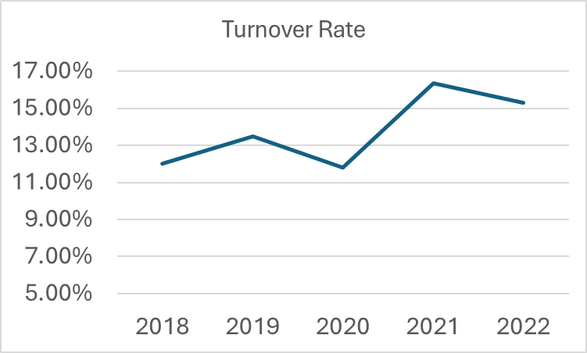
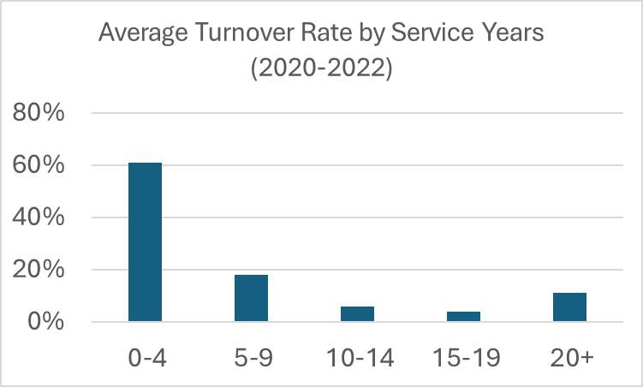
Wake County HR Trends in a Post-COVID Environment

Slide 8
Regional HR Trends
A 2023 survey of CPRC’s local government leadership identified the following concerns:
87% agreed it was harder to recruit into the public sector.
59% indicated a lack of qualified applicants was a primary obstacle.
Top reasons for staff turnover: 1) wages, 2) private sector competition, 3) lack of opportunities for growth, and 4) stress or burnout.
“How do we increase the candidate pool to reduce stealing from each other?”
– Survey Respondent
Notes:
Pulled from 2022 Next100 & GenForward Survey (ages 18-36)
38% Say they know how to get a job in local government
Only 24% agreed/strongly agreed: I believe that local government wants to hire people like me
Only 18% agreed/strongly agreed: I want to work in local government at some point in my career
Only 1 in 3 trust local government
37% viewed working for the government as an effective way to impact their community
Other notes: certain sectors of employment competing with private sector (public health, EMS, public safety)
Potential younger candidates not prepared for workforce (COVID)
Older generations remaining active in the workforce, but not appropriately trained/have experience to match open jobs

Slide 9
How were we already addressing the issue?
As individual agencies:
Upskilling, reskilling and professional development
Improving employee engagement and focus on workplace culture and purpose
Competitive salaries and benefits, flexible work arrangements
As collective agencies:
Sharing successful recruitment and retention strategies through inter-agency collaboratives
Leveraging regional training and development opportunities
Improving regional data and knowledge on hiring trends.
Pooling funds to broaden marketing reach.

Slide 10
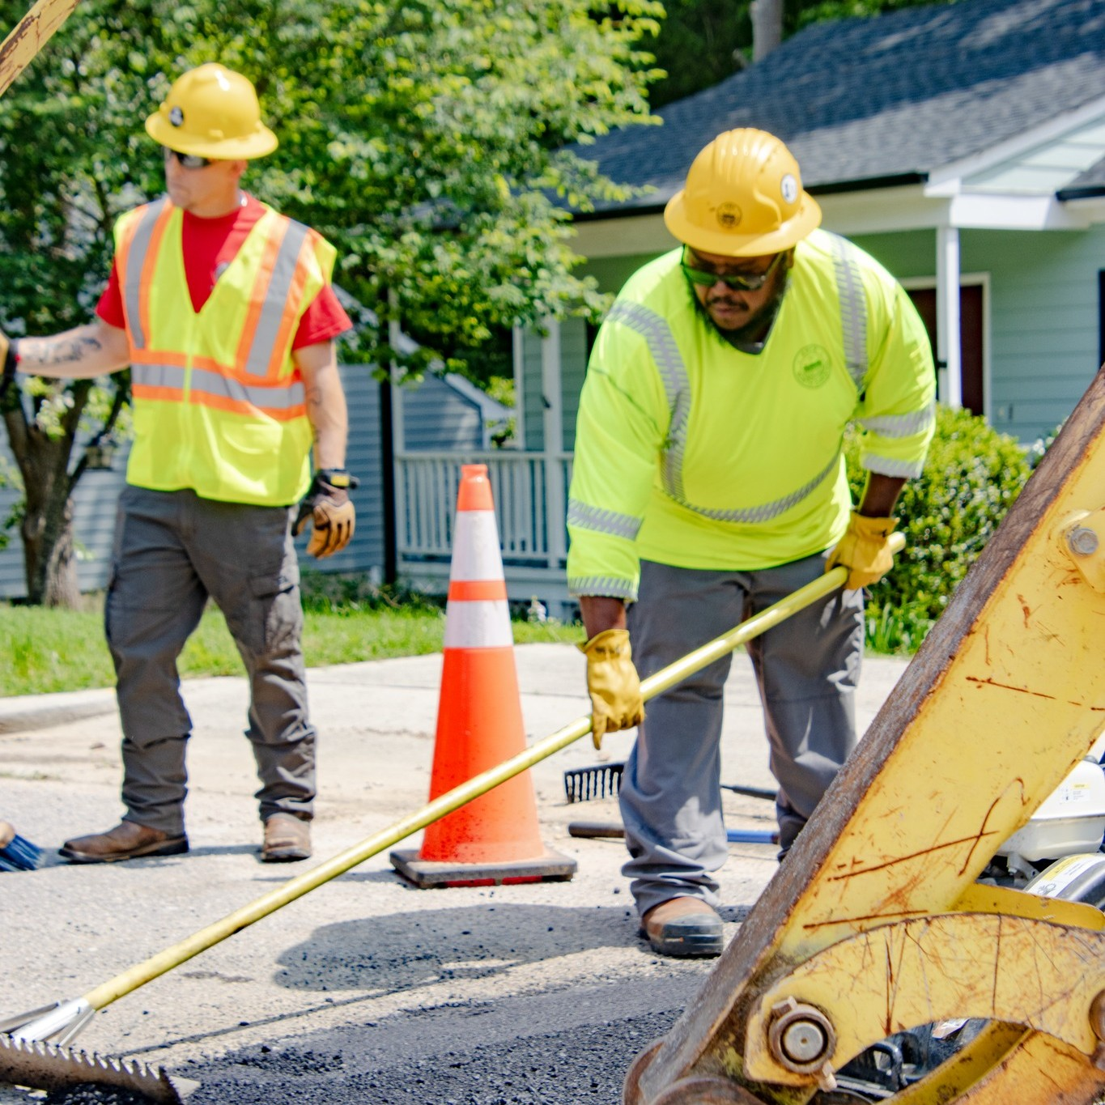
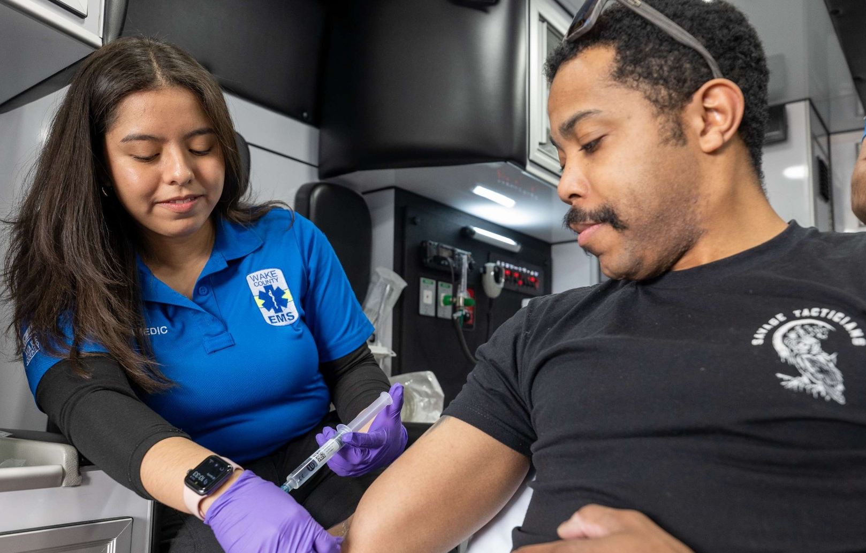
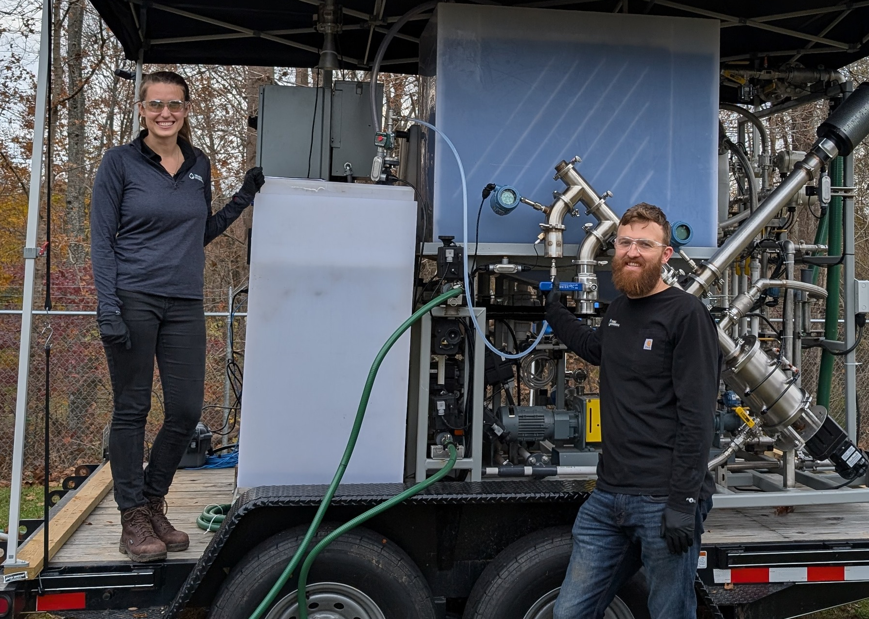
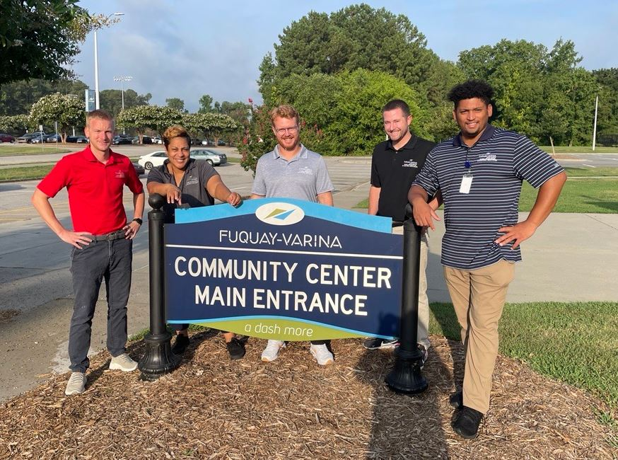
But we could do more, together!
Government is traditionally not good at:
Telling its story
Actively promoting a variety of careers through diverse avenues
Connecting careers to purpose
Appealing to multiple generations
Working together (compared to cannibalizing other agencies)

Slide 11
Addressing the Problem
Ideation, development, and execution of a regional local government career expo

Slide 13
Promoting the story of local government through a multi-jurisdiction career fair
Create a local government brand and brand awareness
Share benefits of working for local government
Showcase variety of career fields available in local government
Provide equitable space for all size governments to be represented

Slide 14
Benefits of regional local government career expo
For local governments:
Cost- and time-effective approach to recruit for multiple jobs at once
Can serve as a pre-screening session for potential job candidates
Reach potential candidates from diverse backgrounds and experiences
For attendees:
Network with multiple organizations in one place
Learn about career development in the public sector
Gather skills for resume writing and interview preparation

Slide 15
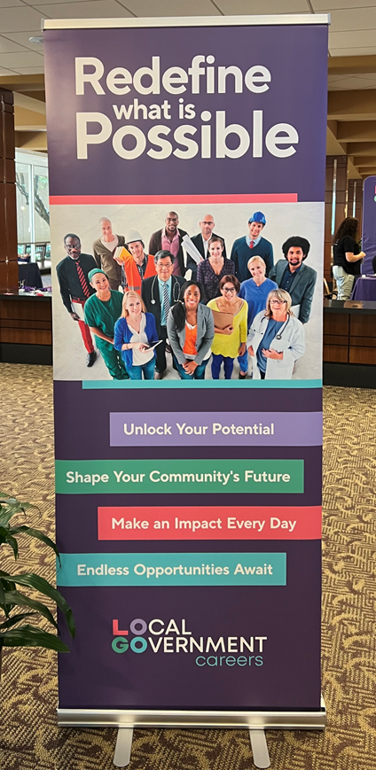
Strengths and challenges of developing a regional career fair
Wake County has breadth of staff to ideate, develop and execute regional branding and marketing, and seek sponsorships from depth and variety of vendors
Wake County does not plan large-scale conference style events: site logistics, registration management
Wake County didn’t want Wake County to be the focus: needed primary partner(s) that are respected as conveners and providing services on a regional basis

Slide 16
Meeting challenges through partnerships
CPRC collaborated with Wake County as primary partner.
Accepted responsibility for collecting and managing sponsorship funds
Helped develop scaled registration fee structure and collect fees
Managed contracts for site logistics, catering, ancillary services, and supply orders
Managed dedicated Website
Convened HR and Communications teams throughout the region to spread the word

Slide 17
Meeting challenges through partnerships
Pre-event workshops (resume writing, elevator pitch development) hosted by Capital Area Workforce Development Board
On-site resources:
NC Works Mobile Career Center with career counseling, resume preparation, and free internet access.
Wake Tech Community College booth offering information on courses/programs
Dress for Success
NCPSHRA members assisted with set-up and worked registration tables
In-kind marketing services provided by Capitol Broadcasting/WRAL

Slide 18
LOGO marketing and outreach was widespread
Local jurisdiction Websites, LOGO Website, and job boards
Social media, news media, and radio
Direct email
Outreach to local colleges and universities in the CPRC region
Billboards
Digital advertising campaign

Slide 19
Developing a Shared Story

Slide 20
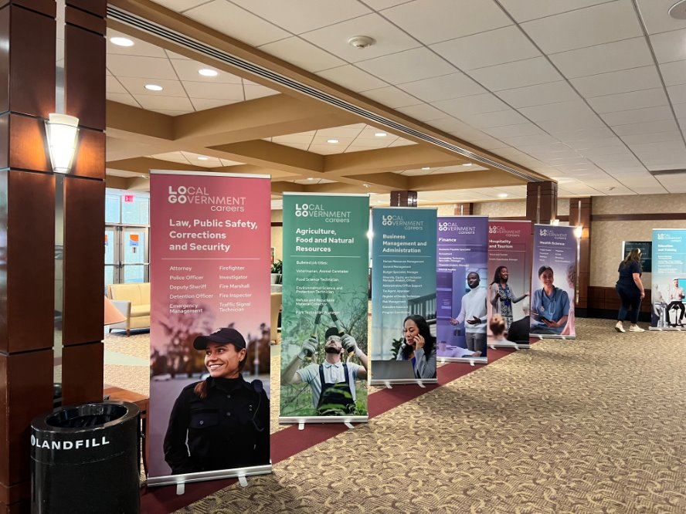
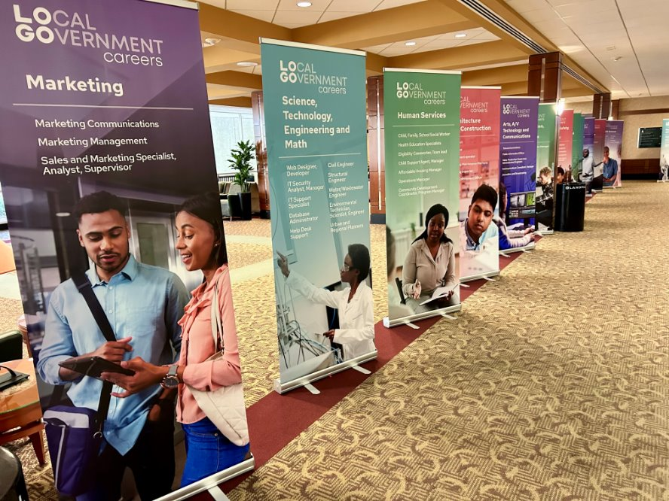
Promoting career fields, not specific organizations

Slide 21
What does it take to run a career expo?
Expense Type | Amount
Advertising | $15,200
Giveaways, prizes, appreciation | $8,600
Event rental & catering | $7,300
Staff t-shirts | $5,800
Banners, signage | $3,700
Total expenses around $46,000
Major categories listed to the right
Does not include staff time from CPRC, Wake or any participating jurisdiction

Slide 22
A career expo can be a self-sustaining event
Revenue Type | Amount
Registration | $32,365
Sponsorship | $42,000
Total | $74,365
Didn't know/estimate all expenses up front
Remaining funds will be used to reduce local registration costs for 2025 LOGO Career Fair and cover up-front payments

Slide 23
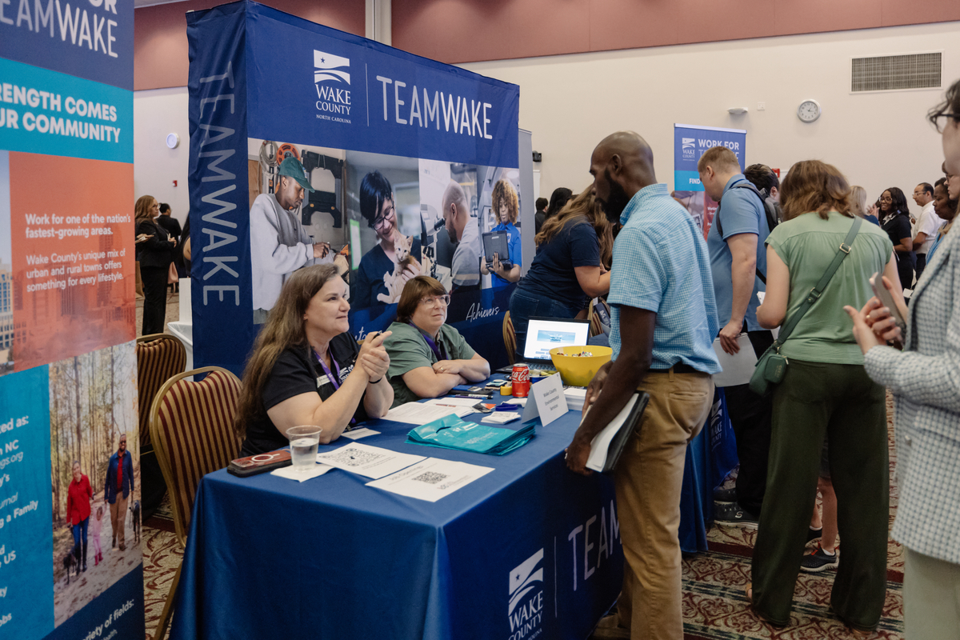
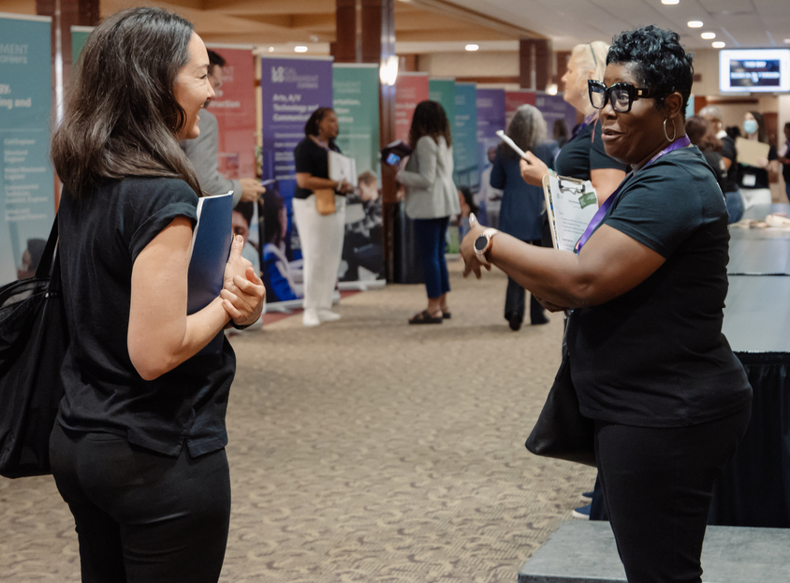
Event Day – 31 Participating Jurisdictions

Slide 24
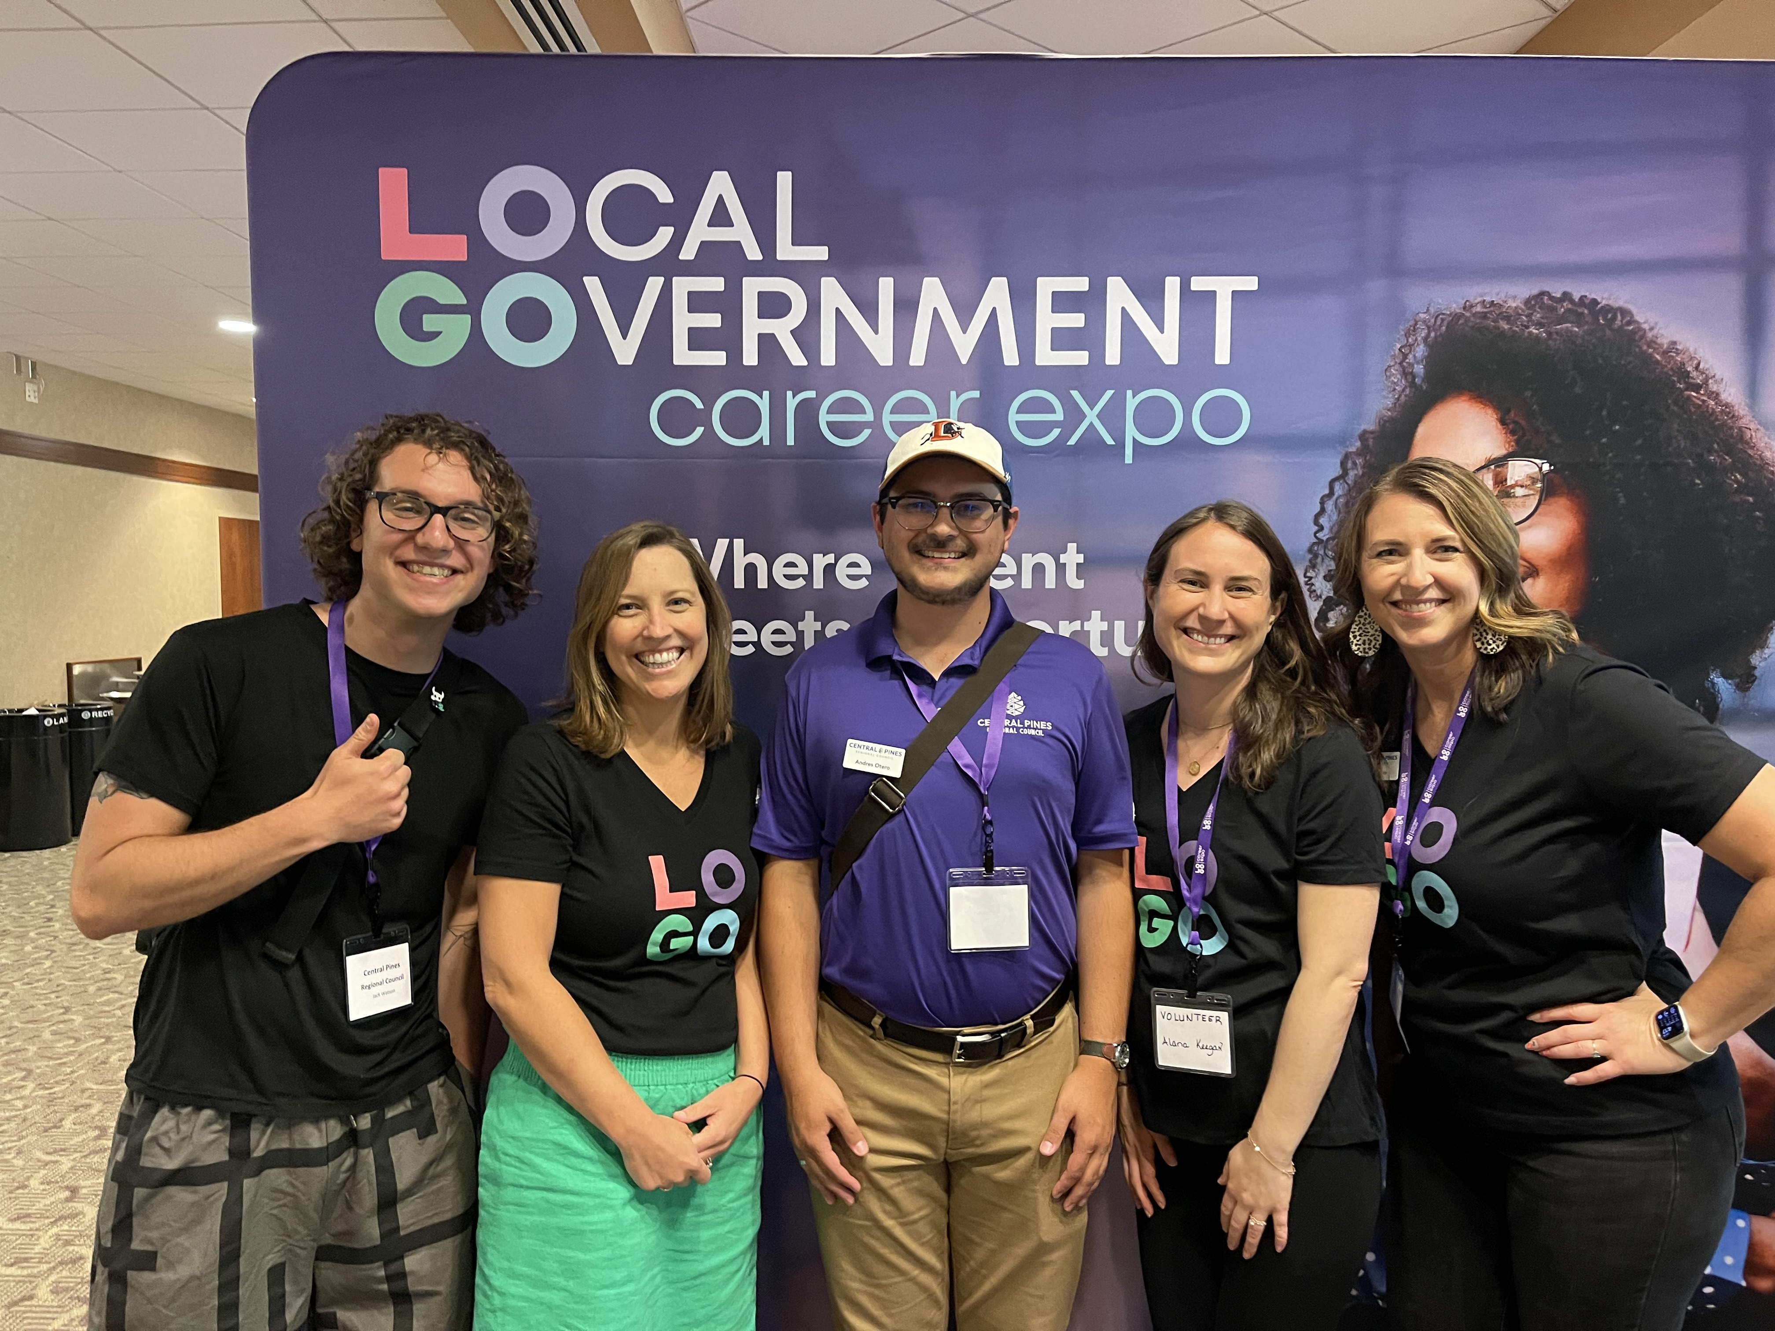
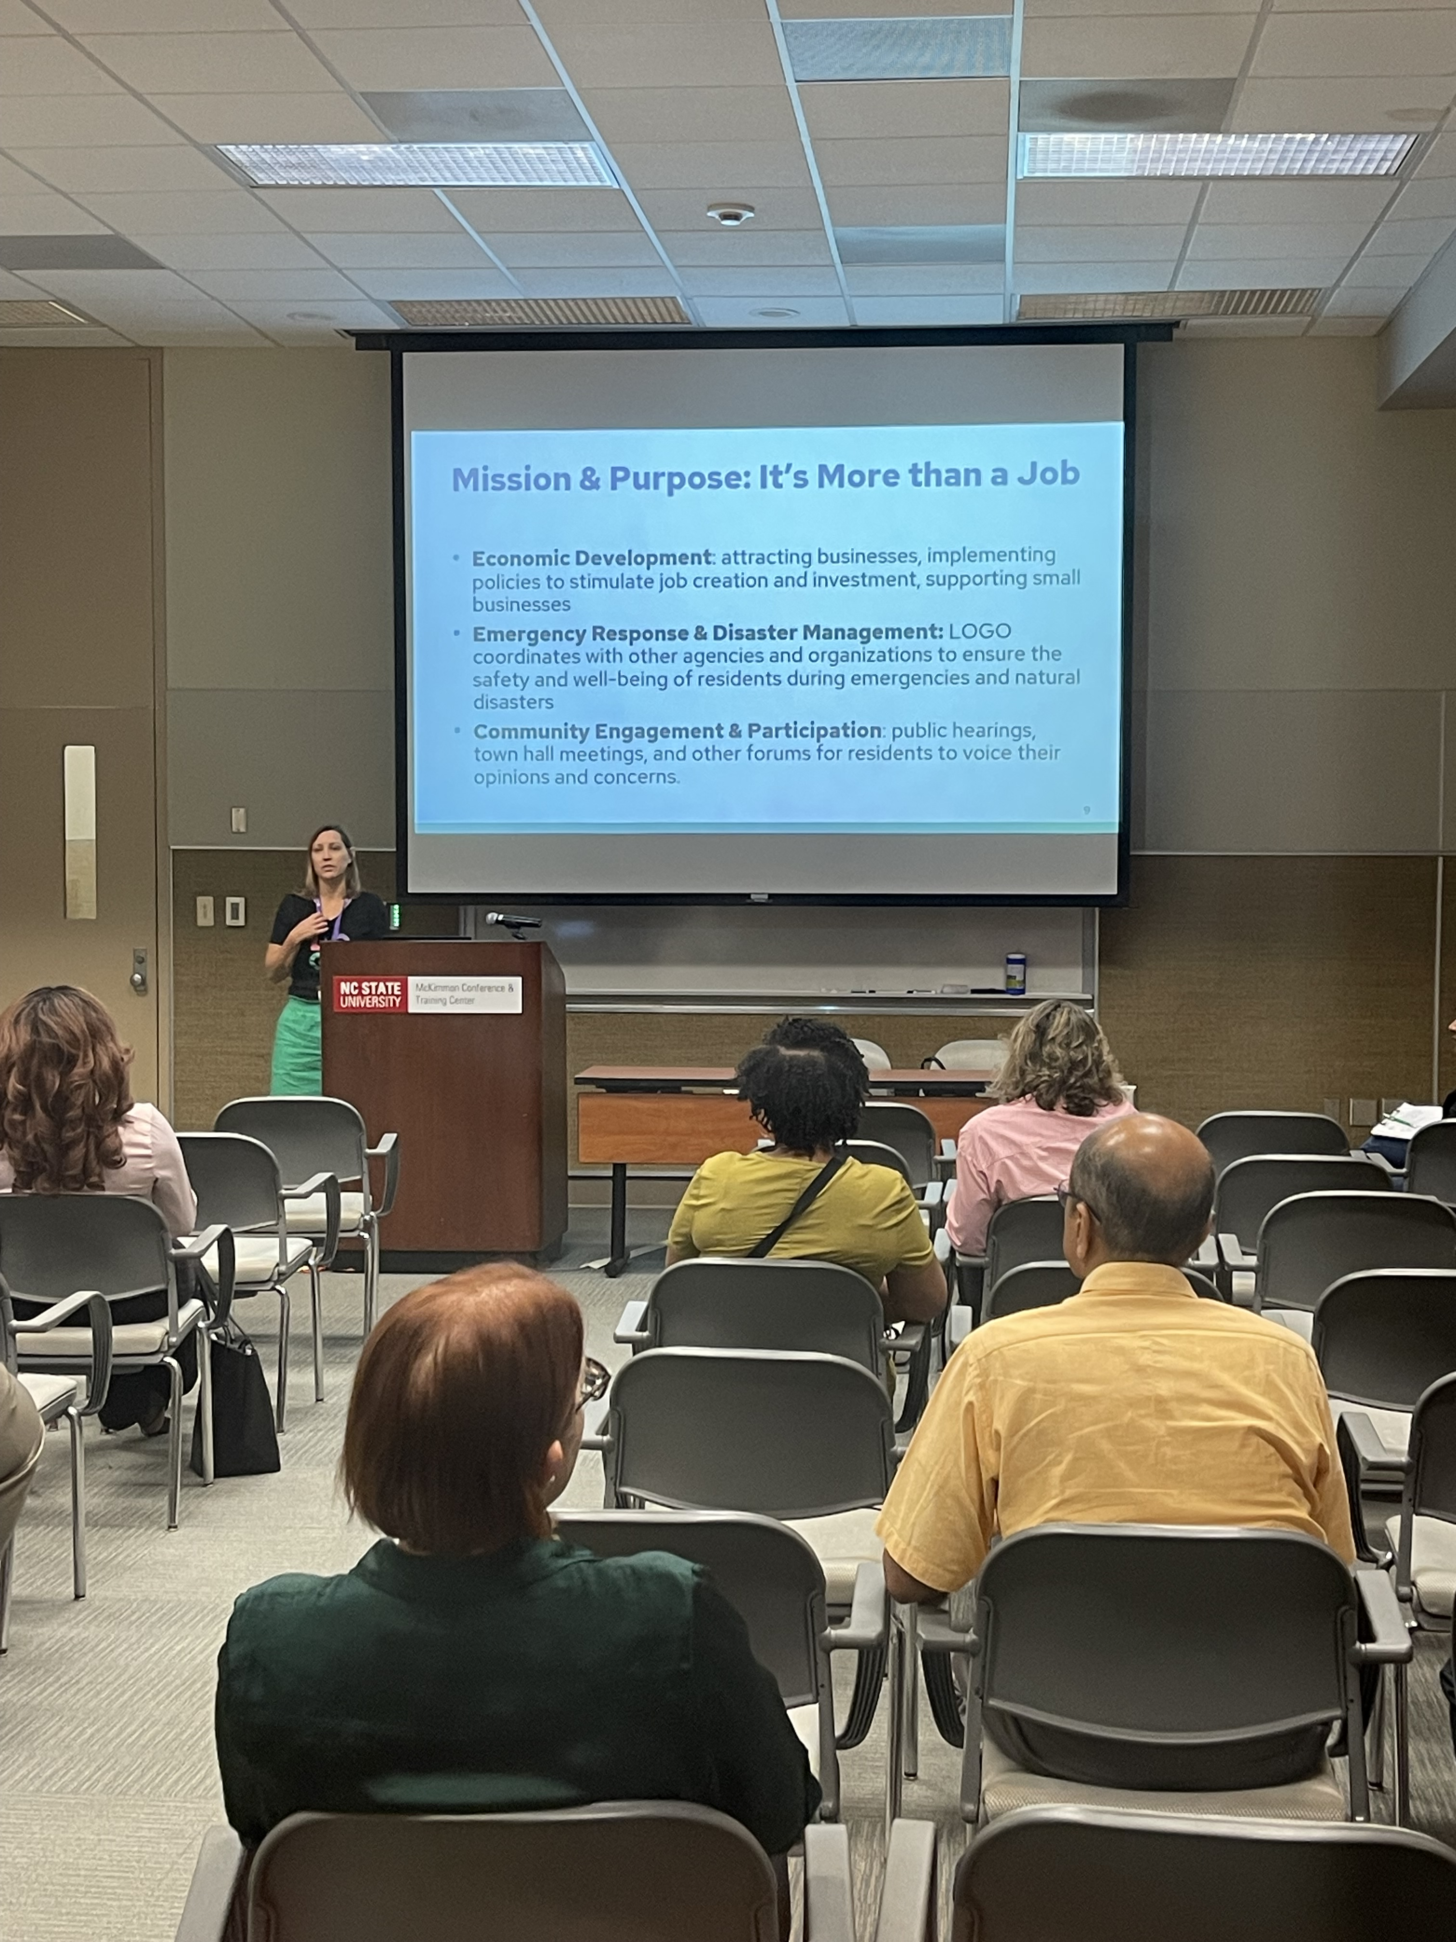
Event Day
Walk Through Video
Breakout Sessions
CPRC Team

Slide 25
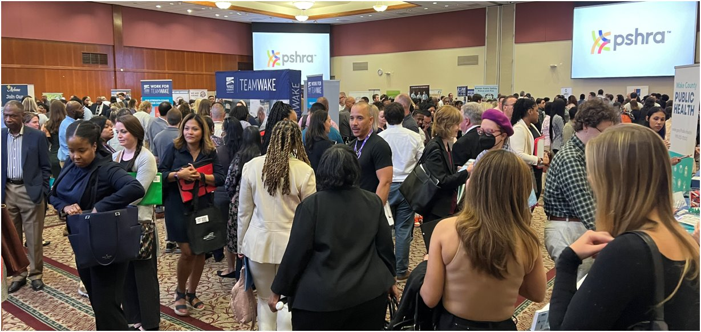
Event Day – 3,000+ Attendees

Slide 26
Lessons Learned & Moving Forward
What's next for LOGO career expos

Slide 27
Outreach, marketing, and timing
Least expensive marketing methods most effective
Surveys indicated word of mouth, social media, and local government career pages brought the most attendees
Consider outreach and marketing in multiple languages - 19% of Wake County residents speak a language other than English at home
Consider recent college graduates' interest in local government careers
Feedback from local colleges is that June is too late for some job seekers
Consider timing based on times of the year people are most likely looking for other careers

Slide 28
Partnerships and measuring success
Consider providing space for sponsors/supporters who are local government adjacent
Showcase benefits, training partnerships (community colleges), credit unions, etc.
While attendees were surveyed post event, we didn't deploy a consistent strategy to track future job applicants

Slide 29
LOGO 2025!!
Three regions in North Carolina have committed to participating in LOGO 2025
Central Pines (Raleigh/Durham)
Rocky Mount, NC area
Charlotte, NC area
Central Pines will serve as a central administrative point to make the LOGO events simpler to manage for the three regions.

