Slide 1
Revisiting and Reimagining ICMA’s Declaration of Ideals
Wally Bobkiewicz, City Administrator Issaquah, WA
WallyB@issaquahwa.gov

Slide 2
Today’s Conversation
The Current Context – What is Community Leadership
National Conversation 2022 to Present
The Changing View of the Purpose and Functions of Government
The Local Government Manager in 2025
Historical Role of the City Manager
Foundational Documents
Historical Discussions on the Role of the Manager
The Future of Our Profession
Recommendations for Revisiting and Reimagining
The Community Leader – Administrative Technician Continuum
ICMA Declaration of Ideals

Slide 3
National Conversation
2019 – National Academy of Public Administration Grand Challenges
2020/21 – Ad Hoc Discussions on Grand Challenges Impacts on Local Government
2022 – ICMA Columbus Focus Group
2023 – ICMA Austin Convening #1 of State Representatives
2024 – ICMA Pittsburgh Convening #2 of State Representatives

Slide 4
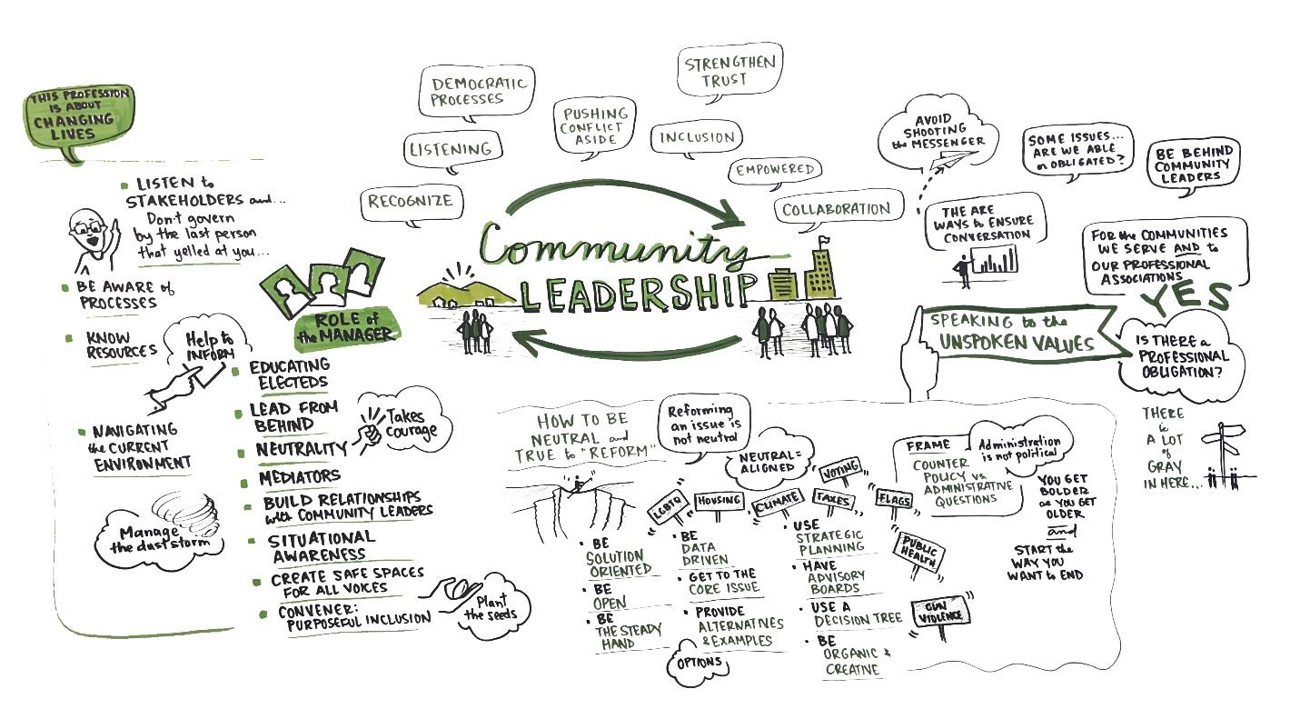
What is Community Leadership?
Notes:
2004 James Svara Achieving Effective Community Leadership: “Local government managers are significant figures not only in their governments but also in their cities or counties as a whole…Although the title “manager” implies an emphasis on carrying out the policies adopted by elected officials and an internal and organizational focus, in reality the people who fill the position of top manager or administrator in cities and counties are community leaders in three respects. They shape the agenda and propose policies for adoption by elected officials; interact with people outside of government and thereby contribute to the life of the community; they shape the orientation of their governmental organization to citizens: how the organization treats citizens and how it facilities citizens’ participation in government affairs

Slide 5
The Effective Local Government Manager
1983, 1993, 2004, 2022
What are the big problems facing my community?
How best to keep my community informed of these needs?
How can I tap resources of my community to address needs?
How can I apply current thinking to these needs?

Slide 6
The Changing View of the Purpose and Function of Government

Slide 7
The Role of the Local Government Manager 2025

Slide 8
The Politics/Administration Dichotomy
Council’s Sphere
Determine “purpose,” scope of services, tax level, constitution issues
Pass ordinances; approve new projects and programs; ratify budget
Make implementing decisions (e.g., site selection); handle complaints; oversee administration
Suggest Management changes to manager; review organization’s performance in manager’s appraisal
Advise (what city “can” do may influence what it “should” do); analyze conditions and trends
Make recommendations on all decisions; formulate budget; determine service distribution formula
Establish practices and procedures and make decision for implementing policy
Control the human, material & informational resources of organization to support policy and administrative functions
Mission
Policy
Administration
Management
Manager’s Sphere
Notes:
This chart has existed in this form since the late 1980’s. It was developed by Profession James Svara and it sets out to challenge how we look at the politics/administration dichotomy.
A dichotomy refers to a division or contrast between two mutually exclusive and often contradictory ideas. The word dichotomy denotes a distinction and a separation.
We (local government professionals) like to see the hard line between Policy and Administration, between the Council’s Sphere and the Manager’s sphere. is laid out as a dichotomy BUT recognizes that the line is not straight or fixed – the line curves a bit – it can move on different issues. Supporting the City Council is how you serve this community. There are times when staff plays in the policy arena – every time you make a “professional recommendation” you are suggestion a shape or outcome of the policy. While it is a dichotomy, we live it as a polarity.
Ultimately, the legitimacy of your operations are grounded in the policies adopted by elected officials who represent the values of the community.

Slide 9
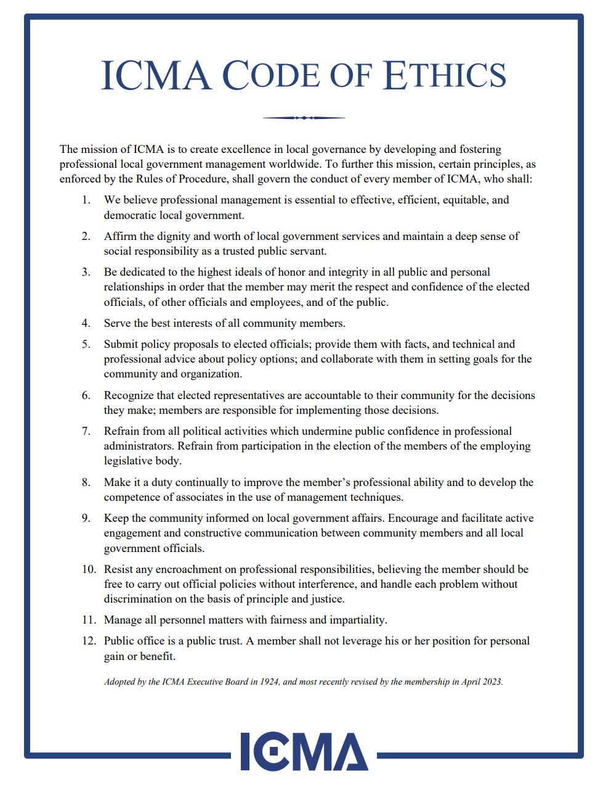
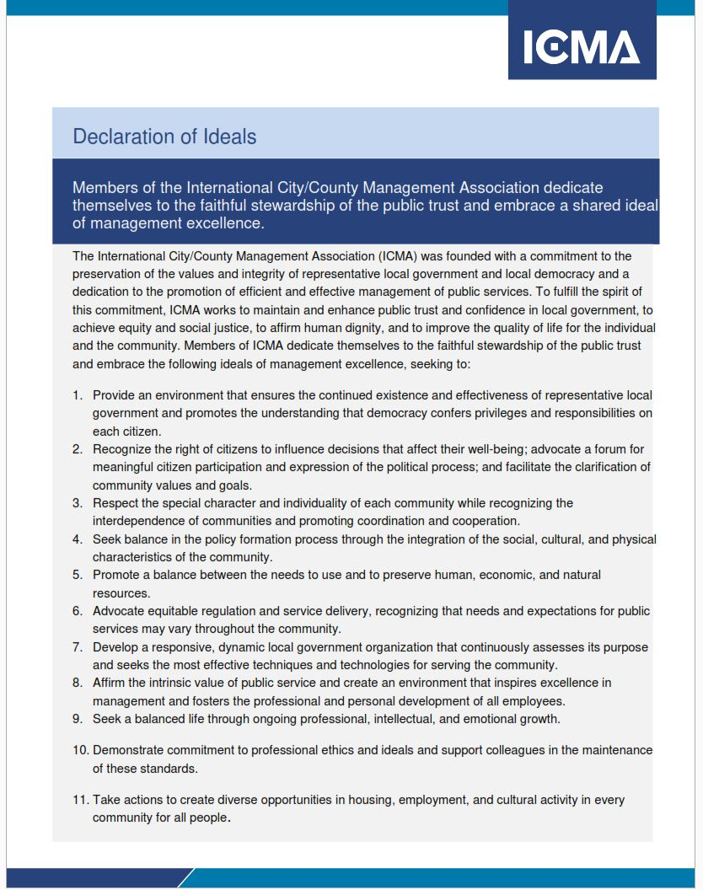
Ethics & Ideals
Notes:
1924 ICMA Code of Ethics adopted at Montreal Conference and has been updated regularly to adapt to changing times – this year we celebrate the 100th Anniversary of the Code of Ethics
The need to develop a set of ideals for the profession was recommended by the members who developed the “…New Worlds of Service” report in 1979. This group looked over the horizon and envisioned what the profession must do to be prepared for the year 2000. The times would demand from the profession an even higher commitment to ideals. They sought “an affirmative statement of the ideals of the profession that goes beyond the ideal of ethical conduct. These ideals should include strong expressions of belief in democratic values and process, the strength of constitutionally representative democracies, needs for social justice, dedication to equity in regulation and service delivery, a conservation ethics, and the importance of striving for excellence in local management.”

Slide 10
The Declaration of Ideals
Notes:
The Ideals were created in the early 1980s by the ICMA Assistants Steering Committee and endorsed by the Membership.
J.A. Ojeda Jr., a member of the Ideals drafting team, noted:
At a time when trust in government is not anywhere near where it should be, our Declaration of Ideals serves to restore that trust by irrevocably stating our commitment to management excellence in each of the 10 relevant and timely management ideals... The Declaration of Ideals is also a significant milestone for ICMA in that it officially recognizes that municipal administrators are now serving in racially and ethnically mixed communities, which represents new challenges and responsibility to all local officials both elected and appointed. This clear reference is made in the preamble to the ideal of equity and social justice, as well as the dignity of each and every one of the citizens we serve. It is a commitment to our basic values as a democratic and pluralistic society, a commitment that emphasizes the need for humility in public service, a statement that there is little room for arrogance and hubris in our profession, for we must serve everyone equally and with the same sense of compassion and professional integrity. This reaffirmation of our basic democratic ideals brings our profession in line with the rapidly changing urban scene.²
Ethics Matter! Ideals for the Profession August 2020 Martha Perego, ICMA-CM
Sylvester Murray, ICMA’s first Black president, noted in 1984, when the Ideals were promoted to the membership, “It is often said that an “ideal” is something unachievable, the highest star to reach for, knowing that you will never do it. That is not the case with our organizational ideals. Our ideals are achievable. Each of us ought to be committed to achieving the ideals set forth in the Declaration of Ideals. Our cities would be better off, our organization would be better off, and we would be better off as individuals.”

Slide 11
The Role of the City Manager Historical Perspectives
There are two distinct roles that have been evident since the inception of the profession, each ebbing and flowing over time.
The Policy Activist
Community Leadership: Actively engage with citizens and community organizations.
The Administrative Technician
Implementation: Execute policies without engaging in political debates or advocacy.
Policy Advocacy: Initiate and advocate for policy proposals to the city council.
Public Participation: Promote and facilitate citizen participation in decision-making processes.
Technical Expertise: Provide factual and technical advice to the city council.
Behind-the-Scenes Management: Focus on internal administration and maintaining organizational efficiency
Notes:
Svara 1995 “because the issue is not resolved, it is periodically rediscovered…” This is the polarity – it is not one or the other – it is a balance…

Slide 13
The Depression and Wartime (30s-40s)
Economic constraints in this period forced city managers to focus on maintaining essential services, curbing the expansion of the role into the realm of policy.
1933: A survey of managers revealed that 24% viewed their role as “the active, aggressive administrator, trying to acquire dominance in determining policies” as opposed to remaining in the background, “pushing the council forward."
1938: The revised Code of Ethics stated in the foreword that “municipal policy shall be determined exclusively by a legislative body,” and tenet 5 stated that the manager should be “in no sense a political leader.”
1940: A Study by Stone and Price noted it was “generally impossible for a city manager to escape being a leader in matters of policy.”
The City Manager Profession, 1934
By: Clarence Ridley (executive director of the ICMA) and Orin Nolting
The book stated that "city government is becoming more and more technical" and called the manager the council's "technical adviser and consultant." Further, the manager should not "let himself be driven or led into taking the leadership or responsibility in matters of policy."
Notes:
Momentum for manager as a policy advisor is curbed, and experts and practitioners alike call for managers to take on the technical role. Purple note is intended to related to general sentiment of era.

Slide 14
Post-War Era (50s-60s)
The return of prosperity and the building boom created a landscape of rapid change in local governance, ushering in new opportunities for city managers.
1952: The Revised ICMA Code of Ethics acknowledged that the manager was a “community leader” who “submits policy proposals to the council and provides the council with facts and advice on matters of policy to give the council a basis for making decisions on community goals.”
1952-1962: ICMA's PM Magazine published 18 articles that indicated the manager should be a "policy leader or innovator"
1963: Scholars concluded that managers are "almost inevitably the major source of policy proposals to the city council.”
C.A. Harrell (1948), an ICMA President, identified the manager as a "community leader" who should be a "positive, vital force in the community.” He asked why managers should "hesitate to initiate policy proposals and submit them to the council." He argued that when the manager "shies away from such leadership the community stands still and important matters are allowed to pass by default.”

Slide 15
Modern Developments (70s - Present)
Acceptance for "activist city manager cities" grows as academics and practitioners reject the premise that the council-manager form was founded on the separation of politics and administration.
1977: Richard Stillman, public administration scholar, argued “Managers cannot totally embrace either role of professional or politician,” He believed they should “cautiously and continuously tread a middle ground between the two poles of politics and expertise”
1982: Declaration of Ideals is adopted.
1984: Sylvester Murray, ICMA’s first Black president, noted in 1984, when the Ideals were promoted to the membership, “It is often said that an “ideal” is something unachievable, the highest star to reach for, knowing that you will never do it. That is not the case with our organizational ideals. Our ideals are achievable. Each of us ought to be committed to achieving the ideals set forth in the Declaration of Ideals. Our cities would be better off, our organization would be better off, and we would be better off as individuals.”
Notes:
Sylvester Murray, ICMA’s first Black president, noted in 1984, when the Ideals were promoted to the membership, “It is often said that an “ideal” is something unachievable, the highest star to reach for, knowing that you will never do it. That is not the case with our organizational ideals. Our ideals are achievable. Each of us ought to be committed to achieving the ideals set forth in the Declaration of Ideals. Our cities would be better off, our organization would be better off, and we would be better off as individuals.”

Slide 16
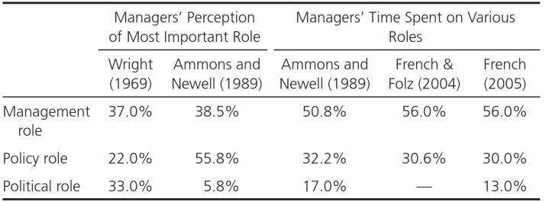
Modern Developments (70s - Present)
2012: ICMA's State of the Profession Survey demonstrates the city managers are involved in significant policy activity, with only 2% indicating they only occasionally or never perform these activities.
Perceptions of Managers on Role Importance and Time Allotment

Slide 17
The Declaration of Ideals
“The Declaration of Ideals approved by ICMA in 1982 gives voice to the aspirations of the profession in many aspects of the manager’s activities. These statements do not, however, go far enough in describing the responsibilities of the manager as a comprehensive professional leader in city government.”
James Svara, Ideal and Practice in Council-Manager Government, 1995

Slide 18
Findings

Slide 19
Findings from State Conversations
Local government managers are called upon to be courageous in their difficult role of providing leadership in their organizations and communities.
Local government managers play a critical role in building and maintaining trust among staff, elected officials and members of the community.
Skills in facilitation, mediation and convening are critical for local government managers to work with staff, elected officials and community partners when discussing community challenges
“The manager should know what the issues are, what issues are coming, and how to creatively and efficiently deploy the resources of their community to solve problems and create scenarios where the community can thrive.”
- Alabama Discussion

Slide 20
Findings from State Conversations (cont.)
Being a skilled communicator is essential for community leadership. Managers must develop and maintain good regular avenues of communication with their elected officials (individually and as a group), staff and members of the community. Listening is a key element in communication.
Local government managers have an obligation to foster regular goal setting with their elected officials and the identification of organizational and community values. Managers much help ensure that all voices in the community are heard during discussions of goals and values.
Local government managers must understand and embrace their role in presenting data and advocating for policy direction as neutral leaders. Managers have responsibility for developing complete definitions for complex problems and understandable language to explain different policy options.

Slide 21
2024 Conference Conversation – Additional Observations
Governance and the process of how we work together is broken
Managers are pushed to act. The complexity of how our communities communicate with us can push us to act too quickly or not thoughtfully enough
Facilitation and mediation can take on different forms. We need training to recognize when these interventions are needed or when it's our role to do it vs. our role to seek it on behalf of our community
Resiliency and a sense of steadfastness is just as important as courage. You have to stay the course in the face of headwinds.
Ensuring everyone has a voice. Sometimes you are the advocate for the process and creating a process to ensure that all the voices are included

Slide 22
Recommendations
To the ICMA Board

Slide 23
Declaration of Ideals
Request that the ICMA Board ask State and Affiliate Organizations and academic thought leaders to form a Task Force to engage the membership in a conversation about the Declaration of Ideals.
Reflect on the purpose behind the development of the Declaration of Ideals in the 1980’s
Discuss how the Declaration of Ideals provides guidance to members regarding their leadership role in todays context and how they navigate the Policy/Administration Dichotomy

Slide 24
Engage Other Organizations
Request that ICMA convene meetings with the leadership of the National League of Cities and the National Association of Counties to:
Discuss these findings and discuss the role of professional management in our communities
Identify how local governments can engage community leaders in promoting civil discourse and civic responsibility

Slide 25
Additional Training at ICMA Conferences
Provide training opportunities on facilitation, mediation and convening skills for members.
Develop training for Manager’s who enter professional local government administration from other professions that highlight the uniqueness of Council-Manager governance; their role and the history of the profession

Slide 26
Additional Recommendations
Request the ICMA Senior Advisors to initiate a dialogue in the profession on the role of courage in being a local government manager. Much is asked of a local government manager and it is important that ICMA support individual managers as they are asked to make courageous decisions. Request the Senior Advisors to report the Executive Board on these discussions at the 2025 ICMA Annual Conference.
Request that ICMA devotes a 2025 issue of Public Management magazine to the topic of community leadership.

Slide 27
Recommendations
To State and Local Government Management Associations

Slide 28
Recommendations to State & Local Government Management Associations
Create a task force to consider the findings and recommendations of this initiative to consider strategies that could be used in the state to further these conversations.
Convene meetings with leadership of state leagues of cities and counties to discuss the findings and recommendations of this project and develop strategies to share these issues with their elected members.
Develop sessions at state association meeting specifically to address the role of local government managers of being courageous and fostering trust in their organizations.

Slide 29
Professional Local Government Management
Our Profession

Slide 30
Next Steps
Local Government Managers Need to be Supported
Declaration of Ideals Only One Step
Leaders Are Needed Now
Future Leaders Needed Even More
The Profession Must Respond to Support Democracy in Our Communities

Slide 31
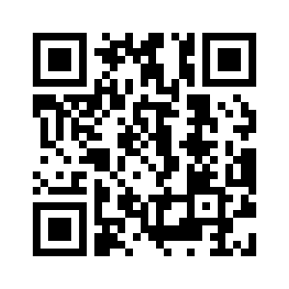
Thank you!
Contact:
Wally Bobkiewicz
WallyB@issaquahwa.gov
Resources available:
localgov2030.com/leadership

